Slide 1

Artificial Intelligence and Machine Learning
Lecture -10
Regularization (Lasso, Ridge, and Elastic-Net)

Slide 2
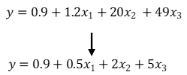
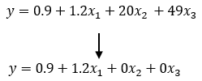
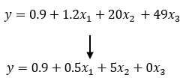
Regularization
Regularization is a technique used to prevent overfitting in machine learning models by adding a penalty term to the loss function.
Overfitting happens when a model learns not only the underlying patterns but also the noise in the training data, making it perform poorly on unseen/test data.
Regularization makes the model simpler and more generalizable, so it performs better on new data.
Purpose: The primary goal of regularization is to reduce the model's complexity and computational cost to make it more generalizable to new data, thus improving its performance on unseen datasets.
Regularization is a technique used to avoid overfitting where the coefficients, if needed, are restricted or shrunken to zero.
Reducing the impact of less important features directly affects the quality of predictions as it reduces the degree of freedom which in turn makes it harder for the model to get more complex or overfit the data.
Ridge Regression
Lasso Regression
Elastic Net Regression

Slide 3
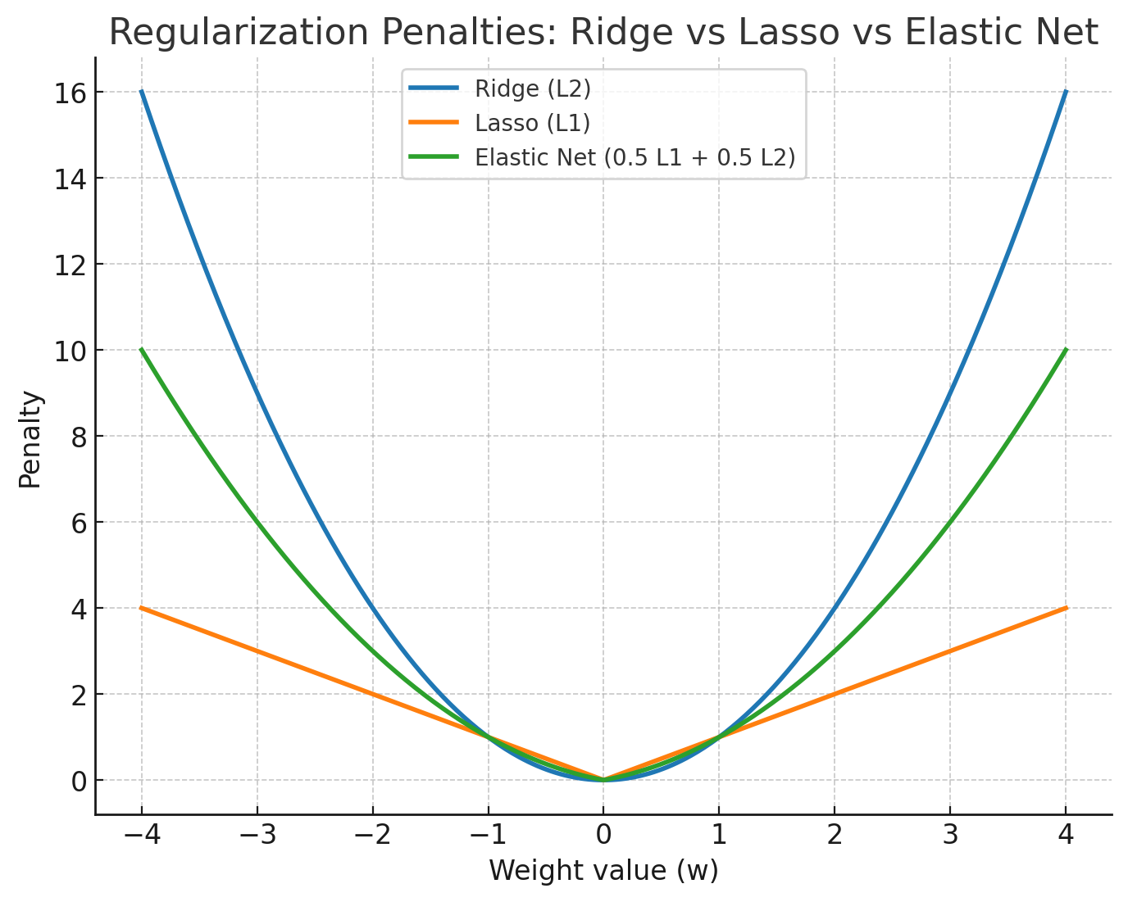
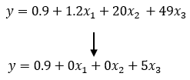
Types of Regularization
L1 Regularization (Lasso): This adds a penalty equal to the absolute value of the magnitude of coefficients. This can lead to some coefficients being zero, which means the model ignores the corresponding features. It is useful for feature selection.
L2 Regularization (Ridge): Adds a penalty equal to the square of the magnitude of coefficients. All coefficients are shrunk by the same factor, and none are eliminated, as in L1.
Elastic Net: This combination of L1 and L2 regularization controls the model by adding penalties from both L1 and L2, which can be a useful middle ground.

Slide 4
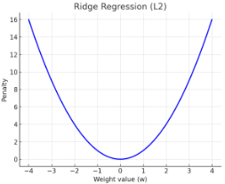

Ridge Regression (L2 Regularization)
Ridge regression is a technique used to address overfitting by adding a penalty to the model's complexity.
It introduces an L2 penalty (also called L2 regularization) which is the sum of the squares of the model's coefficients.
This penalty term reduces the size of large coefficients but keeps all features in the model. This prevents overfitting with correlated features.
where: The first term calculates the prediction error.
The second term penalizes large coefficients controlled by λ..
Example: Let’s assume we are predicting house prices with features like size, location and number of rooms. The model might give coefficients like:
β1 = 5 (Size coefficient); β2= 3 (Number of rooms coefficient is irrelevant and should be removed); and λ= 0.1 (regularization strength).
Sol: The penalty term for Ridge would be calculated as:
This penalty shrinks the coefficients to reduce overfitting but does not remove any features.

Slide 5
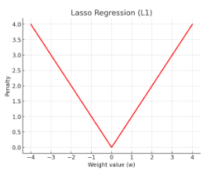
Lasso Regression (L1 Regularization)
Lasso Regression is a regression method based on Least Absolute Shrinkage and Selection Operator and is used in regression analysis for variable selection and regularization.
It helps remove irrelevant data features and prevents overfitting.
This allows features with weak influence to be clearly identified as the coefficients of less important variables are shrunk toward zero.
It improves linear regression by adding a penalty term to the standard regression equation. It works by minimizing the sum of squared differences between the observed and predicted values by fitting a line to the data.
where: The first term calculates the prediction error.
The second term encourages sparsity by shrinking some coefficients to zero.
Example: Let’s assume we are predicting house prices with features like size, location and number of rooms. The model might give coefficients like:
β1 = 5 (Size coefficient); β2= 0 (Number of rooms coefficient is irrelevant and should be removed); and λ= 0.1 (regularization strength).
Sol: The penalty term for Lasso would be:
λ⋅∣β1∣ =0.1⋅∣5∣ = 0.1⋅5 = 0.5
Here Lasso forces β2= 0 removing the Number of Rooms feature entirely from the model.

Slide 6
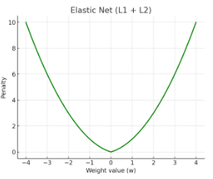
Elastic Net Regression
Elastic Net regression combines both L1 (Lasso) and L2 (Ridge) penalties to perform feature selection, manage multicollinearity and balancing coefficient shrinkage.
This works well when there are many correlated features helps in avoiding the problem where Lasso might randomly pick one and ignore others.
It provides a more stable and generalizable model compared to using Lasso or Ridge alone.
where:
The first term calculates the prediction error.
The second term applies the L1 penalty for feature selection.
The third term applies the L2 penalty to handle multicollinearity.
Example: Let’s assume we are predicting house prices using Size and Number of Rooms. Assume: β1= 5 (Size coefficient); β2 = 3 (Number of rooms coefficient); λ1= 0.1 (L1 regularization); and λ2= 0.1 (L2 regularization).
Sol: The penalty term for Elastic Net would be:
This penalty shrinks both coefficients but because of the mixture of L1 and L2 it does not force any feature to zero unless absolutely necessary.

Slide 7
Difference Between Ridge, Lasso, and Elastic Net
Features | Lasso Regression | Ridge Regression | Elastic Net Regression
Penalty Type | L1 Penalty: Lasso uses the absolute values of coefficients. | L2 Penalty: Ridge uses the square of the coefficients. | L1 + L2 Penalty: Elastic Net uses both absolute and square penalties together.
Effect on Coefficients | It completely removes unnecessary features by setting their coefficients to zero. | It makes all coefficients smaller but doesn’t set them to zero. | It removes some features and reduces others by balancing both.
Best Use Case | It is best when we want to remove irrelevant features | It is good when all features matter, but we want to reduce their impact | It is best for when we features are correlated and feature selection is needed
Hyperparameters involved | Alpha: Controls how much regularization is applied. A higher alpha means more shrinkage. | Alpha: Similar to Lasso which helps in controlling the strength of regularization. | Alpha + L1_ratio: Two parameters. Alpha controls regularization strength and L1_ratio adjusts the balance between Lasso and Ridge.
Bias and Variance | High bias, low variance | Low bias, high variance | Balance of bias and variance
Strengths | It is great for automatically choosing important features. | It works well when features are related but shouldn’t be completely removed. | It combines Lasso’s feature selection and Ridge’s handling of correlations.
Weaknesses | It can sometimes remove useful features if not tuned properly. | It keeps all features which may not help in high-dimensional data with irrelevant features. | It is a bit harder to tune due to having two parameters.
Example | Imagine we have 100 features to predict house prices. It will set the coefficients of irrelevant features (like house color) to zero. | If we have 100 features, it will reduce the impact of every feature but won’t completely remove any. | If we have features like “size” and “rooms” that are similar it will remove one and shrink the other.

