Slide 1
ARTIFICIAL INTELLIGENCE
&
MACHINE LEARNING
Module I
Lec 2

Slide 2
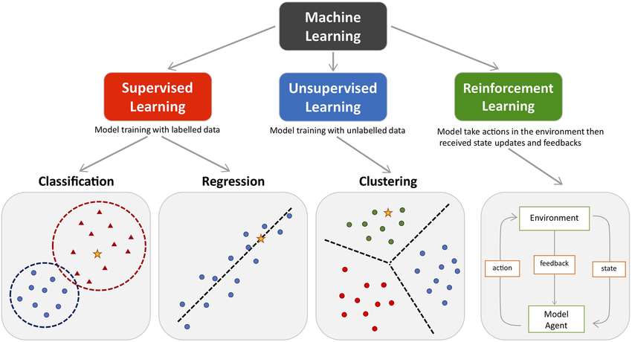
Types of Machine Learning
Machine learning (ML) is a branch of computer science that enables computers to learn and make decisions or predictions based on data without being explicitly programmed.
It achieves this by using algorithms to identify patterns, extract insights, and make decisions with minimal human intervention.
Machine learning is broadly categorized into three types: Supervised Learning, Unsupervised and Reinforcement Learning

Slide 3
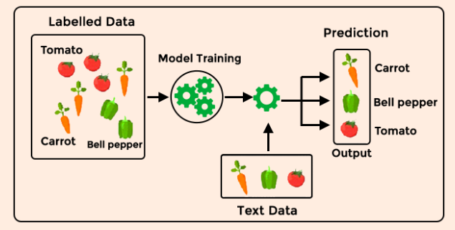
Supervised Learning
Supervised learning is a type of machine learning method in which we provide sample labelled data to the machine learning system to train it, and on that basis, it predicts the output.
The system creates a model using labelled data to understand the datasets and learn about each data, once the training and processing are done then we test the model by providing a sample data to check whether it is predicting the exact output or not.
The goal of supervised learning is to map input data with the output data.

Slide 4
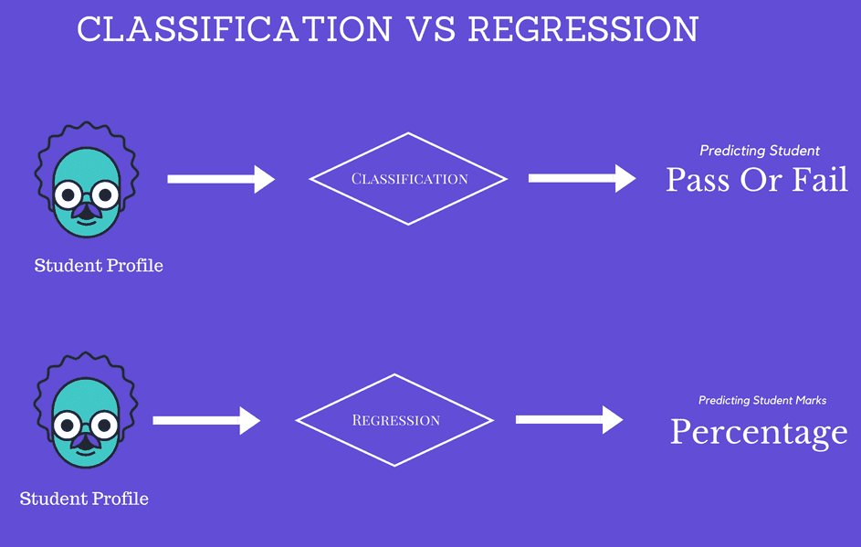
Types of Supervised Learning
Regression: The objective here is to estimate a variable as near to the real output value
Classification: The objective here is to forecast and assess discrete values belonging to a specific class on the grounds of accuracy.

Slide 5
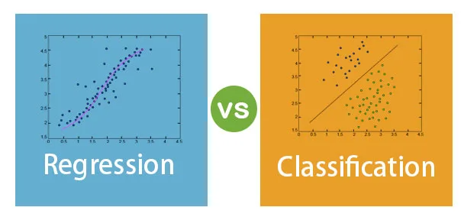
Classification vs Regression
Classification
In a classification task, we are supposed to predict discrete target variables (class labels) using independent features.
In the classification task, we are supposed to find a decision boundary that can separate the different classes in the target variable.
Regression
In a regression task, we are supposed to predict a continuous target variable using independent features.
In the regression tasks, we are faced with generally two types of problems linear and non-linear regression.

Slide 6
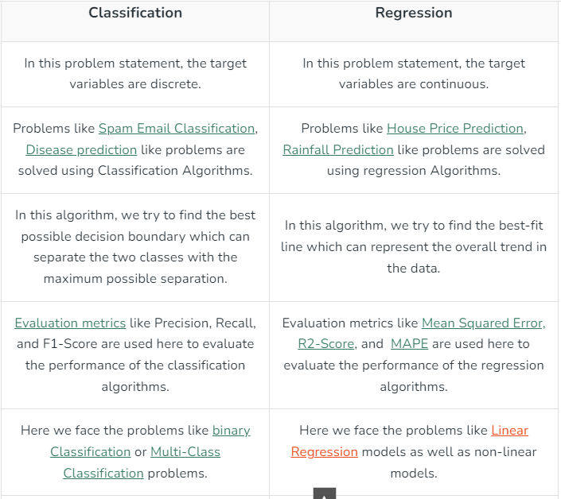

Slide 7
Real-Time Applications
Text categorization.
Face Detection.
Signature recognition.
Customer discovery.
Spam detection.
Weather forecasting.
Predicting housing prices based on the prevailing market price.
Stock price predictions, among others.

Slide 8
Types of Machine Learning
Common Algorithms of Supervised Learning
Regression
Regression predicts continuous values, such as prices or temperature
Common Algorithms:
    Linear Regression
    Support Vector Regression
    Random Forest Regression
Classification
Classification predicts categorical values, such as "spam" or "not spam.“.
Common Algorithms:
    Logistic Regression
    Decision Trees
    Support Vector Machines

Slide 9
Unsupervised Learning
Unsupervised learning is a learning method in which a machine learns without any supervision.
Works on unlabeled datasets.
.
Identifies hidden structures in the data.

Slide 10
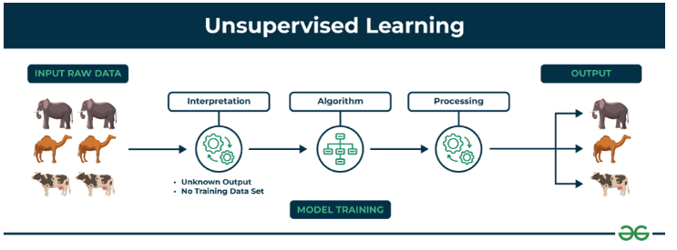
Unsupervised Learning

Slide 11
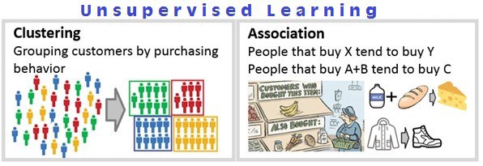
Clustering is the process of grouping data points into clusters based on their similarity. This technique is useful for identifying patterns and relationships in data without the need for labeled examples.
Association rule learning is a technique for discovering relationships between items in a dataset. It identifies rules that indicate the presence of one item implies the presence of another item with a specific probability.

Slide 12
Applications of Unsupervised Learning
Audience segmentation.
Customer persona investigation.
Anomaly detection (for example, to detect bot activity)
Pattern recognition (grouping images, transcribing audio)
Inventory management (by conversion activity or by availability)

Slide 13
Reinforcement Learning
Reinforcement learning is a feedback-based learning method, in which a learning agent gets a reward for each right action and gets a penalty for each wrong action.
The agent learns automatically from feedbacks and improves its performance. In reinforcement learning, the agent interacts with the environment and explores it.
The goal of an agent is to get the most reward points, and hence, it improves its performance.
The robotic dog, which automatically learns the movement of his arms, is an example of Reinforcement learning.

Slide 14
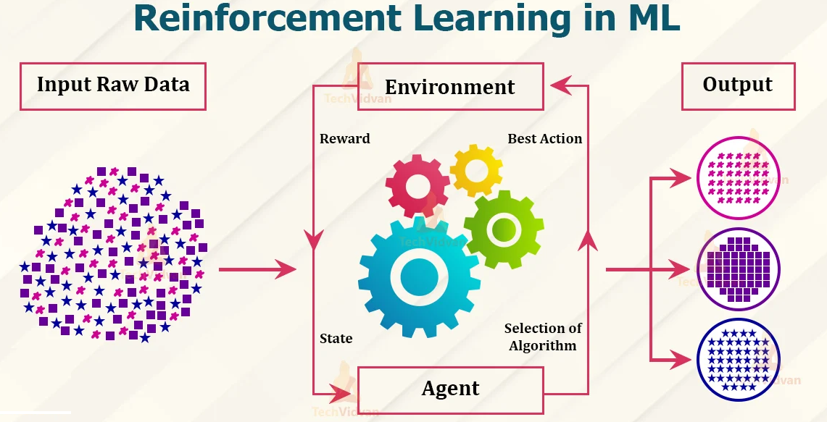
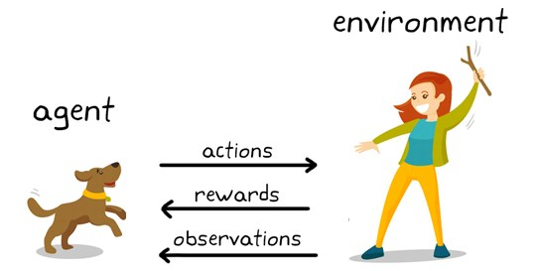
Reinforcement Learning

Slide 15
Types of Machine Learning
Reinforcement Learning (RL)
Reinforcement Learning (RL) is a type of machine learning where an agent learns to make decisions by interacting with an environment. The agent learns to perform actions that maximize a cumulative reward through a process of trial and error. Unlike supervised learning, RL does not rely on labeled data but instead uses feedback in the form of rewards or penalties.
Core Components of Reinforcement Learning
Agent:- The decision-maker in the system.
  Example: A self-driving car, a robot, or an AI player in a game.
Environment:- The world in which the agent operates.
Example: Roads for a self-driving car or a chessboard for a chess-playing AI.
State (S):- Represents the current situation of the environment.
  Example: The position of a car on the road or the arrangement of pieces on a chessboard.
Action (A):- The decision or move the agent can make at any state.
  Example: Speed up, slow down, turn left for a car; move a pawn or queen in chess.

Slide 16
Types of Machine Learning
Reward (R):- Feedback the agent receives after taking an action.
  Example: Positive reward for avoiding a collision; negative reward for hitting an obstacle.
Policy (π):- The strategy or mapping the agent uses to decide actions based on the state.
  Example: If traffic is heavy, slow down.
Value Function (V):- Predicts the expected long-term reward for a given state.
  Example: Estimating the benefits of a particular position on the chessboard.
Q-Value or Action-Value (Q(s,a)):- Predicts the expected reward for taking a specific action in a given state.

Slide 17
Types of Machine Learning
Key Concepts in Reinforcement Learning
Exploration vs. Exploitation
  Exploration: Trying new actions to discover their effects.
  Exploitation: Choosing actions that maximize rewards based on current knowledge
  Example: A game-playing agent might explore new moves to learn or exploit known winning moves to maximize its score.
Markov Decision Process (MDP):- A mathematical framework for modeling decision-making in RL. Includes states, actions, rewards, and probabilities of transitioning from one state to another.
Reward Signal:- The agent's objective is to maximize the cumulative reward over time, not just immediate rewards.
Discount Factor (γ):- Determines the importance of future rewards versus immediate rewards. A value closer to 1 means future rewards are more significant.

Slide 18
Types of Machine Learning
Popular RL Algorithms
Q-Learning:- A model-free algorithm that learns the quality of actions. Uses the Bellman Equation to update the Q-values.
  Example: Training a robot to navigate a maze by maximizing rewards for reaching the exit.
Deep Q-Learning (DQN):- Combines Q-Learning with deep neural networks for handling large state spaces.
  Example: Playing Atari games using raw pixel inputs.
Policy Gradient Methods:- Directly optimize the policy to select the best actions.
  Example: Training robots to walk by adjusting their movement policies.
Actor-Critic Methods:- Combines policy-based (actor) and value-based (critic) approaches for better efficiency.
  Example: Simulating complex tasks like assembling parts in manufacturing.

Slide 19
Types of Machine Learning
Example of Reinforcement Learning in Action
Problem: Train a robot to move to a specific location in a room.
State: The robot's position in the room.
Action: Move forward, backward, left, or right.
Reward:
  +10 for reaching the destination.
  -1 for each wrong step taken.
  -5 for hitting a wall.
Process:
The robot starts randomly moving around, hitting walls, and learning over time to avoid them. Gradually, it finds the shortest path to the target location to maximize its reward

Slide 20
Real Life Applications
Gaming
Robotics
Healthcare : Doctors can discover the treatment type, appropriate doses of drugs, and timings for taking such doses.
Manufacturing
Etc.

Slide 21
Types of Machine Learning
 | Supervised Learning | Unsupervised Learning | Reinforcement Learning
Data Requirement | Requires labeled data (input-output pairs). | Uses unlabeled data. | No labeled data; interacts with an environment.
Goal | Learn a mapping from inputs to outputs. | Find hidden patterns or structures. | Maximize cumulative reward through trial and error.
Feedback | Explicit feedback (correct labels provided). | No feedback; patterns are discovered independently. | Feedback in the form of rewards or penalties.
Common Applications | Classification, regression. | Clustering, dimensionality reduction. | Robotics, gaming, autonomous systems.
Key Challenge | Requires high-quality labeled data. | Interpreting discovered patterns. | Balancing exploration vs. exploitation.
Examples | Predicting house prices, image classification. | Customer segmentation, market basket analysis. | Teaching robots, AI in games, self-driving cars

Slide 22
Thank You

