Slide 1

Artificial Intelligence & Machine Leaning
Lecture 3

Slide 2
Regression (y = mx + b)
Regression is a statistical method that helps us understand and predict the relationship between variables.
Describe how one variable (dependent variable) changes as another variable (independent variable) changes
Dependent variable: we are trying to predict or explain (Y)
Independent variable: That are used to predict or explain the changes in the dependent variable (X)
For Example: Predicting salary based on years of experience, predicting exam, score based on study hours, predicting resale price based on vehicle age.
y
x

Slide 3
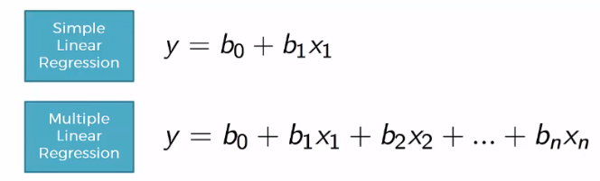
What is Linear Regression?
Linear regression is a type of supervised machine learning algorithm.
It computes the linear relationship between the dependent variable and one or more independent features by fitting a linear equation to observed data.
When there is only one independent feature, it is known as Simple Linear Regression, and when there are more than one feature, it is known as Multiple Linear Regression.
In linear regression we assume that y and x are related with the following equation:
Y = β₀ + β₁X+ e
Where β0 is intercept at y axis (The value of Y when X is zero)
β1 is the slope (how much Y changes for a unit change in X)
β0 and β1 are regression coefficients
e is the random error
Y is the dependent variable (Target Variable)
X is the independent variable (Predictor or Feature)

Slide 4
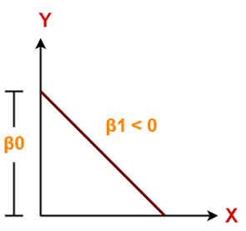
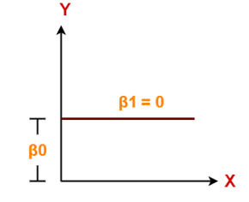
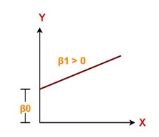
Impact of X on Y in Linear Regression: Relationship
Case I : Negative Linear Relationship
It indicates that variable X has negative impact on Y.
If X increases, Y will decrease and vice-versa.
Case II: Constant Linear Relationship
Case III: Positive Linear Relationship
It indicates that variable X has no impact on Y.
If X changes, there will be no change in Y.
It indicates that variable X has positive impact on Y.
If X increases, Y will increase and vice-versa.

Slide 5
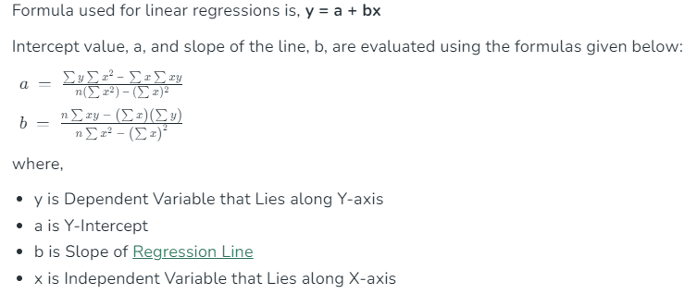
Linear Regression Formula

Slide 6
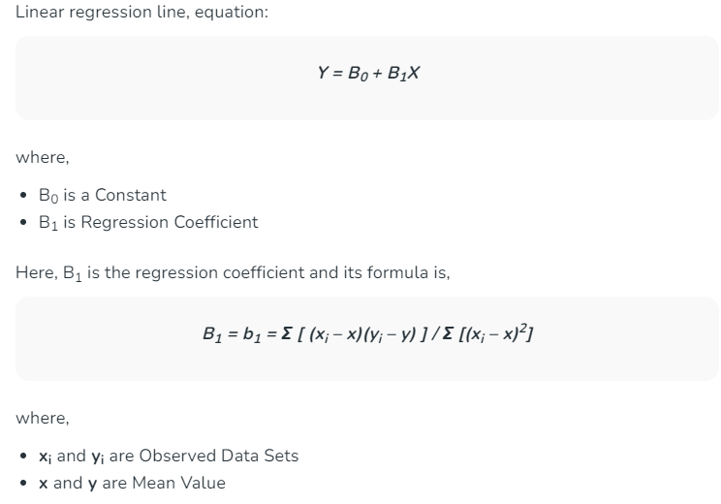
Regression Coefficient

Slide 7
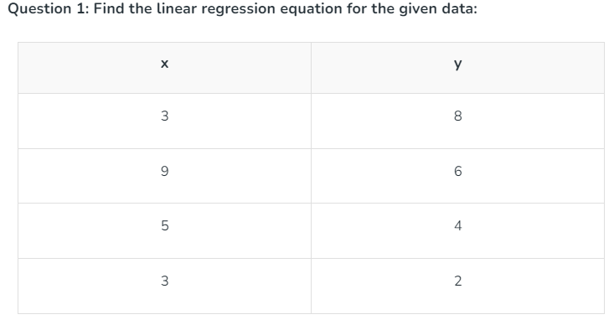

Slide 8
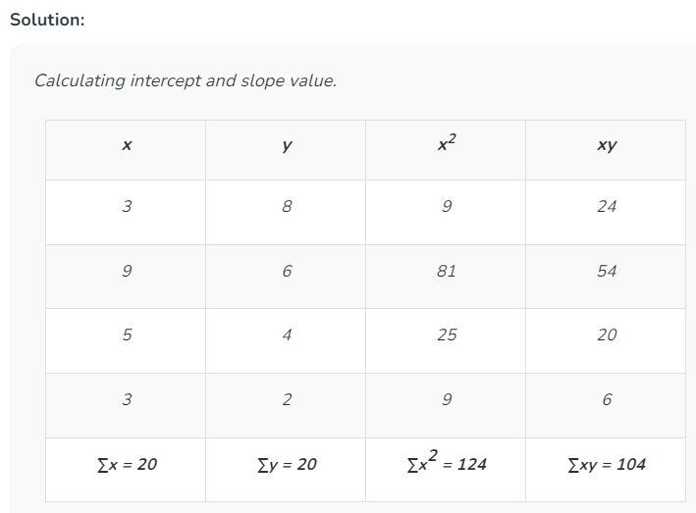
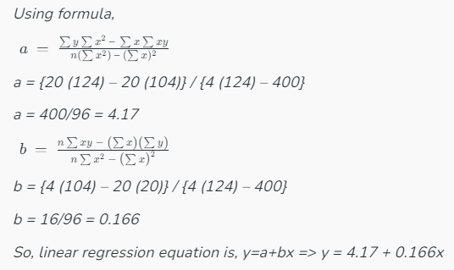

Slide 9
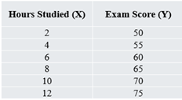
Practice Problems 1 and 2
Find the regression coefficient of the both the problems given below
Practice Problem 1
Given data:
x: [1, 2, 4, 3, 5] y: [2, 3, 5, 4, 7]
Practice Problem 2

Slide 10
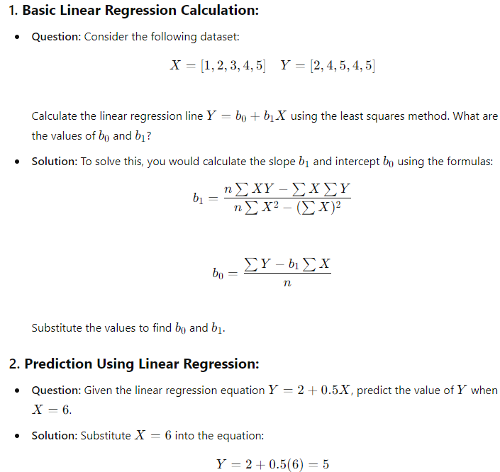

Slide 11
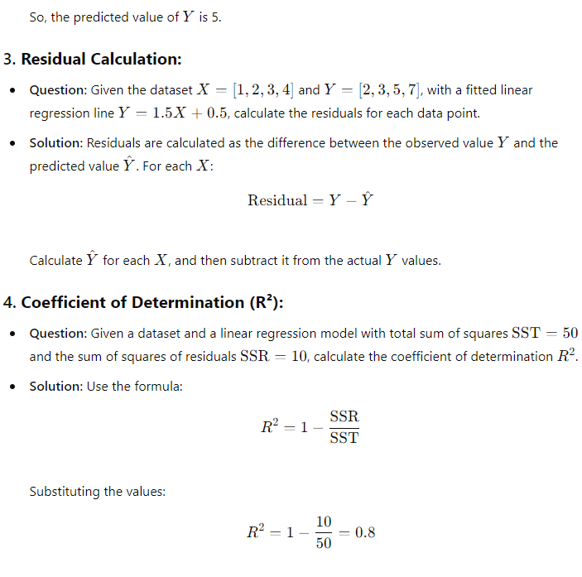

Slide 12
Applications of Linear Regression
It is used in market research and study of customer survey results.
It is used for studying performance of engine of automobiles.
It is used in deciding the effective price of any goods.
It is used in astronomy.

Slide 13
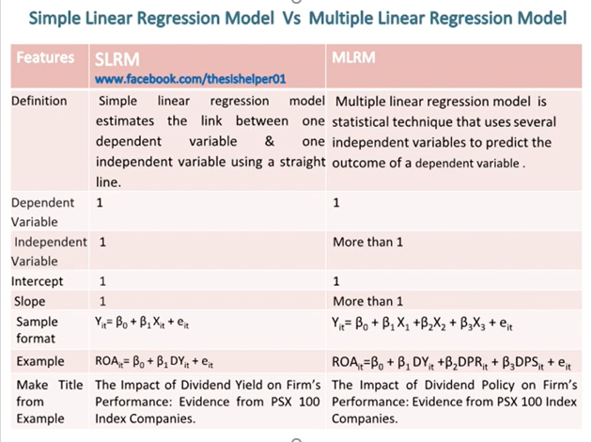
Difference between Simple Linear Regression and Multiple Linear Regression

Slide 14
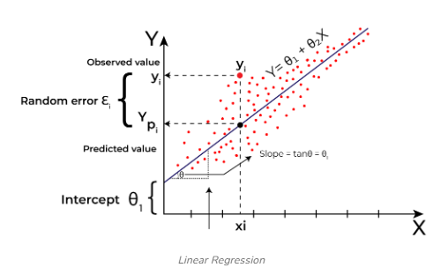
What is the Best Fit Line or Line of Best fit?
Line of best fit also known as the trend line or regression line is a straight line that best represents the relationship between a set of data points.
We can also say that “a straight line drawn on a scatter plot and lies near the majority of the data points is called the line of best fit.
Line of best fit is calculated using the statistical method of linear regression.
The line of best fit minimizes the distance between the observed data points and the predicted data value.
This line attempts to show the pattern within the data by minimizing the total distance between itself and all the data points.
Best fit line means the error between predicted values and actual values should be minimized. The best fit line will have the least error.

