Slide 1
Artificial Intelligence and Machine Learning
Lecture -4

Slide 2

Cost function or Loss Function for Linear Regression
A cost function is an important parameter that determines how well a machine learning model performs for a given dataset.
It calculates the difference between the actual value and predicted value and represents it as a single real number.
The goal of training a model is to minimize the cost function.
For Linear Regression, we use the Mean Squared Error (MSE) cost function, which is the average of squared error occurred between the predicted values and actual values. It can be written as:
Where yi​ : actual value; mxi​ +c: predicted value; m: slope; c: intercept; n: number of data points
Residuals: The distance between the actual value and predicted values is called residual. If the observed points are far from the regression line, then the residual will be high, and so cost function will high. If the scatter points are close to the regression line, then the residual will be small and hence the cost function.

Slide 3
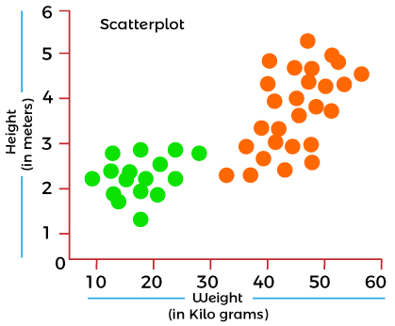
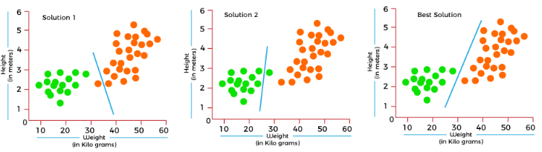
Why Use Cost Function?
While there are different accuracy parameters, then why do we need a Cost function for the Machine learning model. So, we can understand it with an example of the classification of data.
Suppose we have a dataset that contains the height and weights of cats & dogs, and we need to classify them accordingly. If we plot the records using these two features, we will get a scatter plot as shown in the right topmost figure.
In the above image, the green dots are cats, and the orange dots are dogs. Below are the three possible solutions for this classification problem.
In the above solutions, all three classifiers have high accuracy, but the third solution is the best because it correctly classifies each datapoint. The reason behind the best classification is that it is in mid between both the classes, not close or not far to any of them.
To get such results, we need a Cost function. It means for getting the optimal solution; we need a Cost function. It calculated the difference between the actual values and predicted values and measured how wrong was our model in the prediction. By minimizing the value of the cost function, we can get the optimal solution.

Slide 4
Numerical on Cost Function
You are given a dataset of the number of hours students studied (X) and their corresponding exam scores (Y). A linear regression model is trained and gives the hypothesis:
ŷ = 2.5x+10
Now, compute the cost function (MSE) using the following dataset and use the below formula:
X (Hours Studied) | Y (Actual Score)
1 | 15
2 | 18
3 | 21
4 | 30
5 | 35

Slide 5
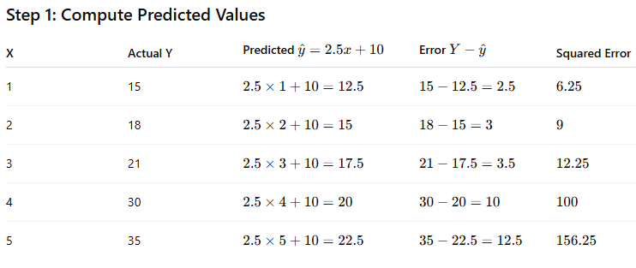
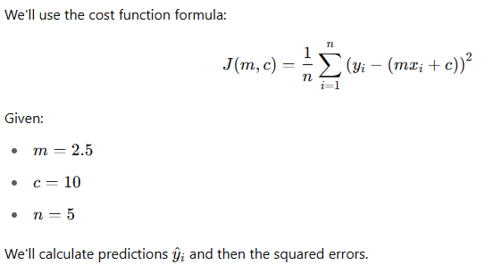
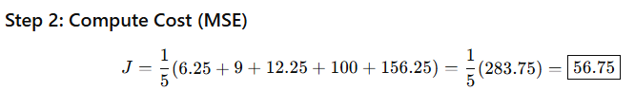

Solution

Slide 6
Practice Problem
A company is analyzing how the number of advertising hours (X) influences product sales (Y). Based on historical data, the marketing team has trained a linear regression model that gives the following hypothesis:
ŷ = 4x+2
You're given the following dataset of advertising hours and observed sales (in thousands of units):
Advertising Hours (X) | Actual Sales (Y)
1 | 8
2 | 10
3 | 15
4 | 20
6 | 28
Using the given model, compute the cost function J(m, c) using Mean Squared Error (MSE).
Ans: J = 2.6

Slide 7
What is gradient descent?
Gradient descent is an algorithm to find the minimum of a function.
In machine learning, the difference between the predicted and the actual value is called residual error.
All error, across all datapoints, when added together is known as the cost.
Naturally, we would want to minimize the function that represents this cost — Cost Function.
When the cost function cannot be differentiated easily, then Gradient Descent does the job.

Slide 8
Why Gradient Descent??
It is easy to find the value of slope and intercept using a closed-form solution
But when you work in Multidimensional data then the technique is so costly and takes a lot of time, thus it fails here.
So, the new technique came as Gradient Descent which finds the minimum very fastly.
Gradient descent is not only up to linear regression, but it is an algorithm that can be applied on any machine learning part including linear regression, logistic regression, and it is the complete backbone of deep learning.

Slide 9
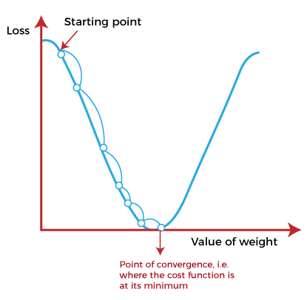
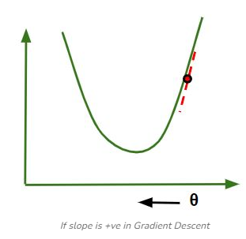
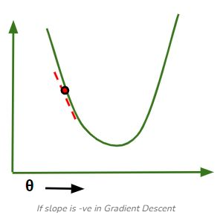
How does Gradient Descent work?
Gradient descent works by moving downward toward the pits or valleys in the graph to find the minimum value.
This is achieved by taking the derivative of the cost function, as illustrated in the figure.
During each iteration, gradient descent step-downs the cost function in the direction of the steepest descent.
By adjusting the parameters in this direction, it seeks to reach the minimum of the cost function and find the best-fit values for the parameters.
The size of each step is determined by parameter α known as Learning Rate.
In the Gradient Descent algorithm, one can infer two points :
If slope is +ve : θ= θ – (+ve value). Hence the value of θ decreases.
If slope is -ve : θ = θ – (-ve value). Hence the value of θ increases.

Slide 10
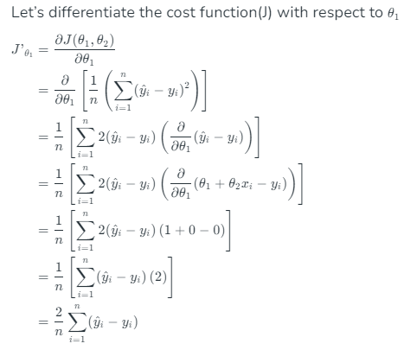
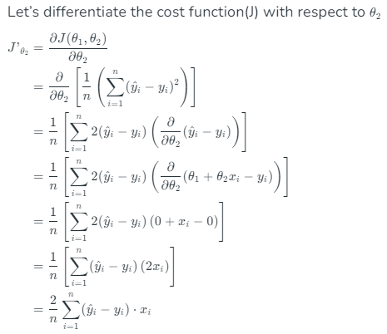
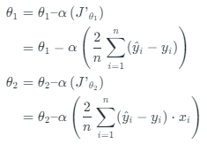
First Order Derivative of Gradient Descent or Steepest Descent
The main objective of using a gradient descent algorithm is to minimize the cost function using iteration.
To achieve this goal, it performs two steps iteratively:
Calculates the first-order derivative of the function to compute the gradient or slope of that function.
Move away from the direction of the gradient, which means slope increased from the current point by alpha times, where Alpha is defined as Learning Rate. It is a tuning parameter in the optimization process which helps to decide the length of the steps.
Finding the coefficients of a linear equation that best fits the training data is the objective of linear regression. By moving in the direction of the Mean Squared Error negative gradient with respect to the coefficients, the coefficients can be changed. And the respective intercept and coefficient of X will be if α is the learning rate.

Slide 11
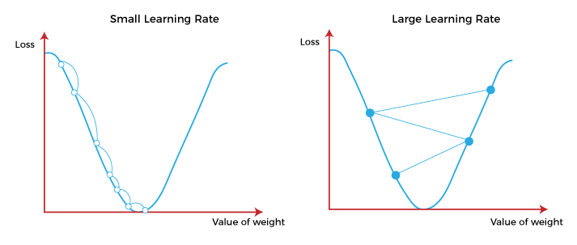
How To Choose Learning Rate?
The choice of correct learning rate is very important as it ensures that Gradient Descent converges in a reasonable time or not.
If we choose α to be very large, Gradient Descent can overshoot the minimum. It may fail to converge or even diverge.
If we choose α to be very small, Gradient Descent will take small steps to reach local minima and will take a longer time to reach minima. It compromises overall efficiency but gives the advantage of more precision.

Slide 12
Advantages Of Gradient Descent
Flexibility: Gradient Descent can be used with various cost functions and can handle non-linear regression problems.
Scalability: Gradient Descent is scalable to large datasets since it updates the parameters for each training example one at a time.
Convergence: Gradient Descent can converge to the global minimum of the cost function, provided that the learning rate is set appropriately.

Slide 13
Disadvantages of Gradient Descent
Sensitivity to Learning Rate: The choice of learning rate can be critical in Gradient Descent since using a high learning rate can cause the algorithm to overshoot the minimum, while a low learning rate can make the algorithm converge slowly.
Slow Convergence: Gradient Descent may require more iterations to converge to the minimum since it updates the parameters for each training example one at a time.
Local Minima: Gradient Descent can get stuck in local minima if the cost function has multiple local minima.
Noisy updates: The updates in Gradient Descent are noisy and have a high variance, which can make the optimization process less stable and lead to oscillations around the minimum.

Slide 14
Types of Gradient Descent
Feature | Batch Gradient Descent | Stochastic Gradient Descent (SGD) | Mini-Batch Gradient Descent
Definition | Computes gradient using the entire dataset | Computes gradient using one data point | Computes gradient using a small batch of data points
Update Frequency | After processing the entire dataset | After each individual data point | After processing each mini-batch
Convergence Speed | Slower convergence, smoother path | Faster convergence, more noisy path | Balance between convergence speed and noise
Computational Efficiency | High memory usage, efficient in vectorized operations | Low memory usage, less efficient with vectorized operations | Balanced memory usage and computational efficiency
Stability | More stable, less noise in updates | Less stable, high variance in updates | Medium stability, less variance than SGD
Use Cases | Suitable for smaller datasets | Suitable for large-scale, online learning, or real-time applications | Suitable for large datasets and when trade-off between speed and accuracy is needed
Parallelism | Difficult to parallelize | Easy to parallelize | Easier to parallelize than batch gradient descent
Memory Requirements | Requires memory for entire dataset | Requires memory for only one data point | Requires memory for a mini-batch
Risk of Overfitting | Lower risk of overfitting | Higher risk of overfitting due to high variance | Moderate risk of overfitting
Example of Use | Traditional machine learning tasks with small to medium datasets | Online advertising, large-scale recommendation systems | Deep learning training, large-scale machine learning tasks

Slide 15
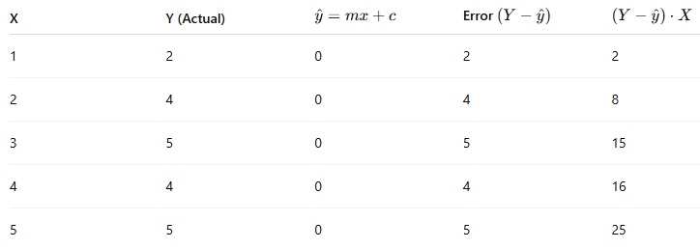
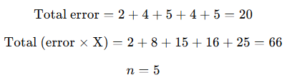
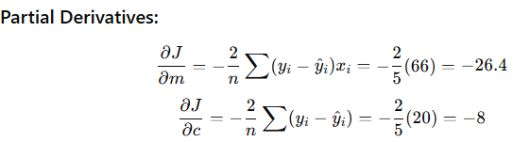
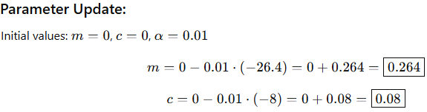
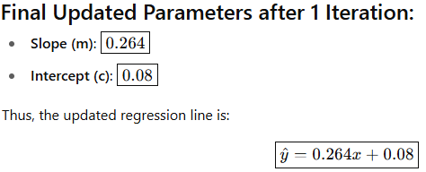
Numerical on Gradient Descent
Given: Initial values: m=0, c=0; Learning rate α=0.01
You are given the following dataset:
X (Hours Studied) | Y (Exam Score)
1 | 2
2 | 4
3 | 5
4 | 4
5 | 5
Use Gradient Descent to perform 1 iteration to update parameters m (slope) and c (intercept). Take Learning rate α=0.01

Slide 16

Practice Problem
We are given the following small dataset with one feature x and output y:
x | y
1 | 1
2 | 2
3 | 3
We want to fit a linear model of the form: ŷ​= wx + b
where w is the weight (slope) and b is the bias (intercept).
Let’s apply Gradient Descent to minimize the cost function:
Find optimal w and b using gradient descent. Let learning Rate = 0.01

