Slide 1
Artificial Intelligence and Machine Learning
Lecture - 6

Slide 2
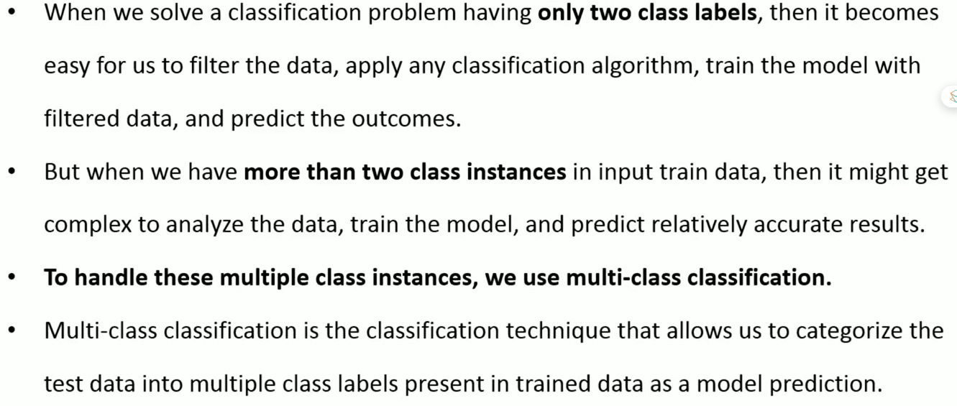
Multi-Class Classification

Slide 3
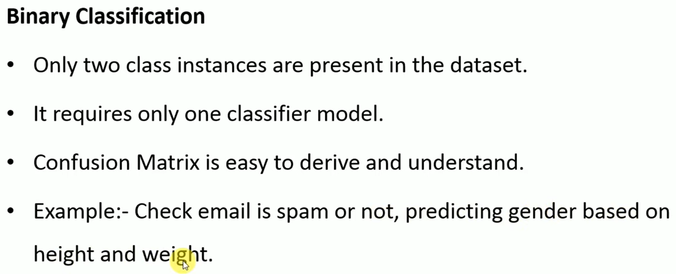
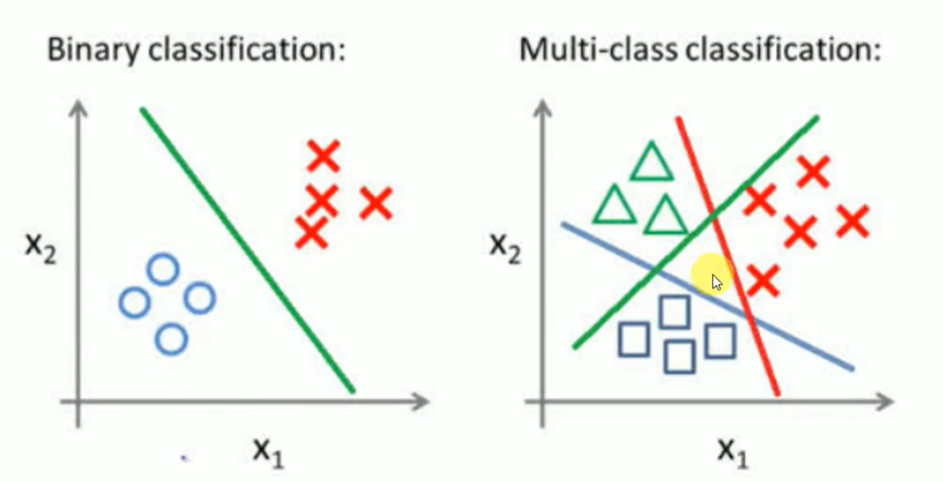
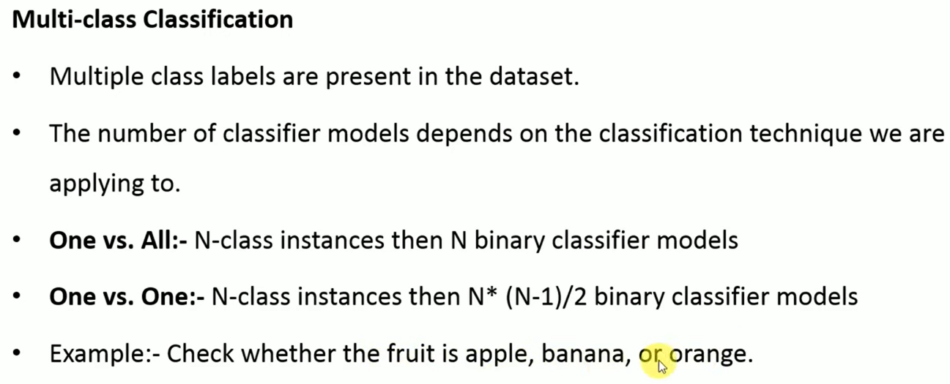
Binary v/s Multiclass Classification

Slide 4
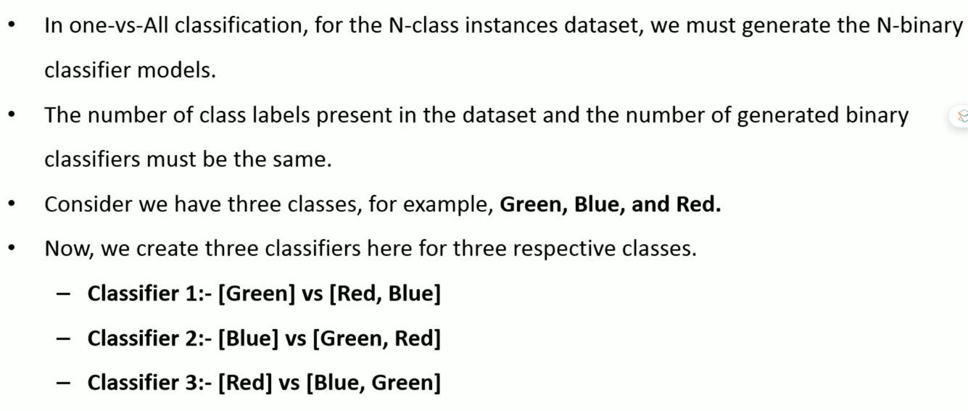
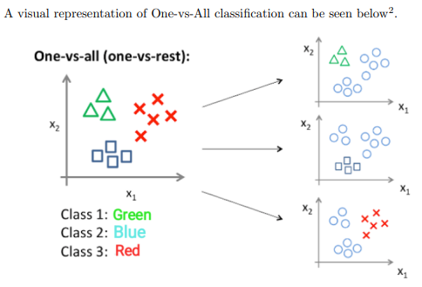
Multi-Class Classification (One vs All or One vs Rest)

Slide 5
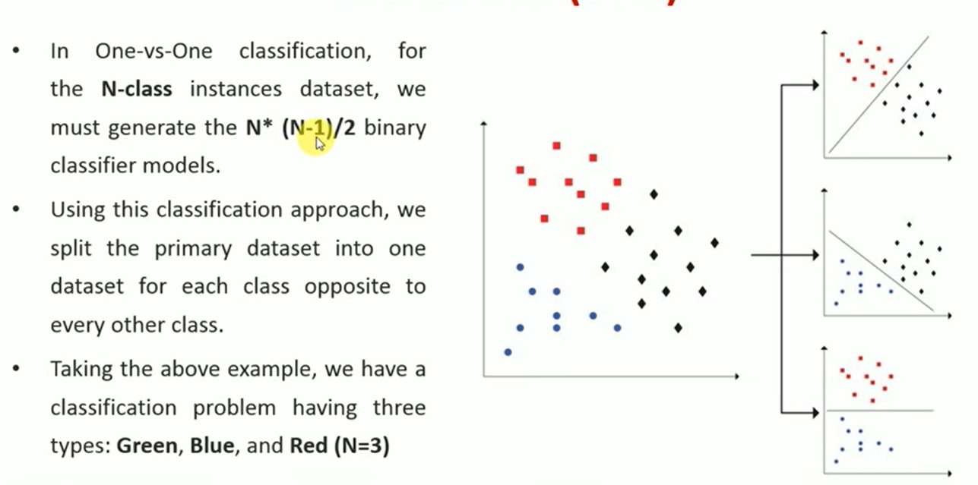
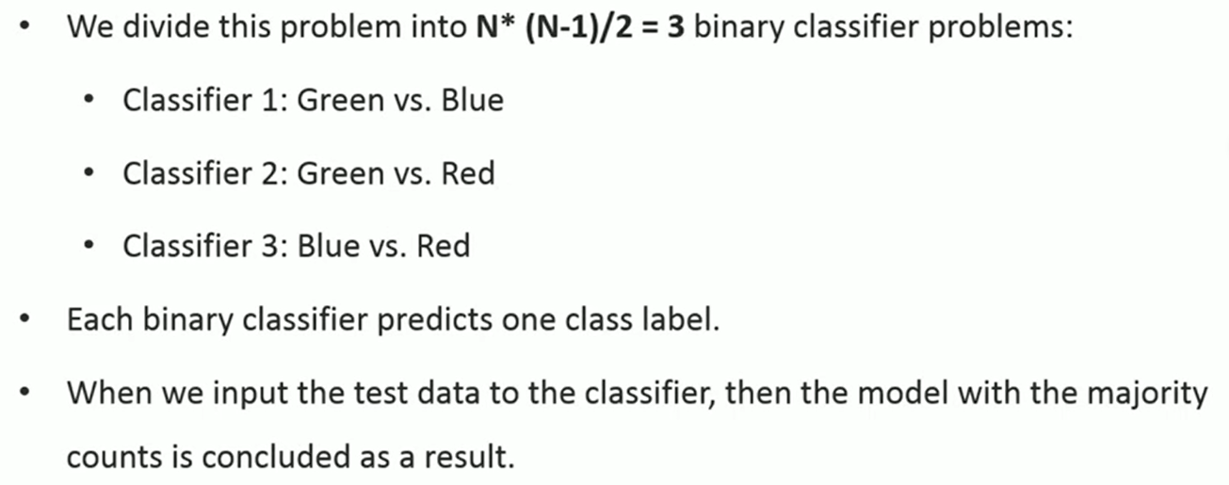
Multi-Class Classification
(One vs One)

Slide 6
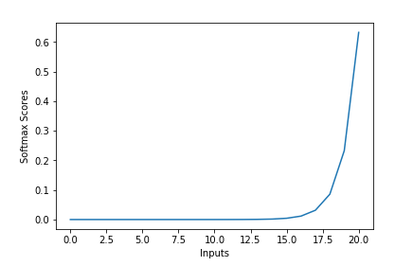
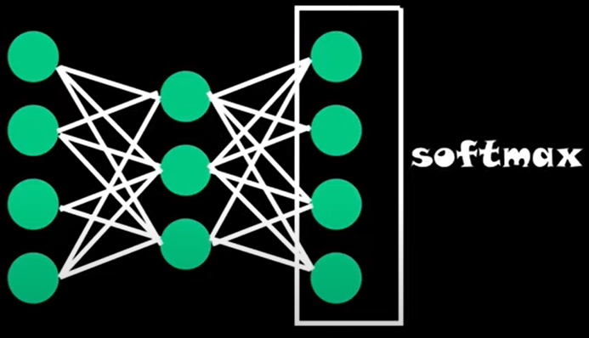
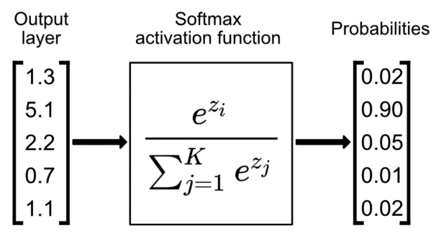
Softmax Function
The Softmax function is an extension of the sigmoid/ logistic function, used for multi-class classification problems.
Its goal is to predict a single label from multiple classes. The output of the softmax function is equivalent to a categorical probability distribution, it tells you the probability that any of the classes are true.
The softmax function, often used in the final layer of a neural network model for classification tasks as shown in Fig. (a)
It converts raw output scores — also known as logits — into probabilities by taking the exponential of each output and normalizing these values by dividing by the sum of all the exponentials. This process ensures the output values are in the range (0,1) and sum up to 1, making them interpretable as probabilities as shown in Fig. (b) and (c).
The class with highest probability is chosen as predicted class.
(a)
(b)
(c)

Slide 7
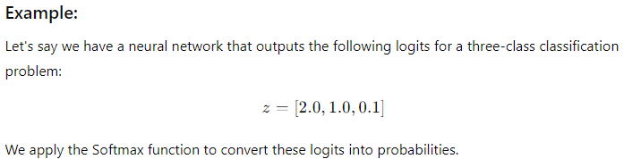
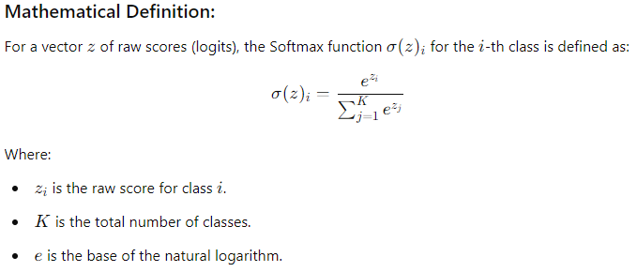
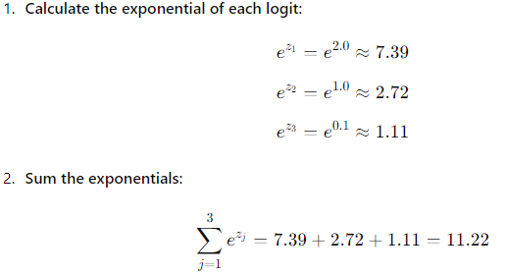
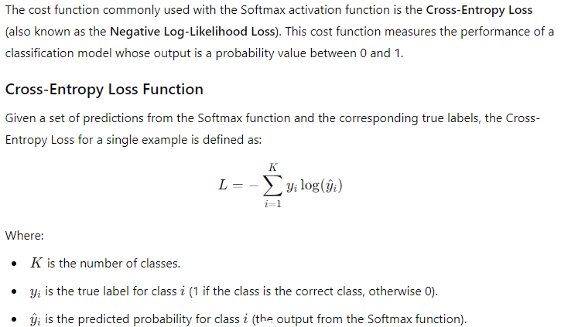
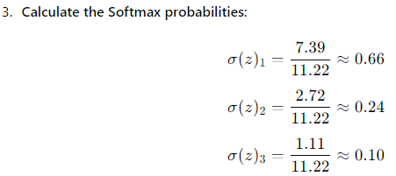
Softmax Function

Slide 8
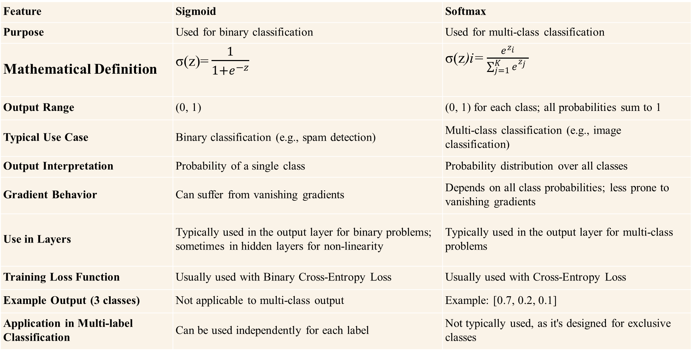
Sigmoid v/s Softmax
Feature | Sigmoid | Softmax
Purpose | Used for binary classification | Used for multi-class classification
Mathematical Definition | σ(z)= $\frac{1}{1+e^{−z}}$ | σ(z)i= $\frac{e^{z_{i}}}{\sum_{j=1}^{K}{e^{z_{j}} }}$
Output Range | (0, 1) | (0, 1) for each class; all probabilities sum to 1
Typical Use Case | Binary classification (e.g., spam detection) | Multi-class classification (e.g., image classification)
Output Interpretation | Probability of a single class | Probability distribution over all classes
Gradient Behavior | Can suffer from vanishing gradients | Depends on all class probabilities; less prone to vanishing gradients
Use in Layers | Typically used in the output layer for binary problems; sometimes in hidden layers for non-linearity | Typically used in the output layer for multi-class problems
Training Loss Function | Usually used with Binary Cross-Entropy Loss | Usually used with Cross-Entropy Loss
Example Output (3 classes) | Not applicable to multi-class output | Example: [0.7, 0.2, 0.1]
Application in Multi-label Classification | Can be used independently for each label | Not typically used, as it's designed for exclusive classes

Slide 9
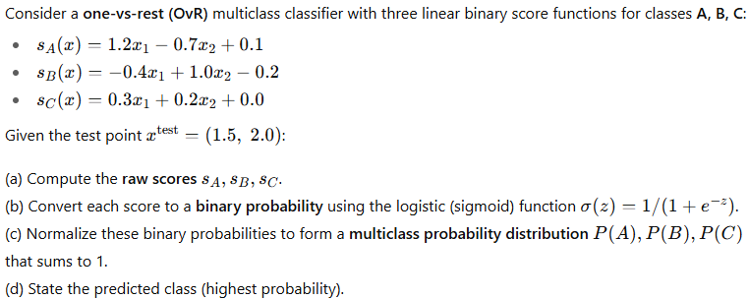

Slide 10
