Slide 1

Artificial Intelligence and Machine Learning
Lecture -7
Polynomial Regression

Slide 2

Polynomial Regression
Polynomial Regression is a regression algorithm that models the relationship between a dependent(y) and independent variable(x) as nth degree polynomial. The Polynomial Regression equation is given below:
It is also called the special case of Multiple Linear Regression in ML. Because we add some polynomial terms to the Multiple Linear regression equation to convert it into Polynomial Regression.
It is a linear model with some modification in order to increase the accuracy.
The dataset used in Polynomial regression for training is of non-linear nature.
It makes use of a linear regression model to fit the complicated and non-linear functions and datasets.

Slide 3
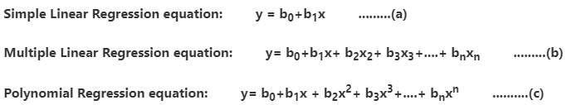
Equations of Polynomial Regression
When we compare the above three equations, we can clearly see that all three equations are Polynomial equations but differ by the degree of variables.
The Simple and Multiple Linear equations are also Polynomial equations with a single degree, and the Polynomial regression equation is Linear equation with the nth degree.
So, if we add a degree to our linear equations, then it will be converted into Polynomial Linear equations.

Slide 4
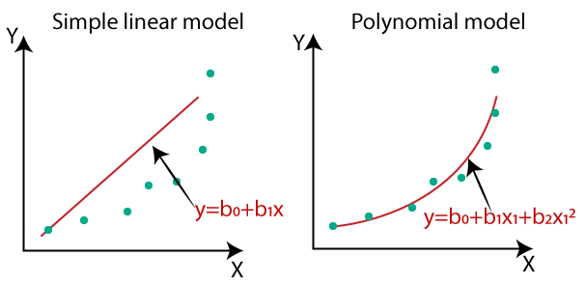
Need of Polynomial Regression
The need of Polynomial Regression in ML can be understood in the below points:
If we apply a linear model on a linear dataset, then it provides us a good result as we have seen in Simple Linear Regression, but if we apply the same model without any modification on a non-linear dataset, then it will produce a drastic output. Due to which loss function will increase, the error rate will be high, and accuracy will be decreased.
So, for such cases, where data points are arranged in a non-linear fashion, we need the Polynomial Regression model. We can understand it in a better way using the below comparison diagram of the linear dataset and non-linear dataset.
In the figure, we have taken a dataset which is arranged non-linearly. So, if we try to cover it with a linear model, then we can clearly see that it hardly covers any data point. On the other hand, a curve is suitable to cover most of the data points, which is of the Polynomial model.
Hence, if the datasets are arranged in a non-linear fashion, then we should use the Polynomial Regression model instead of Simple Linear Regression.

Slide 5
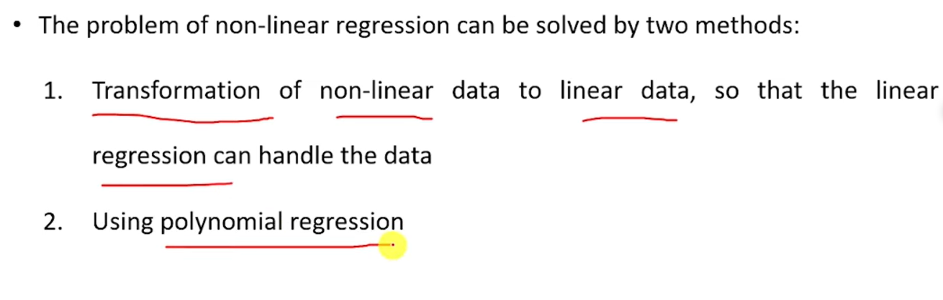
Polynomial Regression

Slide 6
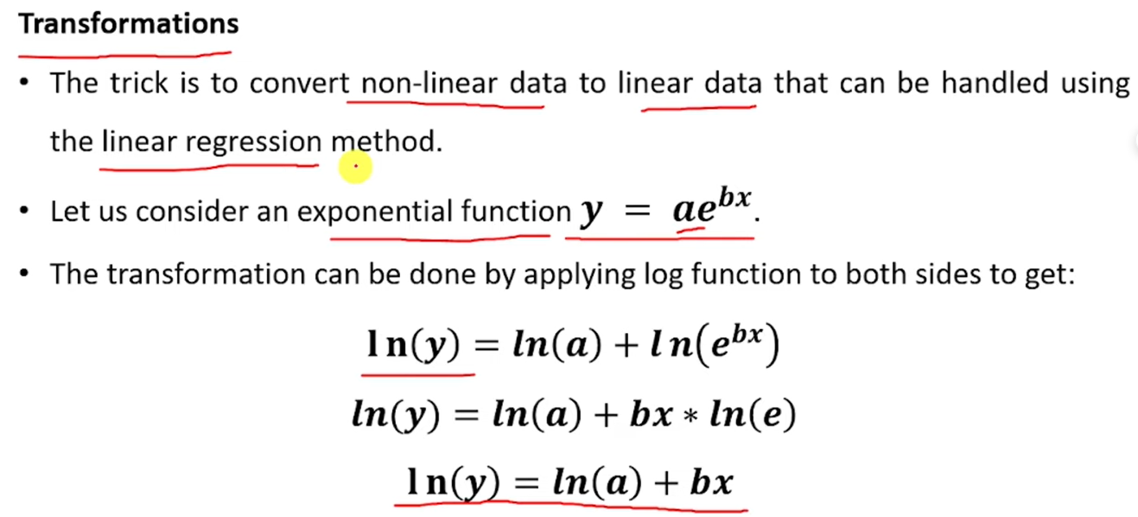
1. Transformation

Slide 7
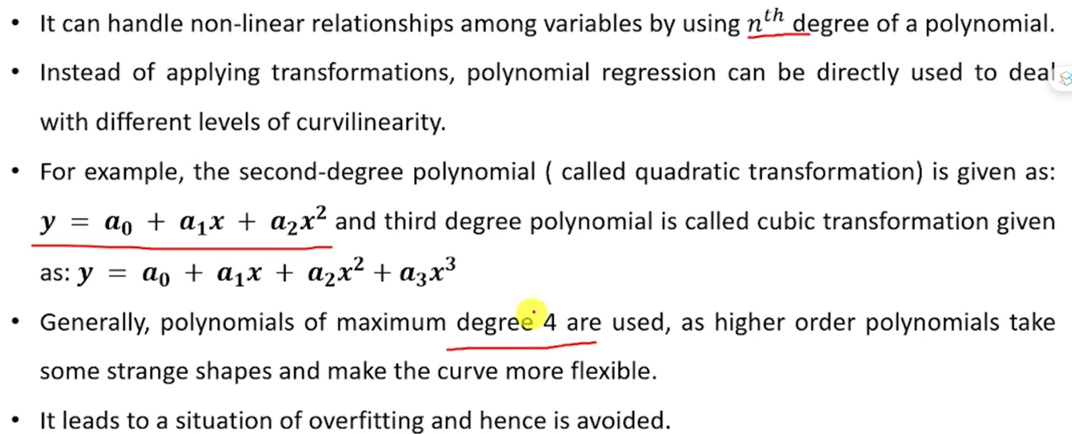
2. Polynomial Regression

Slide 8

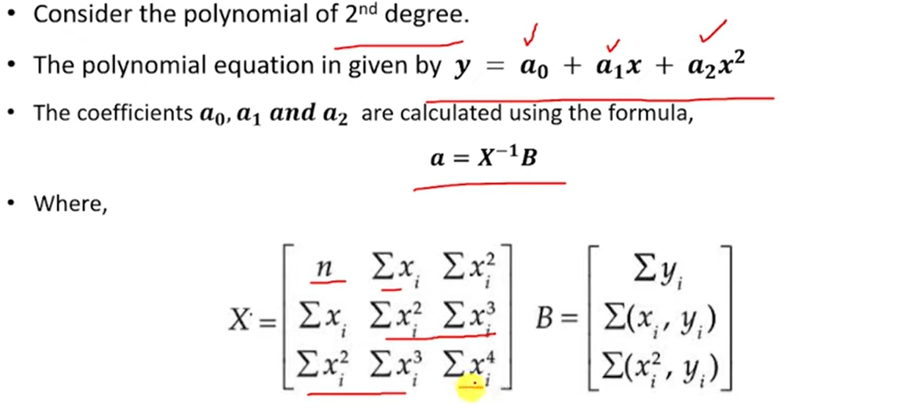

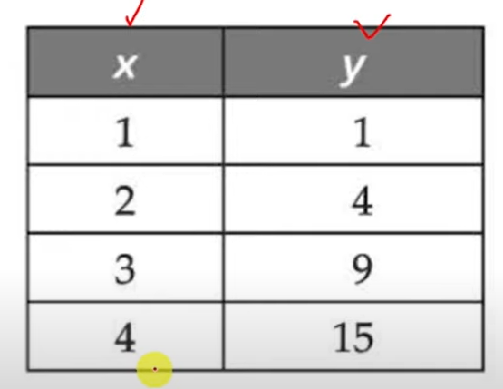


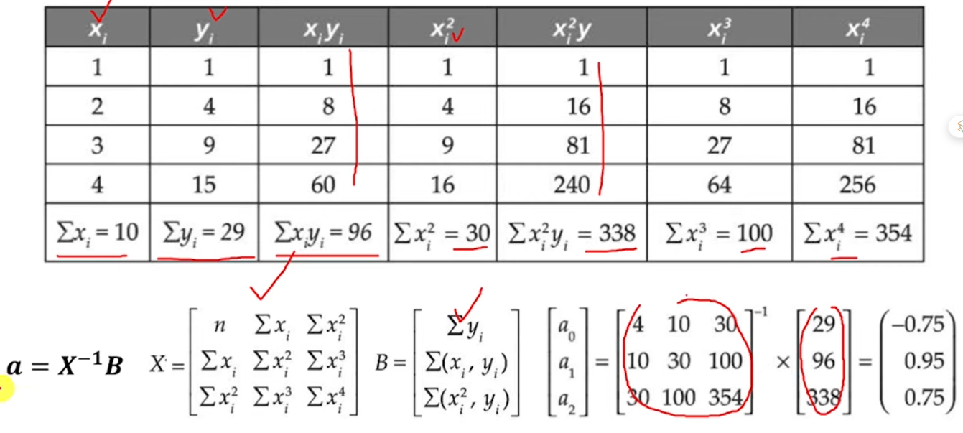

Polynomial Regression

Slide 9
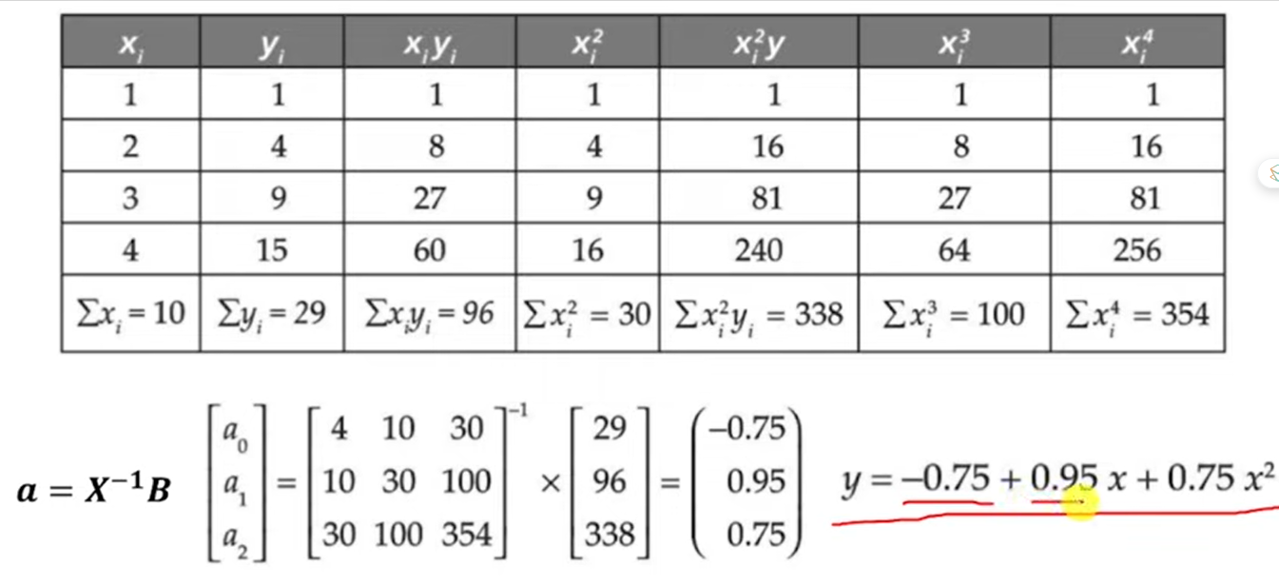
Polynomial Regression

Slide 10
Feature | Linear Regression | Logistic Regression | Polynomial Regression
Purpose | Predicts a continuous dependent variable based on independent variables. | Predicts a binary or categorical outcome (0 or 1) based on independent variables. | Predicts a continuous dependent variable, but the relationship between independent and dependent variables is non-linear.
Type of Model | Regression model (continuous output). | Classification model (categorical output). | Regression model (continuous output).
Output | A continuous value. | A probability between 0 and 1, which is then converted to a class label (0 or 1). | A continuous value.
Linear Relationship | Assumes a linear relationship between independent and dependent variables. | Assumes a linear relationship between independent variables and the log-odds of the outcome. | Models a non-linear relationship between the independent and dependent variables.
Decision Boundary | Not applicable (continuous prediction). | Linear decision boundary (in binary classification). | Can create more complex, non-linear decision boundaries.
Use Case | Predicting prices, sales, or any other continuous measure. | Classifying emails as spam or not spam, predicting if a tumor is malignant or benign. | Predicting outcomes where the relationship between variables is non-linear, such as growth rates.
Complexity | Simpler to implement and interpret. | Moderately complex; requires understanding of probabilities and log-odds. | More complex due to the inclusion of higher-degree polynomial terms.
Overfitting Risk | Lower risk if the relationship is truly linear. | Can overfit if too many features or if the data is not linearly separable. | Higher risk of overfitting, especially with high-degree polynomials.
Interpretability | High, as the relationship between variables is straightforward. | Moderate, as it involves understanding odds and log-odds. | Lower, especially with higher-degree polynomials.
Cost Function | Mean Squared Error (MSE). | Log Loss (Cross-Entropy Loss). | Mean Squared Error (MSE).
Example | Predicting house prices based on area, number of rooms, etc. | Predicting whether a customer will buy a product or not based on age, income, etc. | Predicting the trajectory of an object under the influence of gravity.

