Slide 1
Artificial Intelligence and Machine Learning
Lecture 8
Regression and Classification Performance Metrics

Slide 2


Regression Performance Metrics
Mean Squared Error (MSE):
Definition: The average of the squares of the differences between the predicted and actual values.
Use Case: Penalizes larger errors more than smaller ones, making it sensitive to outliers.
Mean Absolute Error (MAE):
Definition: The average of the absolute differences between the predicted and actual values.
Use Case: Provides a linear score, which means all individual differences are weighted equally in the average.

Slide 3


Regression Performance Metrics
Root Mean Squared Error (RMSE):
Definition: The square root of the Mean Squared Error. It provides the error in the same units as the output variable.
Use Case: More sensitive to outliers compared to MAE and useful when larger errors need to be penalized.
R-squared (R²) Score:
Definition: Represents the proportion of the variance in the dependent variable that is predictable from the independent variables.
Interpretation: An R² score of 1 indicates a perfect fit, while an R² score of 0 indicates that the model does not explain any of the variance in the target variable.

Slide 4
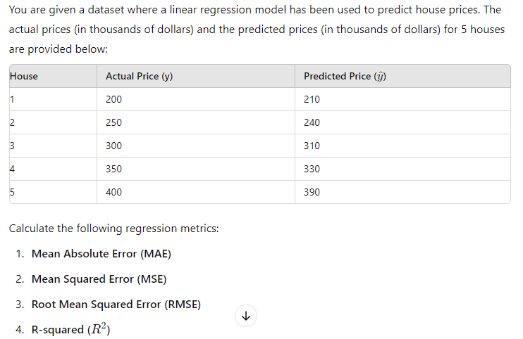
Numerical on Regression Metrics

Slide 5
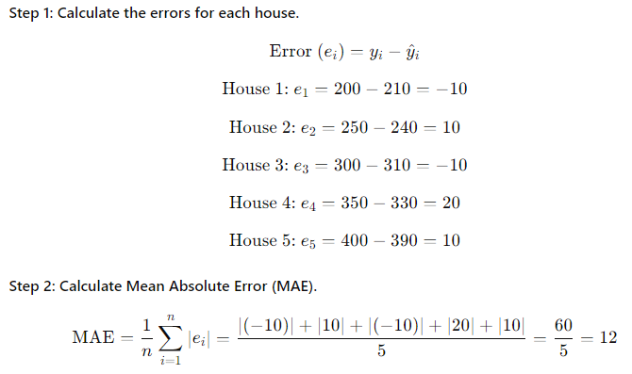
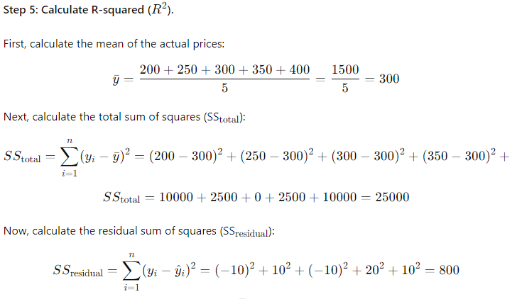
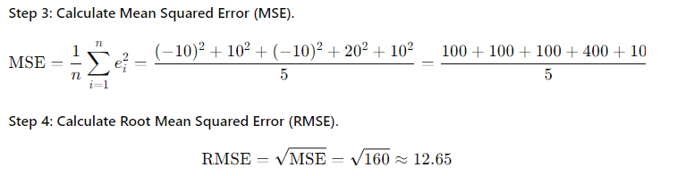

Numerical on Regression Metrics

Slide 6
Classification Performance Metrics
Confusion Matrix: Provides detailed performance metrics (TP, TN, FP, FN).
Accuracy: Overall correctness of the model.
Precision: Proportion of correct positive predictions.
Recall: Proportion of actual positives that were correctly identified.
F1-Score: Balance between precision and recall.
ROC-AUC: Measures the trade-off between true positive and false positive rates across different thresholds.

Slide 7

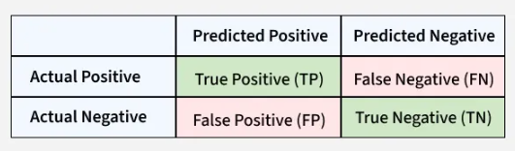
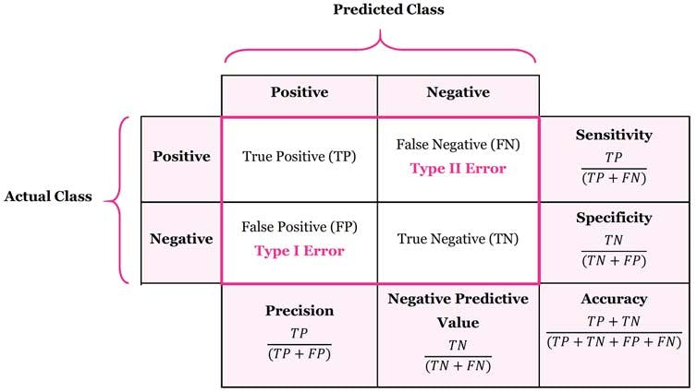
Classification Performance Metrics
Confusion Matrix
Confusion matrix is a simple table used to measure how well a classification model is performing.
It compares the predictions made by the model with the actual results and shows where the model was right or wrong.
This helps you understand where the model is making mistakes so you can improve it. It breaks down the predictions into four categories:
True Positive (TP): The model correctly predicted a positive outcome, i.e., the actual outcome was positive.
True Negative (TN): The model correctly predicted a negative outcome, i.e, the actual outcome was negative.
False Positive (FP): The model incorrectly predicted a positive outcome i.e the actual outcome was negative. It is also known as a Type I error.
False Negative (FN):The model incorrectly predicted a negative outcome i.e the actual outcome was positive. It is also known as a Type II error.

Slide 8
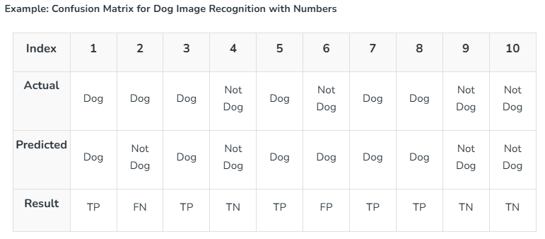
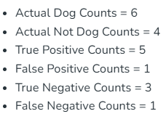
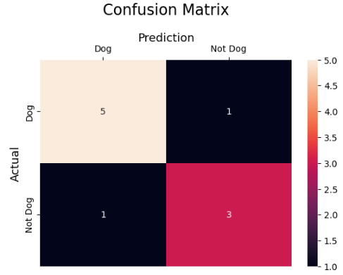
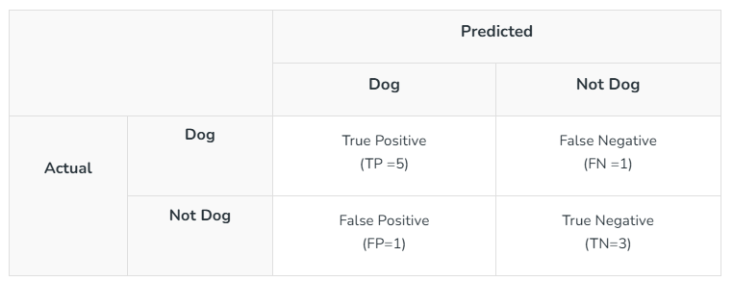

Slide 9


Classification Performance Metrics
Accuracy: Accuracy is the ratio of correctly predicted instances (both positive and negative) to the total number of instances.
Strength: Provides a straightforward measure of overall performance.
Weakness: Can be misleading if the dataset is imbalanced, as it does not distinguish between the types of errors.
Precision: Precision (also called Positive Predictive Value) measures the proportion of true positive predictions out of all positive predictions made by the model.
​Strength: Useful when the cost of false positives is high (e.g., in spam detection).
Weakness: Does not account for false negatives

Slide 10


Classification Performance Metrics
Recall: Recall (also called Sensitivity or True Positive Rate) measures the proportion of true positive instances out of all actual positive instances.
​Strength: Useful when the cost of false negatives is high (e.g., in disease detection).
Weakness: Does not account for false positives.
F1-Score: The F1-score is the harmonic mean of precision and recall. It provides a single metric that balances the trade-off between precision and recall.
Strength: Useful when you need to balance precision and recall, particularly in imbalanced datasets.
Weakness: Does not give as much insight as individual precision or recall scores.

Slide 11
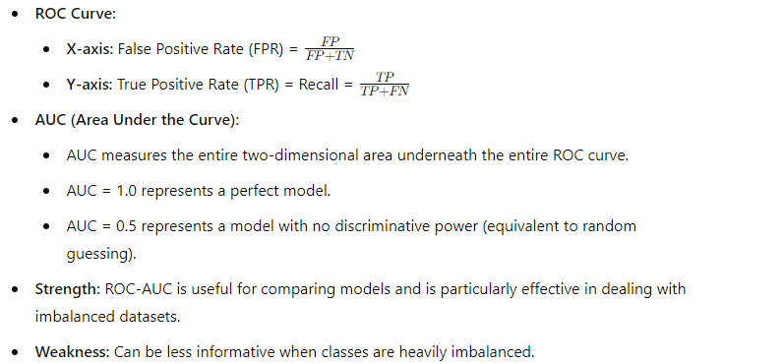
Classification Performance Metrics
ROC-AUC (Receiver Operating Characteristic - Area Under the Curve)
ROC-AUC is a performance measurement for classification problems at various threshold settings. The ROC curve is a plot of the True Positive Rate (Recall) against the False Positive Rate (1 - Specificity).

Slide 12
Applications of the Confusion Matrix
The confusion matrix has applications across various fields:
Model Evaluation: The primary application of the confusion matrix is to evaluate the performance of a classification model. It provides insights into the model's accuracy, precision, recall, and F1-score.
Medical Diagnosis: The confusion matrix finds extensive use in medical fields for diagnosing diseases based on tests or images. It aids in quantifying the accuracy of diagnostic tests and identifying the balance between false positives and false negatives.
Fraud Detection: Banks and financial institutions use confusion matrices to detect fraudulent transactions by showcasing how AI algorithms help identify patterns of fraudulent activities.
Natural Language Processing (NLP): NLP models use confusion matrices to evaluate sentiment analysis, text classification, and named entity recognition.
Customer Churn Prediction: Confusion matrices play a pivotal role in predicting customer churn and show how AI-driven models use historical data to anticipate and mitigate customer attrition.
Image and Object Recognition: Confusion matrices assist in training models to identify objects in images, enabling technologies like self-driving cars and facial recognition systems.

Slide 13

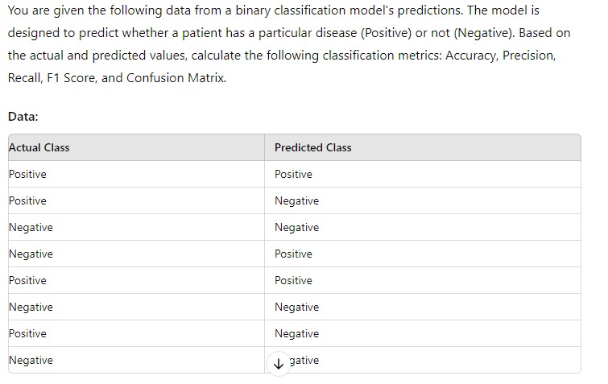



Numerical on Classification Metrics

Slide 14
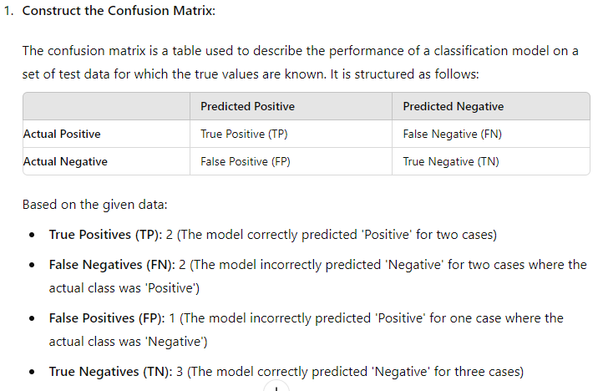
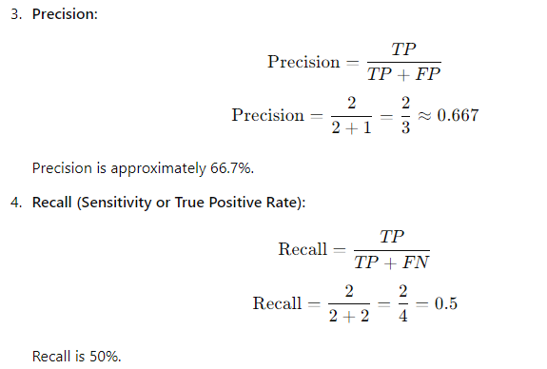
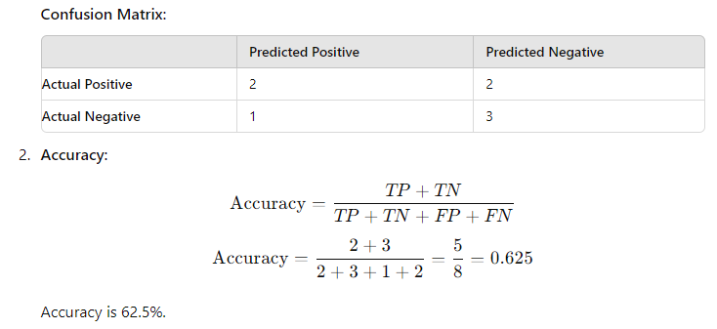
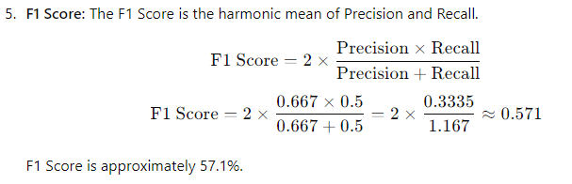

Slide 15
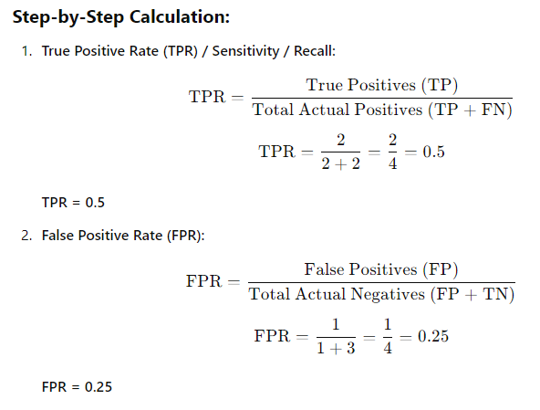
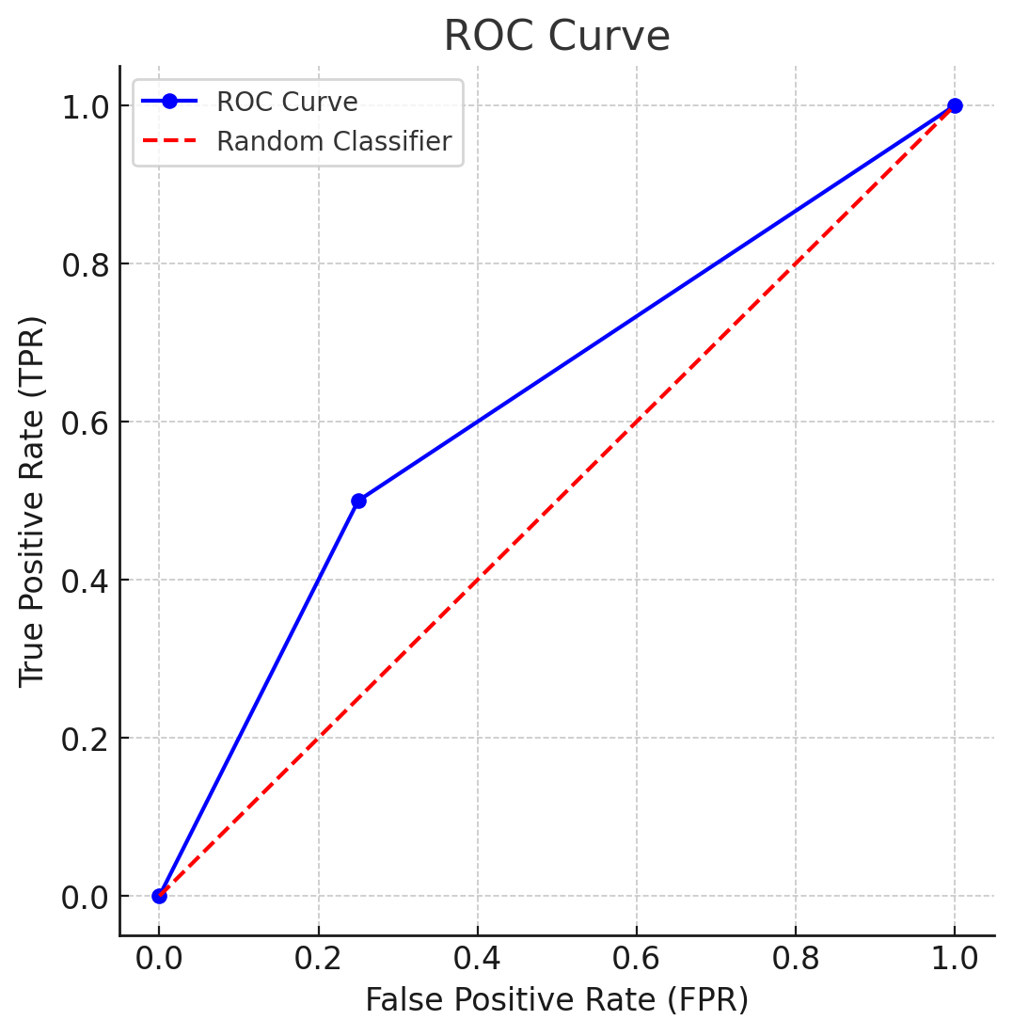
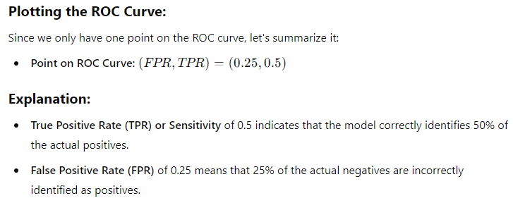
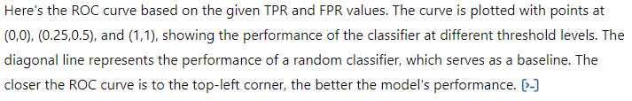

Slide 16
Actual Class | Predicted Class
1 | 1
1 | 0
0 | 1
0 | 0
1 | 1
0 | 0
A logistic regression classifier is used to predict whether a customer will buy a product (1) or not (0). The model makes the following predictions on a test dataset given on the right side.
a. Calculate the precision of the model.
b. Calculate the recall of the model.
c. Calculate the F1-score of the model.

Slide 17
