Slide 1

Artificial Intelligence and Machine Learning
Lecture 9
Errors in Machine Learning (Bias and Variance)

Slide 2

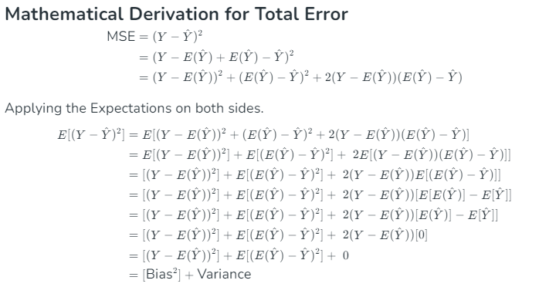
ERRORS IN MACHINE LEARNING
Machine learning is a branch of Artificial Intelligence, which allows machines to perform data analysis and make predictions.
However, if the machine learning model is not accurate, it can make predictions errors, and these prediction errors are usually known as Bias and Variance.
In machine learning, these errors will always be present as there is always a slight difference between the model predictions and actual predictions.
The main aim of ML/data science analysts is to reduce these errors in order to get more accurate results.
In this topic, we are going to discuss about the bias, variance, and bias-variance trade-off

Slide 3
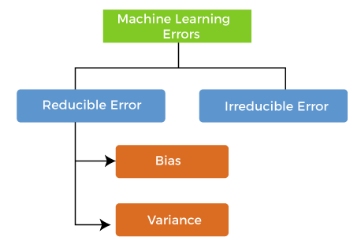
TYPES OF ERRORS IN MACHINE LEARNING
In machine learning, an error is a measure of how accurately an algorithm can make predictions for the unknown dataset.
On the basis of these errors, the machine learning model is selected that can perform best on the particular dataset.
There are mainly two types of errors in machine learning:
Reducible errors: These errors can be reduced to improve the model accuracy. Such errors can further be classified into bias and Variance.
Irreducible errors: These errors will always be present in the model

Slide 4
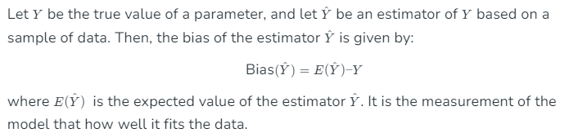
BIAS IN MACHINE LEARNING
Bias is simply defined as the differences between actual values and the predicted values are known as error or bias error or error due to bias.
Bias is a systematic error that occurs due to wrong assumptions in the machine learning process.
A model has either:
Low Bias: A low bias model will make fewer assumptions about the form of the target function.
High Bias: A model with a high bias makes more assumptions, and the model becomes unable to capture the important features of our dataset. A high bias model also cannot perform well on new data.
Examples: (a) Low bias are Decision Trees, k-Nearest Neighbours and Support Vector Machines.
(b) High bias is Linear Regression, Linear Discriminant Analysis and Logistic Regression.

Slide 5
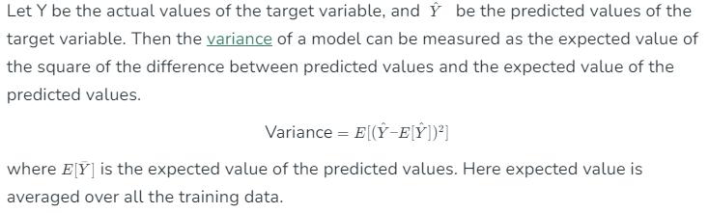
VARIANCE IN MACHINE LEARNING
In machine learning, the variance would specify the amount of variation in the prediction if the different training data was used. In simple words, variance tells that how much a random variable is different from its actual value. Ideally, a model should not vary too much from one training dataset to another, which means the algorithm should be good in understanding the hidden mapping between inputs and output variables. Variance errors are either of low variance or high variance.
Variance is the measure of spread in data from its mean position.
If the machine learning model performs well with the training dataset, but does not perform well with the test dataset, then variance occurs.
Low variance means there is a small variation in the prediction of the target function with changes in the training data set.
High variance shows a large variation in the prediction of the target function with changes in the training dataset.
A model that shows high variance learns a lot and perform well with the training dataset and does not generalize well with the unseen dataset. As a result, such a model gives good results with the training dataset but shows high error rates on the test dataset.

Slide 6
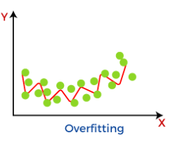
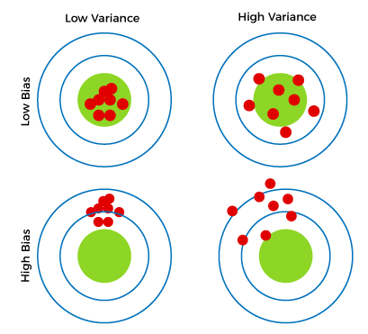
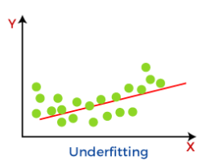
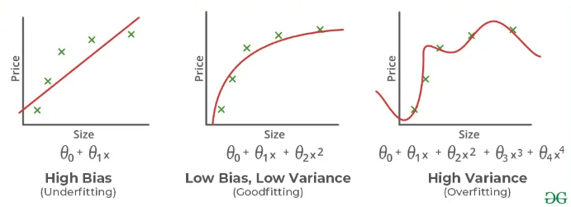
Different Combinations of Bias-Variance
Low-Bias, Low-Variance: The combination of low bias and low variance shows an ideal machine learning model. However, it is not possible practically.
Low-Bias, High-Variance: With low bias and high variance, model predictions are inconsistent and accurate on average. This case occurs when the model learns with a large number of parameters and hence leads to an overfitting
High-Bias, Low-Variance: With High bias and low variance, predictions are consistent but inaccurate on average. This case occurs when a model does not learn well with the training dataset or uses few numbers of the parameter. It leads to underfitting problems in the model.
High-Bias, High-Variance: With high bias and high variance, predictions are inconsistent and also inaccurate on average.
Bulls Eye Representation

Slide 7
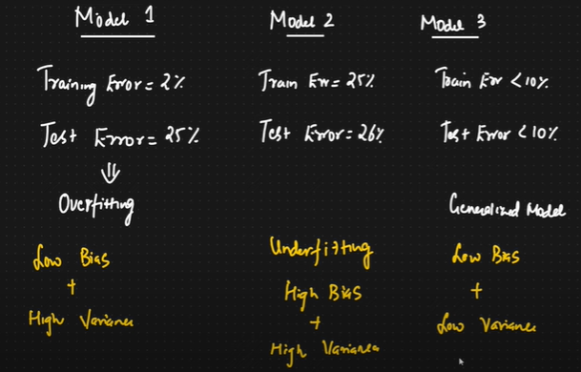





Slide 8
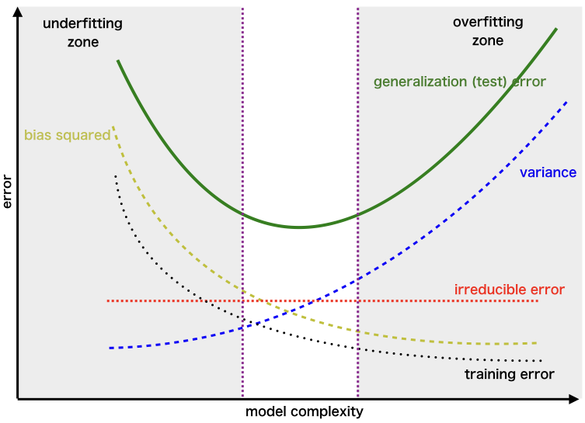

Bias-Variance Trade-Off
While building the machine learning model, it is really important to take care of bias and variance in order to avoid overfitting and underfitting in the model.
If the model is very simple with fewer parameters, it may have low variance and high bias.
Whereas, if the model has a large number of parameters, it will have high variance and low bias.
So, it is required to make a balance between bias and variance errors, and this balance between the bias error and variance error is known as the Bias-Variance trade-off.
For an accurate prediction of the model, algorithms need a low variance and low bias. But this is not possible because bias and variance are related to each other:
If we decrease the variance, it will increase the bias.
If we decrease the bias, it will increase the variance.
Bias-Variance trade-off is about finding the sweet spot to make a balance between bias and variance errors. An algorithm can’t be more complex and less complex at the same time.

Slide 9
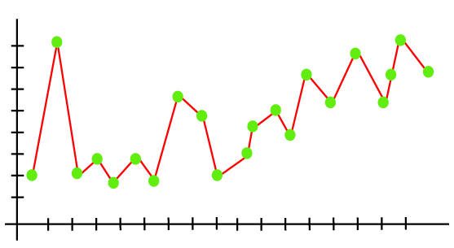
Overfitting and Underfitting
Overfitting occurs when our machine learning model tries to cover all the data points, or more than the required data points present in the given dataset. Because of this, the model starts caching noise and inaccurate values present in the dataset, and all these factors reduce the efficiency and accuracy of the model. The overfitted model has low bias and high variance.
The chances of occurrence of overfitting increase as much we provide training to our model. It means the more we train our model, the more chances of occurring the overfitted model.
As we can see from the above graph, the model tries to cover all the data points present in the scatter plot. It may look efficient, but in reality, it is not so. Because the goal of the regression model to find the best fit line, but here we have not got any best fit, so, it will generate the prediction errors.

Slide 10
Techniques used to remove Overfitting
Improving the quality of training data reduces overfitting by focusing on meaningful patterns, mitigate the risk of fitting the noise or irrelevant features.
Increase the training data can improve the model’s ability to generalize to unseen data and reduce the likelihood of overfitting.
Reduce model complexity.
Early stopping during the training phase (have an eye over the loss over the training period as soon as loss begins to increase stop training).
Ridge Regularization and Lasso Regularization.
Use dropout for neural networks to tackle overfitting.

Slide 11
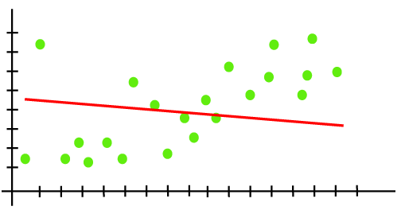
Underfitting
Underfitting occurs when our machine learning model is not able to capture the underlying trend of the data. To avoid the overfitting in the model, the fed of training data can be stopped at an early stage, due to which the model may not learn enough from the training data. As a result, it may fail to find the best fit of the dominant trend in the data.
In the case of underfitting, the model is not able to learn enough from the training data, and hence it reduces the accuracy and produces unreliable predictions.
An underfitted model has high bias and low variance.
How to avoid underfitting
By increasing the training time of the model.
By increasing the number of features.

Slide 12
Ways to reduce High Bias and High Variance
Aspect | High Bias (Underfitting) | High Variance (Overfitting)
Model Complexity | Increase model complexity (e.g., use a more complex model) | Decrease model complexity (e.g., use a simpler model)
Feature Engineering | Add more relevant features or use feature interactions | Remove irrelevant or redundant features
Training Data | Use more informative features and better feature selection | Increase the size of the training dataset
Regularization | Decrease regularization (reduce λ\lambdaλ in Ridge/Lasso) | Increase regularization (increase λ\lambdaλ in Ridge/Lasso)
Model Selection | Choose a more complex algorithm (e.g., moving from linear to non-linear models) | Choose a simpler algorithm (e.g., moving from a deep neural network to a shallow one)
Hyperparameter Tuning | Tune hyperparameters to allow the model more flexibility | Tune hyperparameters to constrain the model
Training Duration | Train the model longer (more epochs in deep learning) | Use early stopping to prevent overfitting
Data Augmentation | Use techniques like polynomial features to increase model capacity | Use data augmentation to increase variability in the training data
Cross-Validation | Cross-validation may not significantly reduce bias but can guide in model selection | Use cross-validation to select a model that generalizes better
Ensemble Methods | Use ensemble methods to combine models and reduce bias | Use techniques like bagging (Bootstrap Aggregating) to reduce variance
Learning Rate | Use a lower learning rate to better fit the model | Use a higher learning rate to prevent overfitting quickly

Slide 13
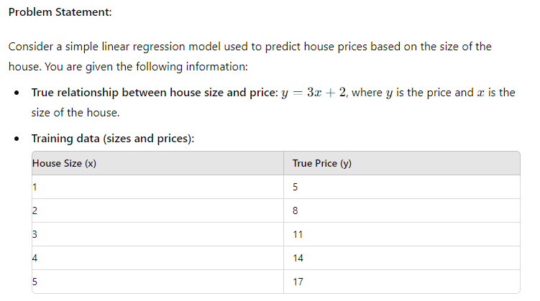
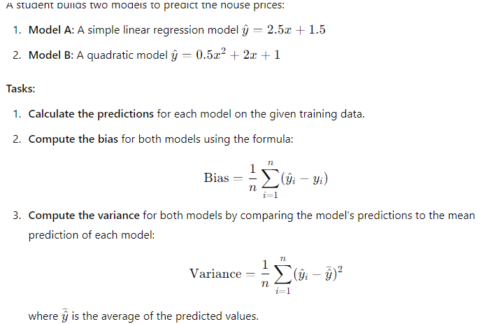

Slide 14
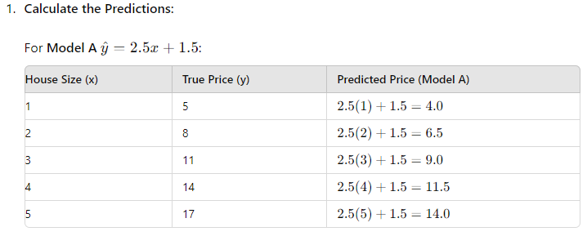
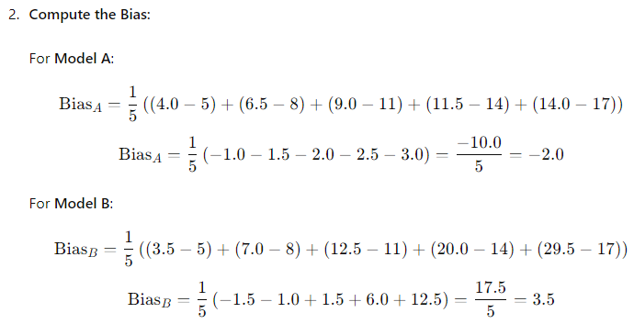
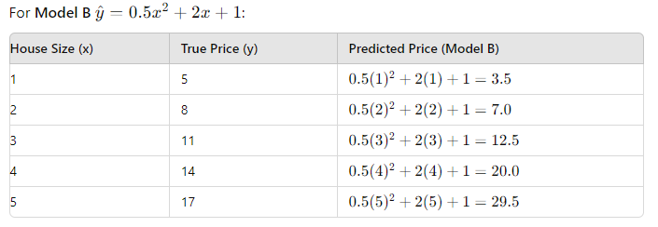
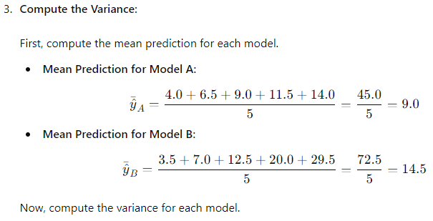
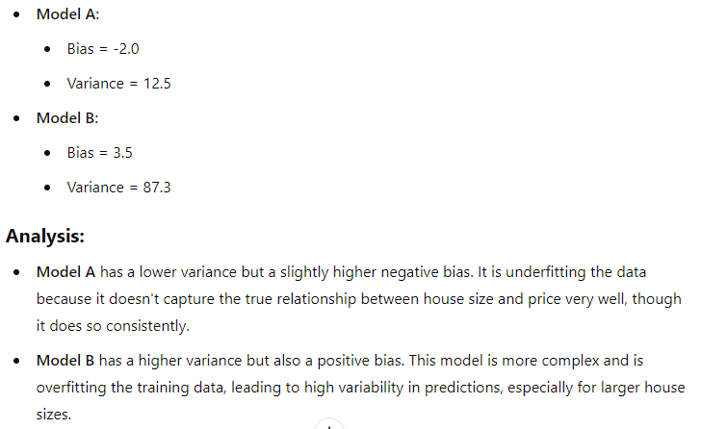

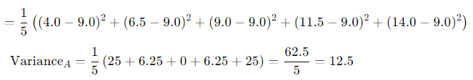

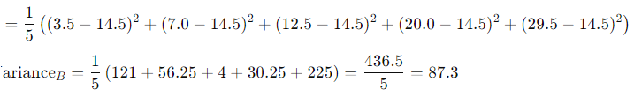

Slide 15
Consider a dataset of house prices with the following variables:
Square footage of the house (in square meters)
The corresponding price of the house (in $1000).
You are given the following data points:
You want to fit a model to predict the price of houses based on their square footage. Explore three scenarios: underfitting, appropriate fitting, and overfitting, and calculate their errors.
Square Footage (x) | Price ($1000) (y)
50 | 150
60 | 180
70 | 200
80 | 220
90 | 250

Slide 16
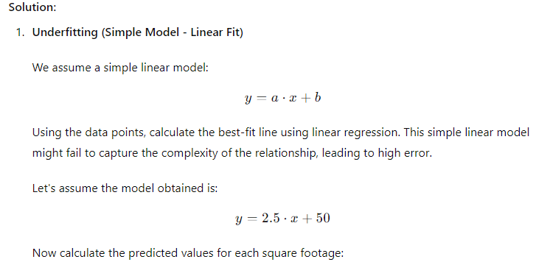
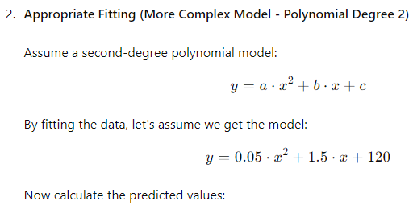
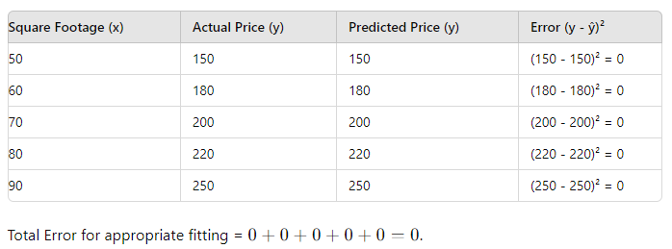
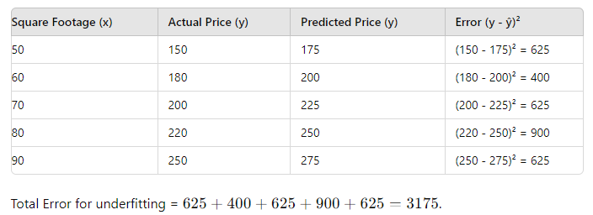

Slide 17
