Slide 1

Artificial Intelligence
Lecture -5

Slide 2
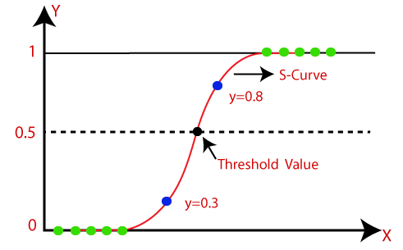
LOGISTIC REGRESSION
Logistic regression is one of the most popular Machine Learning algorithms, which comes under the Supervised Learning technique.
It is used for predicting the categorical dependent variable using a given set of independent variables.
Logistic regression predicts the output of a categorical dependent variable. Therefore, the outcome must be a categorical or discrete value.
It can be either Yes or No, 0 or 1, true or False, etc. but instead of giving the exact value as 0 and 1, it gives the probabilistic values which lie between 0 and 1.
Logistic Regression is much similar to the Linear Regression except that how they are used.
Linear Regression is used for solving Regression problems, whereas Logistic regression is used for solving the classification problems.
The curve from the logistic function indicates the likelihood of something such as whether the cells are cancerous or not, a mouse is obese or not based on its weight, etc.
(Logistic regression analysis is valuable for predicting the likelihood of an event.)
NOTE: Logistic regression uses the concept of predictive modeling as regression; therefore, it is called logistic regression but is used to classify samples; Therefore, it falls under the classification algorithm.

Slide 3
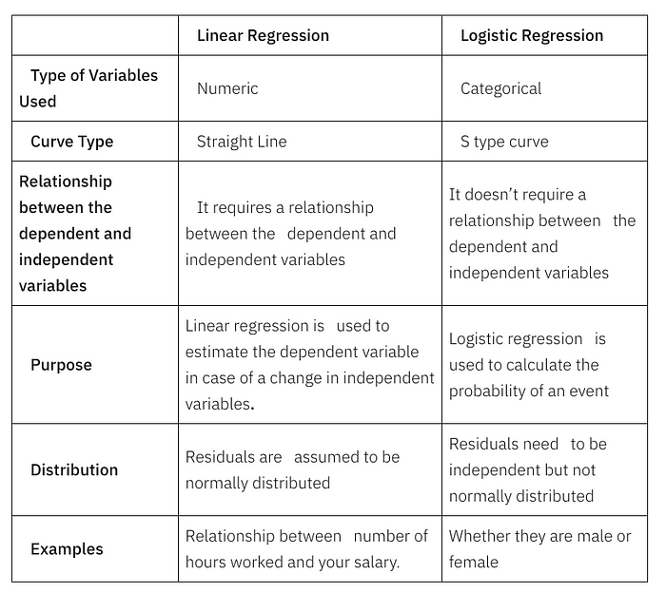
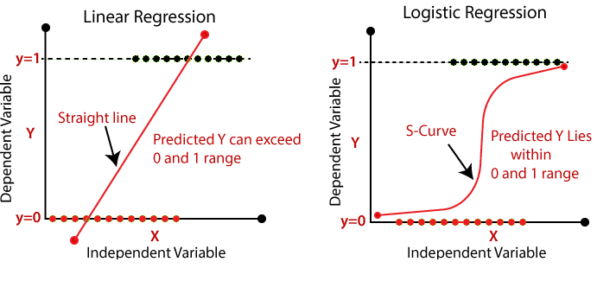
Linear v/s Logistic Regression

Slide 4

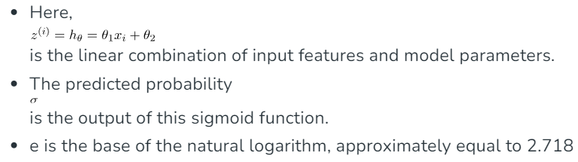
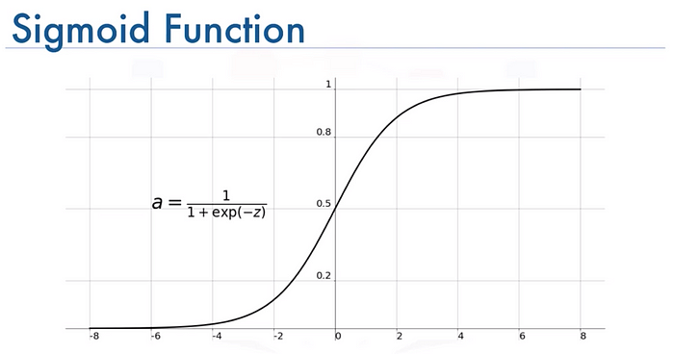
Logistic or Sigmoid Function
The sigmoid function is a mathematical function that converts a real number into a value between 0 and 1. It's often used as an activation function in neural networks, where it takes a real value as input and outputs a value in the same range.
The output value is closer to 1 if the input is larger (more positive), and closer to 0 if the input is smaller (more negative).
The value of the logistic regression must be between 0 and 1, which cannot go beyond this limit, so it forms a curve like the "S" form. The S-form curve is called the Sigmoid function or the logistic function.
In logistic regression, we use the concept of the threshold value, which defines the probability of either 0 or 1. Such as values above the threshold value tends to 1, and a value below the threshold values tends to 0.

Slide 5
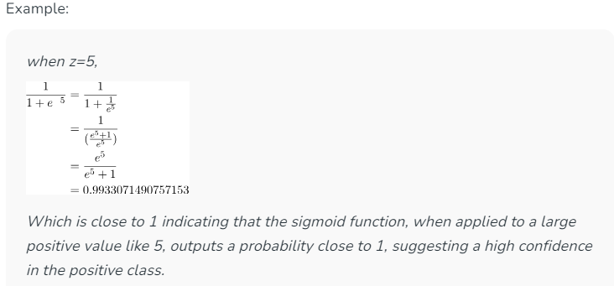
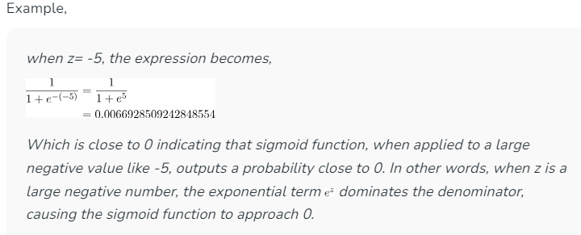
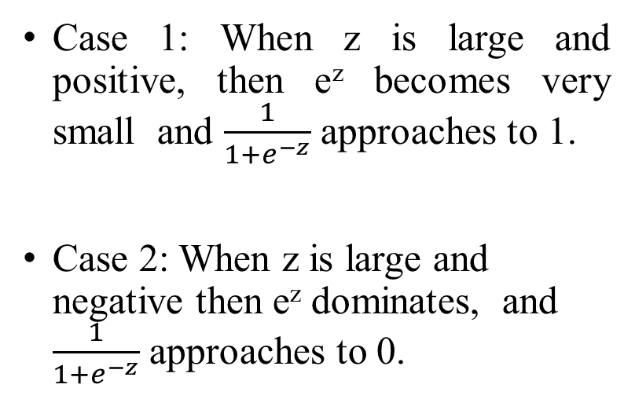
Example of Logistic Regression
Case 1: When z is large and positive, then e^{z} becomes very small and $\frac{1}{1+e^{−z}}$ approaches to 1.
Case 2: When z is large and negative then e^{z} dominates, and $\frac{1}{1+e^{−z}}$ approaches to 0.

Slide 6
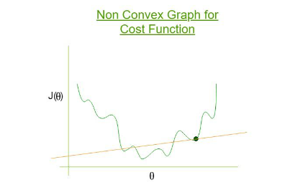
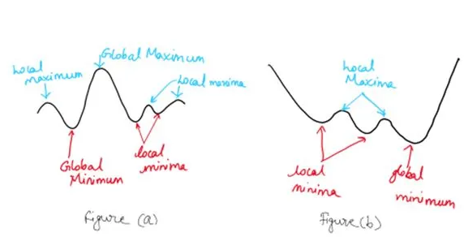
Cost Function for Logistic Regression
Why Mean Squared Error (MSE) cannot be used as a cost function for Logistic Regression?
Mean Squared Error cannot be used as a cost function for Logistic Regression for the following reasons:
Non-Convexity Issue: MSE in logistic regression leads to a non-convex cost function, which means the optimization process can get stuck in local minima, making it difficult to find the global minimum effectively.
Inappropriate for Classification: Logistic regression is a classification model, and MSE, which is designed for regression tasks, does not align well with the probabilistic output of logistic regression (which is between 0 and 1). This mismatch leads to suboptimal performance in classification accuracy.

Slide 7

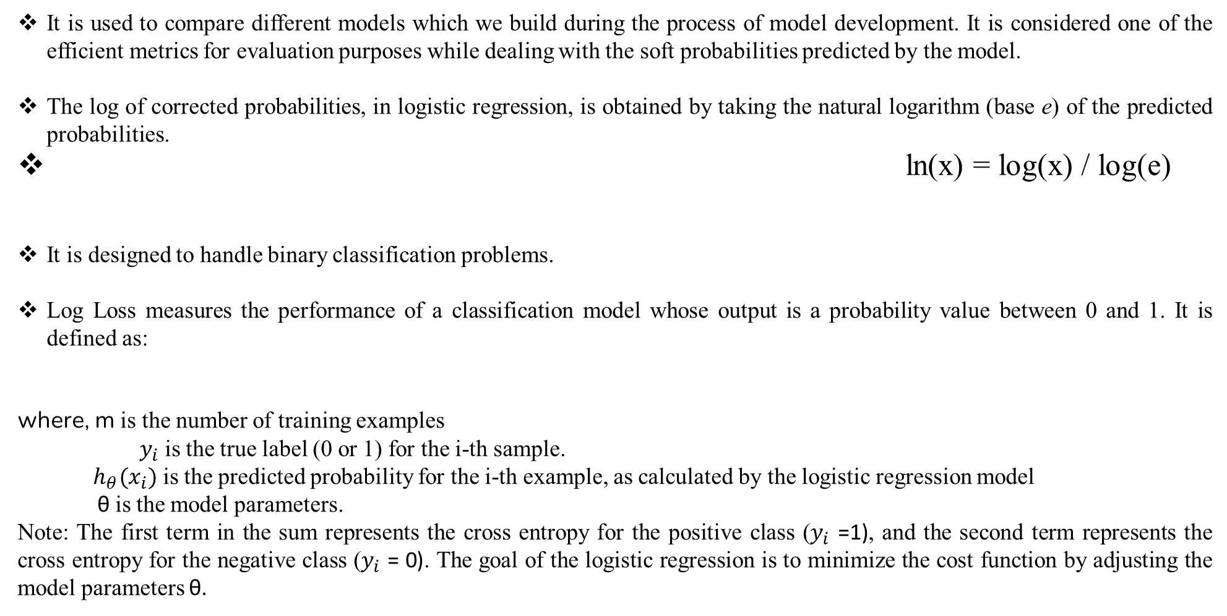
Cost Function or Cross Entropy or Log Loss for Logistic Regression
It is used to compare different models which we build during the process of model development. It is considered one of the efficient metrics for evaluation purposes while dealing with the soft probabilities predicted by the model.
The log of corrected probabilities, in logistic regression, is obtained by taking the natural logarithm (base e) of the predicted probabilities.
ln(x) = log(x) / log(e)
It is designed to handle binary classification problems.
Log Loss measures the performance of a classification model whose output is a probability value between 0 and 1. It is defined as:
where, m is the number of training examples
$y_{i}$ is the true label (0 or 1) for the i-th sample.
$h_{θ}{(x}_{i})$ is the predicted probability for the i-th example, as calculated by the logistic regression model
θ is the model parameters.
Note: The first term in the sum represents the cross entropy for the positive class ($y_{i}$ =1), and the second term represents the cross entropy for the negative class ($y_{i}$ = 0). The goal of the logistic regression is to minimize the cost function by adjusting the model parameters θ.

Slide 8
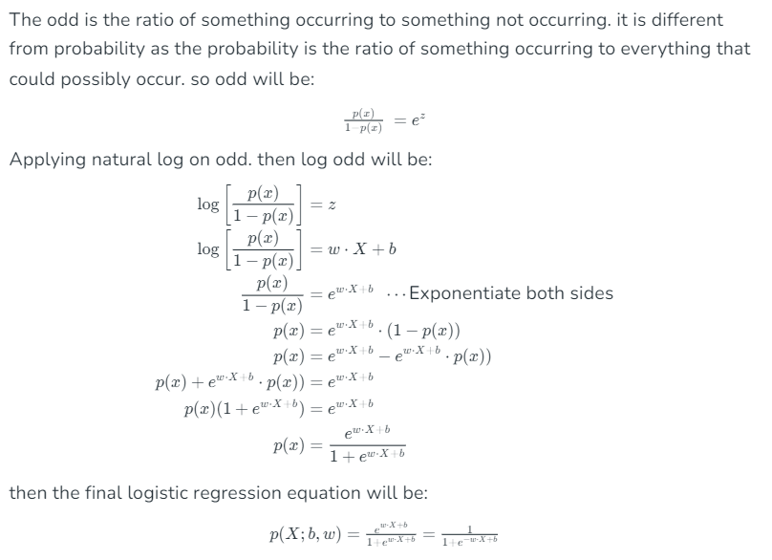
Logistic Regression Equation

Slide 9
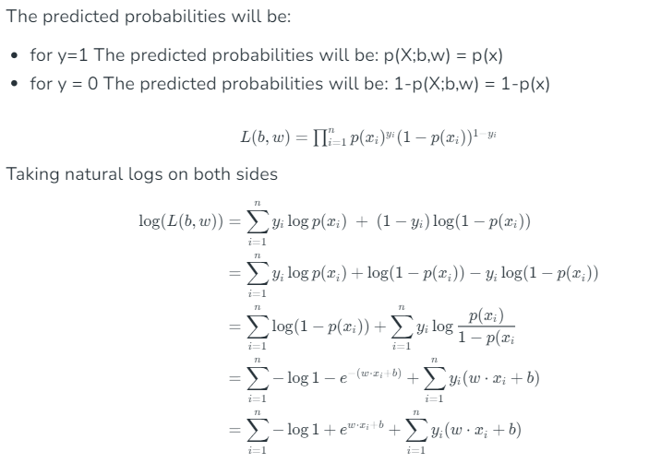
Cross Entropy or Likelihood Function for Logistic Regression

Slide 10
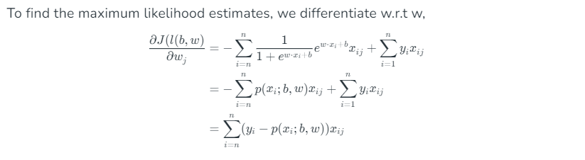
Gradient of the log-likelihood function

Slide 11
Types of Logistic Regression
Binary Logistic Regression
Two or binary outcomes like yes or no
Multinomial Logistic Regression
Three or more outcomes like first, second, and third class or no class degree
Ordinal Logistic Regression
Three or more like multinomial logistic regression but here with the order like customer rating in the supermarket from 1 to 5

Slide 12
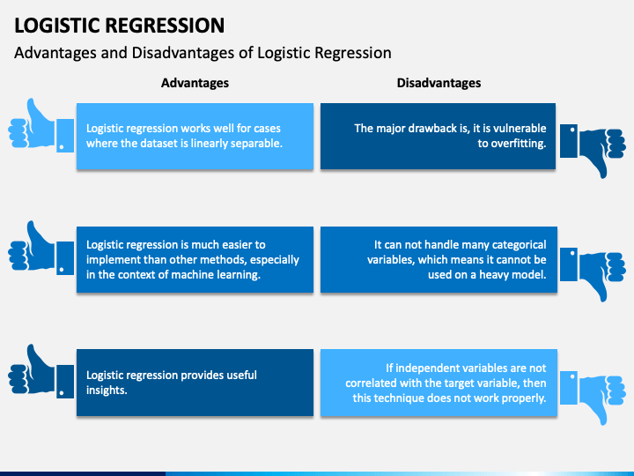
Overfitting occurs when a model is excessively complex, such as having too many parameters relative to the number of observations. A model that has been overfit has poor predictive performance, as it overreacts to minor fluctuations in the training data.

Slide 13
Applications
An email is a spam
It’ll rain today
A tumor is fatal
An individual will purchase a car
An online transaction is fraudulent
A contestant will win an election
A group of users will buy a product
An insurance policyholder will expire before the policy term expires
A promotional email receiver is a responder or non-responder

Slide 14

We are given a dataset of whether a student passed (1) or failed (0) an exam based on the number of hours studied. Let the initial weights θ0=θ1 =0, learning rate α=0.1, and perform one iteration of gradient descent
Student | Hours Studied (x) | Passed (y)
1 | 1 | 0
2 | 2 | 0
3 | 3 | 0
4 | 4 | 1
5 | 5 | 1
1) build a logistic regression model of the form:
2) Calculate the probability of passing the student who studied who studied 3 hours

Slide 15
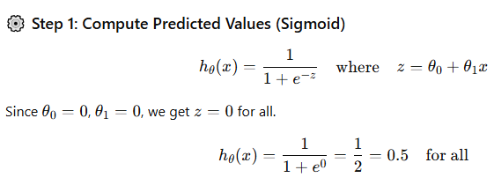
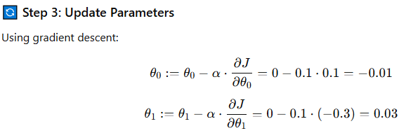
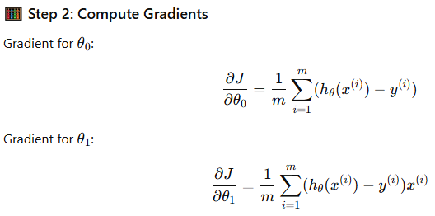
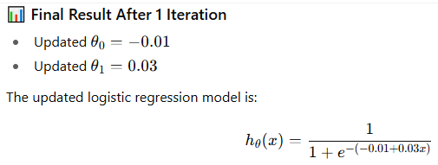
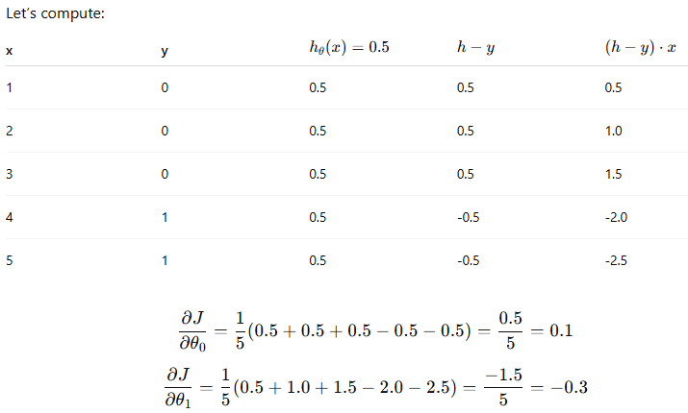
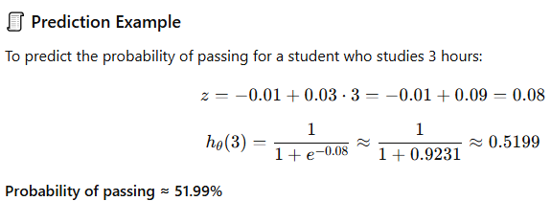

Slide 16
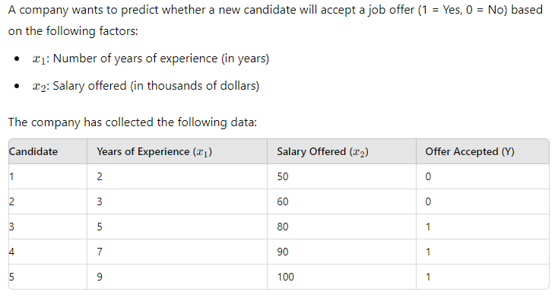
Develop a logistic regression model to predict the probability that a candidate will accept the job offer based on the years of experience and salary offered.

Slide 17
A company wants to predict whether a customer will purchase a product (Purchase = 1) or not (Purchase = 0) based on their income and age. The following dataset represents a sample of customer behavior. We want to use logistic regression to predict whether a customer will purchase the product based on their income and age. .
.
Customer | Age | Income (in $1000) | Purchase (1 = Yes, 0 = No)
1 | 22 | 40 | 0
2 | 25 | 60 | 0
3 | 47 | 80 | 1
4 | 52 | 100 | 1
5 | 46 | 96 | 1
6 | 55 | 120 | 1
7 | 29 | 50 | 0
8 | 31 | 60 | 0
9 | 35 | 70 | 1
10 | 42 | 78 | 1

Slide 18
