Slide 1

Artificial Intelligence and Machine Learning
Module-2 Lecture-1

Slide 2
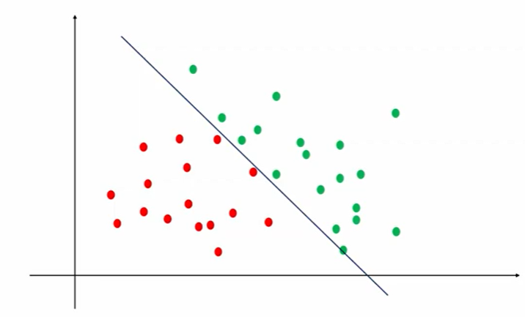
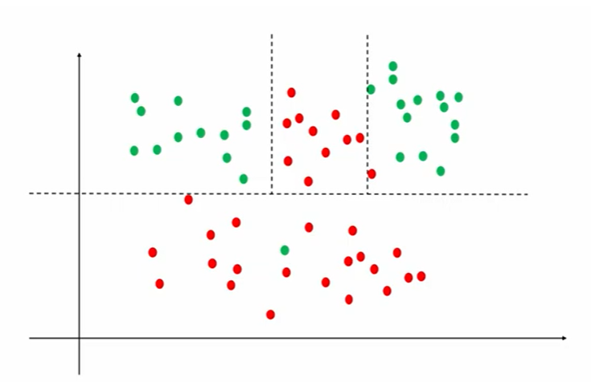
Logistic Regression v/s Decision Tree Classification
Logistic Regression
Decision Tree Classifier

Slide 3
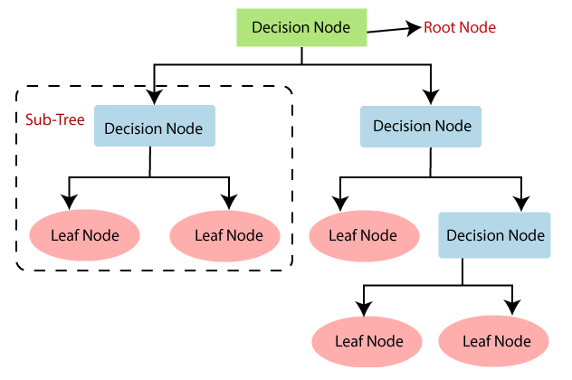
DECISION TREE CLASSIFICATION
Decision Tree is a Supervised learning technique that can be used for both classification and Regression problems, but mostly it is preferred for solving Classification problems.
It is a tree-structured classifier, where decision node represents the features of a dataset (attribute test), branches represent the decision rules (attributes values), and leaf node represents the outcome (final decision or prediction).
The decisions tree performed on the basis of features of the given dataset.
It is a graphical representation for getting all the possible solutions to a problem/decision based on given conditions.
It is called a decision tree because, similar to a tree, it starts with the root node, which expands on further branches and constructs a tree-like structure.
In order to build a tree, we use the CART algorithm, which stands for Classification and Regression Tree algorithm.
A decision tree simply asks a question and based on the answer (Yes/No), it further split the tree into subtrees.
The diagram explains the general structure of a decision tree:

Slide 4
Why Decision Trees?
There are various algorithms in Machine learning, so choosing the best algorithm for the given dataset and problem is the main point to remember while creating a machine learning model. Below are the two reasons for using the Decision tree:
Decision Trees usually mimic human thinking ability while making a decision, so it is easy to understand.
The logic behind the decision tree can be easily understood because it shows a tree-like structure.

Slide 5
Decision Tree Terminologies
Root Node: Root node is from where the decision tree starts. It represents the entire dataset, which further gets divided into two or more homogeneous sets.
Leaf Node: Leaf nodes are the final output node, and the tree cannot be segregated further after getting a leaf node.
Splitting: Splitting is the process of dividing the decision node/root node into sub-nodes according to the given conditions.
Branch/Sub Tree: A tree formed by splitting the tree.
Pruning: Pruning is the process of removing the unwanted branches from the tree.
Parent/Child node: The root node of the tree is called the parent node, and other nodes are called the child nodes.

Slide 6
How is Decision Tree formed?
The process of forming a decision tree involves recursively partitioning the data based on the values of different attributes.
The algorithm selects the best attribute to split the data at each internal node, based on certain criteria such as information gain or Gini impurity.
This splitting process continues until a stopping criterion is met, such as reaching a maximum depth or having a minimum number of instances in a leaf node.

Slide 7
How does Decision Tree Algorithm Works?
Step-1: Begin the tree with the root node, says S, which contains the complete dataset.
Step-2: Find the best attribute in the dataset using Attribute Selection Measure (ASM).
Step-3: Divide the S into subsets that contains possible values for the best attributes.
Step-4: Generate the decision tree node, which contains the best attribute.
Step-5: Recursively make new decision trees using the subsets of the dataset created in step -3. Continue this process until a stage is reached where you cannot further classify the nodes and called the final node as a leaf node.

Slide 8
Attribute Selection Measures
While implementing a Decision tree, the main issue arises that how to select the best attribute for the root node and for sub-nodes.
So, to solve such problems there is a technique which is called as Attribute selection measure or ASM. By this measurement, we can easily select the best attribute for the nodes of the tree.
There are two popular techniques for ASM, which are:
Information Gain
Gini Index

Slide 9
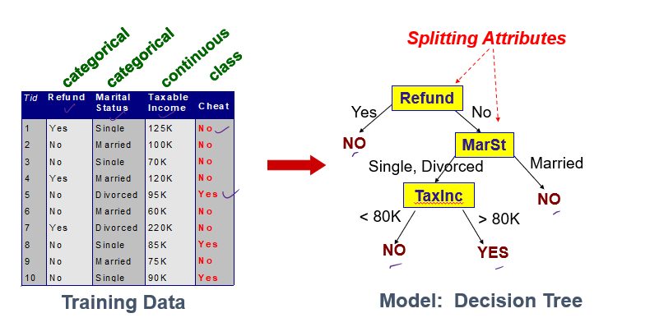
Attribute Selection Measures

Slide 10
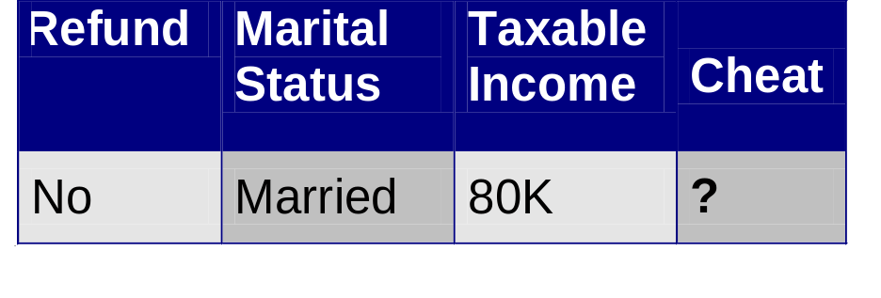
Apply Model to Test Data
Start from the root of tree.
Test Data
Refund
Yes
No
NO
MarSt
Single, Divorced
Married
TaxInc
NO
< 80K
> 80K
NO
YES

Slide 11
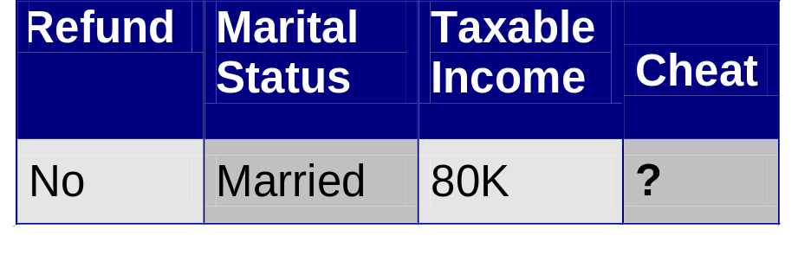
Apply Model to Test Data
Refund
Test Data
Yes
No
NO
MarSt
Single, Divorced
Married
TaxInc
NO
< 80K
> 80K
NO
YES

Slide 12
Apply Model to Test Data
Refund
Test Data
Yes
No
NO
MarSt
Single, Divorced
Married
TaxInc
NO
< 80K
> 80K
NO
YES

Slide 13
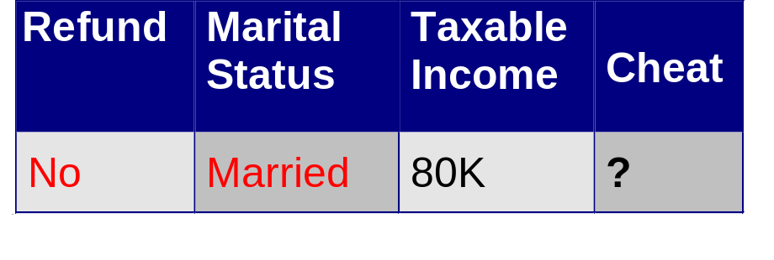
Apply Model to Test Data
Refund
Test Data
Yes
No
NO
MarSt
Single, Divorced
Married
TaxInc
NO
< 80K
> 80K
NO
YES

Slide 14
Apply Model to Test Data
Refund
Test Data
Yes
No
NO
MarSt
Single, Divorced
Married
TaxInc
NO
Assign Cheat to “No”
< 80K
> 80K
NO
YES

Slide 15
Measures for Node Impurity
Information Gain
Gini Index

Slide 16
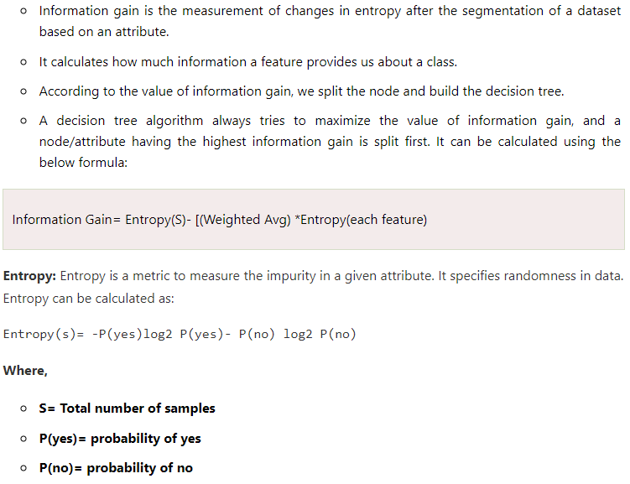
INFORMATION GAIN

Slide 17
INFORMATION GAIN
Which split is more informative?
Less than 50k Equal to or over 50k
Employed Unemployed

Slide 18
INFORMATION GAIN
Impurity or Entropy measures the level of impurity in a group.

Slide 19
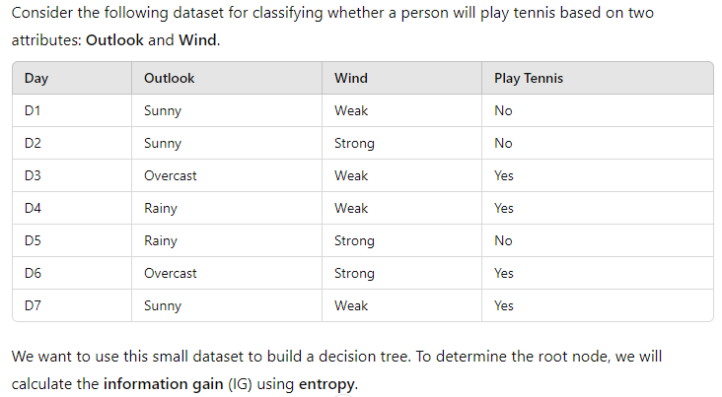
Problem Statement

Slide 20
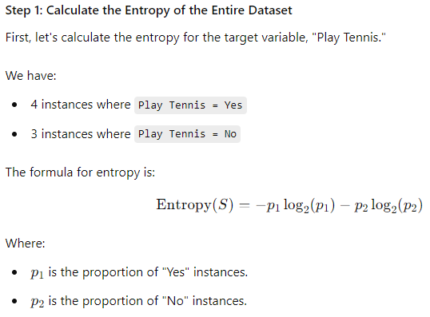
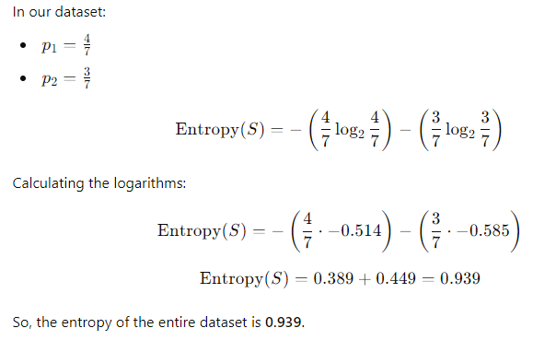
Solution

Slide 21
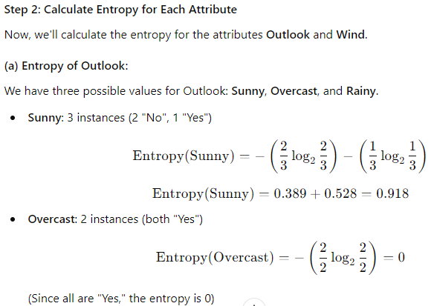
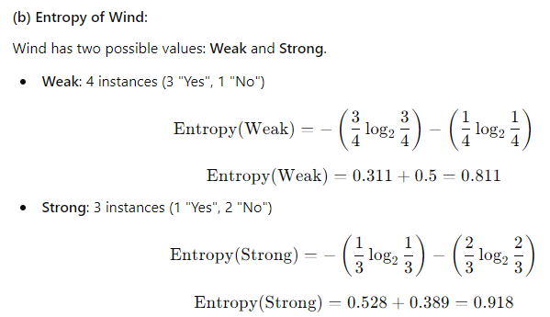
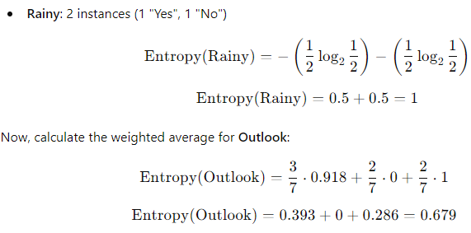
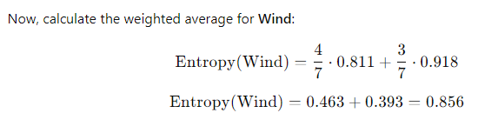
Solution (contd..)

Slide 22
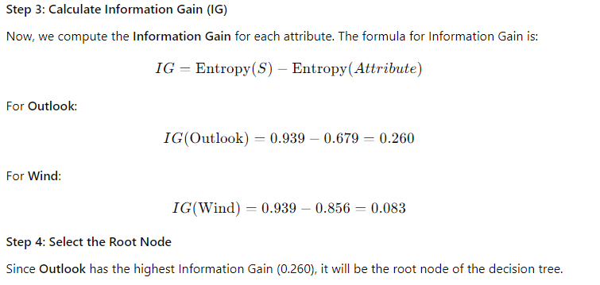
Solution (contd..)

Slide 23

Practice Question
Consider the following dataset for classifying whether a student will buy a computer based on four attributes: Age Income, Student, and Credit Rating.
ID | Age | Income | Student | Credit_Rating | Buys_computer
1 | youth | high | no | fair | NO
2 | youth | high | no | excellent | NO
3 | middle | high | no | fair | YES
4 | senior | medium | no | fair | YES
5 | senior | low | yes | fair | YES
6 | senior | low | yes | excellent | NO
7 | middle | low | yes | excellent | YES
8 | youth | medium | no | fair | NO
9 | youth | low | yes | fair | YES
10 | senior | medium | yes | fair | YES
11 | youth | medium | yes | excellent | YES
12 | middle | medium | no | excellent | YES
13 | middle | high | yes | fair | YES
14 | senior | medium | no | excellent | NO
We want to use this dataset to build a decision tree. To determine the root node, we will calculate the information gain (IG) using entropy.

Slide 24
Practice Question
Consider the following dataset for classifying whether a student will buy a computer based on four attributes: Age Income, Student, and Credit Rating.
ID | Age | Income | Student | Credit_Rating | Buys_computer
1 | youth | high | no | fair | NO
2 | youth | high | no | excellent | NO
3 | middle | high | no | fair | YES
4 | senior | medium | no | fair | YES
5 | senior | low | yes | fair | YES
6 | senior | low | yes | excellent | NO
7 | middle | low | yes | excellent | YES
8 | youth | medium | no | fair | NO
9 | youth | low | yes | fair | YES
10 | senior | medium | yes | fair | YES
11 | youth | medium | yes | excellent | YES
12 | middle | medium | no | excellent | YES
13 | middle | high | yes | fair | YES
14 | senior | medium | no | excellent | NO
We want to use this dataset to build a decision tree. To determine the root node, we will calculate the information gain (IG) using entropy.

Slide 25

GINI INDEX
Gini index is a measure of impurity or purity used while creating a decision tree in the CART(Classification and Regression Tree) algorithm.
Gini index is the measure that parts the probability distributions of the target attribute’s values. It splits the node in a way that yields the least amount of impurity.
It only creates binary splits, and the CART algorithm uses the Gini index to create binary splits.
Gini index can be calculated using the below formula:

Slide 26
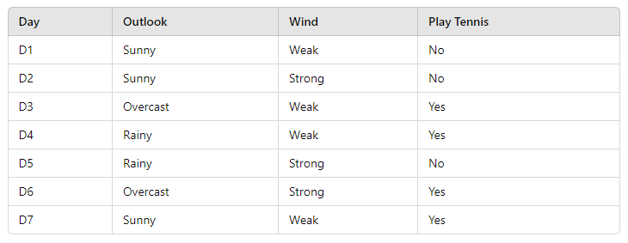
Problem on Gini Index
Consider the following small dataset for classifying whether a person will play tennis based on two attributes: Outlook and Wind.
We want to use the Gini Index to determine the best attribute for the root node..

Slide 27
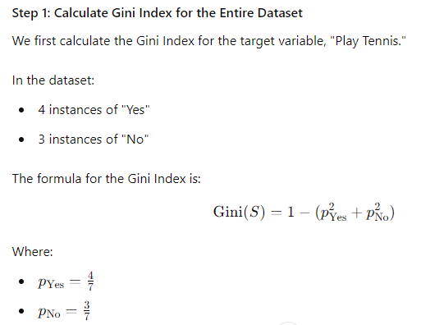
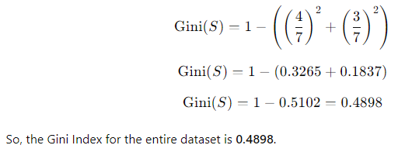
Solution

Slide 28
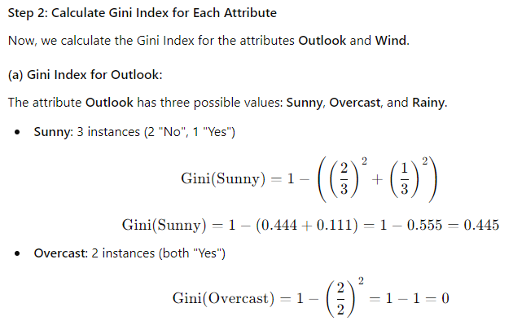
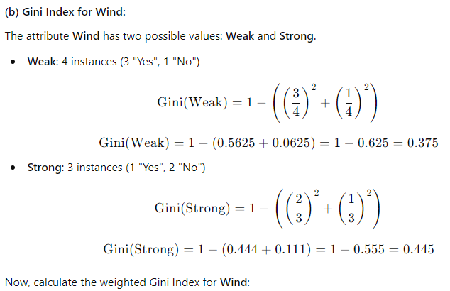
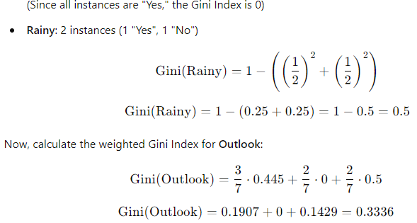
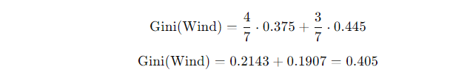
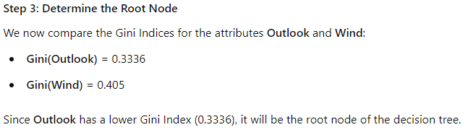
Solution

Slide 29
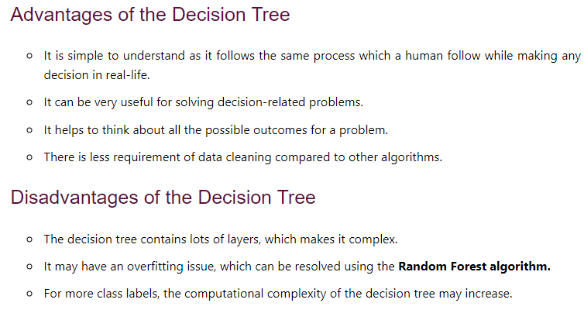
ADVANTAGES and DISADVANTAGES

