Slide 1
Artificial Intelligence and Machine Learning
Module-2
Lecture-3

Slide 2
Model parameters in Decision Trees
Decision Trees are versatile algorithms used in machine learning that perform classification and regression tasks.
They can even handle multi-output tasks for various predictive modeling tasks.
A model parameter is an adjustable parameter that is said to be learned from the training data during the model’s training process.
In decision trees, there are two types of model parameters such as
Learnable parameters
Non-learnable parameters.

Slide 3
Learnable Parameters in Decision Trees
Learnable parameters are calculated or updated iteratively during the training phase of the model.
They play a potential role in capturing the patterns and relationships present in the training data.
Most importantly, the model gains the ability to learn the optimal values for these parameters autonomously, without requiring external assistance.
Examples: Split feature, Split threshold, tree structure, and leaf node prediction

Slide 4
Non-Learnable Parameters or Hyperparameters in Decision Trees
A hyperparameter is a parameter that is defined before the learning process begins and it helps to control aspects of the learning process.
When we define these hyperparameters, the model can control the features of the learning process and possibly impact its performance and behavior.
Examples of hyperparameters include the learning rate, regularization strength, and the choice of optimization algorithm.

Slide 5
Difference between Learnable and Non-Learnable Parameters
Category | Parameters | Description | Who decides?
Learnable Parameters (from data) | Split feature | The feature chosen at a node (e.g., Age, Income) | Learned from training data
 | Split threshold / condition | The exact value or condition used for the split (e.g., Age > 35) | Learned from training data
 | Tree structure | The number of nodes, branches, and arrangement | Learned from training data
 | Leaf node prediction | Final Outcome at each leaf: • Classification → class label / probability • Regression → average value | Learned from training data
Non-Learnable Parameters (hyperparameters) | Max depth | Maximum depth of the tree allowed | Set by user
 | Min samples split | Minimum number of samples needed to split a node | Set by user
 | Min samples leaf | Minimum number of samples required at a leaf | Set by user
 | Criterion | Measure of impurity or error (Gini, Entropy, MSE, etc.) | Set by user
 | Max features | Number of features considered for splitting | Set by user
 | Max leaf nodes | Maximum number of leaf nodes allowed | Set by user
 | Splitter | Strategy for choosing split (best or random) | Set by user
 | Random state | Controls randomness for reproducibility | Set by user

Slide 6
Why Tune hyperparameters in Decision Trees?
While training the machine learning models, the requirement for different sets of hyperparameters arises because of the needs of each dataset and model.
One such solution to determine the hyperparameter is to perform multiple experiments that allow us to choose a set of hyperparameters that best suits our model.
This process of selecting the optimal hyperparameter is called hyperparameter tuning.
Tuning hyperparameters is crucial for decision trees for below reasons:
Improved Performance:
Reduced Overfitting
Enhanced Generalization
Addressing Class Imbalance
Tailoring the Model to Specific Tasks

Slide 7
Why Tune hyperparameters in Decision Trees?
Reduced Overfitting: Decision trees are prone to overfitting, where the model memorizes the training data’s noise instead of learning generalizable patterns. Hyperparameter tuning helps prevent this by controlling the tree’s complexity (e.g., with max_depth) and preventing excessive granularity (e.g., with min_samples_split).
Addressing Class Imbalance: Class imbalance occurs when one class has significantly fewer samples than others. Tuning hyperparameters like min_weight_fraction_leaf allows you to leverage sample weights and ensure the tree doesn’t get biased towards the majority class, leading to more accurate predictions for the minority class.
Enhanced Generalization: The goal is for the decision tree to perform well on unseen data. Tuning hyperparameters helps achieve this by striking a balance between model complexity and flexibility. A well-tuned tree can capture the important trends in the data without overfitting to the specifics of the training set, leading to better performance on new data.

Slide 8
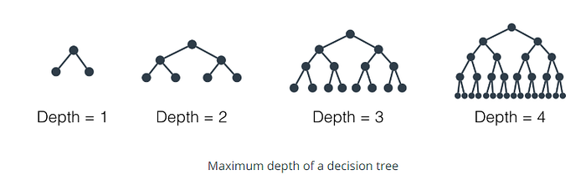
Types of Hyperparameters in Decision Tree
Hyperparameter in decision trees are essential settings that controls the behavior and the structure of the model during the training phase.
The major hyperparameters that are used to fine-tune the decision:
Criteria
max_depth
min_samples_split
min_samples_leaf
max_features
min_weight_fraction_leaf

Slide 9
Types of Hyperparameters in Decision Tree
Criteria: The quality of the split in the decision tree is measured by the function called criteria.
The criteria support two types such as gini (Gini impurity) and entropy (information gain).
Gini index – Gini impurity or Gini index is the measure that parts the probability distributions of the target attribute’s values. It splits the node in a way that yields the least amount of impurity.
Information gain – It is an impurity measure that uses the entropy measure to spilt a node in a way that it yields the most amount of information gain.
criterion{“gini”, “entropy”}, default=“gini”

Slide 10
Types of Hyperparameters in Decision Tree
max_depth:
It controls the maximum depth to which the decision tree is allowed to grow.
When the max_depth is deeper it allows the tree to capture more complex patterns in the training data potentially reducing the training error.
However, setting max_depth too high can lead to overfitting where the model memorizes the noise in the training data.
It is very important to tune max_depth carefully to find the right balance between model complexity and generalization performance.
max_depth: int, default = None
Example:
max_depth = 3 limits the tree to three levels, achieving moderate complexity and reducing overfitting risk.
max_depth = None, then nodes are expanded until all leaves are pure or until all leaves contain less than min_samples_split samples

Slide 11
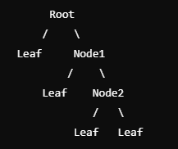
Types of Hyperparameters in Decision Tree
Problem: Consider the following decision tree:
The root node splits into two child nodes (left and right).
  The left child node is a leaf node (it does not split further).
  The right child node splits into two more child nodes.
    The right child’s left child is a leaf node.
    The right child’s right child splits into two leaf nodes.
What is the depth of this decision tree?
Solution:
Root Node: Depth of 0 (starting point).
Left Child of Root: This is a leaf node, so it has no further children. The depth of this branch is 1.
Right Child of Root (Node1): This node splits into two children, meaning we continue down this path.
  The left child of Node1 is a leaf node, so the depth of this branch is 2.
  The right child of Node1 (Node2) further splits into two leaf nodes. Since it adds another layer of depth, the depth of this branch is 3.
Finding the Maximum Depth: The depth of the left branch is 1, and the depth of the right branch is 3. The depth of the entire tree is the maximum of these two values.
Max Depth = max (1,3) = 3
Final Answer: The depth of the decision tree is 3.

Slide 12
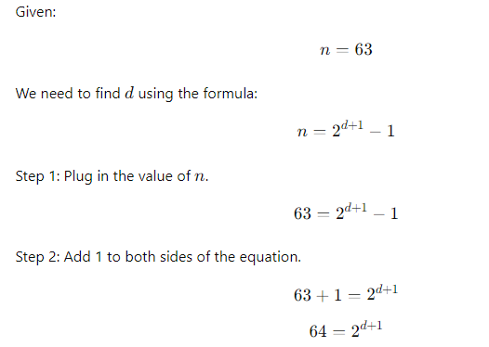
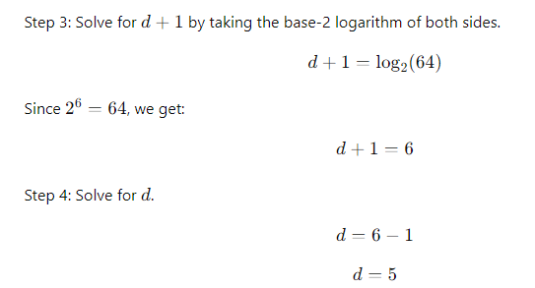
Types of Hyperparameters in Decision Tree (GATE)
Q. Suppose you have a binary decision tree with a total of 63 nodes. calculate the depth (𝑑) of the decision tree.

Slide 13
Impact of Depth on Decision Tree
Underfitting (Shallow Trees): When a decision tree is too shallow, it may not capture enough patterns from the data. This can lead to high bias and low variance, resulting in poor accuracy on both the training and test sets. In such cases, increasing the tree depth can improve accuracy by allowing the tree to capture more complex patterns in the data.
Overfitting (Deep Trees): On the other hand, when a decision tree is too deep, it may memorize the training data instead of learning general patterns. This can lead to high variance and low bias, resulting in high accuracy on the training set but poor performance on the test set. In this case, reducing the tree depth can improve generalization and hence improve accuracy on unseen data.
Note: In overfitting, max_depth= none
In underfitting, max_depth=1

Slide 14
Types of Hyperparameters in Decision Tree
min_sample_split:
It defines the minimal number of samples that are needed to split a node.
It should be noted that the min_samples_split works as a threshold to split a node in a decision tree.
If the number of samples in a node is less than min_samples_split, the node will not be split, and it will turn into a leaf node.
min_samples_split: int or float, default=2

Slide 15
Types of Hyperparameters in Decision Tree
min_samples_leaf
The minimum number of samples required to be at a leaf node.
A split point at any depth will only be considered if it leaves at least min_samples_leaf training samples in each of the left and right branches.
This may have the effect of smoothing the model, especially in regression.
min_samples_leaf: int or float, default=1
For example, min_samples_leaf = 5. We set a hyperparameter value of 5 to min_samples_leaf that ensures each leaf node in the decision tree must contain at least 5 samples which prevents further splitting if the node reaches this threshold.

Slide 16
Types of Hyperparameters in Decision Tree
max_features
The max_features hyperparameter allow us to control the number of features to be considered when looking for the best split in the decision tree.
It can either define an exact number of features to consider at each split or as a percentage that represents the proportion of features to consider.
The input options can be an integer, float, auto, sqrt, log2. It function as follows:
  auto – It allows the decision tree algorithm to consider all the features for each split.
  sqrt – It allows the algorithm to consider only the square root of the total number of features for each split
  log2 – It allows the algorithm to consider the logarithm base 2 of a total number of features for each split.
  max_featuresint, float or {“sqrt”, “log2”}, default=None
  If int, then consider max_features features at each split.
  If float, then max_features is a fraction and max(1, int(max_features * n_features_in_)) features are considered at each split.
  If “sqrt”, then max_features=sqrt(n_features).
  If “log2”, then max_features=log2(n_features).
  If None, then max_features=n_features.

Slide 17
Types of Hyperparameters in Decision Tree
min_weight_fraction_leaf
The min_weight_fraction_leaf hyperparameter that is used to control the tree’s structure based on the weights assigned to each sample.
This hyperparameter determines the minimum fraction of input samples required at a leaf node.
It also has the potential to deal with class imbalance where one class may have particularly fewer samples than others, to solve the class imbalance we use sample weights.
When the decision tree is biased toward the majority classes then it fails to be aware of sample weights like min_sample_leaf.
To resolve this issue, weight-based criteria can be used that are quite less challenging to optimize the tree structure if the samples are weighted.
The min_weight_fraction_leaf hyperparameter’s leaf node holds at least a fraction of the overall sum of the weights.
For example, min_weight_fraction_leaf = 0.1. Here, we set a hyperparameter value of 0.1 which helps us to guarantee that the presence of each leaf node in the decision tree must hold at least 10% if the tidal sum of sample weights potentially helps to address the class imbalance and optimize the tree structure.

Slide 18
Summary of Hyperparameters in Decision Tree
Hyperparameter | Purpose | Effect
Max Depth | Tree height | Controls over/underfitting
Min Samples Split | Samples to split node | Limits branching
Min Samples Leaf | Samples in leaf | Avoids biased leaves
Max Features | Features considered | Adds randomness
Criterion | Split quality | Gini/Entropy/MSE
Max Leaf Nodes | Max terminal nodes | Limits complexity
Splitter | Split strategy | Best/Random
Random State | Reproducibility | Fixed results

