Slide 1

Artificial Intelligence and Machine Learning
Module -2
Lecture- 4

Slide 2
Issues/Limitations in Decision Trees
Overfitting- Decision trees tend to fit noise in the training data if not pruned and generalize poorly.
High Variance (Instability)- Small changes in data can lead to completely different splits and structure.
Bias Toward Features with More Levels- Attributes with many categories (e.g., “ZIP code”) may appear more important.
Greedy Splitting- Best split at each node which does not guarantee a globally optimal tree.
Imbalanced Data Issues: If one class dominates, the tree may be biased toward predicting the majority class.
Interpretability Declines with Size: As deep trees become complex, reducing interpretability.
Computational Cost: For very large datasets, this can be computationally expensive.
Pruning is Tricky: Deciding how much to prune a tree to avoid overfitting without losing accuracy is challenging.

Slide 3
How to Avoid Overfitting in Decision Tree
To avoid overfitting in decision trees, several techniques can be applied:
Pruning: Pruning is a process of deleting the unnecessary nodes from a tree in order to get the optimal decision tree.
Cross-Validation: Cross-validation is a technique used to check how well a machine learning model performs on unseen data. The main purpose of cross validation is to prevent overfitting.
Use Ensemble Methods: Ensemble learning is a method where we use many small models instead of just one. Each of these models may not be very strong on its own, but when we put their results together, we get a better and more accurate answer.

Slide 4
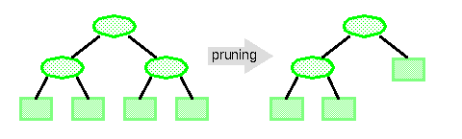
Pruning: Getting an Optimal Decision tree
Pruning is a method used to reduce the size of a decision tree by removing sections that provide little to no additional predictive power.
The goal is to avoid overfitting, where the model becomes too complex and starts learning the noise in the training data rather than the true underlying patterns.
A too-large tree increases the risk of overfitting, and a small tree may not capture all the important features of the dataset, underfitting
There are mainly two types of tree pruning technology used:
  Pre Pruning (Early Stopping): Avoid Overfitting but prone to Underfitting.
  Post Pruning (Cost Complexity)

Slide 5
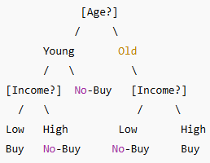
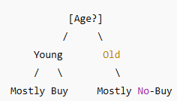
Pre-Pruning (Early Stopping) in Decision Tree
Stop the growth of the tree before it becomes overly complex.
Stop splitting a node early if further splitting does not give significant improvement in accuracy or information gain.
This can be done by setting conditions such as a maximum depth, minimum samples per leaf, minimum samples per split, and maximum features.
  Example:
  Consider a dataset where we want to classify whether a customer will buy a product based on features like age and income. Without pre-pruning, the decision tree might keep splitting the data until each leaf node contains a single data point. However, using pre-pruning with a maximum depth of 3, the tree will stop splitting after 3 levels, even if further splits could slightly improve accuracy on the training data.
Without Pre-Pruning leads to overfitting
With Pre-Pruning

Slide 6
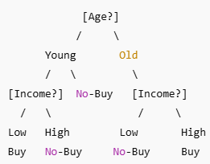
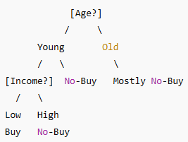
Post-Pruning (Cost Complexity) in Decision Tree
It is the process of growing the decision tree fully, allowing it to overfit the training data.
Trim the unnecessary branches that do not contribute to improving accuracy on unseen data.
  Example:
  Consider a dataset where we want to classify whether a customer will buy a product based on features like age and income. Without pre-pruning, the decision tree might keep splitting the data until each leaf node contains a single data point. However, using pre-pruning with a maximum depth of 3, the tree will stop splitting after 3 levels, even if further splits could slightly improve accuracy on the training data.
Without Post-Pruning
With Post-Pruning

Slide 7
Cross Validation
Cross validation is a technique used in machine learning to evaluate the performance of a model on unseen data.
It involves dividing the available data into multiple folds or subsets, using one of these folds as a validation set, and training the model on the remaining folds.
This process is repeated multiple times, each time using a different fold as the validation set.
Finally, the results from each validation step are averaged to produce a more robust estimate of the model’s performance.
Cross validation is an important step in the machine learning process and helps to ensure that the model selected for deployment is robust and generalizes well to new data.

Slide 8
What is cross-validation used for?
The main purpose of cross validation is to prevent overfitting, which occurs when a model is trained too well on the training data and performs poorly on new, unseen data.
By evaluating the model on multiple validation sets, cross validation provides a more realistic estimate of the model’s generalization performance, i.e., its ability to perform well on new, unseen data.

Slide 9
Types of cross-validation
1. Holdout Validation: In Holdout Validation we perform training on the 50% of the given dataset and rest 50% is used for the testing purpose
2. Leave One Out Cross Validation (LOOCV): In this method we perform training on the whole dataset but leaves only one data-point of the available dataset and then iterates for each data-point. In LOOCV, the model is trained on n-1 samples and tested on the one omitted sample repeating this process for each data point in the dataset.
3. Stratified Cross-Validation: It is a technique used in machine learning to ensure that each fold of the cross-validation process maintains the same class distribution as the entire dataset. This is particularly important when dealing with imbalanced datasets where certain classes may be under-represented.
4. K-Fold Cross Validation: In K-Fold Cross Validation we split the dataset into K number of subsets known as folds then we perform training on the all the subsets but leave one (K-1) subset for the evaluation of the trained model. In this method, we iterate k times with a different subset reserved for testing purpose each time.

Slide 10
K-fold Cross-Validation
Cross-validation is a statistical method used in machine learning to evaluate the performance of a model by splitting the dataset into subsets
K-fold Cross Validation
The dataset is divided into k equal-sized subsets (or "folds").
The model is trained k times, each time using k-1 folds for training and the remaining fold for testing.
The model’s performance is then averaged across the k runs to give a more reliable estimate of its accuracy or error.
Common choices for k are 5 or 10, though other values can be used.
Note: It is always suggested that the value of k should be 10 as the lower value of k takes towards validation and higher value of k leads to LOOCV method.

Slide 11
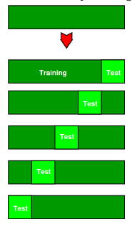
Example for K-fold Cross-Validation
The diagram below shows an example of the training subsets and evaluation subsets generated in k-fold cross-validation. Here, we have total 25 instances. In first iteration we use the first 20 percent of data for evaluation, and the remaining 80 percent for training ([1-5] testing and [5-25] training) while in the second iteration we use the second subset of 20 percent for evaluation, and the remaining three subsets of the data for training ([5-10] testing and [1-5 and 10-25] training), and so on.
Total instances: 25
Value of k : 5
No. Iteration Training set observations Testing set observations
1 [ 5 6 7 8 9 10 11 12 13 14 15 16 17 18 19 20 21 22 23 24] [0 1 2 3 4]
2 [ 0 1 2 3 4 10 11 12 13 14 15 16 17 18 19 20 21 22 23 24] [5 6 7 8 9]
3 [ 0 1 2 3 4 5 6 7 8 9 15 16 17 18 19 20 21 22 23 24] [10 11 12 13 14]
4 [ 0 1 2 3 4 5 6 7 8 9 10 11 12 13 14 20 21 22 23 24] [15 16 17 18 19]
5 [ 0 1 2 3 4 5 6 7 8 9 10 11 12 13 14 15 16 17 18 19] [20 21 22 23 24]

Slide 12
K-fold Cross-Validation
Advantages | Disadvantages
1. Prevents Overfitting: Cross-validation helps to reduce overfitting by testing the model on multiple subsets of the data. | 1. Computationally Expensive: Running the model multiple times (especially with k-fold or LOO) can be resource-intensive.
2. Provides More Reliable Estimates: By averaging the performance over multiple folds, it gives a more reliable measure of how well the model generalizes. | 2. Increased Training Time: Training and validating the model multiple times increases the overall time required.
3. Reduces Bias: Especially useful when the dataset is small or unbalanced, as it allows more accurate performance estimation. | 3. Complex for Large Datasets: Cross-validation, especially with large datasets, requires significant memory and computational resources.
4. Facilitates Hyperparameter Tuning: It allows for better hyperparameter optimization by testing different configurations more robustly. | 4. Risk of High Variance: When using leave-one-out cross-validation (LOO-CV), it may lead to higher variance, causing the model to overfit on small datasets.
5. Handles Data Imbalance: Stratified cross-validation ensures that each fold has a representative distribution of classes, important for imbalanced data. | 5. Not Suitable for Time-Series Data: Regular cross-validation may break the temporal dependencies in time-series data, making the results unreliable.
6. Utilizes Entire Dataset for Training: All data points are used for both training and validation across different iterations. | 6. May Not Be Realistic in Practice: It assumes the data is independent and identically distributed (i.i.d.), which may not always hold true for real-world scenarios.
7. Flexible and Easy to Implement: Works well with a wide range of models and is straightforward to integrate into most workflows. | 7. Difficult to Interpret for Some Algorithms: Some complex algorithms might yield results that are harder to interpret when cross-validated multiple times.

Slide 13
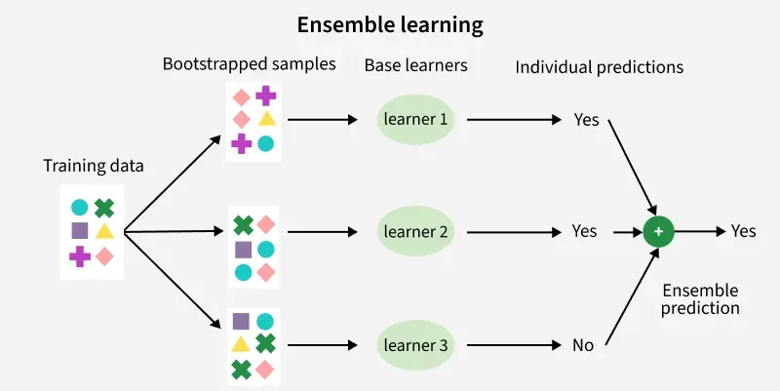
Ensemble Learning
Ensemble learning is a machine learning paradigm where multiple individual models, often referred to as "base learners" or "weak learners," are combined to produce a single, more robust, and accurate predictive model.
The core idea is that by combining the predictions of multiple models, the collective wisdom of the ensemble can overcome the limitations of any single model, leading to improved generalization and reduced overfitting.

Slide 14
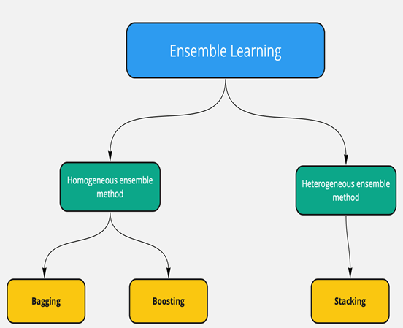
Base Learners in Ensemble Learning
In ensemble learning, base learners, also known as base models or weak learners, are the individual machine learning models that are combined to form a more powerful and robust predictive model.
These base learners are the foundational components of an ensemble system.
Types of Base Learners
Homogeneous Base Learners: Use the same type of algorithm (e.g., decision trees). Example: Bagging and Boosting
Heterogeneous Base Learners: use different types of algorithms (e.g., a support vector machine, and a neural network). Example: Stacking.

Slide 15
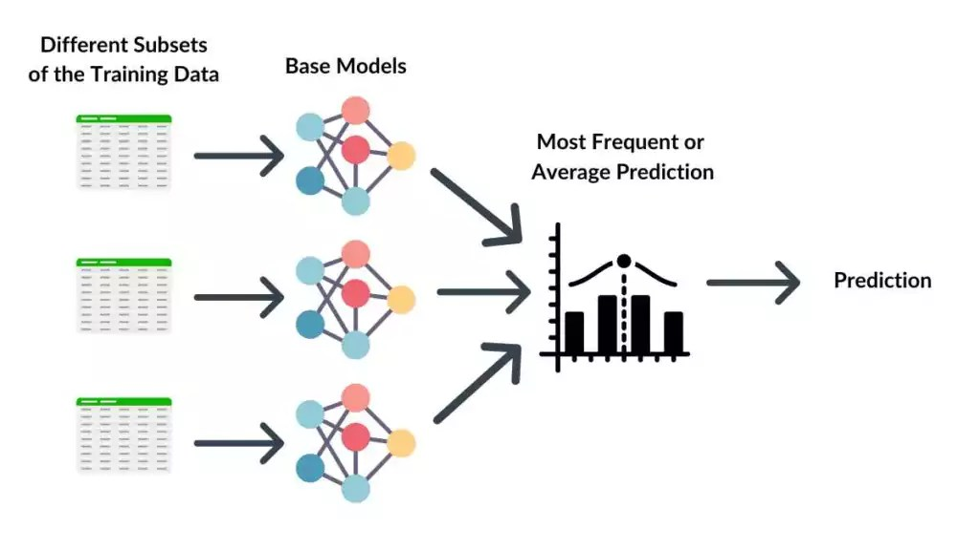
Bootstrap Aggregating (Bagging)
In bagging, multiple base models (typically of the same type, e.g., decision trees) are trained independently on different random subsets of the original training data. These subsets are created using bootstrap sampling, which involves sampling with replacement.
For classification tasks, the final prediction is determined by a majority vote among the base models. For regression tasks, the final prediction is typically the average of the predictions from the base models.
Primarily aims to reduce variance and prevent overfitting by averaging out the noise and variations in individual models.
Example: Random Forest, which uses an ensemble of decision trees.

Slide 16
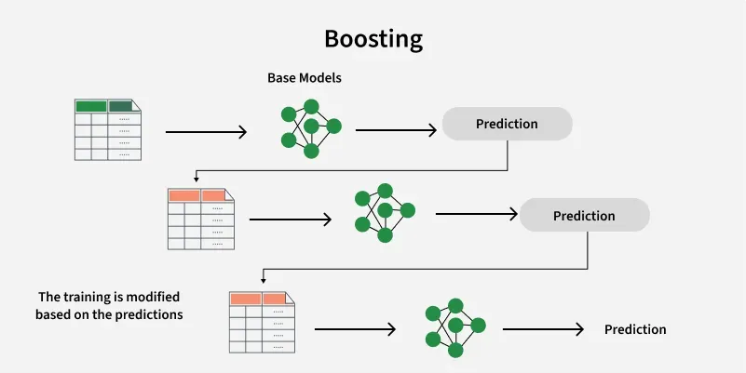
Boosting
Mechanism: In boosting, base models are trained sequentially, with each subsequent model focusing on correcting the errors or misclassifications made by the preceding models.
Prediction: The final prediction is a weighted combination of the predictions from all base models, with more accurate models having higher weights.
Goal: Primarily aims to reduce bias and improve the overall accuracy of the model by iteratively improving upon weaknesses.
Examples: AdaBoost, Gradient Boosting Machines (GBM), XGBoost, LightGBM.

Slide 17
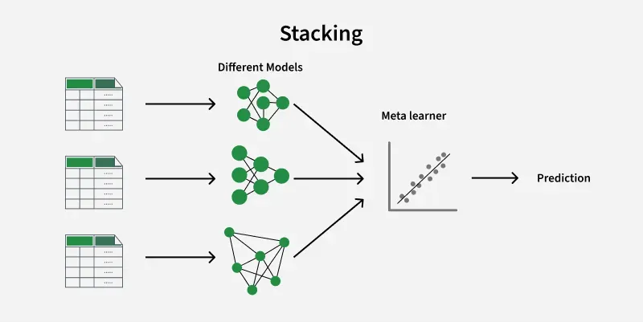
Stacking
Mechanism: Stacking involves training multiple diverse base models on the original training data. The predictions of these base models are then used as input features for a higher-level model, known as a "meta-model" or "blender."
Prediction: The meta-model learns to combine the predictions of the base models to make the final prediction.
Goal: Aims to leverage the strengths of different types of models and combine them in a sophisticated way to achieve higher predictive accuracy.
Example: Using a logistic regression or a neural network as a meta-model to combine predictions from decision trees, support vector machines, and k-nearest neighbors.

Slide 18
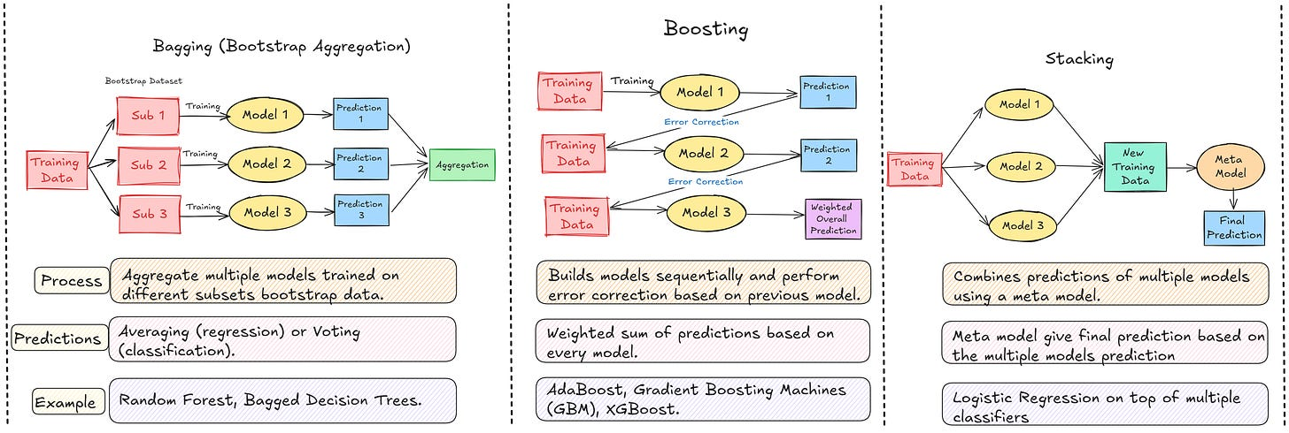
Difference Between Bagging, Boosting, and Stacking

Slide 19
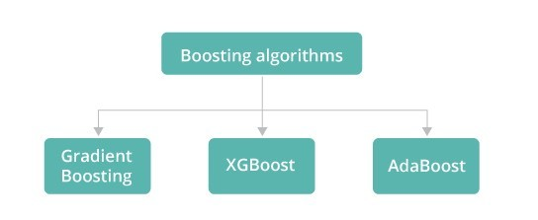
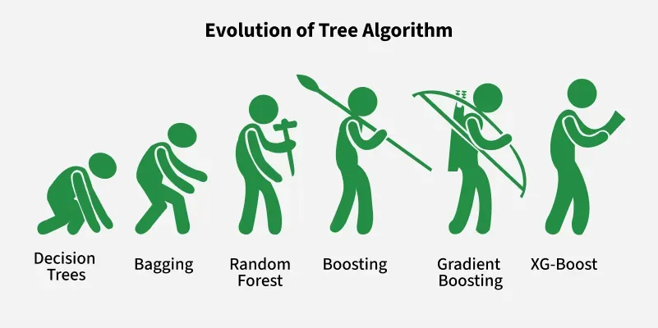
Types of Boosting

Slide 20
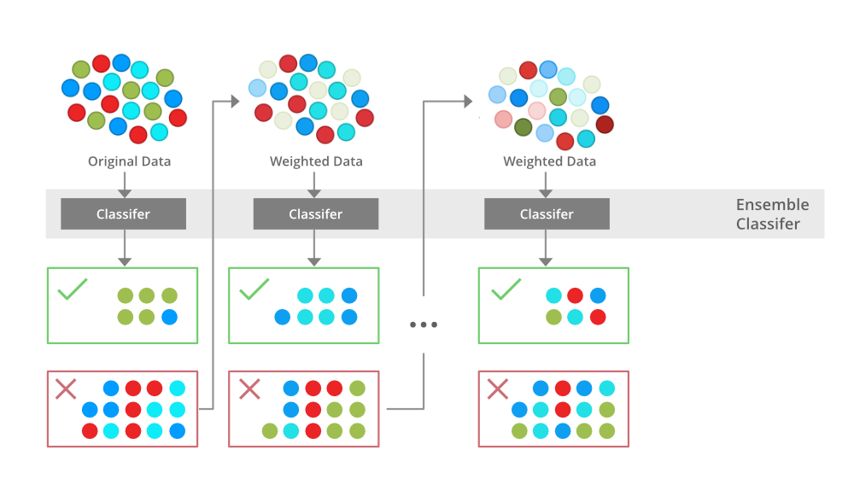
AdaBoost
It works by adjusting the weights of each training sample based on the classification accuracy of the previous models.
If a sample is misclassified, its weight is increased, so the next model focuses more on that difficult case.
It effectively reduces bias and variance making it useful for classification tasks, but it can be sensitive to noisy data and outliers.
Working:
1) Initialize Weights:
  All training samples are given equal weights initially.
2) Train Weak Learner:
  A weak learner (e.g., a decision stump) is trained on the weighted dataset.
3) Evaluate & Update Weights:
Misclassified samples are given higher weights.
Correctly classified samples are given lower weights.
This forces the next weak learner to focus more on the harder cases.
4) Combine Weak Learners:
Each weak learner is assigned a weight based on its accuracy.
Final prediction is made by weighted majority voting (for classification) or weighted sum (for regression).

Slide 21
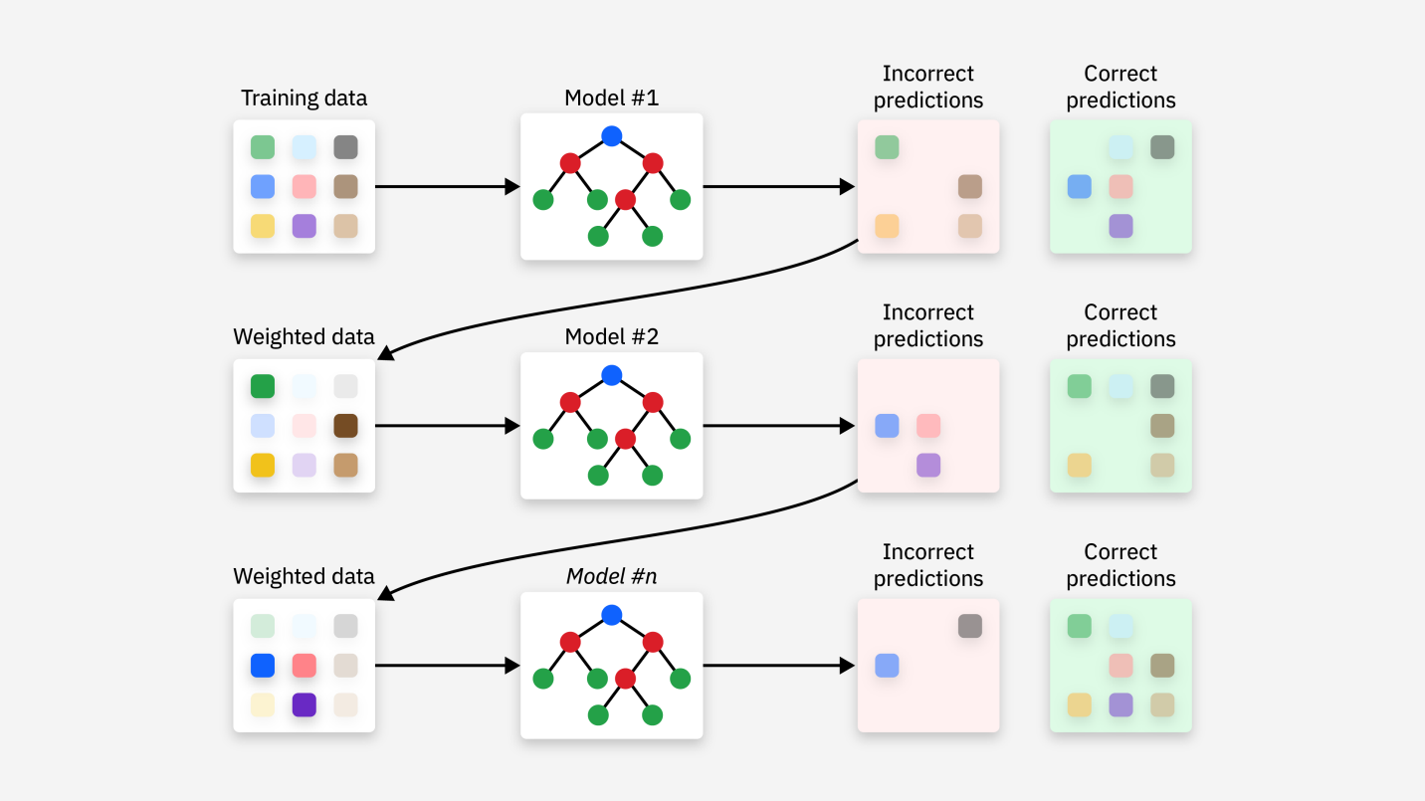
Gradient Boost
Description: Gradient Boosting uses a gradient descent-like procedure to minimize the error of the model. Each new model is trained to correct the residual errors (the difference between actual and predicted values) of the previous model.
Key Characteristics:
  Focuses on minimizing the loss function.
  Uses gradient descent to adjust predictions and correct errors.
  Models are added sequentially to improve performance.
Use Case: Commonly used in both classification and regression tasks.
Example: Gradient Boosting is widely used in structured/tabular datasets for tasks like fraud detection and ranking (e.g., search engines).

Slide 22
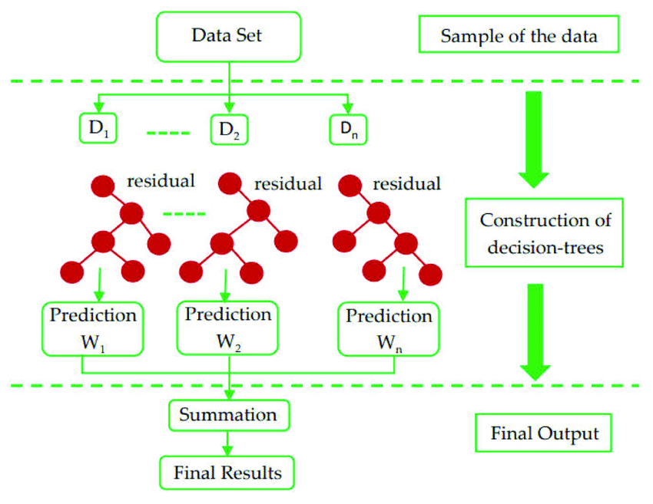
Extreme Gradient (XG) Boost
3. Extreme Gradient Boosting (XGBoost)
Description: XGBoost is an enhanced version of Gradient Boosting that includes additional features like regularization to prevent overfitting, parallelized computations, and optimized performance for large datasets.
Key Characteristics:
  Faster and more efficient than traditional Gradient Boosting.
  Includes regularization (L1 and L2) to prevent overfitting.
  Handles missing values better and provides built-in cross-validation.
Use Case: Highly effective in data science competitions like Kaggle and machine learning tasks involving large datasets.
Example: Widely used in predictive modeling tasks like customer churn prediction and sales forecasting.

Slide 23
Difference Between AdaBoost, Gradient Boost, and XG Boost
Aspect | AdaBoost | Gradient Boosting | XGBoost
Weak Learner | Primarily decision stumps (simple trees with 1 split) | Typically decision trees (more complex than AdaBoost) | Decision trees with additional regularization features
Weighting of Instances | Emphasizes misclassified instances by increasing their weights in each iteration | Focuses on minimizing residual errors using gradient descent | Gradient descent but with additional optimizations like regularization
Error Correction | Corrects misclassified instances by increasing their weight in the next iteration | Trains new models to correct the residual errors of the previous models | Corrects residual errors, but with faster convergence due to optimizations
Loss Function | Exponential loss function | Any differentiable loss function (e.g., MSE for regression, log-loss for classification) | Same as Gradient Boosting, but more efficient handling of the loss
Learning Rate | Not explicitly part of AdaBoost, but implicitly influenced by the weighting mechanism | Explicit learning rate controls the contribution of each model to the final prediction | Explicit learning rate with additional regularization terms
Overfitting Prevention | Prone to overfitting, especially if weak learners are complex | Can overfit if the learning rate is too high or too many iterations are used | Less prone to overfitting due to regularization (L1 and L2) and early stopping
Performance on Large Datasets | Moderate performance on large datasets | Slow to train on large datasets | Optimized for large-scale datasets, better performance and speed
Parallelization | Not parallelizable | Difficult to parallelize | Highly parallelizable (supports distributed computing)
Handling of Missing Values | Does not inherently handle missing values | Does not handle missing values well | Handles missing values by learning default directions in trees
Training Speed | Faster for smaller datasets but scales poorly with larger data | Slower training, especially for deep trees or large datasets | Faster due to optimizations like column block data structure and hardware optimization
Regularization | No regularization | No regularization by default | Regularization (L1 and L2) to control overfitting
Use Cases | Binary classification, face detection, text recognition | Regression, classification, ranking | Large-scale datasets, machine learning competitions, structured data
Popular Libraries | sklearn | sklearn, statsmodels | xgboost library (optimized version of Gradient Boosting)
Examples of Use | Real-time applications like face detection or text classification | Fraud detection, customer churn prediction, regression problems | Kaggle competitions, recommendation systems, customer lifetime value prediction

Slide 24
Comparison Between Logistic Regression, Decision Tree, and Random Forest
Aspect | Logistic Regression | Decision Tree | Random Forest
Algorithm Type | Linear model, classification, or regression. | Non-linear, tree-based classification/regression. | Ensemble method, combining multiple decision trees for classification/regression.
Nature of Model | Predicts probabilities based on a linear decision boundary. | Splits data into branches based on feature thresholds. | Aggregates results from multiple decision trees to improve accuracy and reduce overfitting.
Approach | Fits a linear equation to separate classes. | Divides the feature space into regions by creating a tree structure. | Creates multiple decision trees with bootstrapped datasets and averages or votes for predictions.
Interpretability | Easy to interpret, coefficients represent the impact of features. | Moderately interpretable through decision rules. | Less interpretable due to multiple trees, but feature importance can be evaluated.
Overfitting Risk | Low if regularization is used. | High if tree is deep and not pruned. | Low due to averaging over many trees, reducing variance.
Handling Non-linearity | Handles only linear relationships. | Handles both linear and non-linear relationships. | Handles non-linearity due to diverse decision trees.
Feature Scaling | Requires feature scaling (e.g., normalization). | No need for feature scaling. | No need for feature scaling.
Computation Time | Fast, due to simple linear computations. | Can be slower for large datasets, especially for deep trees. | Slower compared to a single decision tree due to multiple trees, but can be parallelized.
Use Cases | Binary classification, logistic regression, and probability estimation (e.g., spam detection, disease prediction). | Classification and regression tasks (e.g., customer churn prediction, loan approval). | Better for classification and regression with large and complex datasets (e.g., image recognition, recommendation systems).

