Slide 1
Artificial Intelligence and Machine Learning
Module 2
Lecture-5

Slide 2
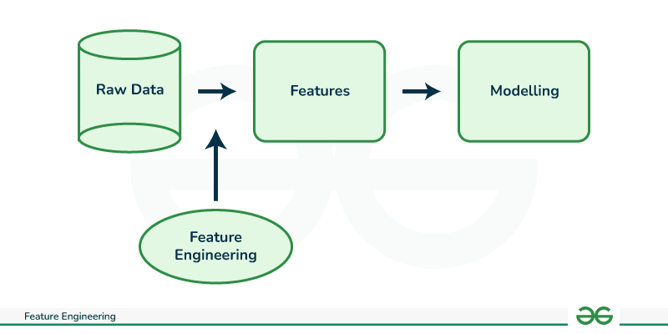
Feature Engineering
Feature engineering is the process of transforming raw data into features that are suitable for machine learning models.
In other words, it is the process of selecting, extracting, and transforming the most relevant features from the available data to build more accurate and efficient machine learning models.
The success of machine learning models heavily depends on the quality of the features used to train them.
Feature engineering involves a set of techniques that enable us to create new features by combining or transforming the existing ones.
These techniques help to highlight the most important patterns and relationships in the data, which in turn helps the machine learning model to learn from the data more effectively.

Slide 3
Need for Feature Engineering in Machine Learning?
Improve User Experience: The primary reason we engineer features is to enhance the user experience of a product or service. By adding new features, we can make the product more intuitive, efficient, and user-friendly, which can increase user satisfaction and engagement.
Competitive Advantage: Another reason we engineer features is to gain a competitive advantage in the marketplace. By offering unique and innovative features, we can differentiate our product from competitors and attract more customers.
Meet Customer Needs: We engineer features to meet the evolving needs of customers. By analyzing user feedback, market trends, and customer behavior, we can identify areas where new features could enhance the product’s value and meet customer needs.
Increase Revenue: Features can also be engineered to generate more revenue. For example, a new feature that streamlines the checkout process can increase sales, or a feature that provides additional functionality could lead to more upsells or cross-sells.
Future-Proofing: Engineering features can also be done to future-proof a product or service. By anticipating future trends and potential customer needs, we can develop features that ensure the product remains relevant and useful in the long term.

Slide 4
Processes Involved in Feature Engineering
Feature engineering in Machine learning consists of mainly 5 processes:
Feature Creation
Feature Transformation
Feature Extraction
Feature Selection
Feature Scaling.

Slide 5
Feature Creation
Feature Creation: Feature Creation is the process of generating new features based on domain knowledge or by observing patterns in the data. It is a form of feature engineering that can significantly improve the performance of a machine-learning model.
Types of Feature Creation:
Domain-Specific: Creating new features based on domain knowledge, such as creating features based on business rules or industry standards.
Data-Driven: Creating new features by observing patterns in the data, such as calculating aggregations or creating interaction features.
Synthetic: Generating new features by combining existing features or synthesizing new data points.

Slide 6
Feature Transformation
Feature Transformation
Feature Transformation is the process of transforming the features into a more suitable representation for the machine learning model. This is done to ensure that the model can effectively learn from the data.
Types of Feature Transformation:
Normalization: Rescaling the features to have a similar range, such as between 0 and 1, to prevent some features from dominating others.
Scaling: Scaling is a technique used to transform numerical variables to have a similar scale, so that they can be compared more easily. Rescaling the features to have a similar scale, such as having a standard deviation of 1, to make sure the model considers all features equally.
Encoding: Transforming categorical features into a numerical representation. Examples are one-hot encoding and label encoding.
Transformation: Transforming the features using mathematical operations to change the distribution or scale of the features. Examples are logarithmic, square root, and reciprocal transformations.

Slide 7
Feature Extraction
Feature Extraction is the process of creating new features from existing ones to provide more relevant information to the machine learning model. This is done by transforming, combining, or aggregating existing features.
Types of Feature Extraction:
Dimensionality Reduction: Reducing the number of features by transforming the data into a lower-dimensional space while retaining important information. Examples are PCA and t-SNE.
Feature Combination: Combining two or more existing features to create a new one. For example, the interaction between two features.
Feature Aggregation: Aggregating features to create a new one. For example, calculating the mean, sum, or count of a set of features.
Feature Transformation: Transforming existing features into a new representation. For example, log transformation of a feature with a skewed distribution.

Slide 8
Feature Selection
Feature Selection is the process of selecting a subset of relevant features from the dataset to be used in a machine-learning model. It is an important step in the feature engineering process as it can have a significant impact on the model’s performance.
Types of Feature Selection:
Filter Method: Based on the statistical measure of the relationship between the feature and the target variable. Features with a high correlation are selected.
Wrapper Method: Based on the evaluation of the feature subset using a specific machine learning algorithm. The feature subset that results in the best performance is selected.
Embedded Method: Based on the feature selection as part of the training process of the machine learning algorithm.

Slide 9
Feature Scaling
Feature Scaling is the process of transforming the features so that they have a similar scale. This is important in machine learning because the scale of the features can affect the performance of the model.
Types of Feature Scaling:
Min-Max Scaling: Rescaling the features to a specific range, such as between 0 and 1, by subtracting the minimum value and dividing by the range.
Standard Scaling: Rescaling the features to have a mean of 0 and a standard deviation of 1 by subtracting the mean and dividing by the standard deviation.
Robust Scaling: Rescaling the features to be robust to outliers by dividing them by the interquartile range.

Slide 10
Advantages of Feature Engineering
1. Improved Model Performance
Better Predictive Power: Well-engineered features can lead to more accurate predictions by helping models capture underlying patterns in the data more effectively. Creating features that represent key relationships in the data (e.g., interaction terms, ratios) can boost the model’s ability to differentiate between outcomes.
Reduced Overfitting: By focusing on more informative and relevant features, models are less likely to overfit to noise in the data. This leads to better generalization on unseen data.
2. Enhanced Interpretability
Domain Knowledge Representation: Feature engineering allows domain expertise to be encoded into the model. New features derived from domain knowledge can make models more interpretable, as they represent known relationships in the data.
Simpler Models: Creating meaningful features can simplify model structures, reducing the need for complex algorithms, and making the results easier to understand and communicate to stakeholders.
3. Dimensionality Reduction
Eliminate Irrelevant Features: By engineering new, more informative features, less relevant or redundant features can be eliminated. This simplifies the dataset and reduces the dimensionality, leading to more efficient computations and often better model performance.
Improved Efficiency: Fewer and more informative features can reduce the time required for training and inference, especially with computationally expensive models like neural networks.

Slide 11
Advantages of Feature Engineering
4. Handling Complex Data Types
Transforming Categorical Variables: Feature engineering techniques like one-hot encoding, target encoding, or label encoding transform categorical variables into formats that machine learning algorithms can process. This is critical for ensuring that categorical data contributes meaningfully to the model.
Capturing Temporal or Sequential Patterns: In time-series data, creating features like moving averages, time lags, or seasonality effects can help capture temporal dependencies that improve predictive accuracy.
5. Improved Scalability
Smarter Feature Selection for Big Data: When working with large datasets, feature engineering can help reduce the amount of data that needs to be processed by creating more condensed, yet informative features, improving the scalability of models.

Slide 12
Feature Extraction vs Feature Selection
Aspect | Feature Extraction | Feature Selection
Definition | Creates new features by transforming or combining the original features. | Selects a subset of the most relevant features from the original dataset.
Objective | To reduce dimensionality by generating new informative features. | To reduce dimensionality by retaining only important features and discarding the rest.
Data Transformation | Transforms data into a new space, often combining features (e.g., PCA, autoencoders). | Does not transform features; instead, it selects features directly from the existing ones.
Output Features | Produces a new set of features that may not have direct interpretability. | Keeps the original features, ensuring better interpretability.
Dependency | May require domain knowledge to design effective transformations or use advanced algorithms like PCA, LDA, or neural networks. | Relies on statistical tests, algorithms, or heuristics to rank and choose features (e.g., mutual information, recursive feature elimination).
Computational Cost | Can be computationally intensive, especially with large datasets or complex transformation methods. | Generally, less computationally demanding as it focuses on selection rather than transformation.
Dimensionality | Generates fewer features by transforming the original feature space into a lower-dimensional space. | Reduces the number of features by eliminating irrelevant or redundant features from the dataset.
Examples | PCA, t-SNE, autoencoders, wavelet transformations, and Fourier transformations. | Filter methods (e.g., Chi-square test), wrapper methods (e.g., RFE), embedded methods (e.g., Lasso regression).
Use Cases | Useful when the original features are highly correlated or not informative in their raw form. | Useful when the dataset has many irrelevant or redundant features.

Slide 13
Principal Component Analysis (PCA)
As the number of features or dimensions in a dataset increases, the amount of data required to obtain a statistically significant result increases exponentially.
This can lead to issues such as overfitting, increased computation time, and reduced accuracy of machine learning models this is known as the curse of dimensionality problems that arise while working with high-dimensional data.
As the number of dimensions increases, the number of possible combinations of features increases exponentially, which makes it computationally difficult to obtain a representative sample of the data.
It becomes expensive to perform tasks such as clustering or classification because the algorithms need to process a much larger feature space, which increases computation time and complexity.
Additionally, some machine learning algorithms can be sensitive to the number of dimensions, requiring more data to achieve the same level of accuracy as lower-dimensional data.
To address the curse of dimensionality, Feature engineering techniques are used which include feature selection and feature extraction.
Dimensionality reduction is a type of feature extraction technique that aims to reduce the number of input features while retaining as much of the original information as possible.

Slide 14
Principal Component Analysis (PCA)
Principal Component Analysis (PCA) technique was introduced by the mathematician Karl Pearson in 1901. It works on the condition that while the data in a higher dimensional space is mapped to data in a lower dimension space, the variance of the data in the lower dimensional space should be maximum.
Principal Component Analysis (PCA) is a statistical procedure that uses an orthogonal transformation that converts a set of correlated variables to a set of uncorrelated variables. PCA is the most widely used tool in exploratory data analysis and in machine learning for predictive models.
Principal Component Analysis (PCA) is an unsupervised learning algorithm technique used to examine the interrelations among a set of variables. It is also known as a general factor analysis where regression determines a line of best fit.
The main goal of Principal Component Analysis (PCA) is to reduce the dimensionality of a dataset while preserving the most important patterns or relationships between the variables without any prior knowledge of the target variables.

Slide 15
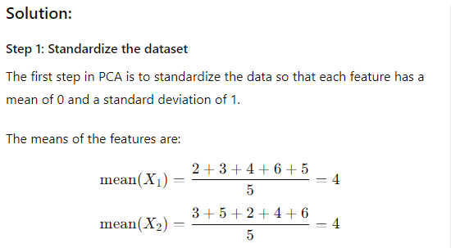
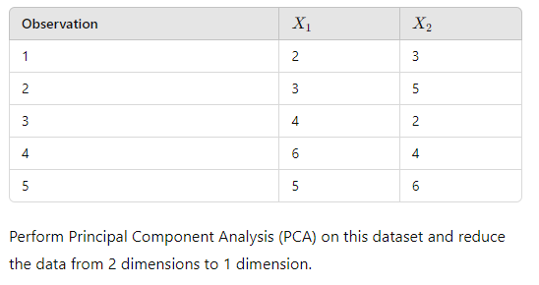
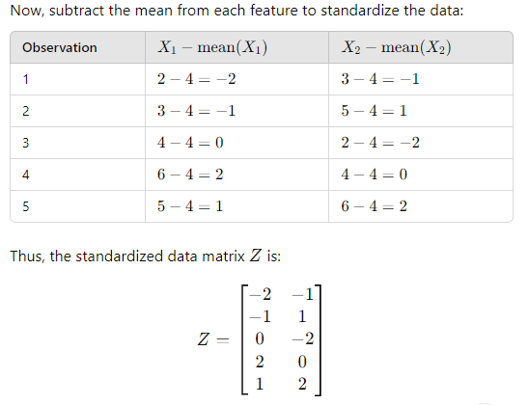
Principal Component Analysis (PCA)
Suppose you have a dataset with 5 observations and 2 features:

Slide 16
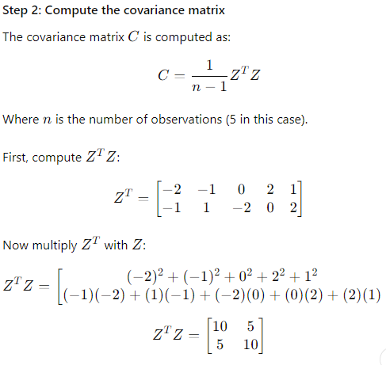
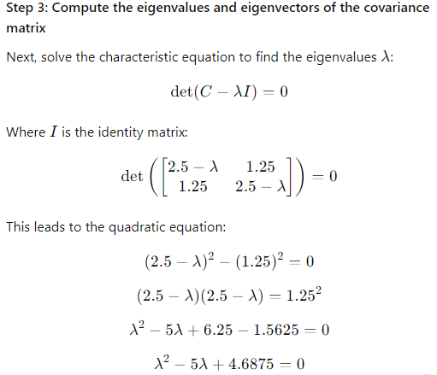
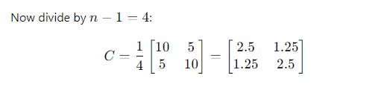

Principal Component Analysis (PCA)

Slide 17
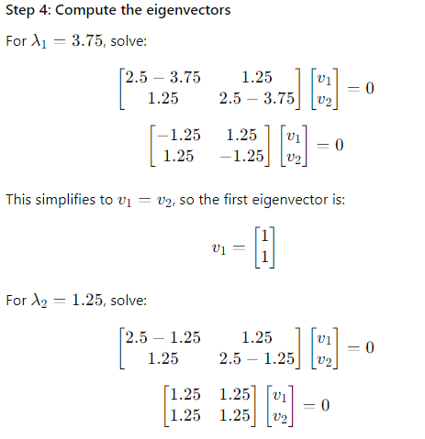
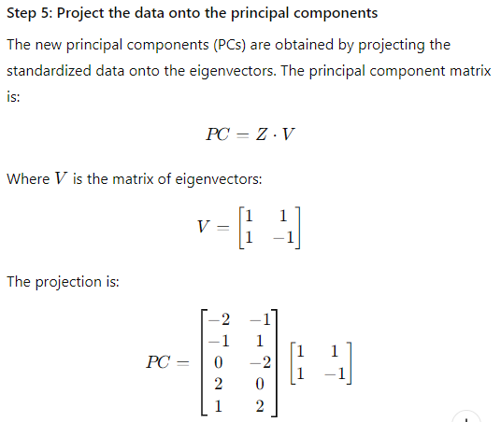
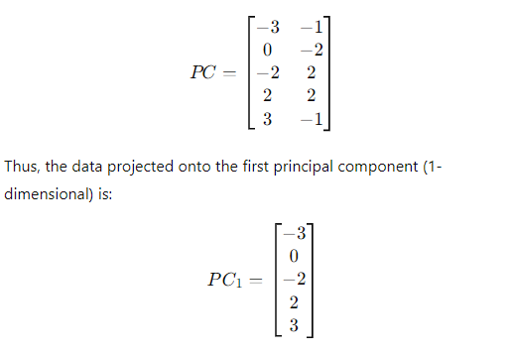

Principal Component Analysis (PCA)

Slide 18
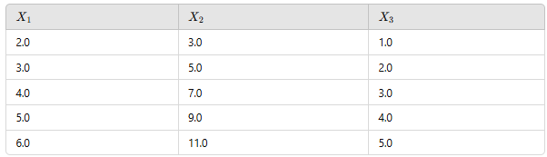
Principal Component Analysis (Practice Problem)(IMP)
Given the following 3-dimensional dataset perform PCA. Perform the following.
1) Calculate the covariance matrix for the dataset.
2) Calculate the eigenvalues and eigenvectors.
3) Identify the top 2 principal components if any.
4) Project the data onto the top 2 principal components (if any) and reconstruct the original data from the reduced dimensions.

