Slide 1

Neural Networks
Module-3
Lecture-1

Slide 2
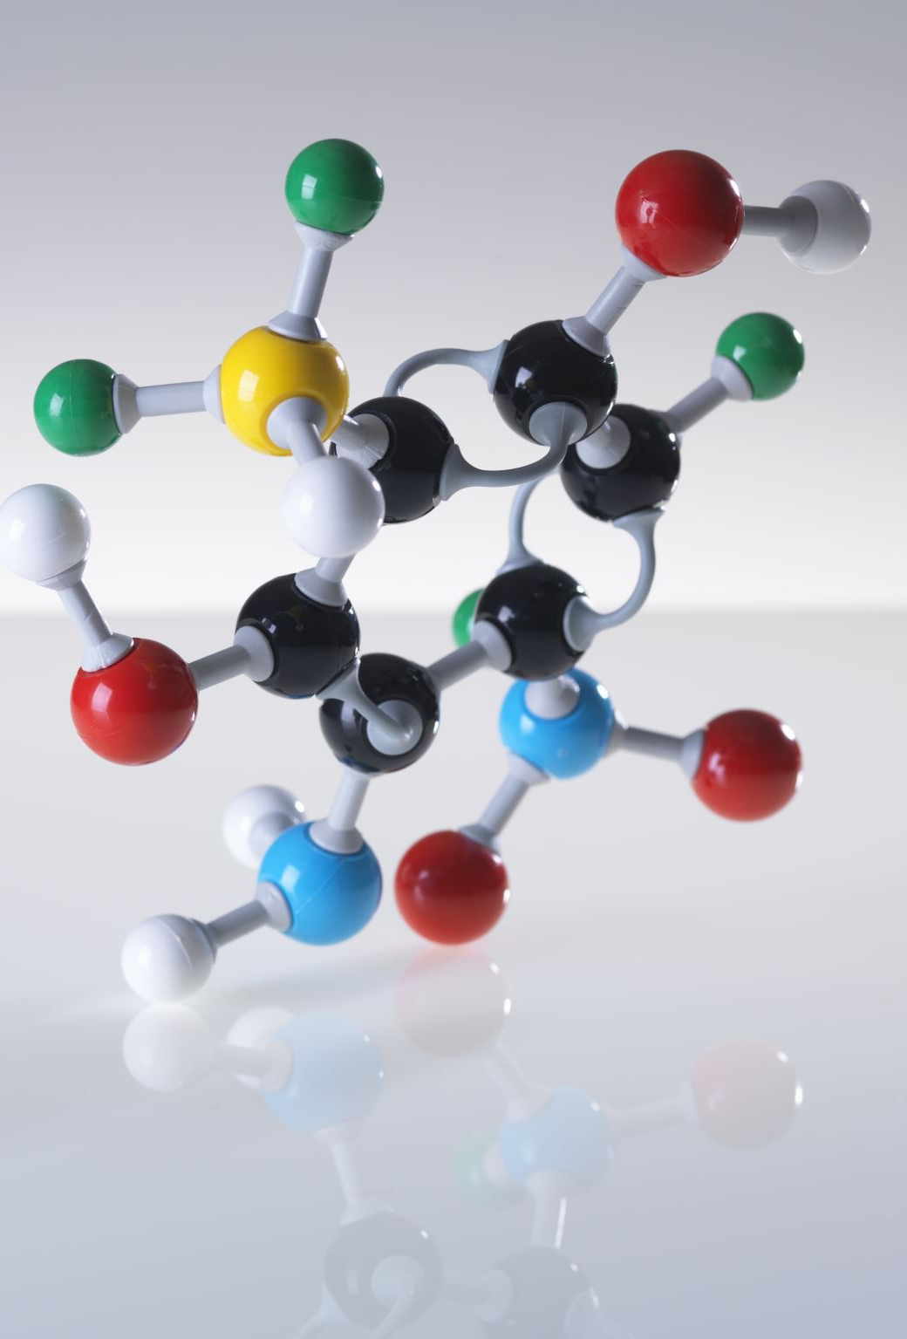
Artificial Neural Networks
Computer algorithms that mimic the biological structures of human brain and are formally called Artificial Neural Networks (ANN).
Massively parallel, distributed system, made up of simple processing units (neurons)
Synaptic connection strengthen the neurons, and are used to store the acquired knowledge
Knowledge is acquired by the network from its environment through a learning process

Slide 3
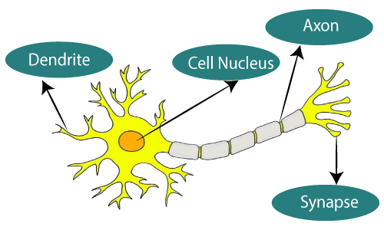
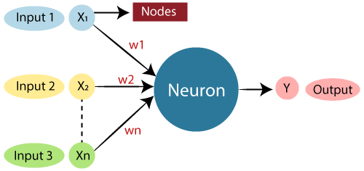
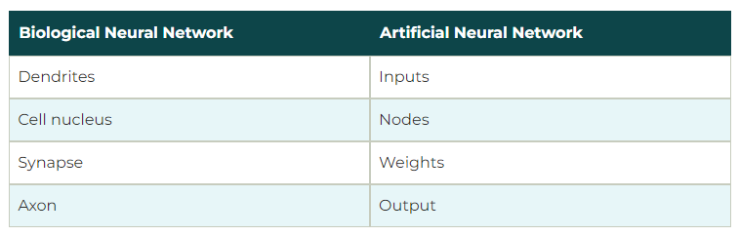

Slide 4
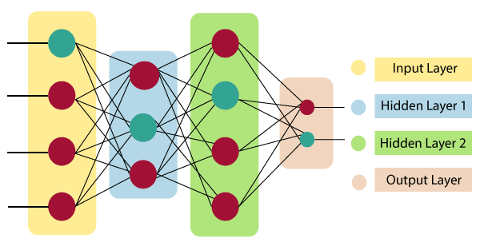
Architecture of ANN
Input Layer: As the name suggests, it accepts inputs in several different formats provided by the programmer.
Hidden Layer: The hidden layer presents in-between input and output layers. It performs all the calculations to find hidden features and patterns.
Output Layer: The input goes through a series of transformations using the hidden layer, which finally results in output that is conveyed using this layer.
Notes:
Thus, they might be better alternatives than classical solutions for problems characterised by: – high dimensionality, noisy, imprecise or imperfect data; and – a lack of a clearly stated mathematical solution or algorithm

Slide 5
Perceptron Model

Slide 6

Perceptron Learning Model
Perceptron's were developed in the 1950s and 1960s by the scientist Frank Rosenblatt, inspired by earlier work by Warren McCulloch and Walter Pitts.
In machine learning, the perceptron is a classification algorithm.
It is a type of linear classifier, i.e., a classification algorithm that makes its predictions based on a linear predictor function combining a set of weights with the feature vector.

Slide 7

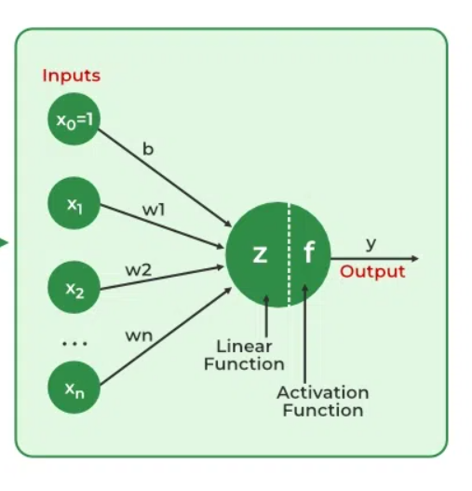

Working of ANN or Perceptron Learning Model
The artificial neural network takes input and computes the weighted sum of the inputs with a bias (b).
This computation is represented in the form of a transfer function as shown below.
It determines weighted total is passed as an input to an activation function to produce the output.
The activation of a neuron is binary. That is, the neuron either fires (activation of one) or does not fire (activation of zero). The activation function refers to the set of transfer functions used to achieve the desired output.
For the network shown here the activation function for unit “y” is:
where y is the total input signal received, and S is the threshold (T) for y.
Notes:
Thus, they might be better alternatives than classical solutions for problems characterised by: – high dimensionality, noisy, imprecise or imperfect data; and – a lack of a clearly stated mathematical solution or algorithm

Slide 8
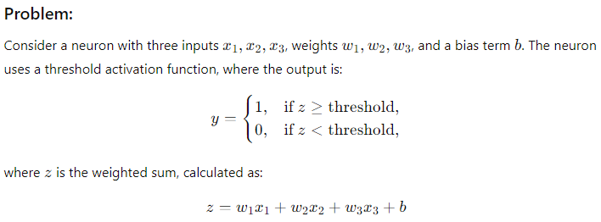
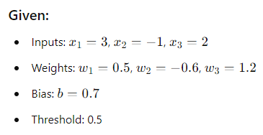

Slide 9
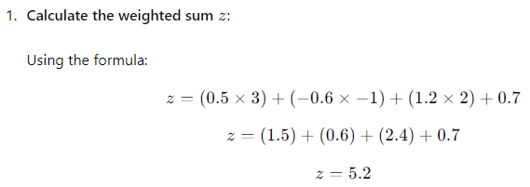
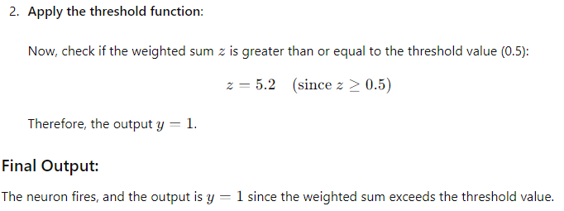

Slide 10
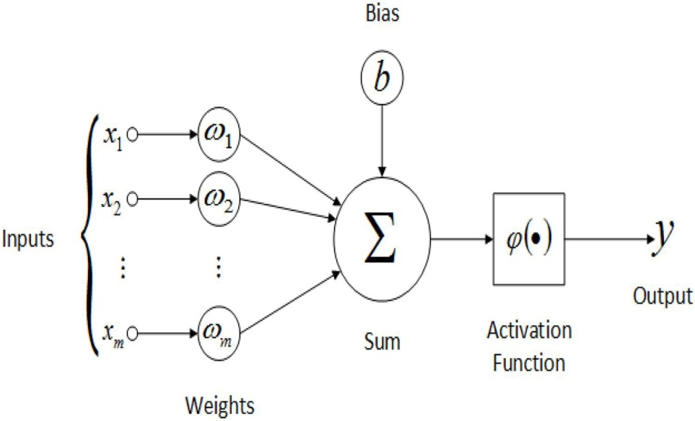
Why Bias?
The bias node is a node that is always 'on'. That is, its value is set to 1 without regard for the data in a given pattern.
It is analogous to the intercept in a regression model and serves the same function.
If a neural network does not have a bias node in a given layer, it will not be able to produce output in the next layer that differs from 0, when the feature values are 0
Notes:
Thus, they might be better alternatives than classical solutions for problems characterised by: – high dimensionality, noisy, imprecise or imperfect data; and – a lack of a clearly stated mathematical solution or algorithm

Slide 11
Why Bias?
Consider a simple example: You have a feed forward perceptron with 2 input nodes A and B, and 1 output node Y.
“A” and “B” are binary features and set as, A=B=0.
Multiply these 2 0’s by whatever weights you like, w_{A} and w_{B}, sum the products and pass it through whatever activation function you prefer.
Without a bias node, only one output value is possible, which may yield a very poor fit.
Notes:
Thus, they might be better alternatives than classical solutions for problems characterised by: – high dimensionality, noisy, imprecise or imperfect data; and – a lack of a clearly stated mathematical solution or algorithm

Slide 12
Perceptron Limitation
  Linearly Separable Data: The perceptron can only classify linearly separable data. If the classes cannot be separated by a straight line (or hyperplane in higher dimensions), the perceptron will fail to converge.
  Binary Classification: A single-layer perceptron can only perform binary classification tasks. For multi-class problems, it requires multiple perceptrons or modifications (like one-vs-all strategies).
  Limited Expressiveness: Perceptrons can only learn to approximate linear functions. They cannot capture complex relationships or patterns in the data that require non-linear decision boundaries.
  Sensitivity to Input Scaling: The performance of a perceptron can be sensitive to the scale of input features. If features have vastly different ranges, it may affect the convergence and performance.
  No Support for Non-linear Activation Functions: The perceptron uses a step function as an activation function, which is non-differentiable. This restricts the use of gradient-based optimization methods, which are crucial for training deeper networks.
  Overfitting Risks: In high-dimensional spaces, a perceptron may overfit the training data, especially if the number of features is large relative to the number of training examples.
Notes:
Thus, they might be better alternatives than classical solutions for problems characterised by: – high dimensionality, noisy, imprecise or imperfect data; and – a lack of a clearly stated mathematical solution or algorithm

Slide 13
Perceptron Limitation
Suppose if we make a small change in some weight (or bias) in the network. What we'd like is - for this small change in weight to cause only a small corresponding change in the output from the network.
The problem is that this isn't what happens when our network contains perceptrons. In fact, a small change in the weights or bias of any single perceptron in the network can sometimes cause the output of that perceptron to completely flip, say from 0 to 1.
We can overcome this problem by introducing a new type of artificial neuron called a sigmoid neuron.
Sigmoid neurons are similar to perceptrons, but modified so that small changes in their weights and bias cause only a small change in their output.
Notes:
Thus, they might be better alternatives than classical solutions for problems characterised by: – high dimensionality, noisy, imprecise or imperfect data; and – a lack of a clearly stated mathematical solution or algorithm

Slide 14

Sigmoid Neuron
Also just like a perceptron, the sigmoid neuron has weights for each input, w1,w2,… and an overall bias, b. But the output is not 0 or 1.
Instead, it's σ(w⋅x+b) and σ is called the sigmoid function (Activation Function or Transfer Function).
Notes:
Thus, they might be better alternatives than classical solutions for problems characterised by: – high dimensionality, noisy, imprecise or imperfect data; and – a lack of a clearly stated mathematical solution or algorithm

Slide 15
Similarity b/w Perceptron & Sigmoid Neuron
Suppose z=w.x+b is a large positive number. Then e^{−z}≈0 and so σ(z)≈1. In other words, when z=w.x+b is large and positive, the output from the sigmoid neuron is approximately 1, just as it would have been for a perceptron.
Suppose on the other hand that z=w.x+b is very negative. Then e^{−z}→∞, and σ(z)≈0. So when z=w.x+b very negative, the behaviour of a sigmoid neuron also closely approximates a perceptron.
Notes:
Thus, they might be better alternatives than classical solutions for problems characterised by: – high dimensionality, noisy, imprecise or imperfect data; and – a lack of a clearly stated mathematical solution or algorithm

Slide 16
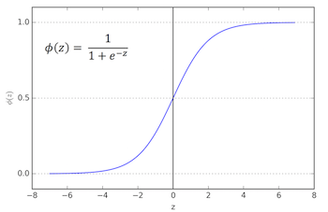
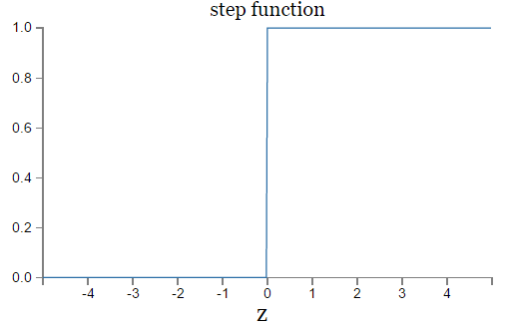
Algebraic Form of Sigmoid & Perceptron Functions
Sigmoid Function
Step Function
Notes:
Thus, they might be better alternatives than classical solutions for problems characterised by: – high dimensionality, noisy, imprecise or imperfect data; and – a lack of a clearly stated mathematical solution or algorithm

Slide 17


Difference between Sigmoid & Perceptron Functions
Feature | Perceptron (Step Function Neuron) | Sigmoid Neuron
Output Type | Binary (0 or 1) | Continuous (between 0 and 1)
Activation Function | Step function (threshold-based) | Sigmoid function (smooth, continuous)
Learning Ability | Can only solve linearly separable problems | Can handle non-linearly separable problems
Mathematical Formula
Range of Output | 0 or 1 | 0 to 1 (real-valued, non-binary output)
Gradient Descent | Cannot use gradient-based optimization | Can use gradient-based optimization (e.g., backpropagation)
Weight Update | Simple rule based on misclassified points | Uses derivatives for weight updates
Decision Boundary | Creates a hard boundary (linear classifier) | Creates a soft boundary (nonlinear classifier)
Smoothness of Output | Non-smooth (discrete steps) | Smooth (continuous curve)
Suitability for Complex Problems | Not suited for complex or non-linear problems | Suited for complex and non-linear problems
Notes:
Thus, they might be better alternatives than classical solutions for problems characterised by: – high dimensionality, noisy, imprecise or imperfect data; and – a lack of a clearly stated mathematical solution or algorithm

Slide 18
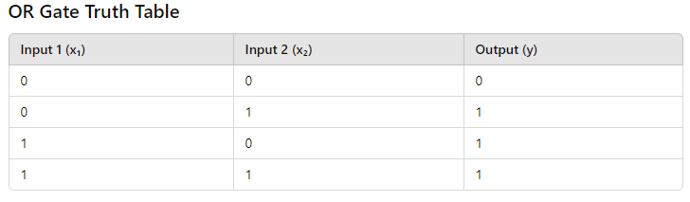
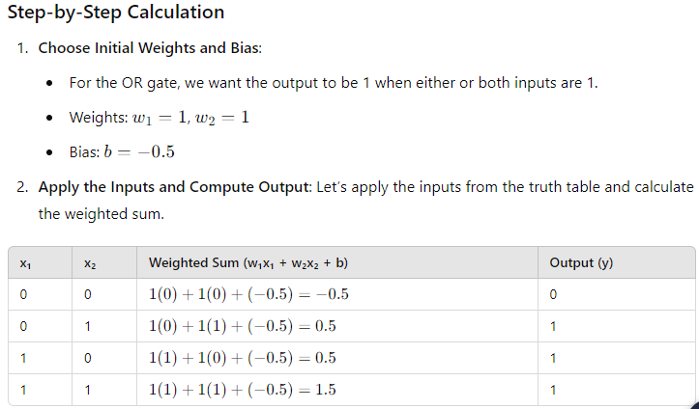
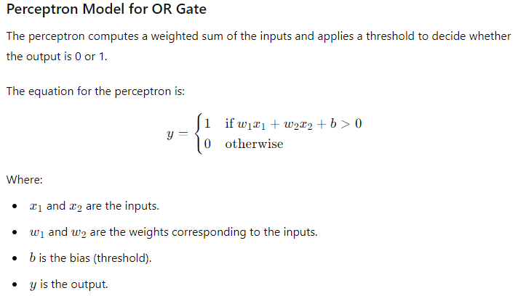
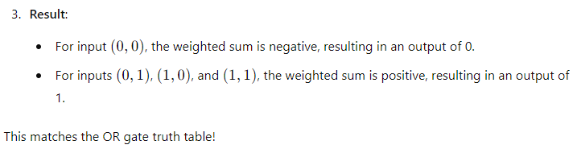
Numerical for Gate Implementation (OR) Using ANN (2, 2, -1.5)
Notes:
Thus, they might be better alternatives than classical solutions for problems characterised by: – high dimensionality, noisy, imprecise or imperfect data; and – a lack of a clearly stated mathematical solution or algorithm

Slide 19
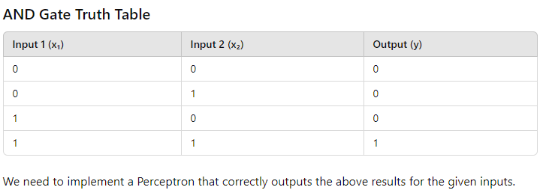
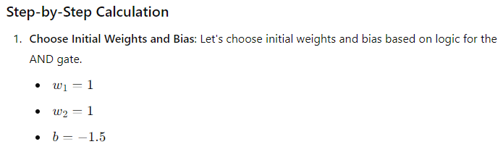
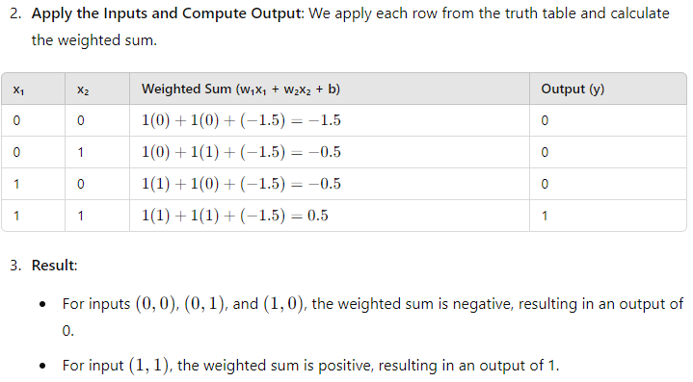
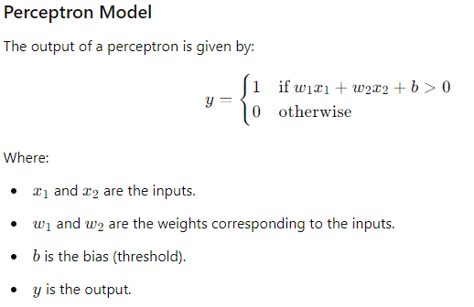
Numerical for Gate Implementation (AND) Using ANN (2, 2, -3)
Notes:
Thus, they might be better alternatives than classical solutions for problems characterised by: – high dimensionality, noisy, imprecise or imperfect data; and – a lack of a clearly stated mathematical solution or algorithm

Slide 20
Numerical for Gate Implementation (NOR, NAND) Using ANN
Perform the following by yourself with following assumptions
NOR (Assumptions 1: w1 = -1, w2=-1, and b = 0.5)
(Assumptions 2: w1 = -1.5 , w2= -1.5, b= 1)
NAND (Assumptions 1: w1 =-2, w2 = -2, and b =3)
(Assumptions 2: w1 = -1.5, w2 = -1.5, and b =2)
Notes:
Thus, they might be better alternatives than classical solutions for problems characterised by: – high dimensionality, noisy, imprecise or imperfect data; and – a lack of a clearly stated mathematical solution or algorithm

