Slide 1
Artificial Intelligence and Machine Learning
Module-3 Lecture - 2

Slide 2
Activation Functions

Slide 3
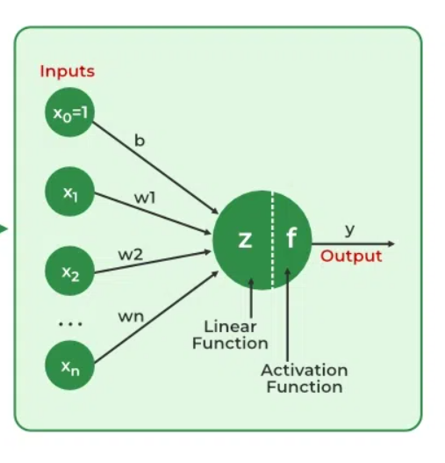
Activation Functions
Activation functions are decision making unit of neural networks.
It is mathematical functions used in artificial neural networks to determine the output of a neuron.
Without activation functions, a neural network would behave like a linear model, limiting its ability to solve complex problems.
They introduce non-linearity into the network, allowing it to model and learn complex patterns.

Slide 4
Activation Functions
Types of Activation Functions
Step-wise function
Linear Activation Function
Non-Linear Activation Functions
Notes:
Thus, they might be better alternatives than classical solutions for problems characterised by: – high dimensionality, noisy, imprecise or imperfect data; and – a lack of a clearly stated mathematical solution or algorithm

Slide 5
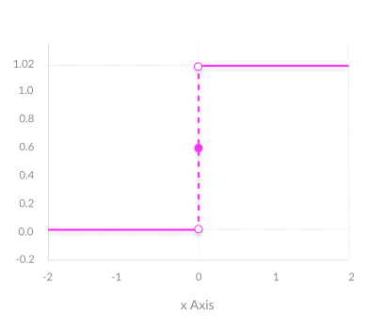

Step-wise Activation Function
A binary step function is a threshold-based activation function.
If the input value is above or below a certain threshold, the neuron is activated and sends exactly the same signal to the next layer.
The problem with a step function is that it does not allow multi-value outputs. For example, it cannot support classifying the inputs into one of several categories.
Notes:
Thus, they might be better alternatives than classical solutions for problems characterised by: – high dimensionality, noisy, imprecise or imperfect data; and – a lack of a clearly stated mathematical solution or algorithm

Slide 6
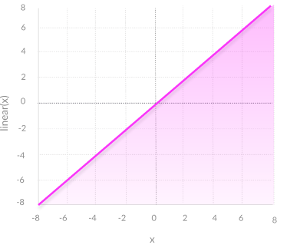
Linear Activation Function
A linear activation function takes the form: f(x) = ax + c
A linear function is better than a step function because it allows multiple outputs, not just yes and no.
A neural network with a linear activation function is simply a linear regression model.
It has limited power and ability to handle complexity varying parameters of input data.
Another issue is the gradient descent when differentiation is done, it has a constant output which is not good because during backpropagation the rate of change of error is constant that can ruin the output and the logic of backpropagation.
Usage: Commonly used in the output layer of neural networks for regression tasks.
Notes:
Thus, they might be better alternatives than classical solutions for problems characterised by: – high dimensionality, noisy, imprecise or imperfect data; and – a lack of a clearly stated mathematical solution or algorithm

Slide 7
Non-Linear Activation Function
Modern neural network models use non-linear activation functions.
They allow the model to create complex mappings between the network’s inputs and outputs, which are essential for learning and modelling complex data, such as images, video, audio, and data sets which are non-linear or have high dimensionality.
They allow backpropagation because they have a derivative function which is related to the inputs.
They allow “stacking” of multiple layers of neurons to create a deep neural network. Multiple hidden layers of neurons are needed to learn complex data sets with high levels of accuracy.
Notes:
Thus, they might be better alternatives than classical solutions for problems characterised by: – high dimensionality, noisy, imprecise or imperfect data; and – a lack of a clearly stated mathematical solution or algorithm

Slide 8
Common Non-Linear Activation Functions
Sigmoid / Logistic
TanH / Hyperbolic Tangent
ReLU ( Rectified Linear Unit)
Leaky ReLU
Parametric ReLU
Softmax
Notes:
Thus, they might be better alternatives than classical solutions for problems characterised by: – high dimensionality, noisy, imprecise or imperfect data; and – a lack of a clearly stated mathematical solution or algorithm

Slide 9
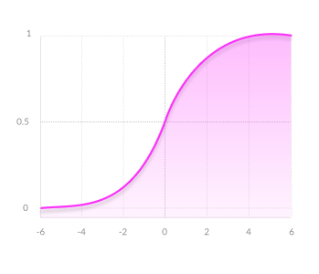
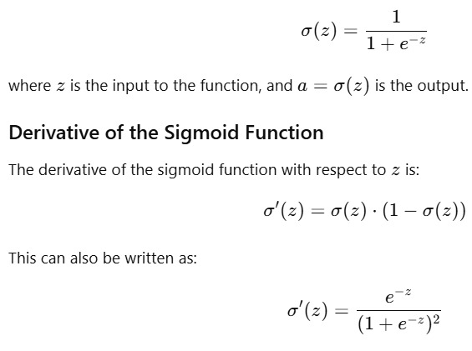
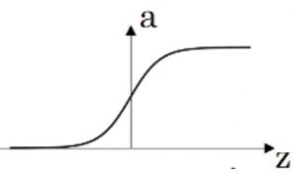
Sigmoid (Logistic) Function
Output values bound between 0 and 1, normalizing the output of each neuron.
Usage: Good for binary classification problems and used in output layers.
Problem: Prone to vanishing gradient, where gradients become very small during backpropagation, slowing down learning.
Notes:
Thus, they might be better alternatives than classical solutions for problems characterised by: – high dimensionality, noisy, imprecise or imperfect data; and – a lack of a clearly stated mathematical solution or algorithm

Slide 10
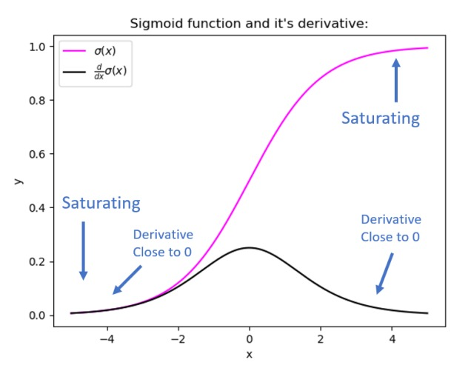
Vanishing Gradient
The vanishing gradient problem happens when the values used to update the neural network’s weights during training become extremely small.
As a result, the model learns very slowly or stops learning altogether, especially in the early layers.
Why does it happen?
  When using certain activation functions like sigmoid or tanh, their derivatives (which are used in backpropagation) become very small when the input is too large or too small.
  In deep networks, these small values are multiplied many times (one for each layer), making the gradient shrink close to zero.
  Example: Imagine you have 5 layers, and at each layer the derivative is 0.2.
  So the gradient is:0.2 × 0.2 × 0.2 × 0.2 × 0.2 = 0.00032.
  This tiny value means the weights in early layers barely change.

Slide 11
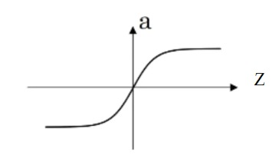

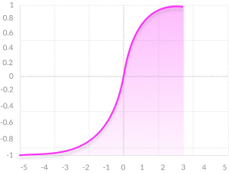


Tangent Hyperbolic function(TanH) Function
Zero centered—making it easier to model inputs that have strongly negative, neutral, and strongly positive values.
Similar to the sigmoid but symmetric around the origin.
Better than sigmoid for inputs with negative values.
Problem: Still susceptible to the vanishing gradient problem, though less severe than sigmoid.
Usage: Utilized in hidden layers to capture complex patterns.
Derivative of tanh(z) =
Notes:
Thus, they might be better alternatives than classical solutions for problems characterised by: – high dimensionality, noisy, imprecise or imperfect data; and – a lack of a clearly stated mathematical solution or algorithm

Slide 12
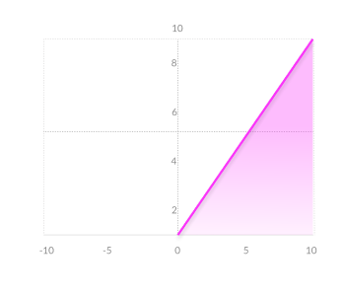
Rectified Linear Unit (ReLU) Function
Computationally efficient—allows the network to converge very quickly
Non-linear—Although it looks like a linear function, ReLU has a derivative function and allows for backpropagation
Formula: 𝑓(𝑥) = max(0,𝑥)
Range: [0, ∞)
Usage: The most widely used activation function, especially in hidden layers.
Notes:
Thus, they might be better alternatives than classical solutions for problems characterised by: – high dimensionality, noisy, imprecise or imperfect data; and – a lack of a clearly stated mathematical solution or algorithm

Slide 13
Rectified Linear Unit (ReLU) Function
Problem:
If weights are large, inputs can be very large → gradients can accumulate and exploding gradients.
So ReLU itself doesn’t cause exploding gradients, but when combined with poor initialization or deep networks, large positive activations accumulate and cause instability.
Dying ReLU, where neurons can "die" during training when they only output 0 and stop updating.
The Dying ReLU problem—when inputs approach zero, or are negative, the gradient of the function becomes zero, the network cannot perform backpropagation and cannot learn.
Notes:
Thus, they might be better alternatives than classical solutions for problems characterised by: – high dimensionality, noisy, imprecise or imperfect data; and – a lack of a clearly stated mathematical solution or algorithm

Slide 14
Exploding Gradient Problem
The exploding gradient problem happens when the gradient values become very large, causing the model’s weights to change dramatically, which leads to instability and makes the learning process fail.
Why does it happen?
When derivatives are large or weights are poorly initialized, multiplying them many times across layers causes the gradient to grow exponentially.
This can make the network output “NaN” or oscillate without converging.
Example:
Imagine 5 layers where the derivative is 5 at each layer.
The gradient becomes:
5×5×5×5×5=31255.
Such a large update causes the network to diverge.

Slide 15
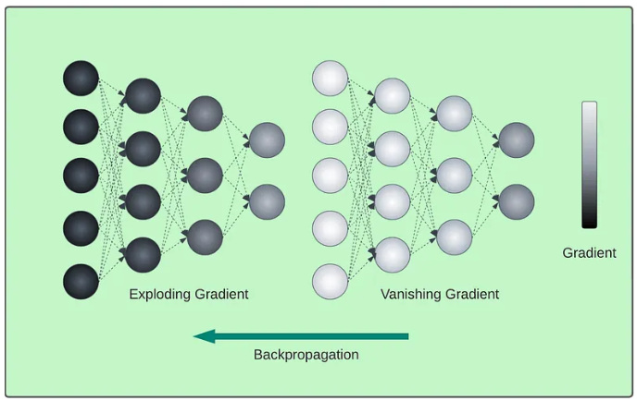

Slide 16
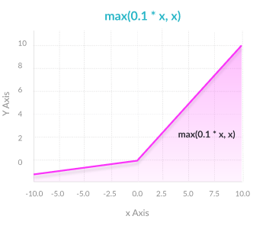
Leaky ReLU Function
Formula: 𝑓(𝑥) = 𝑥 if 𝑥 > 0,
        = 𝛼𝑥 if 𝑥 < 0
(typically, 𝛼 = 0.1)
Range: (-∞, ∞)
Characteristics:
A variation of ReLU that allows a small, non-zero gradient when 𝑥<0.
Mitigates the problem of dying neurons in ReLU.
Prevents dying ReLU problem— this variation of ReLU has a small positive slope in the negative area, so it does enable backpropagation, even for negative input values.
Results not consistent—leaky ReLU does not provide consistent predictions for negative input values.
Notes:
Thus, they might be better alternatives than classical solutions for problems characterised by: – high dimensionality, noisy, imprecise or imperfect data; and – a lack of a clearly stated mathematical solution or algorithm

Slide 17
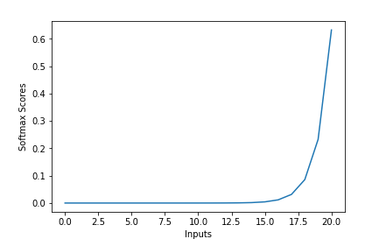
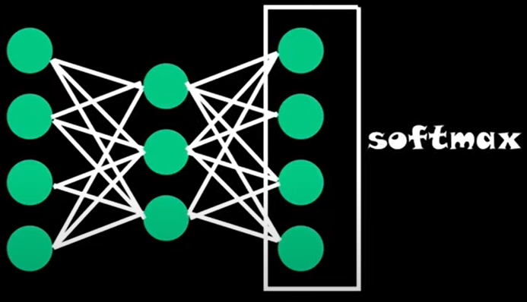
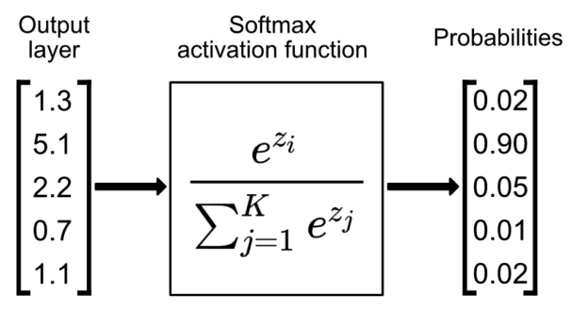
Softmax Function
The Softmax function is an extension of the sigmoid/ logistic function, used for multi-class classification problems.
Its goal is to predict a single label from multiple classes. The output of the softmax function is equivalent to a categorical probability distribution, it tells you the probability that any of the classes are true.
The softmax function, often used in the final layer of a neural network model for classification tasks as shown in Fig. (a)
It converts raw output scores — also known as logits — into probabilities by taking the exponential of each output and normalizing these values by dividing by the sum of all the exponentials. This process ensures the output values are in the range (0,1) and sum up to 1, making them interpretable as probabilities as shown in Fig. (b) and (c).
The class with highest probability is chosen as predicted class.
(a)
(b)
(c)

Slide 18
Softmax Function
Able to handle multiple classes only one class in other activation functions—normalizes the outputs for each class between 0 and 1, and divides by their sum, giving the probability of the input value being in a specific class.
Useful for output neurons—typically Softmax is used only for the output layer, for neural networks that need to classify inputs into multiple categories.
Notes:
Thus, they might be better alternatives than classical solutions for problems characterised by: – high dimensionality, noisy, imprecise or imperfect data; and – a lack of a clearly stated mathematical solution or algorithm

Slide 19
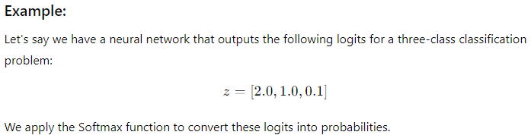
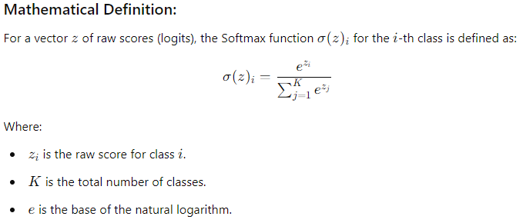
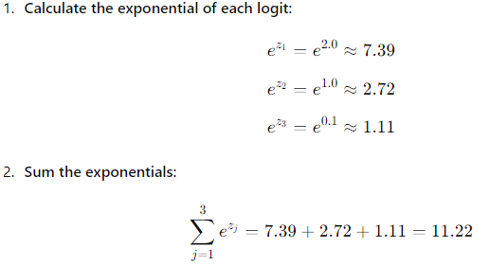
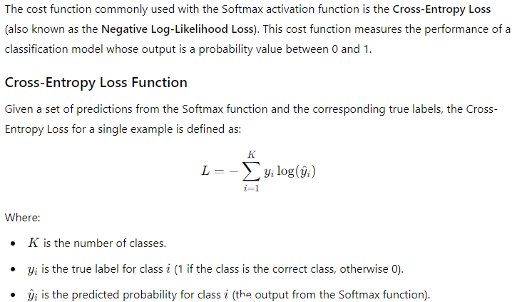
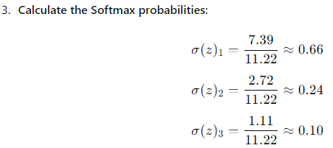
Softmax Function

Slide 20
Applications of Activation Functions
Sigmoid and Softmax: Preferred in the output layers for classification tasks due to their probabilistic output.
ReLU and its variants: Commonly used in hidden layers to efficiently capture complex patterns without significantly increasing computational complexity.
Limitations and Considerations
Vanishing Gradients: Functions like sigmoid and tanh can cause gradients to vanish during backpropagation, making it difficult to train deep networks
Dead Neurons: ReLU can result in dead neurons if the input is always negative, leading to zero output. Variants like Leaky ReLU can mitigate this issue.
Computational Complexity: Some activation functions, such as softmax, can be computationally demanding, affecting the scalability of the model.

Slide 21
Vanishing Gradient v/s Exploding Gradient
Aspect | Vanishing Gradient | Exploding Gradient
Problem Definition | Gradients become extremely small, nearing zero. | Gradients become extremely large, approaching infinity.
Effect on Training | Slow or stalled learning, weights barely change. | Unstable training, weights grow uncontrollably.
Cause | Activation functions (like sigmoid or tanh) squash gradients, especially for deep networks. | Large weights or unnormalized gradients lead to runaway updates.
Common in | Deep neural networks with many layers. | Deep neural networks, especially with poor weight initialization or large learning rates.
Impact on Learning | Network fails to learn meaningful representations for layers deeper in the network. | Learning becomes unstable, leading to diverging values.
Mathematical Representation | Gradients tend to zero as backpropagation is performed over many layers. | Gradients grow exponentially through backpropagation.
Mitigation Strategies | Use ReLU (or variants), gradient clipping, batch normalization, skip connections. | Gradient clipping, careful weight initialization (e.g., Xavier/He initialization), lower learning rates.
Typical Symptoms | Slow convergence or no learning after some point. | Large gradients causing NaNs or weights becoming too large.

Slide 22
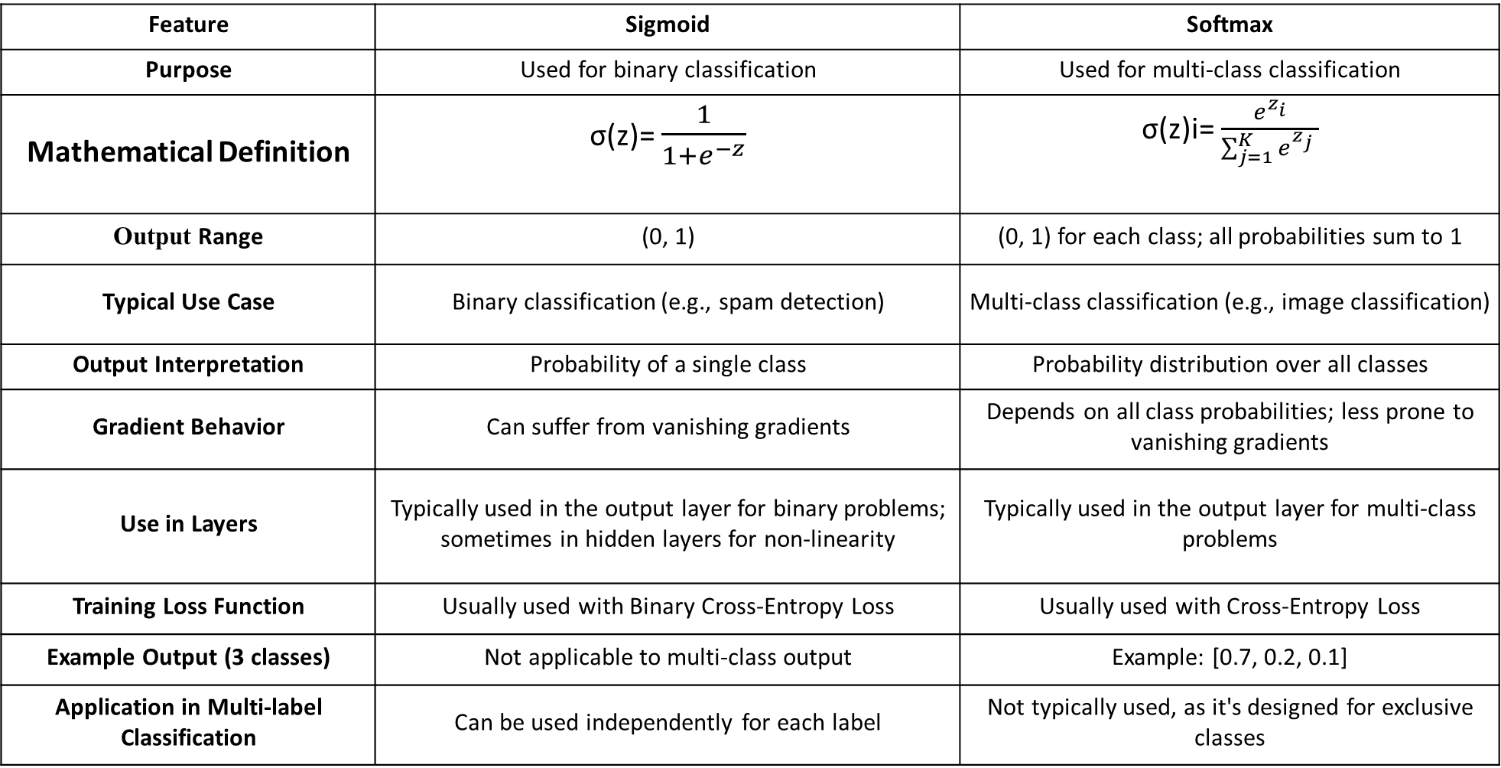
Sigmoid v/s Softmax
Feature | Sigmoid | Softmax
Purpose | Used for binary classification | Used for multi-class classification
Mathematical Definition | σ(z)= $\frac{1}{1+e^{−z}}$ | σ(z)i= $\frac{e^{z_{i}}}{\sum_{j=1}^{K}{e^{z_{j}} }}$
Output Range | (0, 1) | (0, 1) for each class; all probabilities sum to 1
Typical Use Case | Binary classification (e.g., spam detection) | Multi-class classification (e.g., image classification)
Output Interpretation | Probability of a single class | Probability distribution over all classes
Gradient Behavior | Can suffer from vanishing gradients | Depends on all class probabilities; less prone to vanishing gradients
Use in Layers | Typically used in the output layer for binary problems; sometimes in hidden layers for non-linearity | Typically used in the output layer for multi-class problems
Training Loss Function | Usually used with Binary Cross-Entropy Loss | Usually used with Cross-Entropy Loss
Example Output (3 classes) | Not applicable to multi-class output | Example: [0.7, 0.2, 0.1]
Application in Multi-label Classification | Can be used independently for each label | Not typically used, as it's designed for exclusive classes

Slide 23
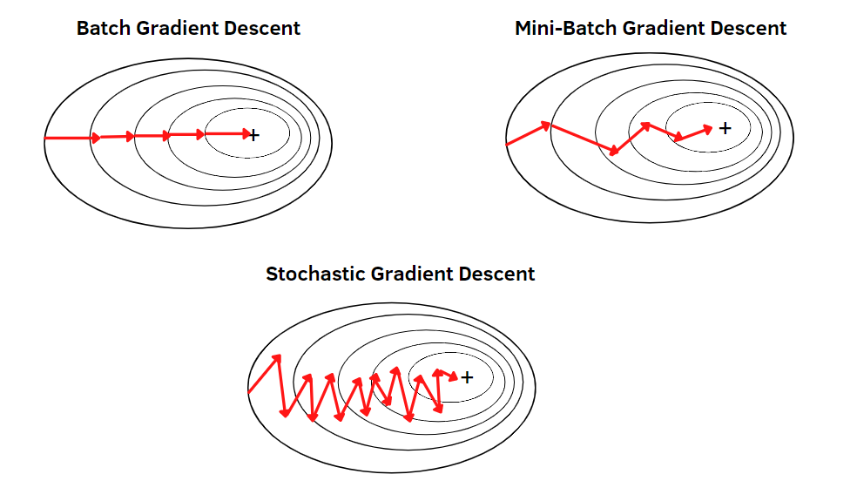
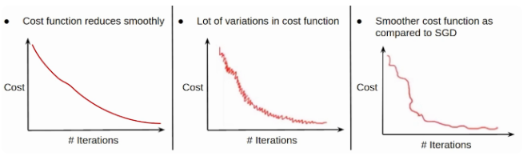
Gradient Descent
Gradient Descent is an optimization algorithm used to minimize the loss function by iteratively updating the weights in the direction of the negative gradient.
Common variants of gradient descent include:
Batch Gradient Descent: Updates weights after computing the gradient over the entire dataset.
Mini-batch Gradient Descent: Updates weights after computing the gradient over a small batch of training examples.
Stochastic Gradient Descent (SGD): Updates weights for each training example individually.

Slide 24
Difference Between Batch, Mini-Batch, and Stochastic Gradient Descent
Aspect | Batch Gradient Descent | Stochastic Gradient Descent (SGD) | Mini-batch Gradient Descent
Definition | Uses the entire dataset to compute gradient before each update | Uses one sample at a time to update weights | Uses a small subset (batch) of samples for each update
Batch Size | All training samples | 1 sample | Small number of samples (e.g., 32, 64, 128)
Computation per Update | Very high (all data) | Very low (one sample) | Moderate (batch)
Convergence Speed | Slow (one update per epoch) | Fast (many updates per epoch) | Balanced
Gradient Estimate | Precise, low variance | Noisy, high variance | More stable than SGD, less costly than batch
Pros | Stable convergence, accurate direction | Fast updates, helps escape local minima | Efficient, stable, GPU-friendly
Cons | Slow, memory-heavy | Noisy, unstable convergence | Requires tuning batch size
Typical Use Case | Small datasets | Online learning, streaming data | Deep learning, large datasets

Slide 25
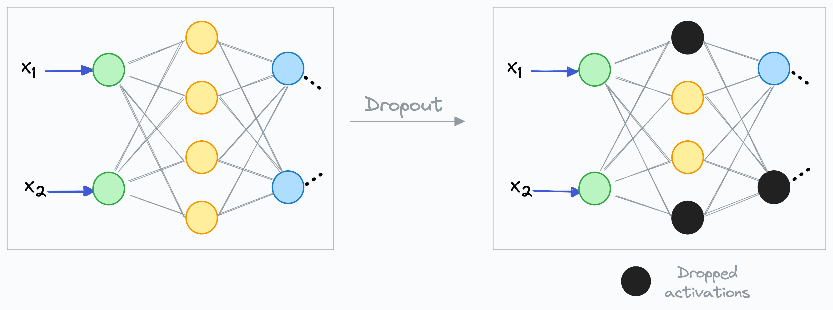
Dropout
Dropout is a regularization technique specifically used in neural networks.
During training, dropout randomly deactivates a fraction of neurons (units) in a neural network, effectively preventing the network from relying too heavily on any one neuron or feature.
This encourages the network to learn more robust and generalizable representations.
It is used in deep neural networks to prevent overfitting.
Dropout is implemented per-layer in various types of layers like dense fully connected, convolutional, and recurrent layers, excluding the output layer.

Slide 26
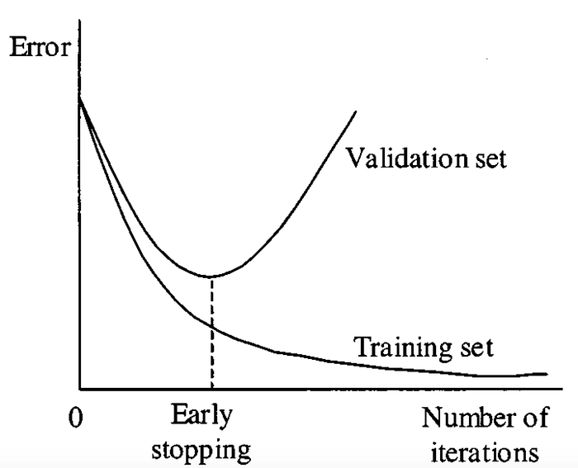
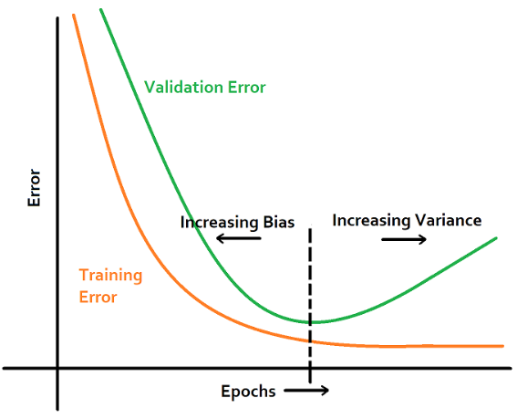
Early Stopping
Early stopping is a form of regularization used to prevent overfitting in machine learning models.
If the performance of the model on the validation dataset starts to degrade (e.g. loss begins to increase, or accuracy begins to decrease), then the training process is stopped.
The model at this stage have low variance and is known to generalize the data well.
Training the model further would increase the variance of the model and lead to overfitting. This regularization technique is called “early stopping”.
Steps:
Train the model.
Monitor validation loss.
Stop training when validation loss starts to increase (overfitting begins).
Use the weights from the epoch with the lowest validation loss.

