Slide 1
Artificial Intelligence and Machine Learning
Module - 3
Lecture - 3

Slide 2
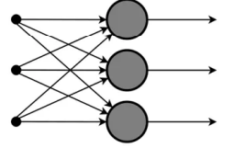
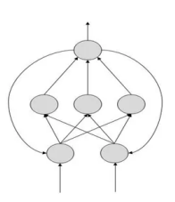
Types of Artificial Neural Networks
Neural networks can be broadly classified into two categories:
Feedforward Neural Networks (FNN): These networks have a unidirectional flow of information from input to output, with no cycles or loops. They are typically used for tasks like image classification and regression.
Feedback Neural Networks (RNNs): These networks have connections that loop back, allowing information to be fed back into the network. This structure enables them to handle sequential data and temporal dependencies, making them suitable for tasks like time series prediction and language modeling.
Feedforward NN
Feedback NN

Slide 3
Feedforward Neural Network

Slide 4
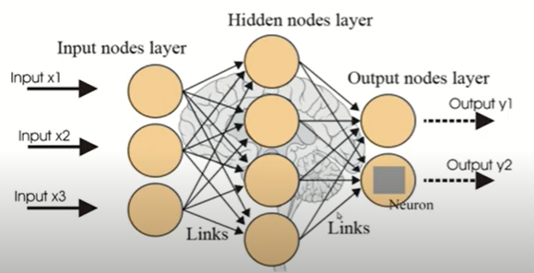
Feedforward Neural Network (FNN)
Also called as Multi-layer Perceptron
A multilayer perceptron (MLP) is a group of perceptrons, organized in multiple layers, that can accurately answer complex questions.
In this network, the information moves in only one direction—forward—from the input nodes, through the hidden nodes (if any), and to the output nodes.
There are no cycles or loops in the network.

Slide 5
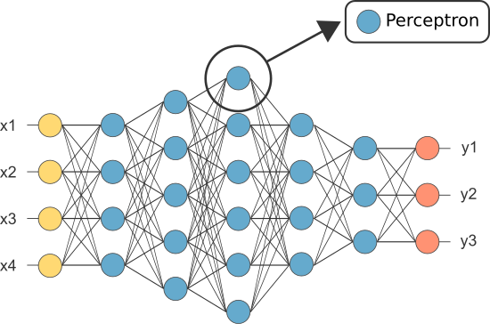
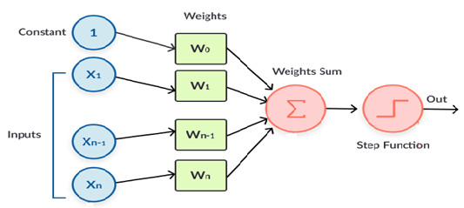
Architecture of FNN
The architecture of a feedforward neural network consists of three types of layers: the input layer, hidden layers, and the output layer. Each layer is made up of units known as neurons, and the layers are interconnected by weights.
Input Layer: This layer consists of neurons that receive inputs and pass them on to the next layer. The number of neurons in the input layer is determined by the dimensions of the input data.
Hidden Layers: These layers are not exposed to the input or output and can be considered as the computational engine of the neural network. Each hidden layer's neurons take the weighted sum of the outputs from the previous layer, apply an activation function, and pass the result to the next layer. The network can have zero or more hidden layers.
Output Layer: The final layer that produces the output for the given inputs. The number of neurons in the output layer depends on the number of possible outputs the network is designed to produce.
Each neuron in one layer is connected to every neuron in the next layer, making this a fully connected network. The strength of the connection between neurons is represented by weights, and learning in a neural network involves updating these weights based on the error of the output.
FNN Architecture
Perceptron Model

Slide 6
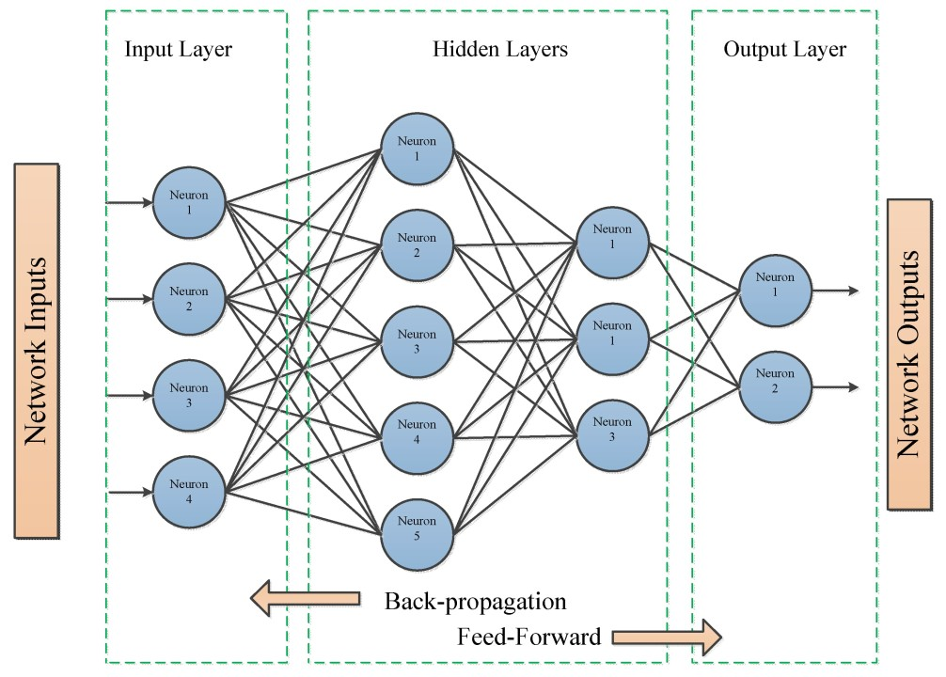
Training FNN
Training a Feedforward Neural Network involves adjusting the weights of the neurons to minimize the error between the predicted output and the actual output. To achieve this two techniques are used:
(1) Forward propagation (2) Back propagation
In forward propagation, we apply a set of weights to the input data and calculate an output. For the first forward propagation, the set of weights is selected randomly.
In backpropagation, the error is propagated back through the network to update the weights. The gradient of the loss function with respect to each weight is calculated, and the weights are adjusted using gradient descent.
Neural networks repeat both forward and back propagation until the weights are calibrated to accurately predict an output.

Slide 7
Evaluation of Feedforward Neural Network
Evaluating the performance of the trained model involves several metrics:
Accuracy: The proportion of correctly classified instances out of the total instances.
Precision: The ratio of true positive predictions to the total predicted positives.
Recall: The ratio of true positive predictions to the actual positives.
F1 Score: The harmonic mean of precision and recall, providing a balance between the two.
Confusion Matrix: A table used to describe the performance of a classification model, showing the true positives, true negatives, false positives, and false negatives.

Slide 8
Applications and Challenges of Feed-Forward Neural Network
Applications
Image Recognition and Classification
Speech Recognition
Predictive Analytics and Forecasting
Fraud Detection
Autonomous Vehicles
Challenges
Lack of Memory and Sequential Processing
Overfitting
Difficulty in Training Deep Networks
High Computational Cost
Sensitive to Hyperparameter Tuning

Slide 9
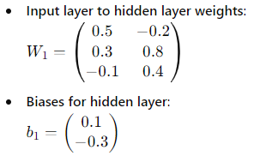
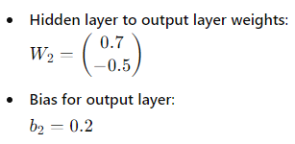

Numerical on Feed-Forward Neural Network
Question:
Consider a feed-forward neural network with the following architecture:
Input layer: 3 neurons
One hidden layer: 2 neurons
Output layer: 1 neuron
The activation function used for the hidden and output neurons is the sigmoid function. The weights and biases are given as follows:
Given the input vector , calculate the output of the network.

Slide 10
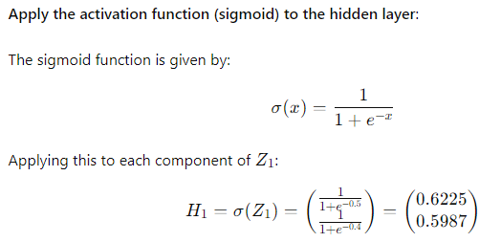
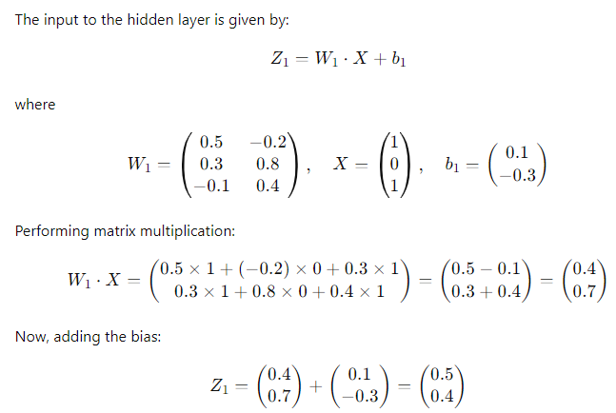
Calculate the input to the hidden layer

Slide 11
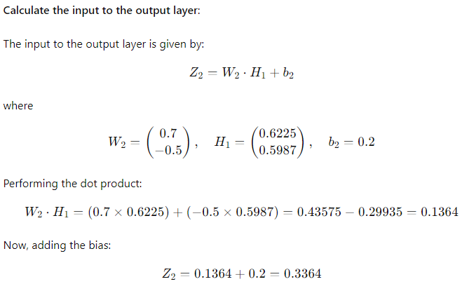
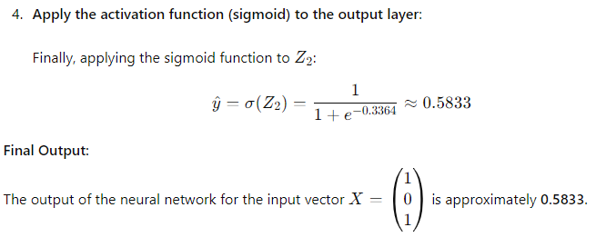

Slide 12
PRACTICE PROBLEM
A small logistics company uses an artificial neural network to predict delivery times based on the distance of delivery and the traffic conditions. The input layer consists of 2 nodes (distance in kilometer and traffic intensity on a scale of 1-10). The network has a single hidden layer with 2 nodes, and an output layer that predicts delivery time in hours.
Given:
Weights from input layer to hidden layer node 1: w₁₁=0.5, w₁₂=0.7
Weights from input layer to hidden layer node 2: w₂₁=0.6, w₂₂=0.4
Weights from hidden layer to output node: w₃₁=0.8, w₃₂=0.3
Biases at hidden layer nodes: b₁=0.1, b₂=0.2
Bias at output node: b₃=0.5
Using sigmoid activation function, calculate the predicted delivery time when the distance is 20 km and the traffic intensity is 7.

Slide 13
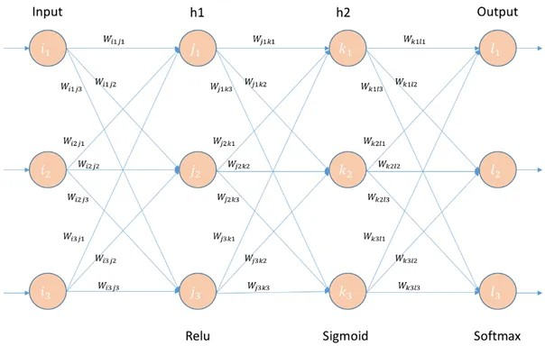
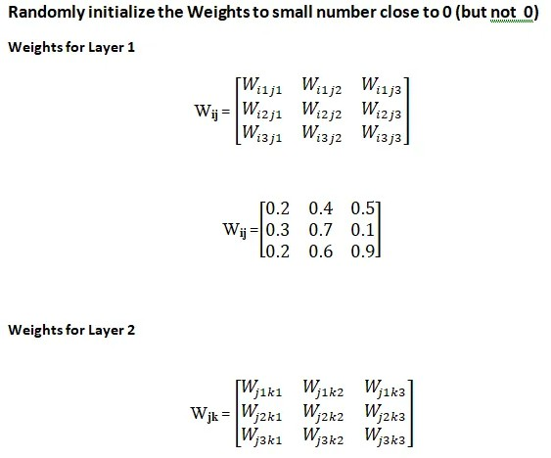
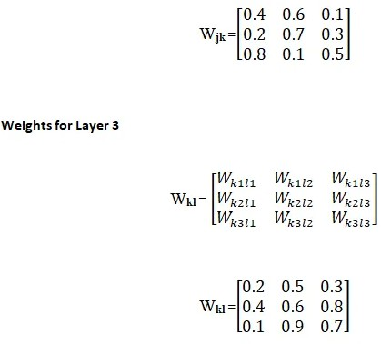
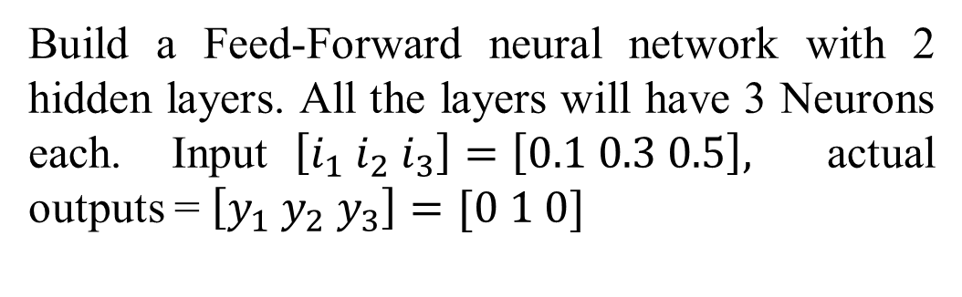
PRACTICE PROBLEM (IMP)
Build a Feed-Forward neural network with 2 hidden layers. All the layers will have 3 Neurons each. Input$\left[i_{1} i_{2} i_{3}\right]=\left[0.1 0.3 0.5\right],$ actual outputs = $\left[y_{1} y_{2} y_{3}\right]=[0 1 0]$

Slide 14
Backpropagation

Slide 15
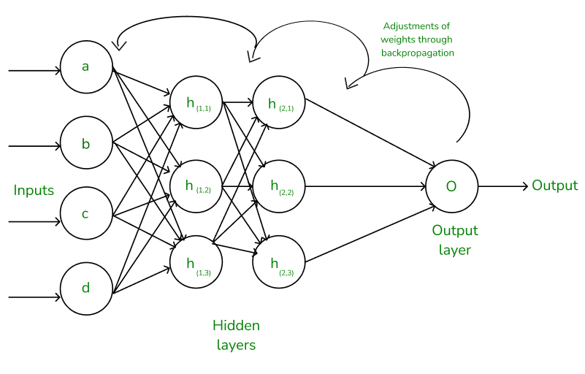
Backpropagation
Backpropagation (short for "Backward Propagation of Errors") is a method used to train artificial neural networks.
Its goal is to reduce the cost function, i.e.., difference between the model’s predicted output and the actual output by adjusting the weights and biases in the network.
It used gradient descent method to optimize the parameters.
It computes the gradient using the chain rule from calculus, allowing it to effectively navigate complex layers in the neural network to minimize the cost function.

Slide 16
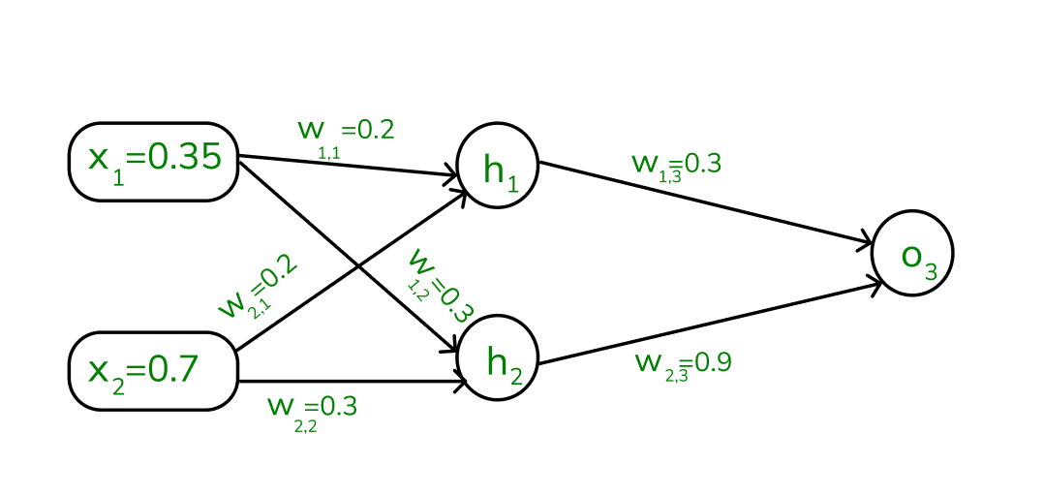
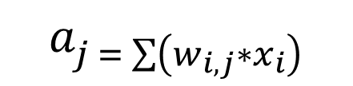
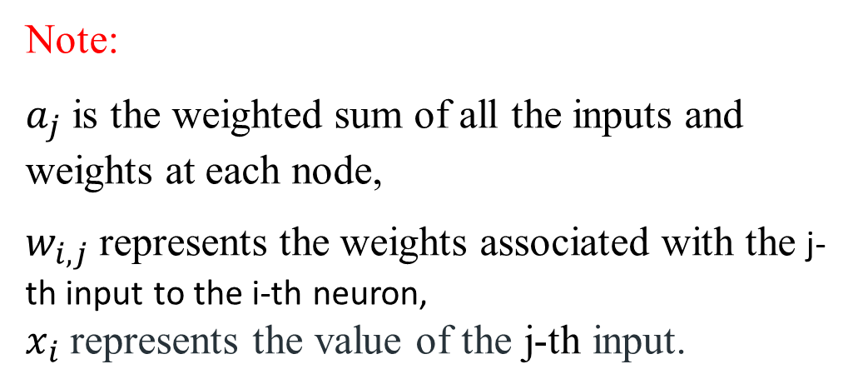

Assume the neurons use the sigmoid activation function for the forward and backward pass. The target output is 0.5, and the learning rate is 1.
Forward Propagation:
1. Initial Calculation: The weighted sum at each node is calculated using:
$$a_{j = \sum{\left(w_{i,j}∗x_{i}\right)}}$$
2. Sigmoid Function: The sigmoid function returns a value between 0 and 1, introducing non-linearity into the model.
Note:
$a_{j}$ is the weighted sum of all the inputs and weights at each node,
$w_{i,j}$ represents the weights associated with the j-th input to the i-th neuron,
$x_{i}$ represents the value of the j-th input.
$$y_{j =\frac{1}{1+e^{{−a}_{j}}} }$$

Slide 17
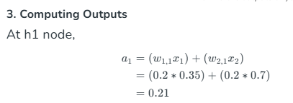

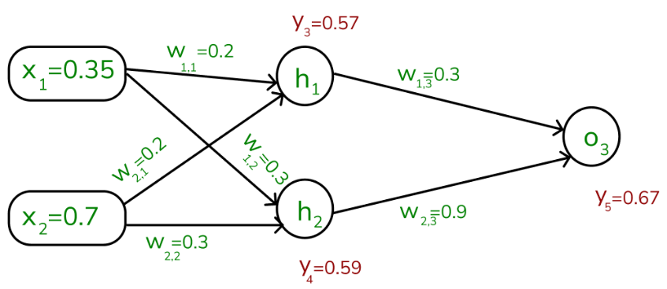


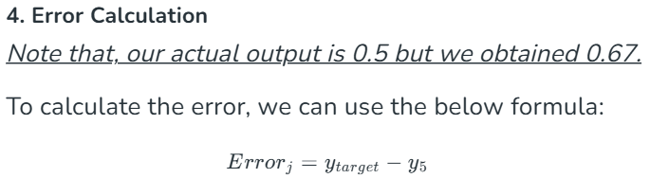
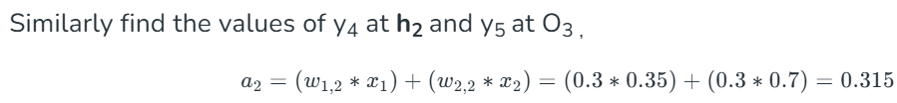
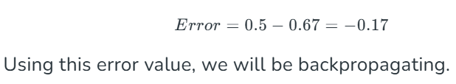

Once, we calculated the a₁ value, we can now proceed to find the y₃ value:
y₃ ₌ 0.57
Y₄ = 0.59

Slide 18
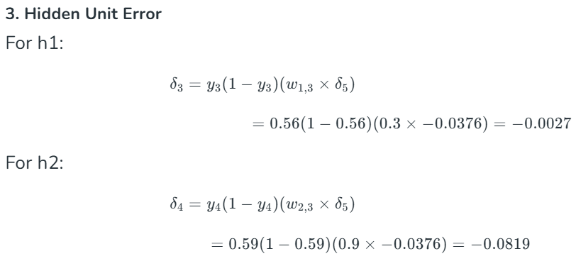
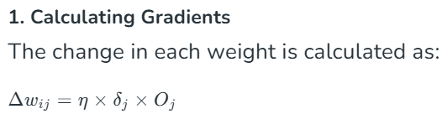
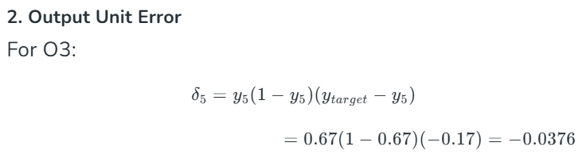
Backpropagation
Where,

Slide 19
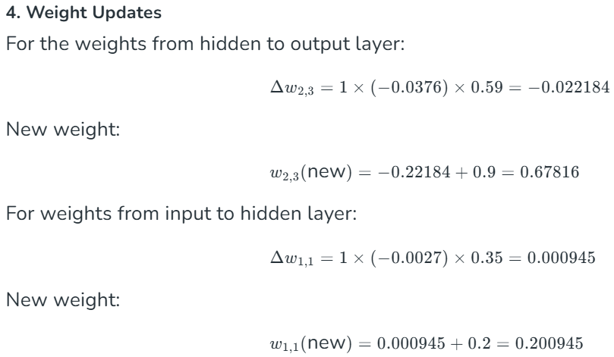
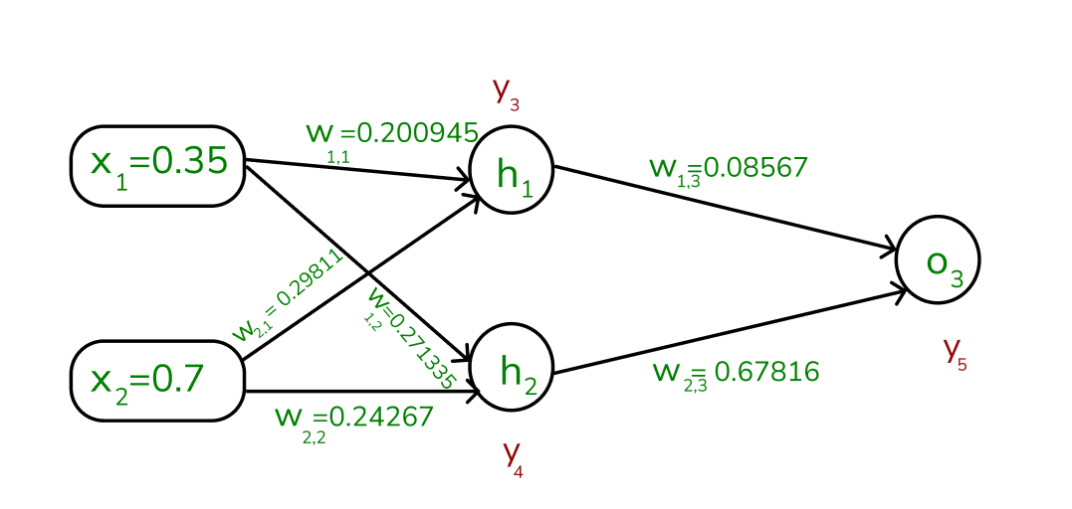
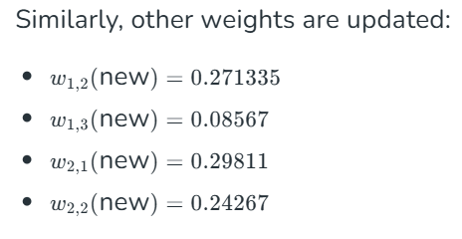

Slide 20
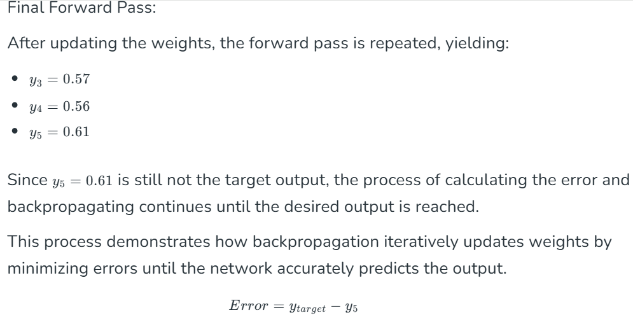
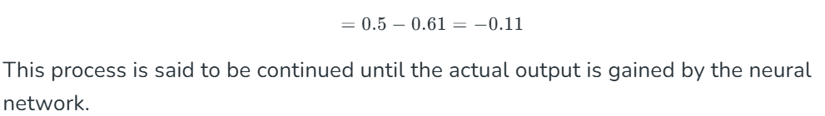

Slide 21
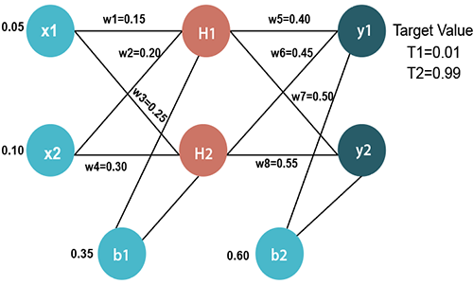
Numerical 2

Slide 22
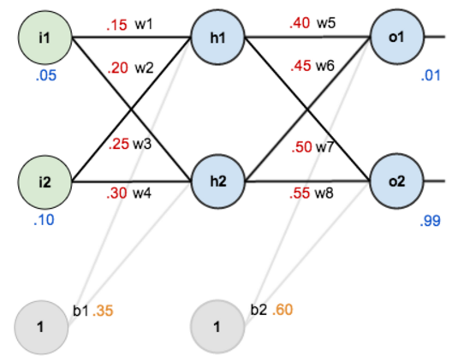
With two feature input, weights and bias values

Slide 23
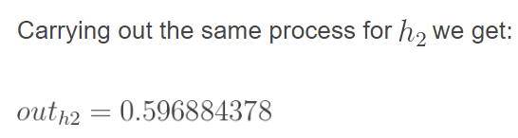
Forward Pass – Hidden Layer
net_{h1} = w₁ * i₁ + w₂ * i₂ + b₁ * 1
net_{h1} = 0.15 * 0.05 + 0.2 * 0.1 + 0.32 * 1 = 0.3775
Passing net_{h1} through sigmoid function, gives the output of h1, out_{h1}
net_{h1}
out_{h1}

Slide 24

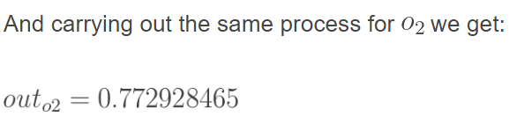
Forward Pass – Output Layer
net_{o1} = w₅ * out_{h1} + w₆ * out_{h2} + b₂ * 1
net_{o1} = 0.4 * 0.593269992 + 0.45 * 0.596884378 + 0.6 * 1 = 1.105905967
Passing net_{o1} through sigmoid function, gives the output of o1, out_{o1}
net_{o1}
out_{o1}

Slide 25









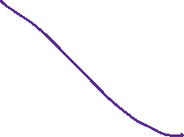



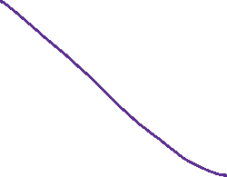

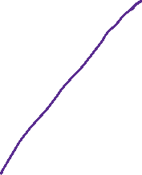





Slide 26







Calculating the total Error
Calculate the total error for each output neuron using the squared error function and sum them to get the total error:
Note: The ½ is included so that exponent is cancelled when we differentiate later on. The result is eventually multiplied by a learning rate anyway so it doesn’t matter that we introduce a constant here

Slide 27
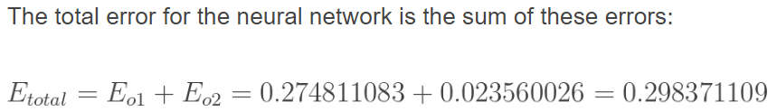

Total Error
The total error for the neural network is the sum of theses errors:

Slide 28
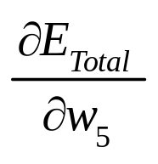

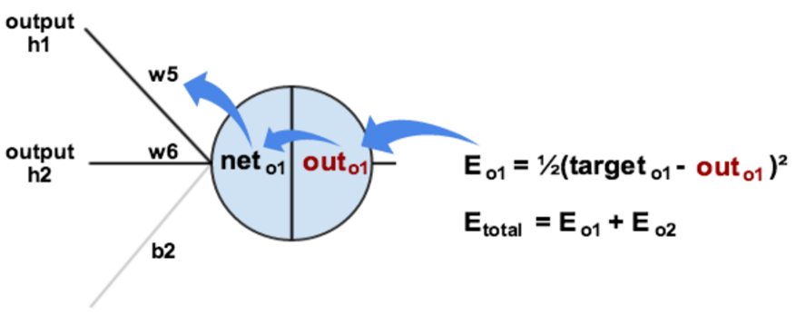
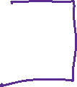


Backward Pass- Actual Learning
Now consider weight w₅. We want how much change in w₅, affects the total error term
By applying the chain rule, we get:

Slide 29




Slide 30
