Slide 1

Machine Learning
UNIT-3
ISHAN BUDHIRAJA

Slide 2
Naïve Bayes
Naive Bayes classifiers are a collection of classification algorithms based on Bayes’ Theorem.
It is not a single algorithm but a family of algorithms where all of them share a common principle, i.e., every pair of features being classified is independent of each other.
Naïve Bayes algorithm is used for classification problems. It is highly used in text classification. In text classification tasks, data contains high dimension (as each word represent one feature in the data).
It is used in spam filtering, sentiment detection, rating classification etc.
The advantage of using naïve Bayes is its speed. It is fast and making prediction is easy with high dimension of data.
It uses Bayes theorem in the algorithm for training and prediction.

Slide 3
Bayes v/s Naïve Bayes Theorem (Imp)
Aspect | Bayes Theorem | Naive Bayes
Definition | A fundamental theorem in probability theory used to calculate conditional probabilities. | A machine learning algorithm based on Bayes Theorem, with the assumption of independence among features.
Purpose | Provides a way to update probabilities based on new evidence. | Classifies data points by calculating posterior probabilities for each class.
Complexity | Can be computationally intensive if there are many dependencies to account for. | Computationally efficient due to its simplicity and independence assumption.
Interpretation | Provides exact probabilities if all probabilities are known. | Approximates probabilities based on the independence assumption, which may not hold in real-world data.
Use Cases | Applications in medical diagnostics, spam detection, and probabilistic reasoning. | Text classification, sentiment analysis, spam filtering, and recommendation systems.
Strengths | Accurately models conditional probabilities with known dependencies. | Works well with high-dimensional data and is computationally efficient.
Weaknesses | Difficult to model complex dependencies in large datasets. | Independence assumption may lead to inaccurate results in cases where features are strongly correlated.

Slide 4
Applications of Naive Bayes Classifier
Medical Diagnosis: predict whether a person is suffering from diabetes based on his diet and daily workout.
Spam Classification: Predict whether an email is spam or not.
Weather: predict whether it will rain tomorrow based on temperature, humidity, wind speed, etc.

Slide 5
Relationship between features and the class variable is non- deterministic.
Need an approach to model probabilistic relationship between the features and class variable.
Need of Naive Bayes Classifier

Slide 6
Naïve Bayes Classifier
Supervised form of learning.
A probabilistic framework to solve classification problems.
Works on Conditional probability.
Based on Bayes theorem.

Slide 7
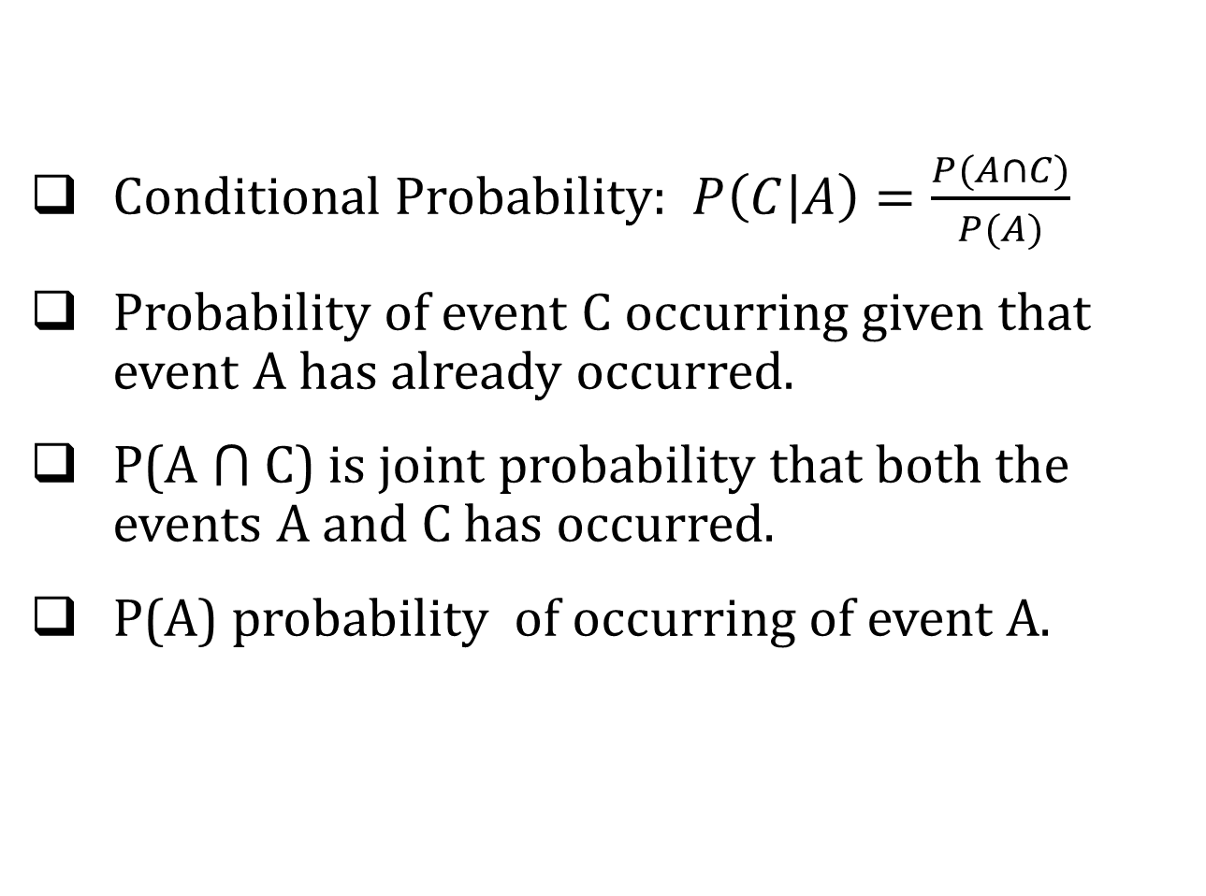
Conditional Probability
Conditional Probability: $P\left(C | A\right)=\frac{P(A∩C)}{P(A)}$
Probability of event C occurring given that event A has already occurred.
P(A ⋂ C) is joint probability that both the events A and C has occurred.
P(A) probability of occurring of event A.

Slide 8
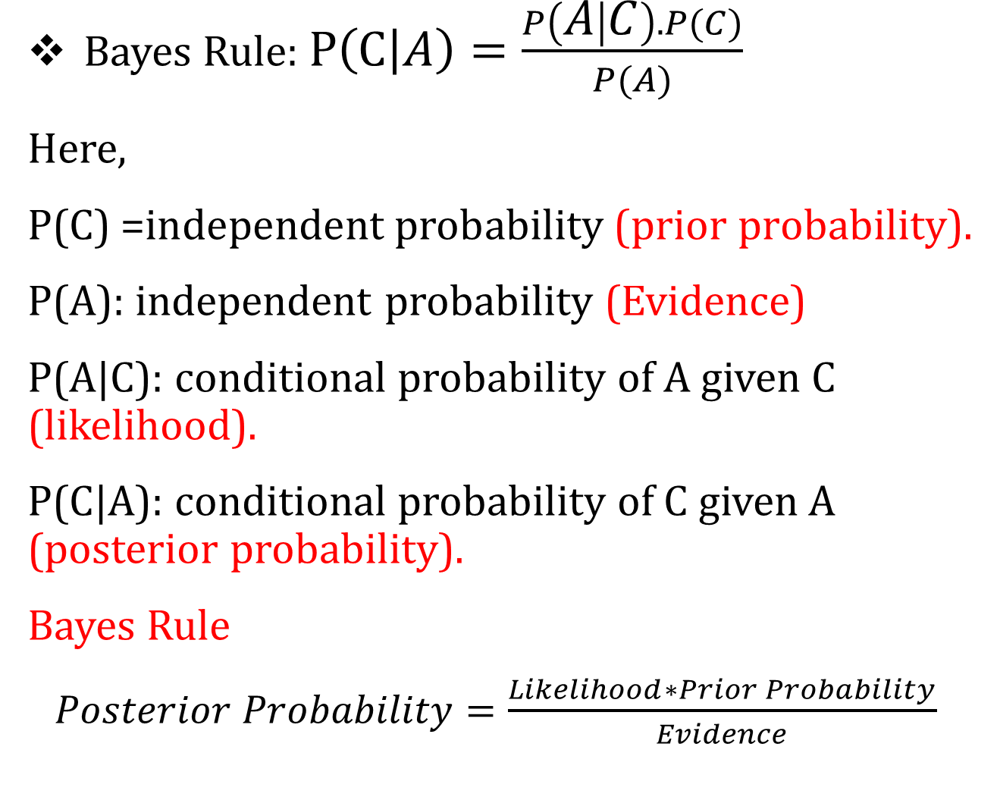
Bayes Theorem
(For one event)
Bayes Rule: $P\left(C | A\right)=\frac{P\left(A | C\right).P(C)}{P(A)}$
Here,
P(C) =independent probability (prior probability).
P(A): independent probability (Evidence)
P(A|C): conditional probability of A given C (likelihood).
P(C|A): conditional probability of C given A (posterior probability).
Bayes Rule
$Posterior Probability=\frac{Likelihood∗Prior Probability}{Evidence}$

Slide 9
Example of Bayes Theorem
Given:
P(C): patient has liver disease, 10% of patients having liver disease.
P(A): patient is an alcoholic, 5% of patients are alcoholic.
P(A|C): probability that patient is alcoholic given that he has a liver disease, 7%.
Find out a patient’s probability of having liver disease if they are alcoholic.
Sol: According to Bayes theorem:
P(C|A)= (0.07*0.1)/0.05=0.14
Therefore, 14% chances of a patient having liver disease if they are alcoholic.
(For Practice)
Problem: Application of Bayes' Theorem with Red and Green Balls
There are two bags:
Bag 1 contains 4 red balls and 6 green balls.
Bag 2 contains 5 red balls and 5 green balls.
You pick a ball at random from one of the bags (Bag 1 or Bag 2). You observe that the ball is red. What is the probability that the ball came from Bag 1?

Slide 10
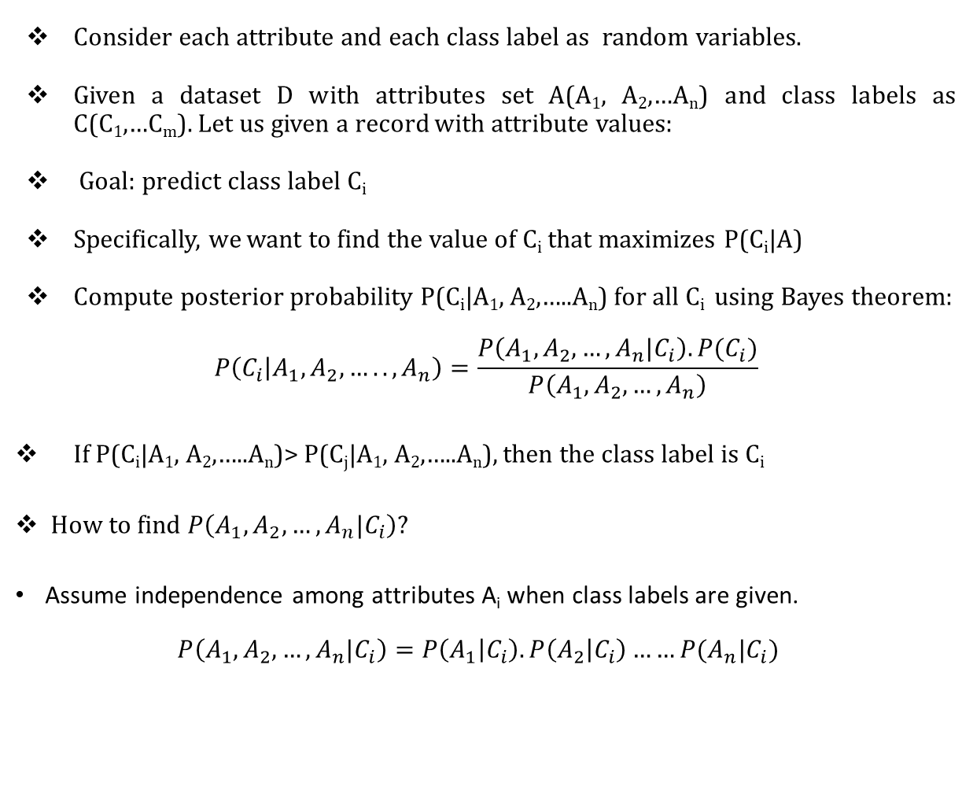
Naive Bayes Classifier
(For Multiple Events)
Consider each attribute and each class label as random variables.
Given a dataset D with attributes set A(A₁, A₂,…A_{n}) and class labels as C(C₁,…C_{m}). Let us given a record with attribute values:
Goal: predict class label C_{i}
Specifically, we want to find the value of C_{i} that maximizes P(C_{i}|A)
Compute posterior probability P(C_{i}|A₁, A₂,…..A_{n}) for all C_{i} using Bayes theorem:
$$P\left(C_{i} | A_{1},A_{2},…..,A_{n}\right)=\frac{P\left(A_{1},A_{2},…,A_{n}|C_{i}\right).P(C_{i})}{P\left(A_{1},A_{2},…,A_{n}\right)}$$
If P(C_{i}|A₁, A₂,…..A_{n})> P(C_{j}|A₁, A₂,…..A_{n}), then the class label is C_{i}
How to find $P\left(A_{1},A_{2},…,A_{n}|C_{i}\right)$?
Assume independence among attributes A_{i} when class labels are given.
$$P\left(A_{1},A_{2},…,A_{n}|C_{i}\right)=P\left(A_{1} | C_{i}\right).P\left(A_{2} | C_{i}\right)……P(A_{n}|C_{i})$$

Slide 11
Working of Naïve Bayes Classifier

Slide 12

ID | Age | Income | Student | Credit_Rating | Buys_computer
1 | youth | high | no | fair | NO
2 | youth | high | no | excellent | NO
3 | middle | high | no | fair | YES
4 | senior | medium | no | fair | YES
5 | senior | low | yes | fair | YES
6 | senior | low | yes | excellent | NO
7 | middle | low | yes | excellent | YES
8 | youth | medium | no | fair | NO
9 | youth | low | yes | fair | YES
10 | senior | medium | yes | fair | YES
11 | youth | medium | yes | excellent | YES
12 | middle | medium | no | excellent | YES
13 | middle | high | yes | fair | YES
14 | senior | medium | no | excellent | NO

Slide 13
Naive Bayes Classifier Example
Given: tuple X <youth, medium, yes, fair, buys_computer=?>
Task: predict whether person X will buy computer?
Let us assume C₁ = YES and C₂ = NO
P(C₁) = 9/14 = 0.643 and P(C₂) = 5/14 = 0.357

Slide 14
Naive Bayes Classifier Example
To Compute P(X|C₁) and P(X|C₂), first compute following conditional probabilities:
P(youth|C₁) = 2/9=0.222
P( medium|C₁) = 4/9= 0.444
P(yes|C₁) = 6/9 =0.667
P(fair|C₁) = 6/9 =0.667
P(youth|C₂) = 3/5=0.600
P(medium|C₂) = 2/5=0.400
P(yes|C₂) = 1/5=0.2000
P(fair|C₂) = 2/5=0.400

Slide 15
Naive Bayes Classifier Example
P(X|C₁)=P(youth|C₁)*P(medium|C₁)* P(yes|C₁)*P(fair|C₁) = 0.222*0.444*0.667* 0.667 = 0.044
P(X| C₁).P(C₁) =0.044 * 0.643=0.028
P(X|C₂) = P(youth|C₂)* P(medium|C₂)* P(yes|C₂)*P(fair|C₂) = 0.600*0.400*0.200* 0.400 = 0.019
P(X| C₂).P(C₂)= 0.019 * 0.357= 0.007
Final class C_{i} is that maximizes P(X| C_{i}).P(C_{i})
P(X| C₁).P(C₁) > P(X| C₂).P(C₂), so tuple X class label is C₁

Slide 16
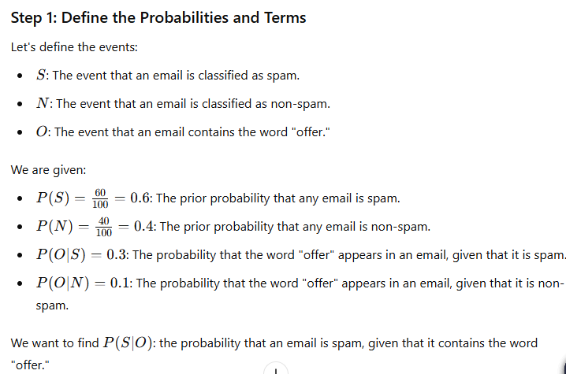
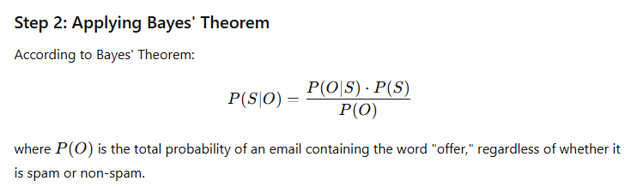
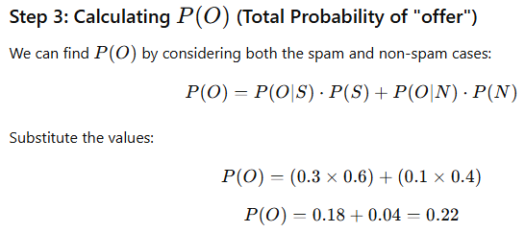
Numerical (Imp)
Consider a dataset where you have the following information: In a collection of 100 emails, 60 are classified as spam and 40 as non-spam. If an email contains the word 'offer,' there is a 30% chance it is classified as spam and a 10% chance it is non-spam. Using the Naïve Bayes classifier, calculate the probability that an email is spam given that it contains the word 'offer.' Explain each step of your calculation and interpret the result in the context of email filtering

Slide 17
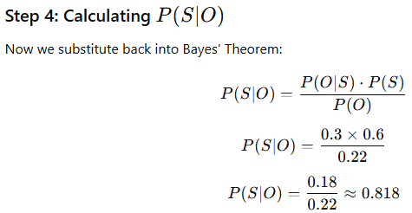
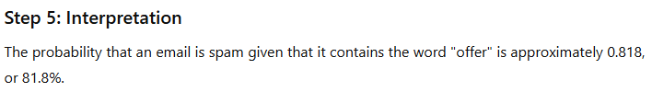
Numerical (Imp) (Contd.)

Slide 18
Types of Naïve Bayes Classifier

Slide 19
Types of Naïve Bayes Classifier
Naïve Bayes Classifier
Gaussian
Multinomial
Bernoulli

Slide 20
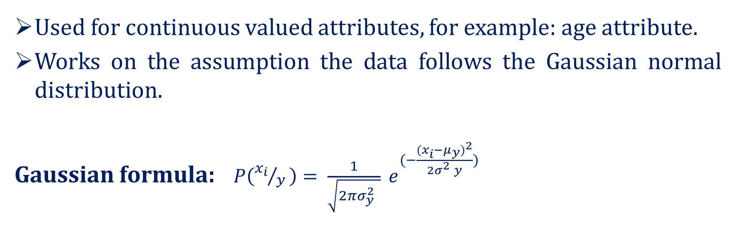
Gaussian Naïve Bayes Classifier
Used for continuous valued attributes, for example: age attribute.
Works on the assumption the data follows the Gaussian normal distribution.
Gaussian formula: $P\left({x_{i}}/{y }\right)= \frac{1}{\sqrt{2πσ_{y}^{2} }} e^{(−\frac{{{(x}_{i}−μ_{y})}^{2}}{{2σ}_{}^{2}y})}$

Slide 21
Multinomial Naïve Bayes Classifier
Mostly used for document classification problem.
For example: document belongs to the category of sports, politics, technology, etc.
The attributes used for classification are the frequency of the words present in the document.

Slide 22
Bernoulli Naïve Bayes Classifier
Similar to multinomial naïve bayes classifier.
But the attributes are boolean valued only .
For example: if a word occurs in a text yes or no.

