Slide 1

Artificial Intelligence and Machine Learning
Module-3 Lecture-4

Slide 2

Gibbs Algorithm
The Bayes classifier always predicts the class with the highest posterior probability.
Formula:
Example:
If for a sample x:
  P(y=1∣x)=0.55
  P(y=0∣x)=0.45
  Bayes classifier will always choose class 1.
Problem: It ignores the uncertainty in predictions. Even though probabilities are close (55% vs 45%), it acts as if class 1 is 100% correct.

Slide 3

Gibbs Algorithm
The Gibbs algorithm chooses a class randomly, according to the posterior distribution.
Formula:
Example: (same probabilities as above)
  P(y=1∣x)=0.55
  P(y=0∣x)=0.45
  Gibbs will predict class 1 with 55% chance and class 0 with 45% chance.
Advantage: It reflects the true uncertainty in the model, rather than always committing to one class.

Slide 4
Comparison between Bayes and Gibbs Algorithm
Feature | Bayes Classifier | Gibbs Algorithm
Prediction | Deterministic (argmax) | Randomized (sample)
Accuracy (0–1 loss) | Highest possible | Always lower/equal
Uncertainty | Collapses to one class | Preserves full distribution
Repeatability | Same result always | Different outputs possible
Theoretical use | Less neat in PAC-Bayes | Central to PAC-Bayes bounds
Use in RL | Less exploration | Naturally encourages exploration

Slide 5
Why Gibbs Over Bayes
Aspect | Bayes Classifier | Gibbs Algorithm | Why Gibbs?
Decision | Always picks most probable class | Samples according to probabilities | Captures uncertainty
Overconfidence | Acts as if prediction is certain | Allows randomness if probabilities close | Better under ambiguity
Ensemble use | Same prediction every time | Can average over many random runs | Useful in bagging/ensembles
Learning theory | Bayes optimal but hard to compute with limited data | PAC guarantees easier to prove | Theoretically convenient
Overfitting risk | Can overfit if assumptions (independence, etc.) are wrong | Randomization works like regularization | More robust in noisy datasets

Slide 6
Gibbs Algorithm
The term "Gibbs algorithm" generally refers to the Gibbs Sampling algorithm.
It is based on a Markov Chain Monte Carlo (MCMC) method for estimating unknown probability distributions.
It works by iteratively sampling each variable from its conditional distribution, given the current values of all other variables.
This process creates a Markov chain that eventually converges to the desired complex joint distribution, allowing for statistical inference, and it's often used when direct sampling from the joint distribution is computationally difficult.

Slide 7
Applications of Gibbs Algorithm
Probably Approximately Correct Bayesian learning theory (Generalize Model).
Uncertainty-aware predictions (risk-sensitive tasks).
Ensemble methods & Bayesian model averaging.
Exploration in reinforcement learning (SoftMax strategy).
Monte Carlo simulations & sampling-based methods.

Slide 8
Need of Gibbs Algorithm
Gibbs sampling is needed to generate samples from complex, high-dimensional joint probability distributions for statistical inference, especially in Bayesian analysis, when direct sampling is impossible.
It is essential when dealing with models containing unobserved or latent variables, or in situations where we need to understand the distributions of parameters in complex systems by breaking them down into simpler, sequentially sampled conditional distributions.

Slide 9
Advantages and Disadvantages of Gibbs Algorithm
Advantages
1)Preserves uncertainty (samples from full posterior).
2) Easier theoretical analysis (PAC-Bayes).
3) Regularization against overconfidence.
4) Supports exploration in RL.
5) Enables ensemble averaging.
Disadvantages
1) Lower accuracy than Bayes (for 0–1 loss).
2) Random, non-repeatable outputs.
3) Higher variance in small samples.
4) Computationally costly if many samples needed.
5) Suboptimal when deterministic accuracy is the goal.

Slide 10
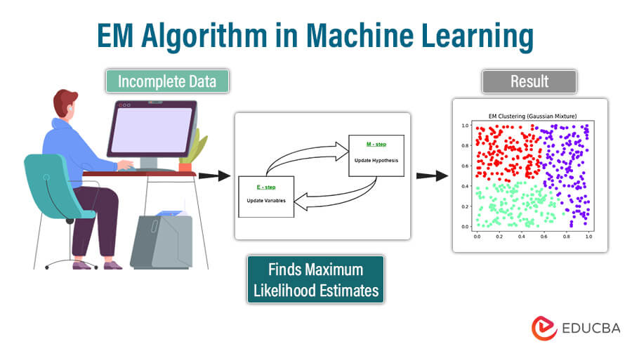
Expectation-Maximization Algorithm
The Expectation-Maximization (EM) algorithm is a statistical method.
It is used in machine learning to find the maximum likelihood or maximum a posteriori (MAP) estimates of model parameters when the data has hidden or incomplete elements, known as latent variables.
The algorithm works iteratively through two key steps:
Expectation Step (E-step): In this step, the algorithm calculates the expected value of the complete-data log-likelihood function using the current estimates of the parameters and the observed data.
It essentially estimates the missing parts of the data based on what is currently known.
Maximization Step (M-step): Using the estimates from the E-step, the algorithm updates the parameters by maximizing the expected log-likelihood function.
This step refines the model parameters to better fit the data.
The EM algorithm repeats these steps until the parameter values stabilize, meaning they no longer change significantly. This process continues iteratively, ensuring that the estimates improve with each cycle, ultimately leading to a solution that maximizes the likelihood of the observed data.

Slide 11
Key Terms in Expectation-Maximization (EM) Algorithm
Latent Variables: Variables that are not directly observed but are inferred from the data. They represent hidden structure (e.g., cluster assignments in Gaussian Mixture Models).
Likelihood: The probability of the observed data given a set of model parameters. EM aims to find parameter values that maximize this likelihood.
Log-Likelihood: The natural logarithm of the likelihood function. It simplifies calculations (turning products into sums) and is numerically more stable when dealing with very small probabilities.
Maximum Likelihood Estimation (MLE): A statistical approach to estimating parameters by choosing the values that maximize the likelihood of observing the given data. EM extends MLE to cases with hidden or missing variables.
Posterior Probability: In Bayesian inference, this represents the probability of parameters (or latent variables) given the observed data and prior knowledge. In EM, posterior probabilities are used in the E-step to estimate the "responsibility" of each hidden variable.
Convergence: The stopping criterion for the iterative process. EM is said to converge when updates to parameters or improvements in log-likelihood become negligibly small, meaning the algorithm has reached a stable solution.

Slide 12
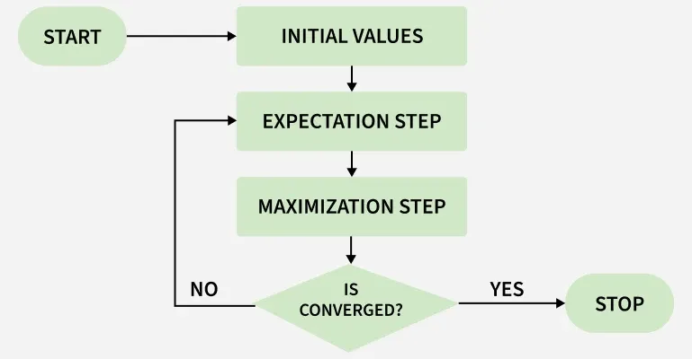
Working of EM Algorithm
Initialization: The algorithm starts with initial parameter values and assumes the observed data comes from a specific model.
E-Step (Expectation Step):
Find the missing or hidden data based on the current parameters.
Calculate the posterior probability of each latent variable based on the observed data.
Compute the log-likelihood of the observed data using the current parameter estimates.
3. M-Step (Maximization Step):
Update the model parameters by maximize the log-likelihood.
The better the model the higher this value.
4. Convergence:
Check if the model parameters are stable and converging.
If the changes in log-likelihood or parameters are below a set threshold, stop. If not repeat the E-step and M-step until convergence is reached

Slide 13
Advantages and Disadvantages
Advantages
Monotonic improvement: Each iteration increases (or at least never decreases) the log-likelihood.
Handles incomplete data well: Works effectively even with missing or hidden variables.
Flexibility: Can be applied to many probabilistic models, not just mixtures of Gaussians.
Easy to implement: The E-step and M-step are conceptually simple and often have closed-form updates.
Disadvantages
Slow convergence: Convergence can be very gradual, especially near the optimum.
Initialization sensitive: Requires good initial parameter guesses; poor choices may yield bad solutions.
No guarantee of global best solution: Unlike some optimization methods, EM doesn’t guarantee reaching the absolute best parameters.
Computationally intensive: For large datasets or complex models, repeated iterations can be costly.

Slide 14
Applications
Clustering: Used in Gaussian Mixture Models (GMMs) to assign data points to clusters probabilistically.
Missing Data Imputation: Helps fill in missing values in datasets by estimating them iteratively.
Image Processing: Applied in image segmentation, denoising and restoration tasks where pixel classes are hidden.
Natural Language Processing (NLP): Used in tasks like word alignment in machine translation and topic modelling (LDA).
Hidden Markov Models (HMMs): EM’s variant, the Baum-Welch algorithm, estimates transition/emission probabilities for sequence data.

Slide 15
Difference Between Gibbs and EM Algorithm
Aspect | Gibbs Algorithm | EM Algorithm
Type | Randomized classifier (in ML theory) / sampling-based method | Iterative optimization algorithm
Core Idea | Makes predictions by sampling from the posterior distribution of labels or parameters. | Finds maximum likelihood / MAP estimates of parameters with latent (hidden) variables.
Output | Stochastic (different runs can give different outputs). | Deterministic (same input → same parameters).
Accuracy | Always ≤ Bayes classifier for 0–1 loss. | Improves log-likelihood with each iteration; converges to local optimum.
Use of Uncertainty | Explicitly preserves uncertainty by sampling. | Collapses uncertainty into point estimates (parameters).
Analysis | Important in PAC-Bayes learning theory (generalization bounds). | Standard tool in statistics and ML for parameter estimation.

Slide 16
Bayesian Belief Networks
Bayesian Belief Network (BBN) is a graphical model that represents the probabilistic relationships among variables. It is used to handle uncertainty and make predictions or decisions based on probabilities.
Graphical Representation: Variables are represented as nodes in a directed acyclic graph (DAG), and their dependencies are shown as edges.
Conditional Probabilities: Each node's probability depends on its parent nodes, expressed as P(Variable | Parent)P(Variable | Parent).
Probabilistic Model: Built from probability distributions, BBNs apply probability theory for tasks like prediction and anomaly detection.
Note: Bayesian Belief Networks are valuable tools for understanding and solving problems involving uncertain events. They are also known as Bayes networks, belief networks, decision networks, or Bayesian models.

Slide 17
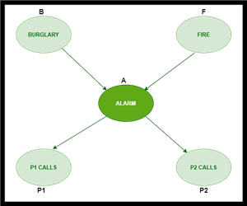
Bayesian Belief Networks
Consider this example:
In the above figure, we have an alarm 'A' - a node, say installed in a house of a person 'gfg', which rings upon two probabilities i.e burglary 'B' and fire 'F', which are - parent nodes of the alarm node. The alarm is the parent node of two probabilities P1 calls 'P1' & P2 calls 'P2' person nodes.
Upon the instance of burglary and fire, 'P1' and 'P2' call person 'gfg', respectively. But, there are few drawbacks in this case, as sometimes 'P1' may forget to call the person 'gfg', even after hearing the alarm, as he has a tendency to forget things, quick. Similarly, 'P2', sometimes fails to call the person 'gfg', as he is only able to hear the alarm, from a certain distance.

