Slide 1

K-Nearest Neighbor (KNN) Classification

Slide 2
Eager Learners v/s Lazy Learners
Eager Learners: constructs generalization model based on training dataset before receiving new (e.g., test) tuples to classify.
Lazy Learners: simply stores the training dataset (or does only minor pre-processing) and waits until it is given a test tuple.
Lazy learners store the training tuples (or instances), also referred to as instance-based learners.

Slide 3
k- Nearest Neighbour Classifier
Simplest classification method.
Instance-based classifier.
Less time in training, more time in testing.
Based on learning by analogy- that is by comparing a given test tuple with training tuples that are similar to it.

Slide 4
k- Nearest Neighbour Classifier
k = 1, the unknown tuple is assigned the class label of the training tuple nearest to it.
When k= 3 or 5 ?
k =5
k =3
?

Slide 5
Why do we need K-NN Algorithm?
It is simple to implement.
It is robust to the noisy training data
It can be more effective if the training data is large.

Slide 6
K-Nearest Neighbor (K-NN)
K-NN algorithm as Supervised Learning technique assumes the similarity between the new case/data and available cases and put the new case into the category that is most similar to the available categories.
K-NN algorithm stores all the available data and classifies a new data point based on the similarity.
K-NN algorithm can be used for Regression as well as for Classification but mostly it is used for the Classification problems.
K-NN is a non-parametric algorithm, which means it does not make any assumption on underlying data.
It is also called a lazy learner algorithm because it does not learn from the training set immediately instead it stores the dataset and at the time of classification, it performs an action on the dataset.

Slide 7
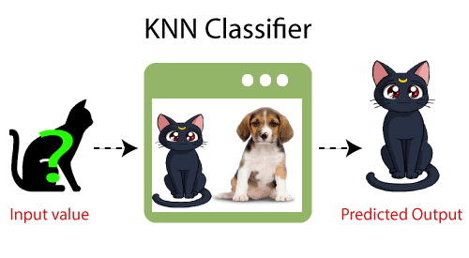
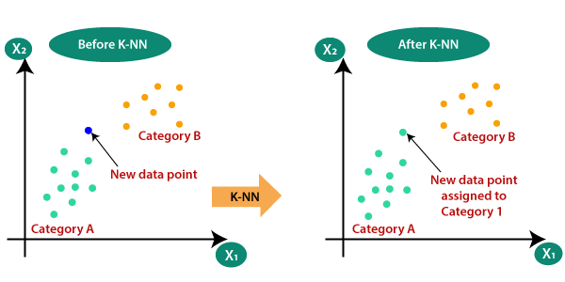
K-Nearest Neighbor (K-NN)
Example: Suppose, we have an image of a creature that looks similar to cat and dog, but we want to know either it is a cat or dog. So, for this identification, we can use the KNN algorithm, as it works on a similarity measure.
Our KNN model will find the similar features of the new data set to the cats and dogs' images and based on the most similar features it will put it in either cat or dog category.

Slide 8
How does K-NN Works?
The K-NN working can be explained on the basis of the below algorithm:
Step-1: Select the number K of the neighbors
Step-2: Calculate the Euclidean/ Manhattan distance of K number of neighbors
Step-3: Take the K nearest neighbors as per the calculated distance.
Step-4: Among these k neighbors, count the number of the data points in each category.
Step-5: Assign the new data points to that category for which the number of the neighbor is maximum.
Step-6: if Tie is there, so apply density weighted voting technique or nearest close point.

Slide 9
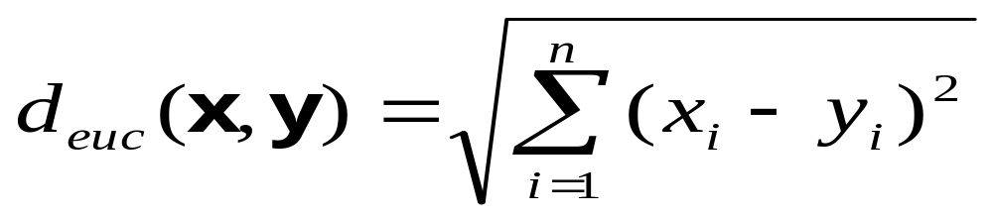
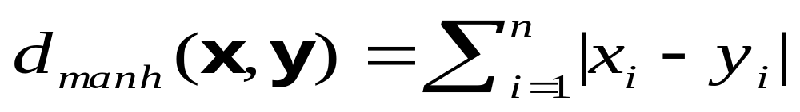
Closeness Measure
Euclidean Distance
Mahattan Distance

Slide 10
Handling Ties
1. Distance-Based Tie-Breaking
If multiple classes have the same number of nearest neighbors, you can break the tie by comparing the distances of the nearest points within the tied classes. The class with the closest neighbor wins the tie.
Example:
If Class A has neighbors at distances 2.1 and 2.3, and Class B has neighbors at distances 2.1 and 2.0, you would choose Class B since it has the closest point (distance = 2.0).

Slide 11

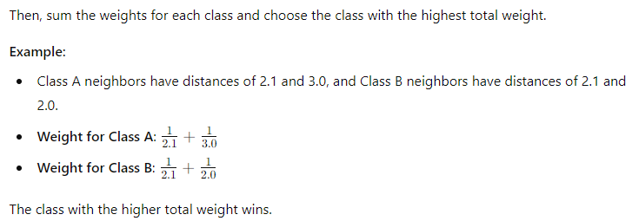
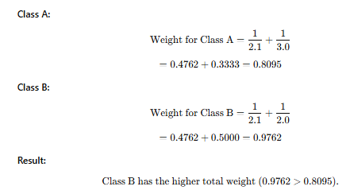
Handling Ties
2. Weighted Voting: Instead of simply counting the number of neighbors for each class, assign a weight to each neighbor based on its distance to the test point. Closer neighbors get more weight than farther ones. You can use inverse distance weighting, where the weight is calculated as the inverse of the distance:

Slide 12
How to Select the Value of K in K-NN Algorithm?
1. General Guidelines:
  K = 1, Very flexible (low bias, high variance) and Model captures noise easily (overfitting).
  Large K→ Smoother decision boundary (high bias, low variance). But too large may underfit.
  2. Practical Ways to Choose K
  (a) Square Root Rule (Quick Heuristic) ​ where N is the number of training samples.
  Example: If you have 400 samples → 𝐾=400=20
  (b) Odd K for Binary Classification: If you have 2 classes, use an odd value of K to avoid ties.
  Example: Instead of 𝐾=10, pick 𝐾=11
  (c) Cross-Validation (Best Practice): Try multiple K values (e.g., 1 to 30).
  Use k-fold cross-validation to test performance for each.
  Choose the K that gives the highest validation accuracy (or lowest error).
  (d) Domain Knowledge: If data has high noise, use larger K to smooth predictions.
  If data is well-separated, smaller K may work better.

Slide 13
Disadvantages of KNN
Disadvantages
Always needs to determine the value of K which may be complex some time.
The computation cost is high because of calculating the distance between the data points for all the training samples.
Prone to Overfitting due to curse of dimensionality

Slide 14
Applications of KNN
Handwritten Digit Recognition – used in postal services to automatically read zip codes (MNIST dataset example).
Medical Diagnosis – predicting diseases like diabetes or cancer based on patient data.
Credit Risk Analysis – classifying loan applicants as “safe” or “risky” in banking.
Recommender Systems – suggesting movies, products, or music by finding similar users/items.
Face Recognition – verifying or identifying people in security and social media applications.

Slide 15
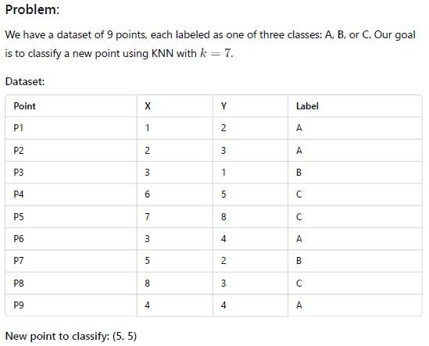

Slide 16
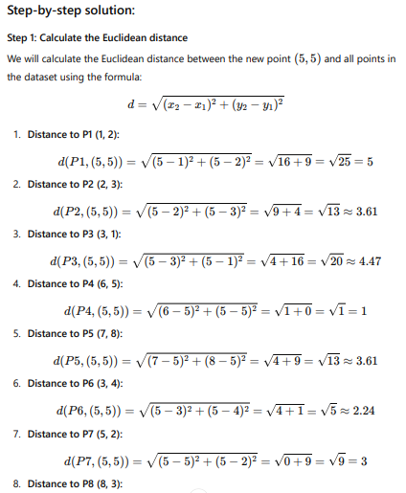
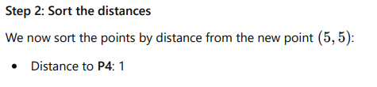
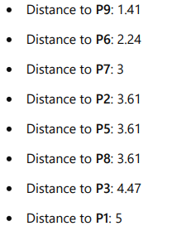

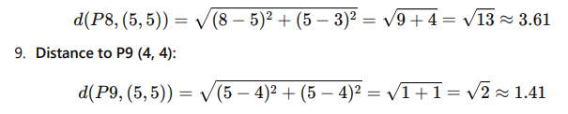

Slide 17
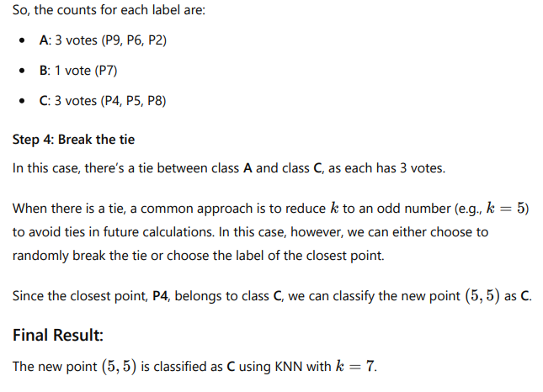
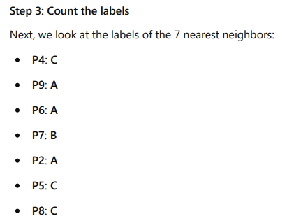

Slide 18
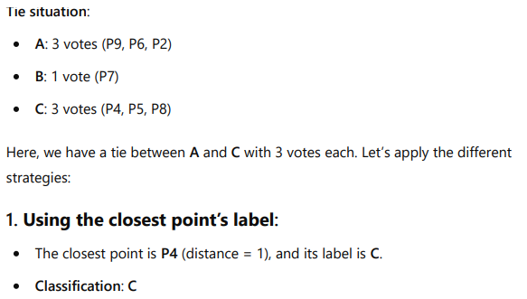
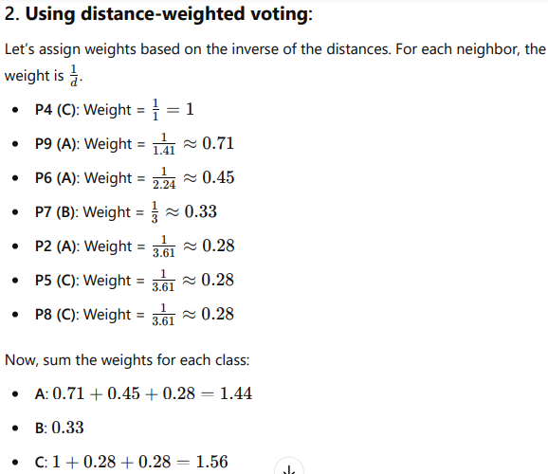
Result: Since class C has the highest total weight, we classify the new point as C.

Slide 19
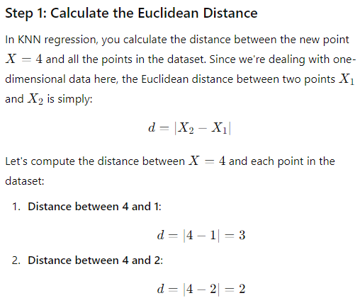
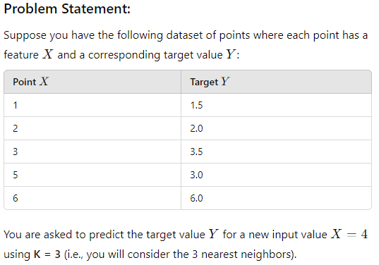
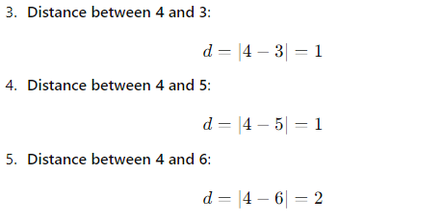

Numerical on KNN Regression
Manhattan Distance

Slide 20
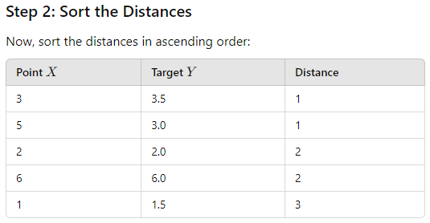
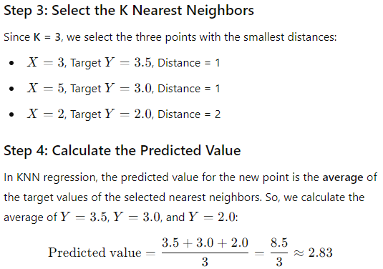
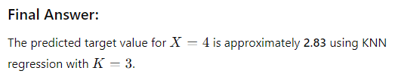
Numerical on KNN Regression
(contd..)

Slide 21
Numerical on KNN Regression
(contd..)

Slide 22
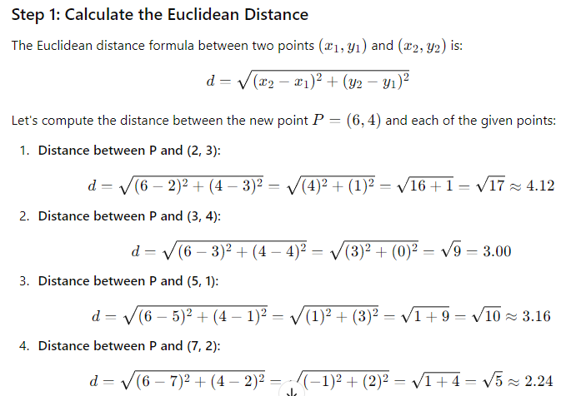
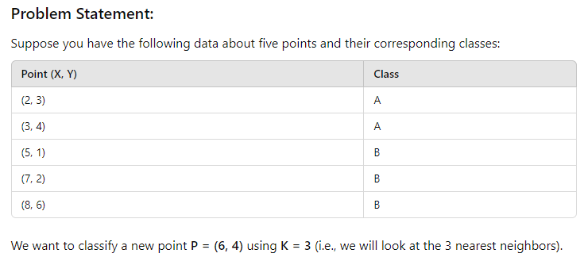
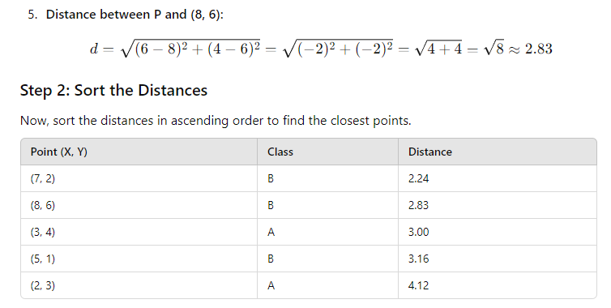
Numerical on KNN Classification

Slide 23
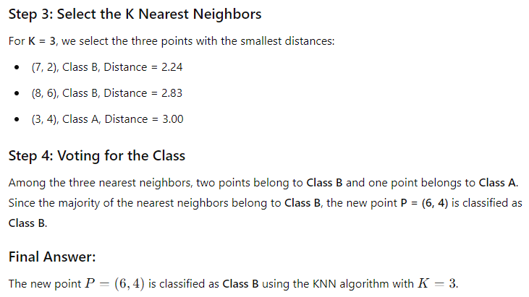
Numerical on KNN Classification (contd..)

