Slide 1

SUPPORT VECTOR MACHINE
(SVM)

Slide 2
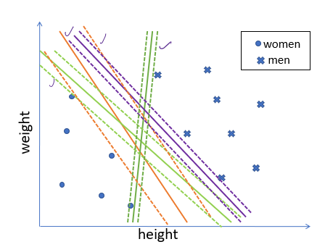
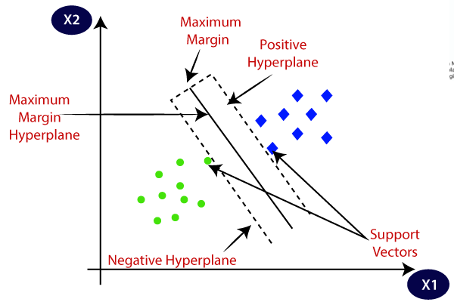
SUPPORT VECTOR MACHINE (SVM)
SVM is a SUPERVISED MACHINE LEARNING algorithm
It is used for Classification as well as Regression problems. However, primarily, it is used for Classification problems in Machine Learning.
The primary objective of the SVM algorithm is to identify the optimal hyperplane in an N-dimensional space that can effectively separate data points into different classes in the feature space.
The dimension of the hyperplane depends on the number of features. For instance, if there are two input features, the hyperplane is simply a line, and if there are three input features, the hyperplane becomes a 2-D plane.
As the number of features increases beyond three, the complexity of visualizing the hyperplane also increases.
The algorithm ensures that the margin between the closest points of different classes, known as support vectors, is maximized.

Slide 3
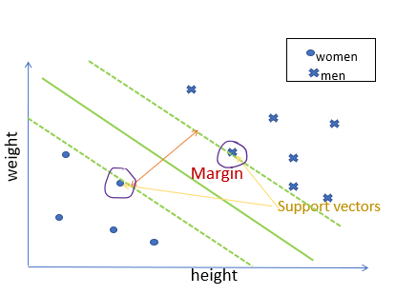
Margin and Optimal Hyperplane
women
men
Margin is the perpendicular distance between the closest data points and the hyperplane on both sides.
The best optimal line (hyperplane) with maximum margin is termed as Margin Maximal Hyperplane.
There will never be any datapoint inside the margin.
The closest point where the margin distance is calculated are considered called as Support Vectors.
Weight
Margin
Height

Slide 4
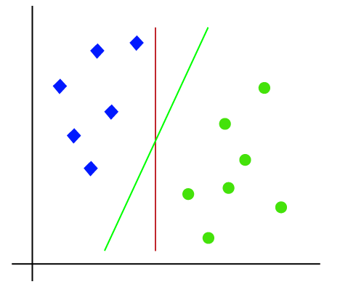
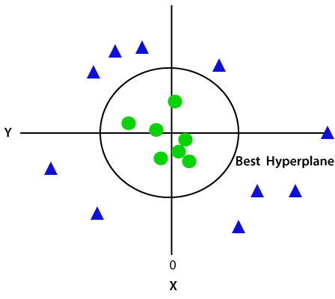
Types of SVM
Linear SVM:
Linear SVMs use a linear decision boundary to separate the data points of different classes.
This means that a single straight line (in 2D) or a hyperplane (in higher dimensions) can entirely divide the data points into their respective classes.
A hyperplane that maximizes the margin between the classes is the decision boundary.
Non-Linear SVM:
Non-Linear SVM can be used to classify data when it cannot be separated into two classes by a straight line (in the case of 2D).
By using kernel functions, nonlinear SVMs can handle nonlinearly separable data.
The original input data is transformed by these kernel functions into a higher-dimensional feature space, where the data points can be linearly separated.
A linear SVM is used to locate a nonlinear decision boundary in this modified space.

Slide 5
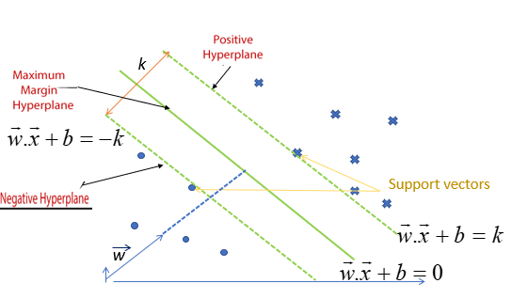



Mathematical Computation of SVM
Consider a binary classification problem with two classes, labeled as +1 and -1. We have a training dataset consisting of input feature vectors X and their corresponding class labels Y.
The equation for the linear hyperplane can be written as:
Where. the vector w represents the normal vector to the hyperplane, i.e., the direction perpendicular to the hyperplane. The parameter b in the equation represents the offset or distance of the hyperplane from the origin along the normal vector w.
The distance between a data point x_{i} and the decision boundary can be calculated as:
where ||w|| represents the Euclidean norm of the weight vector w. Euclidean norm of the normal vector w

Slide 6
SVM Terminologies
Hyperplane: The hyperplane is the decision boundary used to separate data points of different classes in a feature space. For linear classification, this is a linear equation represented as wx+b=0.
Support Vectors: Support vectors are the closest data points to the hyperplane. These points are critical in determining the hyperplane and the margin in Support Vector Machine (SVM).
Margin: The margin refers to the distance between the support vector and the hyperplane. The primary goal of the SVM algorithm is to maximize this margin, as a wider margin typically results in better classification performance.
Kernel: The kernel is a mathematical function used in SVM to map input data into a higher-dimensional feature space. This allows the SVM to find a hyperplane in cases where data points are not linearly separable in the original space. Common kernel functions include linear, polynomial, radial basis function (RBF), and sigmoid.
Hard Margin: A hard margin refers to the maximum-margin hyperplane that perfectly separates the data points of different classes without any misclassifications.
Soft Margin: When data contains outliers or is not perfectly separable, SVM uses the soft margin technique. This method introduces a slack variable for each data point to allow some misclassifications while balancing between maximizing the margin and minimizing violations.
C: The C parameter in SVM is a regularization term that balances margin maximization and the penalty for misclassifications. A higher C value imposes a stricter penalty for margin violations, leading to a smaller margin but fewer misclassifications.
Hinge Loss: The hinge loss is a common loss function in SVMs. It penalizes misclassified points or margin violations and is often combined with a regularization term in the objective function.
Dual Problem: The dual problem in SVM involves solving for the Lagrange multipliers associated with the support vectors. This formulation allows for the use of the kernel trick and facilitates more efficient computation.

Slide 7
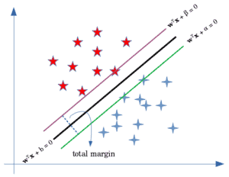
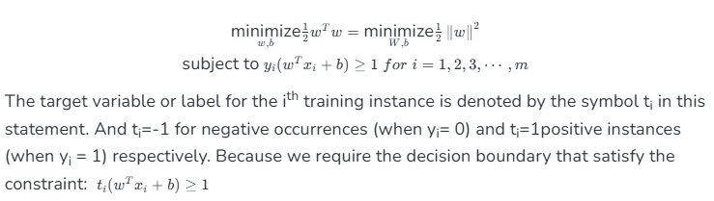
Optimization in SVM
For Hard margin linear SVM classifier:

Slide 8
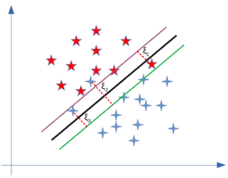

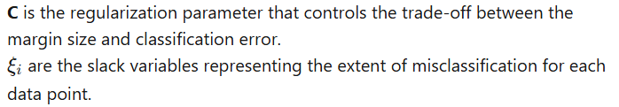
Optimization in SVM
For Soft margin linear SVM classifier:

Slide 9
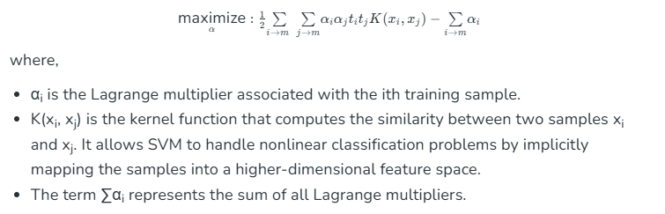

Optimization in SVM
For Dual Problem: A dual Problem of the optimization problem that requires locating the Lagrange multipliers related to the support vectors can be used to solve SVM. The optimal Lagrange multipliers α(i) that maximize the following dual objective function
The SVM decision boundary can be described in terms of these optimal Lagrange multipliers and the support vectors once the dual issue has been solved and the optimal Lagrange multipliers have been discovered. The training samples that have i > 0 are the support vectors, while the decision boundary is supplied by:

Slide 10
Kernel Functions

Slide 11
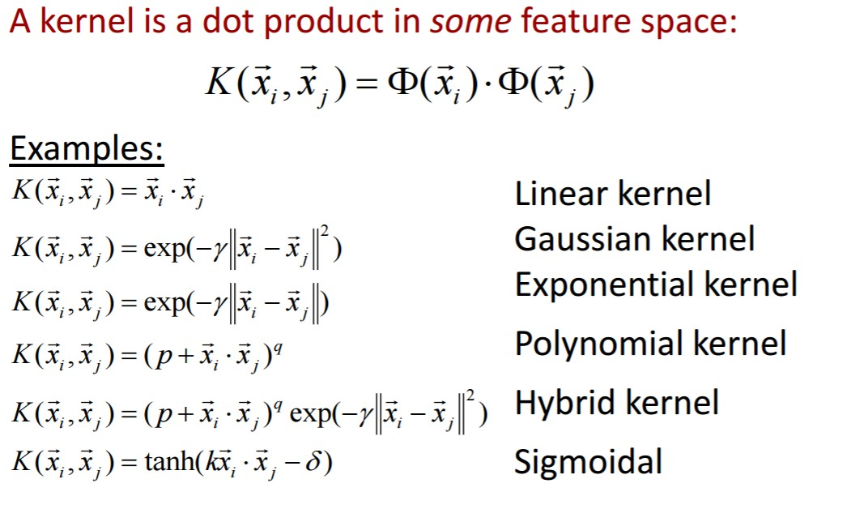
TYPES OF KERNELS
Linear Kernel
Polynomial Kernel
Radial Basis Function (RBF) Kernel
Exponential Kernel
Hybrid Kernel
Sigmoidal Kernel
Multiquadric Kernel

Slide 12

TYPES OF KERNELS
Linear Kernel
Mathematical Form:
Where x and y are input vectors.
Interpretation: The linear kernel is the simplest and corresponds to no transformation of the data, i.e., it works in the original input space. The kernel computes the dot product between two vectors, which is a measure of their similarity.
Use Case:
  Suitable for linearly separable data (data that can be separated by a straight line or hyperplane).
  Often used when the relationship between input features is approximately linear.
Advantages:
  Computationally efficient (fast).
  Requires less memory.
Disadvantages:
  Limited to problems where the data is linearly separable. It won’t perform well if the relationship is complex or non-linear.

Slide 13

TYPES OF KERNELS
2. Polynomial Kernel
Mathematical Form:
Where 𝑑 is the degree of the polynomial and c is a constant (typically set to 0 or a small positive value).
Interpretation: The polynomial kernel maps the data into a higher-dimensional space where it is more likely to be linearly separable. By raising the dot product of the vectors to a power 𝑑, it can capture non-linear relationships between the data points.
Use Case:
  Effective for datasets with non-linear relationships, especially when the degree of non-linearity is moderate.
  Suitable when the decision boundary is polynomial or curve-like.
Advantages:
  Can capture more complex relationships compared to the linear kernel.
  Flexibility in controlling the degree of the polynomial to model different types of non-linearity.
Disadvantages:
  The computational complexity increases with higher degrees of the polynomial.
  The degree of the polynomial must be chosen carefully to avoid overfitting or underfitting.
  Can be sensitive to the choice of 𝑐c and 𝑑d, requiring tuning

Slide 14

TYPES OF KERNELS
2. Radial Basis Function (RBF) Kernel (Gaussian Kernel)
Mathematical Form:
Where ∥x−y∥ is the Euclidean distance between 𝑥 and 𝑦, and 𝜎 is a parameter that controls the width of the kernel.
Interpretation: The RBF kernel, also known as the Gaussian kernel, measures the similarity between two data points based on their distance in the input space. It is highly effective in capturing complex, non-linear patterns in the data.
Use Case:
  Often the default choice for SVMs, especially when the data is not linearly separable and has complex relationships.
  Suitable for most types of non-linear data, where no prior knowledge about the form of the relationship is available.
Advantages:
  Very flexible and powerful for non-linear problems, as it can map data into an infinite-dimensional feature space.
  Performs well even if the decision boundary is highly complex or non-linear.
Disadvantages:
  Computationally expensive, especially for large datasets.
  Sensitive to the choice of the parameter 𝜎σ. A poor choice of 𝜎σ can lead to overfitting or underfitting.
  Requires careful tuning of parameters like 𝜎σ and the regularization parameter to achieve optimal performance.

Slide 15
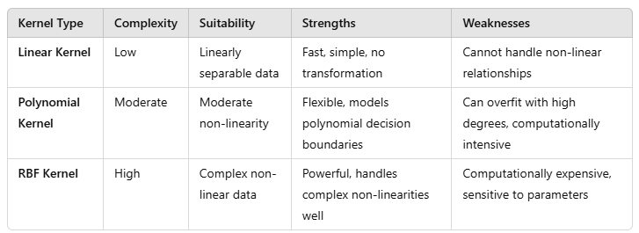
Linear Vs Polynomial Vs RBF (IMP)

Slide 16
Example
A mobile application company seeks to enhance its spam detection algorithm for texts transmitted via its chat service. Scientists utilize a Support Vector Machine (SVM) classifier to classify communications as "spam" or "not spam" based on attributes such as message length, word frequency, and the occurrence of specific keywords. Nevertheless, the existing model encounters difficulties with complex structure, since certain spam communications have begun employing casual language or imitating prevalent words to circumvent detection.
Q. In what ways might each kernel transform the data to facilitate the detection of spam messages in this context?

Slide 17
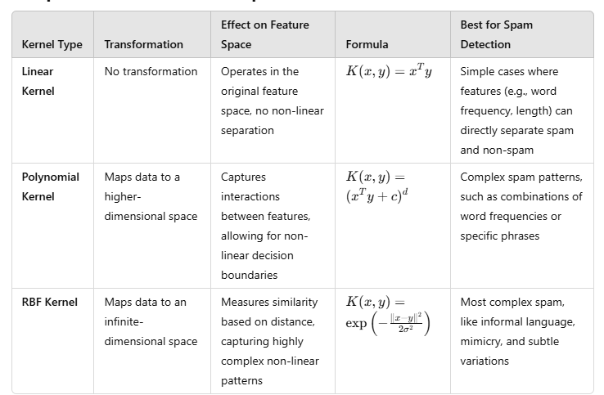
Solution (IMP)
Conclusion:
For the given spam detection problem, the RBF kernel would likely be the most powerful and adaptable option, as it can detect complex, non-linear relationships in the data, which are common when spam messages evolve to evade detection.
However, if computational efficiency is a priority, or if the spam behavior is relatively simple, the linear or polynomial kernels might still be viable, depending on the specific patterns in the data.

Slide 18
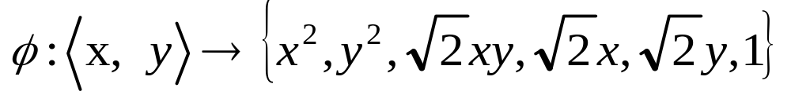
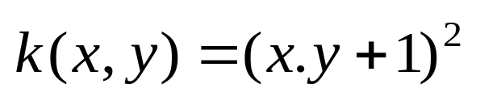
Examples of Kernel
Assume we have input vectors x and y, we use the kernel mapping:
Consider the function:
Then :
Φ(x)^{t} .Φ(y)^{t} = x₁² y₁² + x₂² y₂² + 2 x₁x₂y₁y₂ + 2 x₁y₁ + 2 x₂y₂ +1
= (x₁ y₁ + x₂y₂ + 1)²
= (x.y + 1)²
= K(x,y)

Slide 19
Thank you

