Slide 1

Artificial Intelligence and Machine Learning
Module -5
Computer Vision

Slide 2
Reinforcement Learning
Reinforcement learning is a feedback-based learning method, in which a learning agent gets a reward for each right action and gets a penalty for each wrong action.
The agent learns automatically from feedbacks and improves its performance. In reinforcement learning, the agent interacts with the environment and explores it.
The goal of an agent is to get the most reward points, and hence, it improves its performance.
The robotic dog, which automatically learns the movement of his arms, is an example of Reinforcement learning.

Slide 3


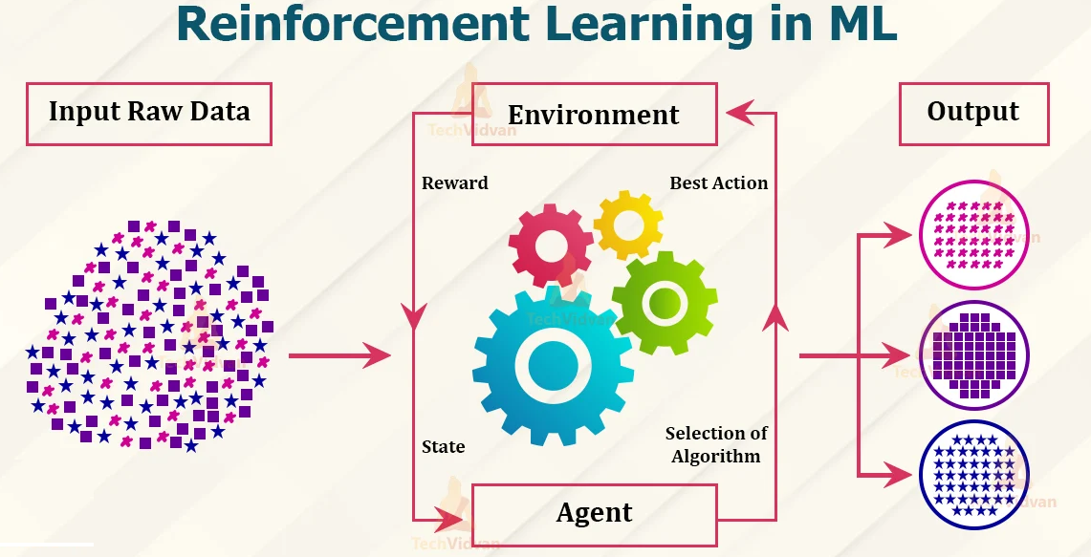


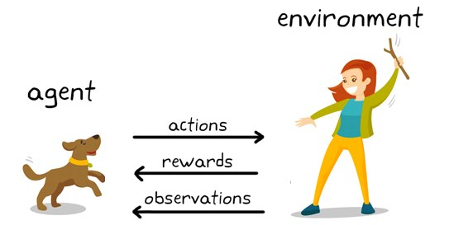

Reinforcement Learning in ML

Slide 4
Tuples of Reinforcement Learning
Agent:- The decision-maker in the system.
  Example: A self-driving car, a robot, or an AI player in a game.
Environment:- The world in which the agent operates.
Example: Roads for a self-driving car or a chessboard for a chess-playing AI.
State (S):- Represents the current situation of the environment.
  Example: The position of a car on the road or the arrangement of pieces on a chessboard.
Action (A):- The decision or move the agent can make at any state.
  Example: Speed up, slow down, turn left for a car; move a pawn or queen in chess.
Reward (R):- Feedback the agent receives after taking an action.
  Example: Positive reward for avoiding a collision; negative reward for hitting an obstacle
Policy (π):- The strategy or mapping the agent uses to decide actions based on the state.
  Example: : If traffic is heavy, slow down.
Value Function (V):- Predicts the expected long-term reward for a given state.
  Example: Estimating the benefits of a particular position on the chessboard.
Q-Value or Action-Value (Q(s,a)):- Predicts the expected reward for taking a specific action in a given state.

Slide 5
Computer Vision
Computer Vision (CV) is a field of Artificial Intelligence (AI) that enables computers and systems to analyze, interpret, and understand visual information from the world — such as images, videos, or live camera feeds — in the same way humans use their eyes and brain to perceive their surroundings.
It uses machine learning and deep learning techniques to automatically extract features, detect objects, recognize faces, read text, and make decisions based on visual input.
In simple terms: Computer Vision helps computers “see” and “understand” what’s inside an image or video.

Slide 6
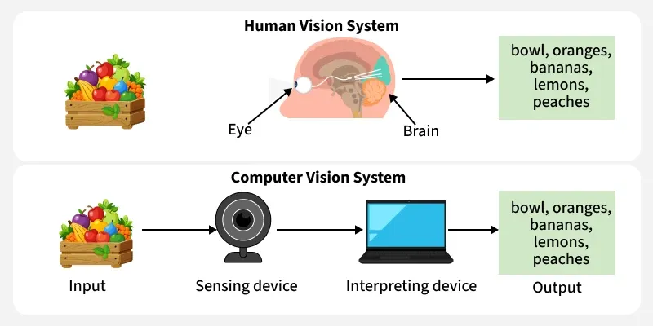
How Does Computer Vision Work?
Computer Vision works much like the human eye and brain. First, our eyes capture the image and send the visual data to our brain. The brain then processes this information and transforms it into a meaningful interpretation, recognizing and categorizing the object based on its properties.
In a similar way, Computer Vision uses a camera (acting like the human eye) to capture images. The visual data is then processed by algorithms to recognize and identify the objects based on patterns it has learned. However, before the system can recognize objects in new images, it needs to be trained on a large dataset of labeled images. This training enables the system to identify and associate various patterns with their corresponding labels.
For example, imagine providing a computer with thousands of bird song recordings. The system learns by analyzing features like pitch, rhythm and duration. Once trained, it can then recognize whether a new sound resembles a bird song or not.

Slide 7
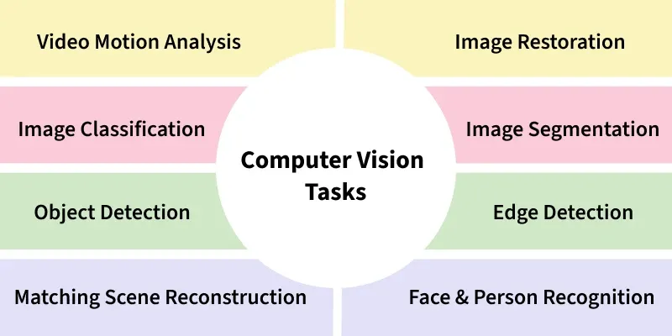

Slide 8
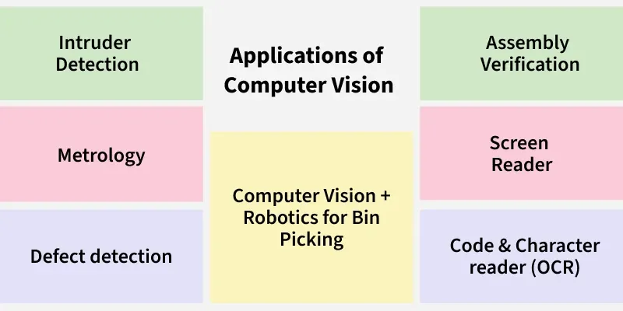

Slide 9
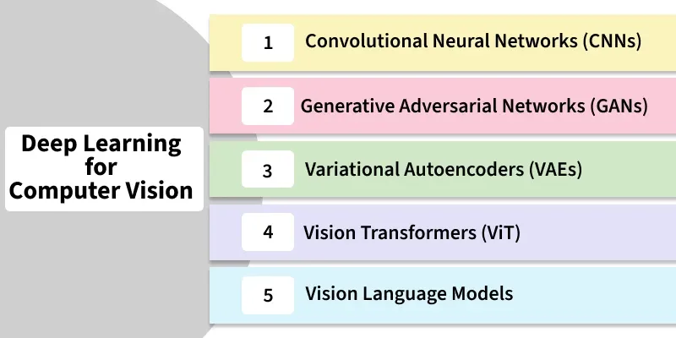

Slide 10
Popular Libraries for Computer Vision
To implement computer vision tasks effectively, various libraries are used:
OpenCV: Mostly used open-source library for computer vision tasks like image processing, video capture and real-time applications.
TensorFlow: A popular deep learning framework that includes tools for building and training computer vision models.
PyTorch: Another deep learning library that provides great flexibility for computer vision tasks for research and development.
scikit-image: A part of the scikit-learn ecosystem, this library provides algorithms for image processing and computer vision.

Slide 11
Need for Computer Vision
High Demand in the Job Market: Critical for careers in AI, machine learning and data science across industries like healthcare, automotive and robotics.
Revolutionizing Industries: Powers advancements in self-driving cars, medical diagnostics, agriculture and manufacturing by automating visual tasks.
Solving Real-World Problems: Enhances safety, improves medical imaging and optimizes industrial processes.
Improving Accessibility: It helps people with disabilities through image recognition and sign language translation.
Enhancing Consumer Experiences: It personalizes shopping and improves customer service in retail and entertainment.

Slide 12
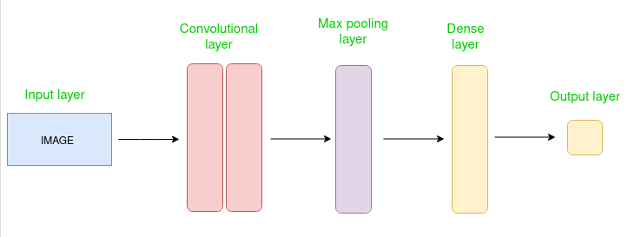
Convolution Neural Networks
Convolutional Neural Network (CNN) is an advanced version of artificial neural networks (ANNs), primarily designed to extract features from grid-like matrix datasets.
This is particularly useful for visual datasets such as images or videos, where data patterns play a crucial role.
CNNs are widely used in computer vision applications due to their effectiveness in processing visual data.
CNNs consist of multiple layers like the input layer, Convolutional layer, pooling layer, and fully connected layers.

Slide 13
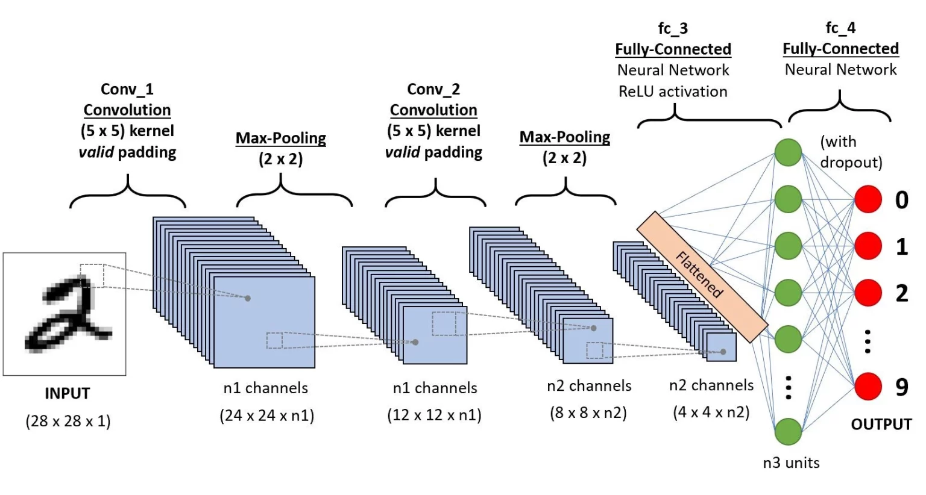
Working of CNN
Input Image: CNN receives an input image which is preprocessed to ensure uniformity in size and format.
Convolutional Layers: Filters are applied to the input image to extract features like edges, textures and shapes.
Pooling Layers: The feature maps generated by the convolutional layers are down sampled to reduce dimensionality.
Fully Connected Layers: The down sampled feature maps are passed through fully connected layers to produce the final output, such as a classification label.
Output: The CNN outputs a prediction, such as the class of the image.

Slide 14
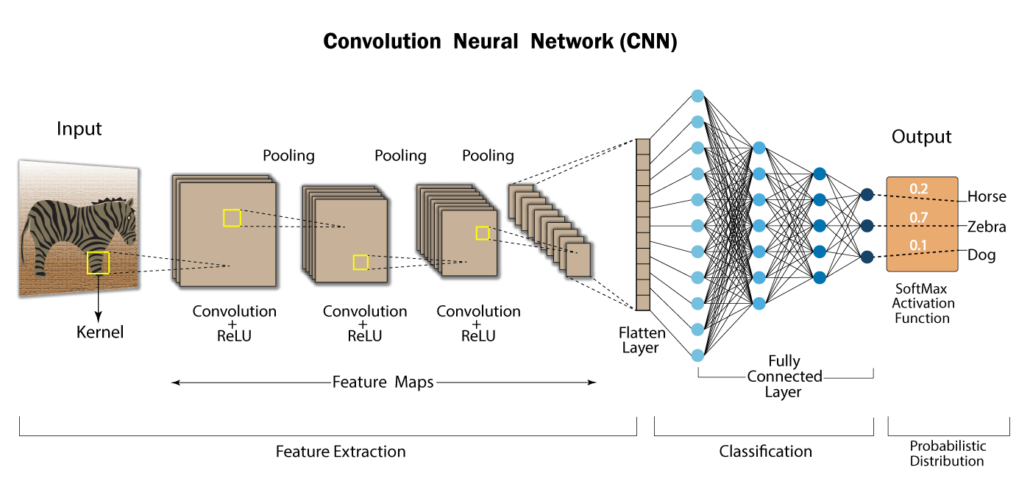
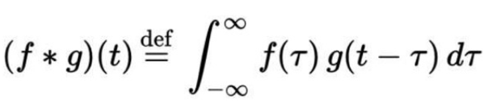
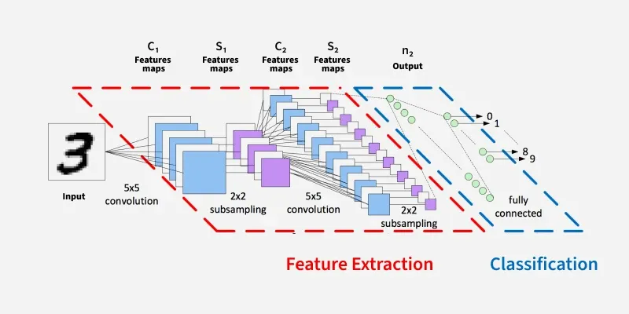
Working of CNN
Convolution is the process involving combination of two functions that produces the other function as a result.
In CNN’s, the input image is subjected to convolution with use of filters that produces a Feature map.

Slide 15
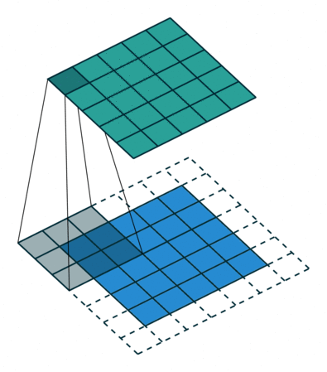
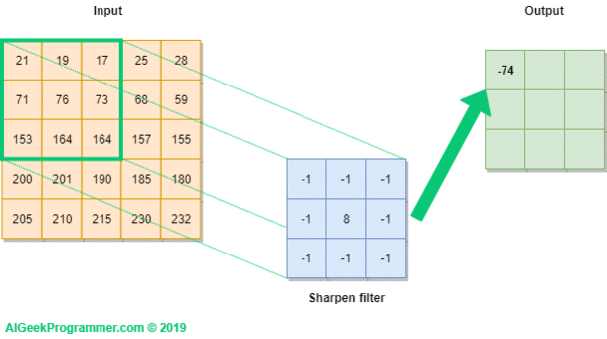
Step By Step Explanation of CNN
Function: Extract features from the input image by applying convolution operations using filters (Kernels)
Mechanism
Filter/Kernels: Small matrices (5x5 or 3x3) that slides over the input image as shown in Fig. 1
Convolution Operation: Each filter convolves (slides) over the input image, computing the dot product between the filter and the input patch. This generates a feature map

Slide 16
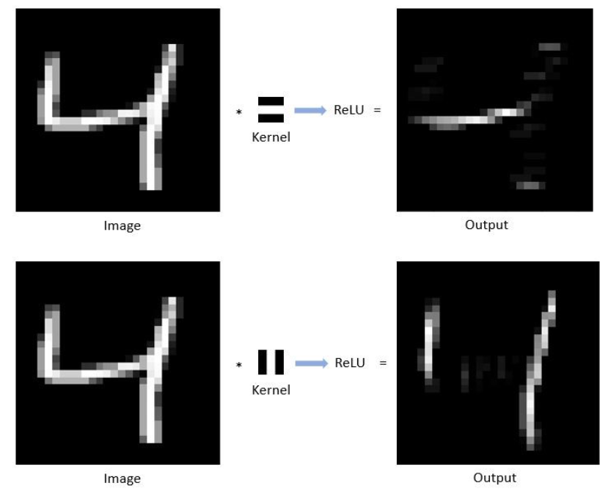
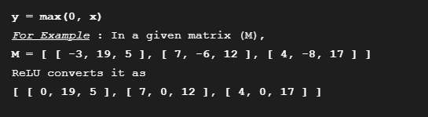
Step By Step Explanation of CNN
ReLU Layer (Rectified Linear Unit)
ReLU is computed after convolution.
It is most deployed activation function that allows the neural network to account for non-linear relationships.
In a given matrix (x), ReLU sets all negative values to zero and all other values remains constant.
It is mathematically represented as :

Slide 17
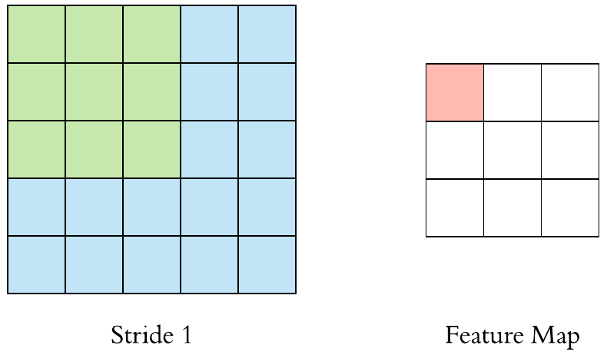
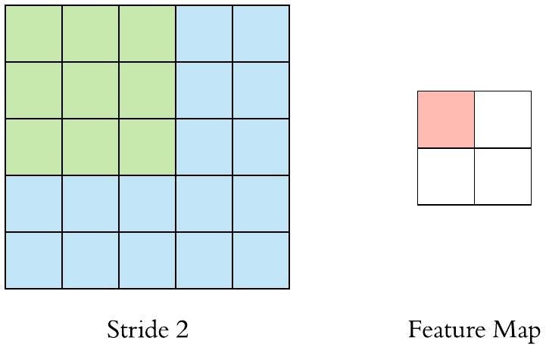
Step By Step Explanation of CNN
Padding and Stride influence how convolution operation is performed.
Padding and stride can be used to alter the dimensions(height and width) of input/output vectors either by increasing or decreasing.
Stride
It controls how filter convolves over input, i.e., the number of pixels shifts over the input matrix.
If stride is set to 1, filter moves across 1 pixel at a time and if stride is 2, filter moves 2 pixels at a time.
More the value of stride, smaller will be the resulting output and vice versa.

Slide 18
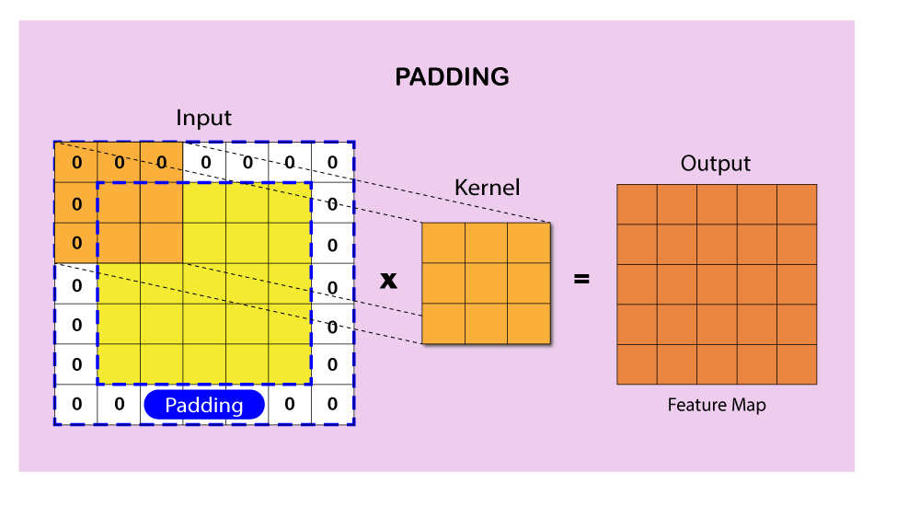
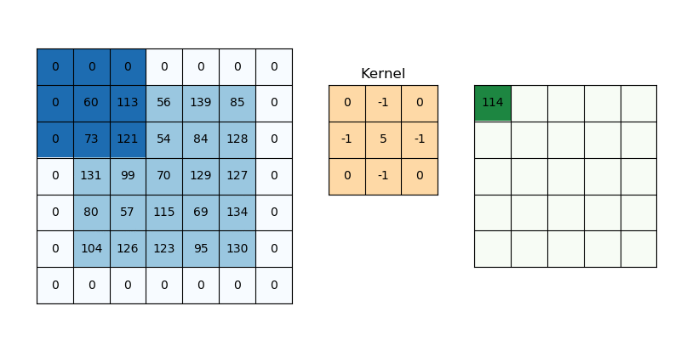
Step By Step Explanation of CNN
Padding
It is used to make dimension of output equal to input by adding zeros to the input frame of matrix.
Padding allows more spaces for kernel to cover image and is accurate for analysis of images.
Due to padding, information on the borders of images are also preserved similarly as at the center of image.

Slide 19
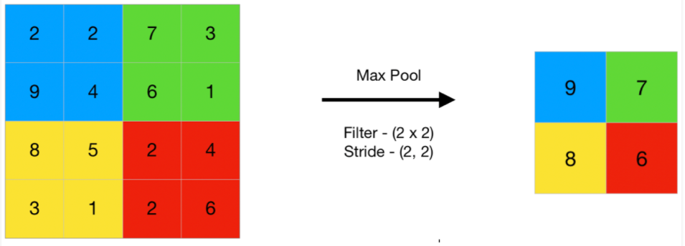
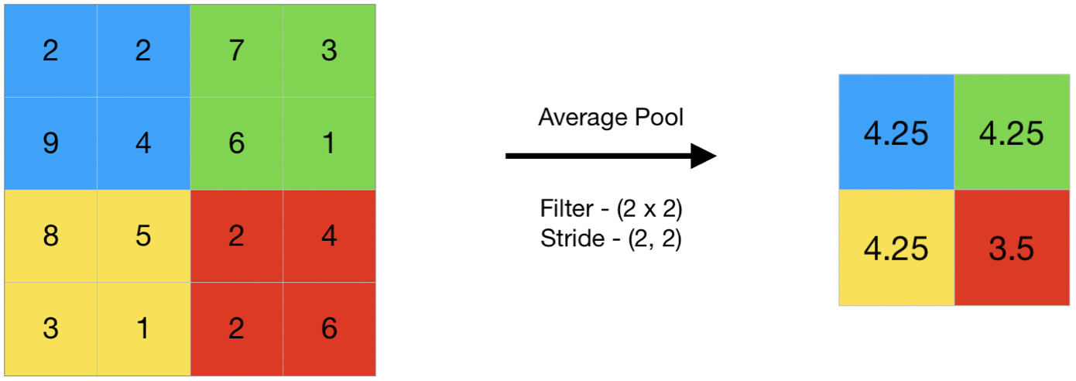
Step By Step Explanation of CNN
Pooling: Pooling layer operates on each feature map independently.
This reduces resolution of the feature map by reducing height and width of features maps but retains features of the map required for classification.
This is called Down-sampling.
Pooling can be done in following ways :
Max-pooling: It selects maximum element from the feature map. The resulting max-pooled layer holds important features of feature map. It is the most common approach as it gives better results.
Average pooling: It involves average calculation for each patch of the feature map.
Why pooling is important ?
It progressively reduces the spatial size of representation to reduce number of parameters and computation in network and also controls overfitting. If no pooling, then the output consists of same resolution as input.

Slide 20
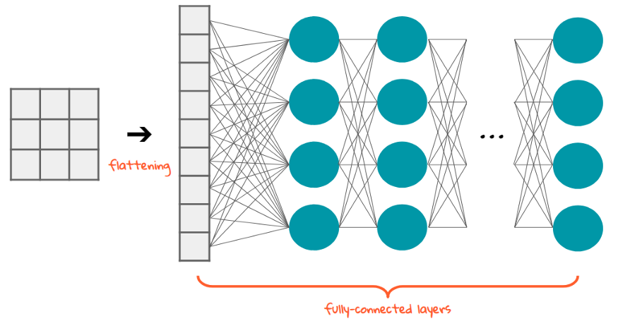
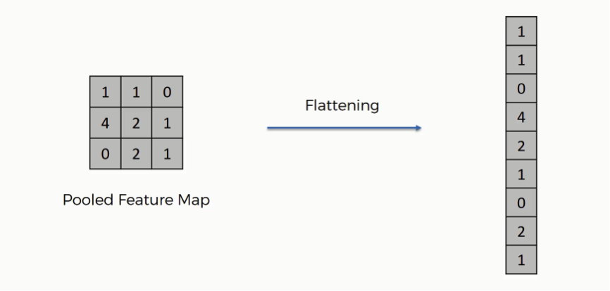
Step By Step Explanation of CNN
Flattening
It is the process of converting the output feature map (matrix) obtained from pooling into a vector (one dimensional array).
This transformation is necessary to feed the data into a fully connected layer, which requires a 1D input to perform classification or other predictions.
Without flattening, the multidimensional feature maps would not be compatible with the dense layers.

Slide 21
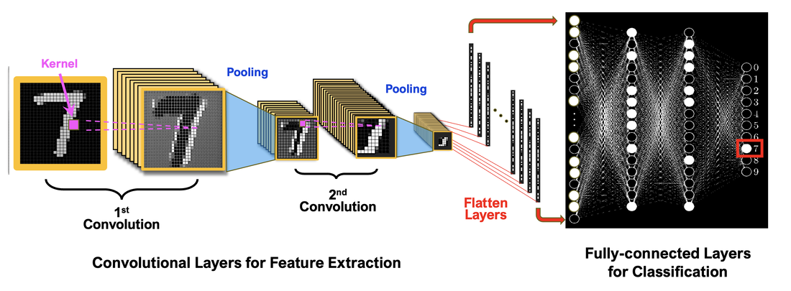
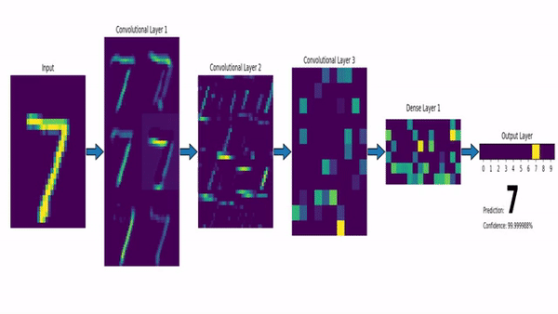
Step By Step Explanation of CNN
Fully Connected Layer: Fully connected layer looks like a regular neural network connecting all neurons and forms the last few layers in the network.
The output from flatten layer is fed to this fully-connected layer.
The feature vector from fully connected layer is further used to classify images between different categories after training.
All the inputs from this layer are connected to every activation unit of the next layer.
Since all the parameters are occupied into fully-connected layer, it causes overfitting.
Dropout is one of the techniques that reduces overfitting.

Slide 22
How to Evaluate CNN Models
Efficiency of CNN can be evaluated using a variety of criteria. Among the most popular metrics are:
Accuracy: Accuracy is the percentage of test images that the CNN correctly classifies.
Precision: Precision is the percentage of test images that the CNN predicts as a particular class and that are actually of that class.
Recall: Recall is the percentage of test images that are of a particular class and that the CNN predicts as that class.
F1 Score: The F1 Score is a harmonic mean of precision and recall. It is a good metric for evaluating the performance of a CNN on classes that are imbalanced.

Slide 23
Applications
Image classification: CNNs are the state-of-the-art models for image classification. They can be used to classify images into different categories such as cats and dogs.
Object detection: It can be used to detect objects in images such as people, cars and buildings. They can also be used to localize objects in images which means that they can identify the location of an object in an image.
Image segmentation: It can be used to segment images which means that they can identify and label different objects in an image. This is useful for applications such as medical imaging and robotics.
Video analysis: It can be used to analyze videos such as tracking objects in a video or detecting events in a video. This is useful for applications such as video surveillance and traffic monitoring.

Slide 24
Advantages and Disadvantages
Advantages
High Accuracy: They can achieve high accuracy in various image recognition tasks.
Efficiency: They are efficient, especially when implemented on GPUs.
Robustness: They are robust to noise and variations in input data.
Adaptability: It can be adapted to different tasks by modifying their architecture
Disadvantages
Complexity: It can be complex and difficult to train, especially for large datasets.
Resource-Intensive: It require significant computational resources for training and deployment.
Data Requirements: They need large amounts of labeled data for training.
Interpretability: They can be difficult to interpret making it challenging to understand their predictions.

Slide 25
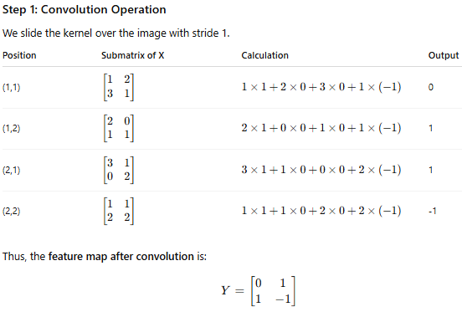
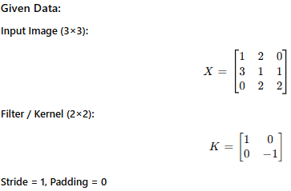
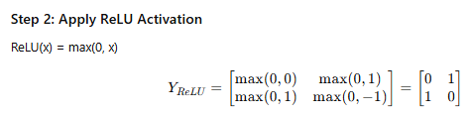
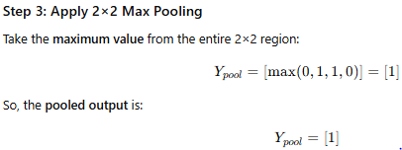

Numerical CNN
Consider a small grayscale image and a single 2×2 filter. Perform convolution, apply ReLU activation, and then apply a 2×2 max pooling operation. Finally, provide the flattened feature vector.

Slide 26

Formula for Output Size in CNN
The formula to calculate the output size (height and width) of a Convolutional Neural Network (CNN) layer is:
where:
O = Output size (height or width)
I = Input size (height or width)
K = Kernel (filter) size
P = Padding
S = Stride

Slide 27
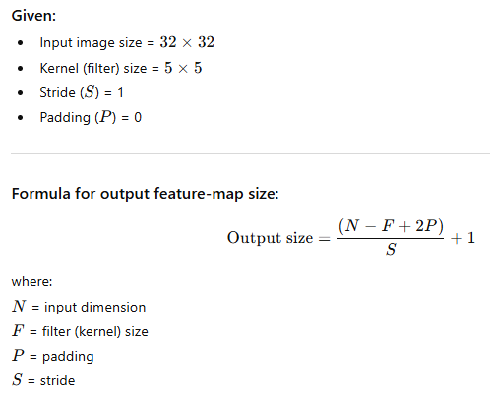
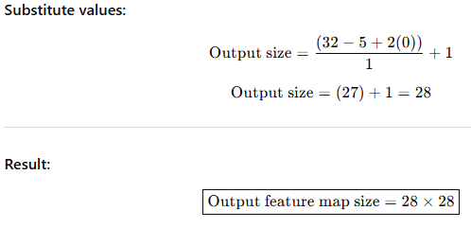
Numerical CNN
A Convolutional Neural Network (CNN) processes a 32 × 32 image using a 5 × 5 kernel, stride = 1, and no padding. Calculate the output feature-map size after this convolution layer.

Slide 28
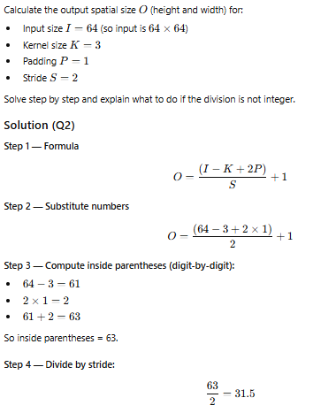


Numerical CNN
Note: The theoretical formula produced 32.5. In practice the output size must be an integer. Most deep-learning libraries expect the value (I−K+2P) to be divisible by S. If it isn’t, implementations either (a) floor the value, (b) raise an error, or (c) you should choose padding/stride, so it divides evenly.
Common convention: take the floor (i.e., integer division) unless a framework specifies otherwise.

Slide 29
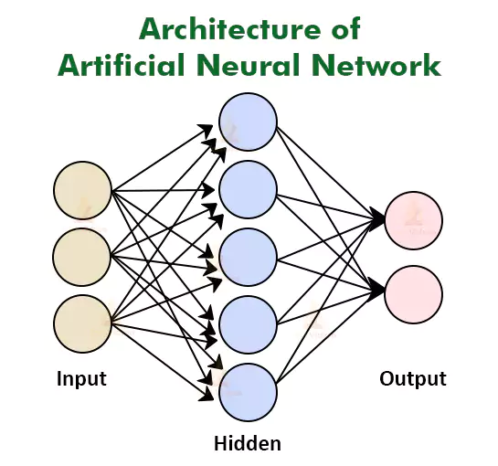
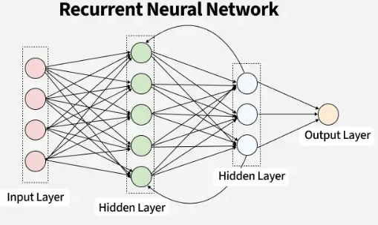
Recurrent Neural Networks (RNNs)
In modern machine learning, understanding sequential and time-dependent data is critical.
Many real-world processes unfold over time, i.e., speech, text, sensor readings, weather conditions, or financial trends —all consist of sequences of information rather than independent data points.
Traditional feedforward neural networks process inputs in isolation. They have no concept of order or memory, which makes them inadequate for tasks where the context of previous inputs affects the current prediction.
To overcome this limitation, Recurrent Neural Networks (RNNs) were developed.
RNNs are a special class of artificial neural networks designed to model temporal or sequential dependencies. They introduce the idea of recurrent connections — feedback loops that allow information to persist over time.
This makes RNNs extremely powerful for time-series prediction, speech recognition, language modeling, and video analysis etc.

Slide 30
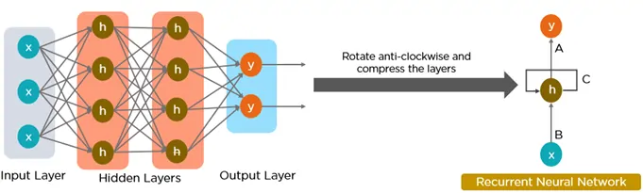
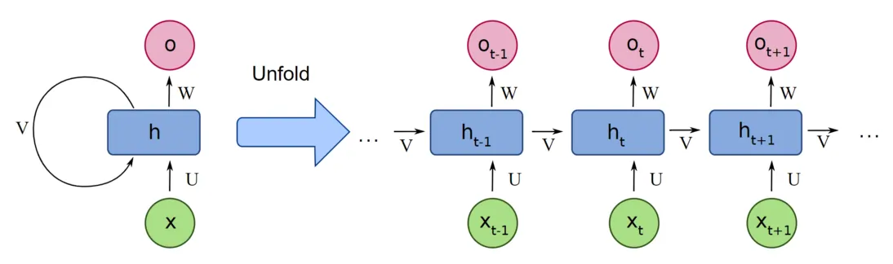
Recurrent Neural Networks
RNNs are a type of neural network that can model sequence data.
RNNs, which are formed from feedforward networks, are similar to human brains in their behaviour.
The most important component of RNN is the hidden state, which remembers specific information about a sequence.
Used memory to stores all information about the calculations.
They employ the same settings for each input since they produce the same outcome by performing the same task on all inputs or hidden layers.

Slide 31
Difference between FNN and RNN
Feature | Feed-forward Neural Network (FNN) | Recurrent Neural Network (RNN)
Data Flow | Straight through (no loops) | Loops through time (with memory)
Memory | No memory of past inputs | Maintains memory via hidden states
Input Assumption | Inputs are independent | Inputs are sequentially dependent
Architecture | Static layers, no time dimension | Unfolds across time steps
Training | Standard backpropagation | Backpropagation Through Time (BPTT)

Slide 32
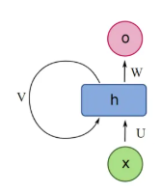
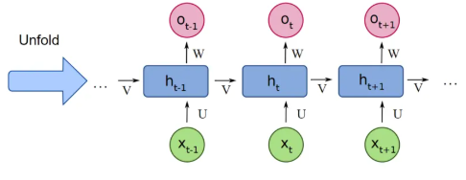
Key Components of RNN
There are mainly two components of RNNs that we will discuss.
1. Recurrent Neurons
The fundamental processing unit in RNN is a Recurrent Unit.
They hold a hidden state that maintains information about previous inputs in a sequence.
Recurrent units can "remember" information from prior steps by feeding back their hidden state, allowing them to capture dependencies across time.
2. RNN Unfolding
RNN unfolding or unrolling is the process of expanding the recurrent structure over time steps.
During unfolding each step of the sequence is represented as a separate layer in a series illustrating how information flows across each time step.
This unrolling enables backpropagation through time (BPTT) a learning process where errors are propagated across time steps to adjust the network’s weights enhancing the RNN’s ability to learn dependencies within sequential data.
Recurrent Neurons
RNN Unfolding

Slide 33
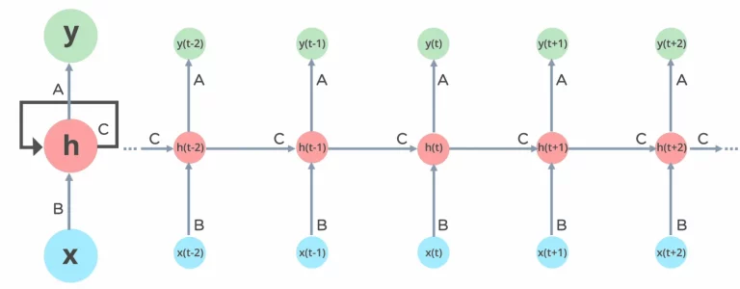
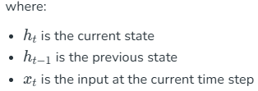

How RNN Works?
The input layer x receives and processes the neural network’s input before passing it on to the middle layer.
In the middle layer h, multiple hidden layers can be found, each with its activation functions, weights, and biases.
There’s a single hidden layer that repeats over time steps.
The same weights are used across all steps.
The hidden state is updated recursively using the current input and the previous hidden state which is calculated as follows:

Slide 34

How RNN Works?
The recurrent neural network will standardize the different activation functions, weights, and biases, ensuring that each hidden layer has the same characteristics. Rather than constructing numerous hidden layers, it will create only one loop over it as many times as necessary.
Activation Function Application:
Here, Whh​​ is the weight matrix for the recurrent neuron and Wxh​​ is the weight matrix for the input neuron.
Output Calculation:
where yt is the output and Why is the weight at the output layer.

Slide 35
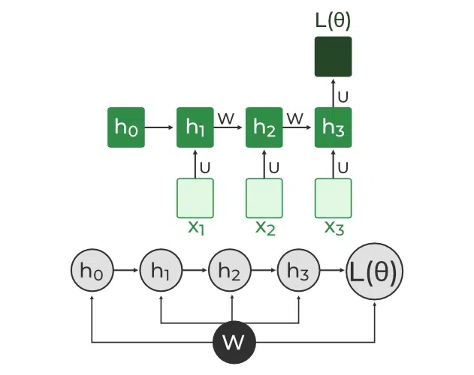
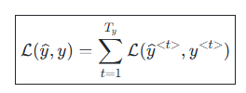
Loss Function of RNN
The loss function L(θ) depends on the final hidden state h3,​ and each hidden state relies on preceding ones forming a sequential dependency chain:
h3​ depends on depends on h2, h2 depends on h1,……, h1 depends on h0.
Loss function: In the case of a recurrent neural network, the loss function L of all time steps is defined based on the loss at every time step as follows:

Slide 36

Backpropagation Through Time (BPTT)
Backpropagation Through Time (BPTT) is a technique which is used to train the RNN.
It extends traditional backpropagation to sequential data by unfolding the network over time and summing gradients across all relevant time steps.
This method enables RNNs to learn complex temporal patterns.
In simple words in BPTT instead of updating weights based only on the current timestep t, all previous timesteps : t−1,t−2,t−3,…t−1,t−2,t−3,…are also considered.
In BPTT, gradients are backpropagated through each time step. This is essential for updating network parameters based on temporal dependencies.
1. Simplified Gradient Calculation:

Slide 37



Backpropagation Through Time (BPTT)
2. Handling Dependencies in Layers: Each hidden state is updated based on its dependencies:
3. Gradient Calculation with Explicit and Implicit Parts: The gradient is broken down into explicit and implicit parts summing up the indirect paths from each hidden state to the weights.
4. Final Gradient Expression: The final derivative of the loss function with respect to the weight matrix W is computed:
This iterative process is the essence of backpropagation through time.

Slide 38
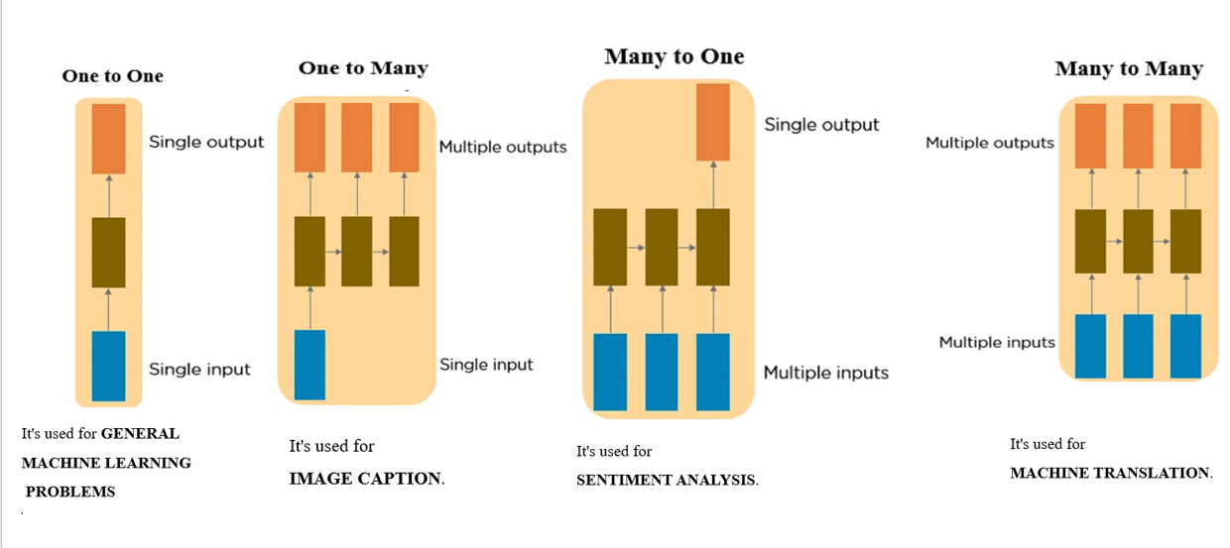
Types of Recurrent Neural Networks

Slide 39
Comparison between Standard Backpropagation and BPTT
Aspect | Standard Backpropagation | Backpropagation Through Time (BPTT)
Used In | Feedforward Neural Networks | Recurrent Neural Networks
Data Type | Static input-output data | Sequential or time-dependent data
Computation | Backpropagates error through layers once | Backpropagates error through layers and time steps
Weight Usage | Separate weights for each layer | Same weights shared across all time steps
Complexity | Lower computation and memory cost | Higher due to unfolding over time
Common Issue | Overfitting or local minima | Vanishing or exploding gradients

Slide 40
RNN ADVANTAGES
Sequential Data Handling: RNNs are designed to process sequential data where the order of inputs matters, such as text, speech, or time series.
Memory of Past Information: They have an internal hidden state that remembers past inputs, helping in learning time-based relationships.
Contextual Understanding: RNNs use past context to interpret current inputs, making them effective for tasks like language understanding.
Parameter Sharing: The same weights are used across all time steps, reducing parameters and improving learning consistency.
Flexible Input and Output Lengths: RNNs can handle variable-length sequences, unlike traditional networks that need fixed-size inputs.
Basis for Advanced Models: They form the foundation for advanced architectures like LSTM and GRU that handle long-term dependencies better.

Slide 41
RNN DISADVANTAGES
Vanishing and Exploding Gradients: During training, gradients can diminish or grow exponentially, making it difficult to learn long-term dependencies.
Limited Long-Term Memory: Standard RNNs struggle to retain information over long sequences.
Sequential Computation: Unlike CNNs, RNNs process one step at a time, making them slower for long sequences.
Difficult Training: RNNs require careful tuning and regularization to converge properly.
High Computational Cost: Due to sequential dependencies, parallel processing is limited.

Slide 42
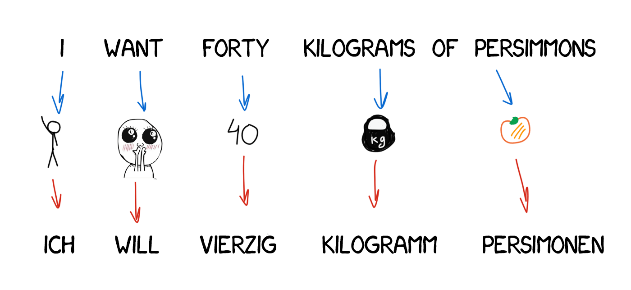
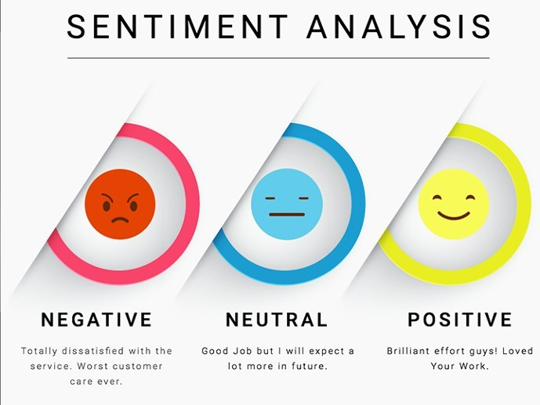
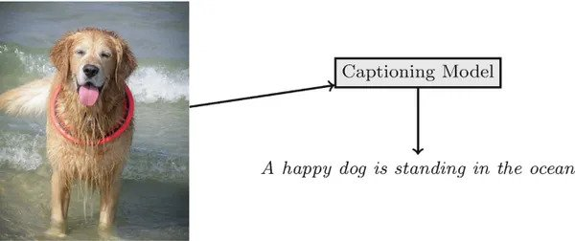

RNN APPLICATIONS
Machine Translation | Text Classification
Captioning Images | Recognition of Speech

Slide 43
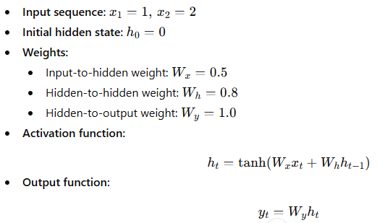
Numerical on RNN
Question: Consider a Simple Recurrent Neural Network (RNN) with the following parameters:
Tasks:
Compute the hidden state values h1​ and h2​ step-by-step.
Compute the corresponding output values y1​ and y2​.
Show all intermediate matrix (or scalar) calculations up to two decimal places.

Slide 44
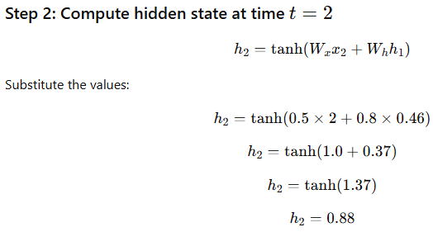
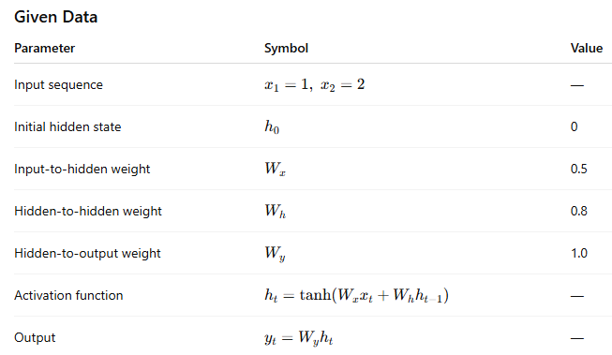
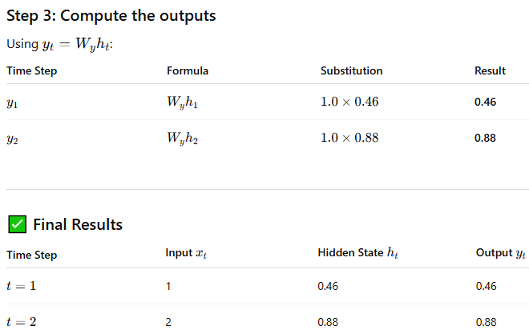

Numerical Solution

Slide 45



Numerical: Consider a Recurrent Neural Network (RNN) model with the following parameters. The task is to perform a forward pass for the input sequence “C A T”, step-by-step, showing all intermediate matrix operations and final outputs up to two decimal places.

Slide 46





Slide 47


Slide 48


Slide 49
Results Summary
Time Step (t) | Input (xₜ) | Hidden State (hₜ) | Output Probabilities (yₜ) | Output Attained with Highest Probability
1 (C) | [0,1,0,0] | [0.72, 0.46, 0.76] | [0.31, 0.20, 0.27, 0.22] | A = 0.31
2 (A) | [1,0,0,0] | [0.81, 0.89, 0.91] | [0.34, 0.16, 0.29, 0.21] | A =0.34
3 (T) | [0,0,0,1] | [0.89, 0.97, 0.68] | [0.35, 0.15, 0.31, 0.19] | A= 0.35
Key Observations
The hidden states gradually increase, showing accumulation of sequential information.
The output probabilities differ slightly at each step, reflecting learned context through time.
This demonstrates Backpropagation Through Time (BPTT) would later adjust weights using these forward results.

Slide 50


Vanishing Gradient
The vanishing gradient problem happens when the values used to update the neural network’s weights during training become extremely small.
As a result, the model learns very slowly or stops learning altogether, especially in the early layers.
Why does it happen?
  When using certain activation functions like sigmoid or tanh, their derivatives (which are used in backpropagation) become very small when the input is too large or too small.
  In deep networks, these small values are multiplied many times (one for each layer), making the gradient shrink close to zero
  Example: Imagine you have 5 layers, and at each layer the derivative is 0.2.
  So, the gradient is:0.2 × 0.2 × 0.2 × 0.2 × 0.2 = 0.00032.
  This tiny value means the weights in early layers barely change.
  This makes it hard for the model to learn long-term patterns since earlier information becomes almost irrelevant.

Slide 51


Exploding Gradient Problem
The exploding gradient problem happens when the gradient values become very large, causing the model’s weights to change dramatically, which leads to instability and makes the learning process fail.
Why does it happen?
When derivatives are large or weights are poorly initialized, multiplying them many times across layers causes the gradient to grow exponentially.
This can make the network output “NaN” or oscillate without converging.
Example: Imagine 5 layers where the derivative is 5 at each layer.
The gradient becomes:
5×5×5×5×5=31255.
Such a large update causes the network to diverge. This makes it difficult for the model to learn properly as the updates to the model become erratic and unpredictable.

Slide 52

Long Short-Term Memory (LSTM)
LSTM is an enhanced version of the RNN designed by Hochreiter and Schmidhuber.
Unlike traditional RNNs which uses only one hidden state, LSTMs include an additional memory cell.
This memory cell helps the model remember information for longer periods and handle long-term dependencies better.
The presence of memory mechanism in LSTM used to overcome the vanishing or exploding gradient problem.
It can learn long-term patterns in sequences, making it useful for language translation, speech recognition, and time series prediction

Slide 53


LSTM CELL
Each LSTM cell has three gates:
Input Gate: Controls how much new information should be added to the cell state.
Forget Gate: Decides what past information should be discarded.
Output Gate: Regulates what information should be output at the current step. This selective memory enables LSTMs to handle long-term dependencies, making them ideal for tasks where earlier context is critical.

Slide 54



WORKING OF LSTM CELL
LSTM architecture has a chain structure that contains four neural networks and different memory blocks called cells.
Information is retained by the cells, and the memory manipulations are done by the gates. There are three gates -
Forget Gate:
The information that is no longer useful in the cell state is removed with the forget gate.
The equation for the forget gate is:
If for a particular cell state the output is 0 or near to 0, the piece of information is forgotten and for output of 1 or near to 1, the information is retained for future use.

Slide 55


WORKING OF LSTM CELL
Input gate:
The addition of useful information to the cell state is done by the input gate.
First the information is regulated using the sigmoid function and filter the values to be remembered similar to the forget gate using inputs ht−1 and xt​.
Then, a vector is created using tanh function that gives an output from -1 to +1 which contains all the possible values from ht−1​ and xt.
At last, the values of the vector and the regulated values are multiplied to obtain the useful information.
The equation for the input gate is:
where,
⊙ denotes element-wise multiplication; and tanh is activation function

Slide 56


WORKING OF LSTM CELL
Output gate:
The output gate is responsible for deciding what part of the current cell state should be sent as the hidden state (output) for this time step.
First, the gate uses a sigmoid function to determine which information from the current cell state will be output.
This is done using the previous hidden state ht−1​​ and the current input xt:
Next, the current cell state Ct​​ is passed through a tanh activation to scale its values between −1 and +1. Finally, this transformed cell state is multiplied element-wise with Ot to produce the hidden state ht​:
where: Ot​​ is the output gate activation.; Ct​​ is the current cell state; ⊙ represents element-wise multiplication; σ is the sigmoid activation function.
This hidden state htht​​ is then passed to the next time step and can also be used for generating the output of the network.

Slide 57
Applications of LSTM
Language Modeling: Used in tasks like language modeling, machine translation and text summarization. These networks learn the dependencies between words in a sentence to generate coherent and grammatically correct sentences.
Speech Recognition: Used in transcribing speech to text and recognizing spoken commands. By learning speech patterns, they can match spoken words to corresponding text.
Time Series Forecasting: Used for predicting stock prices, weather and energy consumption. They learn patterns in time series data to predict future events.
Anomaly Detection: Used for detecting fraud or network intrusions. These networks can identify patterns in data that deviate drastically and flag them as potential anomalies.
Recommender Systems: In recommendation tasks like suggesting movies, music and books. They learn user behavior patterns to provide personalized suggestions.
Video Analysis: Applied in tasks such as object detection, activity recognition and action classification. When combined with CNNs they help analyze video data and extract useful information.

Slide 58

Numerical
Consider a single-step LSTM with scalar inputs.

Slide 59


Solution
Given Parameters
LSTM scalar equations (single step, no recurrent terms because h0 = 0):

Slide 60

Solution
Step 1: Forward Pass for t =1
LSTM scalar equations (single step, no recurrent terms because h0 = 0):

Slide 61


Gated Recurrent Unit
Feature | LSTM (Long Short-Term Memory) | GRU (Gated Recurrent Unit)
Gates Used | Input gate, Forget gate, Output gate | Update gate, Reset gate
Memory Components | Has separate cell state and hidden state | Has a single hidden state (no separate cell state)
Complexity | More complex due to extra gate and state | Simpler with fewer parameters
Training Speed | Slower because of more computations | Faster and more efficient to train
Performance | Performs better for very long sequences | Performs comparably but may struggle with very long dependencies
When to Use | When long-term memory retention is crucial | When faster training and simplicity are preferred

Slide 62


Gated Recurrent Unit
The GRU consists of two main gates:
Update Gate (zt​​): This gate decides how much information from previous hidden state should be retained for the next time step.
Reset Gate (rt​​): This gate determines how much of the past hidden state should be forgotten.
These gates allow GRU to control the flow of information in a more efficient manner compared to traditional RNNs which solely rely on hidden state.
Equations for GRU Operations
The internal workings of a GRU can be described using following equations:
1. Reset Gate
The reset gate determines how much of the previous hidden state ht−1​ should be forgotten.
2. Update Gate
The update gate controls how much of the new information xt​​ should be used to update the hidden state.

Slide 63


Gated Recurrent Unit
Equations for GRU Operations (Contd..)
3. Candidate Hidden State
This is the potential new hidden state calculated based on the current input and the previous hidden state.
4. Hidden State: The final hidden state is a weighted average of the previous hidden state ht−1​ and the candidate hidden state ht′ based on the update gate zt.

Slide 64

MLOps
MLOps stands for Machine Learning Operations.
It is a set of methods that help data science engineering teams to manage the entire machine learning process from collecting data and training models to deploying and monitoring them in real-world systems.
It act as the bridge between machine learning and daily operations.
It brings structure, order and automation to machine learning projects just like how DevOps does for software development.

Slide 65
Importance of MLOPS
MLOps (Machine Learning Operations) is essential for efficiently deploying, managing and scaling machine learning models in production. Traditional ML development often faces challenges that MLOps solves:
Lack of Team Collaboration: When teams work separately without talking to each other it causes confusion, delays and mistakes
Manual Deployment: Manually deploying models takes a lot of time and can cause mistakes
Poor Version Tracking: It’s difficult to track which version of the model is in use or what changes have been made.
No Ongoing Monitoring: Once a model is live there’s no system in place to monitor its performance regularly.
Resource Management Issues: As the project gets bigger it becomes harder to handle computing power and storage without using automation.

Slide 66

Why MLOPS?

Slide 67
MLOPS vs DevOps
MLOps | DevOps
MLOps is used for machine learning projects. It includes data preparation, model training, testing, deployment and monitoring. | DevOps mainly focused on Development, testing and deployment.
MLOps handles the versioning of data and models. | DevOps didn't focus on versioning.
In MLOps, the primary artifacts are machine learning models, data pipelines and feature engineering processes. | In DevOps, the primary things are source code, application binaries, configuration files and infrastructure as code.
MLOps emphasizes model performance, data drift and concept drift for monitoring. Involves specific ML metrics. | In DevOps, it will monitor application performance, system metrics and user experience. Uses traditional IT metrics.
Tools and Technologies are specific ML tools like TensorFlow, PyTorch, scikit-learn and model serving frameworks. | Tools and Technologies are CI/CD tools like Jenkins, GitLab CI/CD and container orchestration tools like Kubernetes.
Teams required: Cross-functional teams may include data scientists, ML engineers, data engineers and DevOps. | Teams required: Developers, IT operations, quality assurance and other stakeholders.

Slide 68
Need of MLOPS
Imagine you build a model to predict house prices and it works well on your computer. But when you try to use it on a website, problems arise like choosing the right model version, handling updated data, retraining regularly and checking performance.
This is where MLOps helps. It ensures:
All your work is well organized and versioned
You can easily repeat model training and testing
The model can be updated and used in real-world applications without extra effort
Note: In short MLOPs brings consistency, reliability, and efficiency to machine learning workflows.

Slide 69
Stages of MLOPS
Data Collection and Storage: Collect data and save it safely
Data Processing: Clean and prepare the data
Model Training: Use data to train a model
Model Testing: Check if the model gives correct results
Model Deployment: Put the model into use e.g., on a website or app.
Monitoring and Maintenance: Watch the model’s performance and update it as needed

Slide 70
Benefits and Limitations of MLOPS
Benefits of MLOps
Faster Model Training and Deployment
Easier Experimentation: Less Human Error
Repeatable and Trackable Steps
Better Teamwork
Limitations of MLOps
Complex Setup
High Costs
Limited Flexibility
Data Privacy and Security
Integration Challenges.

Slide 71

MLFLOW
MLflow is an open-source platform designed to manage and streamline the entire machine learning lifecycle.
It provides a set of tools for tracking experiments, packaging models and deploying them, making it easier to manage the various stages of ML workflows.
Whether we are a data scientist, ML engineer or DevOps engineer, MLflow offers a robust solution to track our experiments and manage models throughout their lifecycle.

Slide 72
MLFLOW
Experiment Tracking: It lets us log and compare experiments, tracking parameters, metrics and model artifacts (like trained models and plots). This helps us organize and analyze different experiments.
Model Packaging: It saves trained models in a reusable format. It supports models from libraries like scikit-learn, TensorFlow and PyTorch, making them easy to share and deploy.
Model Registry: It helps us register and version control models, track their lifecycle stages (e.g., development, production) and manage model transitions.
Model Deployment: It supports deploying models to cloud services(e.g., AWS SageMaker, Azure ML) or locally, making them ready for real-world use.

Slide 73


Natural Language Processing (NLP)
Natural Language Processing (NLP) is a field that combines computer science, artificial intelligence and language studies.
It helps computers understand, process and create human language in a way that makes sense and is useful.
With the growing amount of text data from social media, websites and other sources, NLP is becoming a key tool to gain insights and automate tasks like analyzing text or translating languages.
NLP is used by many applications that use language, such as text translation, voice recognition, text summarization and chatbots.
You may have used some of these applications yourself, such as voice-operated GPS systems, digital assistants, speech-to-text software and customer service bots.
NLP also helps businesses improve their efficiency, productivity and performance by simplifying complex tasks that involve language.

Slide 74

Components of NLP
Natural language processing involves two main components
Natural language understanding (NLU),
Natural language generation (NLG).
Both NLU and NLG are subsets of natural language processing where the overall process looks something like:
Natural language processing (NLP) =
NLU (analyzing input/text data) + NLG (producing output text)
In natural language understanding, the machine focuses on breaking down text data and interpreting its meaning. Natural language understanding involves three linguistic levels to understand text data:
Syntax: The arrangement of words in a sentence (e.g., subject + verb + direct object)
Semantic: Determining the meaning of a text
Pragmatic: Understanding a sentence’s context and what it’s trying to achieve.

Slide 75
Components of NLP
Natural Language Understanding (NLU) helps the machine to understand and analyze human language by extracting the text from large data such as keywords, emotions, relations, and semantics, etc.
Let’s see what challenges are faced by a machine-
For Example:- He is looking for a match.
What do you understand by the ‘match’ keyword? Does it partner or cricket or football or anything else?
This is Lexical Ambiguity. It happens when a word has different meanings.
Lexical ambiguity can be resolved by using parts-of-speech (POS) tagging techniques.

Slide 76
Components of NLP
Natural Language Generation: It is the process of extracting meaningful insights as phrases and sentences in the form of natural language.
It consists −
Text planning − It includes retrieving the relevant data from the domain.
Sentence planning − It is nothing but a selection of important words, meaningful phrases, or sentences.

Slide 77

STEPS IN NLP
The five main steps of natural language processing are:
Lexical analysis
Syntactic analysis
Semantic analysis
Disclosure analysis
Pragmatic analysis

Slide 78


Lexical Analysis
It involves identifying and analyzing the structure of words. Lexicon of a language means the collection of words and phrases in that particular language.
The lexical analysis divides the text into paragraphs, sentences, and words. So, we need to perform Lexicon Normalization.
The most common lexicon normalization techniques are Stemming:
Stemming: Stemming is the process of reducing derived words to their word stem, base, or root form—generally a written word form like-“ing”, “ly”, “es”, “s”, etc
Lemmatization: Lemmatization is the process of reducing a group of words into their lemma or dictionary form. It takes into account things like POS(Parts of Speech), the meaning of the word in the sentence, the meaning of the word in the nearby sentences, etc. before reducing the word to its lemma.

Slide 79

Syntactic Analysis
Syntactic Analysis is used to check grammar, arrangements of words, and the interrelationship between the words.
Example: Mumbai goes to the Sara
Here “Mumbai goes to Sara”, which does not make any sense, so this sentence is rejected by the Syntactic analyzer.
Syntactical parsing involves the analysis of words in the sentence for grammar.
Dependency Grammar and Part of Speech (POS) tags are the important attributes of text syntactic.

Slide 80

Semantic Analysis
Semantic analysis refers to a process of understanding natural language (text) by extracting insightful information such as context, emotions, and sentiments from unstructured data.
It gives computers and systems the ability to understand, interpret, and derive meanings from sentences, paragraphs, reports, registers, files, or any document of a similar kind.
The semantic analysis process begins by studying and analyzing the dictionary definitions and meanings of individual words also referred to as lexical semantics.
Following this, the relationship between words in a sentence is examined to provide clear understanding of the context.

Slide 81

Disclosure Integration
While processing a language there can arise one major ambiguity known as referential ambiguity. Referential ambiguity is the ambiguity that can arise when a reference to a word cannot be determined. For example,
Ram won the race.
Mohan ate half of a pizza.
He liked it.
In the above example, “He” can be Ram or Mohan. This creates an ambiguity.
The word “He” shows dependency on both sentences. This is known as disclosure integration. It means when an individual sentence relies upon the sentence that comes before it.
Like in the above example the third sentence relies upon the sentence before it. Hence the goal of this model is to remove referential ambiguity.

Slide 82

Pragmatic Analysis
The pragmatic analysis means handling the situation in a much more practical or realistic manner than using a theoretical approach.
As we know that a sentence can have different meanings in various situations. For example, The average is 18.
The average is 18. (average may be of sequence)
The average is 18. (average may be of a vehicle)
The average is 18. (average may be of a mathematical term)
We can see that for the same input there can be different perceptions.
To interpret the meaning of the sentence we need to understand the situation. To tackle such problems, we use pragmatic analysis.
The pragmatic analysis tends to make the understanding of the language much clearer and easier to interpret.

Slide 83

Challenges of NLP

Slide 84

Applications of NLP

Slide 85

Word Embedding
Word Embeddings are numeric representations of words in a lower-dimensional space, that capture semantic and syntactic information.
Word embedding is used to represent words as numerical vectors (dense representations) so that a computer can understand and process language efficiently.
In simple terms: It converts words into numbers — but in a way that captures their meaning, context, and relationships with other words.
It allows words with similar meanings to have a similar representation. Thus, Similarity can be assessed based on Similar vector representations.

Slide 86
Need of Word Embedding
Computers don’t understand text — they understand numbers. So, we can’t directly feed words like "king", "queen", or "apple" into a model. We need to represent them numerically.
Note:
To reduce dimensionality.
To use a word to predict the words around it.
Helps in enhancing model interpretability due to numerical representation.
Inter-word semantics and similarity can be captured.

Slide 87
Similarity, Advantages & Limitations
Similarity measures formula:
• Cosine similarity: cos(A,B) = (A·B) / (||A|| ||B||)
• Euclidean distance: ||A - B||
Advantages:
• Capture semantics, compact, enable analogies
• Efficient for downstream tasks (classification, retrieval)
Limitations:
• Static embeddings ignore context (Word2Vec/GloVe)
• Bias in training data (gender, ethnicity, etc.)
• OOV and domain adaptation challenges

Slide 88
Numerical Example of Word Embedding
Let’s assume we have the following vocabulary of words and their 2-dimensional embeddings (numerical representations):
Word | Embedding (Vector)
king | [2, 4]
man | [1, 3]
woman | [1, 2]
queen | [2, 3]
Find the vector result for King − man + woman =? and identify which word in the vocabulary it corresponds to.
Ans: Step 1: Substitute the embeddings
[2,4] − [1,3] + [1,2]

Slide 89
Numerical Example of Word Embedding
Step 2: Perform the subtraction and addition
Component-wise calculation:
Dimension | Operation | Result
1st | 2 - 1 + 1 | = 2
2nd | 4 - 3 + 2 | = 3
So, the resulting vector is: [2,3]
Step 3: Compare with vocabulary
From the table above, queen → [2, 3]
Therefore, King − man + woman = queen
It demonstrates how word embeddings capture semantic relationships between words.

Slide 90

Numerical Example of Word Embedding
Let’s assume we have the following vocabulary of words and their 2-dimensional embeddings (numerical representations):
Word | Embedding (Vector)
king | [2, 4]
man | [1, 3]
woman | [1, 2]
queen | [2, 3]
Find the vector result for King − man + woman =? and identify which word in the vocabulary it corresponds to.
Using the same embeddings, compute the cosine similarity between
king=[2,4] and queen=[2,3]. Show all steps.
Cosine similarity formula

Slide 91

Numerical Example of Word Embedding
The cosine similarity ≈ 0.9923 confirms king and queen are very close (highly similar) in this embedding space.

Slide 92

Numerical Example of Word Embedding
Use cosine similarity to find how close the words “king” and “apple” are numerically, given their word embeddings. Suppose we have the following 3-dimensional word vectors:
King = [0.8,0.6,0.0]; apple = [0.2,0.1,0.9]
This means “king” and “apple” are not closely related semantically.
Their vectors point in quite different directions in the embedding space which matches our intuition that these words are not similar in meaning.

Slide 93
Popular Word Embedding Models
1. Word2Vec (Google)
  Uses CBOW or Skip-gram to learn embeddings.
  Learns from word context (e.g., “The cat sat on the mat.”).
2. GloVe (Stanford)
  Uses global word co-occurrence statistics.
3. FastText (Facebook)
  Represents subword information (useful for rare or new words).
4. BERT / Transformer-based embeddings
  Contextual embeddings — the meaning changes with the sentence context.
  Example: “bank” in “river bank” vs “money bank

Slide 94

Text Representation Models

Slide 95

Transformers
A Transformer is a deep learning model architecture introduced by Vaswani et al. (2017) in the paper “Attention Is All You Need.”
It revolutionized Natural Language Processing (NLP) by replacing older architectures like RNNs and LSTMs.
Core Idea: Transformers use a mechanism called self-attention, which allows the model to understand the importance of each word in a sentence relative to all other words.
Example:
“The cat sat on the mat because it was tired.”
The word “it” refers to “the cat.”
A transformer uses attention to find that “it” is connected to “cat,” even though other words come in between — something RNNs/LSTMs struggled with.

Slide 96

Need of Transformers
Traditional models like RNNs suffer from the vanishing gradient problem which leads to long-term memory loss.
RNNs process text sequentially meaning they analyze words one at a time.
For example:
In the sentence: "XYZ went to France in 2019 when there were no cases of COVID and there, he met the president of that country" the word "that country" refers to "France".
However, RNN would struggle to link "that country" to "France" since it processes each word in sequence leading to losing context over long sentences. This limitation prevents RNNs from understanding the full meaning of the sentence.
While adding more memory cells in LSTMs (Long Short-Term Memory networks) helped address the vanishing gradient issue they still process words one by one. This sequential processing means LSTMs can't analyze an entire sentence at once.
For example: The word "point" has different meanings in these two sentences:
"The needle has a sharp point." (Point = Tip)
"It is not polite to point at people." (Point = Gesture)
Traditional models struggle with this context dependence, whereas Transformer model through its self-attention mechanism processes the entire sentence in parallel addressing these issues and making it significantly more effective at understanding context.

Slide 97
Need of Transformers (Contd..)
Older models like RNNs and LSTMs processed text sequentially (word-by-word), leading to:
Slow training (no parallelism)
Difficulty handling long-term dependencies
Vanishing gradients
Transformers solve these problems by:
Using self-attention to look at all words simultaneously
Allowing parallel training (faster and scalable)
Capturing long-range relationships between words

Slide 98

Architecture of Transformers
A transformer consists of two main components:
Component | Function
Encoder | Reads and understands the input sequence (e.g., a sentence).
Decoder | Generates the output sequence (e.g., translated text).
Each encoder/decoder block has:
Self-Attention Layer → identifies relationships between words.
Feed Forward Layer → processes and transforms features.
Positional Encoding → adds word order information.

Slide 99
Types of Transformers Models
Type | Example Models | Used For | Key Feature
Encoder-only | BERT, RoBERTa, ALBERT | Understanding tasks (classification, NER, sentiment) | Deep bidirectional context
Decoder-only | GPT, GPT-2, GPT-3, GPT-4 | Text generation (chatbots, writing) | Left-to-right language modeling
Encoder–Decoder | T5, BART, mBART | Sequence-to-sequence (translation, summarization) | Combines both understanding and generation

Slide 100
Difference Between BERT and GPT
Feature | BERT (Bidirectional Encoder Representations from Transformers) | GPT (Generative Pre-trained Transformer)
Architecture | Encoder-only | Decoder-only
Training Objective | Masked Language Modeling (fills missing words) | Autoregressive Language Modeling (predicts next word)
Context Direction | Bidirectional (uses both left & right context) | Unidirectional (uses left context only)
Purpose | Understanding language (NLP comprehension tasks) | Generating language (NLP generation tasks)
Example Task | Sentiment analysis, question answering | Chatbots, essay writing, story generation
Example Model Size | BERT-base (110M parameters) | GPT-3 (175B parameters)
Example Sentence | Input: “The man went to the ___.” → predicts “store” | Input: “Once upon a time” → generates a story continuation

Slide 101

Applications of Transformers

