Slide 1
Applications of Artificial Intelligence
Bayes’ Theorem – Simple examples

Slide 2
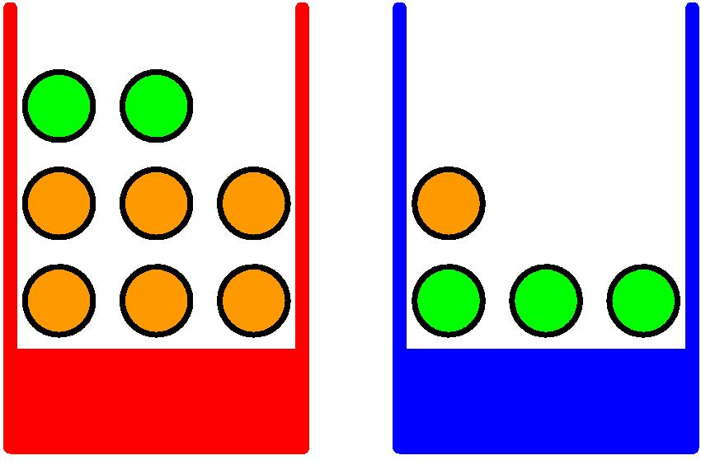
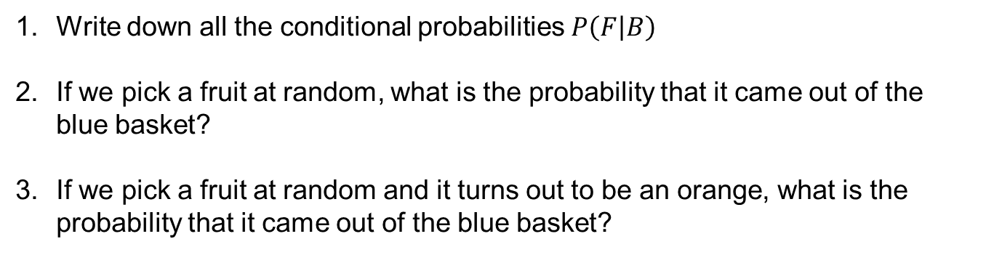
Example 1
P = 0.4
P = 0.6
Write down all the conditional probabilities $P\left(F | B\right)$
If we pick a fruit at random, what is the probability that it came out of the blue basket?
If we pick a fruit at random and it turns out to be an orange, what is the probability that it came out of the blue basket?
Picture from Dr Christopher Bishop’s slides

Slide 3
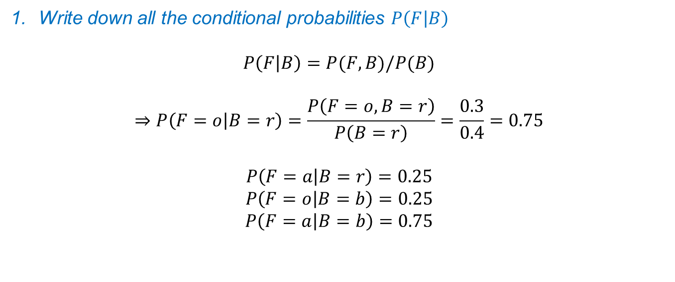
Example 1
Joint probability table
P = 0.4
P = 0.6
 | F = o | F= a | Total
B = r | 0.3 | 0.1 | 0.40
B = b | 0.15 | 0.45 | 0.60
 | 0.45 | 0.55
Write down all the conditional probabilities $P\left(F | B\right)$
$$P\left(F | B\right)=P(F,B)/P(B)$$
$$⇒P\left(F=o | B=r\right)=\frac{P\left(F=o,B=r\right)}{P\left(B=r\right)}=\frac{0.3}{0.4}=0.75$$
$$P\left(F=a | B=r\right)=0.25$$
$$P\left(F=o | B=b\right)=0.25$$
$$P\left(F=a | B=b\right)=0.75$$
Picture from Dr Christopher Bishop’s slides

Slide 4
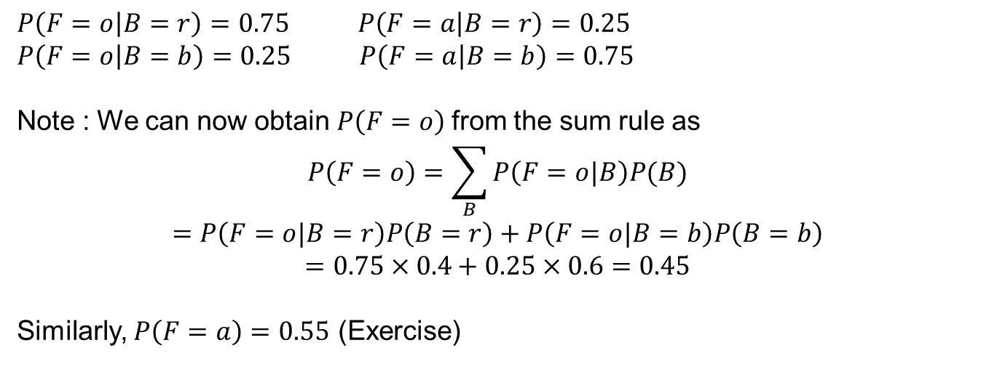
Example 1
Joint probability table
P = 0.4
P = 0.6
 | F = o | F= a | Total
B = r | 0.3 | 0.1 | 0.40
B = b | 0.15 | 0.45 | 0.60
 | 0.45 | 0.55
$P\left(F=o | B=r\right)=0.75$ $P\left(F=a | B=r\right)=0.25$
$P\left(F=o | B=b\right)=0.25$ $P\left(F=a | B=b\right)=0.75$
Note : We can now obtain $P\left(F=o\right)$from the sum rule as
$$P\left(F=o\right)=\sum_{B}{P\left(F=o|B\right)P(B})$$
$$=P\left(F=o|B=r\right)P\left(B=r\right)+P\left(F=o|B=b\right)P\left(B=b\right)$$
$$=0.75×0.4+0.25×0.6=0.45$$
Similarly, $P\left(F=a\right)=0.55$ (Exercise)
Picture from Dr Christopher Bishop’s slides

Slide 5
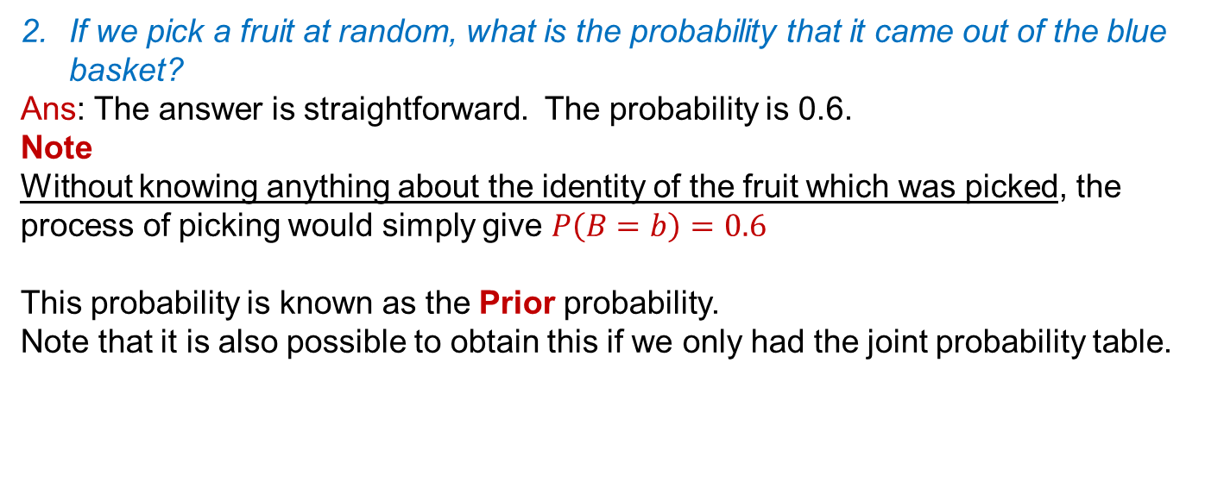
Example 1
Joint probability table
P = 0.4
P = 0.6
 | F = o | F= a | Total
B = r | 0.3 | 0.1 | 0.40
B = b | 0.15 | 0.45 | 0.60
 | 0.45 | 0.55
If we pick a fruit at random, what is the probability that it came out of the blue basket?
Ans: The answer is straightforward. The probability is 0.6.
Note
Without knowing anything about the identity of the fruit which was picked, the process of picking would simply give $P\left(B=b\right)=0.6$
This probability is known as the Prior probability.
Note that it is also possible to obtain this if we only had the joint probability table.
Picture from Dr Christopher Bishop’s slides

Slide 6
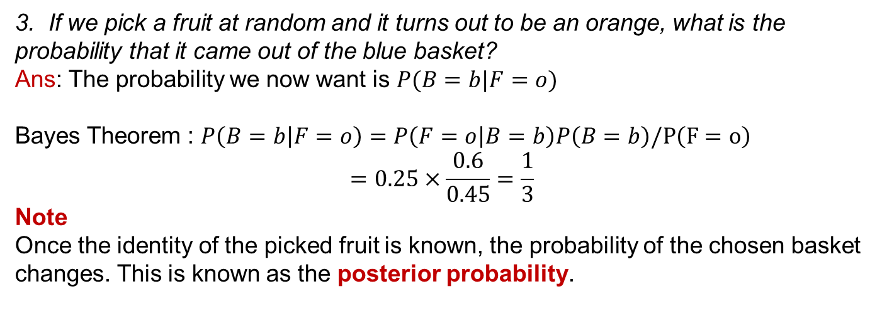
Example 1
Joint probability table
P = 0.4
P = 0.6
 | F = o | F= a | Total
B = r | 0.3 | 0.1 | 0.40
B = b | 0.15 | 0.45 | 0.60
 | 0.45 | 0.55
3. If we pick a fruit at random and it turns out to be an orange, what is the probability that it came out of the blue basket?
Ans: The probability we now want is $P(B=b|F=o)$
Bayes Theorem : $P\left(B=b | F=o\right)=P\left(F=o | B=b\right)P\left(B=b\right)/P\left(F=o\right)$
$$=0.25×\frac{0.6}{0.45}=\frac{1}{3}$$
Note
Once the identity of the picked fruit is known, the probability of the chosen basket changes. This is known as the posterior probability.
Once again, note that the joint probability table is enough to obtain all quantities

Slide 7
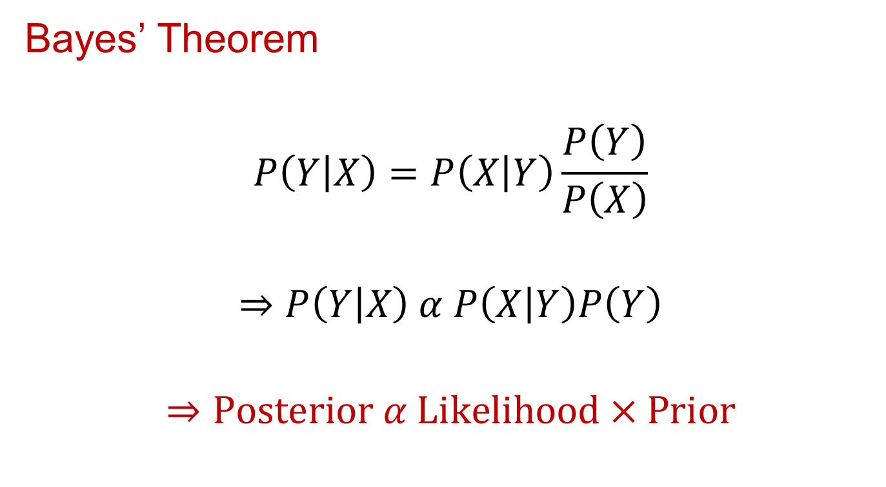
Bayes Theorem --
Likelihood, Prior, Posterior
Bayes’ Theorem
$$P\left(Y | X\right)=P\left(X | Y\right)\frac{P\left(Y\right)}{P\left(X\right)}$$
$$⇒P\left(Y | X\right) α P\left(X | Y\right)P\left(Y\right)$$
$$⇒\text{Posterior} α \text{Likelihood} \text{×} \text{Prior}$$

Slide 8
Another example – Cancer diagnosis
Suppose a person goes to a cancer diagnosis centre for a test and the test is positive (i.e. says the person has cancer).
What questions must the person ask to determine the accuracy of the diagnosis?
What are the chances the person actually has cancer?

Slide 9
Cancer diagnosis
What questions must the person ask to determine the accuracy of the diagnosis?
What percentage of the people with cancer test positive?
  Ans : 99%
What percentage of people without cancer test negative?
  Ans : 99%
What percentage of the population has cancer?
  Ans : 0.5%
Think : What are random variables in this problem?

Slide 10
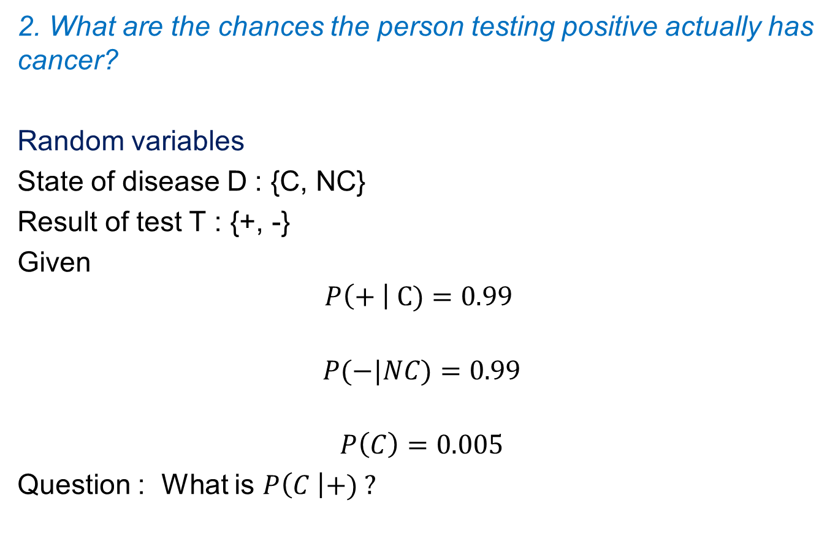
Cancer diagnosis
2. What are the chances the person testing positive actually has cancer?
Random variables
State of disease D : {C, NC}
Result of test T : {+, -}
Given
$$P\left(+ \right| C)=0.99$$
$$P(−|NC)=0.99$$
$$P\left(C\right)=0.005$$
Question : What is $P\left(C \right|+) ?$

Slide 11
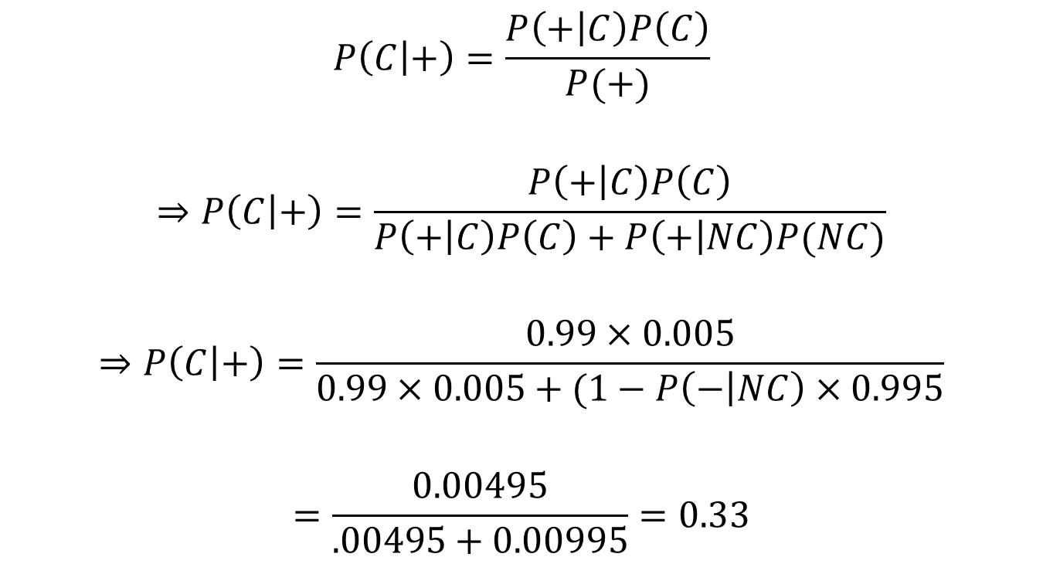
Cancer diagnosis – Bayes’ Theorem
$$P\left(C | +\right)=\frac{P\left(+ | C\right)P\left(C\right)}{P(+)}$$
$$⇒P\left(C | +\right)=\frac{P\left(+ | C\right)P\left(C\right)}{P\left(+ | C\right)P\left(C\right)+P\left(+ | NC\right)P(NC)}$$
$$⇒P\left(C | +\right)=\frac{0.99×0.005}{0.99×0.005+(1−P\left(− | NC\right)×0.995}$$
$$=\frac{0.00495}{.00495+0.00995}=0.33$$

Slide 12
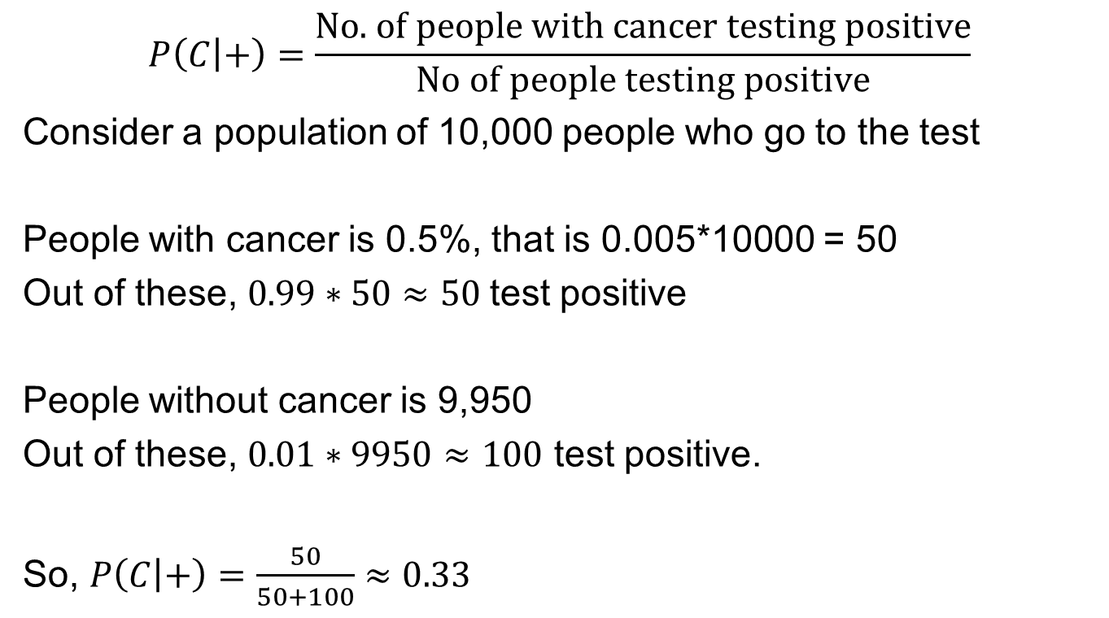
Cancer diagnosis – With numbers
$$P\left(C | +\right)=\frac{\text{No}\text{. }\text{of} \text{people} \text{with} \text{cancer} \text{testing} \text{positive}}{\text{No} \text{of} \text{people} \text{testing} \text{positive}}$$
Consider a population of 10,000 people who go to the test
People with cancer is 0.5%, that is 0.005*10000 = 50
Out of these, $0.99∗50≈50$test positive
People without cancer is 9,950
Out of these, $0.01∗9950≈100$ test positive.
So, $P\left(C | +\right)=\frac{50}{50+100}≈0.33$

