Slide 1
Applications of Artificial Intelligence
Conditional, Joint, Marginal Probabilities
Sum Rule and Product Rule
Bayes’ Theorem

Slide 2
Topics in this video
Joint probability
Marginal probability
Conditional probability
Two rules of probability
  Sum Rule
  Product Rule
Bayes’ Theorem

Slide 3
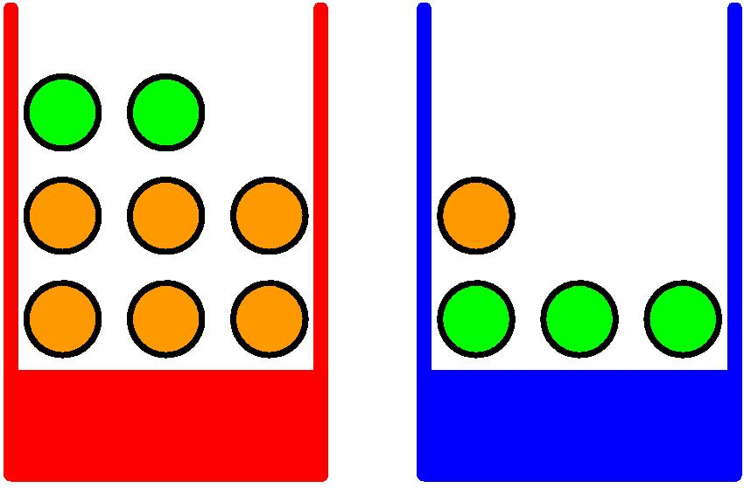


A simple orienting example
$$P\left(B=r\right)=0.4$$
$$P\left(B=b\right)=0.6$$
Adapted from Dr Christopher Bishop’s slides

Slide 4
A simple orienting example
P = 0.4
P = 0.6
Adapted from Dr Christopher Bishop’s slides

Slide 5
A simple orienting example
P = 0.4
P = 0.6
 | F = o | F= a | Total
B = r | 30 | 10 | 40
B = b | 15 | 45 | 60
 | 45 | 55
Adapted from Dr Christopher Bishop’s slides

Slide 6
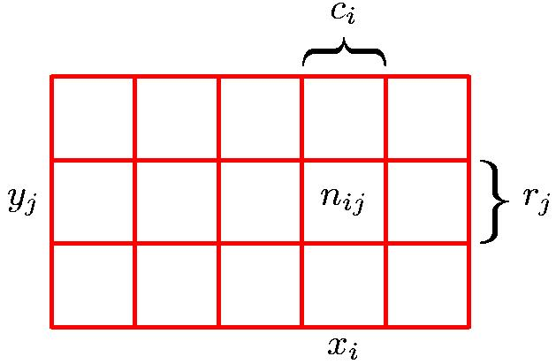
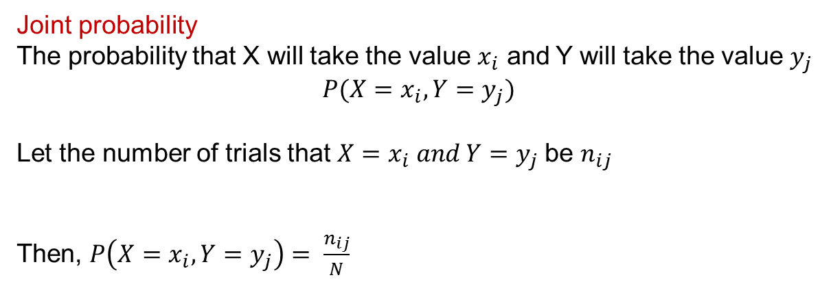
Joint Probability (Discrete)
 | F = o | F= a | Total
B = r | 30 | 10 | 40
B = b | 15 | 45 | 60
 | 45 | 55
Joint probability
The probability that X will take the value $x_{i}$ and Y will take the value $y_{j}$
$$P(X=x_{i},Y=y_{j})$$
Let the number of trials that $X=x_{i} and Y=y_{j}$be $n_{ij}$
Then, $P\left(X=x_{i}, Y=y_{j}\right)= \frac{n_{ij}}{N}$
Adapted from Dr Christopher Bishop’s slides

Slide 7
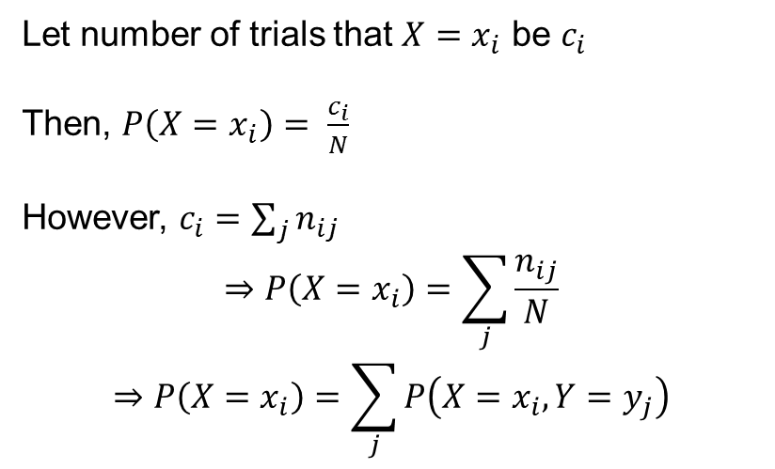
Sum Rule
 | F = o | F= a | Total
B = r | 30 | 10 | 40
B = b | 15 | 45 | 60
 | 45 | 55
Let number of trials that $X=x_{i}$ be $c_{i}$
Then, $P\left(X=x_{i}\right)= \frac{c_{i}}{N}$
However, $c_{i}=\sum_{j}{n_{ij}}$
$$⇒P\left(X=x_{i}\right)=\sum_{j}{\frac{n_{ij}}{N}}$$
$$⇒P\left(X=x_{i}\right)=\sum_{j}{P\left(X=x_{i},Y=y_{j}\right)}$$
Marginal probability
Sum rule of probability
Adapted from Dr Christopher Bishop’s slides

Slide 8
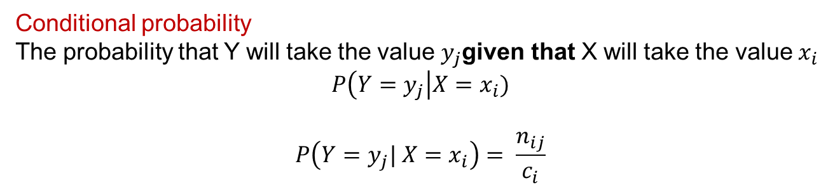
Conditional Probability
 | F = o | F= a | Total
B = r | 30 | 10 | 40
B = b | 15 | 45 | 60
 | 45 | 55
Conditional probability
The probability that Y will take the value $y_{j}$given that X will take the value${ x}_{i}$
$$P\left(Y=y_{j}\right|X=x_{i})$$
$$P\left(Y=y_{j}| X=x_{i}\right)= \frac{n_{ij}}{c_{i}}$$
Adapted from Dr Christopher Bishop’s slides

Slide 9
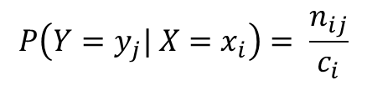

Product Rule
 | F = o | F= a | Total
B = r | 30 | 10 | 40
B = b | 15 | 45 | 60
 | 45 | 55
$$P\left(Y=y_{j}| X=x_{i}\right)= \frac{n_{ij}}{c_{i}}$$
$$P\left(X=x_{i}, Y=y_{j}\right)= \frac{n_{ij}}{N}$$
$$⇒ P\left(X=x_{i}, Y=y_{j}\right)=P\left(Y=y_{j}| X=x_{i}\right)P\left(X=x_{i}\right)$$
Product rule of probability
Adapted from Dr Christopher Bishop’s slides

Slide 10
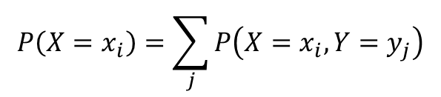
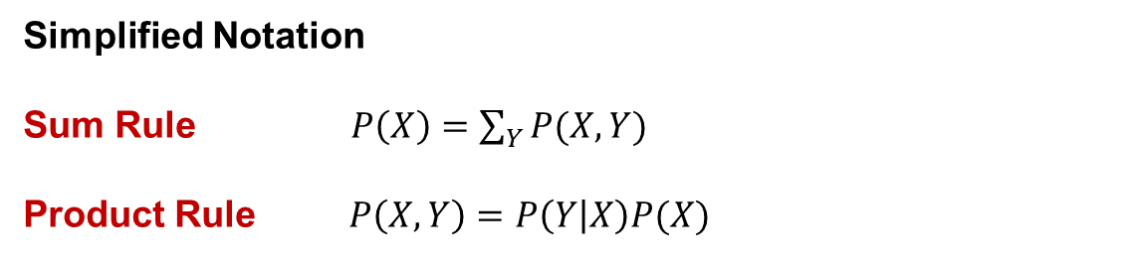
Rules of Probability
(Simplified notation)
$$P\left(X=x_{i}\right)=\sum_{j}{P\left(X=x_{i},Y=y_{j}\right)}$$
Sum rule of probability
$$P\left(X=x_{i}, Y=y_{j}\right)=P\left(Y=y_{j}| X=x_{i}\right)P\left(X=x_{i}\right)$$
Product rule of probability
Simplified Notation
Sum Rule $P\left(X\right)=\sum_{Y}{P(X,Y)}$
Product Rule $P\left(X,Y\right)=P\left(Y | X\right)P(X)$

Slide 11

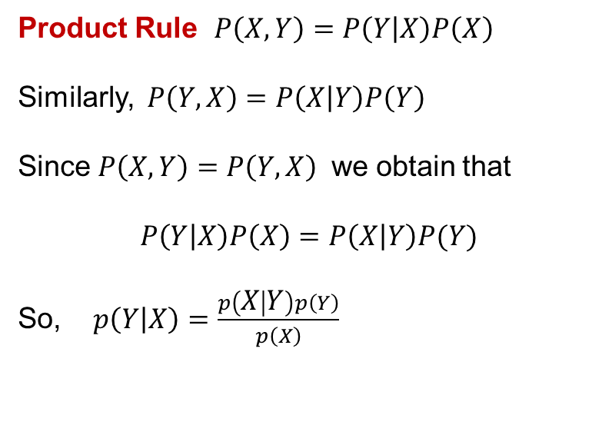
Bayes’ Theorem
Product Rule $P\left(X,Y\right)=P\left(Y | X\right)P\left(X\right)$
Similarly, $P\left(Y,X\right)=P\left(X | Y\right)P\left(Y\right)$
Since $P\left(X,Y\right)=P\left(Y,X\right)$ we obtain that
$$P\left(Y | X\right)P\left(X\right)=P\left(X | Y\right)P(Y)$$
So, $p\left(Y | X\right)=\frac{p\left(X | Y\right)p\left(Y\right)}{p\left(X\right)}$
Bayes’ Theorem
$$p\left(Y | X\right)=\frac{p\left(X | Y\right)p\left(Y\right)}{p\left(X\right)}$$

