Slide 1
Module-2
Reasoning with uncertainty

Slide 2

Introduction to Reasoning with Uncertainty
Q: Have you ever made a decision without having complete information?
Choosing clothes without checking the weather forecast
Diagnosing an illness from symptoms
Investing in stocks

Slide 3
What is Uncertainty?
Uncertainty is a situation where you are not sure if a statement is true or not.
Traditional "if-then" rules (A→B) don't work when we're unsure about the initial statement (A).
We need uncertain reasoning or probabilistic reasoning to represent uncertain knowledge.

Slide 4
Why Uncertainty Matters?
In the real world, information is incomplete, noisy, and uncertain.
Real-world is unpredictable.
AI systems often deal with uncertain data (e.g., medical diagnosis, weather prediction, self-driving cars, fraud detection).
Traditional logic-based reasoning (True/False) is insufficient in such cases.
Deterministic rules fail in complex situations
Hence, we need probabilistic reasoning and other uncertainty-handling frameworks.

Slide 5
Sources of Uncertainty
Incomplete Knowledge – Missing information (e.g., unknown patient history).
Ambiguity – Multiple interpretations possible.
Randomness – Outcomes are inherently probabilistic (e.g., dice roll).
Noisy Data – Sensor errors or human mistakes.
Approximate Models – Simplified representations of complex systems.

Slide 6
Approaches to Reasoning Under Uncertainty

Slide 7
1. Probability Theory
Foundation for handling uncertainty.
Random variable: A variable whose value is uncertain.
Probability distribution: Assigns likelihood to events.
Example:
  Weather:
    P(Sunny) = 0.7
    P(Rainy) = 0.3

Slide 8
2. Probabilistic Models
Probability as a tool for reasoning under uncertainty
Probabilistic model = mathematical framework for predicting likelihood of outcomes
“Predict tomorrow’s weather: Sunny 🌞 or Rainy 🌧 — what probability would you assign?”
Bayesian Networks – Graphical models capturing conditional dependencies.
  Nodes = variables
  Edges = probabilistic relationships
Hidden Markov Models (HMMs) – Handle sequential uncertainty (speech recognition).

Slide 9
Probabilistic Reasoning 🎲
This is a method of knowledge representation that uses the concept of probability to handle uncertainty.
It combines probability theory with logic.
We use it for scenarios where the outcome isn't guaranteed, like "It will rain today“, “A match between two teams or two players” or the result of a sports match.

Slide 10
3. Fuzzy Logic
Deals with vagueness instead of randomness.
Truth values range between 0 and 1, not just True/False.
Example:
  Temperature = 30°C
  “Hot” = 0.7, “Warm” = 0.3

Slide 11
4. Markov Decision Processes (MDPs)
Framework for decision-making under uncertainty over time.
Used in robotics, reinforcement learning, and planning.
Defined by:
  States (S)
  Actions (A)
  Transition probabilities (P)
  Rewards (R)

Slide 12
Why We Need It in AI 🤖
To handle unpredictable outcomes.
When the number of possibilities is too large to manage.
When unknown errors occur during an experiment.

Slide 13
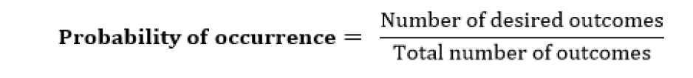
Key Concepts in Probability 📊
Probability: The chance that an uncertain event will happen, measured numerically between 0 and 1.
P(A)=0 means the event is completely uncertain.
P(A)=1 means the event is completely certain.
Formula:
Events: Each possible outcome is an event.
Sample Space: The collection of all possible events.
Prior Probability: The probability of an event calculated before any new information is observed.
Posterior Probability: The probability calculated after considering new evidence.

Slide 14

Conditional Probability & Bayes' Theorem
Conditional Probability:
This is the probability of an event occurring when another event has already happened.
The formula to calculate the probability of A given B is:
P(A∣B) is the conditional probability.
P(A∧B) is the joint probability of A and B.
P(B) is the marginal probability of B.
Example: If 70% of students like English and 40% like both English and Math, the probability that a student who likes English also likes Math is 57%.

Slide 15
Bayes' Theorem
Also known as Bayes' Rule, it's used to determine the probability of an event with uncertain knowledge.
It relates the conditional and marginal probabilities of two events.
It lets you update the probability of a prediction by observing new information.
It is a way to calculate the value of P(B|A) with the knowledge of P(A|B).

Slide 16
Prior & Conditional Probability
Prior Probability (P(A)): belief before new evidence (e.g., probability of rain = 30%)
Conditional Probability (P(A|B)): probability given new evidence (e.g., if clouds = 80% chance of rain)

Slide 17
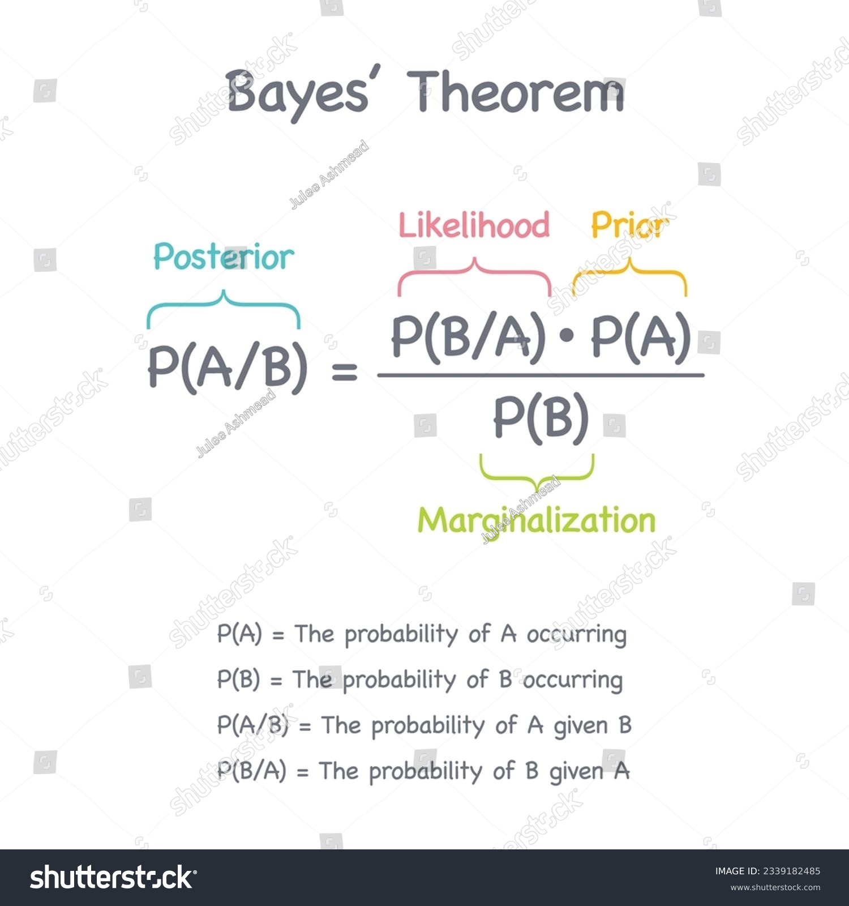

Slide 18
Bayes' Theorem: The Foundation of Probabilistic Reasoning
Bayes' theorem is a fundamental principle that connects prior and conditional probabilities. It provides a way to update our beliefs about an event as we get new evidence.
Formula: P(A∣B)=P(B∣A)⋅P(A)​/P(B)
  P(A∣B) is the posterior probability: the probability of A given the evidence B. This is what we want to find.
  P(B∣A) is the likelihood: the probability of the evidence B given that A is true.
  P(A) is the prior probability: our initial belief in A.
  P(B) is the evidence probability: the overall probability of the evidence B.

Slide 19
Example: Disease Diagnosis
Imagine a doctor is trying to diagnose a patient for a specific disease (D).
P(D): The prior probability that a person has the disease (e.g., 1%).
P(S∣D): The likelihood of a symptom (S) given the patient has the disease (e.g., 95%).
P(S): The evidence probability of the symptom appearing in the general population (e.g., 10%).
Using Bayes' theorem, the doctor can calculate the posterior probability that the patient has the disease given the symptom: P(D∣S)=P(S∣D)*P(D)​ / P(S)
P(D∣S)=0.95*0.01/0.1​=0.095 or 9.5%.
This shows how a low initial probability (1%) can be significantly updated with new evidence (the symptom) to a higher probability (9.5%).

Slide 20
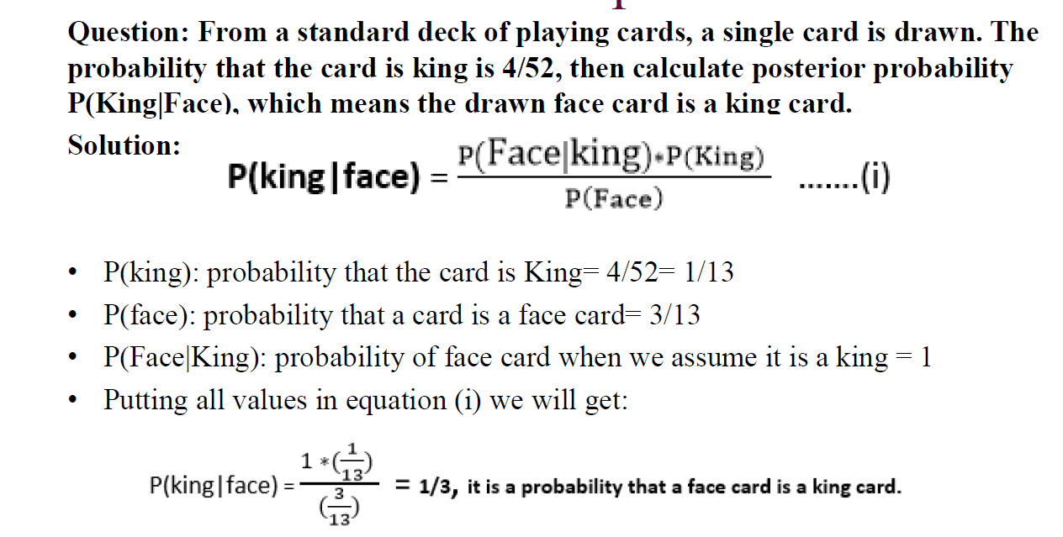
Example-

Slide 21
How Uncertainty Affects Decisions and AI?
Impact on Decision-Making
Uncertainty forces us to move from making definitive choices to making choices based on expected outcomes. We often use utility theory, which assigns values to different outcomes and probabilities to their occurrence.
The goal is to choose the action that maximizes the expected utility.
Example: Should a company launch a new product? The decision depends on the probability of success and the potential profit versus the probability of failure and the potential loss.

Slide 22
Impact on AI Behavior
AI systems that don't account for uncertainty can be brittle and unreliable.
Overconfidence: A classifier might be 99% sure it's seen a cat, but it might be wrong. A system that reasons under uncertainty provides a probability score, like "I'm 99% confident this is a cat," which is much more informative.
Handling Ambiguity: In tasks like natural language processing, words can have multiple meanings. Probabilistic models help AI systems resolve this ambiguity by considering the context.
Robustness: AI models that handle uncertainty are more robust to noisy or missing data, making them more reliable in real-world applications.

