Slide 1
Applications of Artificial Intelligence
Conditional, Joint, Marginal Probabilities
Sum Rule and Product Rule
Bayes’ Theorem

Slide 2
Acknowledgment
Many of the ideas and pictures in this lecture have been borrowed from the slides created by Dr Christopher Bishop of MS Research (with permission) for his Pattern Recognition and Machine Learning book.

Slide 3
Topics in this video
Joint probability
Marginal probability
Conditional probability
Two rules of probability
  Sum Rule
  Product Rule
Bayes’ Theorem

Slide 4
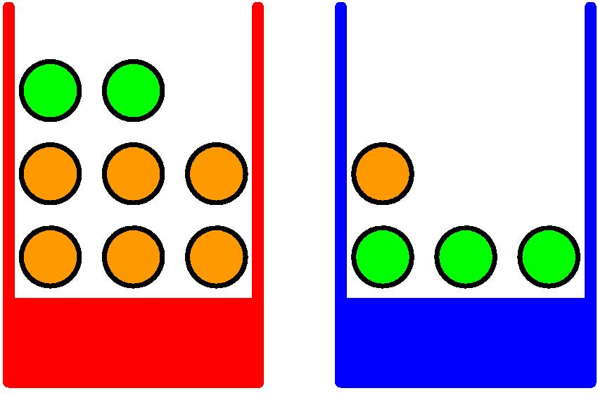


A simple orienting example
$$P\left(B=r\right)=0.4$$
$$P\left(B=b\right)=0.6$$
Adapted from Dr Christopher Bishop’s slides

Slide 5
A simple orienting example
P = 0.4
P = 0.6
Adapted from Dr Christopher Bishop’s slides

Slide 6
A simple orienting example
P = 0.4
P = 0.6
 | F = o | F= a | Total
B = r | 30 | 10 | 40
B = b | 15 | 45 | 60
 | 45 | 55
Adapted from Dr Christopher Bishop’s slides

Slide 7
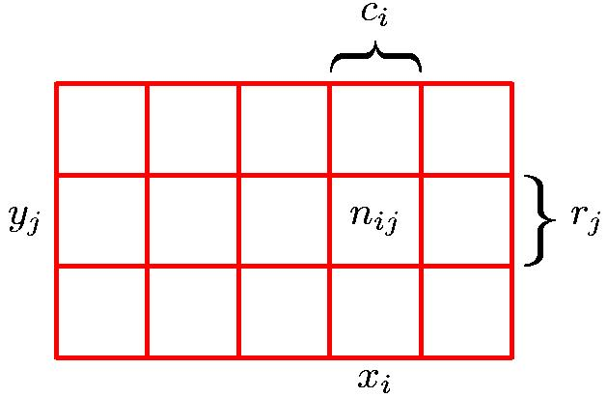
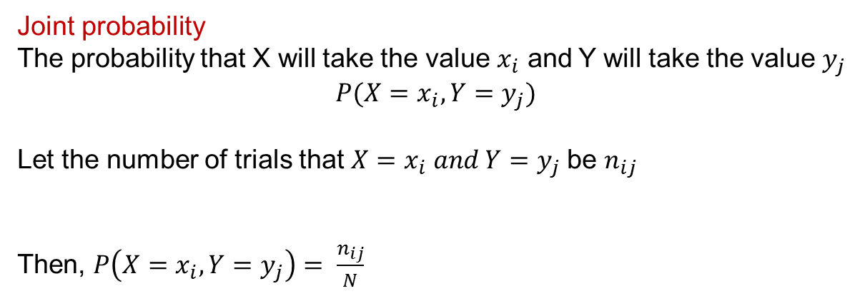
Joint Probability (Discrete)
 | F = o | F= a | Total
B = r | 30 | 10 | 40
B = b | 15 | 45 | 60
 | 45 | 55
Joint probability
The probability that X will take the value $x_{i}$ and Y will take the value $y_{j}$
$$P(X=x_{i},Y=y_{j})$$
Let the number of trials that $X=x_{i} and Y=y_{j}$be $n_{ij}$
Then, $P\left(X=x_{i}, Y=y_{j}\right)= \frac{n_{ij}}{N}$
Adapted from Dr Christopher Bishop’s slides

Slide 8
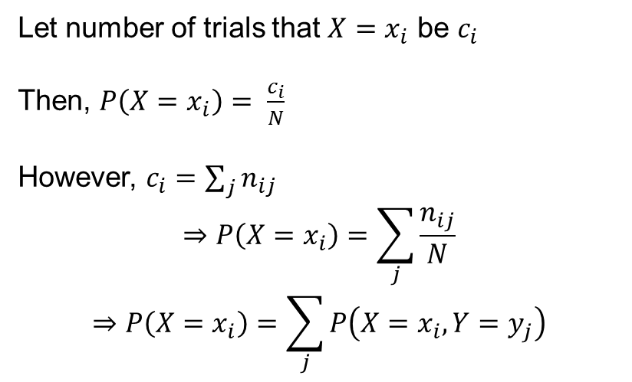
Sum Rule
 | F = o | F= a | Total
B = r | 30 | 10 | 40
B = b | 15 | 45 | 60
 | 45 | 55
Let number of trials that $X=x_{i}$ be $c_{i}$
Then, $P\left(X=x_{i}\right)= \frac{c_{i}}{N}$
However, $c_{i}=\sum_{j}{n_{ij}}$
$$⇒P\left(X=x_{i}\right)=\sum_{j}{\frac{n_{ij}}{N}}$$
$$⇒P\left(X=x_{i}\right)=\sum_{j}{P\left(X=x_{i},Y=y_{j}\right)}$$
Marginal probability
Sum rule of probability
Adapted from Dr Christopher Bishop’s slides

Slide 9
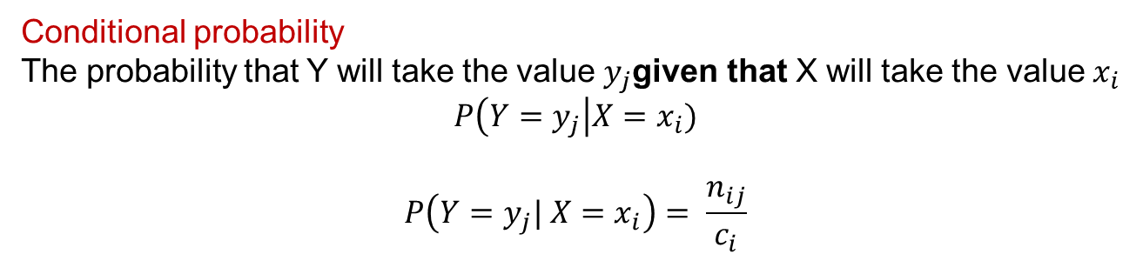
Conditional Probability
 | F = o | F= a | Total
B = r | 30 | 10 | 40
B = b | 15 | 45 | 60
 | 45 | 55
Conditional probability
The probability that Y will take the value $y_{j}$given that X will take the value${ x}_{i}$
$$P\left(Y=y_{j}\right|X=x_{i})$$
$$P\left(Y=y_{j}| X=x_{i}\right)= \frac{n_{ij}}{c_{i}}$$
Adapted from Dr Christopher Bishop’s slides

Slide 10
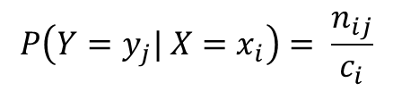

Product Rule
 | F = o | F= a | Total
B = r | 30 | 10 | 40
B = b | 15 | 45 | 60
 | 45 | 55
$$P\left(Y=y_{j}| X=x_{i}\right)= \frac{n_{ij}}{c_{i}}$$
$$P\left(X=x_{i}, Y=y_{j}\right)= \frac{n_{ij}}{N}$$
$$⇒ P\left(X=x_{i}, Y=y_{j}\right)=P\left(Y=y_{j}| X=x_{i}\right)P\left(X=x_{i}\right)$$
Product rule of probability
Adapted from Dr Christopher Bishop’s slides

Slide 11
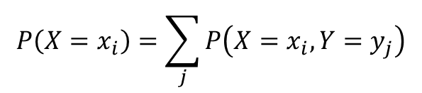
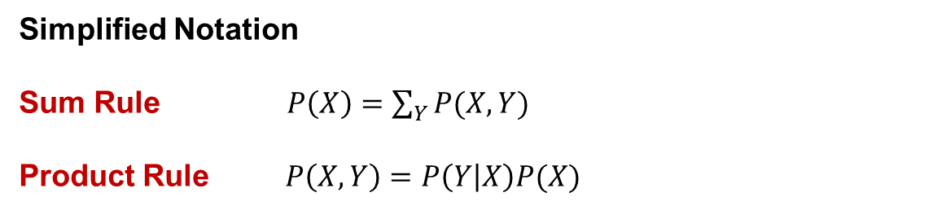
Rules of Probability
(Simplified notation)
$$P\left(X=x_{i}\right)=\sum_{j}{P\left(X=x_{i},Y=y_{j}\right)}$$
Sum rule of probability
$$P\left(X=x_{i}, Y=y_{j}\right)=P\left(Y=y_{j}| X=x_{i}\right)P\left(X=x_{i}\right)$$
Product rule of probability
Simplified Notation
Sum Rule $P\left(X\right)=\sum_{Y}{P(X,Y)}$
Product Rule $P\left(X,Y\right)=P\left(Y | X\right)P(X)$

Slide 12
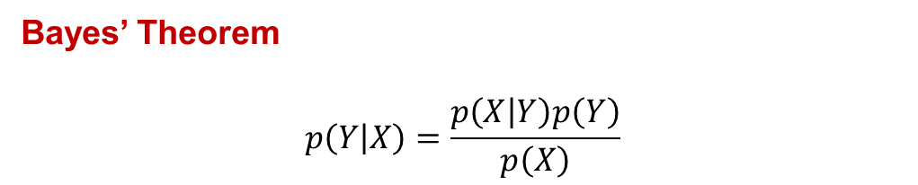
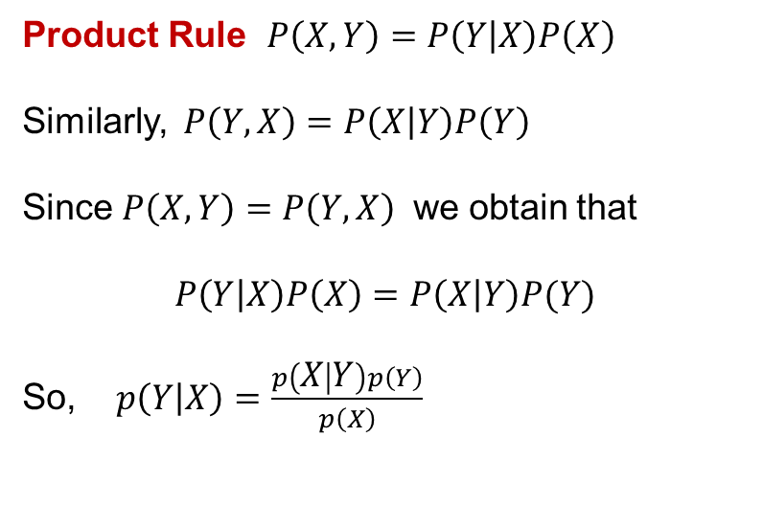
Bayes’ Theorem
Product Rule $P\left(X,Y\right)=P\left(Y | X\right)P\left(X\right)$
Similarly, $P\left(Y,X\right)=P\left(X | Y\right)P\left(Y\right)$
Since $P\left(X,Y\right)=P\left(Y,X\right)$ we obtain that
$$P\left(Y | X\right)P\left(X\right)=P\left(X | Y\right)P(Y)$$
So, $p\left(Y | X\right)=\frac{p\left(X | Y\right)p\left(Y\right)}{p\left(X\right)}$
Bayes’ Theorem
$$p\left(Y | X\right)=\frac{p\left(X | Y\right)p\left(Y\right)}{p\left(X\right)}$$

