Slide 1
Chapter 8
Christopher M. Bishop
Pattern Recognition and Machine Learning
Reviewer : Sunwoo Kim
Yonsei University
Department of Applied Statistics

Slide 2
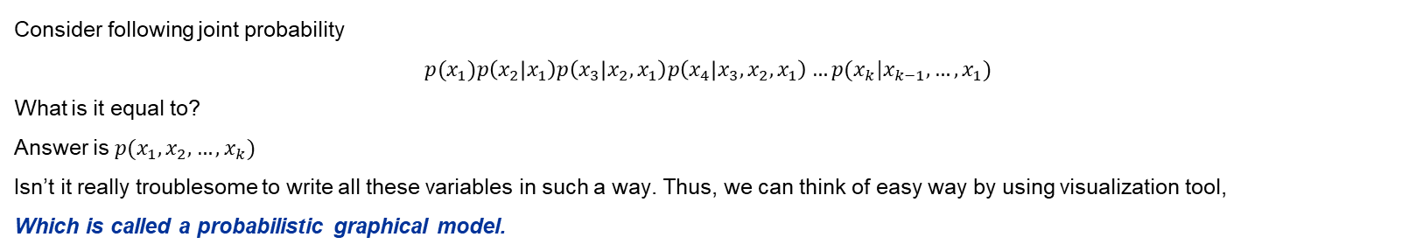
Chapter 8. Probabilistic Graphical Models
Expressing probability in a simple way
Consider following joint probability
$$p(x_{1})p\left(x_{2} | x_{1}\right)p\left(x_{3} | x_{2},x_{1}\right)p\left(x_{4} | x_{3},x_{2},x_{1}\right)…p(x_{k}|x_{k−1},…,x_{1})$$
What is it equal to?
Answer is $p(x_{1},x_{2},…,x_{k})$
Isn’t it really troublesome to write all these variables in such a way. Thus, we can think of easy way by using visualization tool,
Which is called a probabilistic graphical model.
Node : Random Variable
Directed graphical models : A graph which has a direction in edge.
Good in capturing casual relationships(conditional terms)
Undirected graphical models : A graph which its edge does not carry direction.
Good in expressing soft constraints
Now, let’s take an example!
Edge : Probabilistic relationships

Slide 3
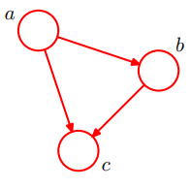
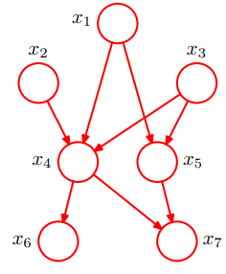
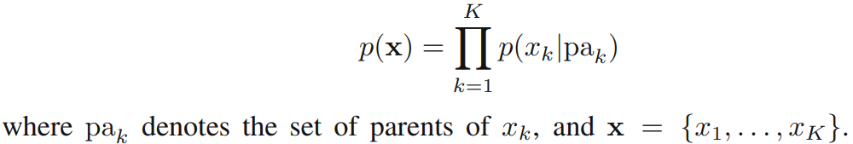
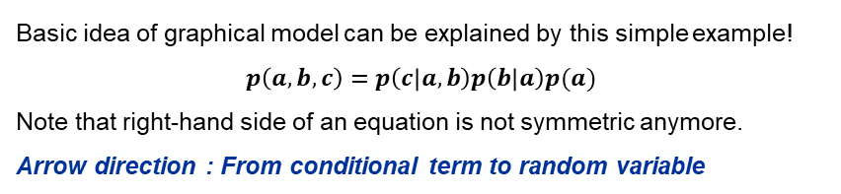
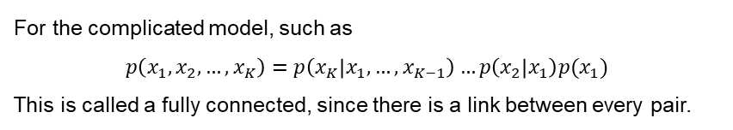
Chapter 8.1. Bayesian Networks
Modeling joint probability
Basic idea of graphical model can be explained by this simple example!
$$p\left(a,b,c\right)=p\left(c | a,b\right)p\left(b | a\right)p(a)$$
Note that right-hand side of an equation is not symmetric anymore.
Arrow direction : From conditional term to random variable
For the complicated model, such as
$$p\left(x_{1},x_{2},…,x_{K}\right)=p\left(x_{K} | x_{1},…,x_{K−1}\right)…p\left(x_{2} | x_{1}\right)p(x_{1})$$
This is called a fully connected, since there is a link between every pair.
In general, we can say…
There are some much complicated form like…
Like left figure, if there does not exist any cycle, such network is called directed acyclic network.

Slide 4
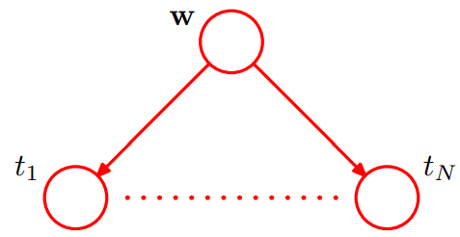
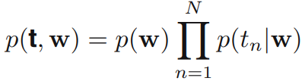
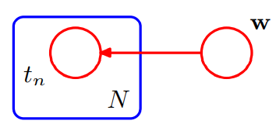
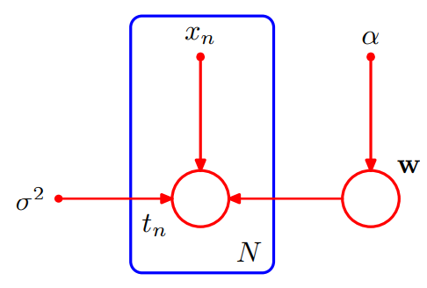
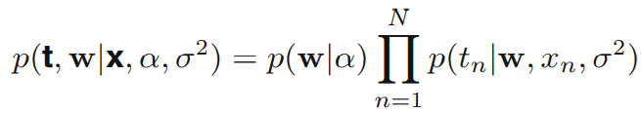
Chapter 8.1. Bayesian Networks
Polynomial regression
Let’s think of Bayesian polynomial regression with N-independent data. We assume a distribution of parameter $w$.
Overall equation can be left-hand side equation, and corresponding figures are right-hand side.
Original form
Original equation
Simplified form
Let’s think of model with more parameters (param for prior and variance.)
Note that this blue box indicates N number of observations, and they are expressed in a form of joint product!

Slide 5
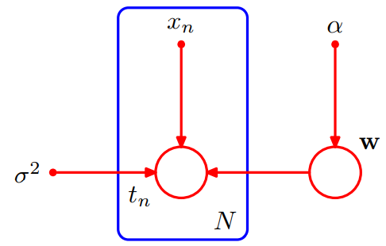
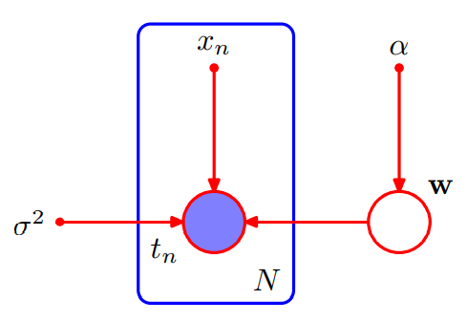
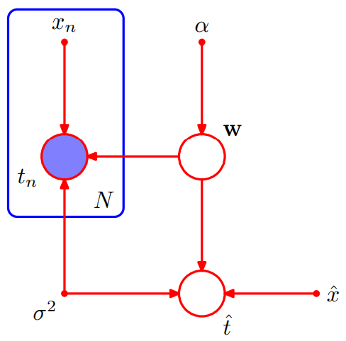

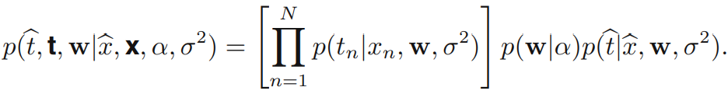
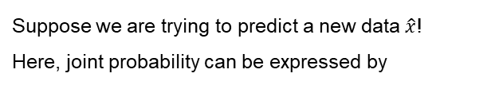
Chapter 8.1. Bayesian Networks
Representation of Observed data
Data $t$ might be observed, or not.
Left hand side expresses the general form, and the right one shows the case of observed data.
To exactly generate predictive distribution, we need…
Suppose we are trying to predict a new data $\hat{x}$!
Here, joint probability can be expressed by
Remember some Laplace approximation and other integral methods!

Slide 6
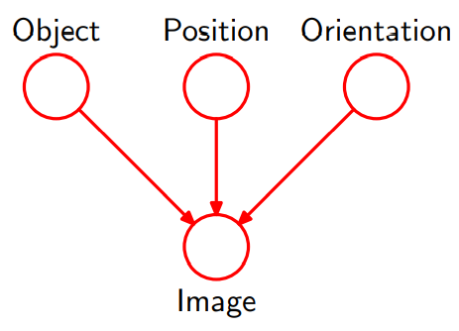
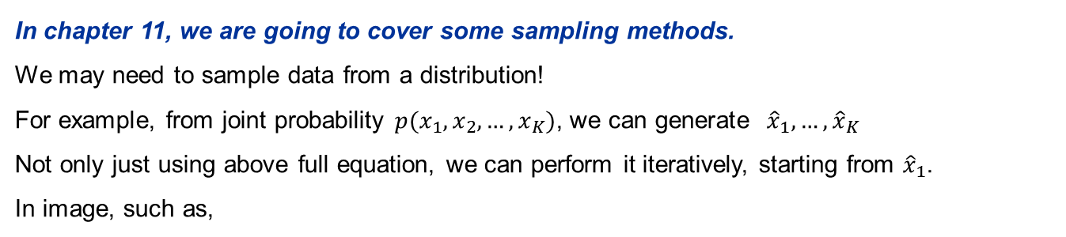
Chapter 8.1. Bayesian Networks
Generative models
In chapter 11, we are going to cover some sampling methods.
We may need to sample data from a distribution!
For example, from joint probability $p(x_{1},x_{2},…,x_{K})$, we can generate ${\hat{x}}_{1},…,{\hat{x}}_{K}$
Not only just using above full equation, we can perform it iteratively, starting from ${\hat{x}}_{1}$.
In image, such as,
Likewise, we consider there is a latent variable beneath the observed data & distribution!
We may interpret hidden variable like in image, but sometimes we cant.
Still, it is useful in modeling some complicated probability models!

Slide 7

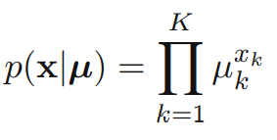

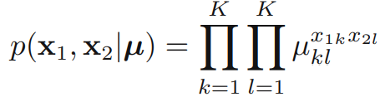

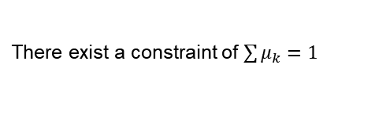
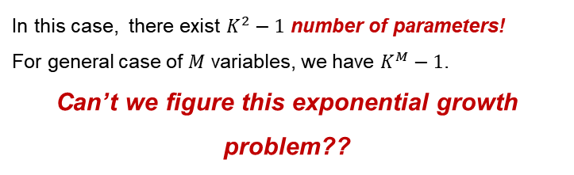
Chapter 8.1. Bayesian Networks
Discrete variables
Exponential family :
Many famous distributions are exponential family, and they form useful building blocks for constructing more complex probability!
If we choose such distributions as parent & child node of graph, we can get many nice properties!
Let’s take a look!
Consider multinomial distribution.
There exist a constraint of $\sum{μ_{k}}=1$
Let’s extend this univariate example to two-variables case.
That is, we are observing event of $x_{1k}=1$ & $x_{2l}=1$ / Note that they are not totally independent! Joint probability is not just product of $μ_{k}∗μ_{l}$
In this case, there exist $K^{2}−1$ number of parameters!
For general case of $M$ variables, we have $K^{M}−1$.
Can’t we figure this exponential growth problem??

Slide 8
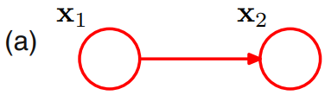
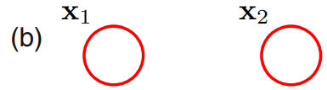
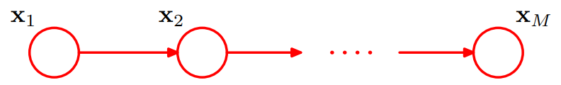
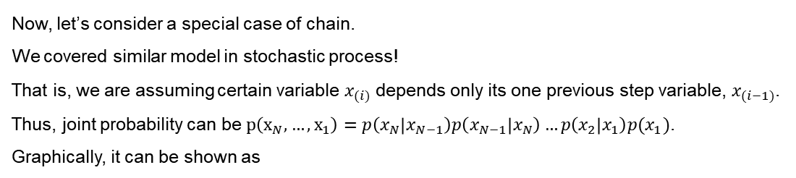


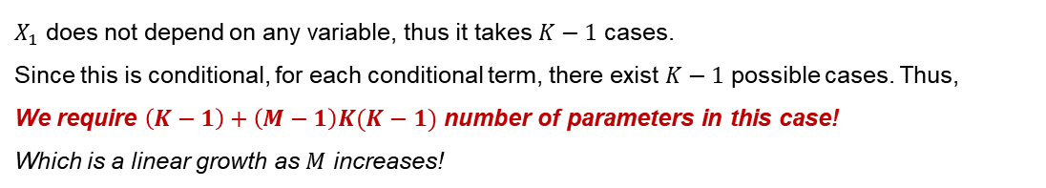
Chapter 8.1. Bayesian Networks
Independence
We can figure it out by assuming independence! Then, calculation gets much! Much! simple!
$$p\left(X_{1},X_{2}\right)=p\left(X_{1}\right)p(X_{2})$$
In this case, we are containing $2(K−1)$ number of parameters! In general case of $M$ variables, we have $K(M−1)$
$$p\left(X_{1},X_{2}\right)=p\left(X_{2}|X_{1}\right)p(X_{1})$$
$$p\left(X_{1},X_{2}\right)=p\left(X_{2}\right)p(X_{1})$$
Chain approach
Now, let’s consider a special case of chain.
We covered similar model in stochastic process!
That is, we are assuming certain variable $x_{(i)}$ depends only its one previous step variable, $x_{(i−1)}$.
Thus, joint probability can be $p\left(x_{N},…,x_{1}\right)=p\left(x_{N} | x_{N−1}\right)p\left(x_{N−1} | x_{N}\right)…p\left(x_{2} | x_{1}\right)p(x_{1})$.
Graphically, it can be shown as
$X_{1}$ does not depend on any variable, thus it takes $K−1$ cases.
Since this is conditional, for each conditional term, there exist $K−1$ possible cases. Thus,
We require $\left(K−1\right)+\left(M−1\right)K(K−1)$ number of parameters in this case!
Which is a linear growth as $M$ increases!

Slide 9
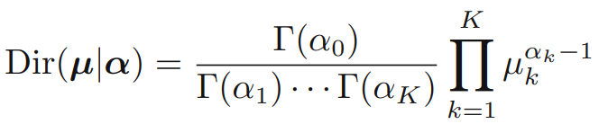
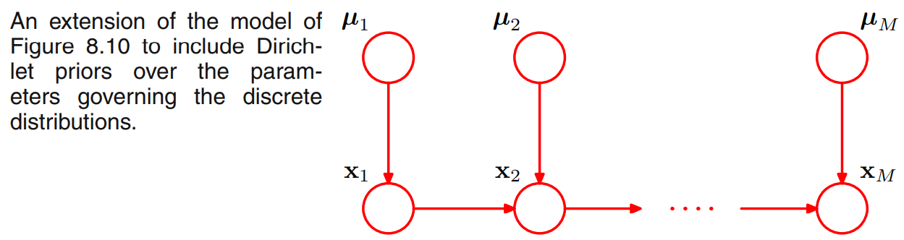
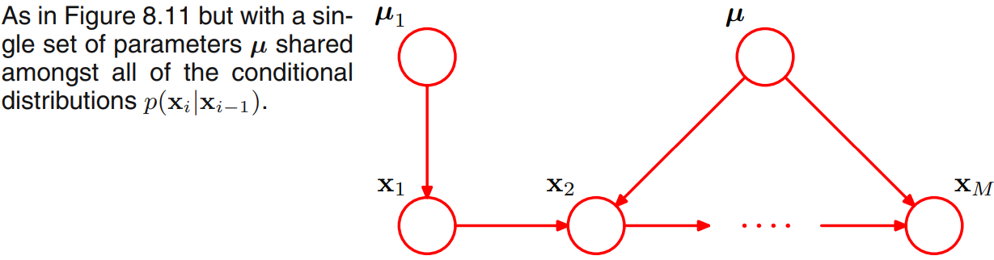
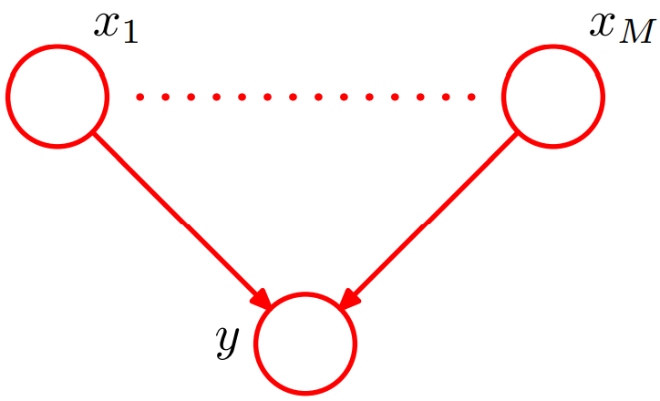
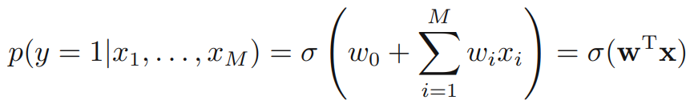
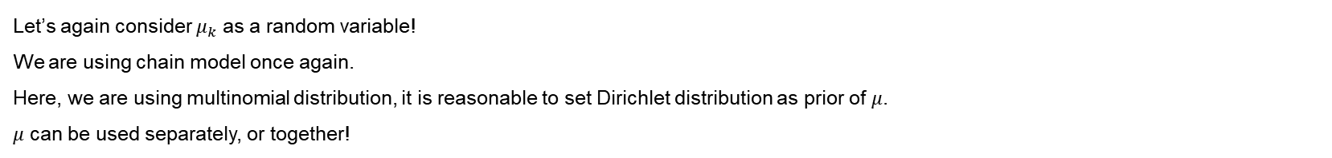
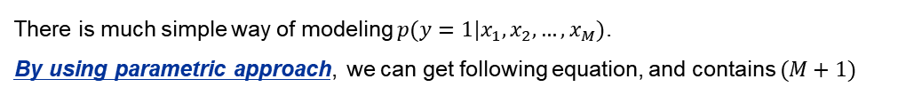
Chapter 8.1. Bayesian Networks
Bayesian approach
Let’s again consider $μ_{k}$ as a random variable!
We are using chain model once again.
Here, we are using multinomial distribution, it is reasonable to set Dirichlet distribution as prior of $μ$.
$μ$ can be used separately, or together!
Parameterized models
There is much simple way of modeling $p(y=1|x_{1},x_{2},…,x_{M})$.
By using parametric approach, we can get following equation, and contains $(M+1)$

Slide 10
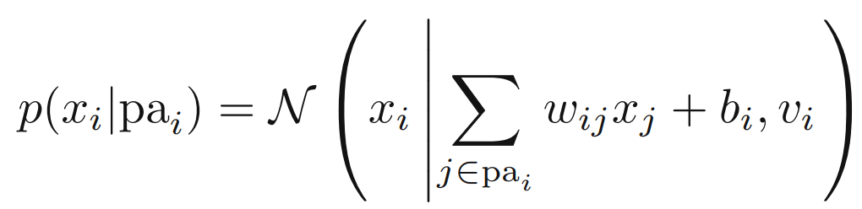
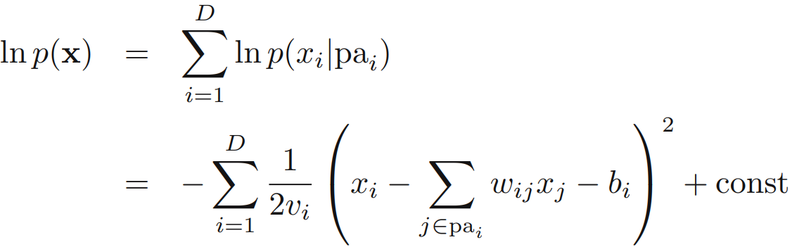
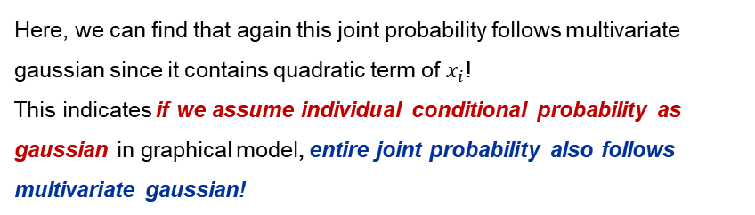
Chapter 8.1. Bayesian Networks
Linear-Gaussian models
We can express multivariate gaussian by graphical models.
Let’s think of arbitrary directed acyclic graph. We assume $p(x_{i}|pa_{i})$ follows gaussian, and its parameters are
By using this, we can extend this idea to the joint probability, by
Here, we can find that again this joint probability follows multivariate gaussian since it contains quadratic term of $x_{i}$!
This indicates if we assume individual conditional probability as gaussian in graphical model, entire joint probability also follows multivariate gaussian!
But here, it is not written how to estimate the value of $w_{ij}$. I don’t have any idea of how to get it…
If we assume we know $w \& b$ values, we can estimate mean and covariance of joint probability!

Slide 11
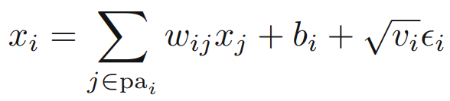
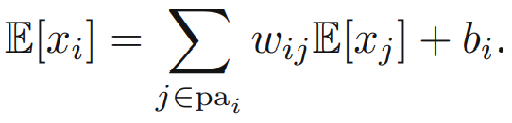

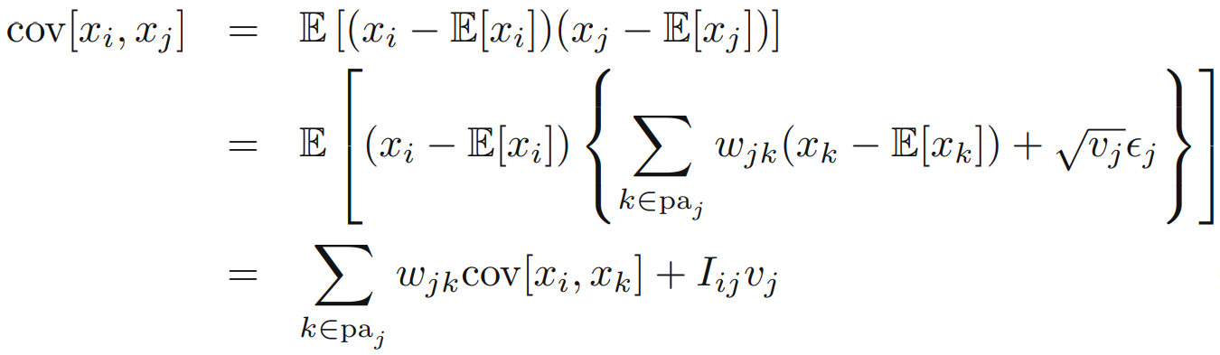
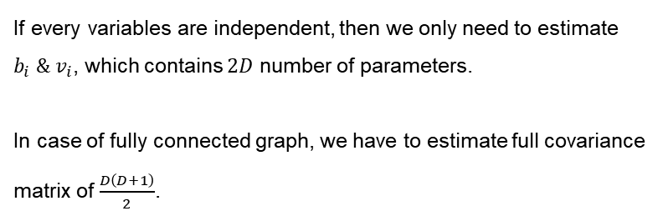
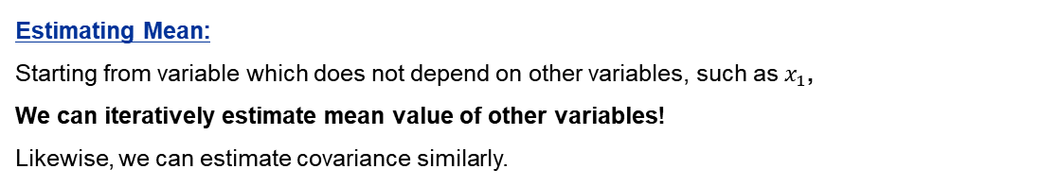
Chapter 8.1. Bayesian Networks
Linear-Gaussian models
Each variable $x_{i}$ can be written as
All these idea can be connected to the
Hierarchical bayes model!
Which assumes the prior of prior,
Which is called hyperprior!
Here, error term $ε_{i}$ follows gaussian distribution.
Estimating Mean:
Starting from variable which does not depend on other variables, such as $x_{1}$,
We can iteratively estimate mean value of other variables!
Likewise, we can estimate covariance similarly.
If every variables are independent, then we only need to estimate
$b_{i} \& v_{i}$, which contains $2D$ number of parameters.
In case of fully connected graph, we have to estimate full covariance matrix of $\frac{D\left(D+1\right)}{2}$.

Slide 12
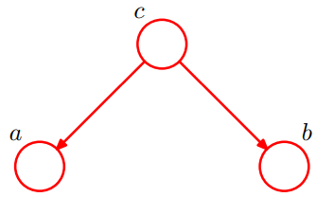


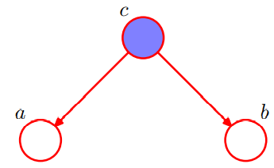
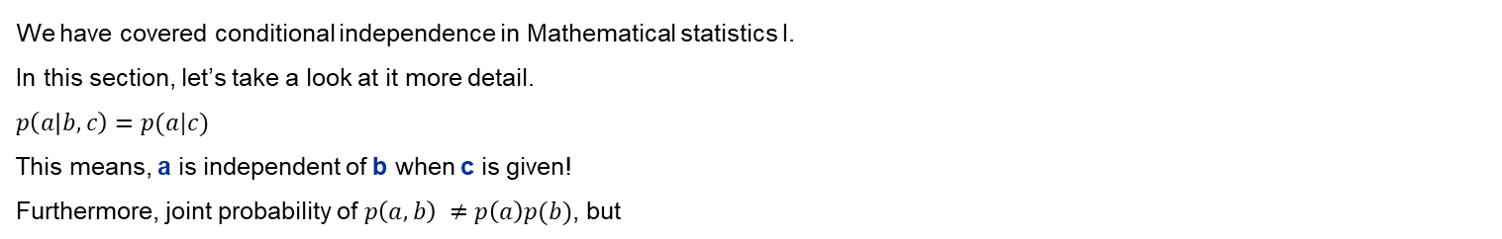
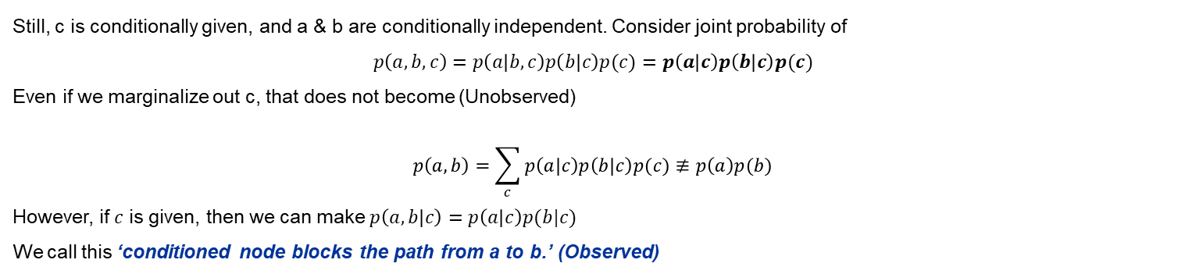
Chapter 8.2. Conditional Independence
Ideation
We have covered conditional independence in Mathematical statistics I.
In this section, let’s take a look at it more detail.
$p\left(a | b,c\right)=p(a|c)$
This means, a is independent of b when c is given!
Furthermore, joint probability of $p\left(a,b\right) ≠p\left(a\right)p(b)$, but
Conditional independence can be notated by
This is significant in various machine learning tasks. Let’s take an example.
Tail-to-tail
Still, c is conditionally given, and a & b are conditionally independent. Consider joint probability of
$$p\left(a,b,c\right)=p\left(a | b,c\right)p\left(b | c\right)p(c)=p\left(a | c\right)p\left(b | c\right)p(c)$$
Even if we marginalize out c, that does not become (Unobserved)
$$p\left(a,b\right)=\sum_{c}{p\left(a | c\right)p\left(b | c\right)p(c)≢p\left(a\right)p(b)}$$
However, if $c$ is given, then we can make $p\left(a,b | c\right)=p\left(a | c\right)p(b|c)$
We call this ‘conditioned node blocks the path from a to b.’ (Observed)

Slide 13


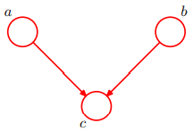
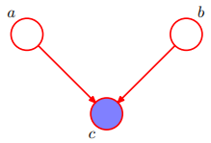
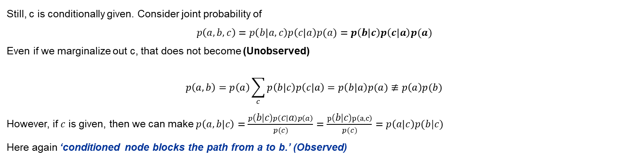
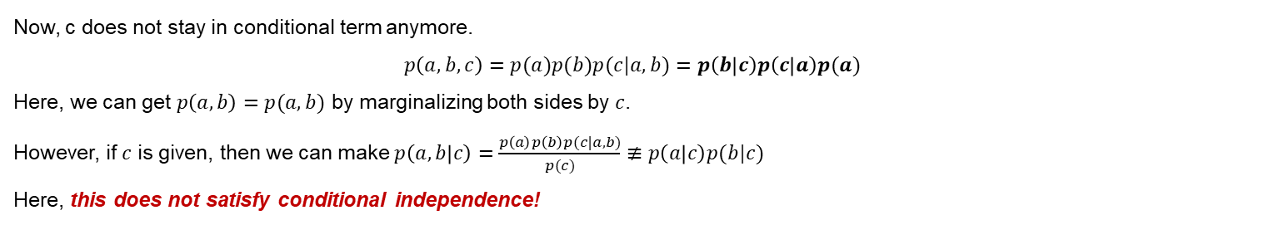
Chapter 8.2. Conditional Independence
Head-to-tail
Still, c is conditionally given. Consider joint probability of
$$p\left(a,b,c\right)=p\left(b | a,c\right)p\left(c | a\right)p(a)=p\left(b | c\right)p\left(c | a\right)p(a)$$
Even if we marginalize out c, that does not become (Unobserved)
$$p\left(a,b\right)=p\left(a\right)\sum_{c}{p\left(b | c\right)p\left(c | a\right)}=p\left(b | a\right)p(a)≢p\left(a\right)p(b)$$
However, if $c$ is given, then we can make $p\left(a,b | c\right)=\frac{p\left(b | c\right)p\left(c | a\right)p\left(a\right)}{p(c)}=\frac{p\left(b | c\right)p\left(a,c\right)}{p(c)}=p\left(a | c\right)p(b|c)$
Here again ‘conditioned node blocks the path from a to b.’ (Observed)
Head-to-head
Now, c does not stay in conditional term anymore.
$$p\left(a,b,c\right)=p(a)p(b)p(c|a,b)=p\left(b | c\right)p\left(c | a\right)p(a)$$
Here, we can get $p\left(a,b\right)=p(a,b)$ by marginalizing both sides by $c$.
However, if $c$ is given, then we can make $p\left(a,b | c\right)=\frac{p\left(a\right)p\left(b\right)p(c|a,b)}{p(c)}≢p\left(a | c\right)p(b|c)$
Here, this does not satisfy conditional independence!

Slide 14
Chapter 8.2. Conditional Independence
General result summary
Parent node (Ancestor)
Independence of different events depend on the fact that
Whether its ancestor and descendant is observed or not.
Details are covered in the below table.
Not blocked means they are having dependent structure.
Blocked means they are having independent structure either by themselves or conditioned.
Child node (Descendant)
 | Unobserved | Observed
Tail to Tail | Not blocked | Blocked
Head to tail | Not blocked | Blocked
Head to head | Blocked | Not blocked

Slide 15








Chapter 8.2. Conditional Independence
Example of this approach
Three variables.
Battery : {0, 1}
Fuel : {0, 1}
Gauge : {0, 1}
This fits our intuition that as battery is already empty, likelihood of fuel tank is also empty when gauge says its empt$y^{1}$ is, much smaller than when only gauge says its empty!
This means battery and fuel is not conditionally independent while state of gauge is given.
This indicates $p\left(F=0 | G=0\right)>p(F=0)$.
This fits our intuition, because the probability of fuel is empty
when gauge says its empty is much bigger than itself says its empty is a common sense!

Slide 16




Chapter 8.2. Conditional Independence
D-separation
Can we identify whether a relation of satisfies by just looking at directed graph?
Let’s think of paths from $A$ to $B$. Any such path is blocked if it includes a node such that either…
Arrows on the path meet either
Head – to – tail
Tail – to – tail
And the node is in the set C.
Arrows on the path meet
Head – to – head
Neither the node, nor any of its descendants, is in the set $C$.
Here, if all paths are blocked, A is said to be d-separated from B by C, and joint distribution satisfies
First and second example!
Last example!
Path from a to b is not blocked by c,
Because node e is head-to-head, but its descendant is c.
Path from a to b is blocked by f,
Because node f is tail-to-tail and observed!

Slide 17





Chapter 8.2. Conditional Independence
I.I.D. (Independent and identically distributed)
Consider the joint probability of $N$ random samples which follow I.I.D. univariate gaussian distribution. That is, $p\left(D | μ\right)=\prod_{n=1}^{N}{p(x_{n}|μ)}$
$$p\left(D | μ\right)=\prod_{n=1}^{N}{p(x_{n}|μ)}$$
Here, note that every data $x$ are conditionally independent given $μ.$ Thus, each data themselves do not become independent even if we integrated $μ$ out! (Tail to tail)
Furthermore, bayes polynomial model is also an example of this i.i.d. data model.
This indicates $t_{n} \& \hat{t}$ is conditionally independent while $w$ is given!
This is pretty intuitive that as model parameter $w$ is given, predictive distribution is independent of training data.
This is what we originally intended!

Slide 18


Chapter 8.2. Conditional Independence
Naïve Bayes model
I brought detail explanation of naïve bayes from Wikipedia!
As we all know, input features are not independent.
However, we can treat input features as conditionally independent while $C_{k}$ is given!
This is useful when we model data which consists of both discrete and continuous type.
We can approximate discrete to multinomial and continuous to gaussian!

Slide 19




Chapter 8.2. Conditional Independence
Role of graphical model
Specific directed graph represents a specific decomposition of a joint probability distribution into a product of conditional probabilities.
Here, we can think of d-separation theorem and its graph as a filter of distribution!
That is, we can express overall distribution in much simpler form.
There is a term called ‘Markov blanket or Markov boundary’. This helps us simplify overall distribution either!
From this, terms that do not depend on $x_{i}$ either on conditional term or probability term are cancelled out. Remaining terms are one depend on $x_{i}$
We can think of right-hand side graph as a minimal set of $x_{i}$ that can be isolated from graph

Slide 20



Chapter 8.3. Markov Random Fields
Conditional independence properties
We have covered some directed network. Now, lets take a look at ‘undirected’ one!
One major problem of directed network was the presence of ‘head-to-head’ nodes.
We can simplify this problems by using undirected network!
To check whether conditionally independence satisfy, find all paths that connect $A \& B$.
Here, above statement satisfies, because as we remove all nodes in set $C$, there does not exist any path that connects set $A$ and $B$.
** This is my personal Idea.
For me, it was much easier to understand overall idea by thinking the connection between two nodes as just ‘probabilistic relationship’.
For now, let’s forget the conditional term. This just contains

Slide 21





Chapter 8.3. Markov Random Fields
Factorization properties
Here, we are trying to model joint probability in much practical way!
Let’s see how general probability can be expressed in undirected graph!
Conditional probability was expressed by arrow in the directed model.
Here, we need a concept of a ‘clique’. Clique is a fully-connected subgraph.
Here, we can think clique as a building block of joint probability.
Here, let’s denote a clique by $C$ and set of variables in that clique by $X_{C}$.
Furthermore, we can define arbitrary function of $C$, a potential function over maximal cliques $ψ_{C}(X_{C})$.
That is, joint probability can be expressed by the product of the functions of maximal cliques.
In fact, this $p(X)$ may not be pure probability, thus we need normalizing constant $Z$.
However, for $M$ discrete nodes over $K$ states, possible case might be $K^{M}$, which has the exponent growth.
However, we don’t need to normalize probability all the time! (Example will be soon covered!)
One of the popular case is using Boltzmann distribution with energy function $E(X_{C})$.
Here, potential function do not have specific interpretation. Rather, we can set it according to our intuition and purpose.

Slide 22






Chapter 8.3. Markov Random Fields
Example. Image de-noising
Let’s say original image as t, and $t_{i}$ as its individual pixel.
We are trying to erase noise from the noise figure.
Noise image can be $y_{i}$, and estimated image $x_{i}$.
We are iteratively erasing noise of the image.
Adjacent pixels should have similar pixel value!
Difference from raw data
Scalar $h, β, η≥0$ is common setting.
As training goes on…
Overall energy should be decreased,
Joint probability should be increased.

Slide 23





Chapter 8.3. Markov Random Fields
Relation to directed graphs
We have covered two ways of graphical models.
Directed was good in modeling conditional probability, while undirected gave intuitive and practical approach.
Let’s find the connection between them.
From (a), equation $p(x_{4}|x_{1},x_{2},x_{3})$ includes every variables.
Thus, we can merge every nodes like (b), which is called moralization. This graph is called moral graph.

Slide 24






Chapter 8.4. Inference in Graphical Models
Relation to directed graphs
Let’s think of how to get $p(x_{n})$ from the joint probability of $(x_{1},x_{2},…,x_{N})$.
Intuitively, for the discrete case, we can marginalize all other variables in a joint probability.
Some of them might be observed, and some would not.
For the simple example, we can think of how to get $p(x|y)$ from the above example (Example of posterior)
$p\left(x,y\right)=p\left(x\right)p(y|x)$, by using this, we can re-express
This was a simple example. Let’s now consider much complicated one
Since this model is much simpler than fully-connected graph model($K^{N}$), we only contain $(N−1)K^{2}$ number of parameters.
To get marginal density of $p(x_{N})$, we can simply sum up all other variables.

Slide 25




Chapter 8.4. Inference in Graphical Models
Inference on Chain
Consider the chain example we have just saw.
Summation over last variable $x_{N}$ only includes $ψ_{N−1,N}$. Thus, formula can be
So, in order to get the marginal distribution of $x_{N}$, which locates somewhere between them, we have to come from both sides.

Slide 26





Chapter 8.4. Inference in Graphical Models
Inference on Chain
Here, $μ_{α}$ and $μ_{β}$ are as follows..
This process of marginalizing can be called as ‘message passing’.
This kind of one-step dependent approach,
We call this ‘Markov chain’.
Let’s think we want to compute $p\left(x_{1}\right),p\left(x_{2}\right),…,p(x_{N})$ respectively.
Then we have complexity of $N X N\left(K^{2}\right)=O(N^{2}K^{2})$. Which has quadratic complexity with respect to number of elements.
Is it efficient? Obviously not. Because the bottom-up ($μ_{α}$) in $p(x_{N−1})$ and $p(x_{N})$ only have a single term difference!
Thus, to compute overall algorithm much efficiently, we have to store calculated values for each step.
If there exist an observed data in the process,
We do not need to sum up that variable. We only need to compute it into the equation!
That is, $x_{k}=\hat{x_{k}}$
Marginal density of joint probability can be expressed by

Slide 27

Chapter 8.4. Inference in Graphical Models
Trees
We can perform similar message passing by using ‘Trees’.
We have seen various decision trees in many undergraduate classes.
Here, structure of tree is same, but the node corresponds to the random variables.
Thus, details of tree structure need not to be covered (may be..?)
One special thing that need to be noticed is that basic tree’s node has at most one parent node.
A tree which contains more than one parent is called a polytree (Figure c).
Note that tree structure does not contain any loop (Since there does not exist any way going upside.)

Slide 28




Chapter 8.4. Inference in Graphical Models
Factor graphs
Consider ‘soo-neung’.
What do we try to measure? We try to measure a student’s capability of understanding, comprehension, or their intelligence.
Can we measure the intelligence directly? Of course not. It is an object that exists in a latent dimension, which we cannot observe.
Thus, we are using pseudo measure, such as exam score, IQ. Which can reflect one’s intelligence.
Thus, exam score is a data, and intelligence is a factor.
Now, let’s extend this idea to the data and probability.
We believe joint probability of data can be expressed by the product of some factor.
Here, factor $f_{S}$ is a function of a corresponding set of variables $x_{S}$.
For graph, in addition to the original data node, we add some factor nodes.
As you can see, factor graph is a bipartite graph.
Bipartite graph means a graph which has two sets of nodes.
Each set of node only has connection with other set.
And two sets are disjoint to each other.
Bipartite G.
Figure from Wikipedia!

Slide 29






Chapter 8.4. Inference in Graphical Models
Examples of factor graph
Undirected graph
Maximal clique with factor variable $f$.
Can also be expressed in this!
Directed graph
Maximal clique with factor variable $f$.
Can also be expressed in this!
As we can see, one undirected network can be expressed in many kinds of factor graphs.
As we can see, one directed network can be expressed in many kinds of factor graphs.
Factor graph of tree also becomes tree
Like undirected network!
Factors can be set between variable!

Slide 30

Chapter 8.4. Inference in Graphical Models
The sum-product algorithm
My major interest is Graph Neural Network(GNN).
Here, I think understanding overall architecture of GNN gives help in understanding.
GNN passes its information through edges, aggregates necessary information.
From Jure Leskovec CS224W (My favorite prof. )
For now, we don’t need to understand what those neural networks are. Rather, please focus on the idea that ‘We are aggregating information!’
In our example of probability graph, we are aggregating information by using sum & product!
This is called belief propagation, which is also known as sum-product algorithm.

Slide 31



Chapter 8.4. Inference in Graphical Models
The sum-product algorithm
As you can see,
We merge information via product term.
Here, please check that information from the backward terms are not being decomposed!
We just let them be some constant.

Slide 32






Chapter 8.4. Inference in Graphical Models
The sum-product algorithm
Aggregation of edges : Product
Aggregation of $f_{S}$ values : Sum
Here, we define $μ →f(x)$ link
In the following page!

Slide 33






Chapter 8.4. Inference in Graphical Models
The sum-product algorithm
Aggregation of edges : Product
Here, we do not need to consider factor values!
Note that this link connects
$f$ to $x$!

Slide 34




Chapter 8.4. Inference in Graphical Models
The sum-product algorithm
When we are doing something with the leaf nodes…
Note that there are two kinds of link,
From factor to data, $μ_{f →x}$ : This contains summation with product
From data to factor, $μ_{x →f}$ : This only contains product
Suppose we are trying to get marginal probability for every nodes in the graph.
Performing propagation for every nodes from the beginning is very inefficient.
Here, note that the message passing is independent from which node has been designated as root.
Thus, we can save or moving in a reverse order to compute the passing value.
For the joint set, we can simply compute this function of
As we have seen, link from variable to factor is a simple product of factor to nodes.
Thus, we can make entire process much simpler by eliminating this
Variable to factor links.

Slide 35





Chapter 8.4. Inference in Graphical Models
Normalization
If we start from directed graph which is intrinsically conditional probability, we don’t need to compute normalizing constant Z.
For undirected, we need to compute normalization constant $Z$ to make a probability.
Easy way of find this constant $Z$ is by marginalizing $p(x_{i})$. Once $p(x_{i})$ is being solved, we can get it by simply getting
$$p\left(\hat{x_{i}}\right)=\frac{p\left(x_{i}\right)}{\sum{p(x_{i})}}$$
Let’s understand overall algorithm with a simple example!
Simple Example for sum-product algorithm
Our goal of computation!

Slide 36


Chapter 8.4. Inference in Graphical Models
Normalization
If we start from directed graph which is intrinsically conditional probability, we don’t need to compute normalizing constant Z.
For undirected, we need to compute normalization constant $Z$ to make a probability.
Easy way of find this constant $Z$ is by marginalizing $p(x_{i})$. Once $p(x_{i})$ is being solved, we can get it by simply getting
$$p\left(\hat{x_{i}}\right)=\frac{p\left(x_{i}\right)}{\sum{p(x_{i})}}$$
Let’s understand overall algorithm with a simple example!
Simple Example for sum-product algorithm
Our goal of computation!
Here, let $x_{3}$ be the root!

Slide 37



Chapter 8.4. Inference in Graphical Models
Example of sum-product algorithm
Now, let’s see with a specific probability!
We have considered every variable as unobserved variables.
Now, let’s assume some of them are observed in the set of variables.
Then, we can simply multiply indicator function of observed data to the joint probability $p\left(x\right)∗\prod{I(v_{i},\hat{v_{i}})}$
Where indicator gives 1 for $v_{i}=\hat{v_{i}}$ o.w. 0.
This means we are generating $p(h , v=\hat{v})$, that we can ignore the hidden summation of $v_{i}$ term.
(Actually, for the observed condition, I can’t get some of them intuitively. Thus, someone who understood this notion well may explain it instead of me ☹)

Slide 38







Chapter 8.4. Inference in Graphical Models
Max-Sum Algorithm
In sum-product, we have found the joint distribution $p(X)$ with a factor graph.
Here, we are going to find the setting of variables that has the largest probability.
Problem is that we cannot generate it from the naïve individual $p(x_{i})$. Bottom example tells why.
Here, by computing marginal distribution, we get
$$p\left(x=0\right)=0.6, p\left(x=1\right)=0.4, p\left(y=0\right)=0.7 p\left(y=1\right)=0.3$$
There exist a difference between marginal max, and joint max.
Thus, we have to use joint max!
By using
Here, every algorithm is same with sum-product!
Thus, message passing and other mechanisms are same!
Just summation is replaced by maximization.
Furthermore, we use monotonic function log to get computational convenience!

Slide 39




Chapter 8.4. Inference in Graphical Models
Max-Sum Algorithm
Everything go in a similar way!
Summation was replaced by maximization!
Initial value of transmitting!
Maximum probability can be computed as
Here, corresponding $x$ value can be
To obtain the estimated value, we again use message passing of different kinds!
Unlike other common MLE problem, parameters exist in a complicated joint structure.
Thus, we are using iterative (sequential) method to get estimation!

Slide 40







Chapter 8.4. Inference in Graphical Models
Max-Sum Algorithm
Initial value!
Here, we are tracking back the maximized value of $x_{N}$ to compute previous $x_{N−1}$
Then, we are moving along the black line to back-propagate the maximized values!
For efficient calculation for max value, we store the computed maximized value $x^{Max}$ since they can be reused to compute other state of variables!
Application of this model is a Hidden Markov Model!

