Slide 1
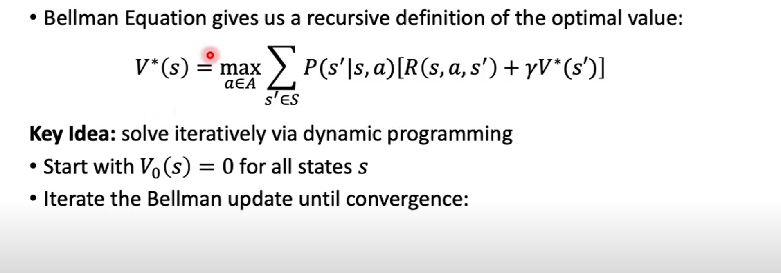
Solving MDP: Value Evaluation

Slide 2
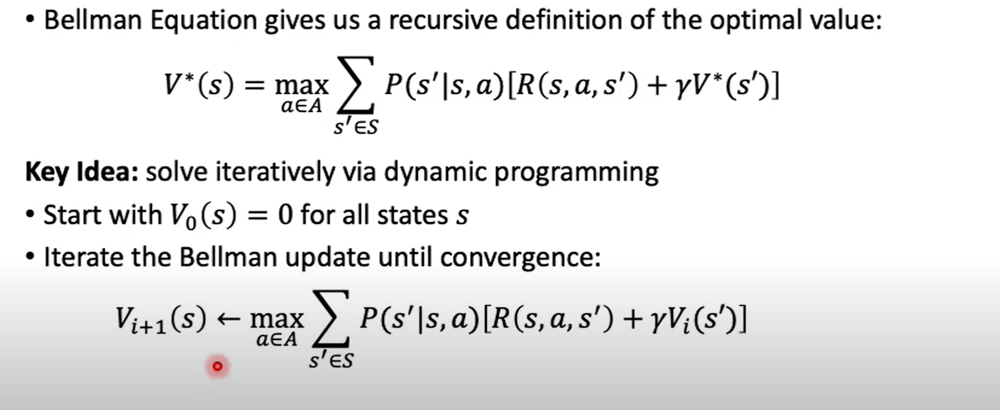
Solving MDP: Value Evaluation

Slide 3
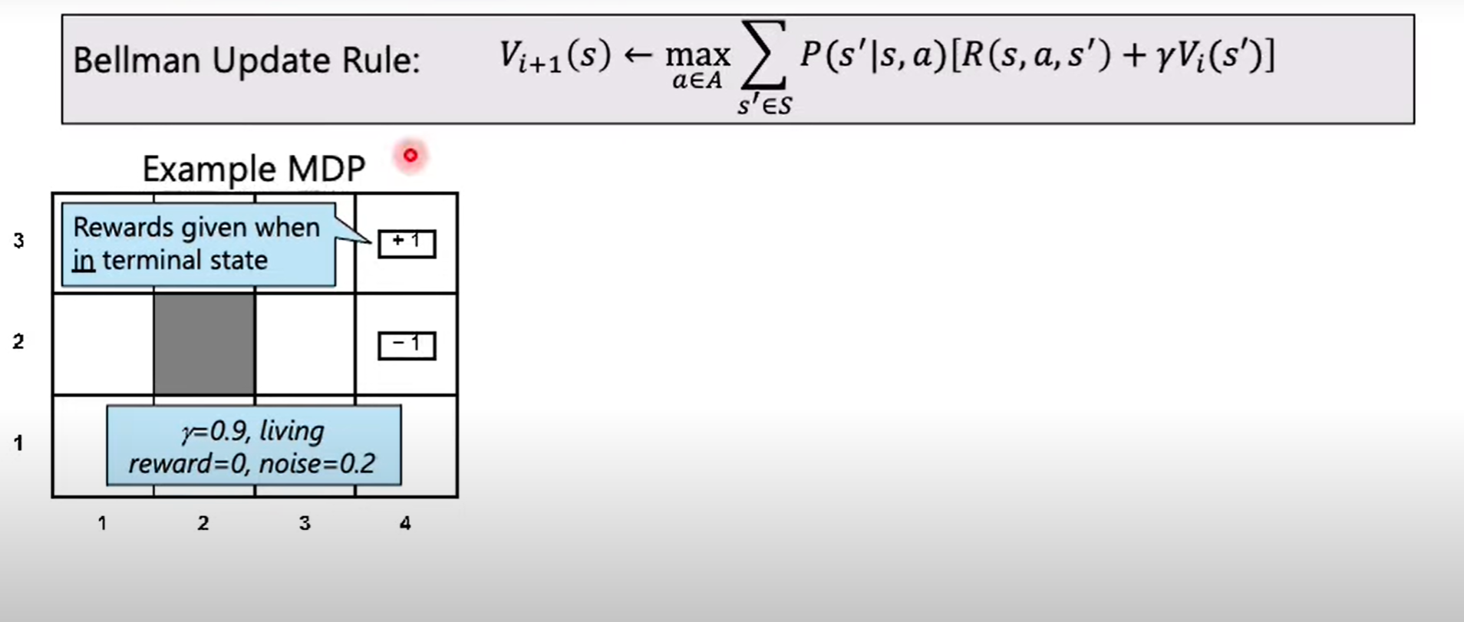
Value Evaluation: Example

Slide 4
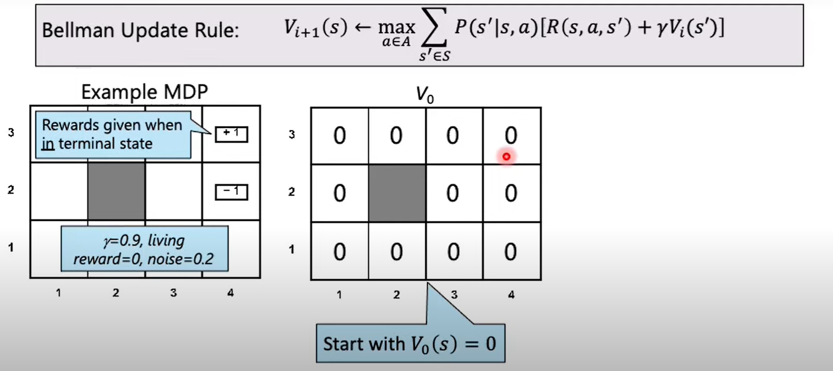
Value Evaluation: Example

Slide 5
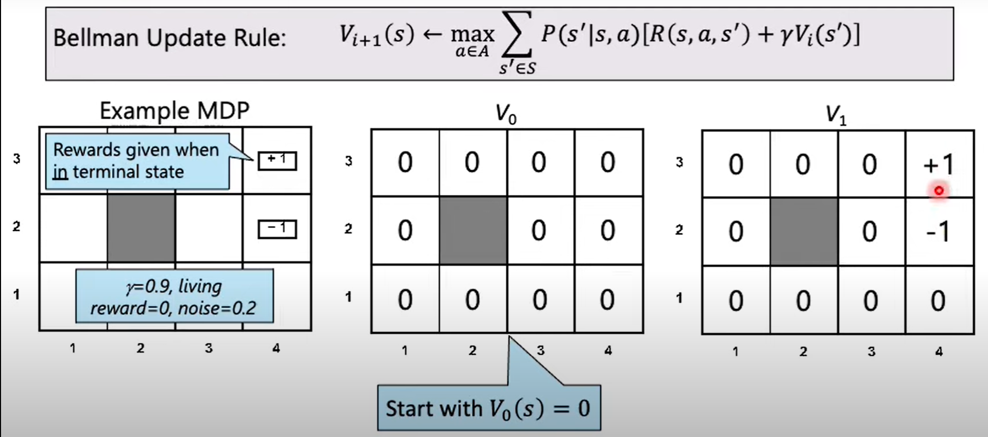
Value Evaluation: Example

Slide 6
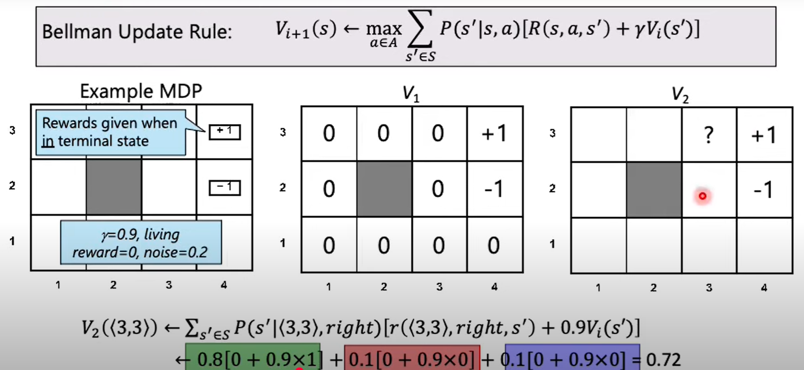
Value Evaluation: Example

Slide 7
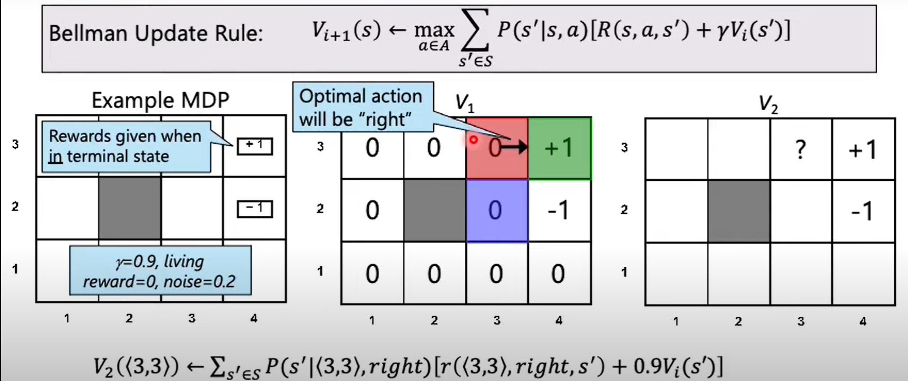
Value Evaluation: Example

Slide 8
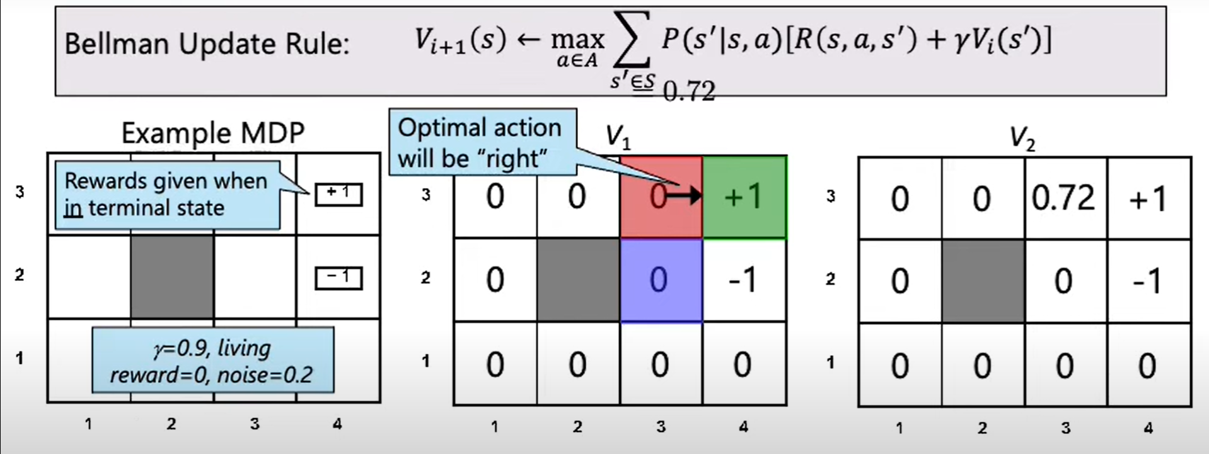
Value Evaluation: Example

Slide 9
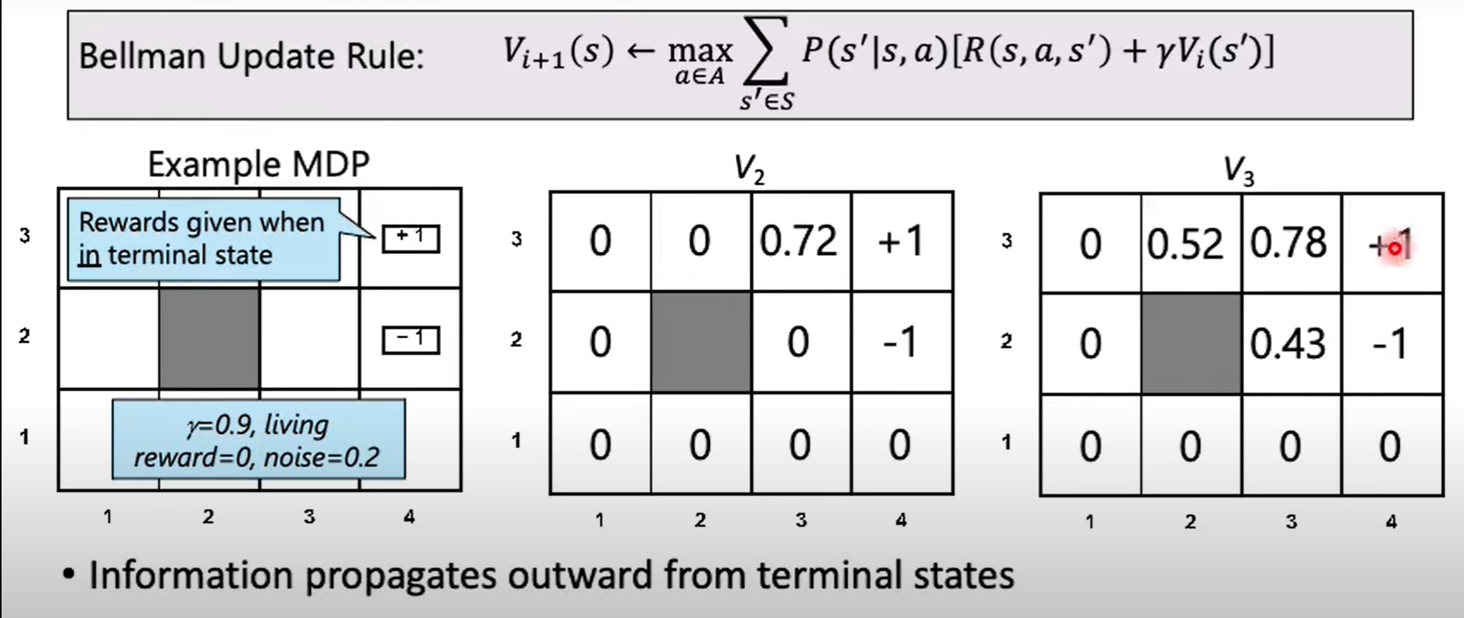
Value Evaluation: Example

Slide 10
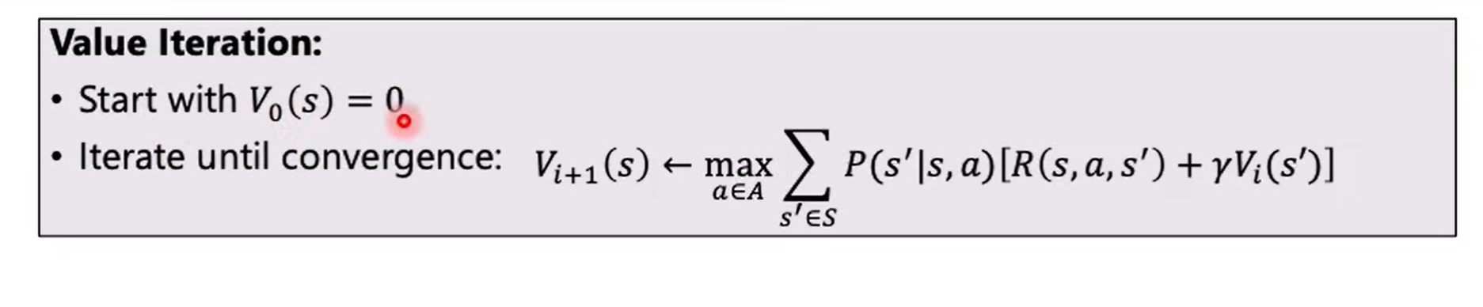
Value Evaluation: Algorithm

