Slide 1
Game Theory

Slide 2
Overview of Game Theory
Origins: Developed by John von Neumann and Oskar Morgenstern in 1928
Core Approach: Optimal strategies depend on opponents’ moves

Slide 3

Recap of Game Theory
A mathematical framework for modeling decision-making in multi-agent environments.
Focuses on strategic interactions, where the outcome for one agent depends on the actions of others.
Game theory provides tools for designing rational strategies in competitive and cooperative settings.

Slide 4

Recap of Game Theory
Key Elements
Players → Agents (humans, machines, algorithms).
Strategies → Possible actions/choices available.
Payoffs → Rewards or outcomes for each strategy combination.
Games → Defined as sets of players, strategies, and payoffs.

Slide 5
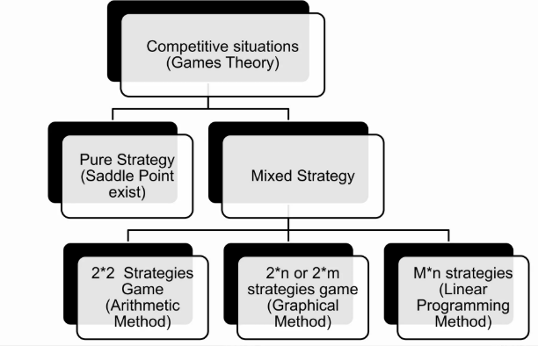

Slide 6
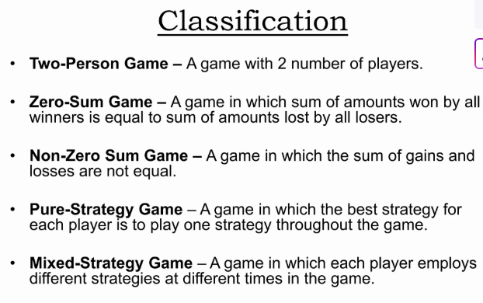

Slide 7
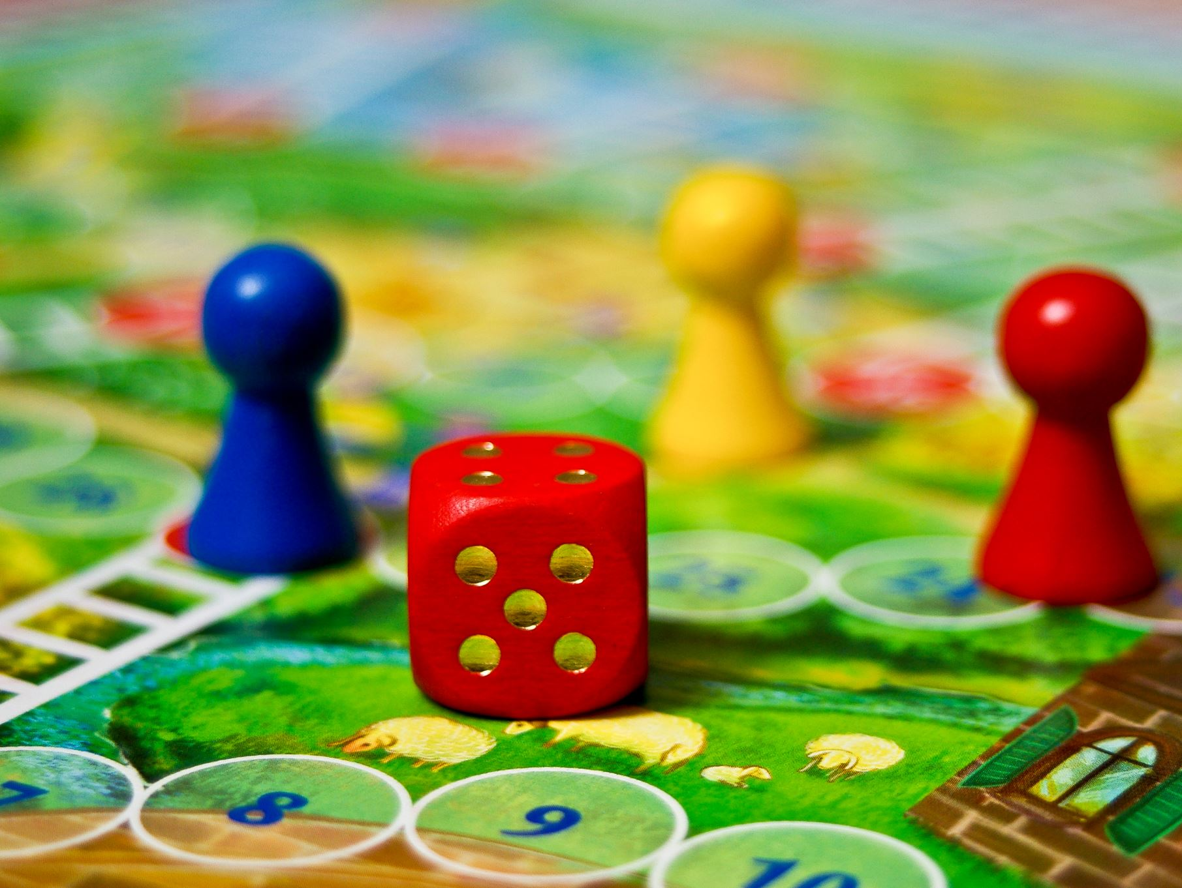
Types of Games

Slide 8
Turn-Based Games
• Players take turns to make moves, one at a time.
• Game state changes only after a player completes their turn.
• Allows players to carefully strategize before acting.
• Examples: Chess, Tic-Tac-Toe, Civilization series.

Slide 9
Real-Time Games
• Players act simultaneously without waiting for turns.
• Requires quick decision-making and fast reactions.
• Often more dynamic and competitive in nature.
• Examples: StarCraft, Counter-Strike, racing games.

Slide 10
Deterministic Games
• Outcomes are fully determined by players’ actions.
• No element of randomness or chance involved.
• Players with complete knowledge can predict results.
• Examples: Chess, Checkers, Go.

Slide 11
Stochastic Games
• Outcomes depend on both players’ actions and random events.
• Introduces uncertainty, making strategy adaptation essential.
• Often modeled using probability distributions.
• Examples: Poker, Monopoly, games involving dice or cards.

Slide 12
Comparison of Game Types
• Turn-Based vs Real-Time: Sequential vs simultaneous actions.
• Deterministic vs Stochastic: Predictable vs probabilistic outcomes.
• Real-world games often combine these categories (e.g., turn-based + stochastic).

Slide 13
Limitations of Game Theory
• Assumes perfect information
• Assumes complete rationality
• Complexity increases with more players

