Slide 1
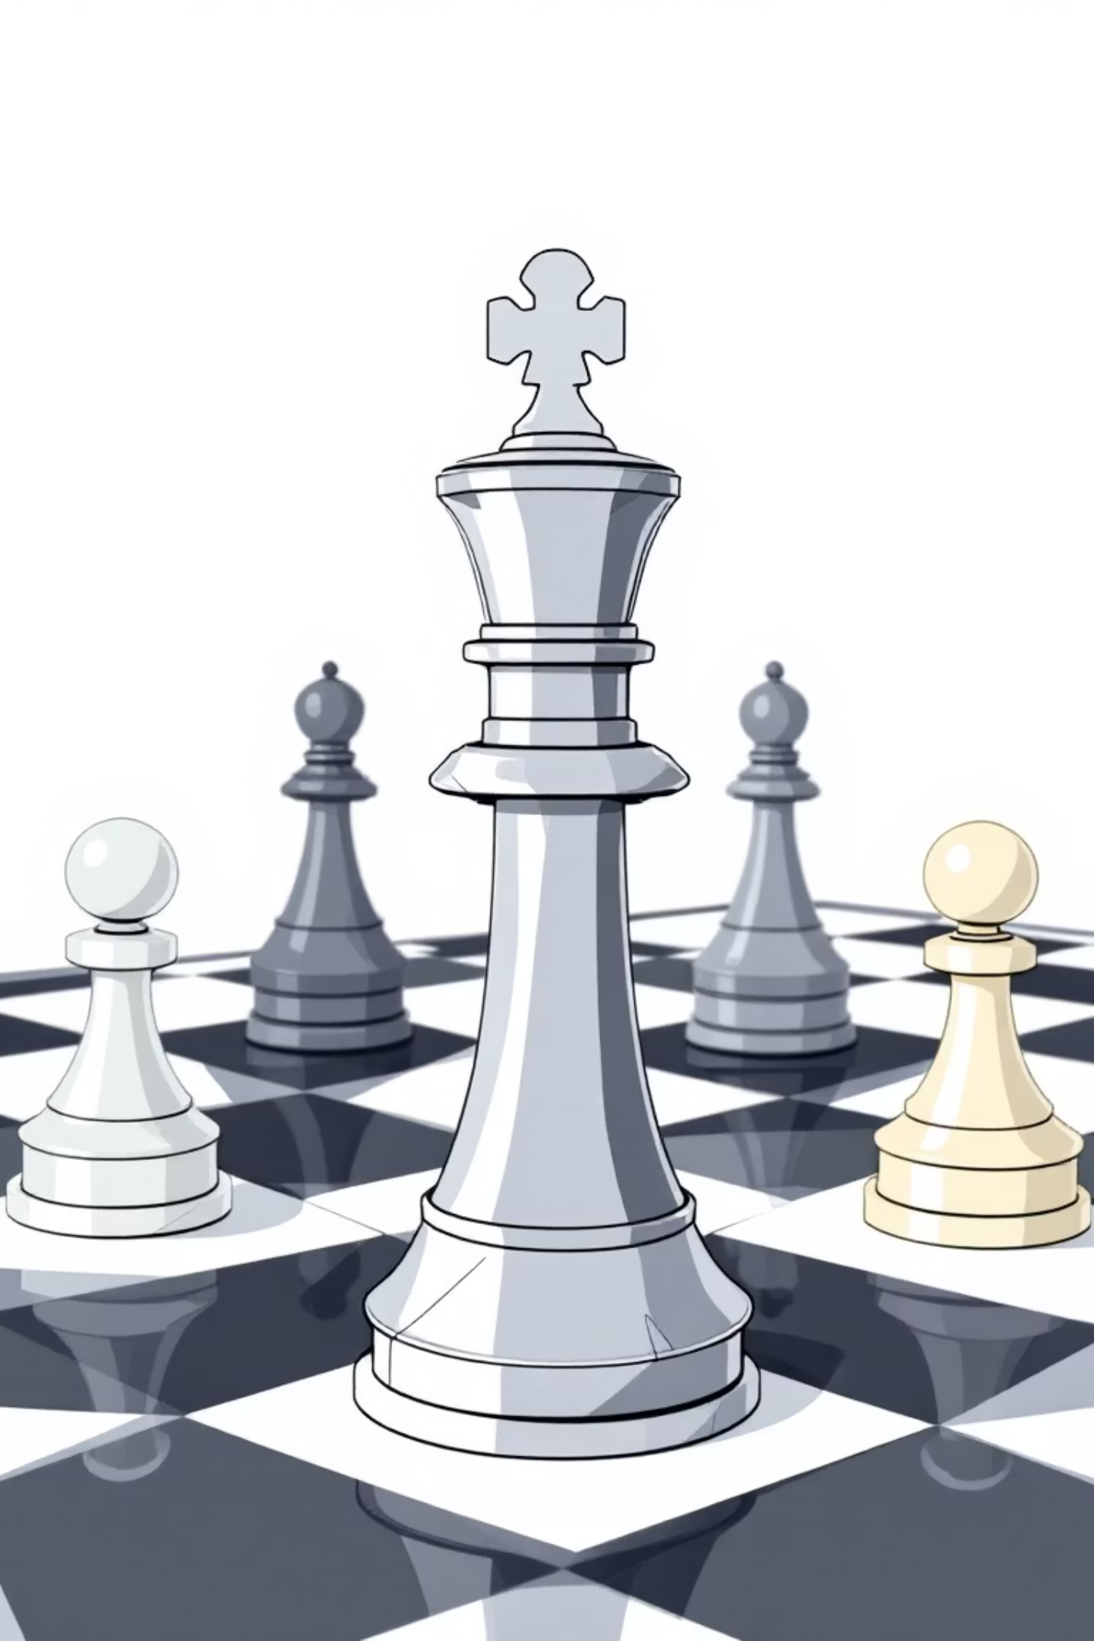
Game Theory Fundamentals
Understanding strategic decision-making in competitive and cooperative environments

Slide 2

What is Game Theory?
Game theory is the mathematical study of strategic decision-making among rational actors. It analyzes situations where the outcome for each participant depends on the actions of all others involved.
Originally developed by mathematician John von Neumann and economist Oskar Morgenstern in 1944, game theory has applications in economics, politics, biology, and psychology.

Slide 3
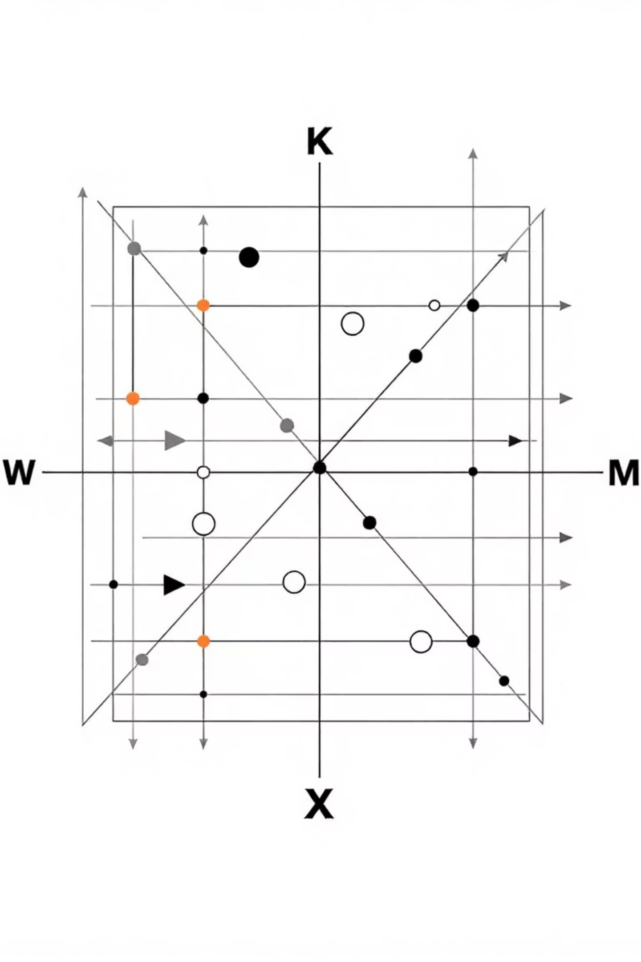
Essential Components of Any Game
Players
Strategies
The decision-makers in the game - individuals, companies, or countries who choose strategies
The complete set of actions available to each player at every decision point
Payoffs
The outcomes or rewards each player receives based on the combination of strategies chosen

Slide 4
Cooperative vs Non-Cooperative Games
Cooperative Games
Non-Cooperative Games
Players can form binding agreements and coalitions. Communication and collaboration are allowed, leading to coordinated strategies that benefit all parties.
Players act independently without binding agreements. Each player pursues their own self-interest, unable to make enforceable commitments.
Business partnerships
Market competition
International treaties
Political elections
Team sports strategies
Individual decision-making

Slide 5
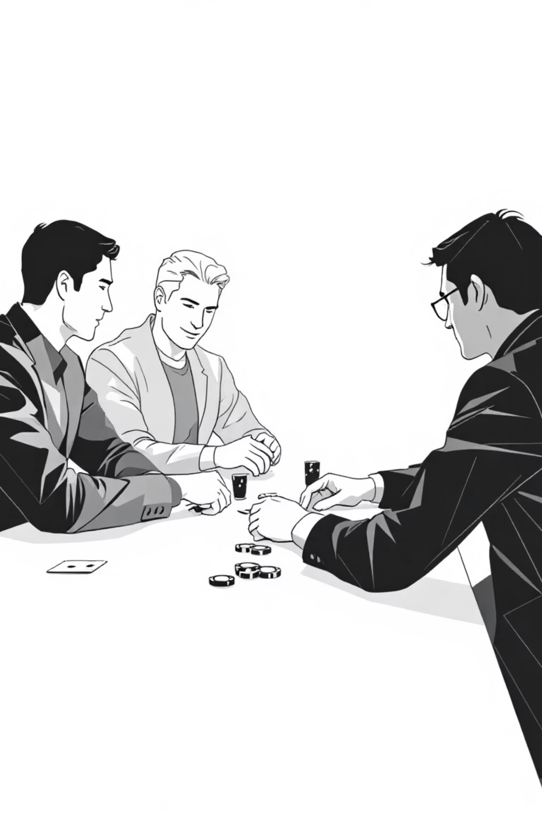
Zero-Sum Games
In zero-sum games, one player's gain exactly equals another player's loss. The total payoff across all players always sums to zero, creating pure competition.
Poker and gambling
Money won by one player comes directly from others' losses
Sports competitions
One team's victory means another team's defeat
Market share battles
When total market size is fixed, gains come at competitors' expense

Slide 6

Non-Zero-Sum Games
Non-zero-sum games allow for mutual benefit or mutual harm. Players can create value together or destroy it, leading to win-win or lose-lose scenarios.
01
02
Trade agreements
Research collaborations
Both countries benefit from increased commerce and specialization
Shared knowledge and resources lead to breakthrough innovations
03
Environmental cooperation
Collective action prevents climate damage that would harm everyone

Slide 7
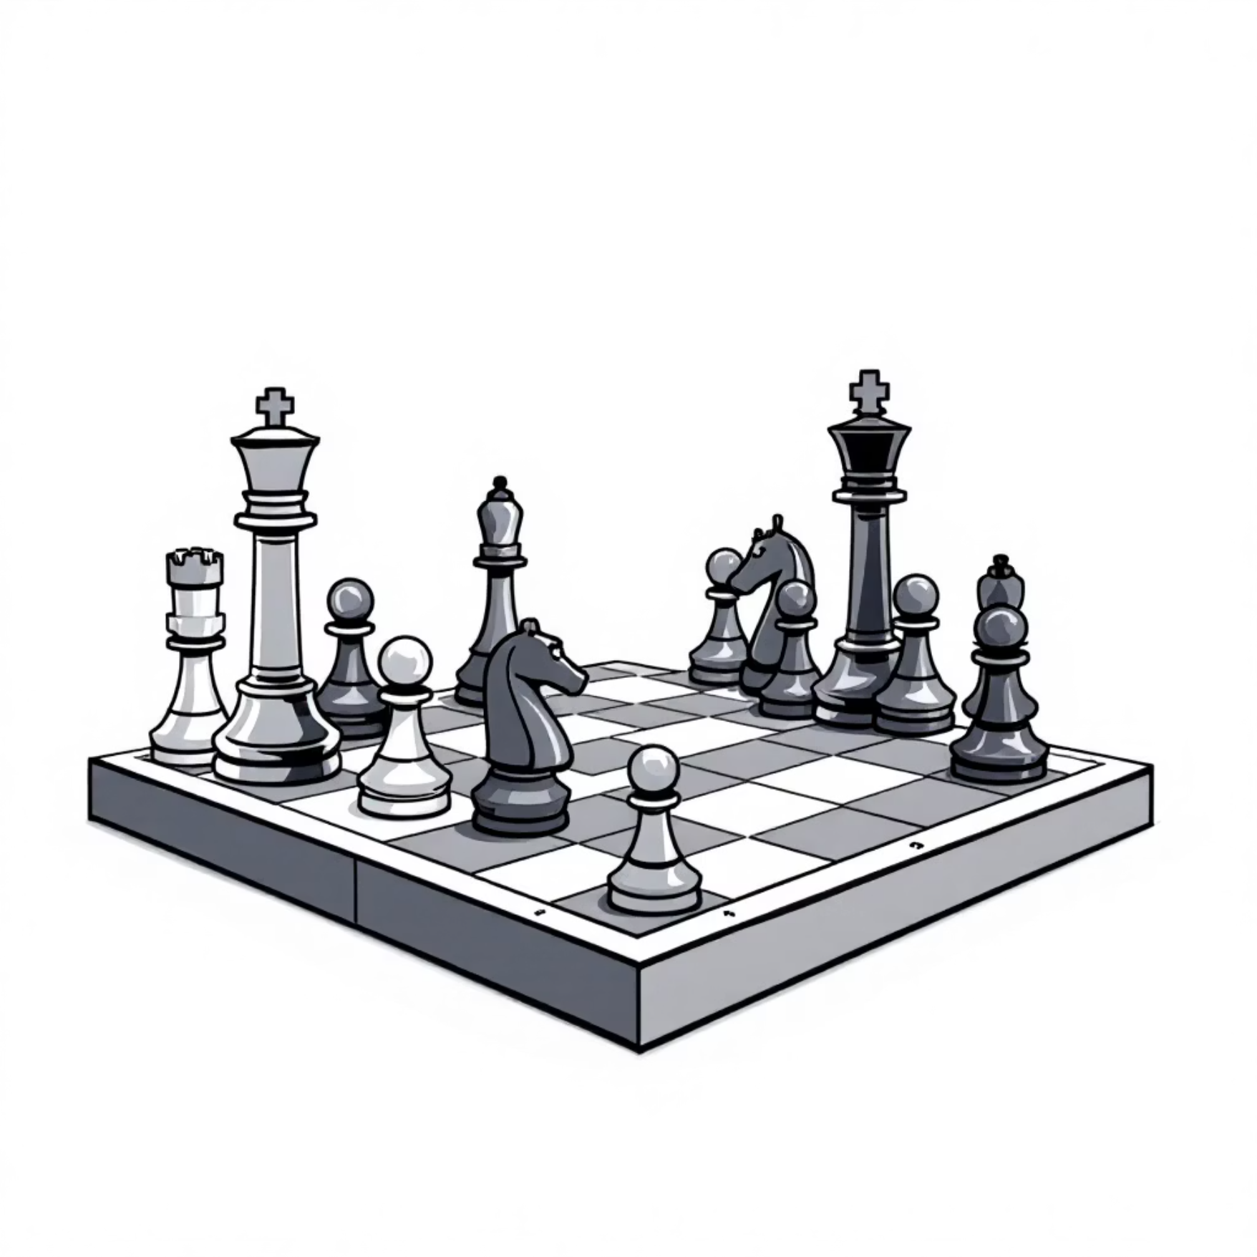

Turn-Based vs Real-Time Games
Turn-Based Games
Real-Time Games
Players take turns making decisions sequentially. Each player has time to analyze the situation and plan their next move carefully.
All players make decisions simultaneously without knowing others' choices. Time pressure and uncertainty create different strategic dynamics.
Chess and board games
Financial markets
Legal negotiations
Auction bidding
Legislative voting
Traffic flow decisions

Slide 8

Deterministic vs Stochastic Games
Deterministic Games
Stochastic Games
Outcomes are completely determined by players' strategies. No random events or uncertainty affect the results once strategies are chosen.
Random events or incomplete information introduce uncertainty. Probability and expected values become crucial for strategy formulation.
Examples: Tic-tac-toe, pure strategy Nash equilibrium games
Examples: Card games, weather-dependent business decisions, evolutionary games

Slide 9
Game Classification Matrix
Game Type
Cooperation
Sum Nature
Example
Prisoner's Dilemma
Non-cooperative
Non-zero-sum
Arms race between nations
Poker
Non-cooperative
Zero-sum
Casino card games
Coalition Formation
Cooperative
Non-zero-sum
Political party alliances
Matching Pennies
Non-cooperative
Zero-sum
Competitive sports plays
Understanding these classifications helps identify the appropriate analytical tools and solution concepts for different strategic situations.

Slide 10




Key Takeaways
Foundation for Analysis
Classification Matters
Game theory provides a systematic framework for analyzing strategic interactions in any competitive or cooperative scenario.
Identifying whether games are cooperative, zero-sum, turn-based, or stochastic determines which analytical tools and strategies apply.
Real-World Applications
These concepts appear everywhere from business negotiations to international relations, making game theory invaluable for decision-makers.

