Slide 1
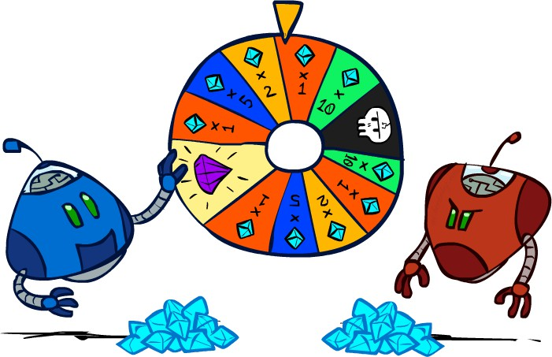
Reasoning in Uncertainty

Slide 2
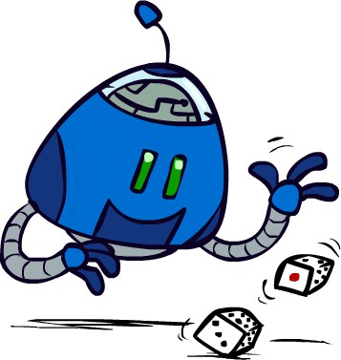
Uncertain Outcomes

Slide 3
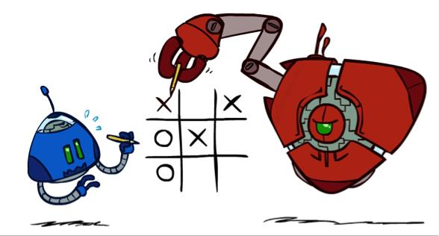
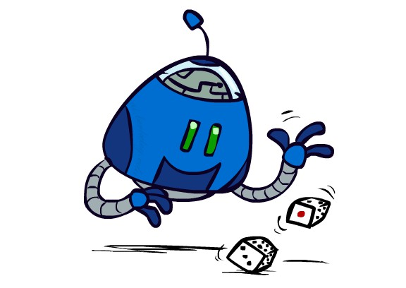

Worst-Case vs. Average Case
max
min
10
10
9
100
Idea: Uncertain outcomes controlled by chance, not an adversary!

Slide 4
Expectimax Search
Why wouldn’t we know what the result of an action will be?
  Explicit randomness: rolling dice
max
Unpredictable opponents: the ghosts respond randomly
Actions can fail: when moving a robot, wheels might slip
Values should now reflect average-case (expectimax) outcomes, not worst-case (minimax) outcomes
chance
Expectimax search: compute the average score under optimal play
  Max nodes as in minimax search
10
10
9
100
10
4
5
7
Chance nodes are like min nodes but the outcome is uncertain
Calculate their expected utilities
I.e. take weighted average (expectation) of children
Later, we’ll learn how to formalize the underlying uncertain- result problems as Markov Decision Processes

Slide 5
Expectimax Pseudocode
def value(state):
if the state is a terminal state: return the state’s utility
if the next agent is MAX: return max-value(state) if the next agent is EXP: return exp-value(state)
def max-value(state): initialize v = -∞
for each successor of state:
v = max(v, value(successor)) return v
def exp-value(state): initialize v = 0
for each successor of state:
p = probability(successor) v += p * value(successor)
return v

Slide 6
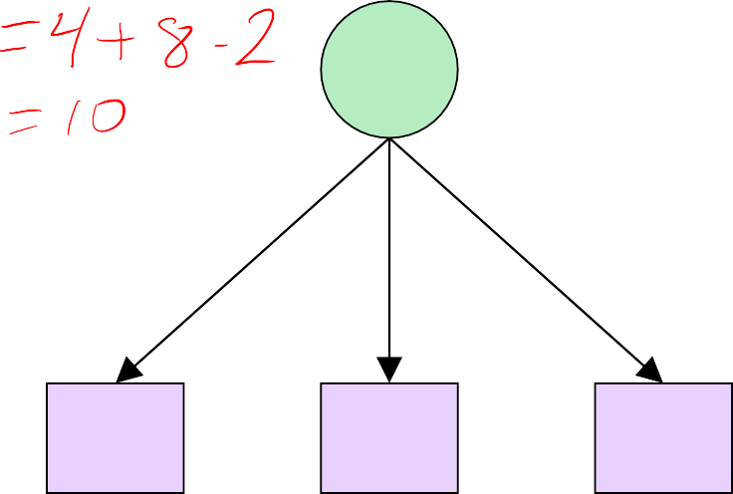
Expectimax Pseudocode
def exp-value(state):
initialize v = 0
for each successor of state:
p = probability(successor) v += p * value(successor)
return v
1/2
1/3
1/6
8
24
-12
7
v = (1/2) (8) + (1/3) (24) + (1/6) (-12) = 10

Slide 7
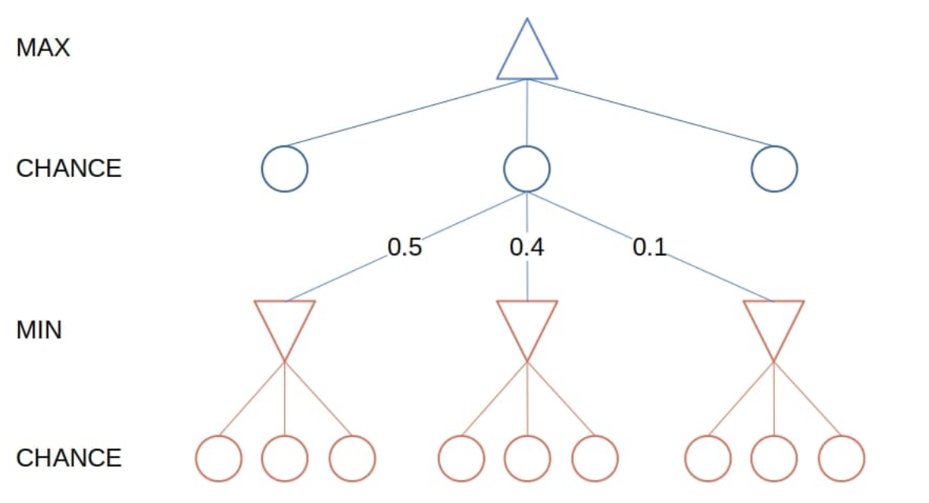
Expectimax Visualization

Slide 8
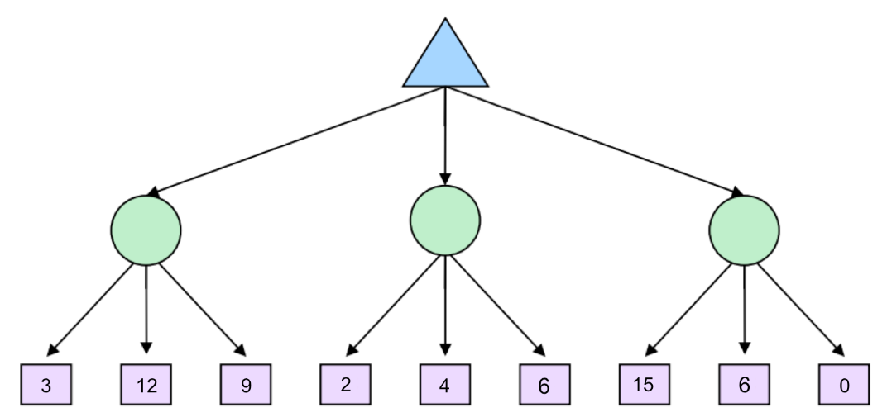
Expectimax Example
MAX
CHANCE
MAX

Slide 9
Expectimax Example
MAX
CHANCE
MAX
1/3
1/3
1/3
1/3
1/3
1/3
1/3
1/3
1/3

Slide 10
Expectimax Example
MAX
CHANCE
MAX
8
1/3
1/3
1/3
1/3
1/3
1/3
1/3
1/3
1/3

Slide 11
Expectimax Example
MAX
CHANCE
MAX
8
4
7
1/3
1/3
1/3
1/3
1/3
1/3
1/3
1/3
1/3

Slide 12
Expectimax Example
MAX
CHANCE
MAX
8
8
4
7
1/3
1/3
1/3
1/3
1/3
1/3
1/3
1/3
1/3

Slide 13
Difference Between Minimax and Expectimax Algorithm
Aspect | Minimax Algorithm | Expectimax Algorithm
Purpose | Used in deterministic, adversarial games (e.g., Chess, Tic-Tac-Toe). | Used in stochastic games with chance elements (e.g., Backgammon, dice-based games).
Decision Making | Assumes opponent always plays optimally (worst-case scenario). | Considers expected utility by averaging outcomes according to probability.
Node Types | Max nodes (agent’s turn) and Min nodes (opponent’s turn). | Max nodes, Chance nodes (probabilistic outcomes), and sometimes Min nodes.
Evaluation | Chooses moves that maximize the agent’s gain while minimizing opponent’s. | Chooses moves that maximize the agent’s expected value of outcomes.

Slide 14
Difference Between Minimax and Expectimax Algorithm (Contd.)
Aspect | Minimax Algorithm | Expectimax Algorithm
Uncertainty Handling | No randomness; outcomes are fully predictable. | Handles uncertainty by incorporating probability distributions.
Applications | Chess, Checkers, Tic-Tac-Toe. | Backgammon, Monopoly, Poker, AI for games involving dice or randomness.
Complexity | O(b^d), where b = branching factor, d = depth. | Higher complexity: O(b^d × c), where c = number of chance outcomes.
Strength | Guarantees optimal play against an optimal opponent. | Provides better strategy in probabilistic environments.
Weakness | Overly pessimistic if the opponent does not always play optimally. | Computationally expensive due to probability calculations.

