Slide 1

AI and Games
CSET381

Slide 2
Why Use AI to Play Games?
Core Question:
  Why deploy AI in games?
Focus:
    Is the AI playing to win?
    Or serving another role (entertainment, challenge, realism)?

Slide 3
Is the AI Playing to Win?
Winning often = high performance:
                High scores
                Beating the opponent
                Surviving longer

Slide 4
AI Roles in Games
AI can be designed to:
          Play in human-like manner
          Entertain players
          Behave predictably for training
Trade-off:
Optimizing for “winning” may produce boring, non-human behavior

Slide 5
AI as Human or Non-Human Player
Two possibilities:
  Human player role: AI acts as if it’s a player
    Seen in board games, single-player vs. AI modes
  Non-player character (NPC) role: AI controls in-game characters
    Common in RPGs (e.g., Skyrim)
    NPCs usually have limited possibilities compared to main players

Slide 6
Core Uses of AI in Games
AI may play:
To win OR for the experience of play
As player role OR as NPC role

Slide 7
Why Use of AI in Games
 | Player | Non player
Win | Motivation: AI testbeds, competitive AI, simulation-based testing | Motivation: Roles humans won’t play, game balancing
 | Examples: Deep Blue, AlphaGo, Watson (Jeopardy!), StarCraft | Examples: Rubber banding (dynamic difficulty adjustment)
Experience | Motivation: Simulation-based testing, game demonstrations | Motivation: Believable and human-like agents
 | Examples: Game Turing Tests, Persona modeling | Examples: Storytelling NPCs, Assistive AI, Expressive agents

Slide 8
Playing to Win in the Player Role
Common use in academia:
AI plays as a human player with the goal to win
Purpose:
Games as AI testbeds
  Evaluate capabilities & performance of algorithms
Key milestones:
  IBM’s Deep Blue defeated Garry Kasparov (Chess)
  Google DeepMind’s AlphaGo defeated Lee Sedol & Ke Jie (Go)
  IBM’s Watson won Jeopardy!

Slide 9
AI Playing to Win (Player Role)
Publicized successes:
  IBM Watson
  DeepMind’s & Facebook AI Research’s StarCraft II projects
Why games are great AI testbeds:
  Designed to challenge human intelligence
  Provide gradual skill progression → good for testing AI at multiple levels
  Fun derives from learning by playing → games act as teachers

Slide 10
AI Playing to Win (Player Role)
Other motivations for AI playing to win:
  Provide strong challenge to human players (e.g., Chess, Checkers, Go)
  In hidden-information games (e.g., Civilization), AI often uses cheating mechanisms (access to hidden state or preferential conditions)
Game design use case:
  Simulation-based testing → agents ensure game/level is playable
  Ideally: play in a human-like style to give realistic feedback
Observation:
  Academia = strong focus on AI winning as a player
  Industry = focus on NPCs and experience-driven roles

Slide 11
Playing to Win in a Non-Player Role
Typical NPCs → designed to be entertaining & humanlike, not maximally challenging
When NPCs need to win well:
  Strategy games (e.g., Civilization): need strong, non-cheating opponents
  XCOM: Enemy Unknown: roles humans would not play → require winning NPCs
Prerequisite for experience-driven AI:
  To make NPCs adapt for fun/experience, first need a high-performing controller

Slide 12
Playing to Win in a Non-Player Role
Example – Racing Games:
  Rubber band AI: NPC cars adjust speed to match the player
  Works only if AI can already play well (fairly or via undetectable “cheating”)
  AI performance is dialed down to balance gameplay

Slide 13
Playing for Experience (Player Role)
Why not focus on winning?
  Need human-like agents instead of optimal ones
  Supports simulation-based testing and demonstrations
Applications:
  Demo modes / assist features (New Super Mario Bros auto-play)
  Testing game content (especially procedurally generated levels)
  Evaluating playability in a human-like way

Slide 14
Playing for Experience (Player Role)
Human-likeness goals:
  Comparable reaction times
  Makes mistakes like humans
  Explores/acts with curiosity
  Shows hesitation, varied playstyles
Competitions:
  2K BotPrize (Unreal Tournament 2004)
  Mario AI Competition – agents judged on “humanness”
Player Archetypes / Personas:
  Aggressive, cautious, curious, skilled, etc.
  AI agents can mirror personas or adapt to specific players

Slide 15
Playing for Experience (Non-Player Role)
Most common industry goal for game AI
  NPCs act in ways not focused on winning
  Purpose: entertainment, believability, immersion
NPC roles & objectives:
  Adversaries, helpers, puzzle elements, storytellers, emotive characters, world population
  Sometimes require illusion of intelligence rather than true AI

Slide 16
Playing for Experience (Non-Player Role)
Design choices:
  Human-like or non-human-like? (depends on role: robot vs dragon)
  Predictability important in stealth & boss battles (e.g., patrol patterns, attack cycles)
  Too adaptive/“intelligent” can break game design
Challenges with “winning” NPCs:
  High-performing strategies often = boring gameplay
    Example: Defensive camping in FPS, exploit strategies in FIFA 99
  AI may find exploits/bugs → efficient but not fun

Slide 17
Playing for Experience (Non-Player Role)
Examples:
  Space Invaders aliens (simple patterns)
  Mario Koopas (predictable movement)
  Bioshock Infinite NPCs (nuanced behaviors)
  Alien: Isolation alien (complex, adaptive tension)

Slide 18
Summary of AI Game-Playing Goals & Roles
Academia:
Strong focus on playing to win (player role)
Other perspectives often neglected
Industry:
Emphasis on playing for experience (non-player role)
Heavy reliance on behavior authoring methods
  Finite State Machines (FSMs)
  Behavior Trees

Slide 19
Summary of AI Game-Playing Goals & Roles
Challenge with advanced methods:
Search, optimization, and learning = powerful but less predictable
Designers want control + authorial intent → tension between fun vs. realism
Looking forward:
Better understanding of AI roles/goals = balance between winning & experience
Convergence of academia and industry approaches

Slide 20
AI & Game Design – Number of Players
Game types by players (Elias et al. [192]):
  Single-player: puzzles, time-trial racing
  1.5-player: FPS campaign with meaningful NPCs
  Two-player: Chess, Checkers, Spacewar!
  Multi-player: League of Legends, Mario Kart, online FPS

Slide 21
AI & Game Design – Number of Players
AI algorithm fit:
  Single-player: Single-agent search (BFS, DFS, A*) works well
  Two-player zero-sum: Minimax (+ α–β pruning) → optimal play
  Multi-player: Minimax becomes too complex
    Often approximate by modeling other players (opponents, learned behavior, random models)
Key insight:
  Number of players greatly affects which AI algorithms are effective
  Collaboration/competition mix adds more complexity

Slide 22
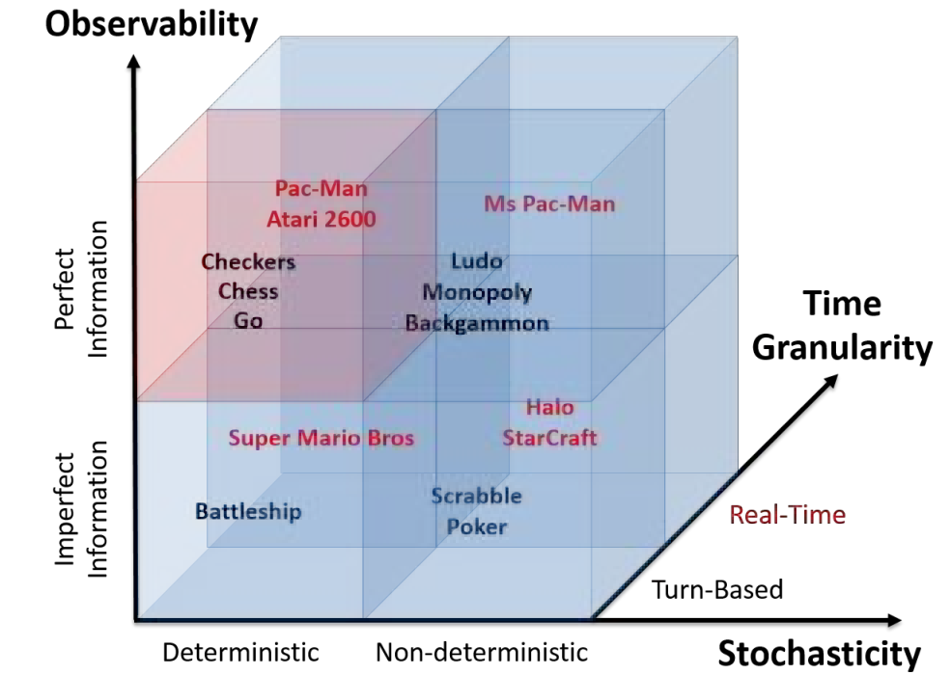
Characteristics of games: game examples across the dimensions of stochasticity, observability and time granularity.
Notes:
Characteristics of games: game examples across the dimensions of stochasticity, observability and time granularity. Note that the game examples presented are sorted by complexity (action space and branching factor) within each cube. Minimax can theoretically solve merely any deterministic, turn-based game of perfect information (red cube in the figure)—in practice, it is still impossible to solve games with substantially large branching factors and action spaces such as Go via Minimax. Any AI method that eventually approximates the Minimax tree (e.g., MCTS) can be used to tackle imperfect information, non-determinism and real-time decision making (see blue cubes in figure). Strictly speaking, Super Mario Bros (Nintendo, 1985) involves a small degree of non-determinism only when a player helps creating a particular scene; we can, thus, safely classify the game as deterministic [163].

Slide 23
AI & Game Design – Stochasticity
What is Stochasticity?
  Games include randomness / unpredictability (dice, cards, RNGs).
  Violates the Markov property → outcome not fully determined by actions.
  Same actions ≠ same outcome across playthroughs.
Examples
  Deterministic: Chess, Tetris.
  Stochastic: Roulette, Ludo, Yahtzee, Monopoly, Ms. Pac-Man.

Slide 24
AI & Game Design – Stochasticity
Impact on AI Algorithms
  Tree Search: Must handle uncertainty (e.g., Monte Carlo Tree Search with determinization).
  Reinforcement Learning: Policies must be tested many times; adds computational cost.
Opportunity:
  Stochasticity can help train robust agents (less brittle than purely deterministic training).
Special case:
  Early hardware (e.g., Atari 2600) had no RNG → fully deterministic outcomes

Slide 25
AI & Game Design – Observability
What is Observability?
  Degree to which the game state is visible to the player/AI.
  Perfect information: Full state known (e.g., Chess, Go, Sudoku).
  Partial observability: Hidden info exists (e.g., Poker, Battleship, Zork, StarCraft with fog of war).
Examples
  Board games: Chess (perfect info).
  Card games: Poker (hidden hands).
  Video games: Super Mario (limited screen view), Halo, StarCraft II (fog of war).

Slide 26
AI & Game Design – Observability
AI Approaches
  Naïve: Ignore hidden info → works in simple linear games.
  Better: Model hidden states (opponents’ hands, off-screen map, future events).
  Advanced methods: Information Set Monte Carlo Tree Search (IS-MCTS).
Impact on AI
  Requires memory & prediction.
  Adds computational complexity, but improves strategic play.

Slide 27
AI & Game Design – Action Space & Branching Factor
Action Space
  Set of possible actions at each decision point.
  Branching Factor (b): Number of actions available.
Examples
  Flappy Bird: b = 2 (flap / no flap).
  Pac-Man: b = 4 (up, down, left, right).
  Super Mario Bros: ~32 (movement + button combos).
  Chess: ~35, Checkers: lower.
  Go: ~400 (first move).
  StarCraft / Civilization: millions (multiple units, continuous inputs).

Slide 28
AI & Game Design – Action Space & Branching Factor
Continuous Inputs
  Modern FPS / console games → thumbsticks, touchscreens.
  Require discretization to make action space manageable.
Impact on AI
  Tree search complexity = O(bᵈ) (branching factor ^ depth).
  High branching factor = shallow search possible.
  Explains why Go was much harder for AI than Chess for decades.

Slide 29
Challenges of High Branching Factor
Tree Search Algorithms
  Complexity = O(bᵈ) grows rapidly.
  With millions of actions, even depth-1 search is impractical.
  Leads to imbalanced search trees → poor decision-making.
Reinforcement Learning (RL)
  Neural network policies: need one output per action, or evaluation of all → computationally expensive.
  Exploration-exploitation dilemma:
    More actions = longer to explore adequately.
    Slows down learning.

Slide 30
Challenges of High Branching Factor
Dynamic Branching Factors
  Chess: few moves at start, many in midgame, fewer in endgame.
  Go: decreases as the board fills.
  RPGs (e.g., Final Fantasy): action space expands as skills/items are acquired.
Key Insight:
  Branching factor directly limits which AI methods are feasible.
  Low b → tree search works.
  High b → need approximation, heuristics, or RL.

Slide 31
AI & Game Design – Time Granularity
AI & Game Design – Time Granularity
Definition
  How often actions can be taken in a game.
  Ranges from turn-based (discrete moves) to real-time (continuous actions).
Examples
  Turn-based: Chess (~40 turns per game).
  Real-time: StarCraft (3–5 actions/sec → thousands per game).
  FPS / Racing / Platformers: actions tied to frame rate (up to 60 fps).

Slide 32
AI & Game Design – Time Granularity
Implications for AI
  Search Depth Meaning Changes
    10 moves ahead in Chess = strategic planning.
    10 actions ahead in StarCraft = a few seconds → little strategic change.
  Computational Challenge:
    Real-time games require hundreds/thousands of action steps for meaningful lookahead; Tree search becomes infeasible.
Possible Solutions
  Macro-actions: bundle sequences of fine-grained actions (e.g., “build base”, “launch attack”).Abstractions: focus on strategic decisions instead of micro-moves.

