Slide 1
INTRODUCTION TO NEURAL NETWORKS
(NN)

Slide 2
Outline
Definition, why and how are neural
networks being used in solving problems
Human biological neuron Artificial Neuron
Applications of ANN
Comparison of ANN vs conventional AI methods

Slide 3
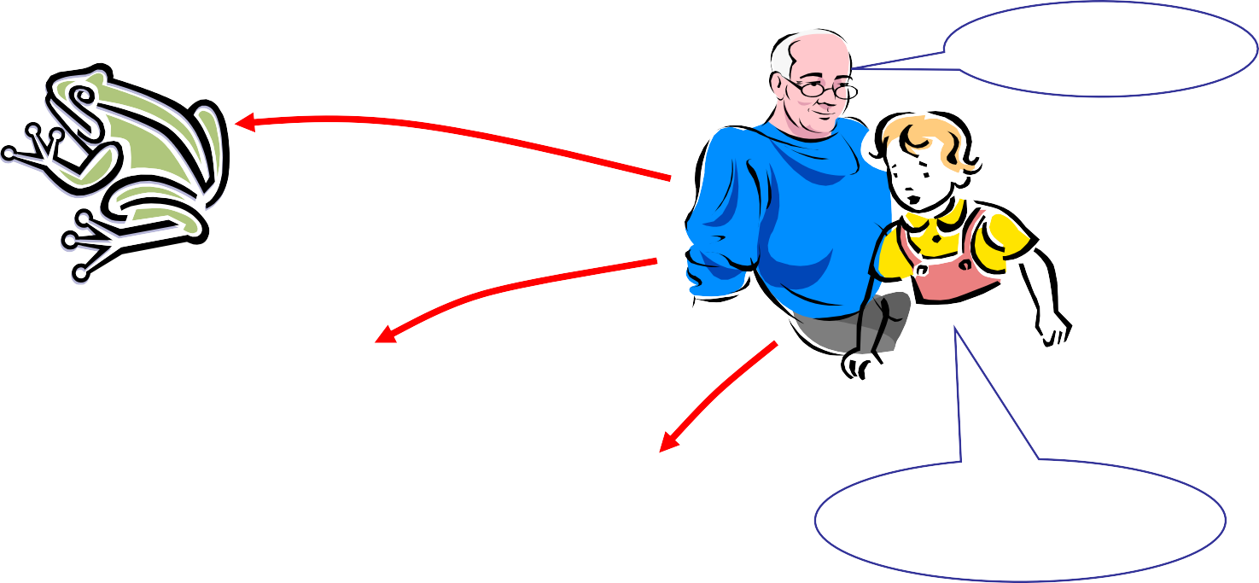




The idea of ANNs..?
NNs learn relationship between cause and effect or organize large volumes of data into orderly and informative patterns.
It’s a frog
frog
lion
bird
What is that?

Slide 4
Neural networks to the rescue…
Neural
paradigm
network: information inspired by biological
processing nervous
systems, such as our brain
Structure: large number of highly interconnected processing elements (neurons) working together
Like people, they learn from experience (by example)

Slide 5
Definition of ANN
“Data large
processing system consisting of a number of simple,
highly elements
interconnected processing
(artificial neurons) in an architecture inspired by the structure of the cerebral cortex of the brain”
(Tsoukalas & Uhrig, 1997).

Slide 6
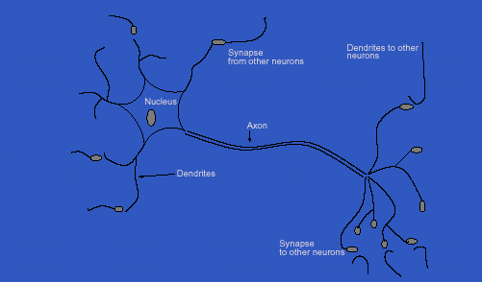
Inspiration from Neurobiology
Human Biological Neuron

Slide 7
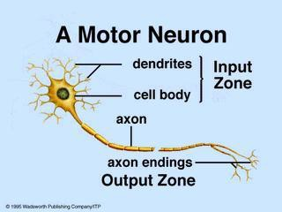
Biological Neural Networks
A biological neuron has three types of main components; dendrites, soma (or cell body) and axon.
Dendrites signals neurons.
receives
other
from
The soma, sums the incoming signals. When sufficient input is received, the cell fires; that is it transmit a signal over its axon to other cells.

Slide 8
Artificial Neurons
ANN is an information processing system that has
certain performance characteristics in common
with biological nets.
Several key features of the processing elements of ANN are suggested by the properties of biological neurons:
The processing element receives many signals.
Signals may be modified by a weight at the
receiving
synapse.
The processing element sums the weighted inputs.
Under appropriate circumstances (sufficient input), the neuron transmits a single output.
The output from a particular neuron may go to many other neurons.

Slide 9
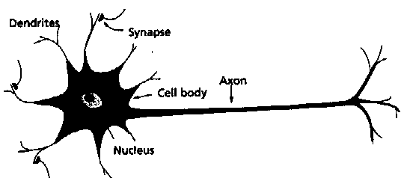
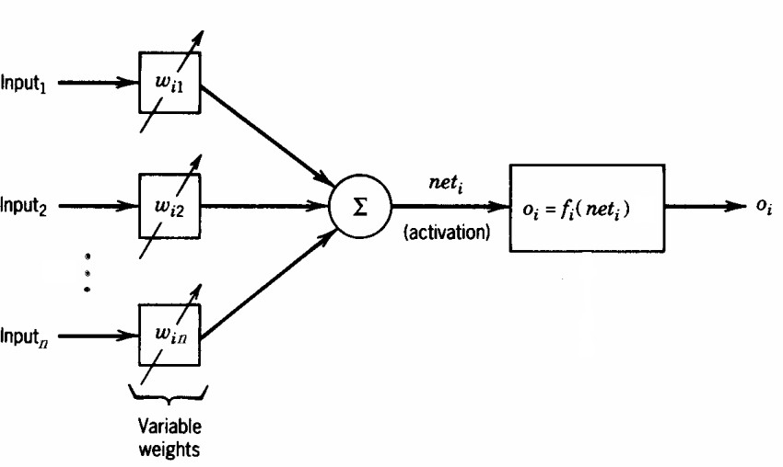
Artificial Neurons
A physical neuron
From experience: examples / training data
Strength of connection between the neurons is stored as a weight- value for the specific
connection.
Learning the solution to a problem = changing the connection weights

Slide 10
Artificial Neurons
ANNs have been developed as generalizations of mathematical models of neural biology, based on the assumptions that:
Information processing occurs at many simple elements called neurons.
Signals are passed between neurons over connection links.
Each connection link has an associated weight, which, in typical neural net, multiplies the signal transmitted.
Each neuron applies an activation function to its net input to determine its output signal.

Slide 11
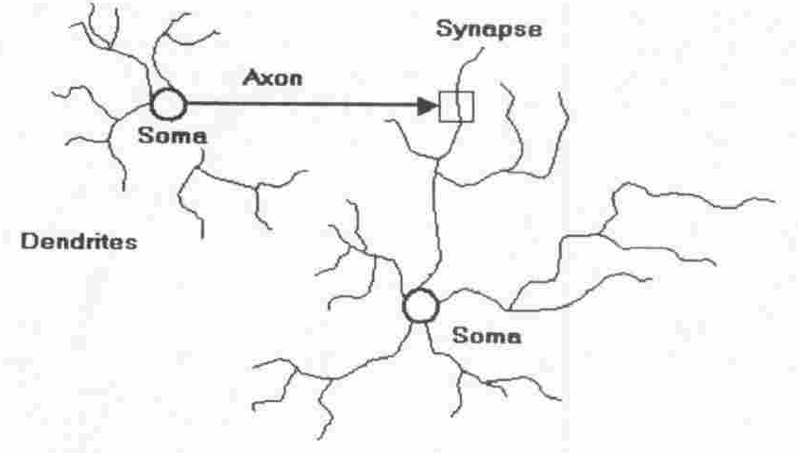
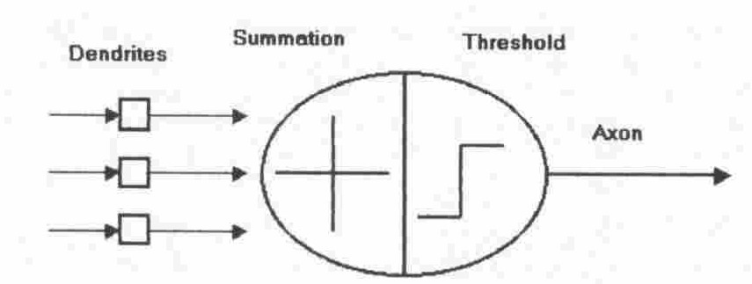
Artificial Neuron
Four basic components of a human biological
neuron
The components of a basic artificial neuron

Slide 12
Model Of A Neuron
W_{a}
X₁
W_{b}
f(μ)
Y
X₂
μ
W_{c}
X₃
Input units
Connection weights
Summing function
computation
(dendrite)
(synapse)
(axon)
(soma)

Slide 13
A neural net consists of a large number of simple processing elements called neurons, units, cells or nodes.
Each neuron is connected to other neurons by means of directed communication links, each with associated weight.
The weight represent information being used by the net to solve a problem.

Slide 14
Each neuron has an internal state, called its activation or activity level, which is a function of the inputs it has received. Typically, a neuron sends its activation as a signal to several other neurons.
It is important to note that a neuron can send only one signal at a time, although that signal is broadcast to several other neurons.

Slide 15
Neural networks are configured for a specific application, such as pattern recognition or data classification, through a learning process
In a biological system, learning involves adjustments to the synaptic connections between neurons
➔ same for artificial neural networks (ANNs)

Slide 16
Artificial Neural Network
Synapse
Nukleus
x₁
w₁
∑ ƒ
y
Axon
x₂
w₂
Activation Function:
ƒ(y-in) = 1 if y-in >= θ
and ƒ(y-in) = 0
y_{in} = x₁w₁ + x₂w₂
Dendrite
-A neuron receives input, determines the strength or the weight of the input, calculates the total weighted input, and compares the total weighted with a value (threshold)
-The value is in the range of 0 and 1
- If the total weighted input greater than or equal the threshold value, the neuron will produce the output, and if the total weighted input less than the threshold value, no output will be produced

Slide 17

Characterization
Architecture
  a pattern of connections between neurons
    Single Layer Feedforward
    Multilayer Feedforward
    Recurrent
Strategy / Learning Algorithm
  a method of determining the connection weights
    Supervised
    Unsupervised
    Reinforcement
Activation Function
  Function to compute output signal from input signal

Slide 18
Single Layer Feedforward NN
x₁
^{w}11
^{w}12
y_{m}
^{w}21
x₂
y_{n}
^{w}22
output layer
Input layer

Slide 19

Multilayer Neural Network
z₁
∑ ƒ
x₁
^{V}11
w
11
V
^{w}12
1n
^{w}12
y
1
x₂
z₂
•
•
•
•
∑ ƒ
y
2
z_{n}
∑ ƒ
x_{m}
^{V}mn

Slide 20

Recurrent NN
Input
Outputs

Slide 21

Strategy / Learning Algorithm
Supervised Learning
Learning is performed by presenting pattern with target
During learning, produced output is compared with the desired output
– The difference between both output is used to modify learning weights according to the learning algorithm
Recognizing hand-written digits, pattern recognition and etc.
Neural Network models: perceptron, feed-forward, radial basis function,
support vector machine.

Slide 22
Unsupervised Learning
Targets are not provided
Appropriate for clustering task
– Find similar groups of documents in the web, content addressable memory, clustering.
Neural Network models: Kohonen, self organizing maps, Hopfield networks.

Slide 23
Reinforcement Learning
Target is provided, but the desired output is absent.
The net is only provided with guidance to determine the produced output is correct or vise versa.
Weights are modified in the units that have errors

Slide 24
Activation Functions
Identity
f(x) = x
Binary step
f(x) = 1 if x >= θ
f(x) = 0 otherwise
Binary sigmoid
f(x) = 1 / (1 + e^{-αx})
Bipolar sigmoid
f(x) = -1 + 2 / (1 + e^{−αx})
Hyperbolic tangent
f(x) = (e^{x} – e^{-x}) / (e^{x} + e^{-x})

Slide 25

Exercise
2 input AND
2 input OR
1 | 1 | 1
1 | 0 | 0
0 | 1 | 0
0 | 0 | 0
1 | 1 | 1
1 | 0 | 1
0 | 1 | 1
0 | 0 | 0

Slide 26
w₁= 0.5
x₁
∑ ƒ
y
x₂
w₂ = 0.3
Activation Function:
Binary Step Function
θ = 0.5,
y_{in} = x₁w₁ + x₂w₂
ƒ(y-in) = 1 if y-in >= θ
dan ƒ(y-in) = 0

Slide 27
Where can neural network systems help…
when we can't formulate an algorithmic solution.
when we can get lots of examples of the behavior we require.
"learning from experience"
when we need to pick out the structure from existing data.

Slide 28
Who is interested?...
Electrical Engineers – signal processing, control theory
Computer Engineers – robotics
Computer Scientists – artificial intelligence, pattern recognition
Mathematicians – modelling tool when explicit relationships are unknown

Slide 29
Problem Domains
Storing and recalling patterns
Classifying patterns
Mapping inputs onto outputs
Grouping similar patterns
Finding solutions to constrained optimization problems

Slide 30













Classification
Coronary
Disease
STOP
01
10
10
00
11
Neural
11
00
Net
00
11
Input patterns
Input layer
Output layer
00
01
10
11
00 | 10 | 11 | Sorted pa. tterns
00 |  | 11

Slide 31
Clustering
00
11
10
11
10
11
00
00
01

Slide 32

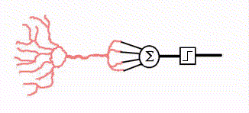

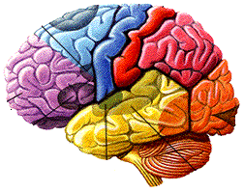

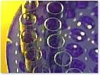






ANN Applications
Medical Applications
Information Searching & retrieval
Chemistry
Education
Business & Management

Slide 33
Applications of ANNs
Signal processing
Pattern recognition, e.g. handwritten characters or face identification.
Diagnosis or mapping symptoms to a medical case.
Speech recognition
Human Emotion Detection
Educational Loan Forecasting

Slide 34
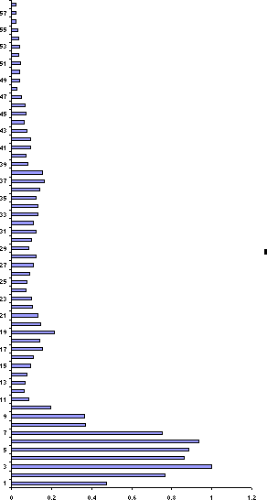
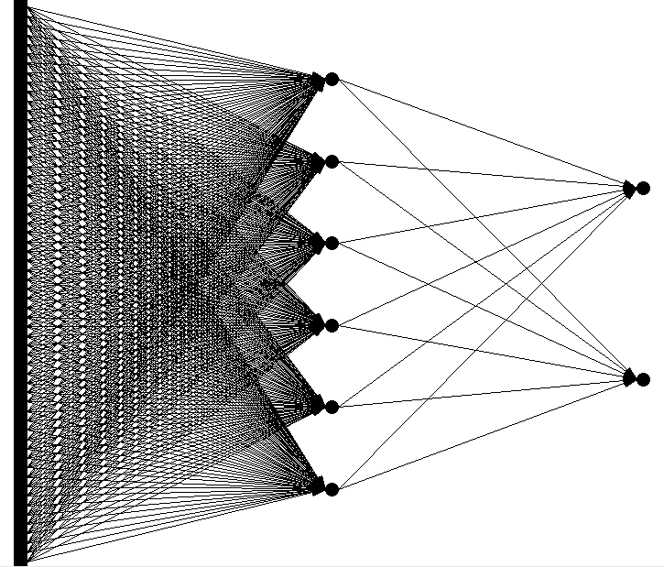

Voice Recognition

Slide 35
Advantages Of NN
NON-LINEARITY
It can model non-linear systems
INPUT-OUTPUT MAPPING
It can derive a relationship between a set of input & output responses
ADAPTIVITY
The ability to learn allows the network to adapt to changes in the surrounding environment
EVIDENTIAL RESPONSE
It can provide a confidence level to a given solution

Slide 36
Advantages Of NN
CONTEXTUAL INFORMATION
Knowledge is presented by the structure of the network. Every neuron in the network is potentially affected by the global activity of all other neurons in the network. Consequently, contextual information is dealt with naturally in the network.
FAULT TOLERANCE
Distributed nature of the NN gives it fault tolerant capabilities
NEUROBIOLOGY ANALOGY
Models the architecture of the brain

Slide 37
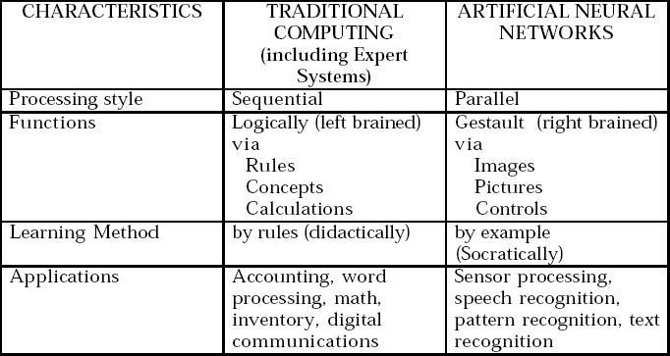
Comparison of ANN with conventional AI methods

Slide 38
Fuzzy logic

Slide 39
WHAT IS FUZZY LOGIC?
Definition of fuzzy
  Fuzzy – “not clear, distinct, or precise; blurred”
Definition of fuzzy logic
  A form of knowledge representation suitable for notions that cannot be defined precisely, but which depend upon their contexts.

Slide 40


TRADITIONAL REPRESENTATION OF LOGIC
Slow
Speed = 0
bool speed; get the speed
if ( speed == 0) {
// speed is slow
}
Fast
Speed = 1
else {
// speed is fast
}

Slide 41


FUZZY LOGIC REPRESENTATION
Slowest
[ 0.0 – 0.25 ]
For every problem must represent in terms of fuzzy sets.
Slow
[ 0.25 – 0.50 ]
What are fuzzy sets?
Fast
[ 0.50 – 0.75 ]
Fastest
[ 0.75 – 1.00 ]

Slide 42
FUZZY LOGIC REPRESENTATION CONT.
Slowest
Slow
float speed; get the speed
Fast
Fastest
if ((speed >= 0.0)&&(speed < 0.25)) {
// speed is slowest
}
else if ((speed >= 0.25)&&(speed < 0.5))
{
// speed is slow
}
else if ((speed >= 0.5)&&(speed < 0.75))
{
// speed is fast
}
else // speed >= 0.75 && speed < 1.0
{
// speed is fastest
}

Slide 43
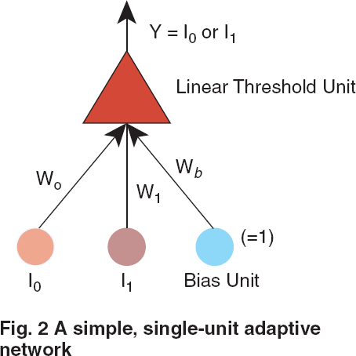
FUZZY LOGIC VS. NEURAL NETWORKS
How does a Neural Network work?
Both model the human brain.
  Fuzzy Logic
  Neural Networks
Both used to create behavioral systems.

Slide 44
FUZZY LOGIC IN CONTROL SYSTEMS
Fuzzy Logic provides a more efficient and resourceful way to solve Control Systems.
Some Examples
  Temperature Controller
  Anti – Lock Break System ( ABS )

Slide 45
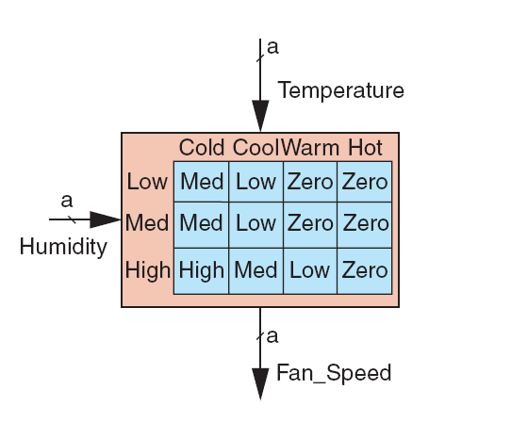
TEMPERATURE CONTROLLER
The problem
  Change the speed of a heater fan, based off the room temperature and humidity.
A temperature control system has four settings
  Cold, Cool, Warm, and Hot
Humidity can be defined by:
  Low, Medium, and High
Using this we can define the fuzzy set.

Slide 46
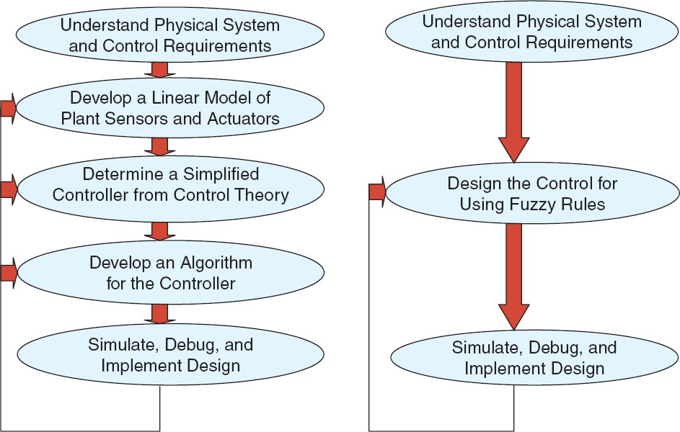
BENEFITS OF USING FUZZY LOGIC

Slide 47
FUZZY LOGIC IN OTHER FIELDS
Business
Hybrid Modeling
Expert Systems

Slide 48
Fuzzy Logic Example
Automotive Speed Controller
3 inputs:
speed (5 levels)
acceleration (3 levels)
distance to destination (3 levels)
1 output:
power (fuel flow to engine)
Set of rules to determine output based on input values

Slide 49
Fuzzy Logic Example
1.0
Too Slow
Slow
Optimum
Fast
Too Fast
Speed
1.0
Decelerating
Constant
Accelerating
Acceleration
1.0
Very Close
Close
Distant
Distance

Slide 50
Fuzzy Logic Example
Example Rules
IF speed is TOO SLOW and acceleration is DECELERATING,
THEN INCREASE POWER GREATLY
IF speed is SLOW and acceleration is DECREASING, THEN INCREASE POWER SLIGHTLY
IF distance is CLOSE,
THEN DECREASE POWER SLIGHTLY
. . .

Slide 51
THANKYOU

