Slide 1
Artificial Neural Networks

Slide 2
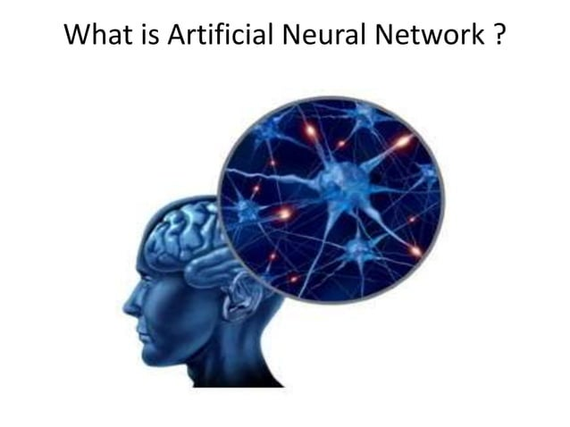

Slide 3
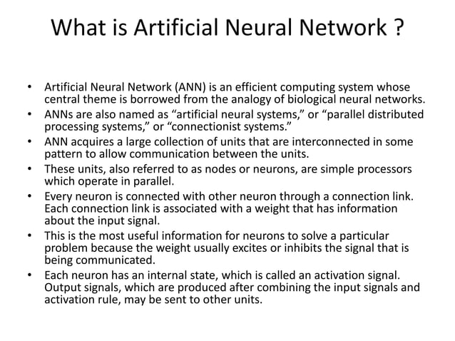

Slide 4
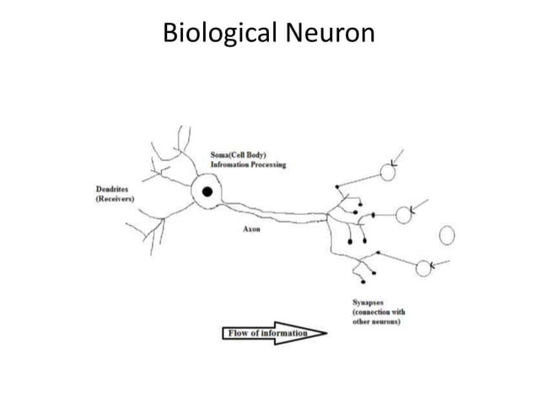

Slide 5
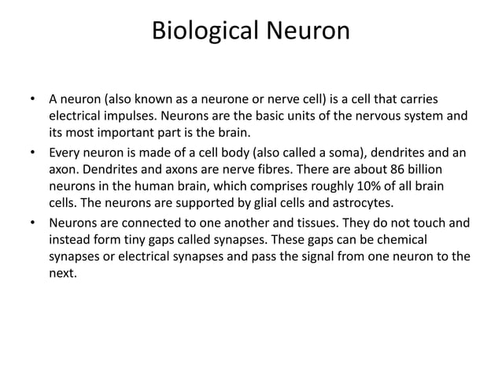

Slide 6
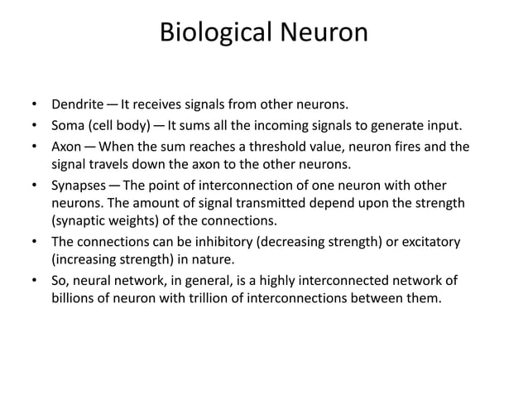

Slide 7
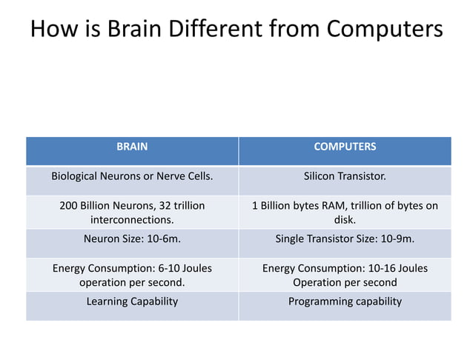

Slide 8
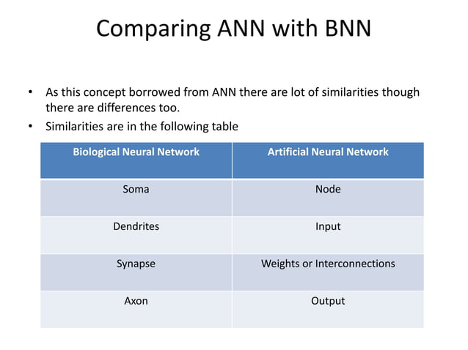

Slide 9
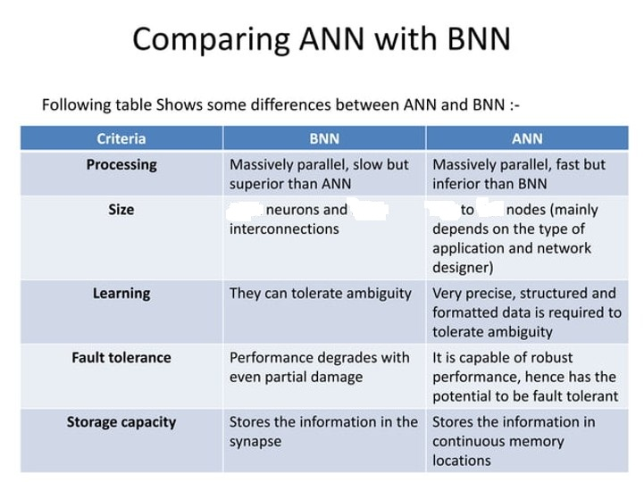
10^11
10^15
10^2
10^4

Slide 10
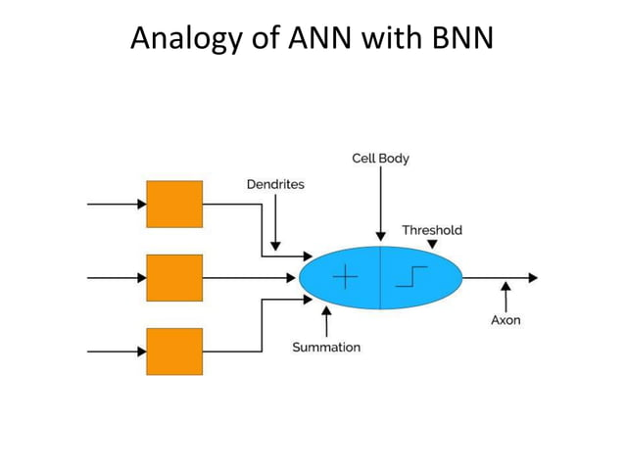

Slide 11
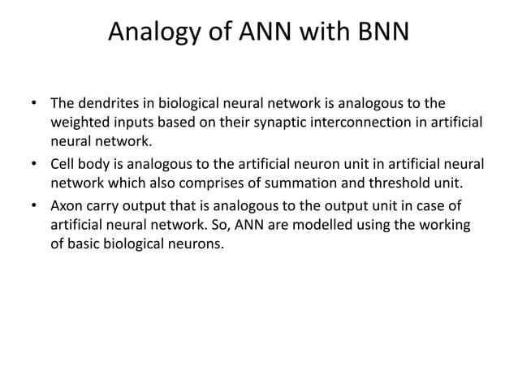

Slide 12
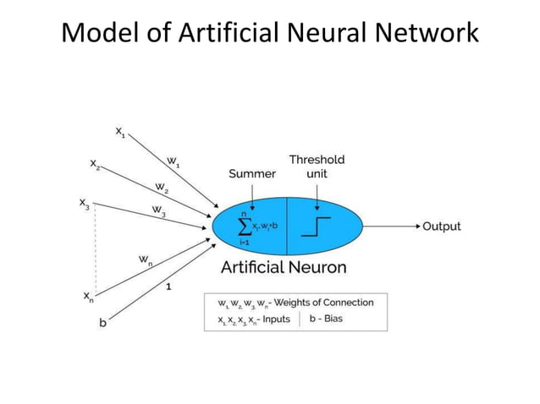

Slide 13
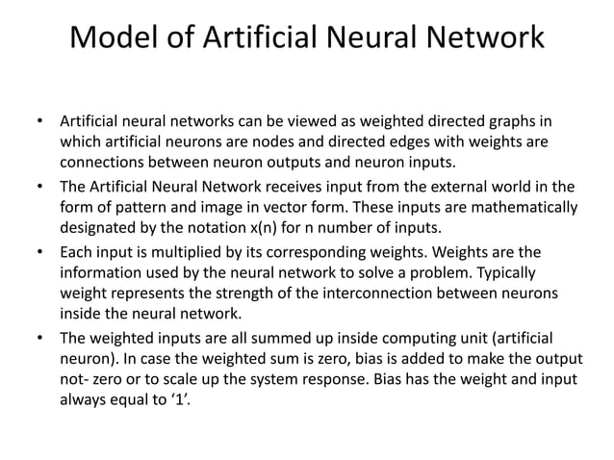

Slide 14
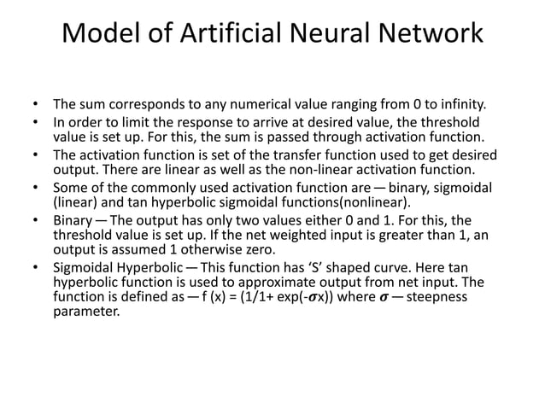

Slide 15
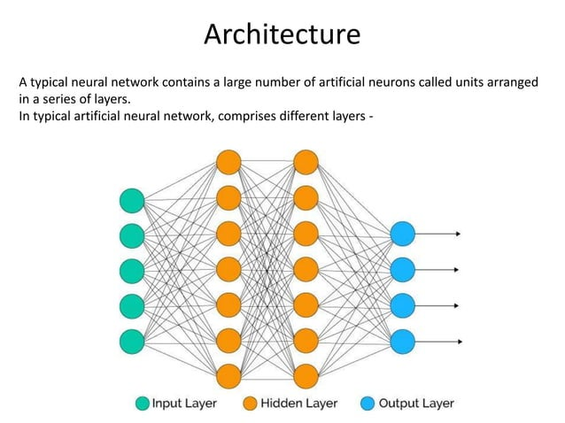

Slide 16
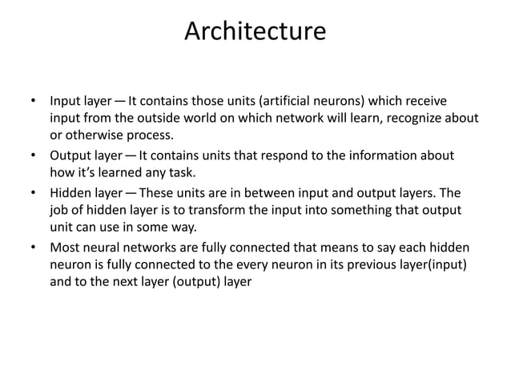

Slide 17
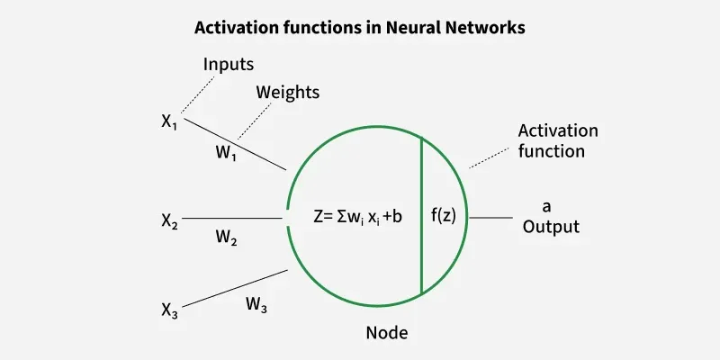
Activation Function
It is a mathematical function applied to the output of a neuron.
It introduces non-linearity into the model, allowing the network to learn and represent complex patterns in the data.
Activation function decides whether a neuron should be activated by calculating the weighted sum of inputs and adding a bias term.

Slide 18
Activation Function
Non-Linearity
Without non-linearity even deep networks would be limited to solving only simple, linearly separable problems.
Activation functions help neural networks to model highly complex data distributions and solve advanced deep learning tasks.
Adding non-linear activation functions introduce flexibility and enable the network to learn more complex and abstract patterns from data.

Slide 19
Activation Function
Non-Linearity
To illustrate the need for non-linearity in neural networks with a specific example let's consider a network with two input nodes (i1and i2​), a single hidden layer containing neurons h1 and h2​ and an output neuron (out).
We will use w1, w2​ as weights connecting the inputs to the hidden neuron and w5 as the weight connecting the hidden neuron to the output. We'll also include biases (b1​​ for the hidden neuron and b2​ for the output neuron) to complete the model.

Slide 20
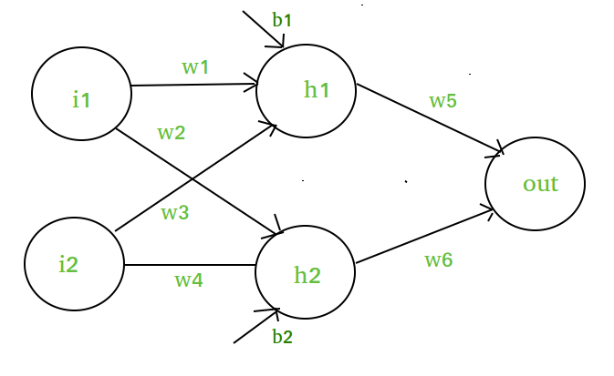
Activation Function
h1 ​= i1​.w1 ​+ i2​.w3 ​+ b1​
h2 = i1.w2 + i2.w4 + b2h2​
Output = h1​.w5​ + h2​.w6​ + bias

Slide 21
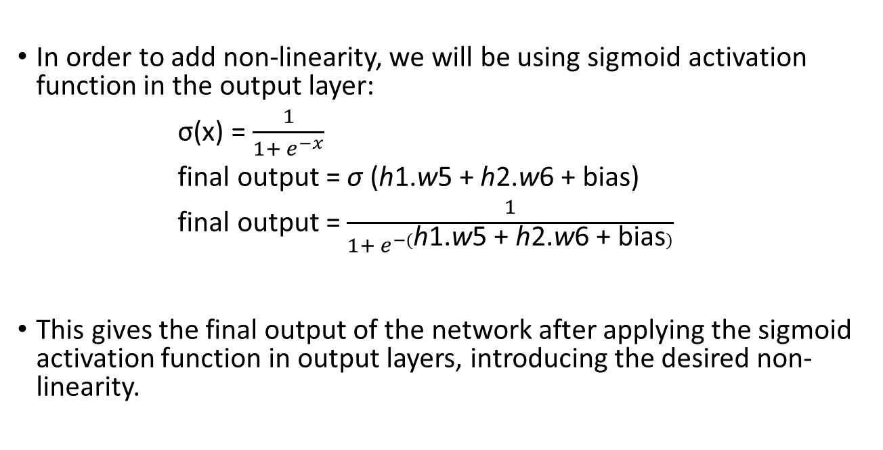
Activation Function
In order to add non-linearity, we will be using sigmoid activation function in the output layer:
σ(x) = $\frac{1}{1+ e^{−x}}$
final output = σ (h1​.w5​ + h2​.w6​ + bias)
final output = $\frac{1}{1+ e^{−(\text{h}\text{1​.}\text{w}\text{5​} \text{+} \text{h}\text{2​.}\text{w}\text{6} \text{​+} \text{bias})}}$
This gives the final output of the network after applying the sigmoid activation function in output layers, introducing the desired non-linearity.

Slide 22
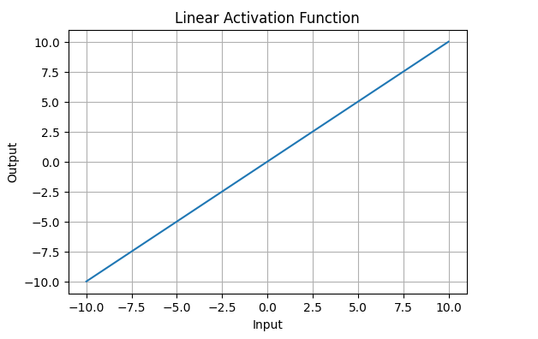
Types of Activation Functions
Linear Activation Function
The range of the output spans from −∞ to +∞.
Linear activation function is used at just one place i.e. output layer.
Using linear activation across all layers makes the network's ability to learn complex patterns limited.

Slide 23
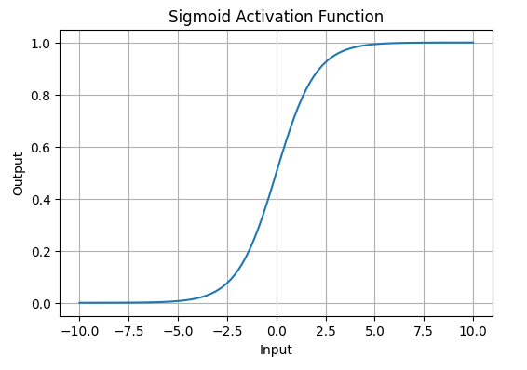
Types of Activation Functions
Non-Linear Activation Function
Sigmoid
    It allows neural networks to handle and model complex patterns that linear equations cannot.
    The output ranges between 0 and 1, hence useful for binary classification

Slide 24
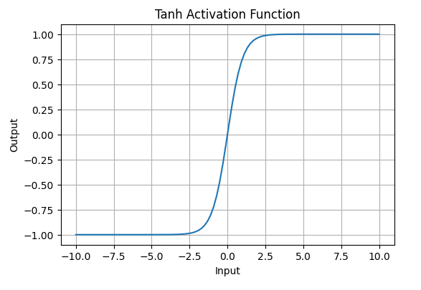
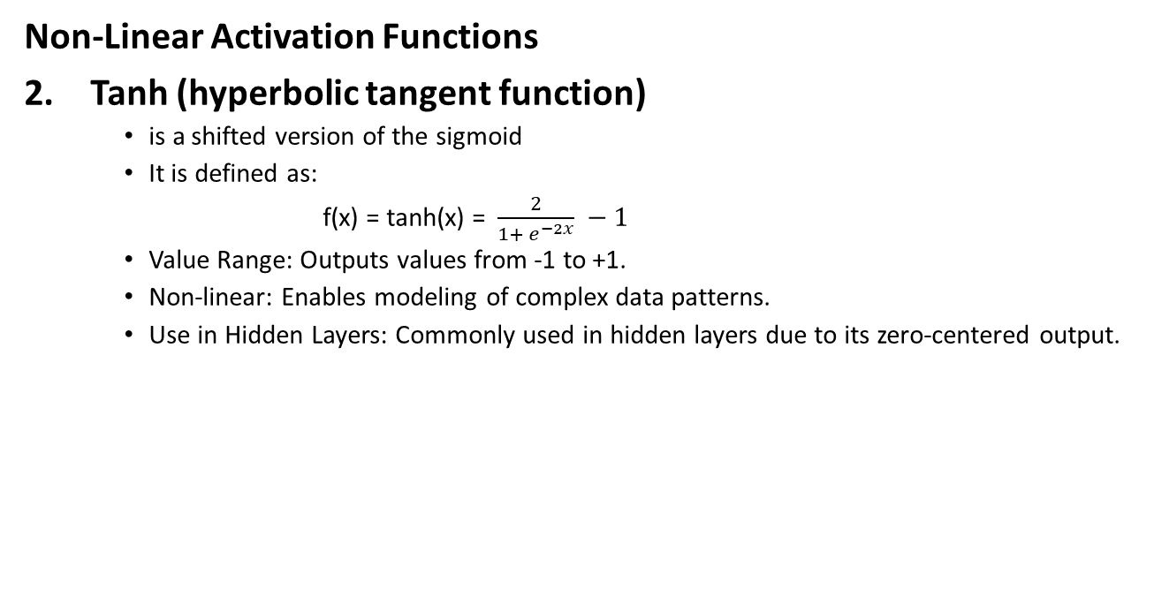
Types of Activation Functions
Non-Linear Activation Functions
Tanh (hyperbolic tangent function)
    is a shifted version of the sigmoid
    It is defined as:
    f(x) = tanh(x) = $\frac{2}{1+ e^{−2x}} −1$
    Value Range: Outputs values from -1 to +1.
    Non-linear: Enables modeling of complex data patterns.
    Use in Hidden Layers: Commonly used in hidden layers due to its zero-centered output.

Slide 25
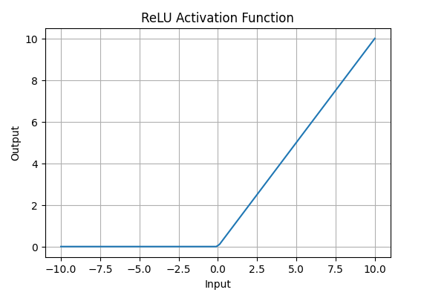
Types of Activation Functions
Non-Linear Activation Functions
ReLU (Rectified Linear Unit) Function
    Value Range: (0,∞) meaning the function only outputs non-negative values.
    Nature: It is a non-linear activation function, allowing neural networks to learn complex patterns and making backpropagation more efficient.
    Advantage over other Activation: ReLU is less computationally expensive than tanh and sigmoid because it involves simpler mathematical operations. At a time only a few neurons are activated making the network sparse making it efficient and easy for computation.

Slide 26
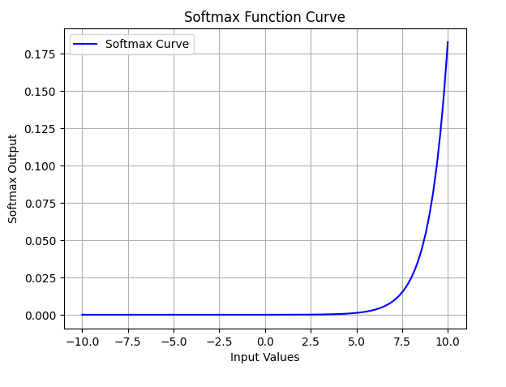
Types of Activation Functions
Exponential Linear Units
Softmax Function
    It is designed to handle multi-class classification problems.
    It transforms raw output scores from a neural network into probabilities.
    It works by squashing the output values of each class into the range of 0 to 1 while ensuring that the sum of all probabilities equals 1.
    The Softmax function ensures that each class is assigned a probability, helping to identify which class the input belongs to.

Slide 27
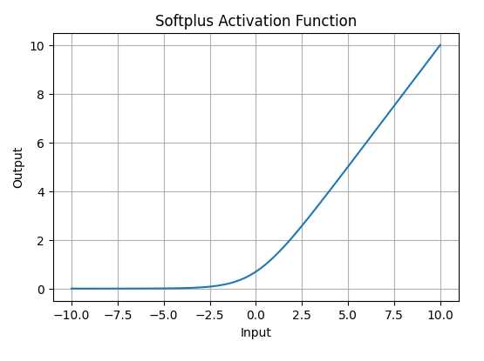
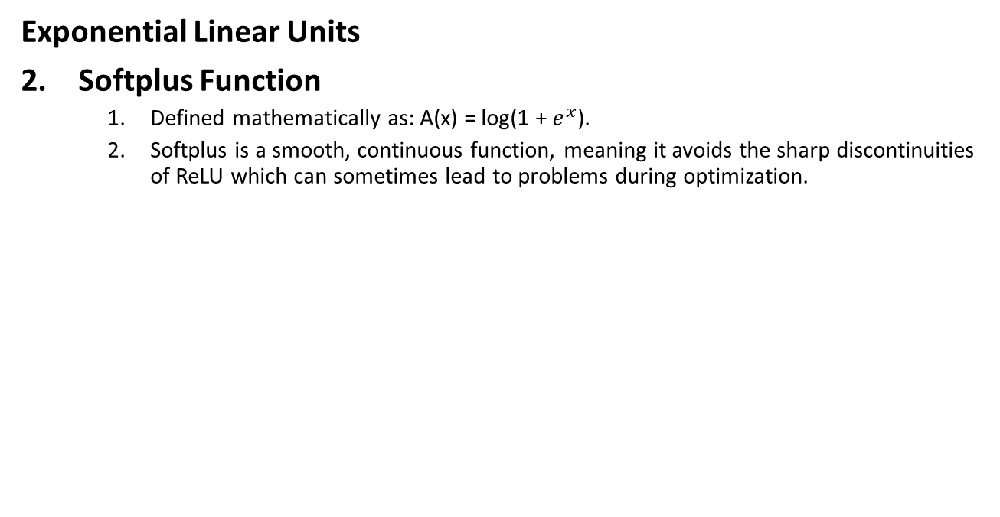
Types of Activation Functions
Exponential Linear Units
Softplus Function
    Defined mathematically as: A(x) = log⁡(1 + $e^{x}$).
    Softplus is a smooth, continuous function, meaning it avoids the sharp discontinuities of ReLU which can sometimes lead to problems during optimization.

Slide 28
Impact of Activation Functions
Convergence Speed: Functions like ReLU allow faster training by avoiding the vanishing gradient problem while Sigmoid and Tanh can slow down convergence in deep networks.
Gradient Flow: Activation functions like ReLU ensure better gradient flow, helping deeper layers learn effectively.
Model Complexity: Activation functions like Softmax allow the model to handle complex multi-class problems, whereas simpler functions like ReLU or Leaky ReLU are used for basic layers.

Slide 29
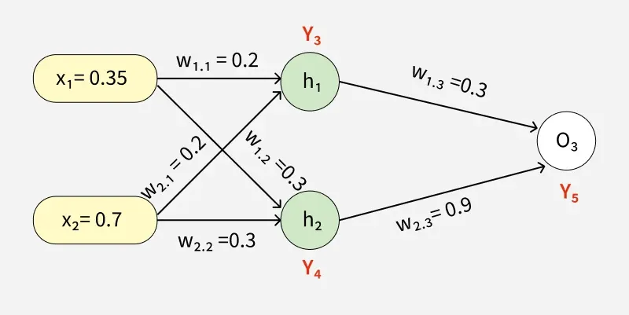
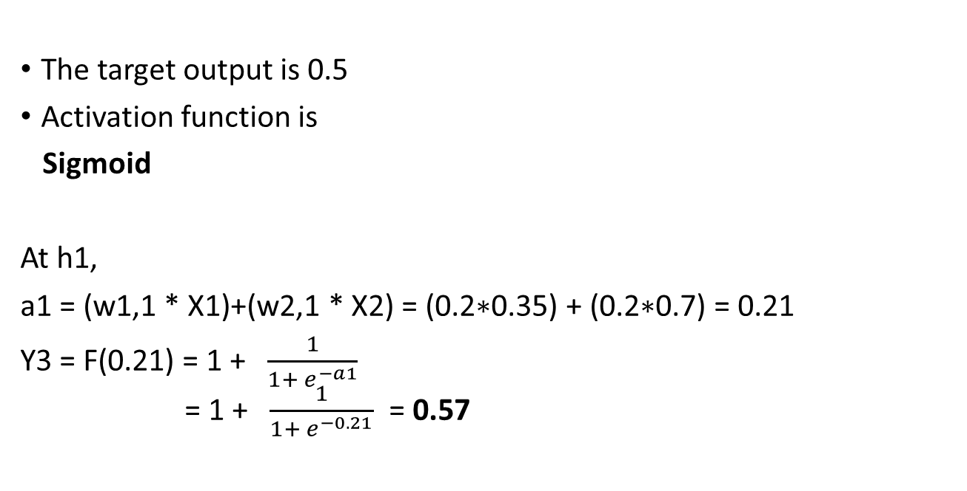
Working of Forward Pass
The target output is 0.5
Activation function is
Sigmoid
At h1,
a1 = (w1,1 * X1)+(w2,1 * X2) = (0.2∗0.35) + (0.2∗0.7) = 0.21
Y3​ = F(0.21) = 1 + $\frac{1}{1+ e^{−a1}}$
= 1 + $\frac{1}{1+ e^{−0.21}}$ = 0.57

Slide 30
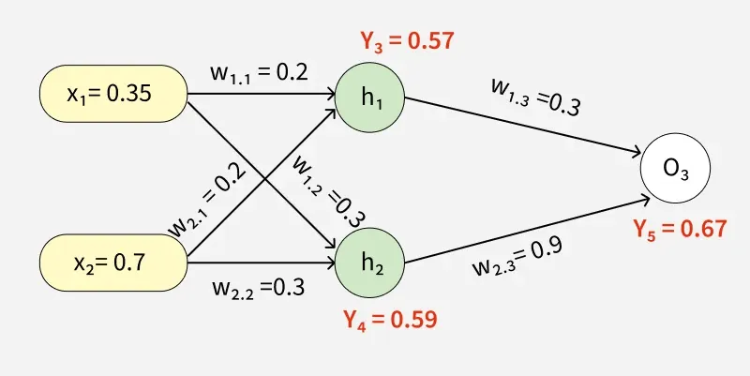
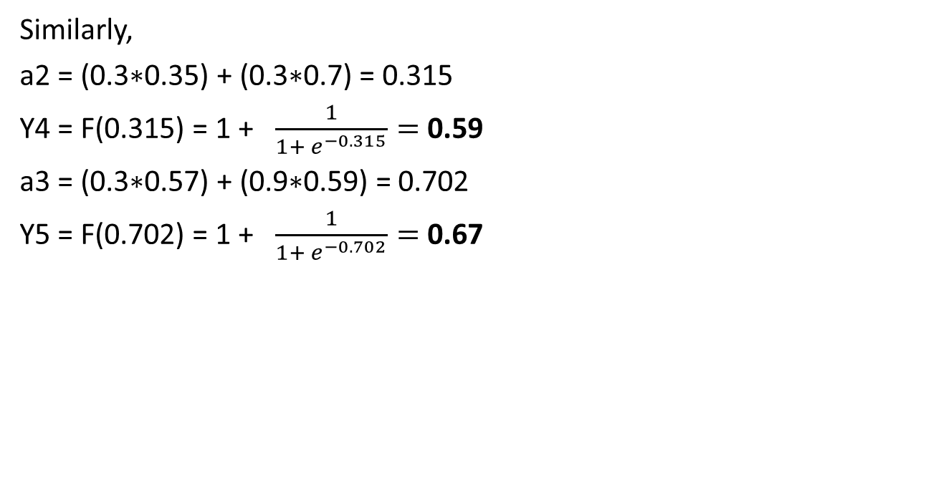
Working of Forward Pass
Similarly,
a2 = (0.3∗0.35) + (0.3∗0.7) = 0.315
Y4 = F(0.315) = 1 + $\frac{1}{1+ e^{−0.315}}=$0.59
a3 = (0.3∗0.57) + (0.9∗0.59) = 0.702
Y5 = F(0.702) = 1 + $\frac{1}{1+ e^{−0.702}}=$0.67

Slide 31
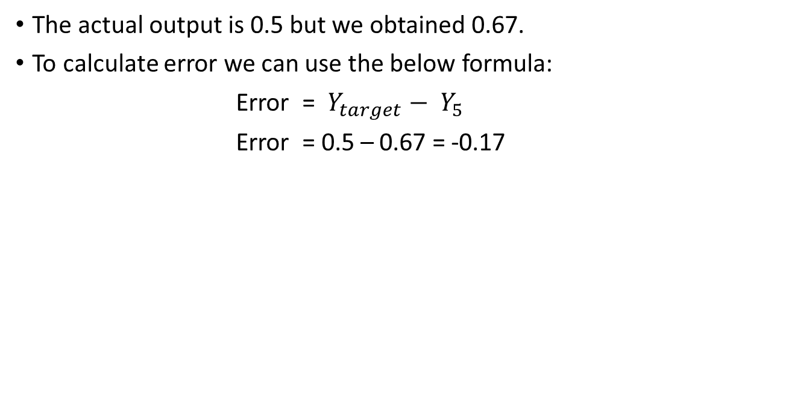
Working of Forward Pass
The actual output is 0.5 but we obtained 0.67.
To calculate error we can use the below formula:
Error =${ Y}_{target} −{ Y}_{5}$
Error = 0.5 – 0.67 = -0.17

Slide 32
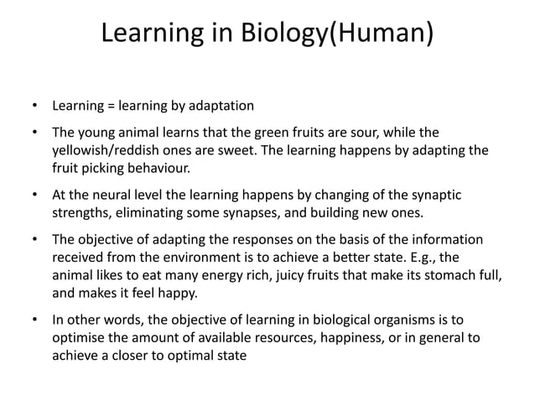

Slide 33


Slide 34
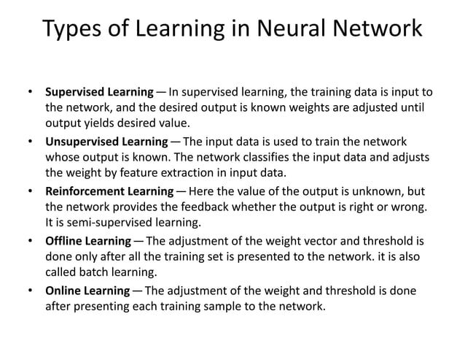

Slide 35
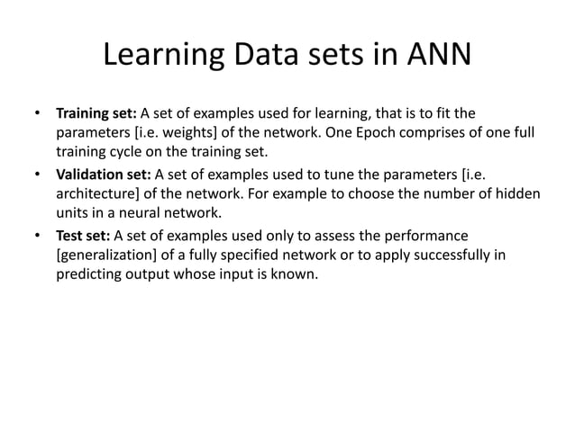

Slide 36
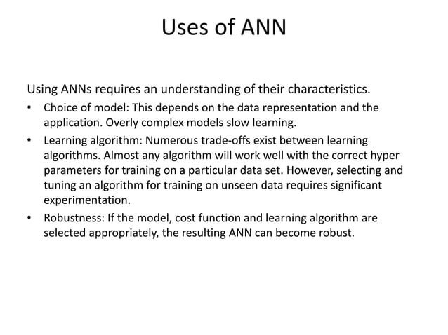

Slide 37
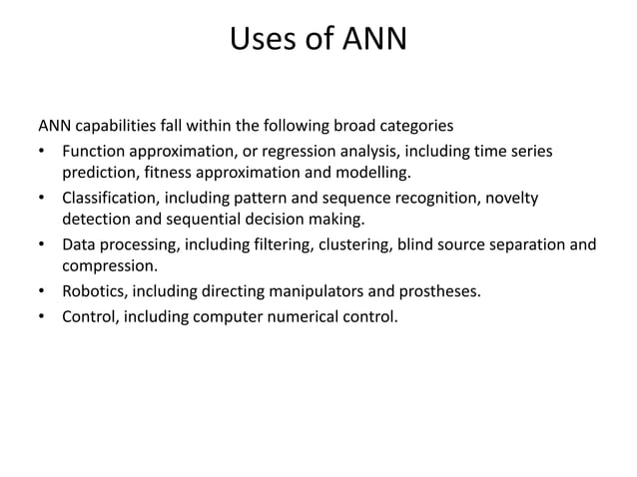

Slide 38
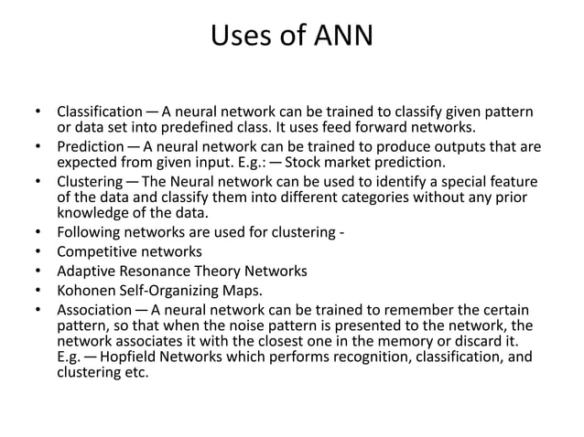

Slide 39
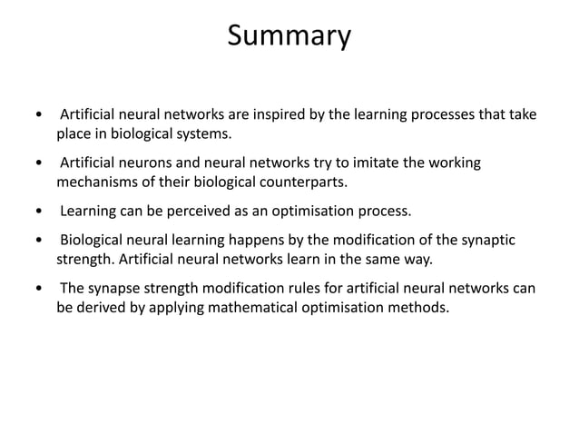

Slide 40
