Slide 1

Applications of AI
Introduction to Search:
Problem Solving & Search Space

Slide 2
Problem Solving as Search
• AI Agent has a model of the world with a known initial state and goal.
• Search = find a path (sequence of actions) from start state to goal state.
• Performed in a state space: all possible configurations of the world.
• This is different from searching the web or looking for physical objects.

Slide 3
State Space Representation
• A state captures everything needed to predict outcomes of actions.
• Assumptions: full observability, deterministic actions, known goals.
• Solution = a sequence of actions leading to a goal state.
Example: Robot navigating rooms or delivering parcels.

Slide 4
Examples of Search Problems
• Route Planning: Finding the best path from location X to Y.
• Vacuum World: Clean all dirty locations with minimal moves.
• 8-Puzzle: Reach the goal tile configuration.
• Tutoring System: Teach student to master all target topics.

Slide 5

What are Search Problems?
We will consider the problem of designing goal-based agents in
  known,
  fully observable,
  and deterministic environments.
Example environment:
Start
Exit

Slide 6
Planning for Search Problems
Initial state
For now, we consider only a discrete environment using an atomic state representation (states are just labeled 1, 2, 3, …).
The state space is the set of all possible states of the environment and some states are marked as goal states.
The optimal solution is the sequence of actions (or equivalently a sequence of states) that gives the lowest path cost for reaching the goal.
1
Goal
state
z

Slide 7
Planning for Search Problems
Initial state
Phases:
Search/Planning: the process of looking for the sequence of actions that reaches a goal state. Requires that the agent knows what happens when it moves!
Execution: Once the agent begins executing the search solution in a deterministic, known environment, it can ignore its percepts (open-loop system).
1
Goal
state
z

Slide 8
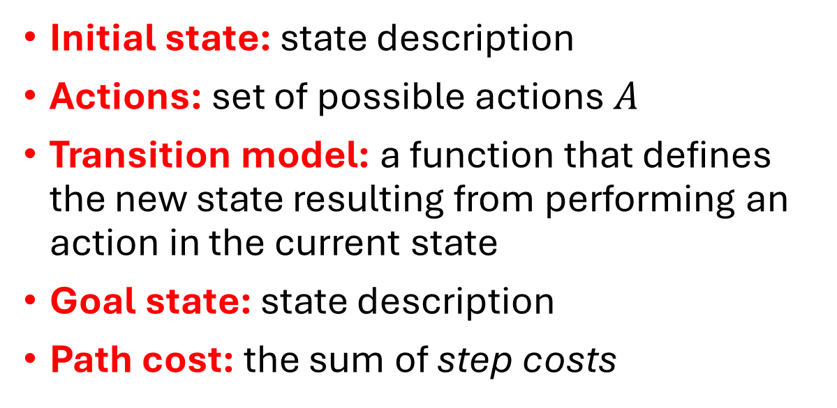
Definition of a Search Problem
Initial state
Actions: {N, E, S, W}
Initial state: state description
Actions: set of possible actions $A$
Transition model: a function that defines the new state resulting from performing an action in the current state
Goal state: state description
Path cost: the sum of step costs
Transitions
1
g
i
4
a
Goal
state
z
Discretization grid
Important: The state space is typically too large to be enumerated, or it is continuous. Therefore, the problem is defined by initial state, actions and the transition model and not the set of all possible states.

Slide 9
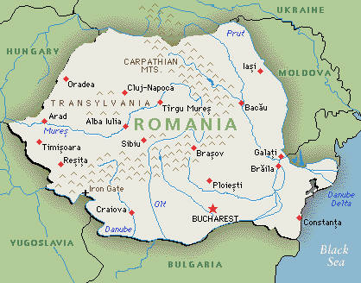
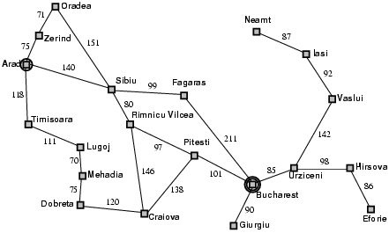
Example: Romania Vacation
Original Description
On vacation in Romania; currently in Arad
Flight leaves tomorrow from Bucharest
Initial state: Arad
Actions: Drive from one city to another.
Transition model and states: If you go from city A to city B, you end up in city B.
Goal state: Bucharest
Path cost: Sum of edge costs.
State Space/Transition model
Defined as a graph
Distance in miles

Slide 10
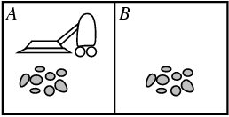
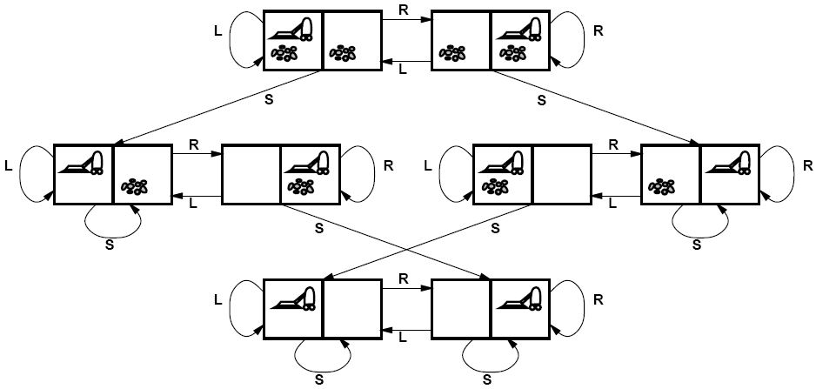
Example: Vacuum world
State Space
There are 8 possible atomic states of the system.
Goal states
Initial State: Defined by agent location and dirt location.
Actions: Left, right, clean
Transition model: Clean a location or move.
Goal state: All locations are clean.
Path cost: E.g., number if actions

Slide 11
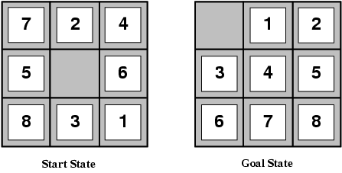
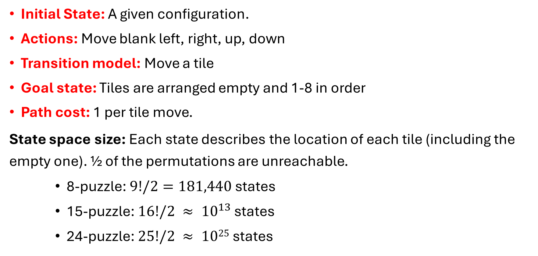
Example: Sliding-tile Puzzle
Initial State: A given configuration.
Actions: Move blank left, right, up, down
Transition model: Move a tile
Goal state: Tiles are arranged empty and 1-8 in order
Path cost: 1 per tile move.
State space size: Each state describes the location of each tile (including the empty one). ½ of the permutations are unreachable.
    8-puzzle: $9!/2=181,440$states
    15-puzzle: $16!/2 ≈ {10}^{13}$ states
    24-puzzle: $25!/2 ≈ 1025$states

Slide 12
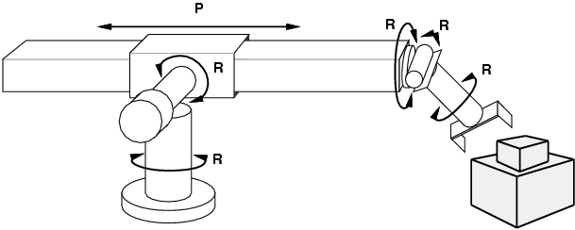
Example: Robot Motion Planning
Initial State: Current arm position with real-valued coordinates of robot joint angles.
Actions: Continuous motions of robot joints.
Transition model: Movement.
Goal state: Desired final configuration (e.g., object is grasped).
Path cost: Time to execute, smoothness of path, etc.

Slide 13
Search Strategies: Properties
A search strategy is defined by picking the order of node expansion.
Strategies are evaluated along the following dimensions:
  Completeness: does it always find a solution if one exists?
  Optimality: does it always find a least-cost solution?
  Time complexity: how long does it take?
  Space complexity: how much memory does it need?

Slide 14
Solving Search Problems
Once the problem is formulated, need to solve it.
Solution – action sequences.
Search algorithms work by considering various possible action sequences.
Given a search problem definition
Initial state
Actions
Transition model
Goal state
Path cost
How do we find the optimal solution (sequence of actions/states)?
Construct a search tree for the state space graph!

Slide 15
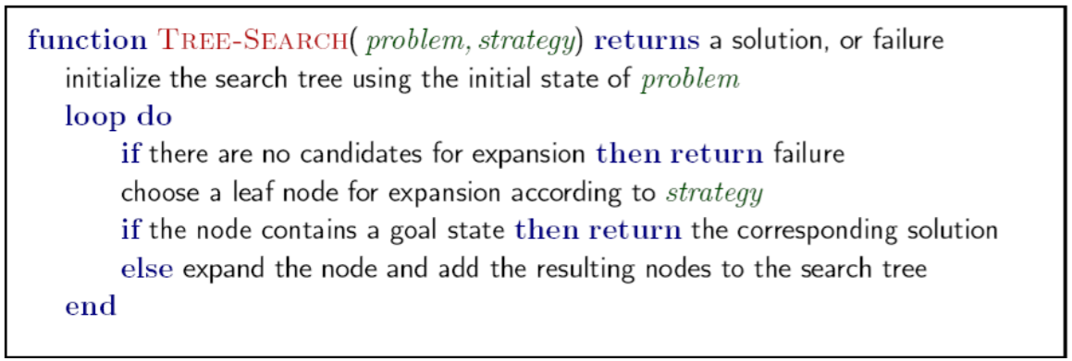
Tree Search Algorithm Outline

Slide 16
Creating a Search Tree
Superimpose a “what if” tree of possible actions and outcomes (states) on the state space graph.
The Root node represents the initial stare.
An action child node is reached by an edge representing an action. The corresponding state is defined by the transition model.
Trees cannot have cycles (loops). Cycles in the search space must be broken to prevent infinite loops.
Trees cannot have multiple paths to the same state. These are called redundant paths. Removing other redundant paths improves search efficiency.
A path through the tree corresponds to a sequence of actions (states).
A solution is a path ending in a node representing a goal state.
Nodes vs. states: Each tree node represents a state of the system. If redundant path cannot be prevented then state can be represented by multiple nodes in the tree.
Root node = Initial state
a
Edge = Action
Child node
Non-cycle redundant
path
b
c
d
e
e
Cycle
…
…
…
b
Solution path
Node representing
a Goal state
f

Slide 17
Typical Tree Search vs. AI Search
Typical tree search
Assumes a given tree that fits in memory.
Trees have by construction no cycles or redundant paths.
AI tree/graph search
The search tree is too large to fit into memory.
  Builds parts of the tree from the initial state using the transition function representing the graph.
  Memory management is very important.
The search space is typically a very large and complicated graph. Memory-efficient cycle checking is very important to avoid infinite loops or minimize searching parts of the search space multiple times.
Checking redundant paths often requires too much memory and we accept searching the same part multiple times.

Slide 18
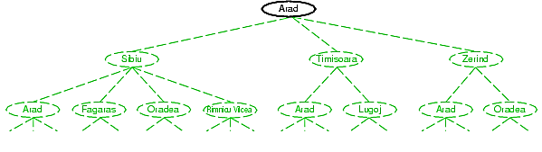
Tree Search Example
Frontier
Transition model

Slide 19
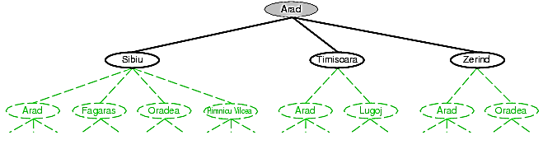
Tree Search Example
1. Expand Arad
Frontier
Transition model

Slide 20
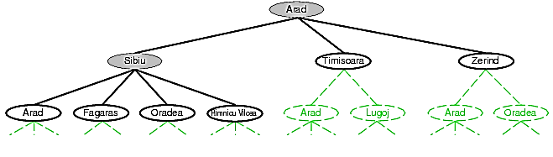
Tree Search Example
Frontier
2. Expand Sibiu
Transition model
Example of a cycle
We could have also expanded Timisoara or Zerind!

Slide 21
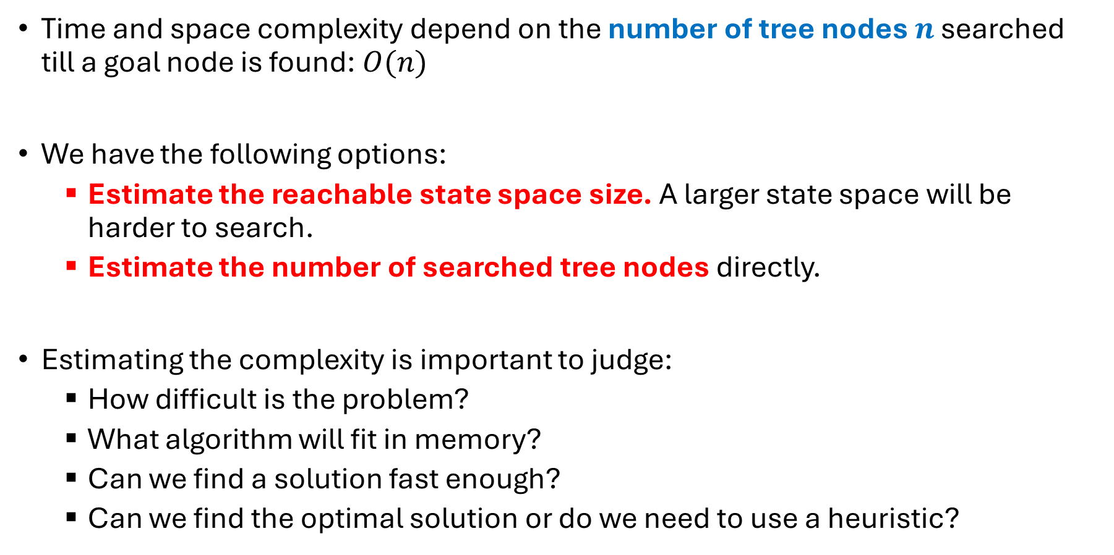
Time and Space Complexity of Tree Search
Time and space complexity depend on the number of tree nodes $n$ searched till a goal node is found:$O(n)$
We have the following options:
  Estimate the reachable state space size. A larger state space will be harder to search.
  Estimate the number of searched tree nodes directly.
Estimating the complexity is important to judge:
  How difficult is the problem?
  What algorithm will fit in memory?
  Can we find a solution fast enough?
  Can we find the optimal solution or do we need to use a heuristic?

Slide 22
State Space
Number of different states the agent and environment can be in.
Reachable states are defined by the initial state and the transition model. Only reachable states are important for search.

Slide 23
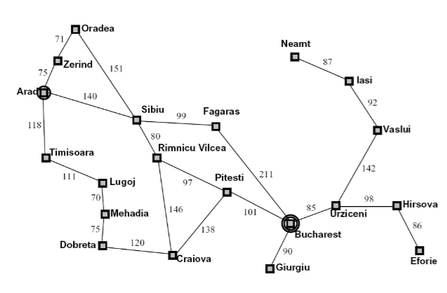

State Space Graphs
A representation of a search problem
  Nodes are (abstracted) world configurations
  Arcs represent successors (action results)
  The goal test is a set of goal nodes (maybe only one)
  Each state occurs only once
The full graph is usually too large.
The graph is built and explored implicitly byapplying actions on states.
$$x_{1}$$
…

Slide 24
Search Strategies
The strategy for exploration of nodes leads to a variety of search algorithms
1. Uninformed Search
Only use information about the state in the problem definition.
Generate successors and distinguish goal states from no-goal states.
2. Informed Search
Use problem-specific knowledge beyond the problem definition
Heuristics for more efficient search

Slide 25
Uninformed Search Strategies
The search algorithm/planning agent is not provided with information about how close a state is to the goal state.
It only uses the labels of the atomic states and the transition function.
It blindly searches, following a simple strategy, until it reaches the goal state.
Search strategies:
  Breadth-first search strategy: BFS and uniform-cost search
  Depth-first search strategy: DFS and Iterative deepening search

Slide 26
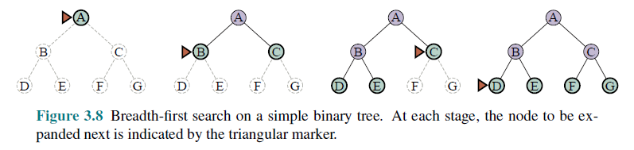
Breadth-First Search (BFS)
Expansion rule: Expand shallowest unexpanded node in the frontier (=FIFO).
Data Structures
Frontier data structure: holds references to the green nodes (green) and is implemented as a FIFO queue.
Reached data structure: holds references to all visited nodes (gray and green) and is used to prevent visiting nodes more than once (cycle and redundant path checking).
Builds a complete tree with links between parent and child.

Slide 27
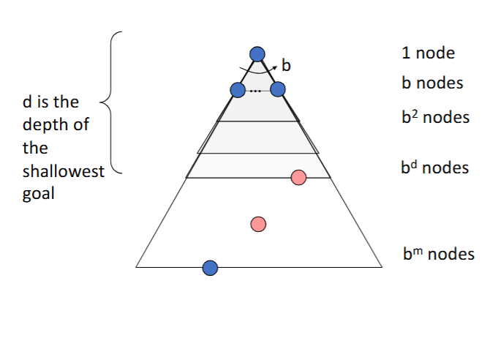
Implementation: Breadth-First Search
• Expansion Strategy
Expands the shallowest unexplored node in the frontier of the search tree.
Time Complexity
Search takes time
O(b^{d})
Space Complexity
• Frontier nodes O(b^{d})
• Explored nodes O(b^{d-1})
• Memory requirement is a problem.

Slide 28
Implementation: Breadth-First Search
• Is it complete?
Yes.
• The shallowest goal is at a finite depth, d
• If the branching factor, b, is finite
then BFS will find it.
• Is it optimal?
Yes.
If the path cost is a non-decreasing
function of depth.
For example, if all edge costs are equal.

Slide 29
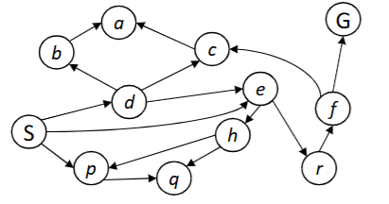
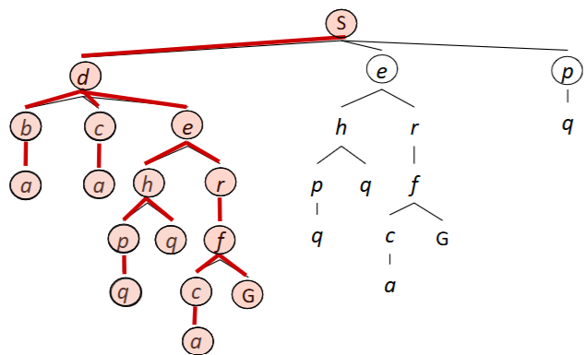
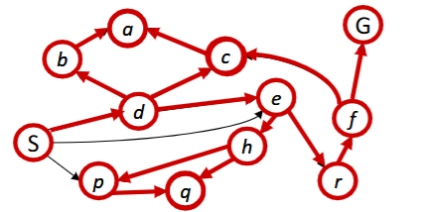
Depth-First Search (DFS)
Strategy: expand a deepest node first
Implementation: Frontier is a LIFO stack

Slide 30
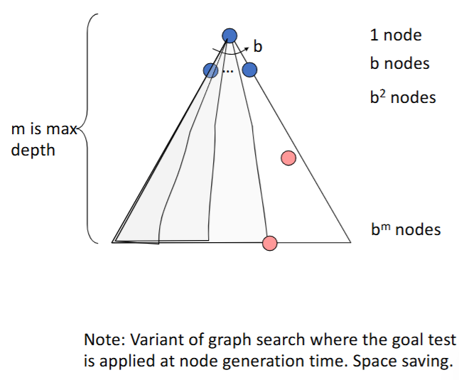
Implementation: Depth-First Search
Expansion Strategy
• Expands the deepest unexplored node in thefrontier of the search tree
Time Complexity
• Worst case: processes the whole tree.
• If m is finite, takes time O(b^{m})
Space Complexity
• Frontier stores:
  • Single path from the root to the leaf node.
  • Sibling nodes on the path that are unexplored.
• Memory requirement is low O(bm)

Slide 31
Implementation: Depth-First Search
• Is it complete?
• Yes (Partially), if m is finite. Eventually, finds the path. But if there exists a cycle, then the DFS will enter an endless loop
• Is it optimal?
• No, it finds the “leftmost” solution, regardless of depth or cost

Slide 32
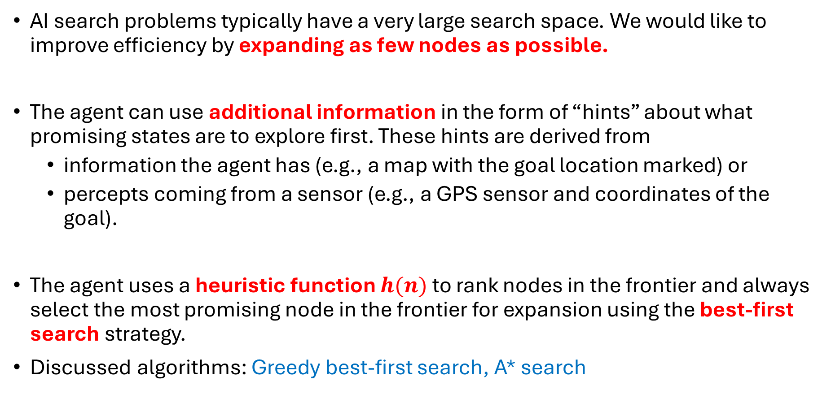
Informed Search
AI search problems typically have a very large search space. We would like to improve efficiency by expanding as few nodes as possible.
The agent can use additional information in the form of “hints” about what promising states are to explore first. These hints are derived from
  information the agent has (e.g., a map with the goal location marked) or
  percepts coming from a sensor (e.g., a GPS sensor and coordinates of the goal).
The agent uses a heuristic function $h(n)$ to rank nodes in the frontier and always select the most promising node in the frontier for expansion using the best-first search strategy.
Discussed algorithms: Greedy best-first search, A* search

Slide 33
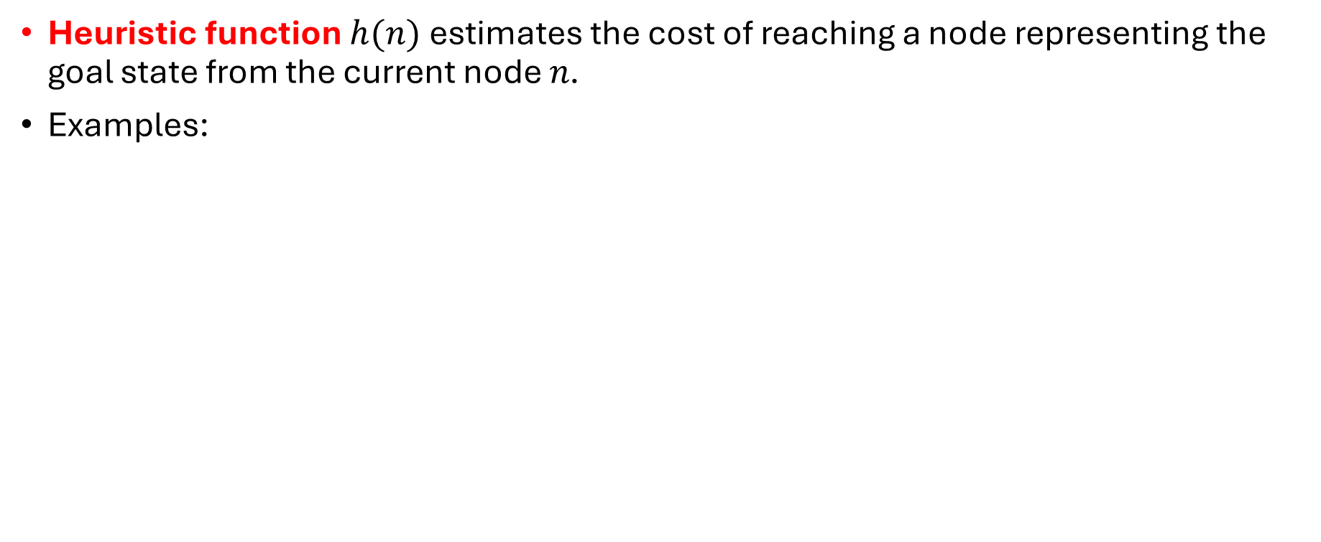
Heuristic Function
Heuristic function $h(n)$estimates the cost of reaching a node representing the goal state from the current node $n$.
Examples:
Euclidean distance
Manhattan distance
Start state
Start state
Goal state
Goal state

Slide 34
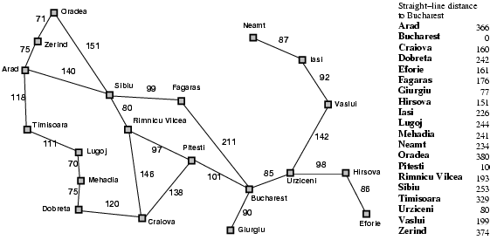
Heuristic for the Romania Problem
Estimate the driving distance from Arad to Bucharest using a straight-line distance.
h(n)
366

Slide 35

Greedy Best-First Search Example
Expansion rule: Expand the node that has the lowest value of the heuristic function h(n)
h(n)=

Slide 36
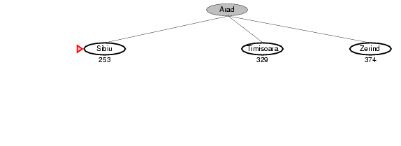
Greedy Best-First Search Example

Slide 37
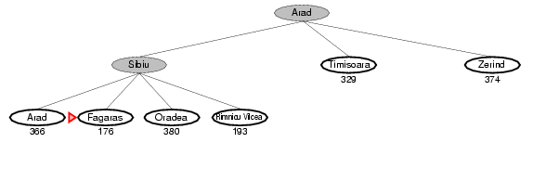
Greedy Best-First Search Example

Slide 38
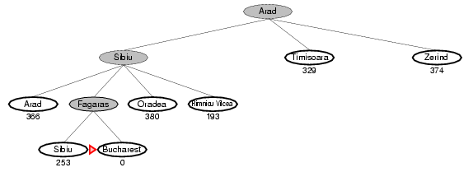
Greedy Best-First Search Example
Total:
140 + 99 + 211 = 450 miles

Slide 39
Implementation of Greedy Best-First search
Best-First Search
Expand the frontier using
$$f\left(n\right)=h(n)$$
Expand the frontier using
𝑓(𝑛)=ℎ(𝑛)

Slide 40
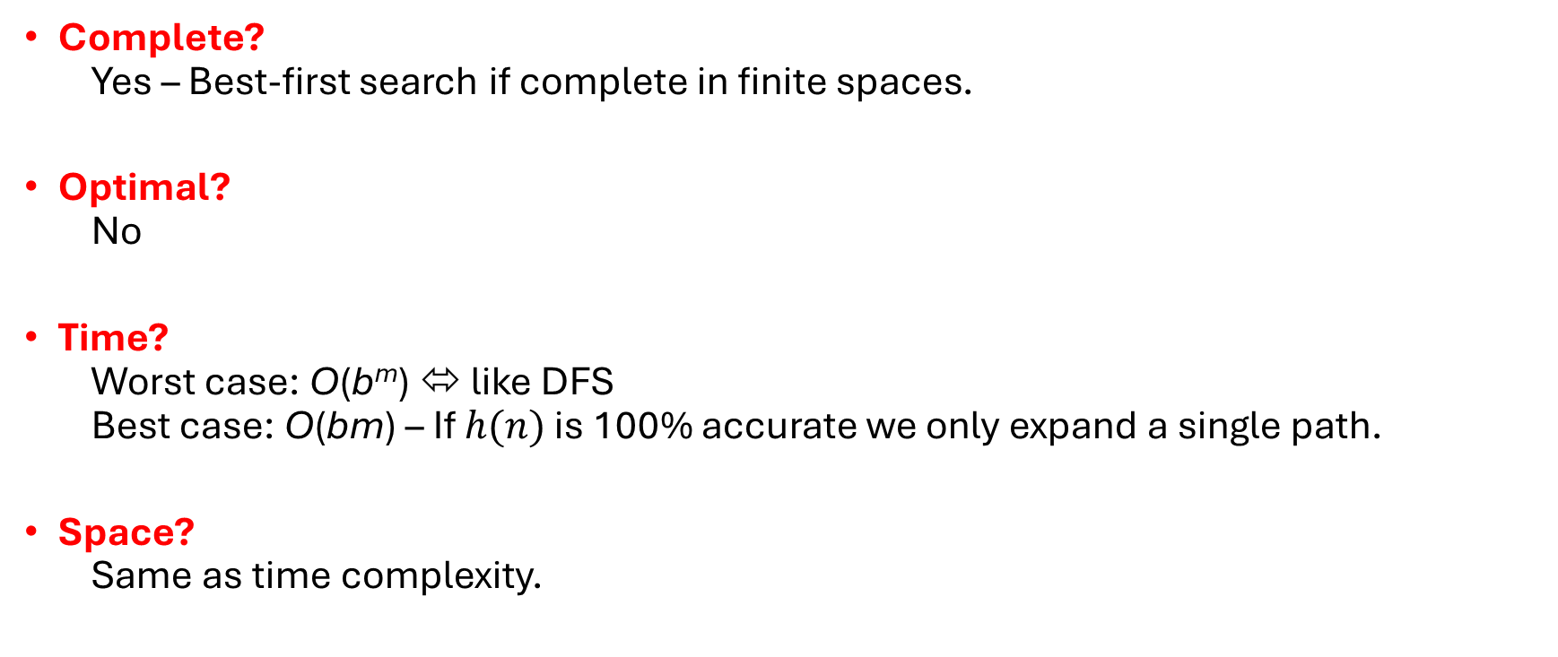
Properties of Greedy Best-First Search
Complete?
  Yes – Best-first search if complete in finite spaces.
Optimal?
  No
Time?
  Worst case: O(b^{m}) ⬄ like DFS
  Best case: O(bm) – If $h(n)$ is 100% accurate we only expand a single path.
Space?
  Same as time complexity.
d: depth of the optimal solution
m: max. depth of tree
b: maximum branching factor

Slide 41
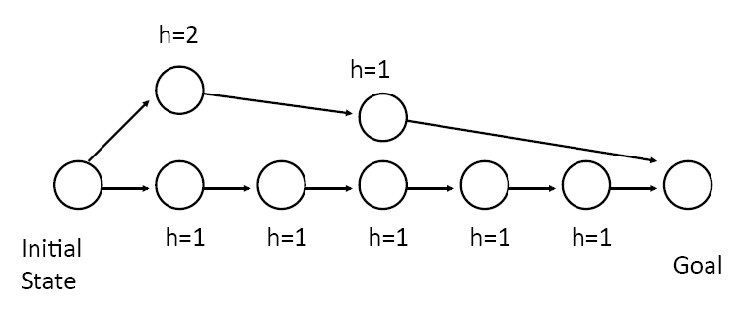
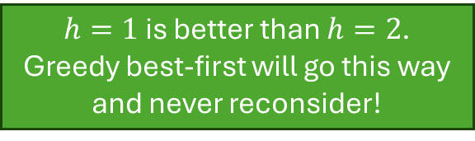
The Optimality Problem of
Greedy Best-First search
Greedy best-first search only considers the estimated cost to the goal.
$h=1$ is better than $h=2$.
Greedy best-first will go this way and never reconsider!

Slide 42
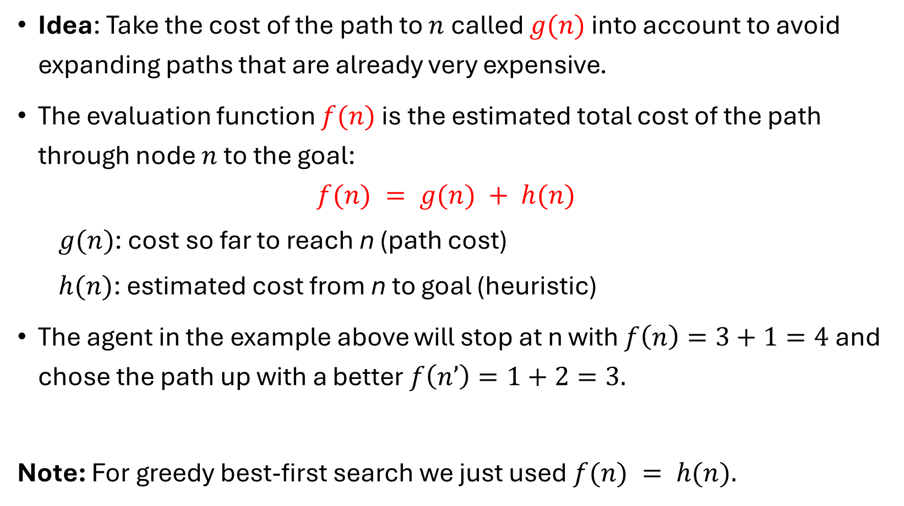



A* Search
$f\left(n′\right)=3$
n’
$g(n)$ = 3
$f\left(n\right)=4$
n
Idea: Take the cost of the path to $n$ called $g(n)$ into account to avoid expanding paths that are already very expensive.
The evaluation function $f(n)$ is the estimated total cost of the path through node $n$ to the goal:
$$f(n) = g(n) + h(n)$$
  $g(n)$: cost so far to reach n (path cost)
  $h(n)$: estimated cost from n to goal (heuristic)
The agent in the example above will stop at n with $f\left(n\right)=3+1=4$and chose the path up with a better $f\left(n’\right)=1+2=3.$
Note: For greedy best-first search we just used $f(n) = h(n).$
Notes:
Dates back to 1968

Slide 43



A* Search Example
Expansion rule: Expand the node with the smallest f(n)
$$f\left(n\right)=g(n)+h(n)=$$
$$h(n)$$

Slide 44
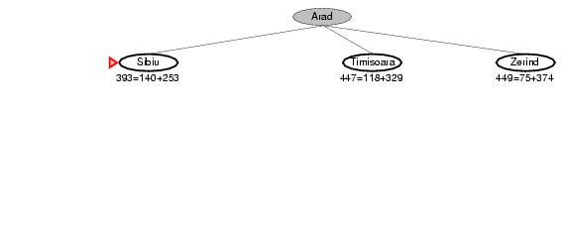


A* Search Example
$$f\left(n\right)=g\left(n\right)+h(n)$$
$$h(n)$$

Slide 45
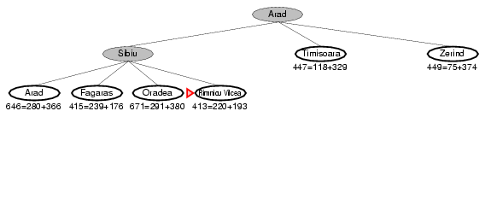

A* Search Example
$$f\left(n\right)=g\left(n\right)+h(n)$$
$$h(n)$$

Slide 46
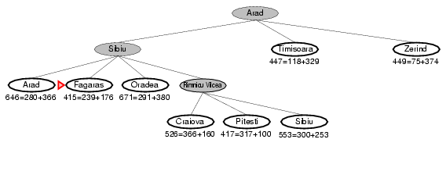
A* Search Example
$$f\left(n\right)=g\left(n\right)+h(n)$$
$$h(n)$$
Reconsiders Rimnicu Vilcea because Fagaras may have a shorter total cost to Bucharest.

Slide 47
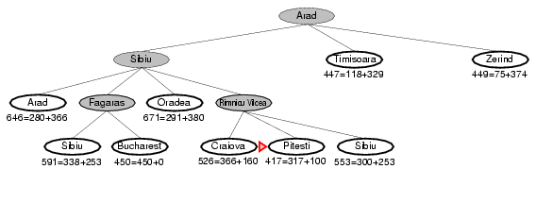
A* Search Example
$$f\left(n\right)=g\left(n\right)+h(n)$$
$$h(n)$$

Slide 48
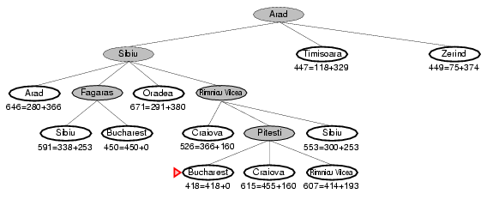
A* Search Example
$$f\left(n\right)=g\left(n\right)+h(n)$$
$$h(n)$$

Slide 49
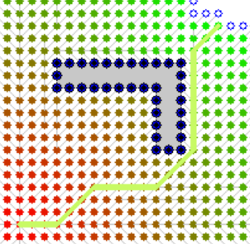
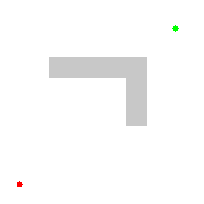
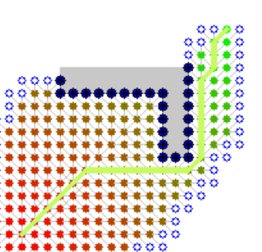
BFS vs. A* Search
BFS
A*
A*
Source: Wikipedia
A* Search expands fewer nodes than BFS!

Slide 50
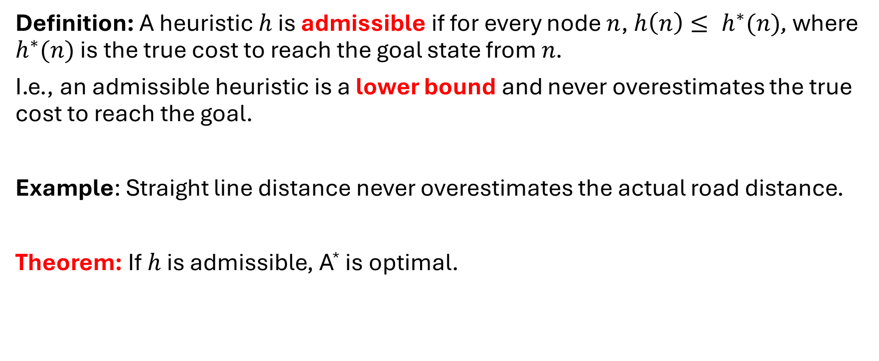
Optimality: Admissible Heuristics
Definition: A heuristic $h$ is admissible if for every node $n$, $h\left(n\right)≤ h^{∗}(n)$, where $h^{∗}(n)$ is the true cost to reach the goal state from $n$.
I.e., an admissible heuristic is a lower bound and never overestimates the true cost to reach the goal.
Example: Straight line distance never overestimates the actual road distance.
Theorem: If $h$ is admissible, A* is optimal.

Slide 51

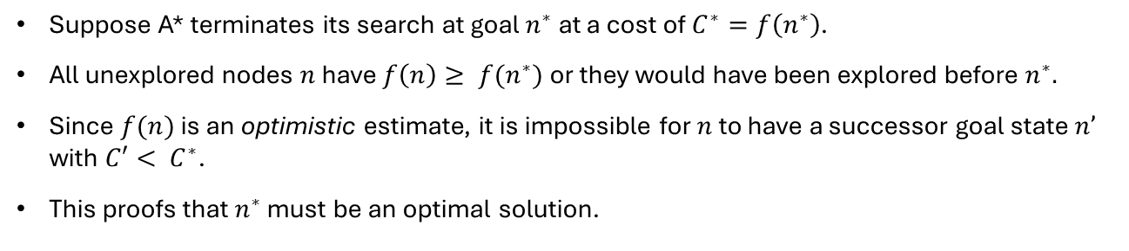





Proof of Optimality of
A* Search
$$f(n) = g(n) + h(n)$$
For goal states:
$$f(n^{∗}) = g(n) +0$$
n* (goal)
Any unexplored node $n$ has:
$$C^{∗}=f(n^{∗}) = g(n^{∗}) + 0$$
n
$$f\left(n\right)≥ f(n^{∗})$$
n’ (other goal)
$$g\left(n^{′}\right)≥ f\left(n\right)⟺g\left(n^{′}\right)≥ C^{∗}$$
Suppose A* terminates its search at goal $n^{∗}$ at a cost of $C^{∗}=f\left(n^{∗}\right)$.
All unexplored nodes $n$ have $f\left(n\right)≥ f(n^{∗})$or they would have been explored before $n^{∗}.$
Since $f(n)$ is an optimistic estimate, it is impossible for $n$ to have a successor goal state $n’$ with $C′< C^{∗}$.
This proofs that $n^{∗}$ must be an optimal solution.

Slide 52
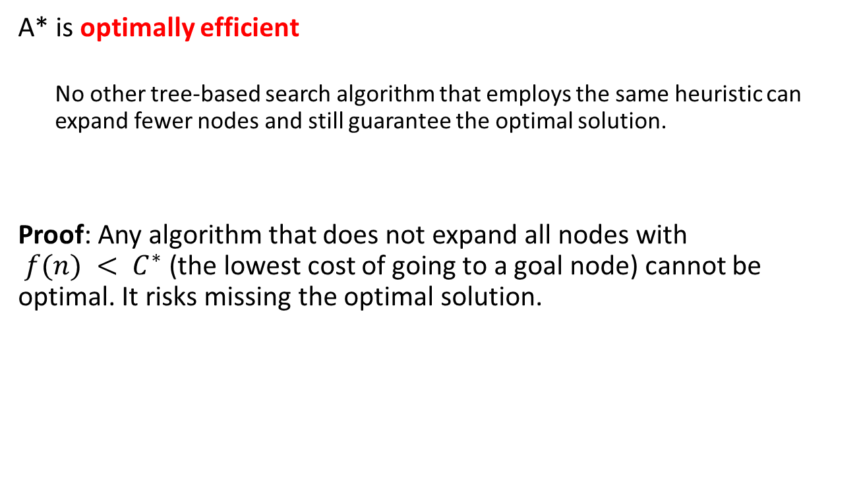
Guarantees of A* Search
A* is optimally efficient
  No other tree-based search algorithm that employs the same heuristic can expand fewer nodes and still guarantee the optimal solution.
Proof: Any algorithm that does not expand all nodes with
$f(n) < C^{∗}$(the lowest cost of going to a goal node) cannot be optimal. It risks missing the optimal solution.

Slide 53
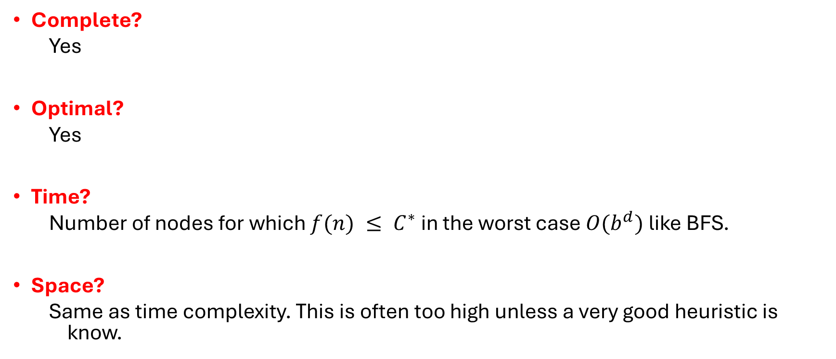
Properties of A*Search
Complete?
  Yes
Optimal?
  Yes
Time?
  Number of nodes for which $f(n) ≤ C^{∗}$ in the worst case $O(b^{d})$ like BFS.
Space?
  Same as time complexity. This is often too high unless a very good heuristic is know.

Slide 54
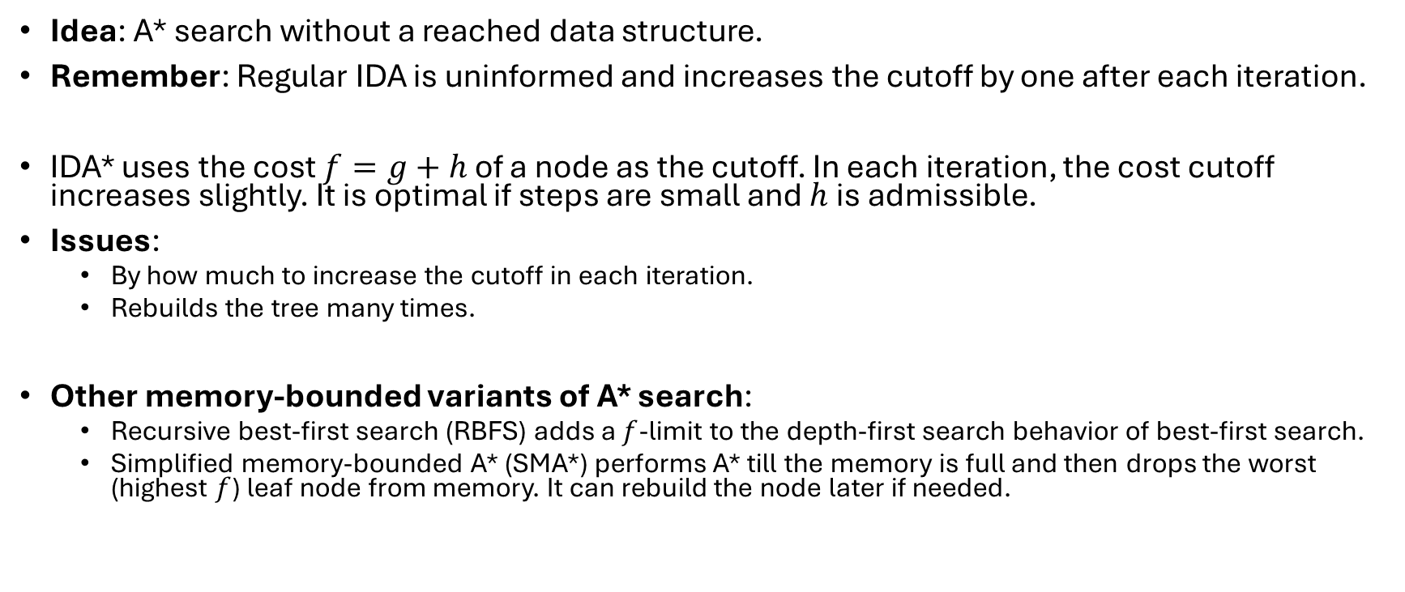
Iterative-Deepening A* Search – IDA*
Idea: A* search without a reached data structure.
Remember: Regular IDA is uninformed and increases the cutoff by one after each iteration.
IDA* uses the cost $f=g+h$ of a node as the cutoff. In each iteration, the cost cutoff increases slightly. It is optimal if steps are small and $h$ is admissible.
Issues:
  By how much to increase the cutoff in each iteration.
  Rebuilds the tree many times.
Other memory-bounded variants of A* search:
  Recursive best-first search (RBFS) adds a $f$-limit to the depth-first search behavior of best-first search.
  Simplified memory-bounded A* (SMA*) performs A* till the memory is full and then drops the worst (highest $f$) leaf node from memory. It can rebuild the node later if needed.

Slide 55
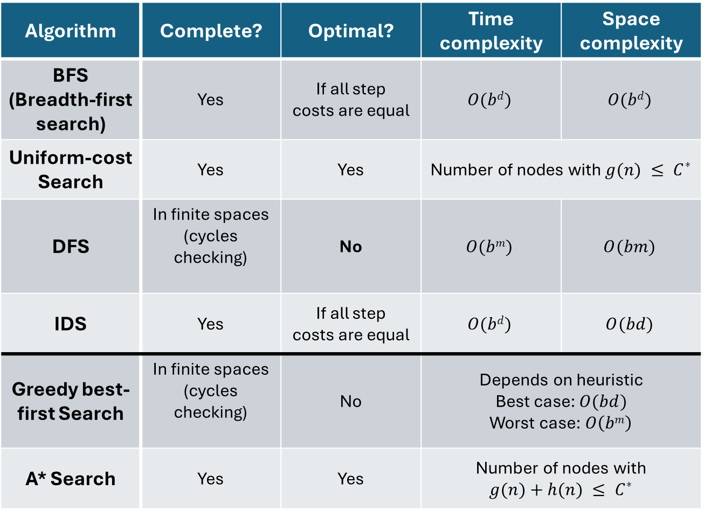
Summary:
All Search Strategies
b: maximum branching factor of the search tree
d: depth of the optimal solution
m: maximum length of any path in the state space
C*: cost of optimal solution
Algorithm | Complete? | Optimal? | Time complexity | Space complexity
BFS (Breadth-first search) | Yes | If all step costs are equal | $$O(bd)$$ | $$O(bd)$$
Uniform-cost Search | Yes | Yes | Number of nodes with $g(n) ≤ C^{∗}$
DFS | In finite spaces (cycles checking) | No | $$O(bm)$$ | $$O(bm)$$
IDS | Yes | If all step costs are equal | $$O(bd)$$ | $$O(bd)$$
Greedy best-first Search | In finite spaces (cycles checking) | No | Depends on heuristic $$\text{Best} \text{case}\text{: }O(bd)$$ Worst case: $O\left(bm\right)$
A* Search | Yes | Yes | Number of nodes with $$g(n)+h(n) ≤ C^{∗}$$
With a good heuristic

Slide 56
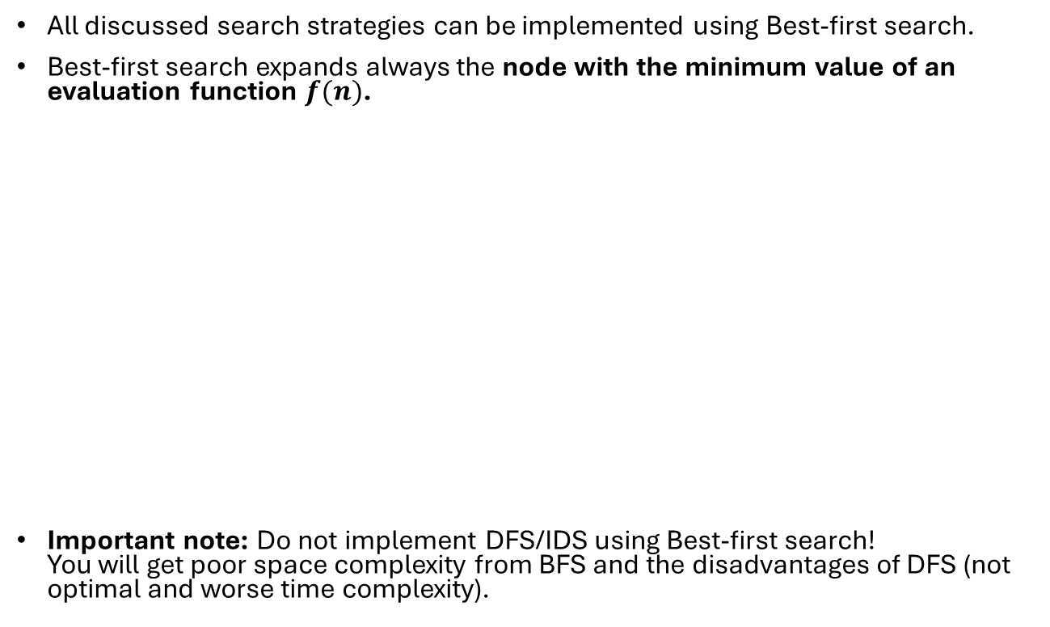
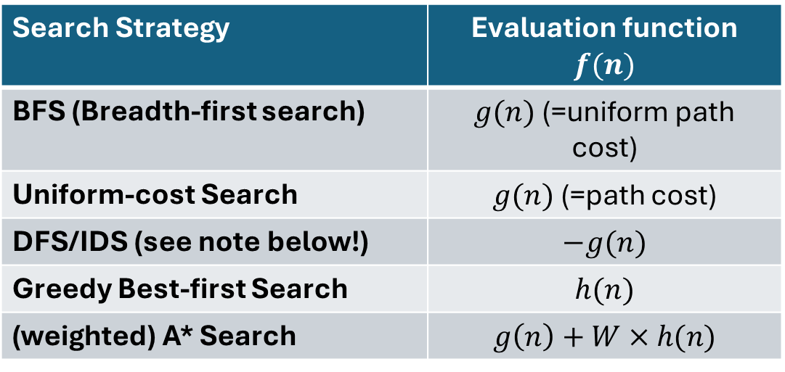
Implementation as Best-First Search
All discussed search strategies can be implemented using Best-first search.
Best-first search expands always the node with the minimum value of an evaluation function $f(n)$.
Important note: Do not implement DFS/IDS using Best-first search!
You will get poor space complexity from BFS and the disadvantages of DFS (not optimal and worse time complexity).
Search Strategy | Evaluation function $f(n)$
BFS (Breadth-first search) | $g(n)$ (=uniform path cost)
Uniform-cost Search | $g(n)$ (=path cost)
DFS/IDS (see note below!) | $$−g(n)$$
Greedy Best-first Search | $$h(n)$$
(weighted) A* Search | $$g\left(n\right)+W×h(n)$$

