Slide 1

Informed Search Strategies
Greedy Best-First Search, A* Search
Presenter:
Dr. Solanki Gupta

Slide 2
Agenda
Heuristic search
Properties of Heuristic Algorithms
Best-first search
  Greedy Best First Search
  A* Search
  Examples
Summary

Slide 3
Heuristic
  Heuristic \Heu*ris"tic\, a. [Gr. ? to discover.] Serving to discover or find out.
The Free On-line Dictionary of Computing heuristic 1. <programming> A rule of thumb, simplification or educated guess that reduces or limits the search for solutions in domains that are difficult and poorly understood. Unlike algorithms, heuristics do not guarantee feasible solutions and are often used with no theoretical guarantee.
  2. <algorithm> approximation algorithm.
In General:
“Heuristics are criteria, methods or principles for deciding which among several alternative courses of action promises to be the most effective in order to achieve some goal”.

Slide 4
Informed methods add domain-specific information
Add domain-specific information to select the best path along which to continue searching
Define a heuristic function, h(n), that estimates the “goodness” of a node n.
Specifically, h(n) = estimated cost (or distance) of minimal cost path from n to a goal state.
The heuristic function is an estimate, based on domain-specific information that is computable from the current state description, of how close we are to a goal

Slide 5
Heuristic
All domain knowledge used in the search is encoded in the heuristic function h.
Heuristic search is an example of a “weak method” because of the limited way that domain-specific information is used to solve the problem.
Examples:
  Missionaries and Cannibals: Number of people on starting river bank
  8-puzzle: Number of tiles out of place
  8-puzzle: Sum of distances each tile is from its goal position
In general:
  h(n) ≥ 0 for all nodes n
  h(n) = 0 implies that n is a goal node
  h(n) = infinity implies that n is a dead-end from which a goal cannot be reached

Slide 6
Weak vs. strong methods
We use the term weak methods to refer to methods that are extremely general and not tailored to a specific situation.
Examples of weak methods include
  Space splitting is a strategy in which we try to list the possible solutions to a problem and then try to rule out classes of these possibilities.
  Subgoaling means to split a large problem into several smaller ones that can be solved one at a time.
Called “weak” methods because they do not take advantage of more powerful domain-specific heuristics

Slide 7
Properties of Heuristics Algorithm
Admissibility/ Optimality: Algorithm A is admissible if it guarantees to return an optimal solution(lowest path cost) when one exists. A heuristic function h is called admissive if many general estimates., we always have h(n) ≤ h^* (n)
Completeness: Algorithm A is complete if it always terminates with a solution when one exists.

Slide 8
Properties of Heuristics Algorithm
Space Complexity: A function describing the amount of space(memory) an algorithm takes in terms of input to the algorithm. That is how much space is used by the algorithm? Usually measured in terms of the maximum number of nodes in memory at a time.
Time Complexity: A function describing the amount of time the algorithm takes in terms of input to the algorithm. That is, how long (worst or average case) does it take to find a solution?

Slide 9
Best-first search
Generic way of referring to the class of informed methods.
Best first search uses an evaluation function f(n) that gives an indication of which node to expand next for each node. This f(n) incorporates domain-specific information in some way to these nodes.
Every node in a search space has an evaluation function (heuristic function) associated with it. A heuristic function value h(n) on each node indicates how the node is from the goal node.
Based on the evaluation function, f(n), Best-first search can be categorized into the following categories:
  1) Greedy Best first search
  2) A* search

Slide 10
Greedy Best First Search
Use as an evaluation function f(n) = h(n), sorting nodes by increasing values of f.
Selects node to expand believed to be closest (hence “greedy”) to a goal node (i.e., select node with smallest f value)
Not complete
Not admissible, as in the example. Assuming all arc costs are 1, then greedy search will find goal g, which has a solution cost of 5, while the optimal solution is the path to goal I with cost 3.
a
h=2
b
g
h=4
c
h
h=1
h=1
d
i
h=0
h=1
e
h=1
g
h=0

Slide 11
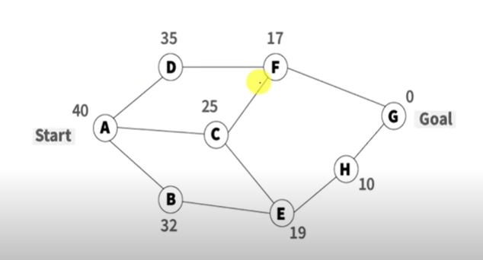
Example: Greedy Best First Search

Slide 12
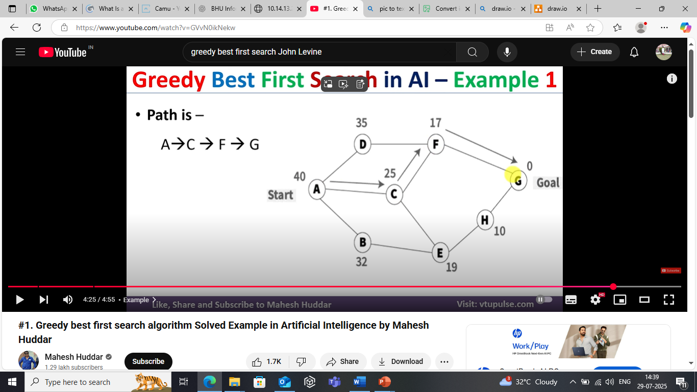
Solution

Slide 13
Algorithm A*
Use as an evaluation function
  f(n) = g(n) + h(n)
g(n) = minimal-cost path from the start state to state n.
The g(n) term adds a “breadth-first” component to the evaluation function.
Ranks nodes on search frontier by estimated cost of solution from start node through the given node to goal.
Not complete if h(n) can equal infinity.
Not admissible.
S
1
5
8
1
A
5
B
C
8
9
3
5
1
4
D
G
9
C is chosen next to expand
g(d)=4
h(d)=9

Slide 14
Algorithm A*
1. Put the start node S on the nodes list, called OPEN
2. If OPEN is empty, exit with failure
3. Select node in OPEN with minimal f(n) and place on CLOSED
4. If n is a goal node, collect path back to start and stop.
5. Expand n, generating all its successors and attach to them pointers back to n. For each successor n' of n
  1. If n' is not already on OPEN or CLOSED
    put n ' on OPEN
    compute h(n'), g(n')=g(n)+ c(n,n'), f(n')=g(n')+h(n')
  2. If n' is already on OPEN or CLOSED and if g(n') is lower for the new version of n', then:
    Redirect pointers backward from n' along path yielding lower g(n').
    Put n' on OPEN.

Slide 15
Algorithm A*
Algorithm A with constraint that h(n) ≤ h*(n)
h*(n) = true cost of the minimal cost path from n to a goal.
Therefore, h(n) is an underestimate of the distance to the goal.
h is admissible when h(n) ≤ h*(n) holds.
Using an admissible heuristic guarantees that the first solution found will be an optimal one.
A* is complete whenever the branching factor is finite, and every operator has a fixed positive cost
A* is admissible

Slide 16
Example search space
start state
parent pointer
0
S
8
arc cost
1
8
5
1
A
5
B
4
8
C
3
8
3
9
7
4
h value
5
g value
4
D
∞
8
E
∞
9
G
0
goal state

Slide 17
Example
    n g(n) h(n) f(n) h*(n)
    S 0 8 8 9
    A 1 8 9 9
    B 5 4 9 4
    C 8 3 11 5
    D 4 inf inf inf
    E 8 inf inf inf
    G 9 0 9 0
h*(n) is the (hypothetical) perfect heuristic.
Since h(n) ≤ h*(n) for all n, h is admissible
Optimal path = S B G with cost 9.

Slide 18
Greedy Best First search
f(n) = h(n)
node expanded nodes list
{ S(8) }
S { C(3) B(4) A(8) }
C { G(0) B(4) A(8) }
G { B(4) A(8) }
Solution path found is S C G, 3 nodes expanded.
See how fast the search is!! But it is NOT optimal.

Slide 19
A* search
f(n) = g(n) + h(n)
node exp. nodes list
{ S(8) }
S { A(9) B(9) C(11) }
A { B(9) G(10) C(11) D(inf) E(inf) }
B { G(9) G(10) C(11) D(inf) E(inf) }
G { C(11) D(inf) E(inf) }
Solution path found is S B G, 4 nodes expanded..
Still pretty fast. And optimal, too.

Slide 20
Proof of the optimality of A*
We assume that A* has selected G2, a goal state with a suboptimal solution (g(G2) > f*).
We show that this is impossible.
  Choose a node n on the optimal path to G.
  Because h(n) is admissible, f(n) ≤ f *.
  If we choose G2 instead of n for expansion, f(G2) ≤ f(n).
  This implies f(G2) ≤ f *.
  G2 is a goal state: h(G2) = 0, f(G2) = g(G2).
  Therefore g(G2) ≤ f*
  Contradiction.

Slide 21
What’s a good heuristic?
If h1(n) < h2(n) ≤ h*(n) for all n, h2 is better than (dominates) h1.
Relaxing the problem: remove constraints to create a (much) easier problem; use the solution cost for this problem as the heuristic function
Combining heuristics: take the max of several admissible heuristics: still have an admissible heuristic, and it’s better!
Use statistical estimates to compute g: may lose admissibility
Identify good features, then use a learning algorithm to find a heuristic function: also may lose admissibility

Slide 22
Summary: Informed search
Best-first search is general search where the minimum-cost nodes (according to some measure) are expanded first.
Greedy search uses minimal estimated cost h(n) to the goal state as measure. This reduces the search time, but the algorithm is neither complete nor optimal.
A* search combines uniform-cost search and greedy search:
f(n) = g(n) + h(n).
A* handles state repetitions and h(n) never overestimates.
  A* is complete and optimal, but space complexity is high.
  The time complexity depends on the quality of the heuristic function.

Slide 23



Questions...

