Slide 1

Alpha-Beta Pruning
Presenter: Dr. Solanki Gupta

Slide 2
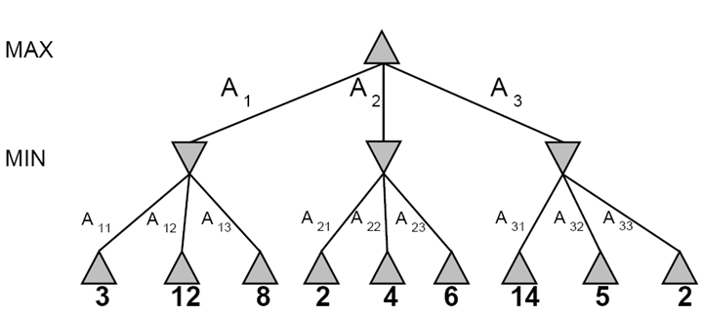
Recap: Minimax Search
3
3
2
2
Minimax(node) =
  Utility(node) if node is terminal
  max_{action} Minimax(Succ(node, action)) if player = MAX
  min_{action} Minimax(Succ(node, action)) if player = MIN

Slide 3
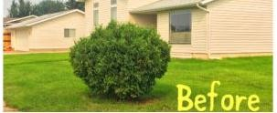
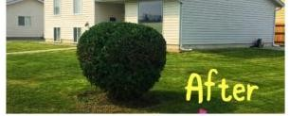
ALPHA - BETA PRUNING

Slide 4

Alpha - Beta Pruning
Avoid processing those sub-trees that have no effect on the result.
Two new parameters
  α:The best value for MAX seen so far
  β:The best value for MIN seen so far

Slide 5
Alpha - Beta Pruning
α is used in MIN nodes, and is assigned in MAX nodes.
β is used in MAX nodes, and is assigned in MIN nodes.
When maximizing:
  cut off values lower than Alpha
When minimizing:
  cut off values greater than Beta

Slide 6
When to Prune
Prune whenever α≥ β
Prune below a Max node whose alpha value becomes >= the beta value of its ancestors.
  Max nodes update alpha based on children’s returned values.
Prune below a Min node whose beta value becomes <= the alpha value of its ancestors.
  Min nodes update beta based on children’s returned values.

Slide 7
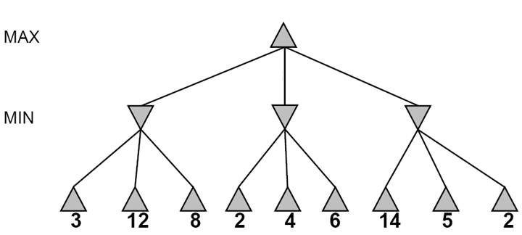

Alpha-beta pruning (Demonstration)
It is possible to compute the exact minimax decision without expanding every node in the game tree.

Slide 8

Alpha-beta pruning (Demonstration)
≥3
3

Slide 9
≥3
3
≤2

Slide 10
≥3
3
≤2
≤14

Slide 11
≥3
3
≤2
≤5

Slide 12
3
3
≤2
2
Notes:
Could we have done better with the right branch?

Slide 13
Alpha-Beta Pruning
Key point that I find most counter-intuitive:
If MIN discovers that, at a particular node in the tree, she can make a move that’s REALLY REALLY GOOD for her…
She can assume that MAX will never let her reach that node.
… and she can prune it away from the search and never consider it again.

Slide 14
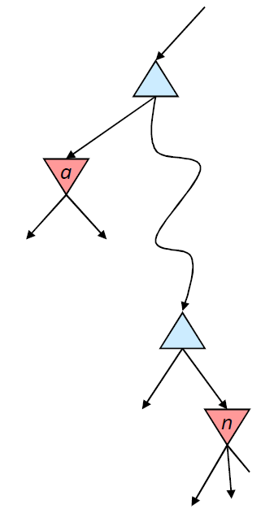

Alpha pruning: Nodes MIN can’t reach
α is the value of the best choice for the MAX player found so far
at any choice point above node n
More precisely: α is the highest number that MAX knows how to force MIN to accept
We want to compute the
MIN-value at n
As we loop over n’s children,
the MIN-value decreases
If it drops below α, MAX will never choose n, so we can ignore n’s remaining children

Slide 15
Beta pruning: Nodes MAX can’t reach
β is the value of the best choice for the MIN player found so far
at any choice point above node m
More precisely: β is the lowest number that MIN know how to force MAX to accept
We want to compute the
MAX-value at m
As we loop over m’s children,
the MAX-value increases
If it rises above β, MIN will never choose m, so we can ignore m’s remaining children
β
m

Slide 16
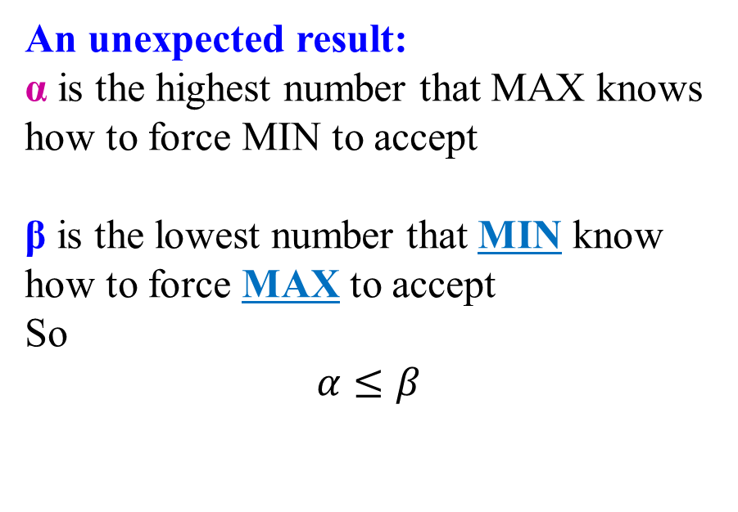
Alpha-beta pruning
An unexpected result:
α is the highest number that MAX knows how to force MIN to accept
β is the lowest number that MIN know how to force MAX to accept
So
$$α≤β$$
β
m

Slide 17
Alpha-beta pruning
Function action = Alpha-Beta-Search(node)
v = Min-Value(node, −∞, ∞)
return the action from node with value v
α: best alternative available to the Max player
β: best alternative available to the Min player
Function v = Min-Value(node, α, β)
if Terminal(node) return Utility(node)
v = +∞
for each action from node
v = Min(v, Max-Value(Succ(node, action), α, β))
if v ≤ α return v
β = Min(β, v)
end for
return v
node
action
…
Succ(node, action)

Slide 18
Alpha-beta pruning
Function action = Alpha-Beta-Search(node)
v = Max-Value(node, −∞, ∞)
return the action from node with value v
α: best alternative available to the Max player
β: best alternative available to the Min player
Function v = Max-Value(node, α, β)
if Terminal(node) return Utility(node)
v = −∞
for each action from node
v = Max(v, Min-Value(Succ(node, action), α, β))
if v ≥ β return v
α = Max(α, v)
end for
return v
node
action
…
Succ(node, action)

Slide 19


Alpha-beta pruning is optimal!
5
Pruning does not affect final result
5
$$≤2$$
$$≤1$$
X
X
X
X
5
6
8
2
1

Slide 20


Alpha-beta pruning: Complexity
5
Amount of pruning depends on move ordering
  Should start with the “best” moves (highest-value for MAX or lowest-value for MIN)
With perfect ordering, I have to evaluate:
  ALL OF THE GRANDCHILDREN who are daughters of my FIRST CHILD, and
  The FIRST GRANDCHILD who is a daughter of each of my REMAINING CHILDREN
5
$$≤2$$
$$≤1$$
X
X
X
X
5
6
8
2
1

Slide 21
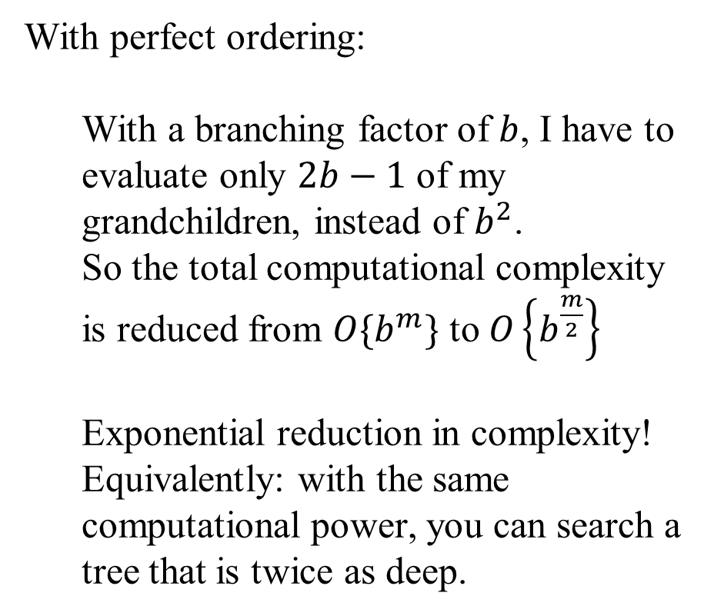
Alpha-beta pruning: Complexity
5
With perfect ordering:
  With a branching factor of $b$, I have to evaluate only $2b−1$ of my grandchildren, instead of $b^{2}$.
  So the total computational complexity is reduced from $O\{b^{m}\}$ to $O\left\{b^{\frac{m}{2}}\right\}$
  Exponential reduction in complexity!
  Equivalently: with the same computational power, you can search a tree that is twice as deep.
5
$$≤2$$
$$≤1$$
X
X
X
X
5
6
8
2
1

Slide 22
ALPHA - BETA PRUNING
Examples

Slide 23

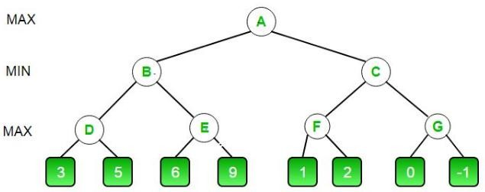
Example 1

Slide 24
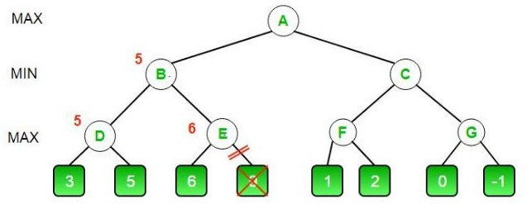
Example 1

Slide 25
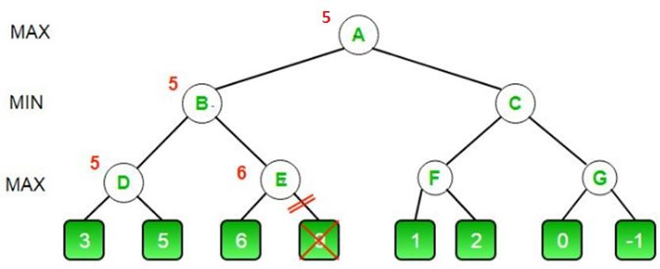
Example 1

Slide 26
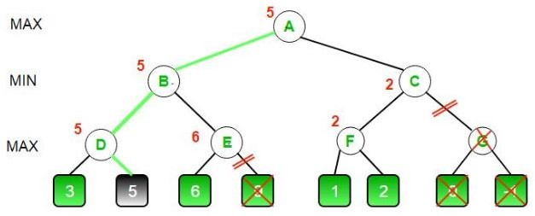
Example 1

Slide 27

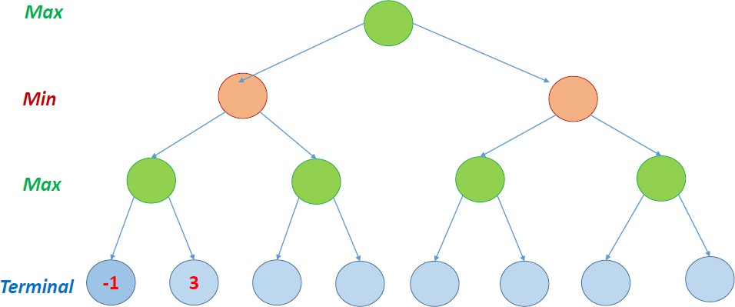
Example 2

Slide 28
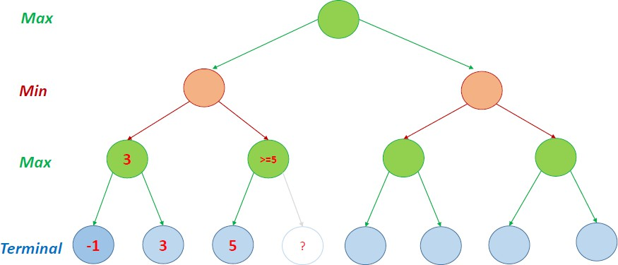
Example 2

Slide 29

Example 2

Slide 30
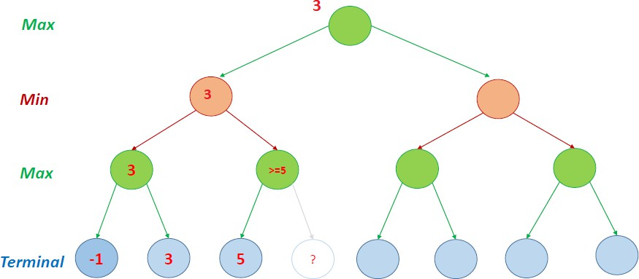
Example 2

Slide 31
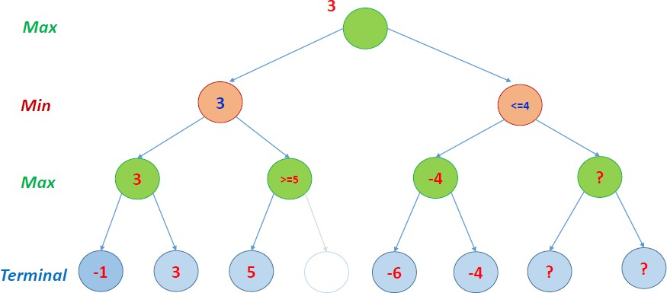
Example 2

Slide 32
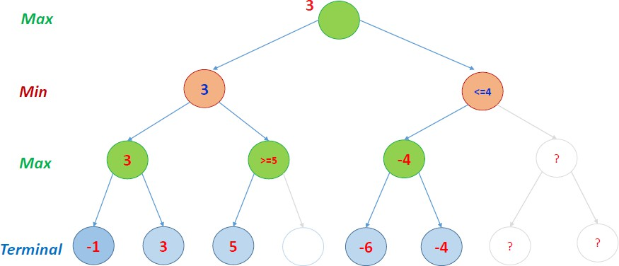
Example 2

Slide 33
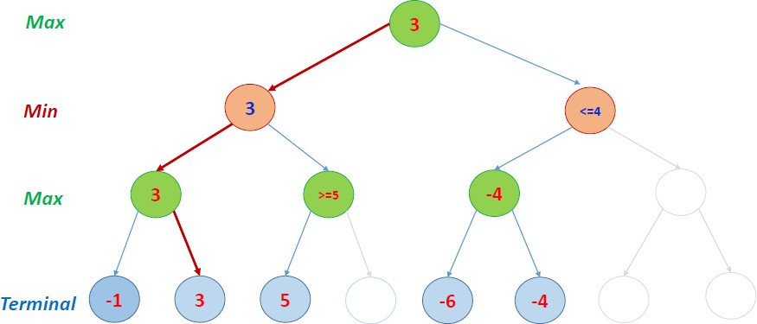
Example 2

Slide 34

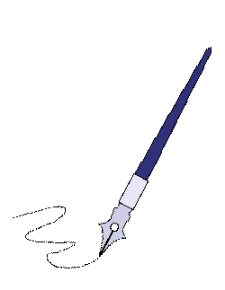
Questions...

Slide 35
References
Stuart Russell,Peter Norvig, “Artificial Intelligence-A Modern Approach”, Pearson.
Elaine Rich and Kevin Knight, “Artificial Intelligence”, McGraw-Hill.
E Charniak and D McDermott, “Introduction to Artificial Intelligence”, Pearson.
https://www.geeksforgeeks.org/minimax-algorithm-in-game-theory-set-4-alpha- beta-pruning/

