Slide 1
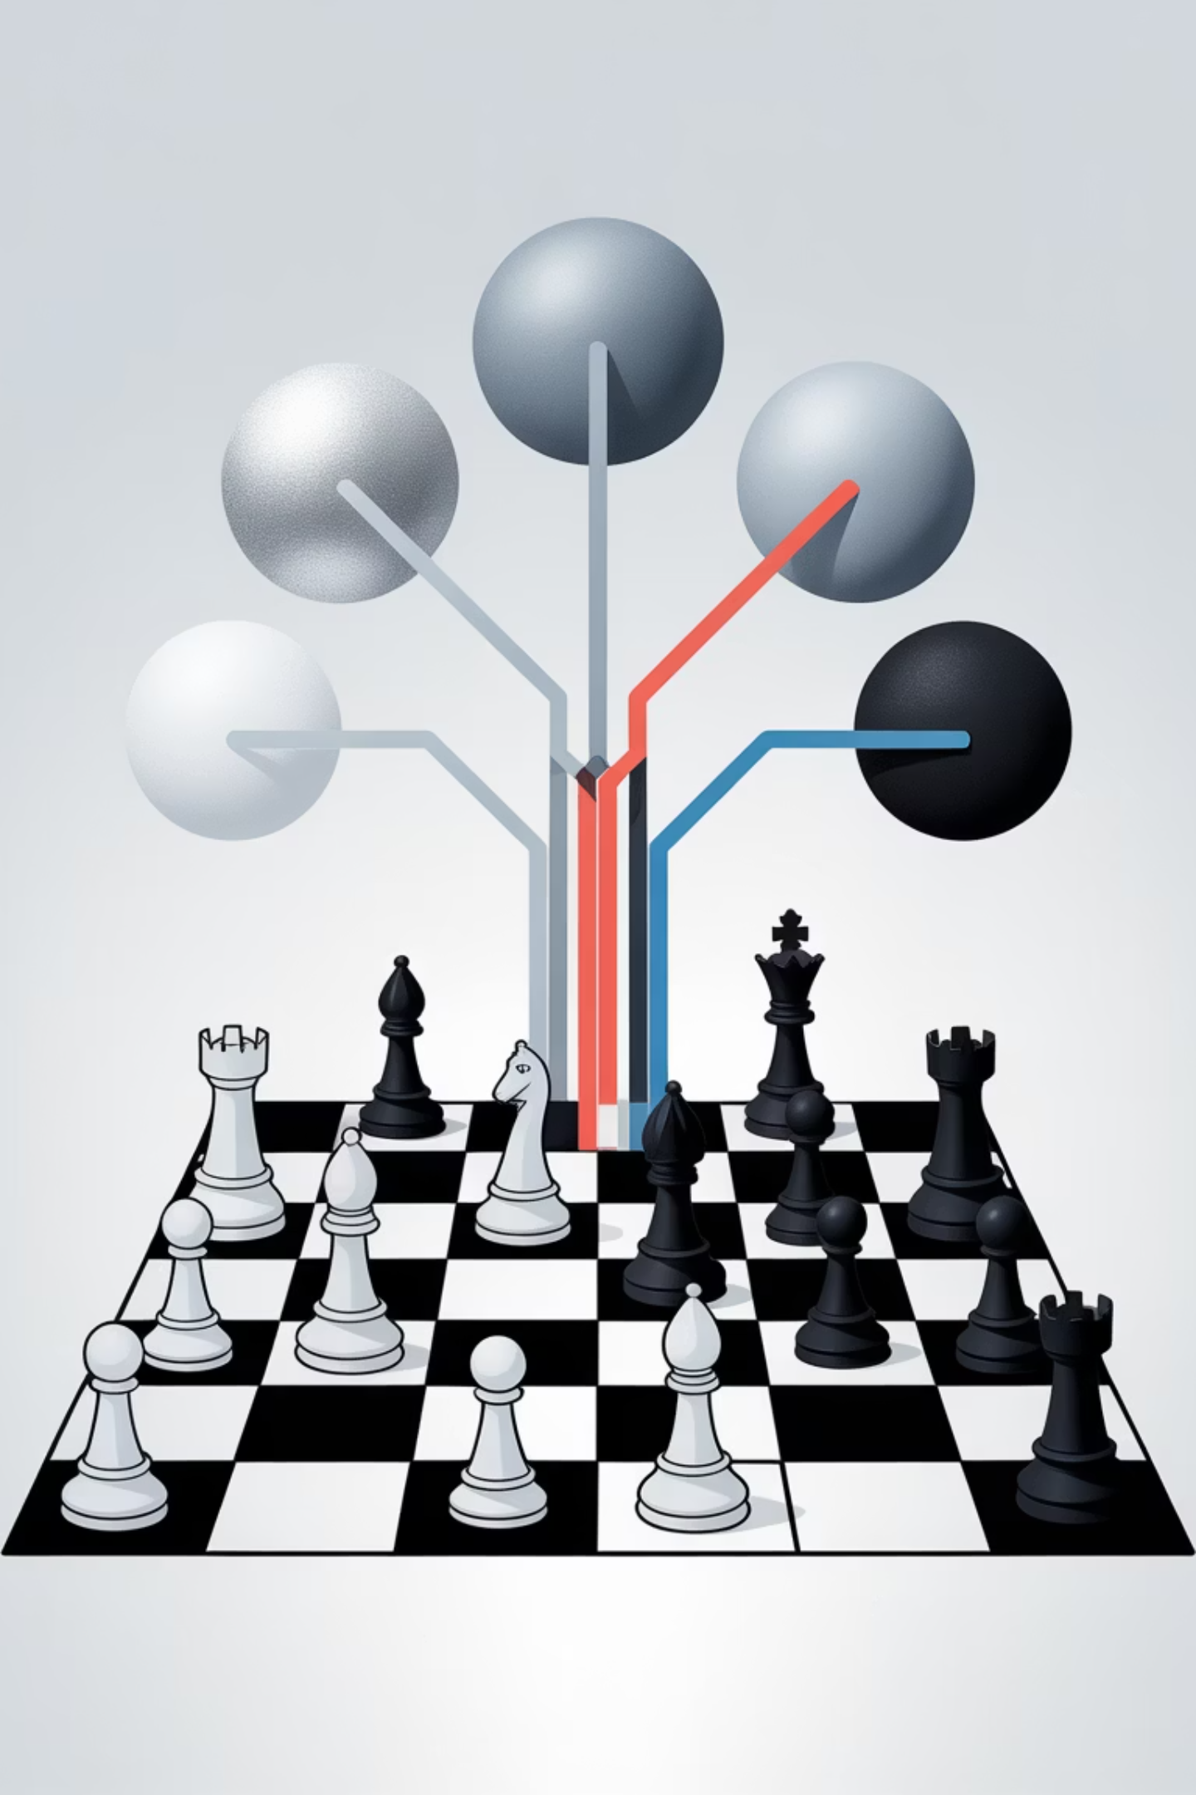
CSET381
Search for Games

Slide 2
Search Strategies in Two-Player Zero-Sum Games:
From Trees to Pruning
Discover how computational strategies enable machines to master complex games through systematic decision-making approaches.
Also explore the fundamental algorithms and techniques that power game-playing AI systems.

Slide 3
Game playing
Rich tradition of creating game-playing programs in AI
Many similarities to search
Most of the games studied
  have two players,
  are zero-sum: what one player wins, the other loses
  have perfect information: the entire state of the game is known to both players at all times
E.g., tic-tac-toe, checkers, chess, Go, backgammon, …
Will focus on these for now
Recently more interest in other games
  Esp. games without perfect information; e.g., poker
    Need probability theory, game theory for such games

Slide 4

Understanding Two-Player Zero-Sum Games
In the world of game theory, zero-sum games represent pure competition where one player's gain exactly equals another player's loss. These mathematical models form the foundation for understanding strategic decision-making in adversarial scenarios.
Total payoffs across all players always sum
to zero
Perfect information games like Chess,
Tic-Tac-Toe, and Go
Each move aims to maximize your outcome
while minimizing your opponent's
The zero-sum nature creates a fascinating dynamic where optimal play requires thinking several moves ahead while anticipating your opponent's best countermoves.

Slide 5



Turn-Based Decision-Making in Game Trees
Player Decision Points
Terminal States
Utility Function
At each node, the active player chooses from available legal actions based on strategic goals
Game-ending positions (win, loss, draw) that terminate branches of the tree
Assigns numeric values to outcomes (typically +1 for win, 0 for draw, -1 for loss)
The exponential growth of possible states creates the central challenge in game AI: even modest-sized games quickly become too complex for exhaustive search. A 10-move chess game could have over 10²⁰ possible positions!

Slide 6
“Sum to 2” game
Player 1 moves, then player 2, finally player 1 again
Move = 0 or 1
Player 1 wins if and only if all moves together sum to 2
Player 1
0
1
Player 2
Player 2
0
1
0
1
Player 1
Player 1
Player 1
Player 1
0
1
0
1
0
1
0
1
-1
-1
-1
1
-1
1
1
-1
Player 1’s utility is in the leaves; player 2’s utility is the negative of this

Slide 7
Backward induction
(aka. minimax)
From leaves upward, analyze best decision for player at node, give node a value
  Once we know values, easy to find optimal action (choose best value)
1
Player 1
0
1
Player 2
-1
1
Player 2
0
1
0
1
Player 1
-1
Player 1
1
1
Player 1
1
Player 1
0
1
0
1
0
1
0
1
-1
-1
-1
1
-1
1
1
-1

Slide 8
Modified game
From leaves upward, analyze best decision for player at node, give node a value
6
Player 1
0
1
Player 2
-1
6
Player 2
0
1
0
1
Player 1
-1
Player 1
4
6
Player 1
7
Player 1
0
1
0
1
0
1
0
1
-1
-2
-3
4
-5
6
7
-8

Slide 9
A recursive implementation
Value(state)
If state is terminal, return its value
If (player(state) = player 1)
  v := -infinity
  For each action
    v := max(v, Value(successor(state, action)))
  Return v
Else
  v := infinity
  For each action
    v := min(v, Value(successor(state, action)))
  Return v
Space? Time?

Slide 10
Do we need to see all the leaves?
Do we need to see the value of the question mark here?
Player 1
0
1
Player 2
Player 2
0
1
0
1
Player 1
Player 1
Player 1
Player 1
0
1
0
1
0
1
0
1
-1
-2
?
4

Slide 11
Do we need to see all the leaves?
Do we need to see the values of the question marks here?
Player 1
0
1
Player 2
Player 2
0
1
0
1
Player 1
Player 1
Player 1
Player 1
0
1
0
1
0
1
0
1
-1
-2
?
?
-5
6
7
-8

Slide 12
Alpha-beta pruning
Pruning = cutting off parts of the search tree (because you realize you don’t need to look at them)
  When we considered A* we also pruned large parts of the search tree
Maintain alpha = value of the best option for player 1 along the path so far
Beta = value of the best option for player 2 along the path so far

Slide 13
Pruning on beta
Beta at node v is -1
We know the value of node v is going to be at least 4, so the -1 route will be preferred
No need to explore this node further
Player 1
0
1
Player 2
Player 2
0
1
0
1
node v
Player 1
Player 1
Player 1
Player 1
0
1
0
1
0
1
0
1
-1
-2
?
4

Slide 14
Pruning on alpha
Alpha at node w is 6
We know the value of node w is going to be at most -1, so the 6 route will be preferred
No need to explore this node further
Player 1
0
1
Player 2
node w
Player 2
0
1
0
1
Player 1
Player 1
Player 1
Player 1
0
1
0
1
0
1
0
1
-1
-2
?
?
-5
6
7
-8

Slide 15
Modifying recursive implementation to do alpha-beta pruning
Value(state, alpha, beta)
If state is terminal, return its value
If (player(state) = player 1)
  v := -infinity
  For each action
    v := max(v, Value(successor(state, action), alpha, beta))
    If v >= beta, return v
    alpha := max(alpha, v)
  Return v
Else
  v := infinity
  For each action
    v := min(v, Value(successor(state, action), alpha, beta))
    If v <= alpha, return v
    beta := min(beta, v)
  Return v

Slide 16
Benefits of alpha-beta pruning
Without pruning, need to examine O(b^{m}) nodes
With pruning, depends on which nodes we consider first
If we choose a random successor, need to examine O(b^{3m/4}) nodes
If we manage to choose the best successor first, need to examine O(b^{m/2}) nodes
  Practical heuristics for choosing next successor to consider get quite close to this
Can effectively look twice as deep!
  Difference between reasonable and expert play

Slide 17
Repeated states
As in search, multiple sequences of moves may lead to the same state
Again, can keep track of previously seen states (usually called a transposition table in this context)
  May not want to keep track of all previously seen states…

Slide 18
Using evaluation functions
Most games are too big to solve even with alpha-beta pruning
Solution: Only look ahead to limited depth (nonterminal nodes)
Evaluate nodes at depth cutoff by a heuristic (aka. evaluation function)
E.g., chess:
  Material value: queen worth 9 points, rook 5, bishop 3, knight 3, pawn 1
  Heuristic: difference between players’ material values

Slide 19
Chess example
White to move
Depth cutoff: 3 ply
  Ply = move by one player
Ki |  |  |  |  | B
p |  |  |  |  |  |  | R
 |  |  | R
 | p
p |  | p
 | K
White
Rd8+
…
Black
Kb7
White
Rxf8
Re8
…
2
-1

Slide 20
Chess (bad) example
White to move
Depth cutoff: 3 ply
  Ply = move by one player
Ki |  |  |  |  | B |  | R
p
 |  |  | R
 | p
p |  | p
 | K
White
Rd8+
…
Black
Kb7
White
Rxf8
Re8
…
2
-1
Depth cutoff obscures fact that white R will be captured

Slide 21
Addressing this problem
Try to evaluate whether nodes are quiescent
  Quiescent = evaluation function will not change rapidly in near future
  Only apply evaluation function to quiescent nodes
If there is an “obvious” move at a state, apply it before applying evaluation function

Slide 22
Playing against suboptimal players
Minimax is optimal against other minimax players
What about against players that play in some other way?

Slide 23
Many-player, general-sum games of perfect information
Basic backward induction still works
  No longer called minimax
What if other players do not play this way?
Player 1
0
1
Player 2
Player 2
0
1
0
1
Player 3
(1,2,3)
Player 3
Player 3
Player 3
0
1
0
1
0
1
0
1
(1,2,3)
(3,4,2)
vector of numbers gives each player’s utility

Slide 24
Games with imperfect information
Players cannot necessarily see the whole current state of the game
  Card games
Ridiculously simple poker game:
  Player 1 receives King (winning) or Jack (losing),
  Player 1 can bet or stay,
  Player 2 can call or fold
Dashed lines indicate
indistinguishable states
Backward induction does not work, need random strategies for optimality! (more later in course)
“nature”
1 gets King
1 gets Jack
player 1
player 1
bet
stay
bet
stay
player 2
player 2
call
fold
call
fold
call
fold
call
fold
2
1
1
1
-2
1
-1
1

Slide 25
Games with random moves by “Nature”
E.g., games with dice (Nature chooses dice roll)
Backward induction still works…
  Evaluation functions now need to be cardinally right (not just ordinally)
  For two-player zero-sum games with random moves, can we generalize alpha-beta? How?
Player 1
0
1
Nature
(2,3.5)
Nature
50%
50%
40%
60%
Player 2
(1,3)
Player 2
(3,4)
Player 2
Player 2
0
1
0
1
0
1
0
1
(1,3)
(3,2)
(3,4)
(1,2)

Slide 26
Games with imperfect information
Players cannot necessarily see the whole current state of the game
  Card games
Ridiculously simple poker game:
  Player 1 receives King (winning) or Jack (losing),
  Player 1 can bet or stay,
  Player 2 can call or fold
Dashed lines indicate
indistinguishable states
Backward induction does not work, need random strategies for optimality! (more later in course)
“nature”
1 gets King
1 gets Jack
player 1
player 1
bet
stay
bet
stay
player 2
player 2
call
fold
call
fold
call
fold
call
fold
2
1
1
1
-2
1
-1
1

Slide 27
Intuition for need of random strategies
Suppose my strategy is “bet on King, stay on Jack”
  What will you do?
  What is your expected utility?
What if my strategy is “always bet”?
What if my strategy is “always bet when given King, 10% of the time bet when given Jack”?
“nature”
1 gets King
1 gets Jack
player 1
player 1
bet
stay
bet
stay
player 2
player 2
call
fold
call
fold
call
fold
call
fold
2
1
1
1
-2
1
-1
1

Slide 28
The state of the art for some games
Chess:
  1997: IBM Deep Blue defeats Kasparov
  … there is still debate about whether computers are really better
Checkers:
  Computer world champion since 1994
  … there was still debate about whether computers are really better…
  until 2007: checkers solved optimally by computer
Go:
  Computers still not very good
  Branching factor really high
  Some recent progress
Poker:
  Competitive with top humans in some 2-player games
  3+ player case much less well-understood

Slide 29
Is this of any value to society?
Some of the techniques developed for games have found applications in other domains
  Especially “adversarial” settings
Real-world strategic situations are usually not two-player, perfect-information, zero-sum, …
But game theory does not need any of those
Example application: security scheduling at airports

