Slide 1

Data Link Layer
FRAMING

Slide 2
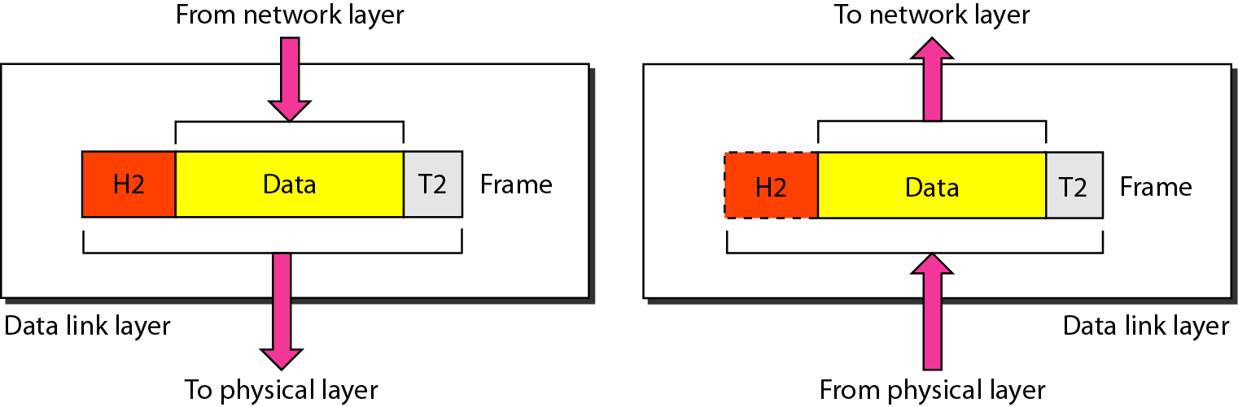
Data link Layer
The data link layer is responsible for
Moving frames from one hop (node) to the next.
Framing
Physical Address
Flow Control
Error Control

Slide 3
Data Link Layer
Data Link Layer | Data Link Control (DLC)
 | Media Access Control (MAC)
The two main functions of the data link layer are data link control and media access control.
Data link control functions include framing, flow and error control, and software implemented protocols that provide smooth and reliable transmission of frames between nodes.
The second function of the data link layer is media access control, or how to share the link.

Slide 4

FRAMING
The data link layer needs to pack bits into frames, so that each frame is distinguishable from another.
The postal system practices are a type of framing. The simple act of inserting a letter into an envelope separates one piece of information from another; the envelope serves as the delimiter.

Slide 5
Framing approaches
Bit-Oriented Framing
Byte-Oriented Framing
Clock Based Framing

Slide 6
Framing
Bit Oriented
Byte Oriented
It views the frames as a collection of bits. The data is transmitted as a sequence of bits that can be interpreted as text and multimedia data in the upper layer.
High-Level Data Link Control (HDLC) is a data link layer protocol (bit-oriented).
It views the frames as a collection of bytes(8 bits), also known as a character.
Byte-Oriented Protocols:
Binary Synchronous Communication Protocol (BISYNC)
Digital Data Communication Message Protocol (DDCMP)
Point-to-Point Protocol(PPP).

Slide 7
TYPES OF FRAMING
Character Count
Flag byte with byte stuffing
Start and End flag with bit stuffing
Physical Coding Violation

Slide 8
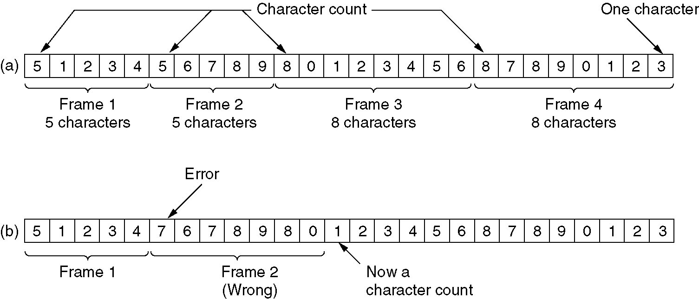
Character Count
A character stream. 1 2 3 4 6 7 8 9 0 1 2 3 4 5 6 7 8 9 0 1 2 3
(a) Without errors. (b) With one error.

Slide 9
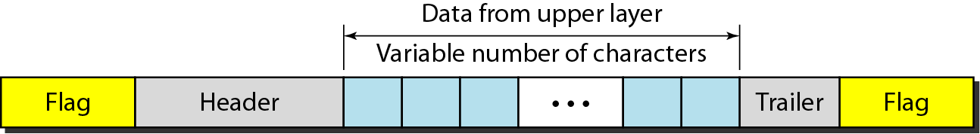
Flag byte with byte stuffing
A frame in a character-oriented protocol

Slide 10
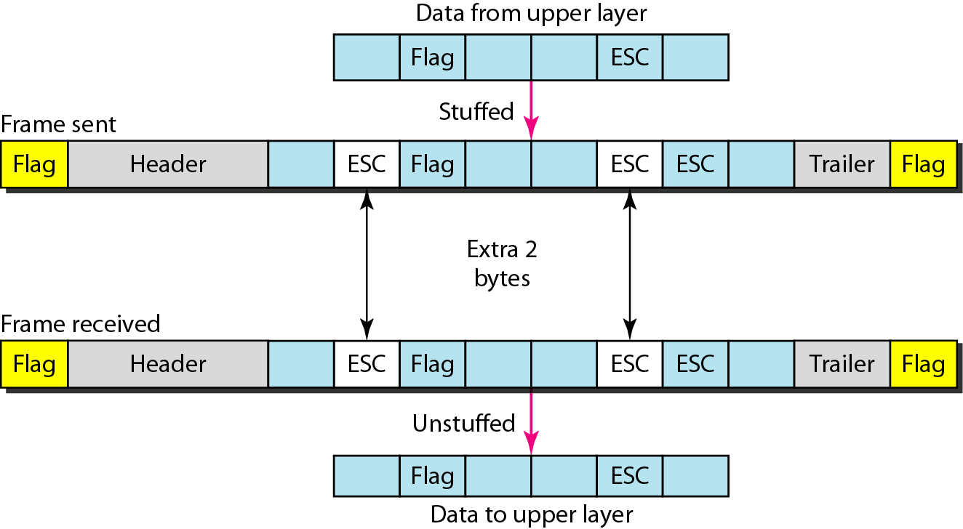
Flag byte with byte stuffing
Byte stuffing is the process of adding 1 extra byte whenever there is a flag or escape character in the text.
Byte stuffing
Unstuffing
Problem : fixed character size assumes character size to be 8 bits : can’t handle heterogeneous environment.

Slide 11
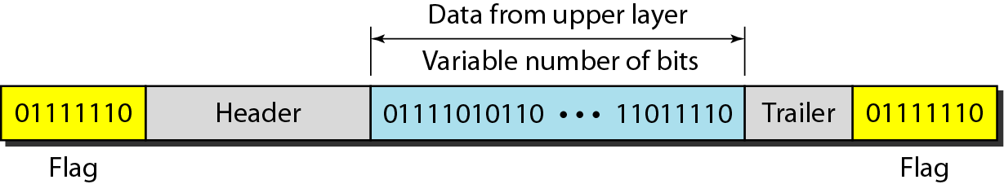
Start and End flag with bit stuffing
In Bit stuffing, Each frame begins and ends with a special bit pattern 01111110
Bit stuffing is the process of adding one extra 0 whenever five consecutive 1s follow a 0 in the data, so that the receiver does not mistake the pattern 0111110 for a flag.

Slide 12
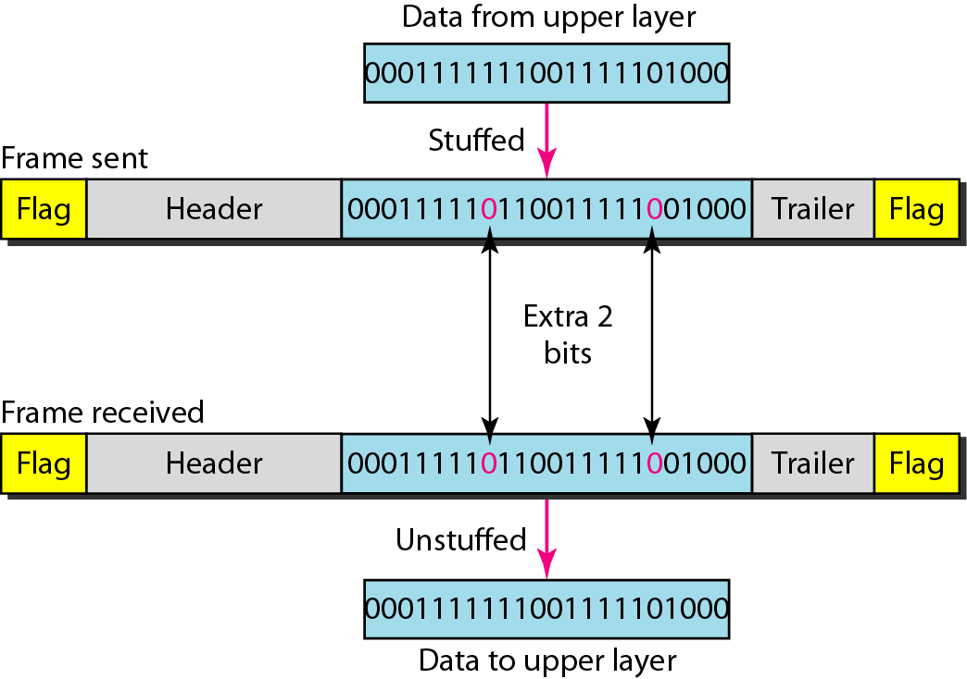
Start and End flag with bit stuffing
Bit stuffing
Unstuffing

Slide 13

Physical Layer Coding Violation
Physical layer coding violations is applicable to networks in which the encoding on the physical medium contains some redundancy.
In such cases normally, a 1 bit is a high-low pair and a 0 bit is a low-high pair.
The combinations of low-low and high-high which are not used for data may be used for marking frame boundaries.

