Slide 1

Data Link Layer
Error Detection and Correction

Slide 2
Error Detection and Correction
Data can be corrupted during transmission.
Some applications require that errors be detected and corrected.
Types of Errors
Single-bit error
Burst error
To detect or correct errors, we need to send extra (redundant) bits with data.
These Redundant bits are added by sender and removed by the receiver
Redundancy is achieved through various coding schemes

Slide 3
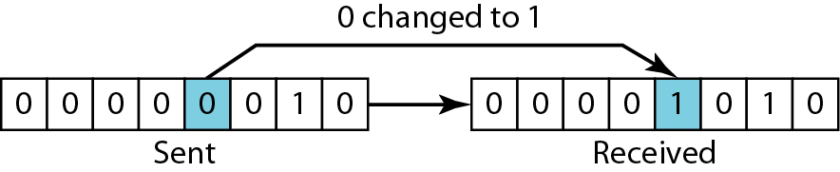
Single-bit error
In a single-bit error, only 1 bit in the data unit has changed.

Slide 4
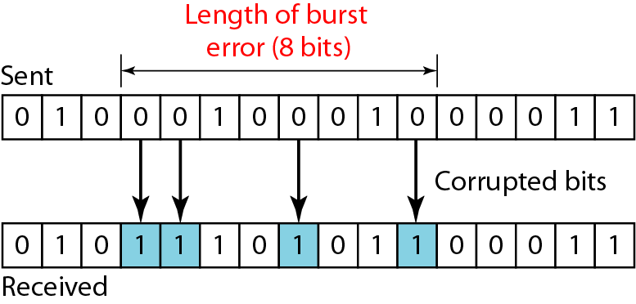
Burst error
A burst error means that 2 or more bits in the data unit have changed.
A burst error is more likely to occur than a single-bit error.
The duration of noise is normally longer than the duration of 1 bit, which means that when noise affects data, it affects a set of bits.
The number of bits affected depends on the data rate and duration of noise.

Slide 5
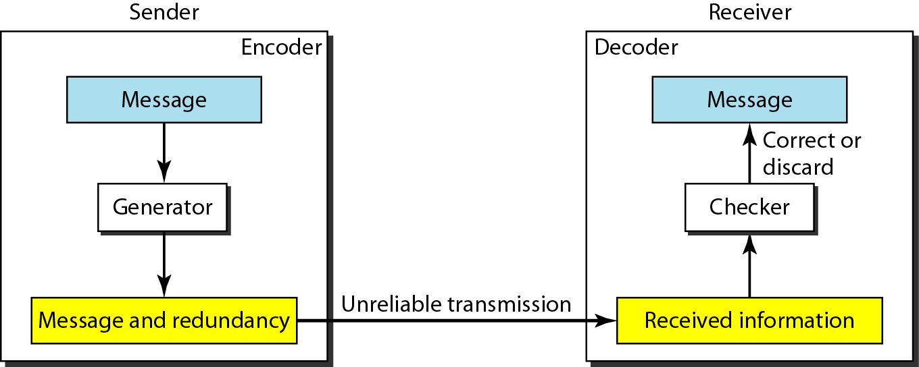
The structure of encoder and decoder

Slide 6

BLOCK CODING
In block coding, message is divided into blocks, each of k bits, called datawords.
We add r redundant bits to each block to make the length n = k + r.
The resulting n-bit blocks are called codewords.

Slide 7
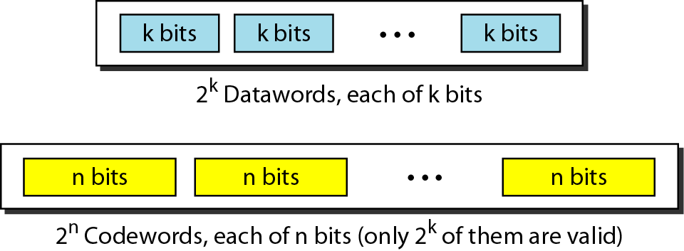
Datawords and codewords
BLOCK CODING
Example:- 4B/5B block coding

Slide 8
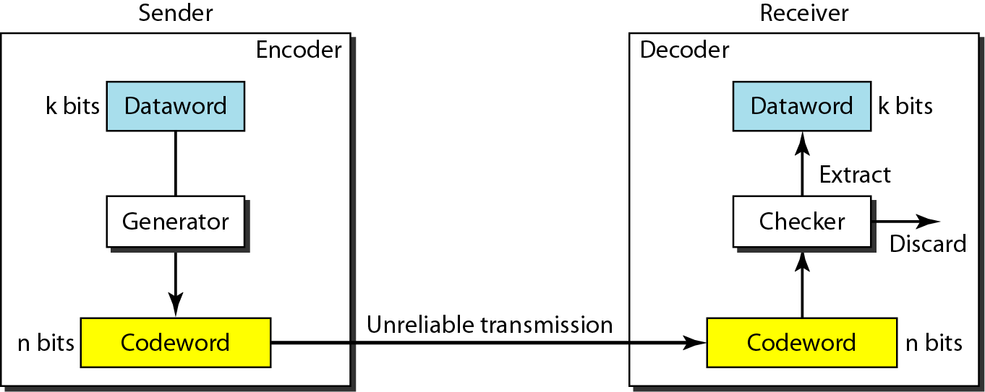
BLOCK CODING
Process of error detection in block coding

Slide 9
Example: single bit error detection
Let us assume that k = 2 and n = 3.
Assume the sender encodes the dataword 01 as 011 and sends it to the receiver. Consider the following cases:
The receiver receives 011. It is a valid codeword. The receiver extracts the dataword 01 from it.
The codeword is corrupted during transmission, and 111 is received. This is not a valid codeword and is discarded.
The codeword is corrupted during transmission, and 000 is received. This is a valid codeword. The receiver incorrectly extracts the dataword 00.
Two corrupted bits have made the error undetectable.

Slide 10
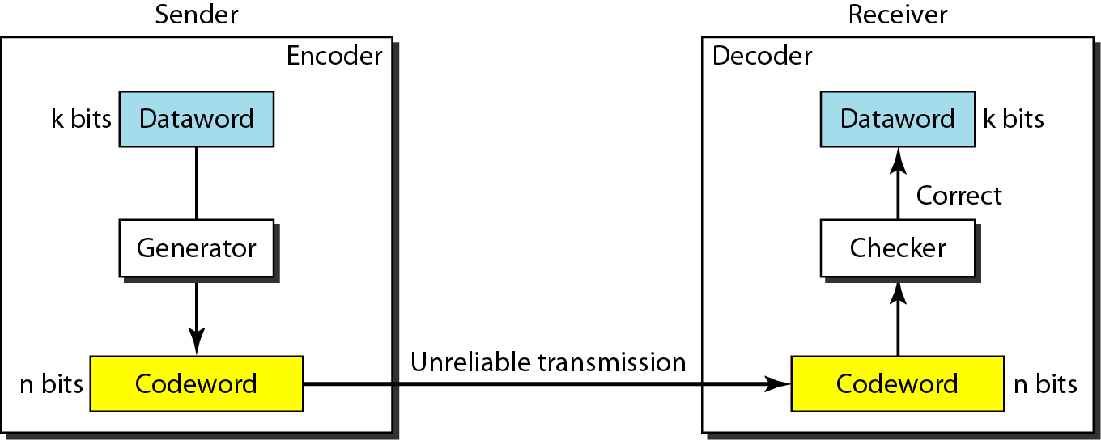
Structure of encoder and decoder
Error correction

Slide 11
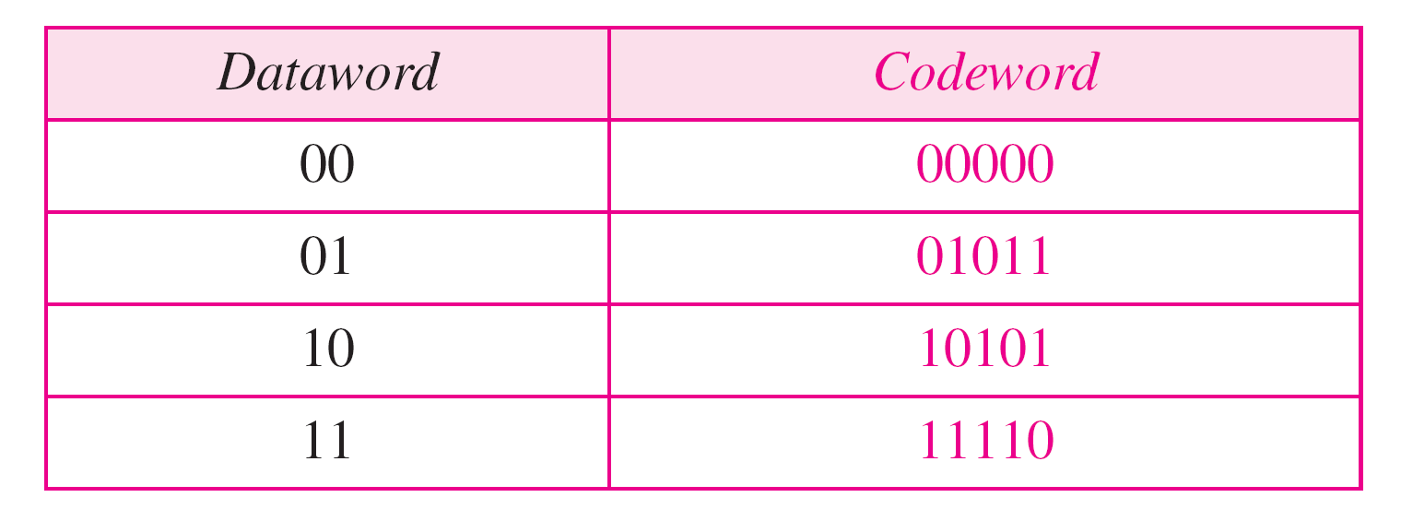
Example: Add more redundant bits.
3 redundant bits added to the 2-bit dataword to make 5-bit codewords.
Assume the dataword is 01. The sender creates the codeword 01011. The codeword is corrupted during transmission, and 01001 is received.
First, the receiver finds that the received codeword is not in the table. This means an error has occurred.
The receiver, assuming that there is only 1 bit corrupted, uses the following strategy to guess the correct dataword.
Comparing the received codeword with the first codeword in the table (01001 versus 00000), there are two different bits.
By the same reasoning, the original codeword cannot be the third or fourth one in the table.
The original codeword must be the second one in the table because this is the only one that differs from the received codeword by 1 bit. The receiver replaces 01001 with 01011 and consults the table to find the dataword 01.
A code for error correction

Slide 12
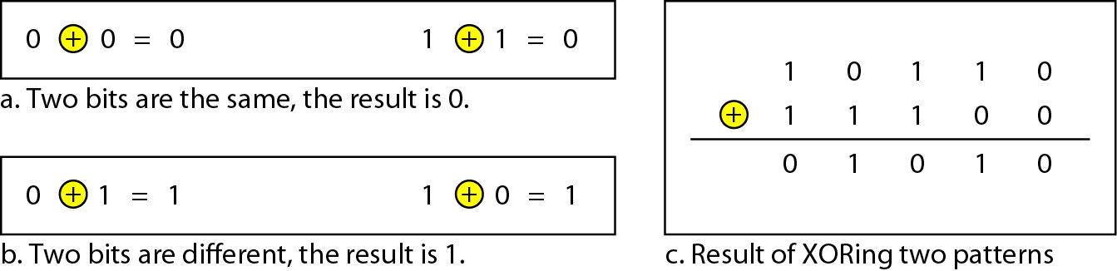
XORing of two single bits or two words

Slide 13
Hamming distance
The Hamming distance between two words is the number of differences between corresponding bits.
Find the Hamming distance between two pairs of words.
1. The Hamming distance d(000, 011) is 2 because
2. The Hamming distance d(10101, 11110) is 3 because

Slide 14
Minimum Hamming distance
The minimum Hamming distance is the smallest Hamming distance between
all possible pairs in a set of words.
Find the minimum Hamming distance of the coding scheme in table shown in previous slide
Solution
We first find all Hamming distances.
The d_{min} in this case is 2.

Slide 15
Question
Find the minimum Hamming distance of the coding scheme
Solution
We first find all the Hamming distances.
The d_{min} in this case is 3.
To guarantee the detection of up to s errors in all cases, the minimum Hamming distance in a block code must be d_{min} = s + 1.

