Slide 1

Data Link Layer
Error Control-Error Detection Techniques

Slide 2

Error Detection Techniques
Parity Checker
CRC (Cyclic Redundency Check)
Checksum

Slide 3

Parity Checker
Parity Checker:- In this approach, an extra bit is added to the data before transmission
Types of parity checker:-
Even Parity- Number of 1’s in the given word should be even
Odd Parity- Number of 1’s in the given word should be odd
Limitations of parity checker
Not suitable for detection of burst error
Unable to detect the location of erroneous bit and correct the same.

Slide 4
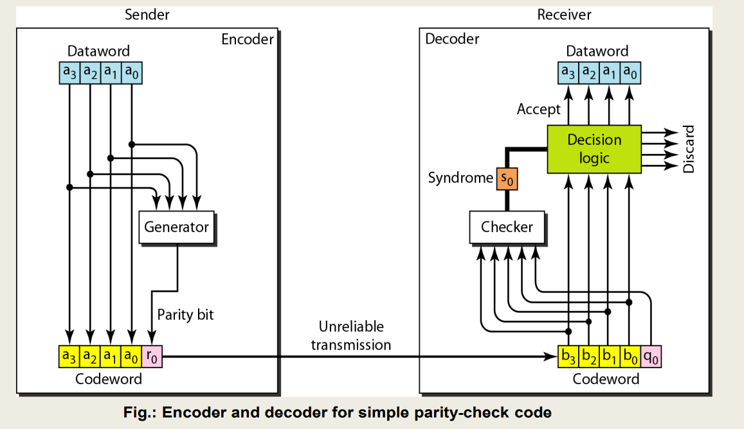
Parity Checker

Slide 5
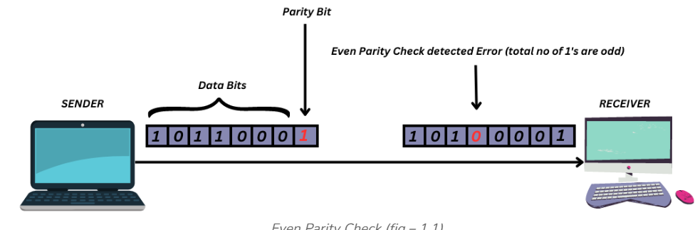
Parity Checker

Slide 6
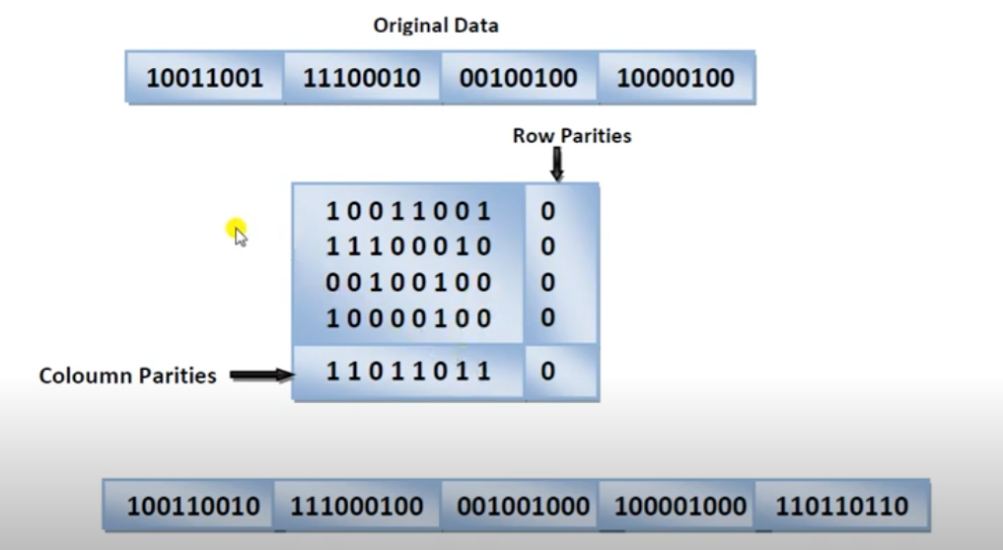
Two-dimensional parity-checker
A better approach is the two-dimensional parity check.
In this method, the dataword is organized in a table (rows and columns).
It can detect up to three bit error

Slide 7
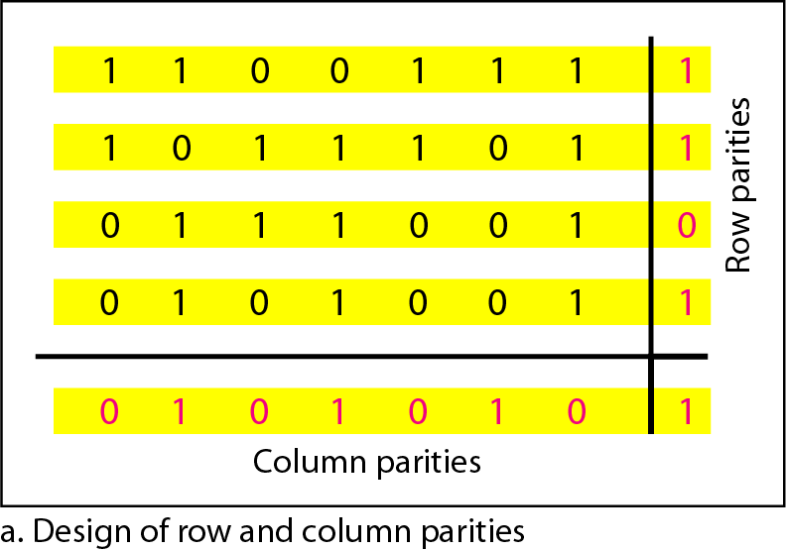
Two-dimensional parity-checker
A better approach is the two-dimensional parity check.
In this method, the dataword is organized in a table (rows and columns).
It can detect up to three bit error

Slide 8
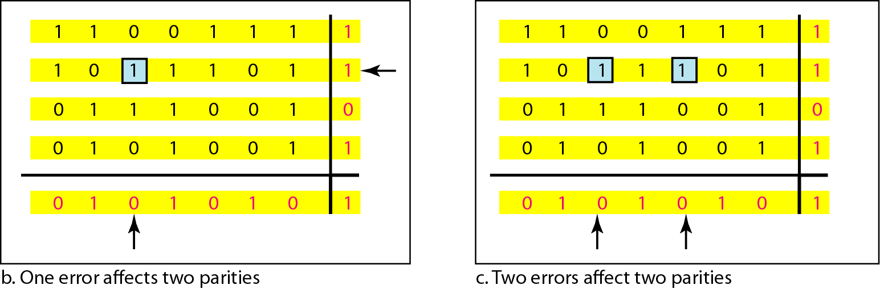
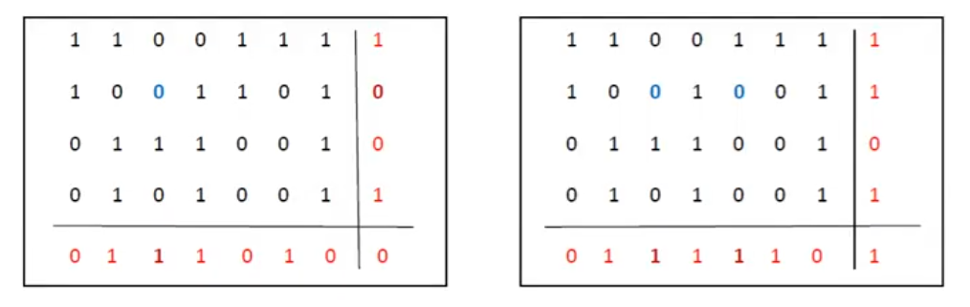
Two-dimensional parity-check code

Slide 9
Two-dimensional parity-check code

Slide 10
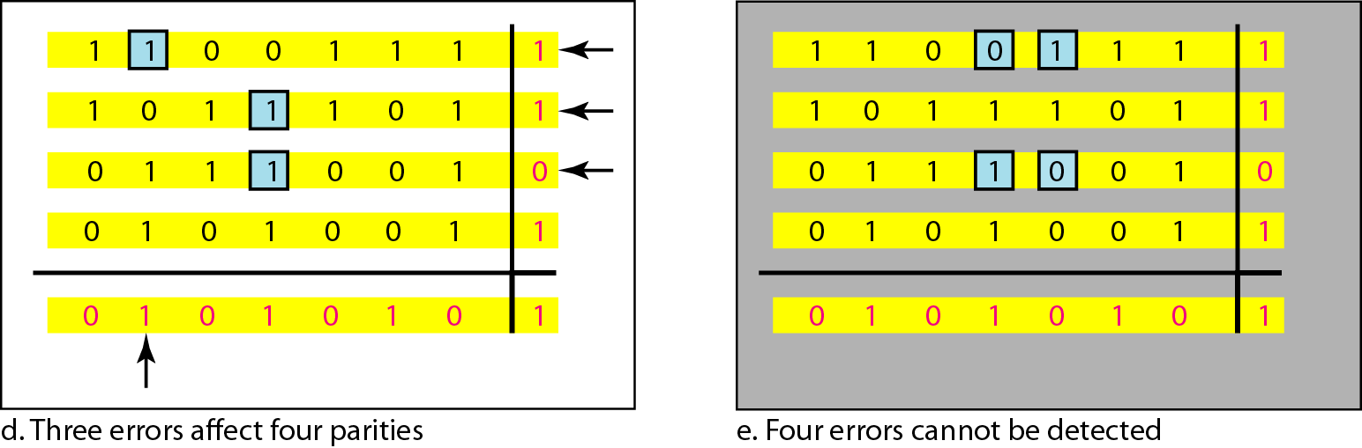
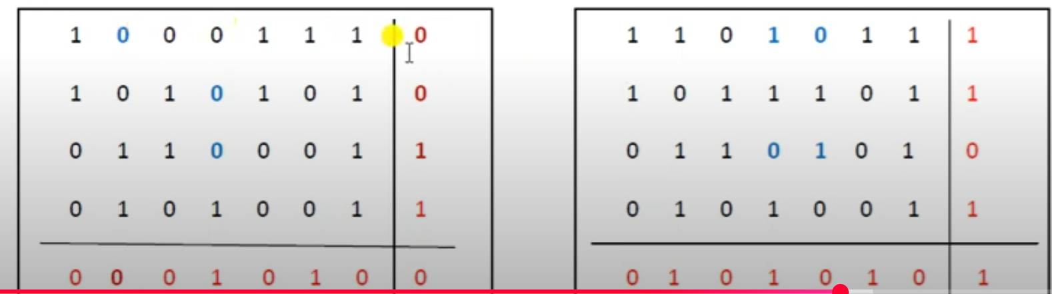
Two-dimensional parity-check code

Slide 11
Two-dimensional parity-check code
Error affecting 4 bit may not be detected

Slide 12

Cyclic Redundancy Check
Cyclic codes are special linear block codes with one extra property. In a cyclic code, if a codeword is cyclically shifted (rotated), the result is another codeword.
It is based on the concept of binary division

Slide 13
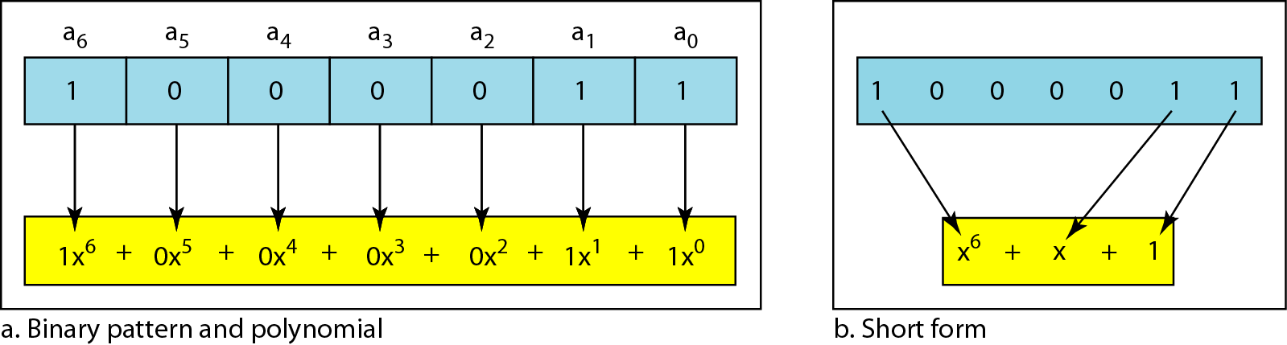
Cyclic Redundancy Check
The divisor in a cyclic code is normally called the generator polynomial or simply the generator.

Slide 14
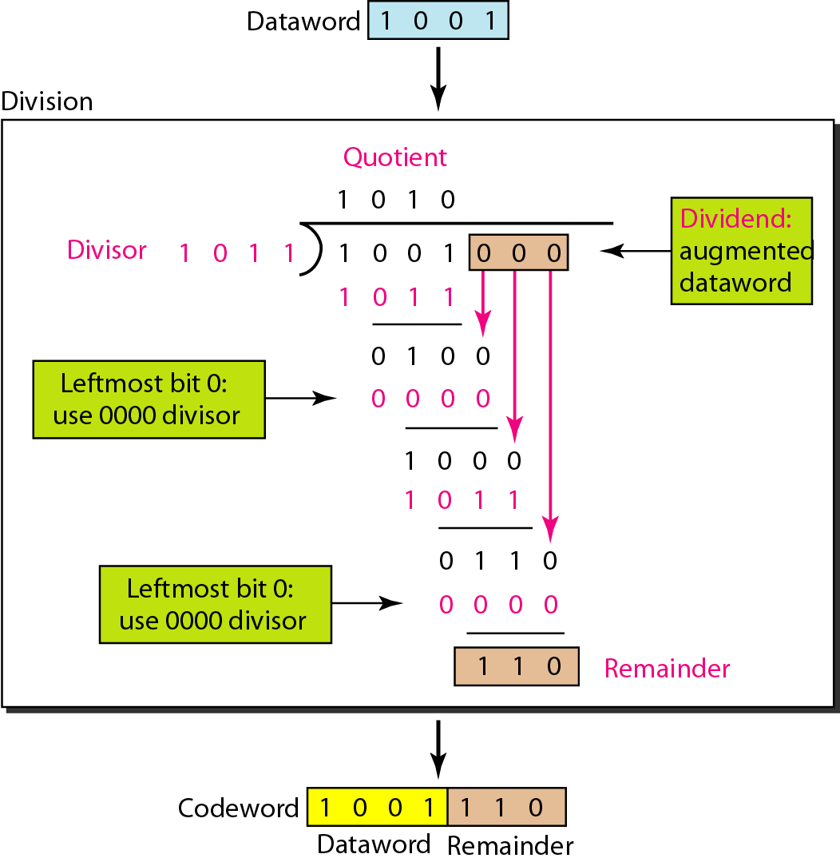
Division in CRC encoder
Message= 1001
Sender appends number of zeros in message equals to degree of generator polynomial
Divide the appended message with generated polynomial using modulo 2 arithmetic
Remainder becomes CRC
Remove the appended zeros from message and append the calculated CRC
Send the code word to receiver

Slide 15
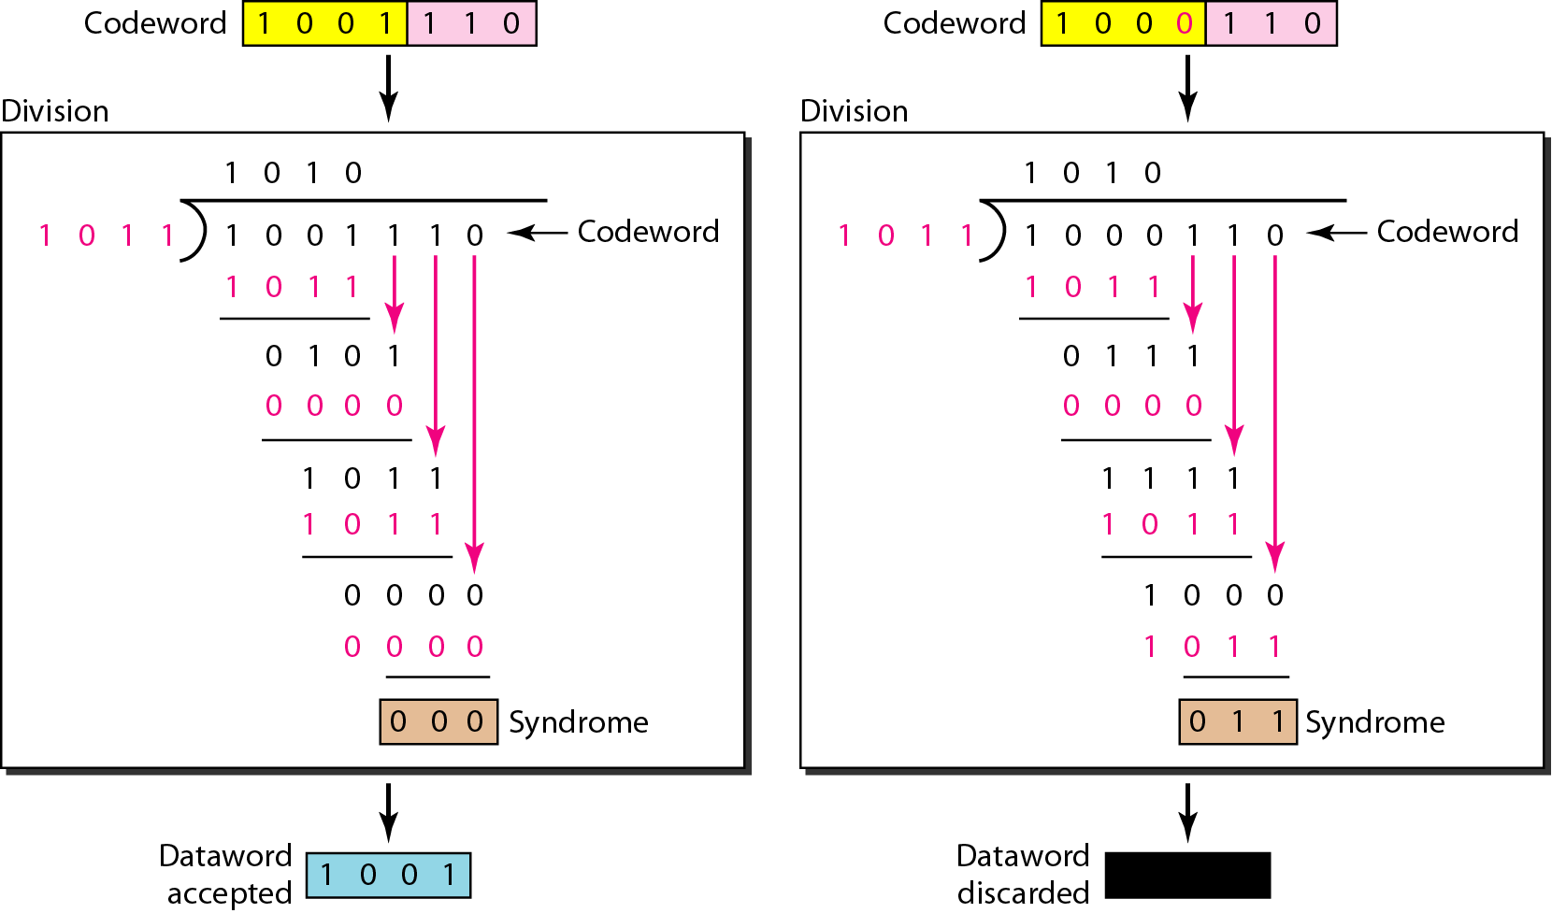
Division in the CRC decoder for two cases
At receiver Side
Receiver takes the code word
It divides the codeword with same generator polynomial using modulo 2 arithmetic
If remainder contains all zero bits, message is accepted otherwise it is discarded

Slide 16
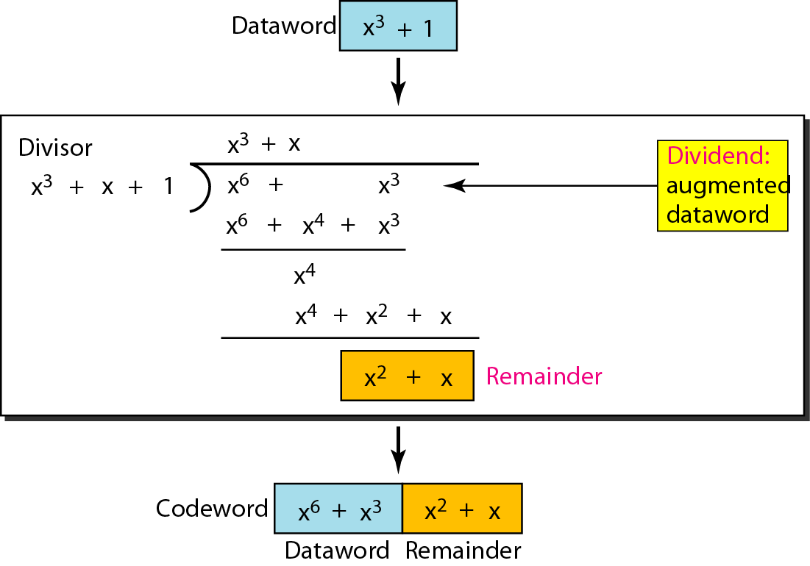
CRC division using polynomials

Slide 17
Cyclic Redundancy Check
If the generator has more than one term and the coefficient of x⁰ is 1, all single errors can be caught.
If a generator cannot divide x^{t} + 1 (t between 2 and n – 1), then all isolated double errors can be detected. The variable 𝑛n represents the length of the data/message (in bits) that is being transmitted and checked for errors using CRC.
A generator that contains a factor of x + 1 can detect all odd-numbered errors.

Slide 18

CHECKSUM
In this method, each data word is added to the previous data word and total sum (checksum) is calculated.
Data along with checksum is then transmitted.
This method detects all odd bit error; Even bit error may or may not be detected

Slide 19

Idea of Checksum
Suppose data is a list of five 4-bit numbers (7, 11, 12, 0, 6),
Sender will send (7, 11, 12, 0, 6, 36), where 36 is the sum of the original numbers.
The receiver adds the five numbers and compares the result with the sum.
If the two are the same, the receiver assumes no error, accepts the five numbers and discards the sum
If the two are not same, the receiver assumes there is an error somewhere and the data are not accepted.
To make the job of the receiver easier if we send the negative (complement) of the sum, called the checksum.
In this case, we send (7, 11, 12, 0, 6, −36).
The receiver can add all the numbers received (including the checksum).
If the result is 0, it assumes no error; otherwise, there is an error.

Slide 20
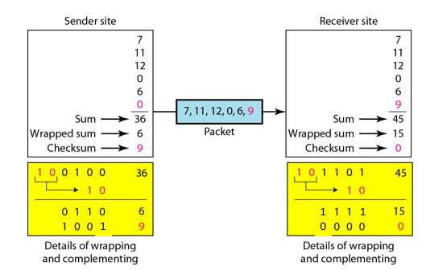
Example : Checksum

Slide 21
Internet Checksum
Sender
Receiver
1. The message is divided into 16-bit words.
2. The value of the checksum word is set to 0.
3. All words including the checksum are added using one’s complement addition.
4. The sum is complemented and becomes the checksum.
5. The checksum is sent with the data.
1. The message (including checksum) is divided into 16-bit words.
2. All words are added using one’s complement addition.
3. The sum is complemented and becomes the new checksum.
4. If the value of checksum is 0, the message is accepted; otherwise, it is rejected.

