Slide 1
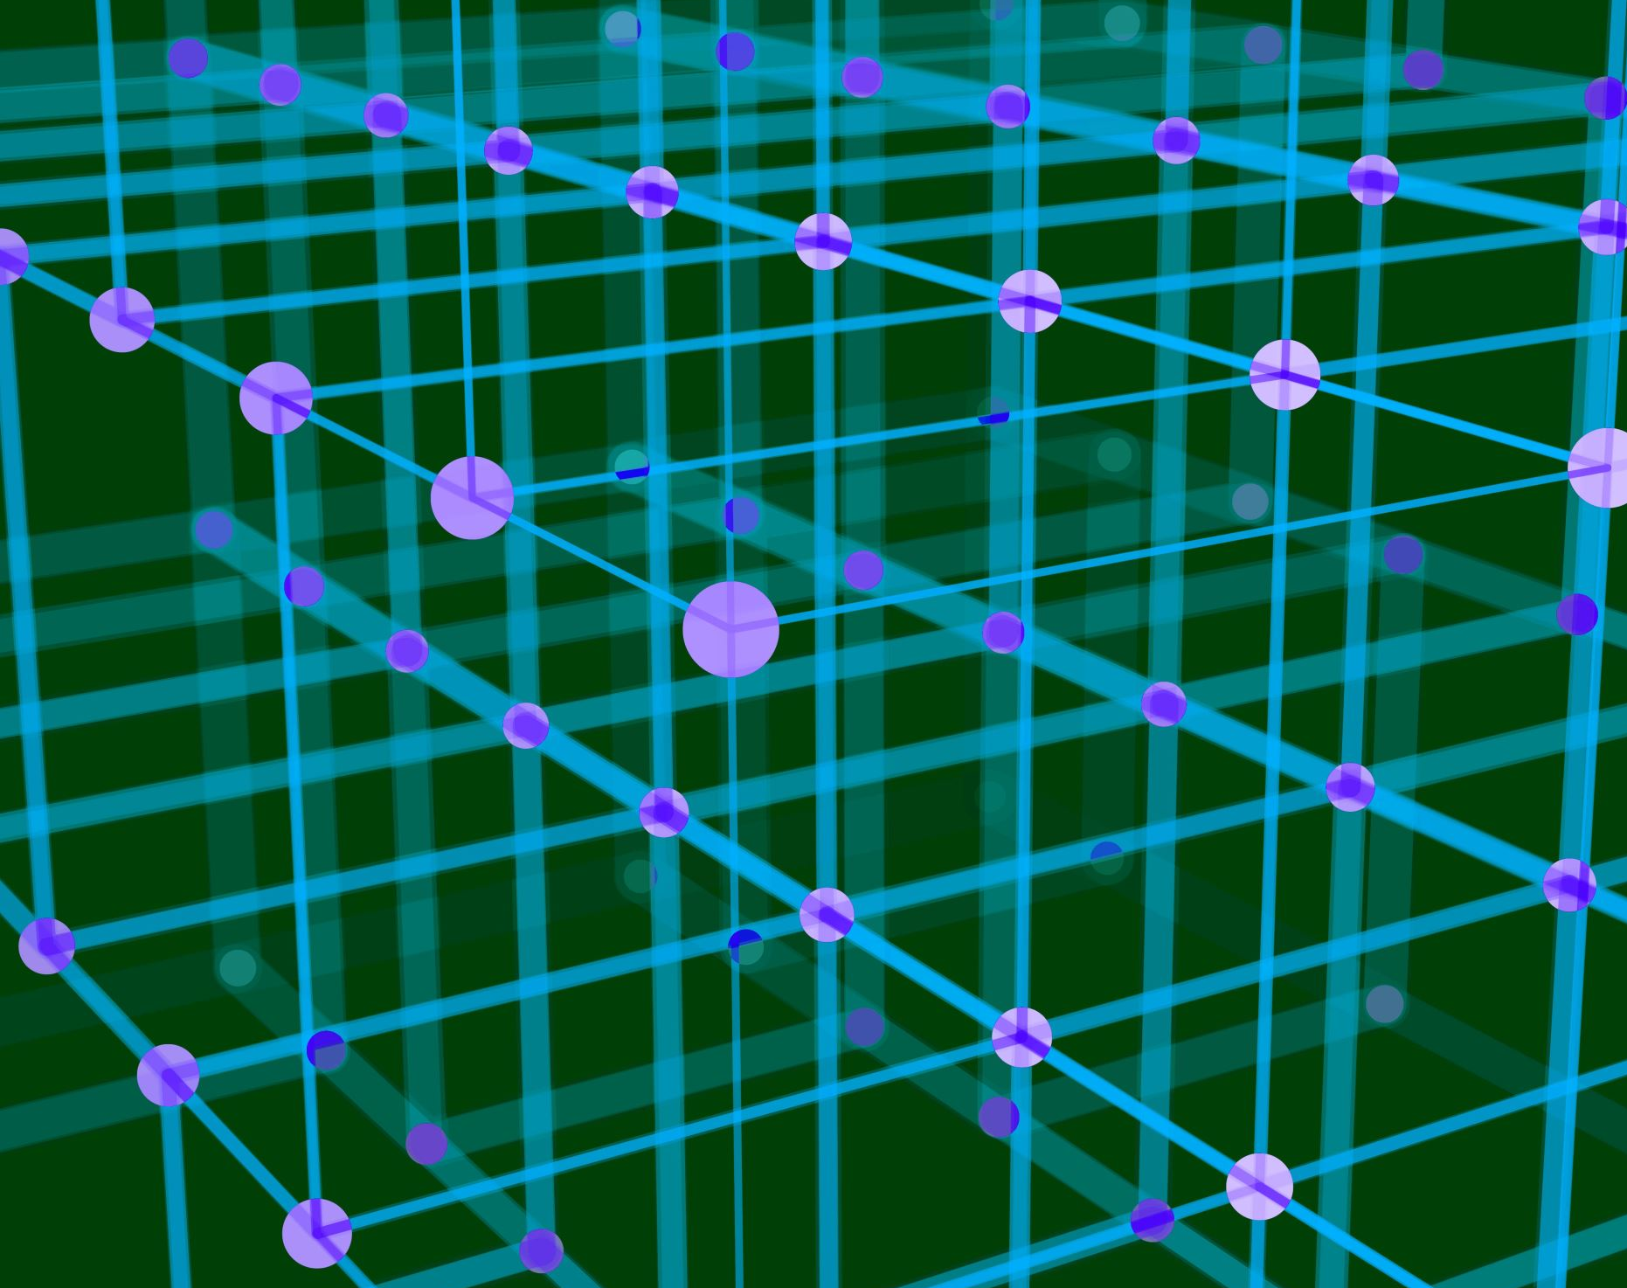
Data Link Layer
Flow Control

Slide 2

FLOW CONTROL
The most important responsibilities of the data link layer are flow control and error control. Collectively, these functions are known as data link control.
Flow control refers to a set of procedures used to restrict the amount of data that the sender can send before waiting for acknowledgment

Slide 3

Flow Control Protocols
How the data link layer can combine framing, flow control, and error control to achieve the delivery of data from one node to another.
The protocols are normally implemented in software by using one of the common programming languages.

Slide 4
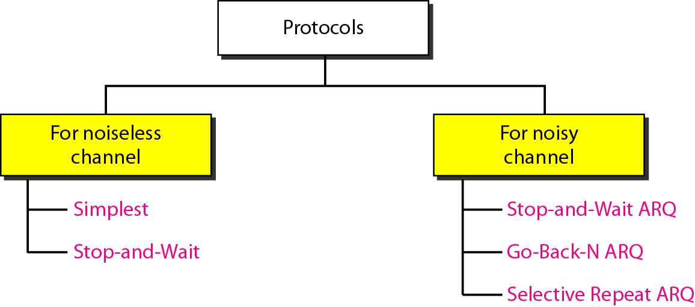
Types of protocols

Slide 5

NOISELESS CHANNELS
Let us first assume we have an ideal channel in which no frames are lost, duplicated, or corrupted.
Two protocols for this type of channel.
Simplest Protocol
Stop-and-Wait Protocol

Slide 6
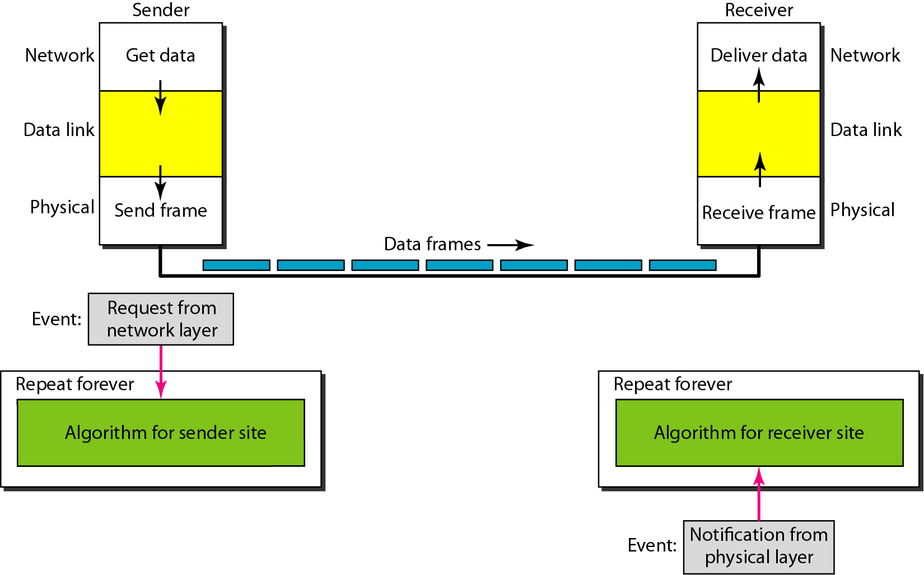
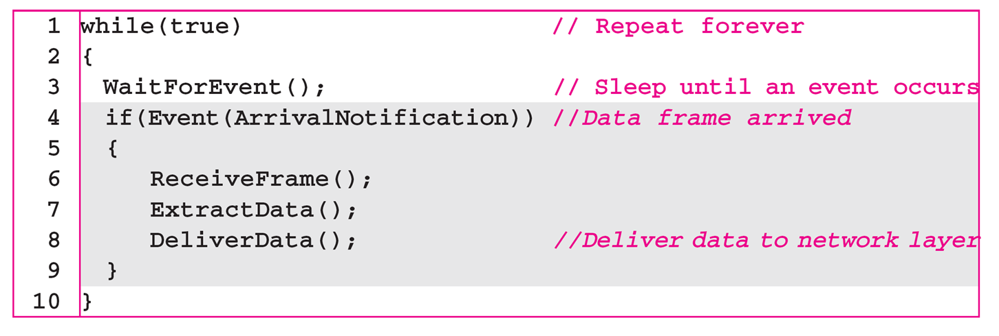
The design of the simplest protocol
with no flow or error control
Sender-site algorithm for the simplest protocol
Receiver-site algorithm for the simplest protocol

Slide 7
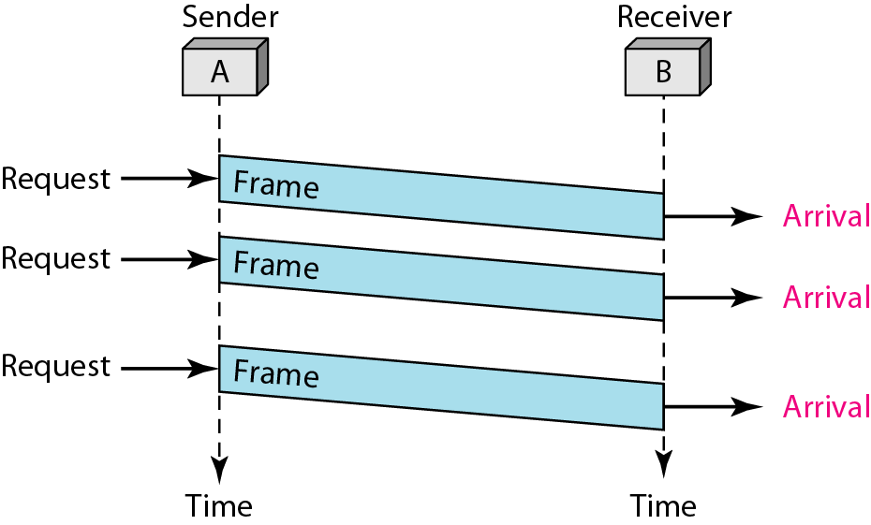
No flow or error control
Simplest protocol :Flow diagram

Slide 8
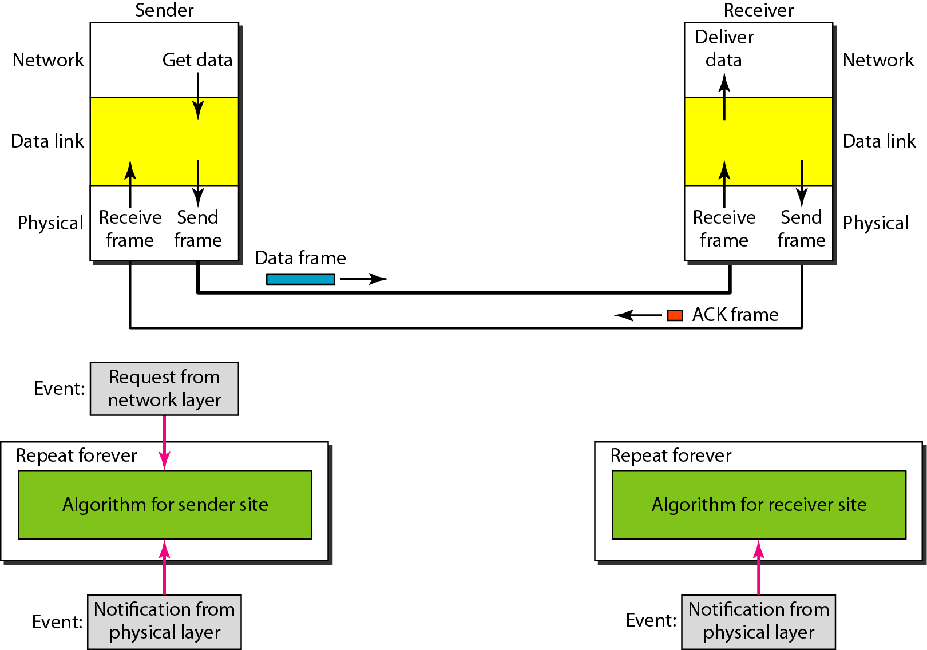
Design of Stop-and-Wait Protocol
Sender-site algorithm for the stop and wait
Receiver-site algorithm for the stop and wait

Slide 9
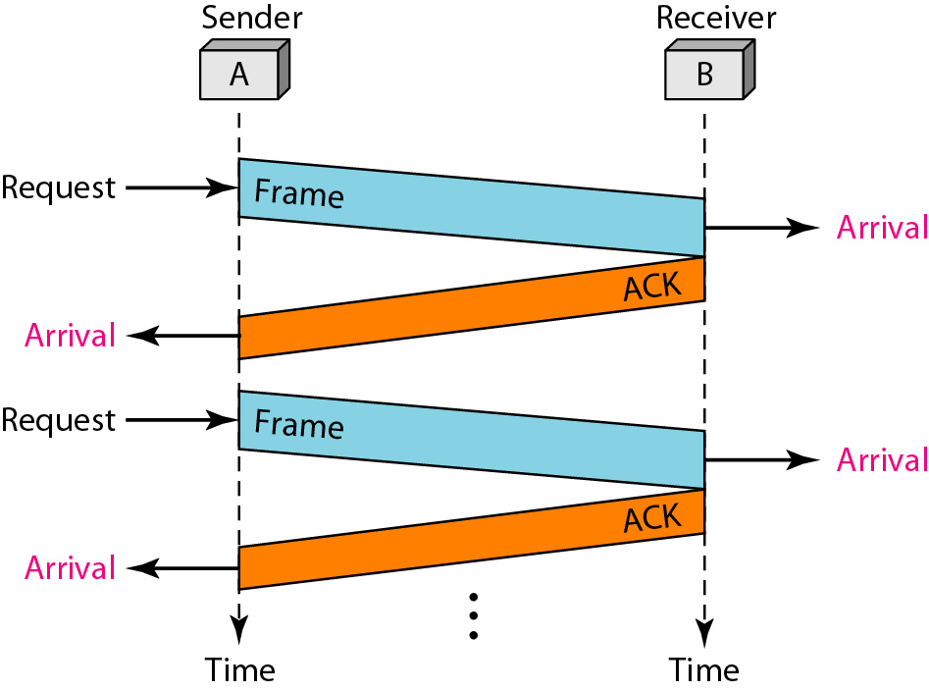
Stop-and-Wait Protocol :Flow diagram
The sender sends one frame and waits for feedback from the receiver.
When the ACK arrives, the sender sends the next frame.
Sending two frames in the protocol involves the sender in four events and the receiver in two events.

Slide 10
NOISY CHANNELS
Noiseless channels are nonexistent.
Three protocols that use error control.
Stop-and-Wait Automatic Repeat Request
Go-Back-N Automatic Repeat Request
Selective Repeat Automatic Repeat Request

Slide 11
Error correction in Stop-and-Wait ARQ is done by keeping a copy of the sent frame and retransmitting of the frame when the timer expires.
Stop-and-Wait Automatic Repeat Request
In Stop-and-Wait ARQ, sequence numbers to number the frames is used. The sequence numbers are based on modulo-2 arithmetic.
In Stop-and-Wait ARQ, the acknowledgment number always announces in modulo-2 arithmetic the sequence number of the next frame expected.

Slide 12
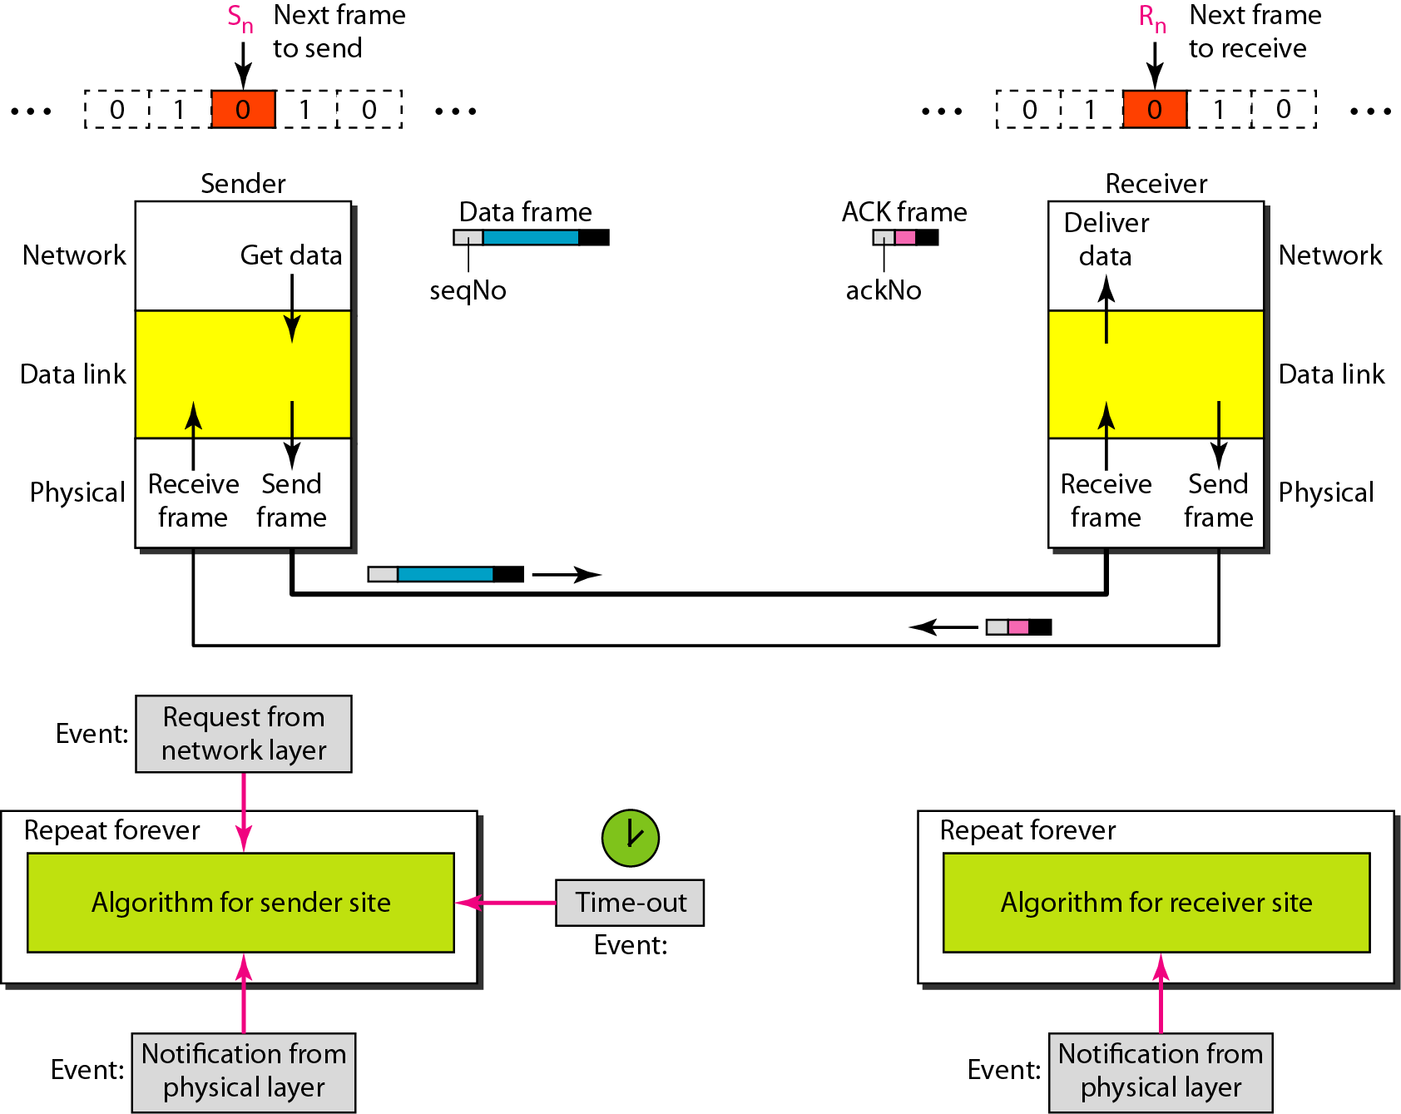
Design of the Stop-and-Wait ARQ Protocol

Slide 13
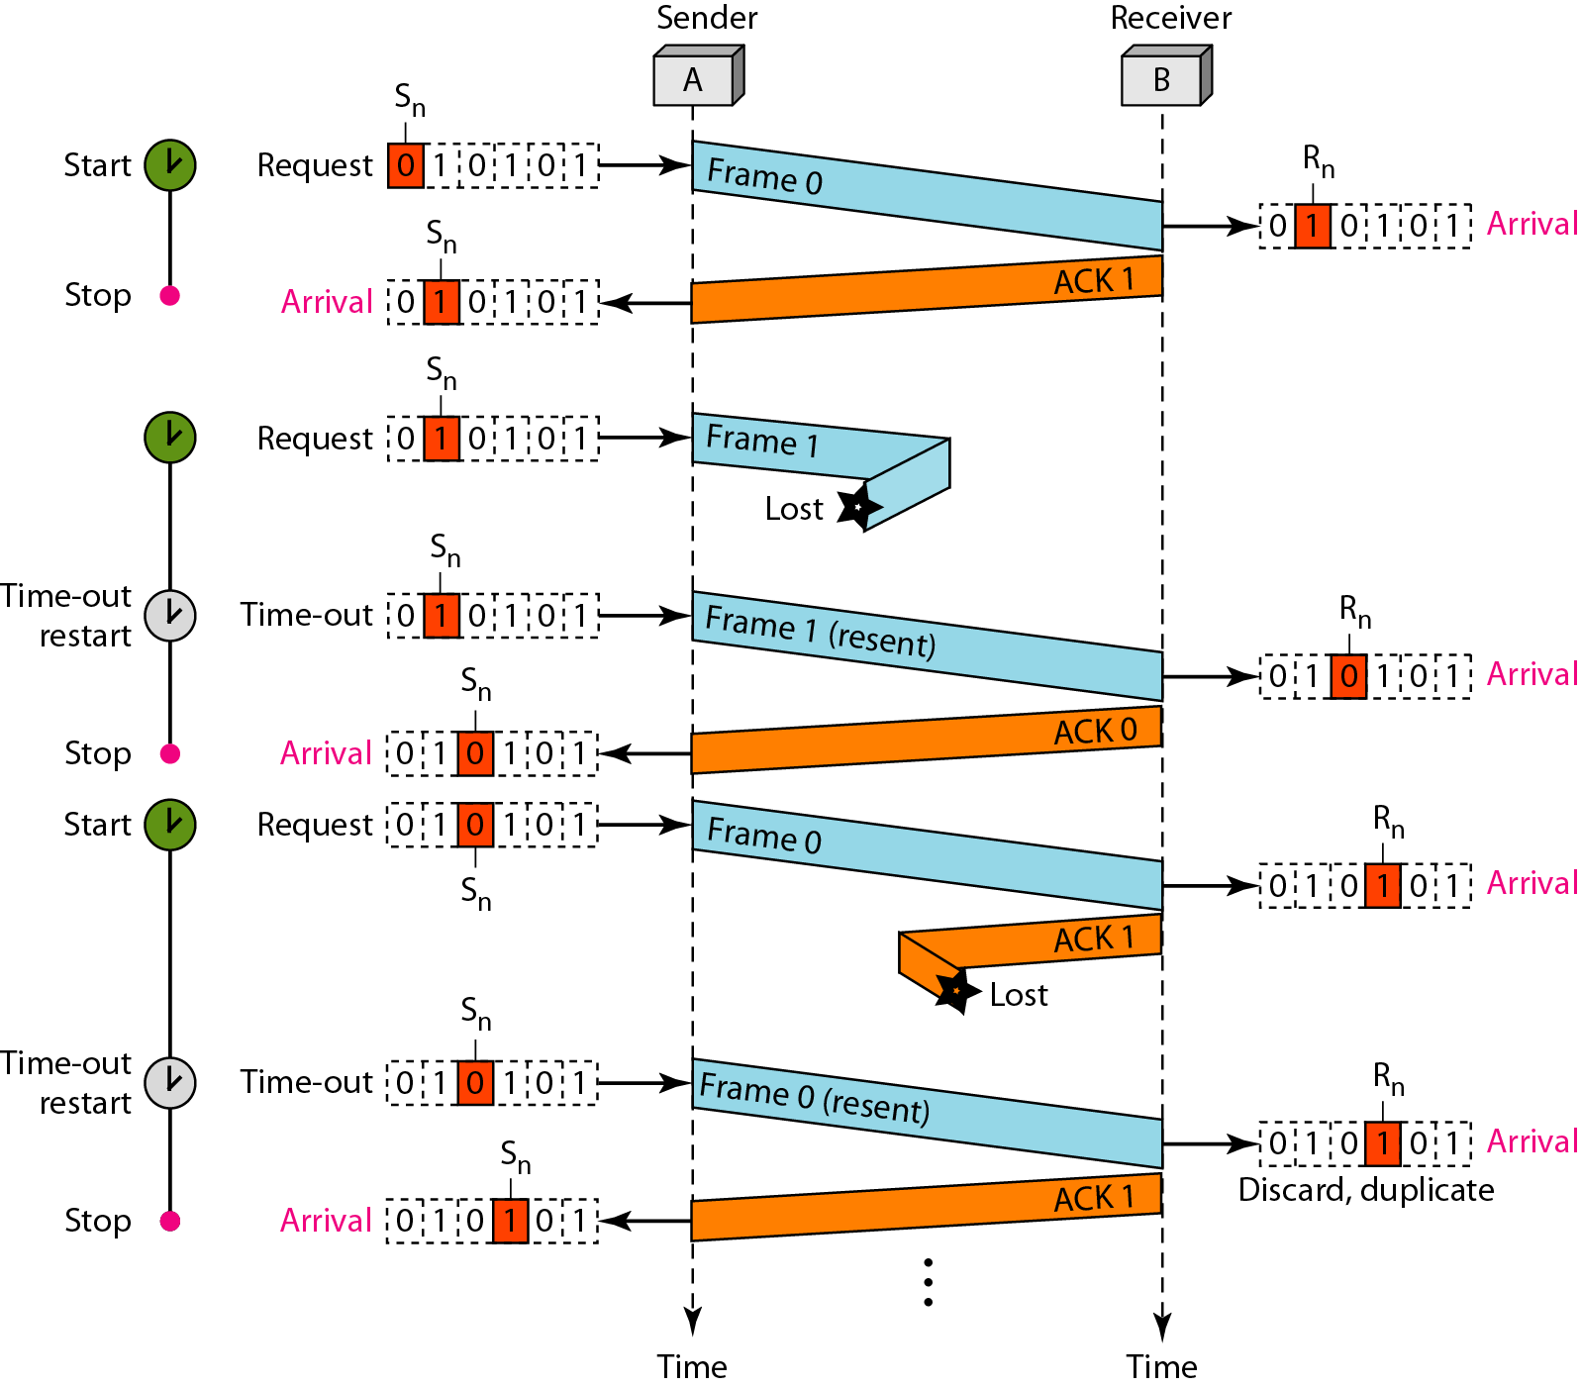
Flow diagram
An example of Stop-and-Wait ARQ.
Frame 0 is sent and acknowledged.
Frame 1 is lost and resent after the time-out.
The resent frame 1 is acknowledged and the timer stops.
Frame 0 is sent and acknowledged, but the acknowledgment is lost.
The sender has no idea if the frame or the acknowledgment is lost, so after the time-out, it resends frame 0, which is acknowledged.

Slide 14
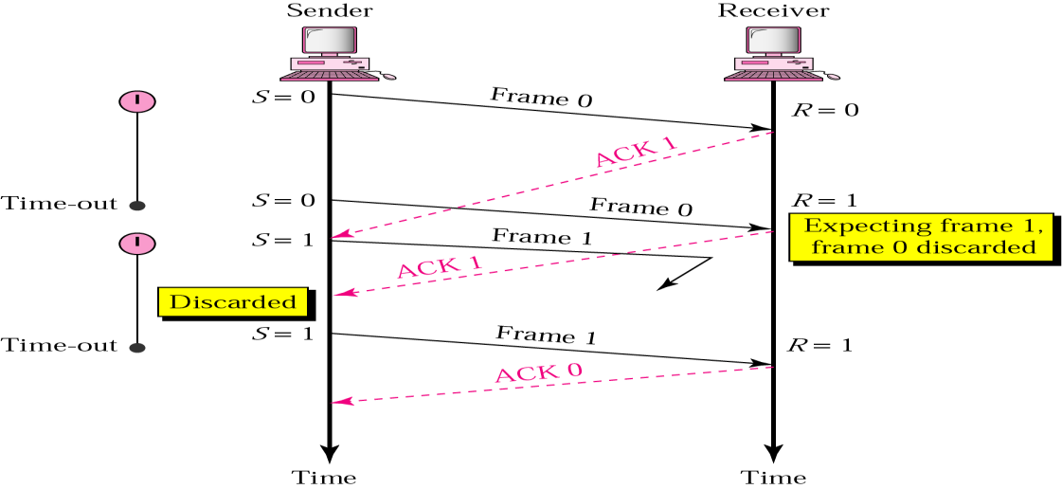
Stop-and-Wait ARQ
Importance of frame numbering
Delayed ACK and lost frame

Slide 15
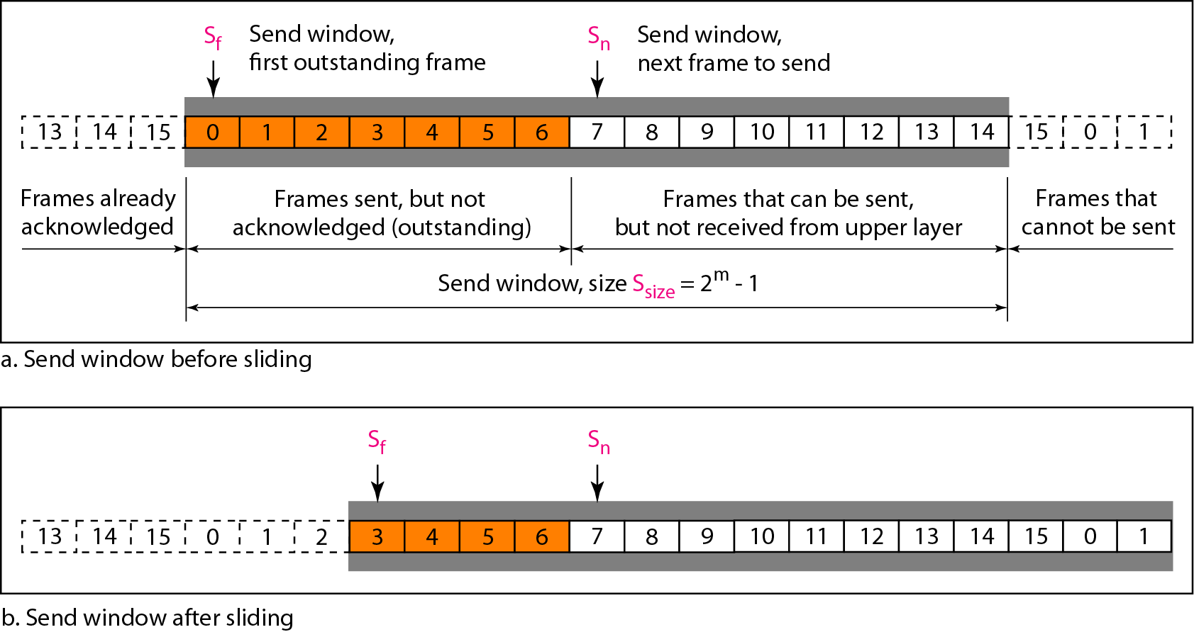
Send window for Go-Back-N ARQ
In the Go-Back-N Protocol, the sequence numbers are modulo 2^{m}, where m is the size of the sequence number field in bits.
The send window is an abstract concept defining an imaginary box of size 2^{m} − 1 with three variables: Sf, Sn, and S_{size}.
The send window can slide one or more slots when a valid acknowledgment arrives.
^{m = 4}

Slide 16
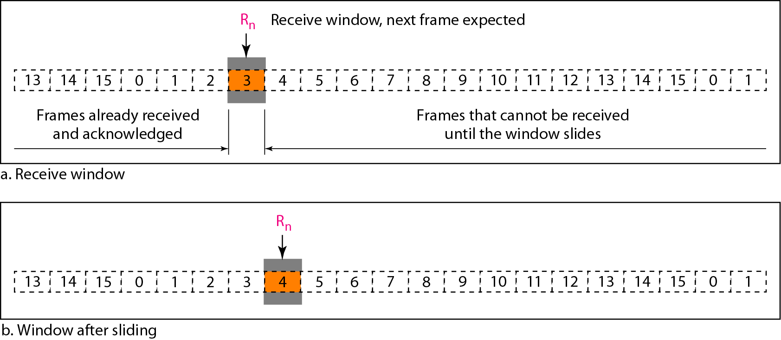
Receive window for Go-Back-N ARQ
The receive window is an abstract concept defining an imaginary box of size 1 with one single variable R_{n}.
The window slides when a correct frame has arrived; sliding occurs one slot at a time.

Slide 17
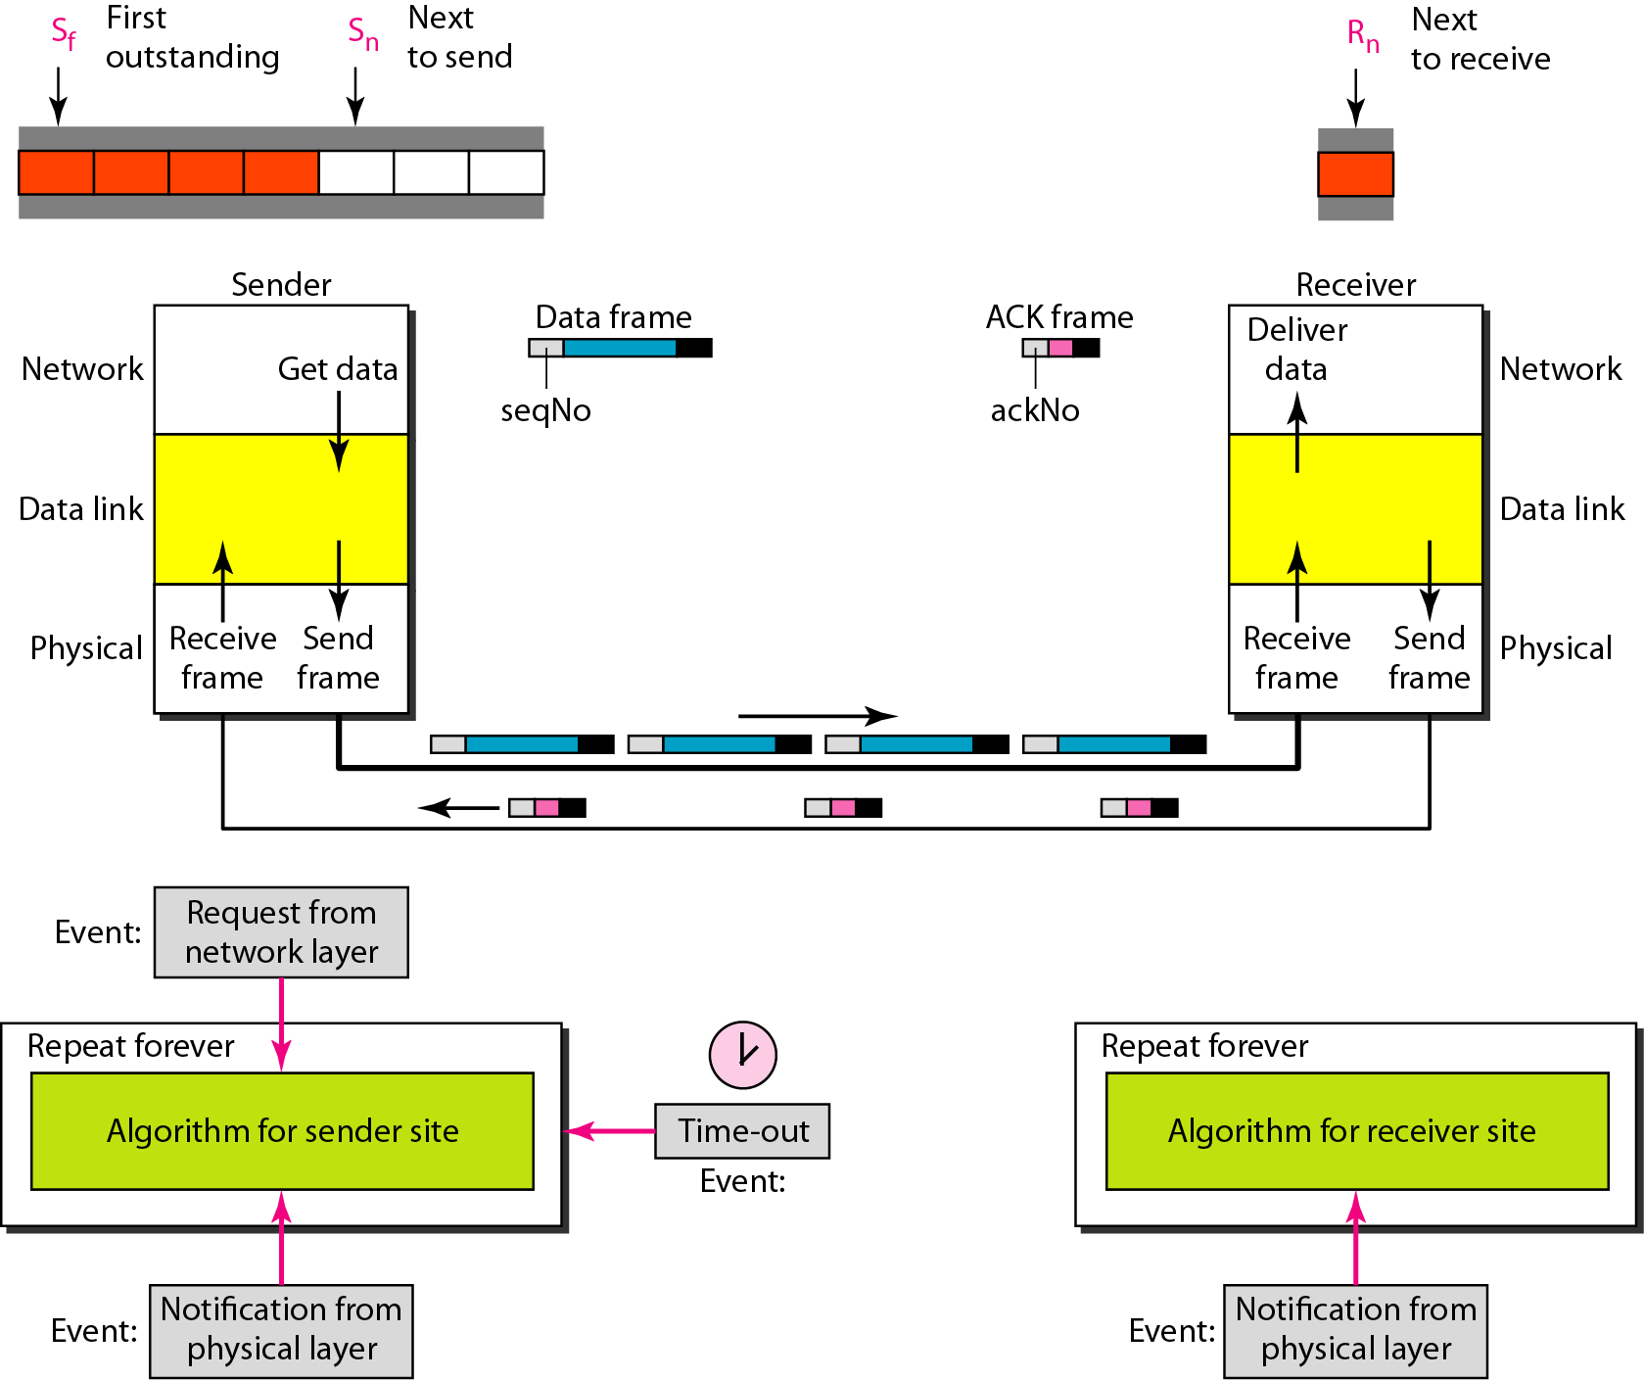
Design of Go-Back-N ARQ

Slide 18
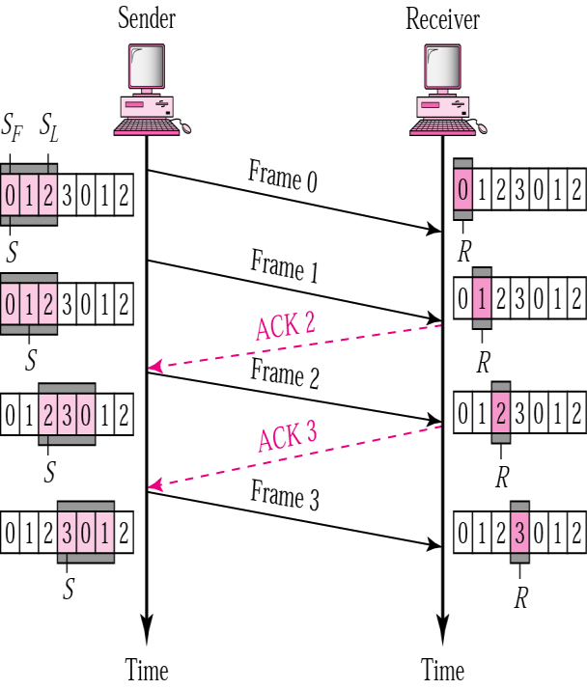
Go-Back-N ARQ
Normal operation
How many frame scan be transmitted Without acknowledgment?
ACK1 is not necessary if ACK2 is sent: Cumulative ACK

Slide 19
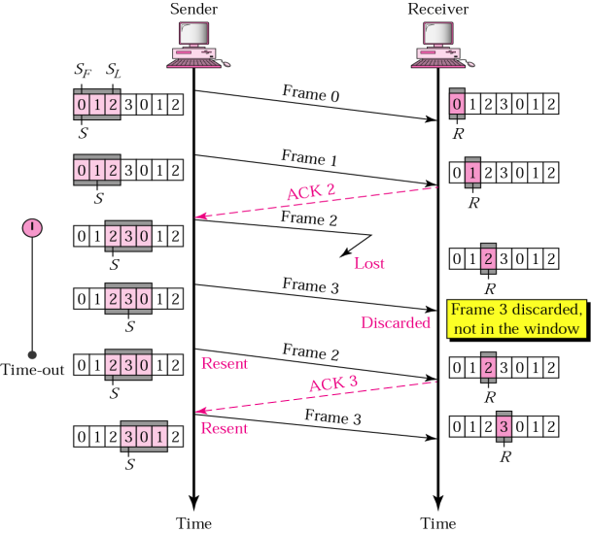
Damage or Lost Frame
Go-Back-N ARQ

Slide 20
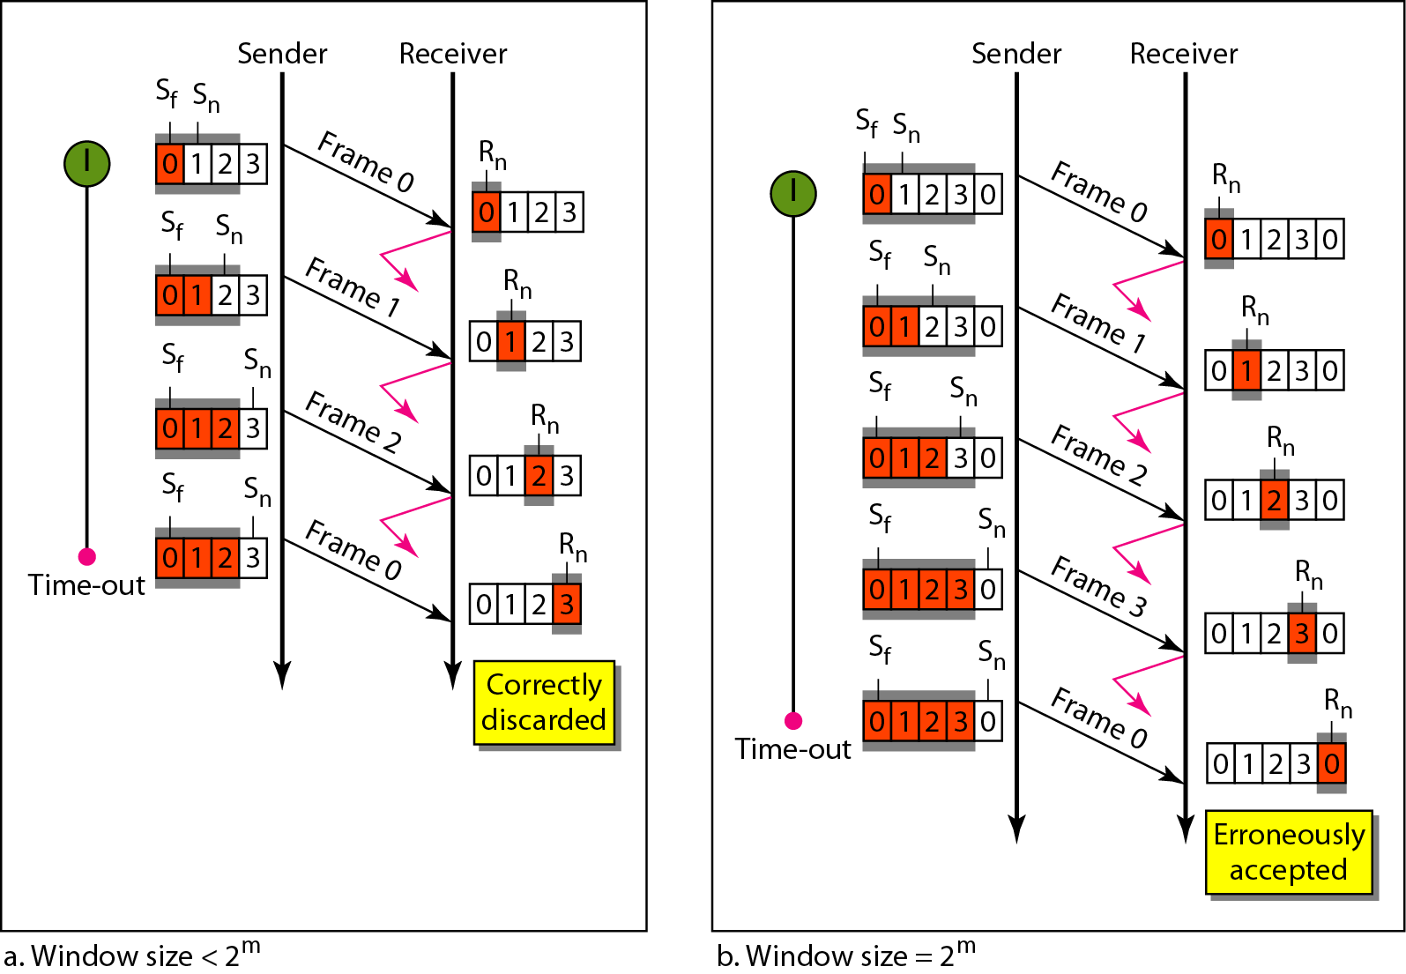
Window size for Go-Back-N ARQ
In Go-Back-N ARQ, the size of the send window must be less than 2^{m} ?
the size of the receiver window is always 1.

Slide 21
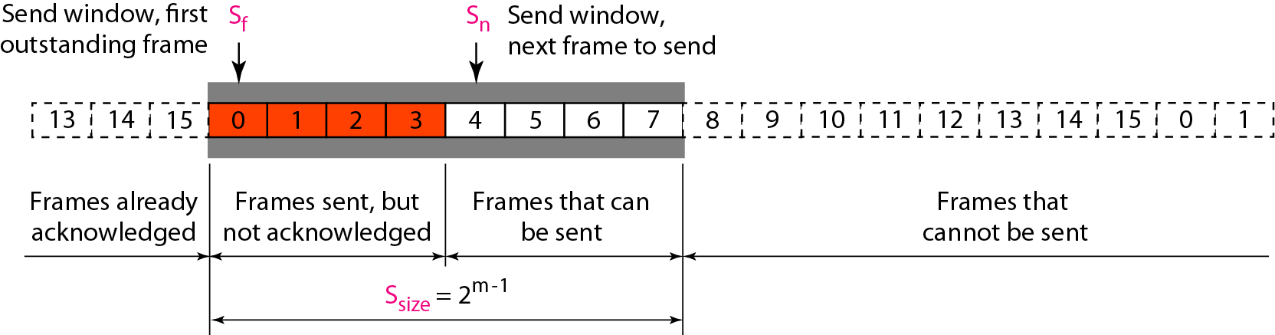
Send window for Selective Repeat ARQ

Slide 22
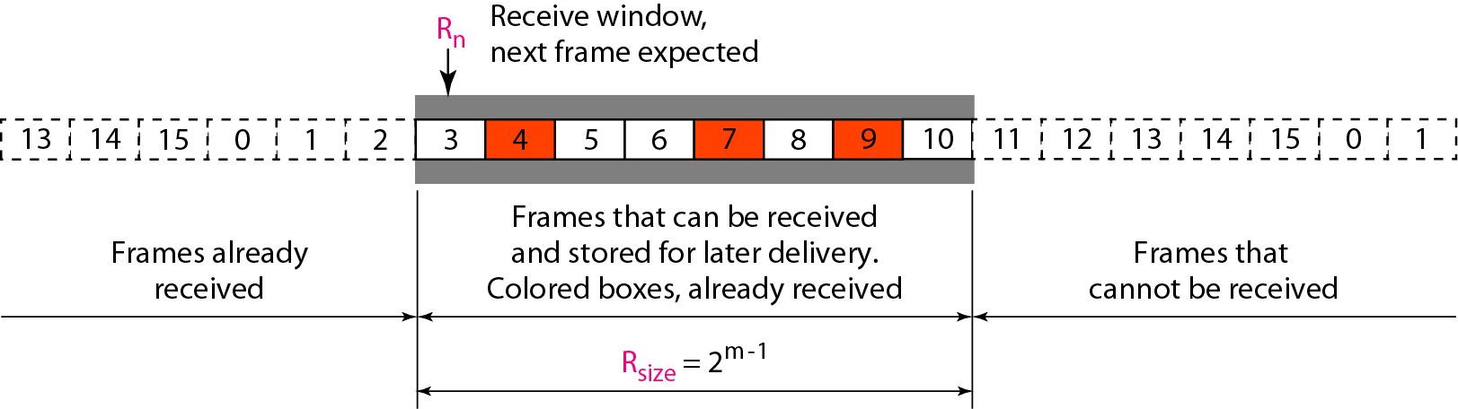
Receive window for Selective Repeat ARQ

Slide 23
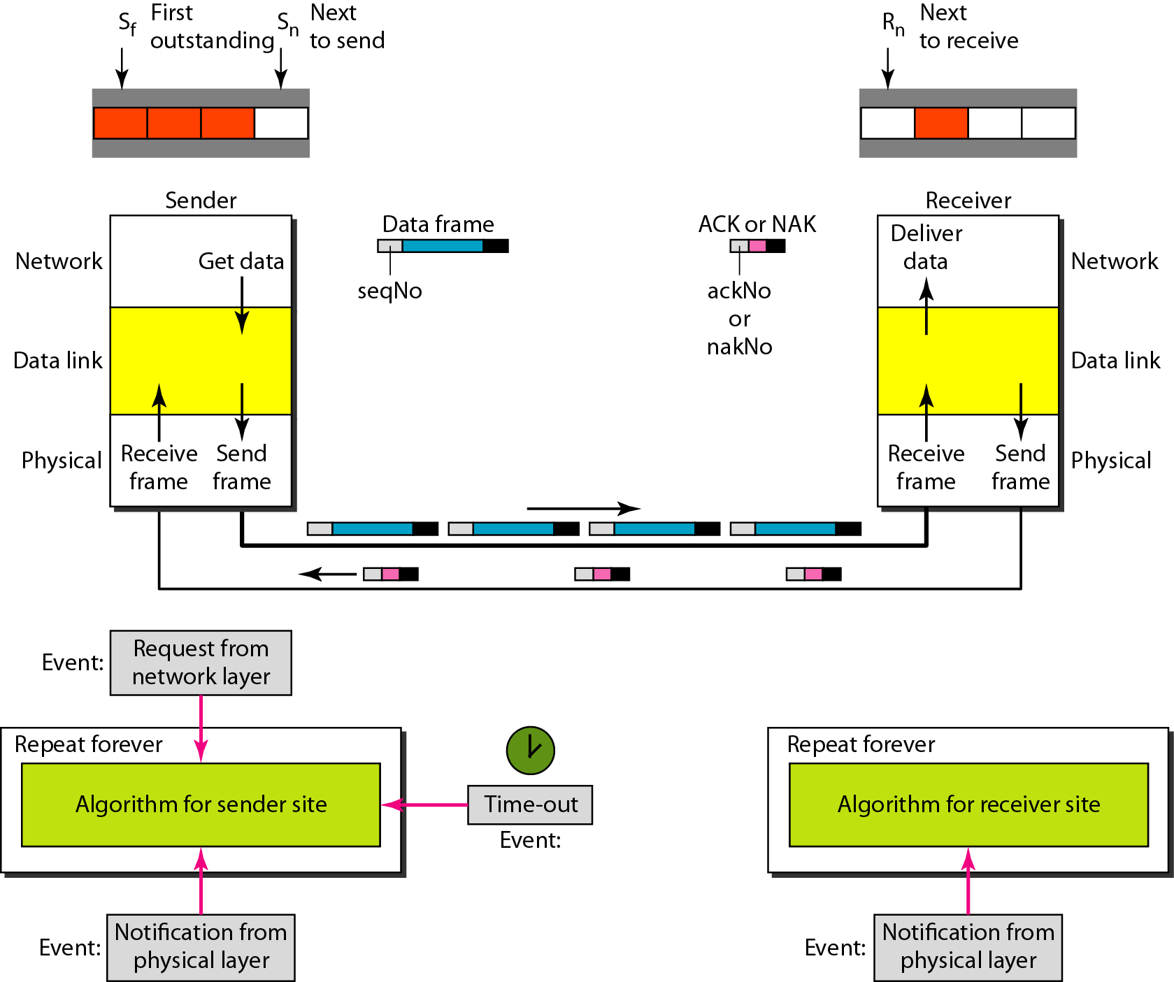
Design of Selective Repeat ARQ

Slide 24
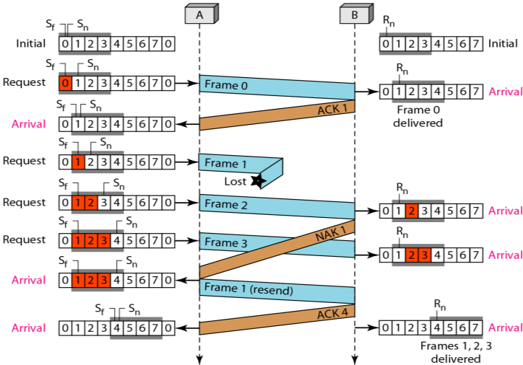
Selective Repeat ARQ
Lost Frame
m=3
Sequences no= 2^{m} =8 : 0,1,2 ,3,4,5,6,7
Window size = 2^{m-1} =4

Slide 25
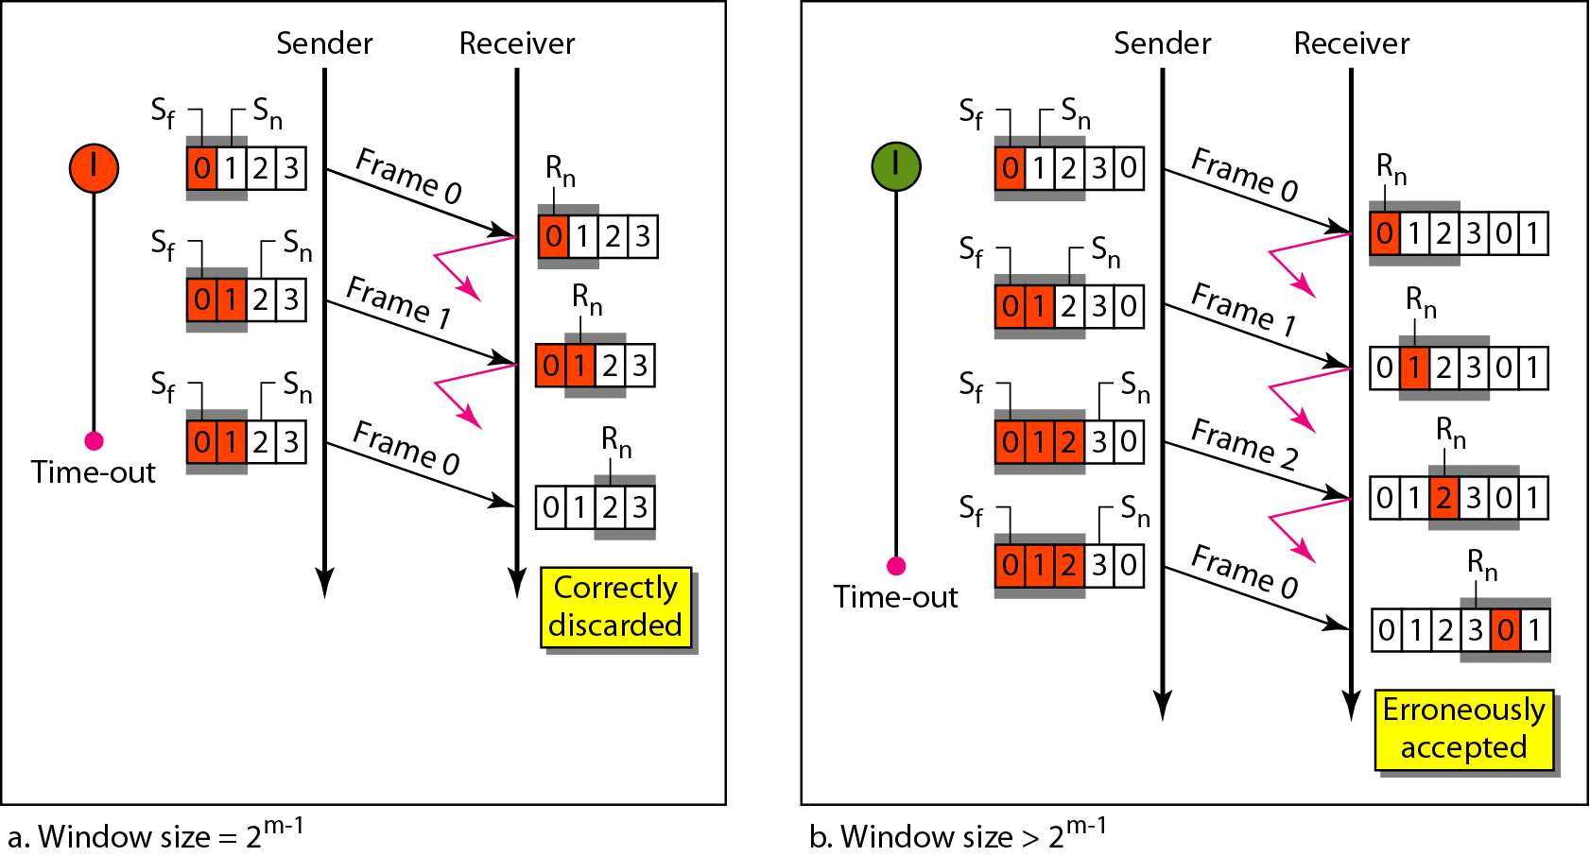
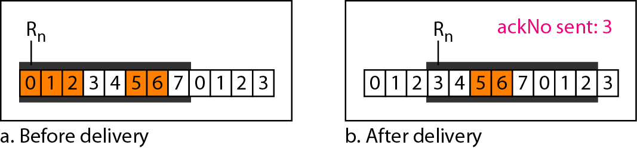
Selective Repeat ARQ, window size
In Selective Repeat ARQ, the size of the sender and receiver window must be at most one-half of 2^{m}.
Delivery of data in Selective Repeat ARQ

Slide 26
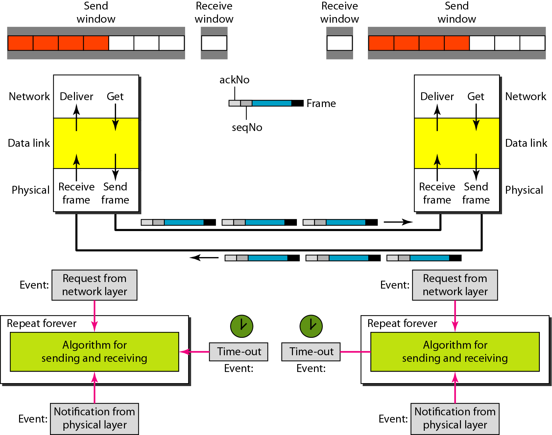
Design of piggybacking in Go-Back-N ARQ
In real life, data frames are normally flowing in both directions: from node A to node B and from node B to node A.
The control information also needs to flow in both directions. A technique called piggybacking is used to improve the efficiency of the bidirectional protocols
Each node now has two windows: one send window and one receive window. Both also need to use a timer.
Both are involved in three types of events: request, arrival, and time-out.

Slide 27
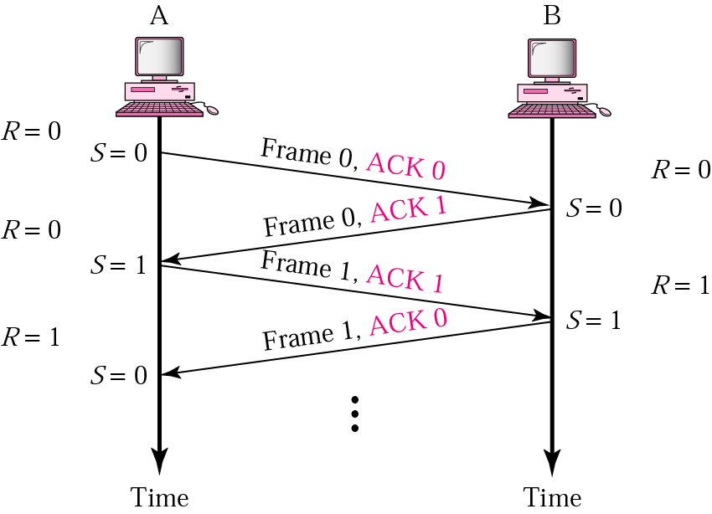
Piggybacking ( Bidirectional transmission)
Is a method to combine a data frame with an acknowledgment.
It can save bandwidth because data frame and an ACK frame can combined into just one frame

Slide 28

Question
In Go-Back-N window, when the timer of the packet times out, several packets have to be resent even some may have arrived safe. Whereas in Selective Repeat window, the sender resends ___________
Packet which are not lost
Only those packets which are lost or corrupted
Packet from starting
All the packets

