Slide 1
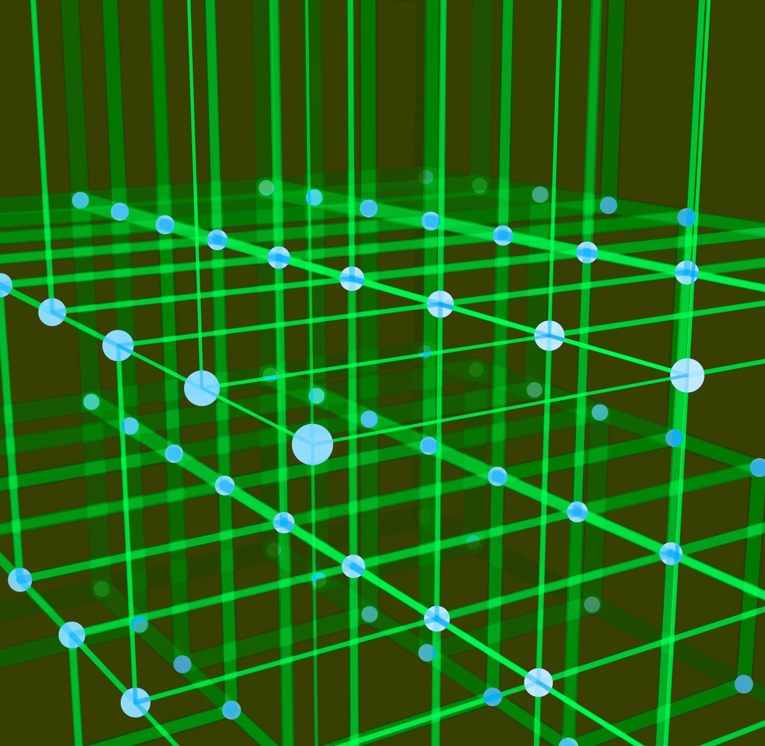
Data Link Layer
MAC- Random Access Protocols

Slide 2
Data link layer divided into two
functionality-oriented sublayers
Data Link Layer | Data Link Control (DLC)
 | Media Access Control (MAC) Multiple access resolution
The upper sublayer is responsible for data link control
Lower sublayer is responsible for resolving access to the shared media

Slide 3
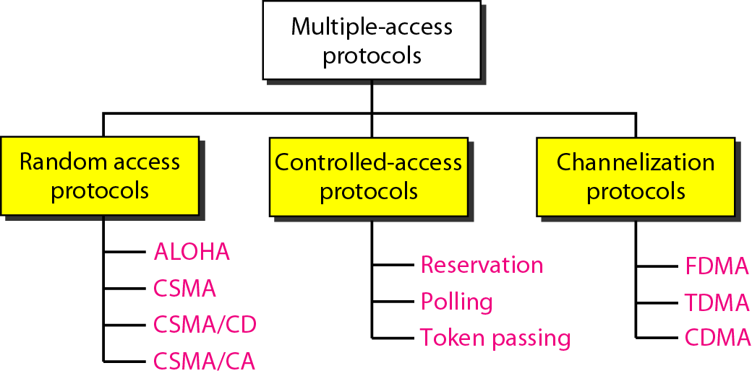
Taxonomy of multiple-access protocols
CSMA- Carrier Sense Multiple Access
CSMA/CD- Carrier Sense Multiple Access with Collision Detection
CSMA/CA- Carrier Sense Multiple Access with Collision Avoidance
FDMA- Frequency Division Multiple Access
TDMA- Time Division Multiple Access
CDMA- Code Division Multiple Access

Slide 4

RANDOM ACCESS
In random access or contention methods, no station is superior to another station and none is assigned the control over another. No station permits, or does not permit, another station to send.
Stations uses a procedure defined by the protocol to make a decision on whether or not to send.
ALOHA- Pure ALOHA and Slotted ALOHA
Carrier Sense Multiple Access- Station sense the medium before transmitting
Carrier Sense Multiple Access with Collision Detection- It tells the station what to do when a collision is detected.
Carrier Sense Multiple Access with Collision Avoidance- It tries to avoid the collision

Slide 5
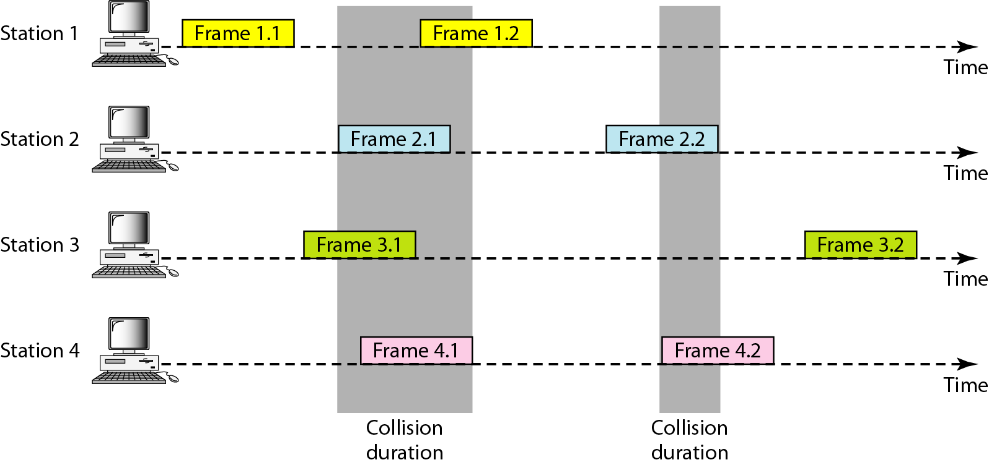
Frames in a pure ALOHA network
The medium is shared between the stations. When a station sends data, another station may attempt to do so at the same time. The data from the two stations collide and become garbled.
There are four stations (unrealistic assumption) that contend with one another for access to the shared channel.
Only two frames survive: frame 1.1 from station 1 and frame 3.2 from station 3. We need to mention that even if one bit of a frame coexists on the channel with one bit from another frame, there is a collision and both will be destroyed.

Slide 6
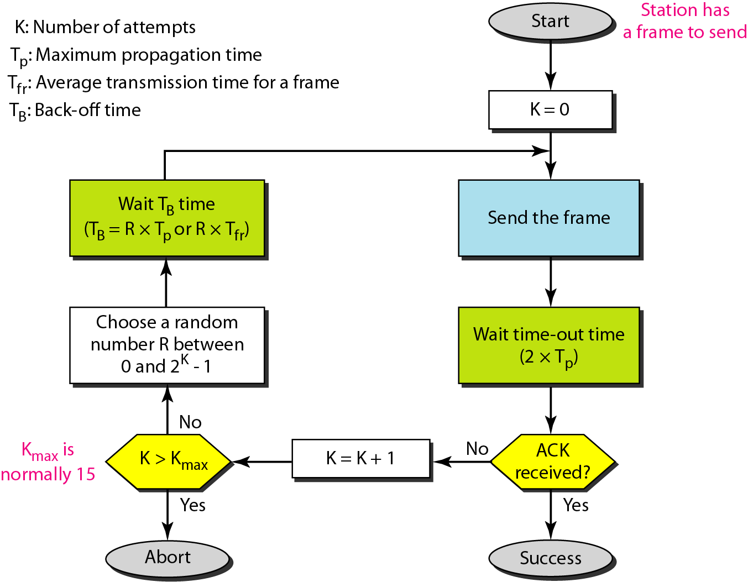
Procedure for pure ALOHA protocol
The original ALOHA protocol is called pure ALOHA. This is a simple, but elegant protocol.
The idea is that each station sends a frame whenever it has a frame to send.
However, since there is only one channel to share, there is the possibility of collision between frames from different stations.
when the time-out period passes, each station waits a random amount of time before resending its frame. This time is called back-off time TB.

Slide 7
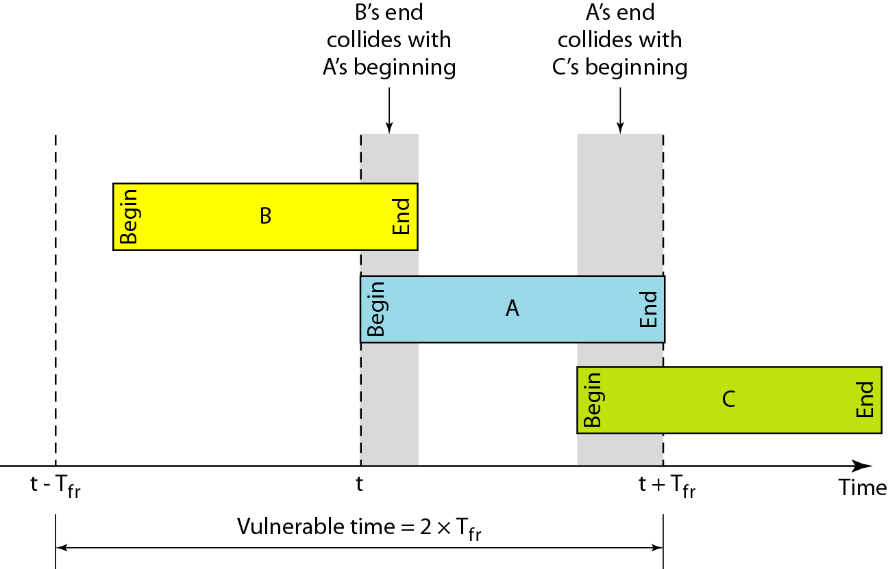
Vulnerable time for pure ALOHA protocol
Vulnerable time, during which a collision may occur in pure ALOHA, is 2 times the frame transmission time.
The throughput for pure ALOHA is S = G × e ^{−2G}
Where G is the total load on the channel per frame time
The maximum throughput
S_{max} = 0.184
when G= (1/2)

Slide 8
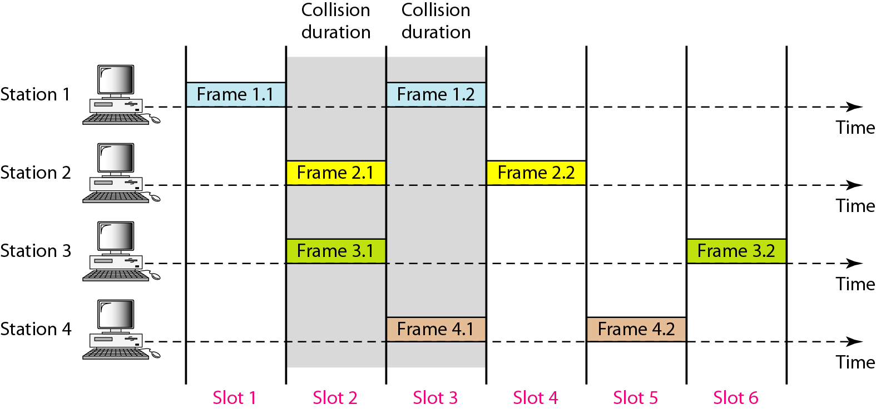
Frames in a slotted ALOHA network
Slotted ALOHA was invented to improve the efficiency of pure ALOHA.
In slotted ALOHA time is divided into slots of Tfr sec and force the station to send only at the beginning of the time slot.

Slide 9
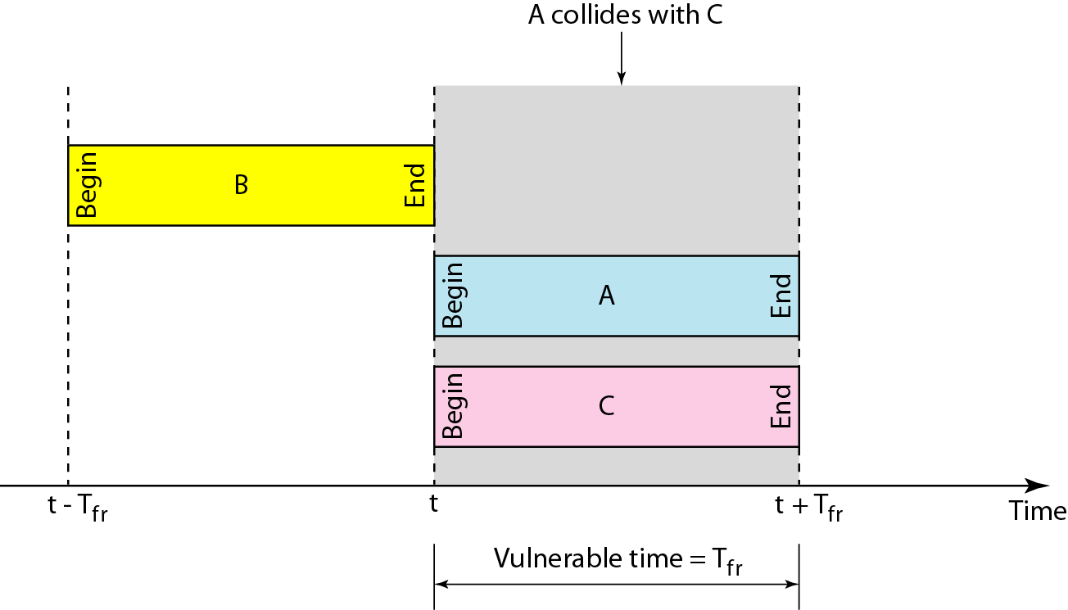
Vulnerable time for slotted ALOHA protocol
Vulnerable time for slotted ALOHA is one-half that of
pure ALOHA.
The throughput for slotted ALOHA is S = G × e^{−G}
The maximum throughput S_{max} = 0.368
when G = 1

Slide 10
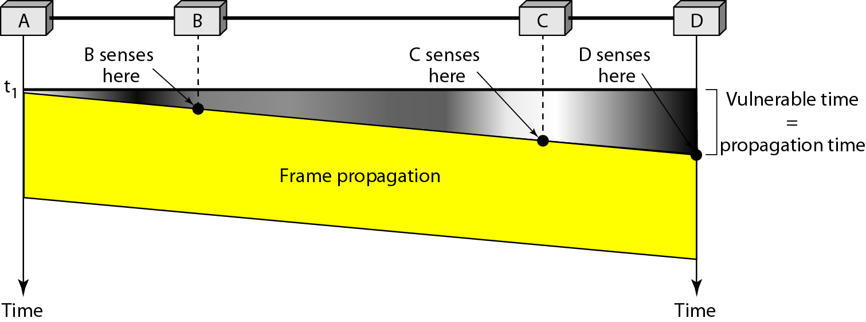
Carrier Sense Multiple Access (CSMA)
Carrier sense multiple access (CSMA) requires that each
station first listen to the medium (or check the state of the medium) before sending.
In other words, CSMA is based on the principle "sense before transmit" or "listen before talk."
Vulnerable time in CSMA

Slide 11
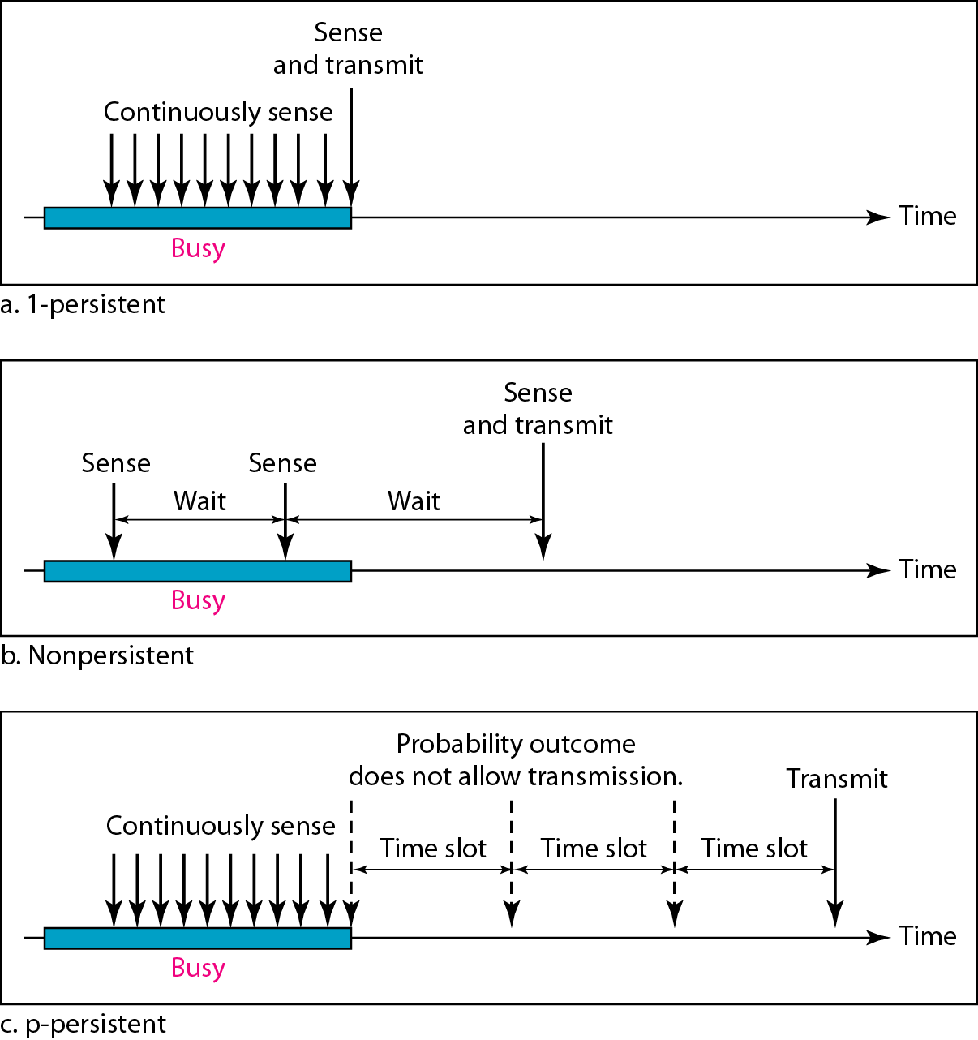
Behavior of three persistence methods
of CSMA
1-persistent:- Sense the channel before sending the data
If channel is idle- immediately send the data
If channel is busy- Continuously sense the channel, as soon as channel is free, send the data
Nonpersistent/ 0- persistent:- Sense the channel before sending the data
If channel is idle- immediately send the data
If channel is busy- wait for random amount of time and again send the data
P-persistent:- Time is divided into slots,
sense the channel before sending the data
If channel is idle- send the data with p probability
If channel is busy- wait for next slot

Slide 12
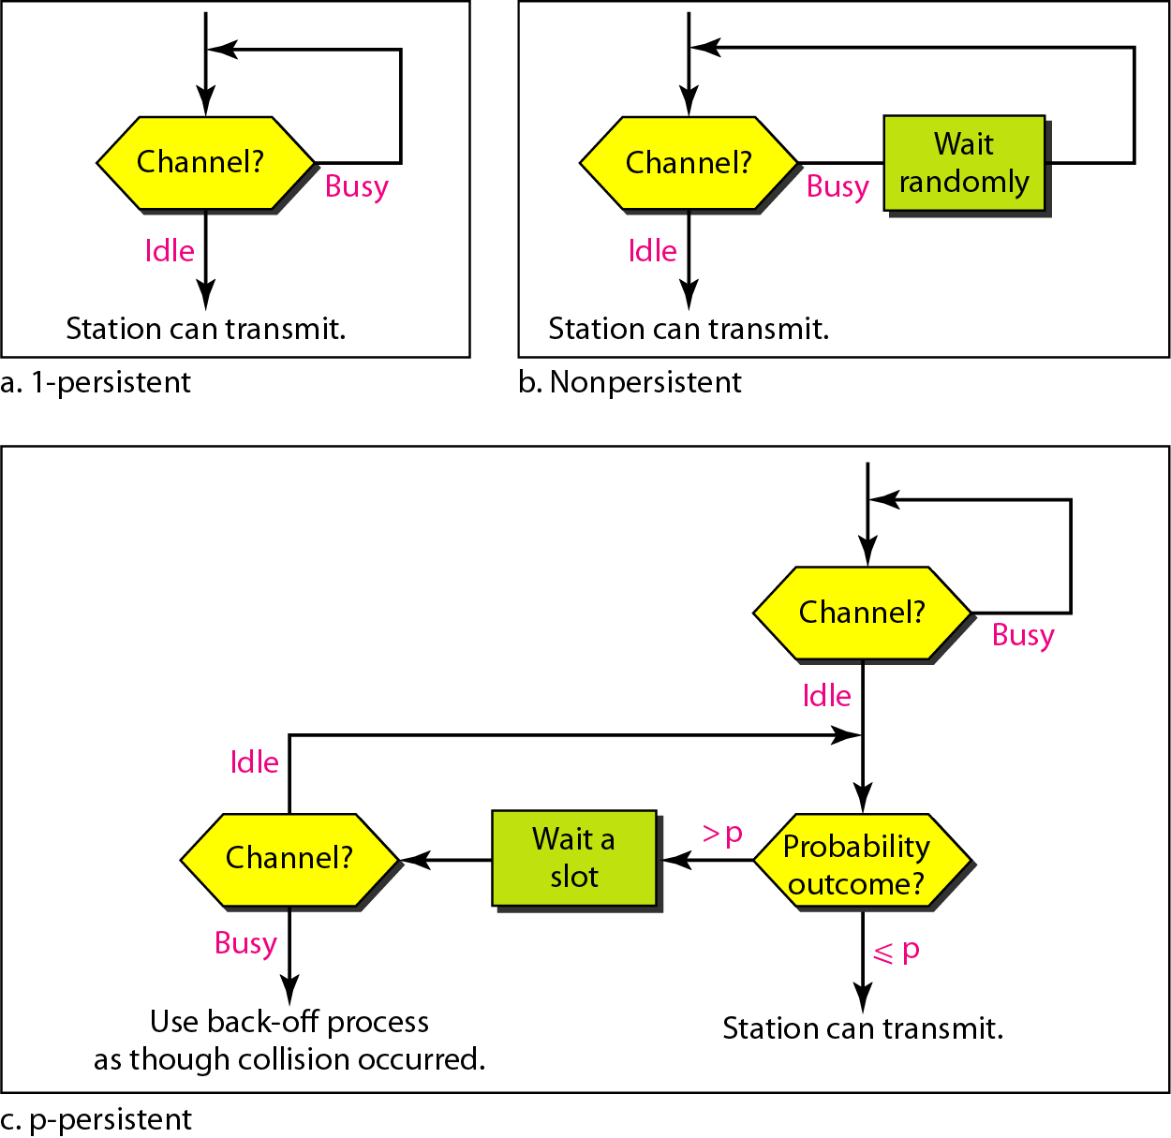
Flow diagram for three persistence methods

Slide 13
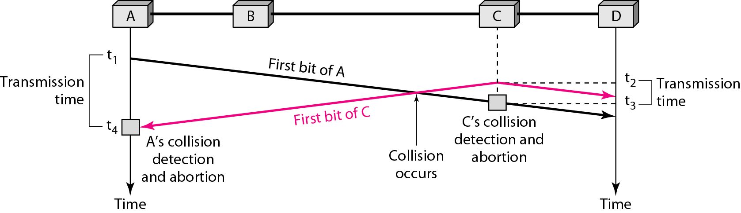
CSMA/CD
It tells the station what to do when a collision is detected.
Stations sense the channel, if channel is free- send the data
if collision occurs, detect the collision, wait for random amount of time and again send the data.
For CSMAlCD to work, restriction on the frame size is needed. Before sending the last bit of the frame, the sending station must detect a collision, if any, and abort the transmission.
Frame transmission time Tfr must be at least two times the maximum propagation time Tp.
Collision of the first bit in CSMA/CD
Minimum frame size= 2 Tp *data rate
Tp= propagation time

Slide 15

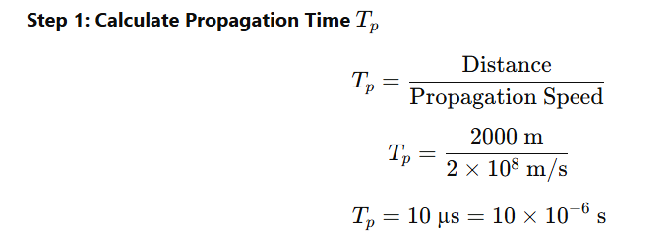
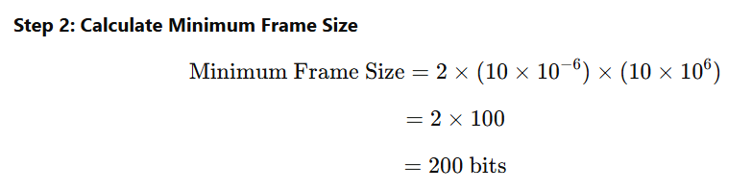

Slide 16
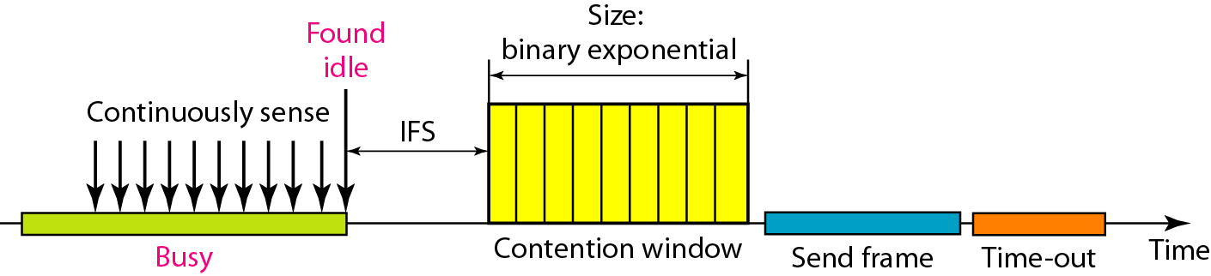
Collisions are avoided through the use of CSMA/CA's three strategies: the interframe space, the contention window, and acknowledgments
When channel is free, the station does not send immediately. It waits for a period of time called the interframe space or IFS.
The contention window is an amount of time divided into slots
The positive acknowledgment and the time-out timer can help guarantee that the receiver has received the frame.
CSMA/CA

Slide 17
CSMA/CA (CSMA with collision Avoidance)
All terminals listen to the same medium as CSMA/CD.
Terminal ready to transmit senses the medium.
If medium is busy it waits until the end of current transmission.
It again waits for an additional predetermined time period DIFS (Distributed inter frame Space).
Then picks up a random number of slots (the initial value of backoff counter) within a contention window to wait before transmitting its frame.
If there are transmissions by other terminals during this time period (backoff time), the terminal freezes its counter.
It resumes count down after other terminals finish transmission + DIFS. The terminal can start its transmission when the counter reaches to zero.

Slide 18
CSMA/CA with RTS/CTS
DIFS
SIFS
Data
Time
Source
RTS
SIFS
SIFS
Destination
CTS
ACK
DIFS
Contention window
Next Frame
Other
Defer access
Backoff after defer

