Slide 1

Network Layer

Slide 2

Network Layer Tasks
Logical Addressing: The network layer adds a header that includes the logical addresses of the sender and receiver to the packet coming from the upper layer.
Routing: When independent networks or links are connected together to create an internetwork, routers or switches route packets to their final destination.
The network layer is responsible for the delivery of individual packets from the source host to the destination host

Slide 3

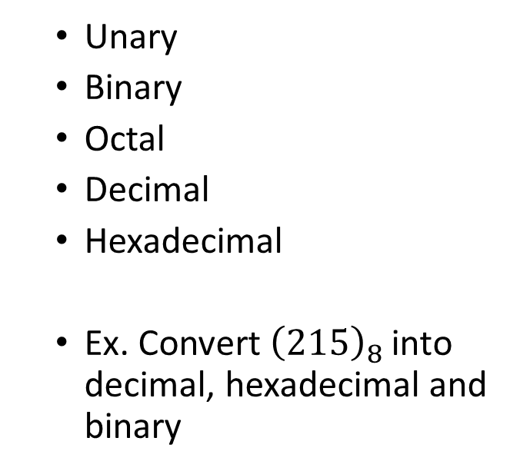
Number System
Unary
Binary
Octal
Decimal
Hexadecimal
Ex. Convert ${\left(215\right)}_{8}$ into decimal, hexadecimal and binary

Slide 4
Binary Number System
1 bit | 2 bits | 3 bits
0 | 00 | 000
1 | 01 | 001
 | 10 | 010
 | 11 | 011
 |  | 100
 |  | 101
 |  | 110
 |  | 111
If n bit space is divided into k parts, then the
Total possible numbers in k parts = 2^k
Size of each part = 2^n/2^k = 2^(n-k)
n bits
k | n-k

Slide 5
IP Addressing Schemes : Static Partitioning (ARPANET)
8 bits | 24 bits
NID | HID
32 bits IPv4 address
Total number of network addresses = 2^8 = 256
Total number of hosts with one network = 2^24 = 16 M (approx.)

Slide 6
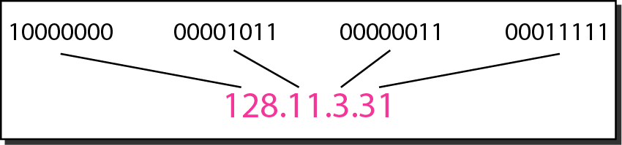
IPv4 ADDRESSES
An IPv4 address is a 32-bit address that uniquely and universally defines the connection of a device (for example, a computer or a router) to the Internet.
The address space of IPv4 is 2³² or 4,294,967,296.
Dotted-decimal notation and binary notation for an IPv4 address

Slide 7
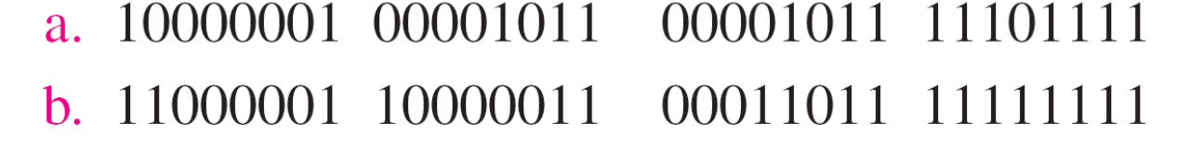
Q1. Change the following IPv4 addresses from binary notation to dotted-decimal notation.

Slide 8
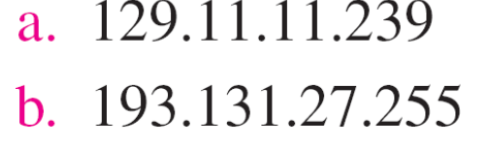
Q1. Change the following IPv4 addresses from binary notation to dotted-decimal notation.

Slide 9
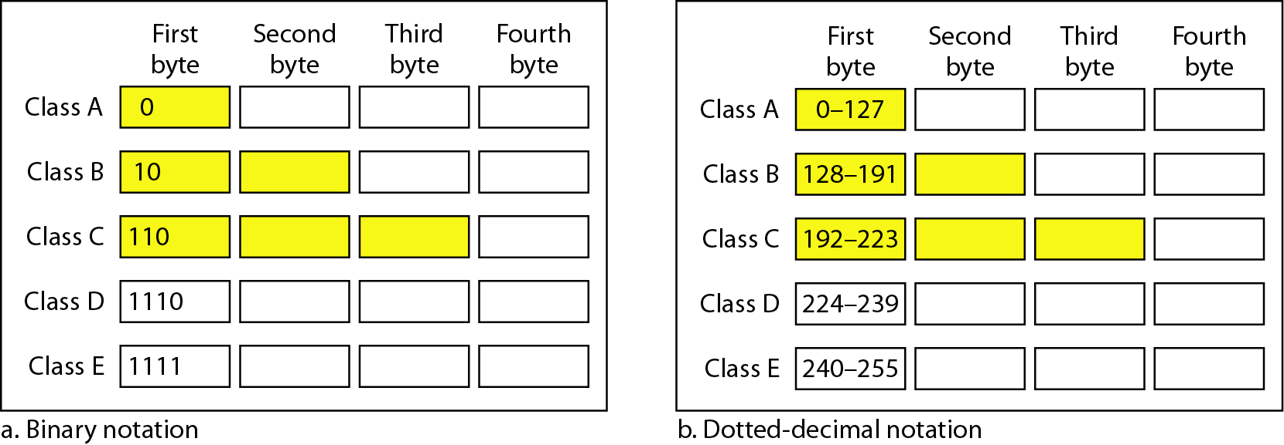
Classful addressing
IPv4 addressing, at its inception, used the concept of classes. This architecture is called classful addressing.
In classful addressing, the address space is divided into five classes: A, B, C, D, and E.
Classes in binary and dotted-decimal notation
In classful addressing, an IP address in class A, B, or C is divided into netid and hostid.
A mask (also called the default mask), a 32-bit number made of contiguous 1s followed by contiguous 0s.

Slide 10
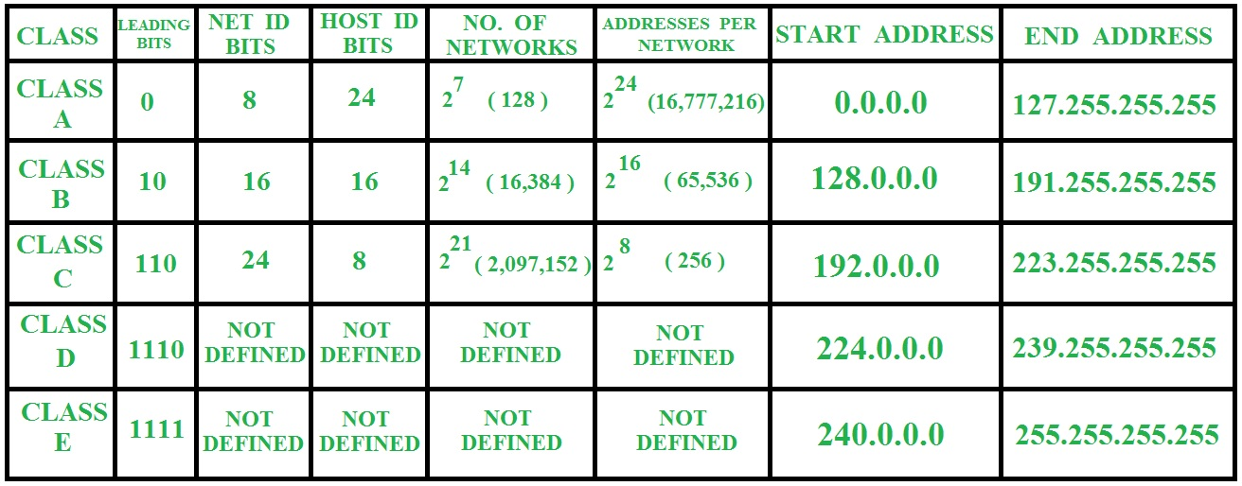

Slide 11
Number of blocks and block size in classful IPv4 addressing

Slide 12
Default masks for classful addressing

Slide 13
Classless Addressing
In classful addressing, a large part of the available addresses were wasted. It is replaced with classless addressing.
To overcome address depletion and give more organizations access to the Internet, classless addressing was designed and implemented.
In IPv4 addressing, a block of addresses can be defined as x.y.z.t /n (Classless Inter-Domain Routing(CIDR) notation)
Where x.y.z.t defines one of the addresses and the /n defines the mask.

Slide 14

Classless Addressing
To simplify the handling of addresses, the Internet authorities impose, three restrictions on classless address blocks:
1. The addresses in a block must be contiguous, one after another.
2. The number of addresses in a block must be a power of 2 (I, 2, 4, 8, ... ).
3. The first address must be evenly divisible by the number of addresses.
The first address in the block can be found by setting the rightmost 32 − n bits to 0s

Slide 15

Q2
A block of addresses is granted to a small organization. We know that one of the addresses is 205.16.37.39/28. What is the first and last address in the block?
Solution:
The binary representation of the given address is
11001101 00010000 00100101 00100111
If we set 32−28 rightmost bits to 0, we get
11001101 00010000 00100101 0010000 or 205.16.37.32.
The binary representation of the given address is
11001101 00010000 00100101 00100111
If we set 32 − 28 rightmost bits to 1, we get
11001101 00010000 00100101 00101111 or 205.16.37.47

Slide 16
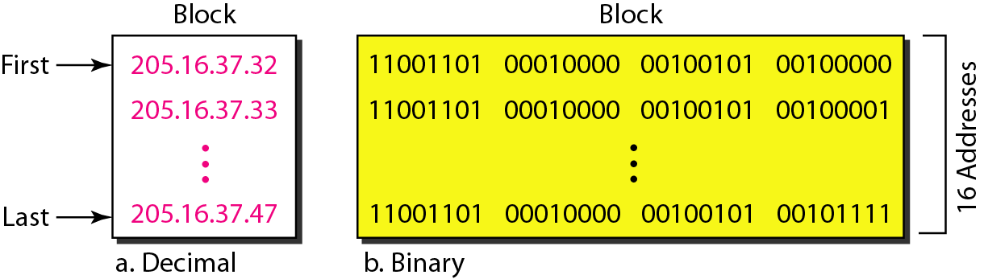
A network configuration for the block 205.16.37.32/28
A block of 16 addresses granted to a small organization
The first address in a block is normally not assigned to any device; it is used as the network address that represents the organization to the rest of the world.

Slide 17
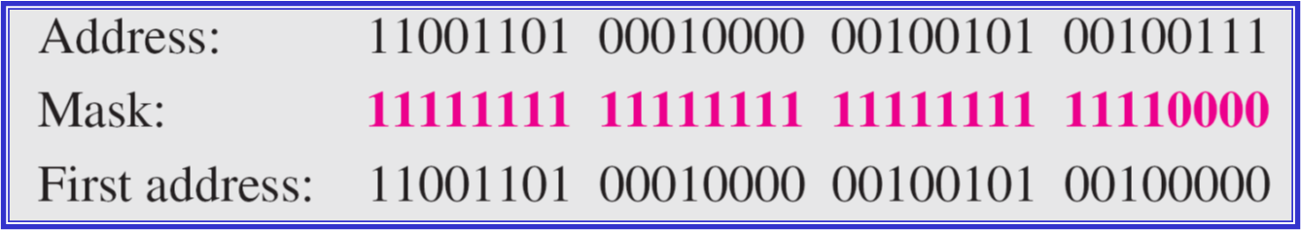
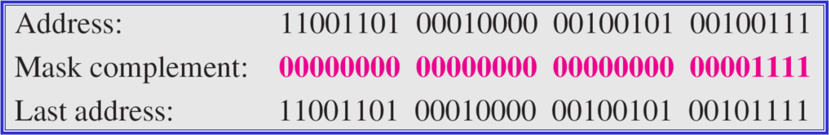
First and Last Address: AND/OR Operations 205.16.37.39/28
The first address can be found by ANDing the given addresses with the mask
The last address can be found by ORing the given addresses with the complement of the mask.

Slide 18
Short-Cut Method
** If the byte in the mask is 255, copy the byte in the address.
** If the byte in the mask is 0, replace the byte in the address with 0.
** If the byte in the mask is neither 255 nor 0, we write the mask and the address in binary and apply the AND operation.

Slide 19
Example 2
What is the subnetwork address if the destination address is 19.30.84.5 and the mask is 255.255.192.0?
Solution

Slide 20
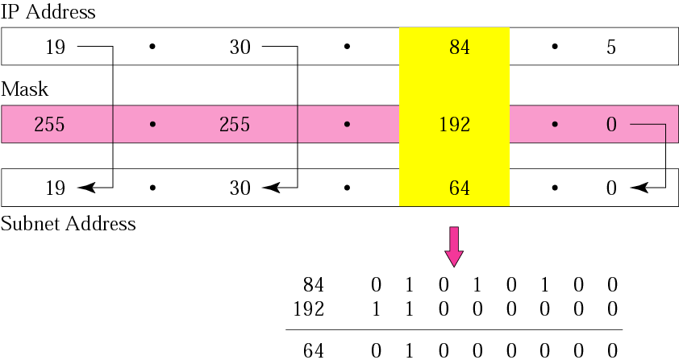
Example 2

Slide 21
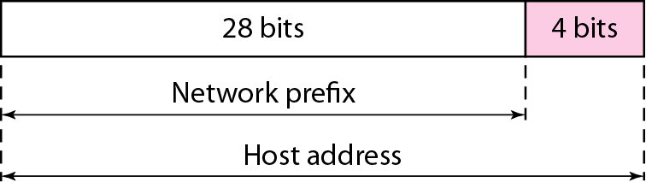
Two-Level Hierarchy: No Subnetting
Each address in the block can be considered as a two-level hierarchical structure the leftmost n bits (prefix) define the network; the rightmost 32 − n bits define the host.

Slide 22
Subnetting is the process of dividing a network into multiple logical sub-networks.
What is Subnetting?
1
1 2
1
2
1
2
4
3

Slide 23
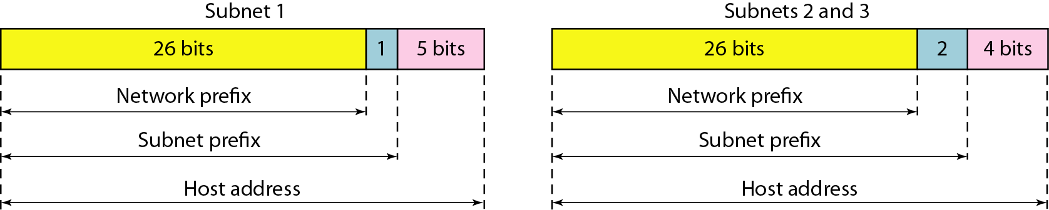
Subnetting and Supernetting
If an organization was granted a large block in class A or B, it could divide the addresses into several contiguous groups and assign each group to smaller networks (called subnets)
Three-level hierarchy in an IPv4 address
In supernetting, an organization can combine several class C blocks to create a larger range of addresses.
Supernetting decreases the number of 1s in the mask.

Slide 24
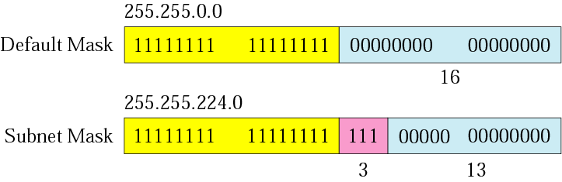
Figure 5-7
Comparison of a default mask and
a subnet mask

Slide 25

The number of subnets must be a power of 2.

Slide 26
Example 3
A company is granted the site address 201.70.64.0 (class C). The company needs six subnets. Design the subnets.
Solution
The number of 1s in the default mask is 24 (class C).

Slide 27
Solution (Continued)
The company needs six subnets. This number 6 is not a power of 2. The next number that is a power of 2 is 8 (2³). We need 3 more 1s in the subnet mask. The total number of 1s in the subnet mask is 27 (24 + 3).
The total number of 0s is 5 (32 − 27). The mask is

Slide 28
Solution (Continued)
11111111 11111111 11111111 11100000
or
255.255.255.224
The number of subnets is 8.
The number of addresses in each subnet is 2⁵ (5 is the number of 0s) or 32.

Slide 29
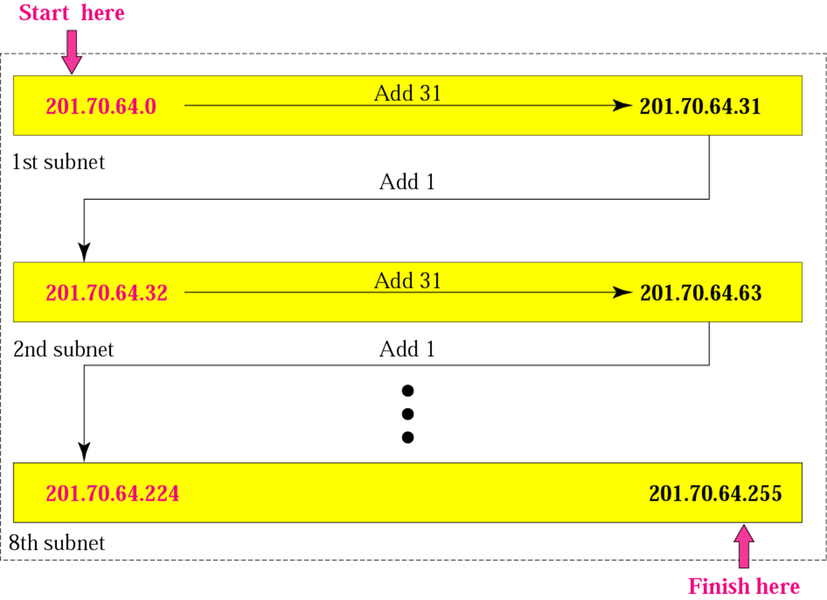

Slide 30
Example 4
A company is granted the site address 181.56.0.0 (class B). The company needs 1000 subnets. Design the subnets.
Solution
The number of 1s in the default mask is 16 (class B).

Slide 31
Solution (Continued)
The mask is
11111111 11111111 11111111 11000000
or
255.255.255.192.
The number of subnets is 1024.
The number of addresses in each subnet is 2⁶ (6 is the number of 0s) or 64.
See Figure 5.9

Slide 32
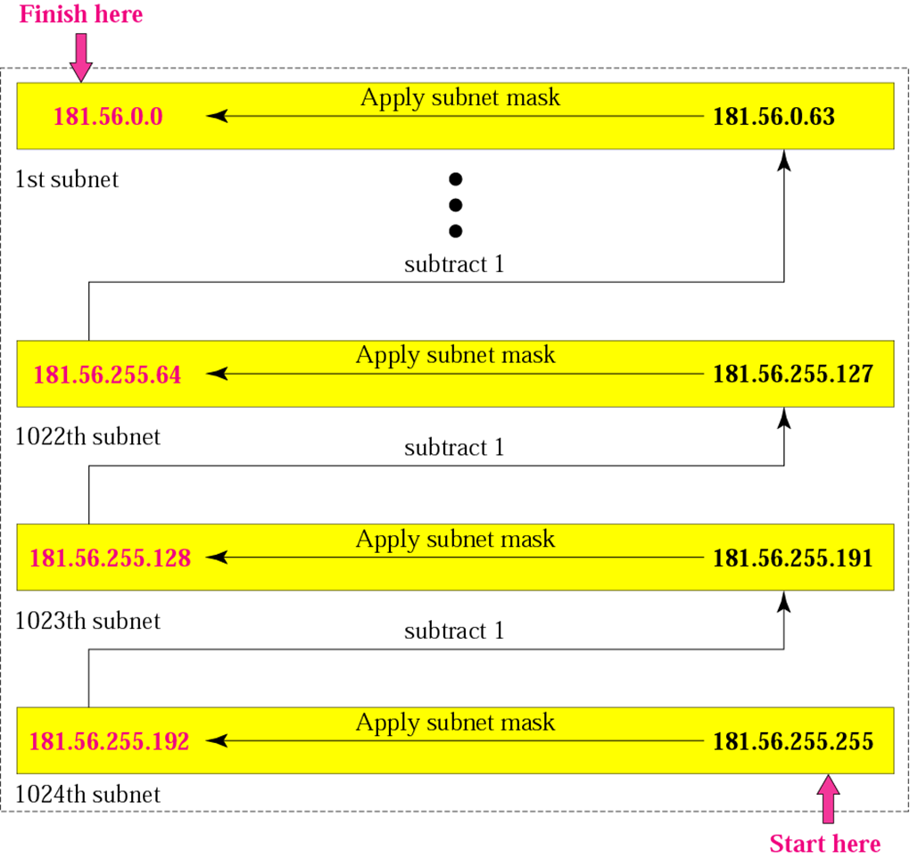

Slide 33
Solution (Continued)
The company needs 1000 subnets. This number is not a power of 2. The next number that is a power of 2 is 1024 (2¹⁰). We need 10 more 1s in the subnet mask.
The total number of 1s in the subnet mask is 26 (16 + 10).
The total number of 0s is 6 (32 − 26).

Slide 34
Fixed Length Subnet Mask (FLSM)- This strategy allows all subnet masks to be the same size.
Variable Length Subnet Mask (VLSM)- This strategy allows all subnet masks to be variable sizes.
Subnetting Types

Slide 35
Que. There is a requirement in a university to setup five Computer Labs (Lab1- 7 PCs; Lab2- 14 PCs; Lab3- 28 PCs; Lab4- 14 PCs; Lab5- 11 PCs ) in different departments for a Class C IPV4 address - 200.15.5.0/24, using Fixed Length Subnet Mask (FLSM).
IP Address
Decimal- 200.15.5.0
Binary- 11001000.00001111.00000101.00000000
Subnet Mask- 255.255.255.0
For setting up five departments, We need five subnetworks to be setup
Therefore, 3 bits need to be borrowed from host bits
Using 3bits, 2^3 =8 subnets can be created
11001000.00001111.00000101.00000000
New Subnet Mask- 11111111. 11111111. 11111111.11100000 or 255.255.255.224
No. of Host in each subnet= 2^5= 32
Usable IP address in each subnet= 32-2=30

Slide 36
IP Address
Decimal- 200.15.5.0
Binary- 11001000.00001111.00000101.00000000
Subnet 1- 11001000.00001111.00000101.00000000
Subnet 2- 11001000.00001111.00000101.00100000
Subnet 3- 11001000.00001111.00000101.01000000
Subnet 4- 11001000.00001111.00000101.01100000
Subnet 5- 11001000.00001111.00000101.10000000
Subnet 8- 11001000.00001111.00000101.11100000

Slide 37

How Do You Get IPs?
IP address ranges controlled by IANA
Internet Assigned Number Authority
Roots go back to 1972, ARPANET, UCLA
Today, part of ICANN
IANA grants IPs to regional authorities
ARIN (American Registry of Internet Numbers) may grant you a range of IPs
You may then advertise routes to your new IP range
There are now secondary markets, auctions, …

Slide 38
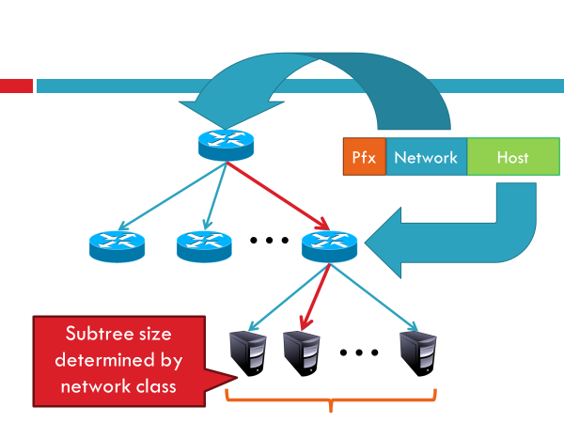
Classless Addressing: The Two Level Hierarchy

Slide 39
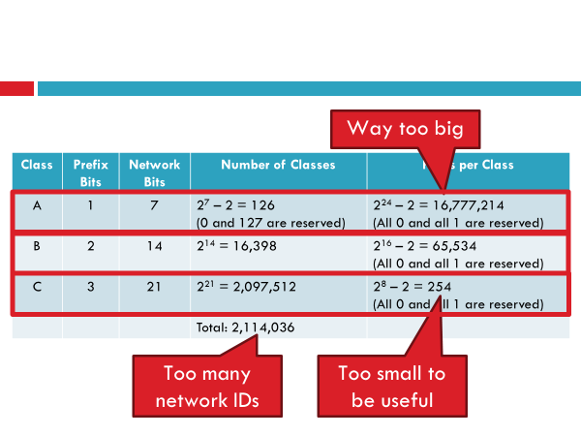
Classless Addressing: Class Sizes and Issues

Slide 40
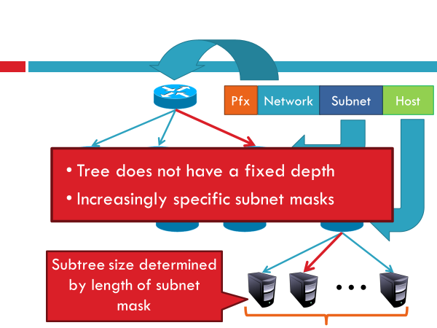
Classless Addressing: N-Level Subnet Hierarchy

Slide 41
Classless Addressing Examples
In a classless addressing scheme, a network has a /20 CIDR block assigned to it. What is the maximum number of useful addresses that can be assigned to a host?
4096
4094
4098
2048

Slide 42
Classless Addressing Example
Consider a class B network address 130.50.0.0. The last 7 bits of the host id are allotted for host number and the remaining 9 bits are reserved for subnet number. How many usable subnets and usable number of hosts in each subnet are possible with the above addressing scheme?
128, 512
512, 128
126, 510
None of these

Slide 43
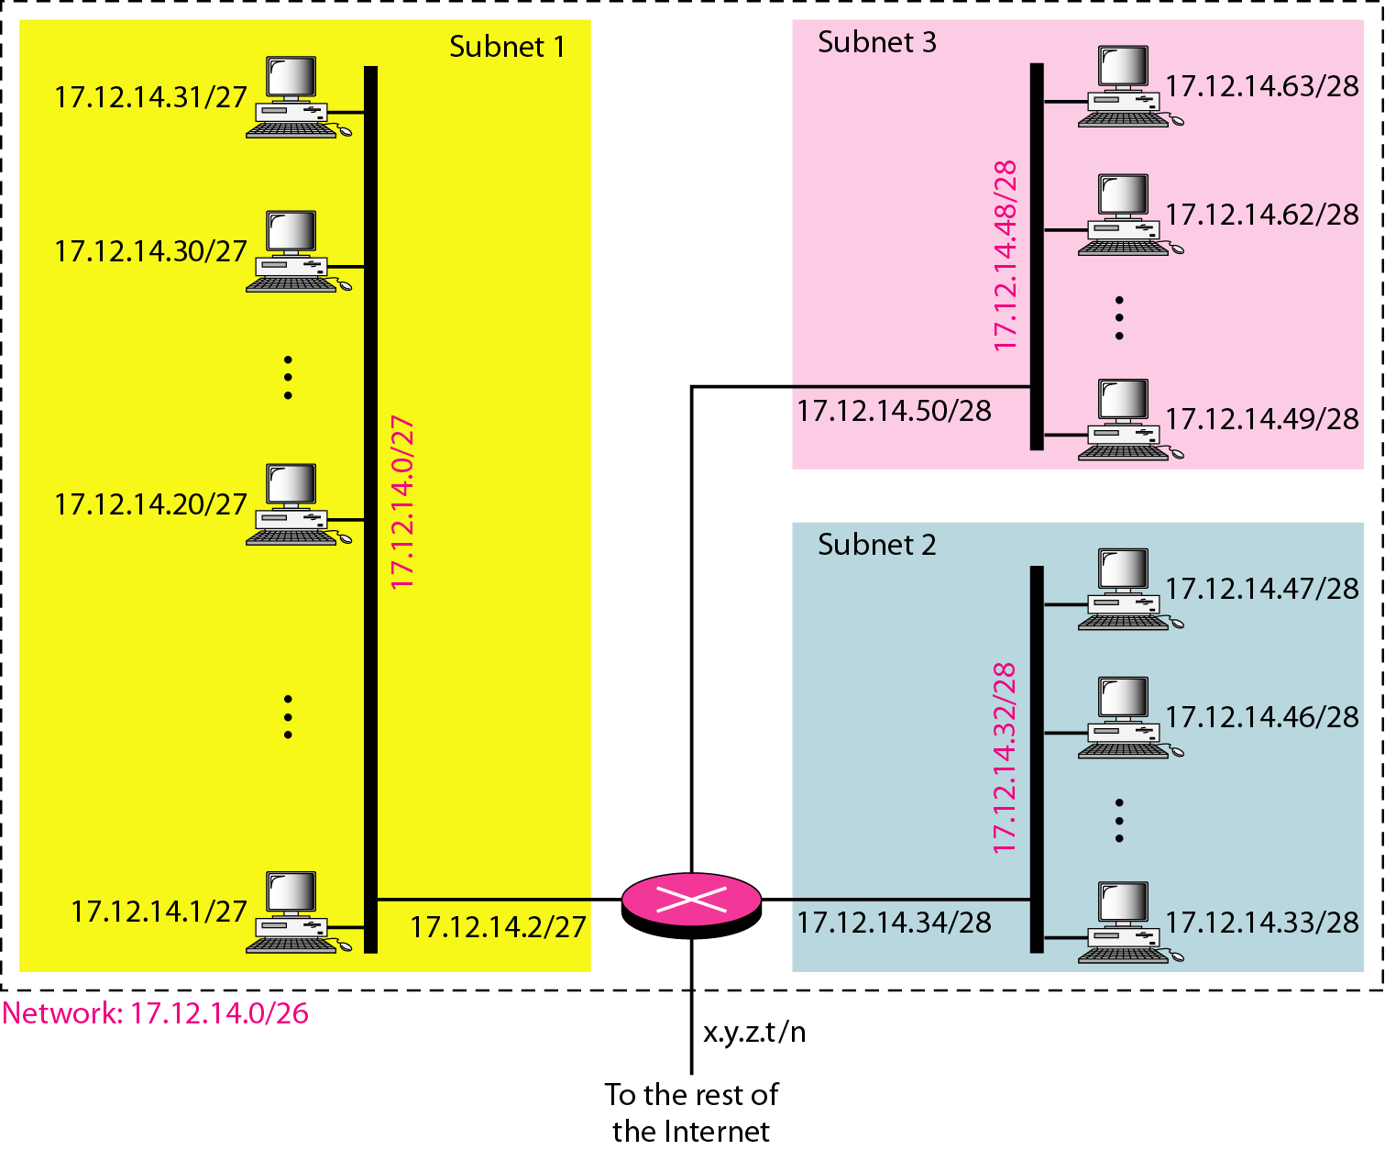
Configuration and addresses in a subnetted network
suppose an organization is given the block 17.12.14.0/26, which contains 64 addresses.
The organization has three offices and needs to divide the addresses into three subblocks of 32, 16, and 16 addresses.
Suppose the mask for the first subnet is n1, then 2^32- n1 must be 32, which means that n1 =27.
Suppose the mask for the second subnet is n2, then 2^32- n2 must be 16, which means that n2 = 28.
Suppose the mask for the third subnet is n3, then 2^32- n3 must be 16, which means that n3 =28.

