Slide 1

Network Layer Network Address Translation, IPV6

Slide 2
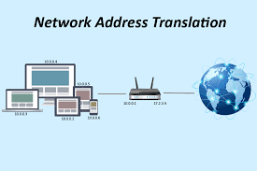
Network Address Translation (NAT).
NAT enables a user to have a large set of addresses internally and one address, or a small set of addresses, externally.
The traffic inside can use the large set; the traffic outside, the small set.

Slide 3

To separate the addresses used inside the home or business and the ones used for the Internet, the Internet authorities have reserved three sets of addresses as private addresses, shown below.
Addresses for private networks
No router will forward a packet that has one of these addresses as the destination address.

Slide 4

NAT implementation and Address Translation
A private network uses private addresses. The router that connects the network to the global address uses one private address and one global address.
The private network is transparent to the rest of the Internet; the rest of the Internet sees only the NAT router with the address 200.24.5.8.
A NAT implementation

Slide 5
NAT implementation and Address Translation
All the outgoing packets go through the NAT router, which replaces the source address in the packet with the global NAT address.
NAT router also replaces the destination address in the packet (the NAT router global address) with the appropriate private address in all incoming packets
Addresses in a NAT

Slide 6

IPv6 ADDRESSES
Despite all short-term solutions, address depletion is still a long-term problem for the Internet. This and other problems in the IP protocol itself have been the motivation for IPv6.
An IPv6 address is 128 bits long.

Slide 7
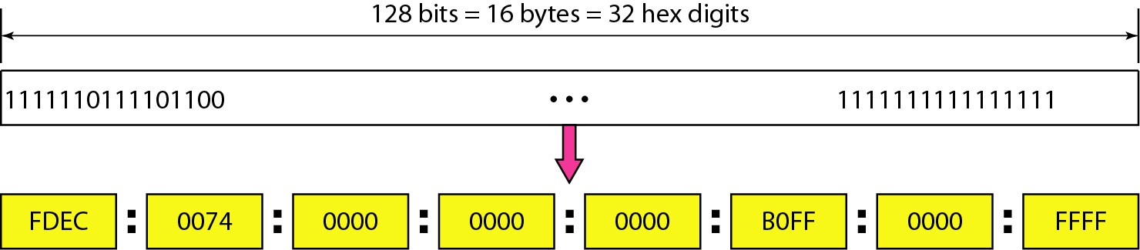
IPv6 address in binary and hexadecimal colon notation

Slide 8
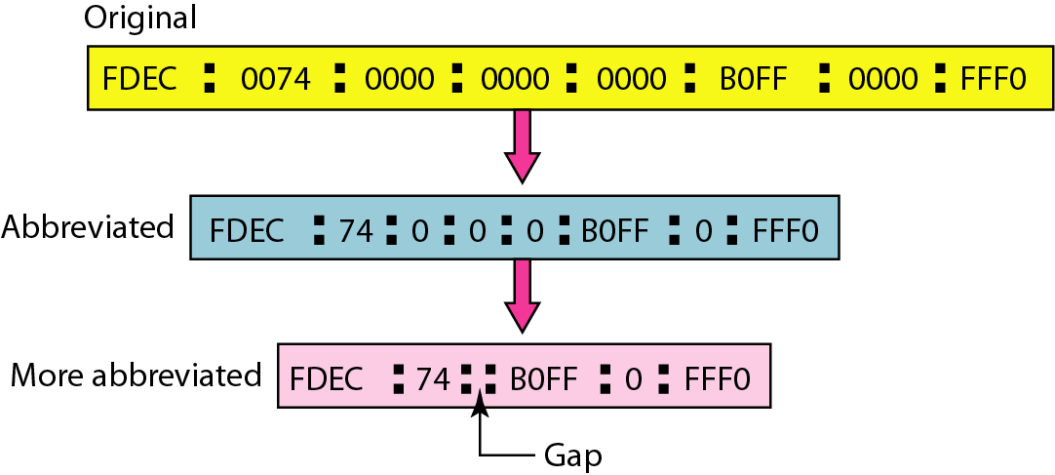
Abbreviated IPv6 addresses

Slide 9
IPv6: Advantages
Larger address space.
Better header format.
New options.
Allowance for extensions.
Support for resource allocation.
Support for more security.

Slide 10
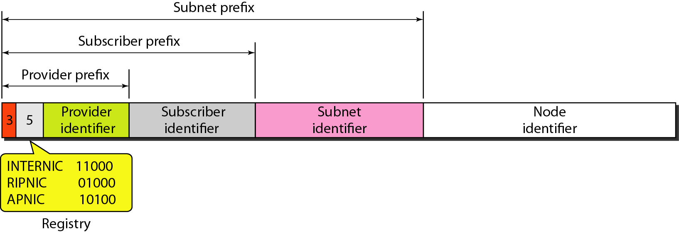
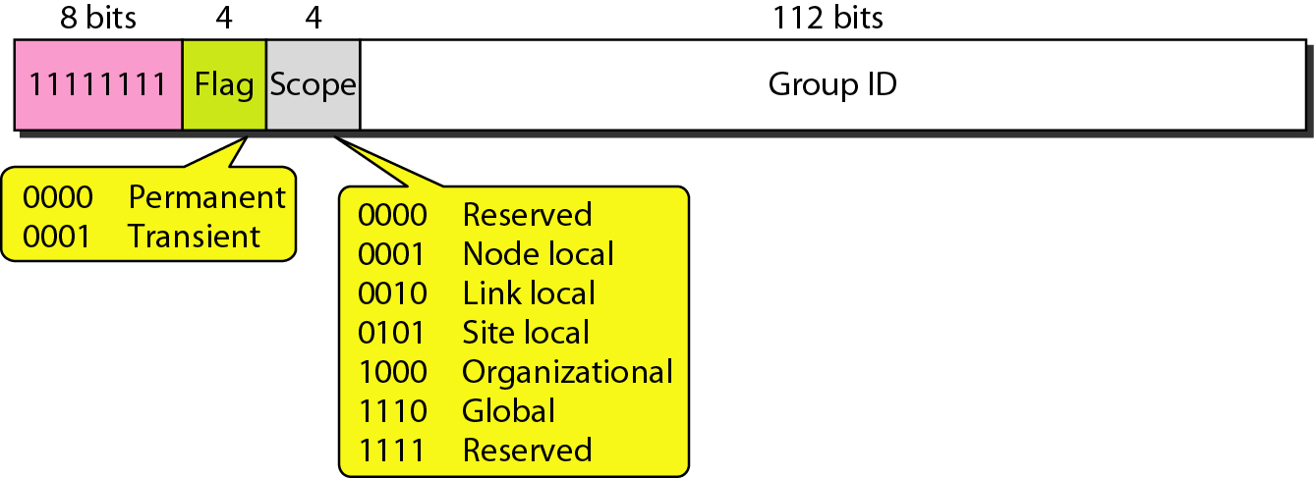
Unicast and Multicast address in IPV6
A unicast address defines a single computer.
Multicast addresses are used to define a group of hosts instead of just one.
Unicast address in IPv6
Multicast address in IPv6
Anycast address, like a multicast address, also defines a group of nodes.

Slide 11
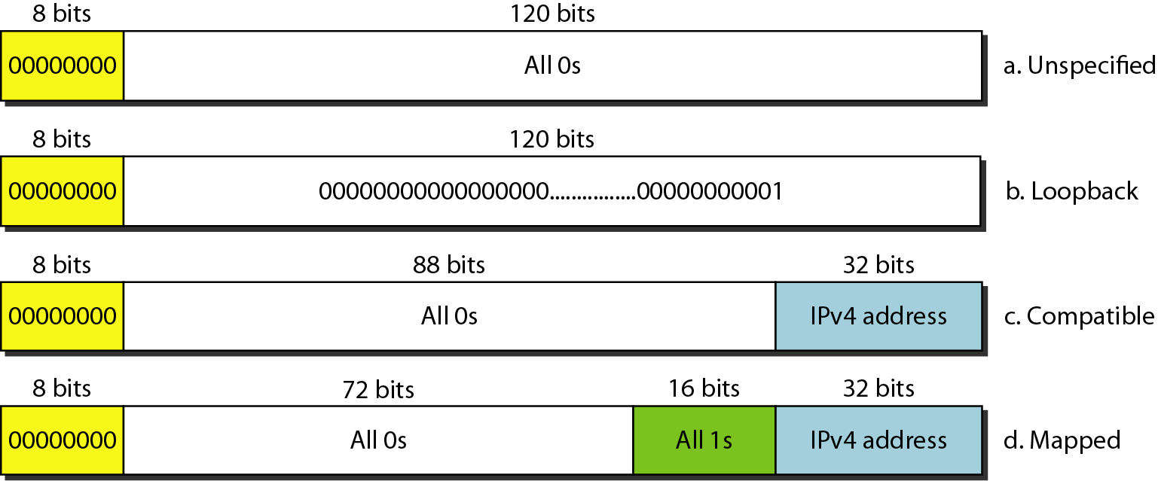
Reserved addresses in IPv6

Slide 12
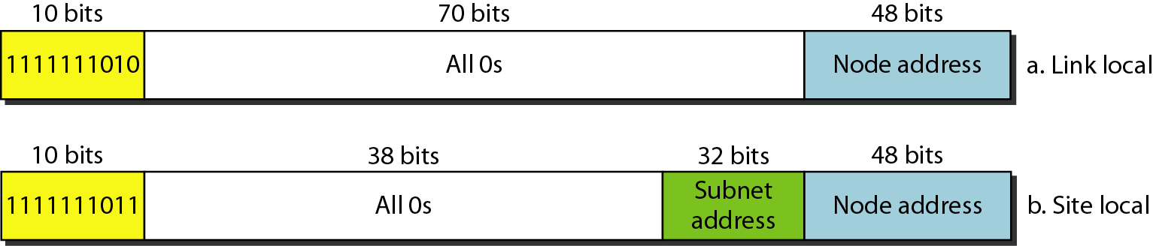
Local addresses in IPv6
These addresses are used when an organization wants to use IPv6 protocol without being connected to the global Internet. In other words, they provide addressing for private networks.
A link local address is used in an isolated subnet; a site local address is used in an isolated site with several subnets.

Slide 13

Question
Which command will show you all the translations active on your router?
A. show ip nat translations
B. show ip nat statistics
C. debug ip nat
D. clear ip nat translations

Slide 14


Question
Expand the address 0:15::1:12:1213 to its original.
SOLUTION

