Slide 1
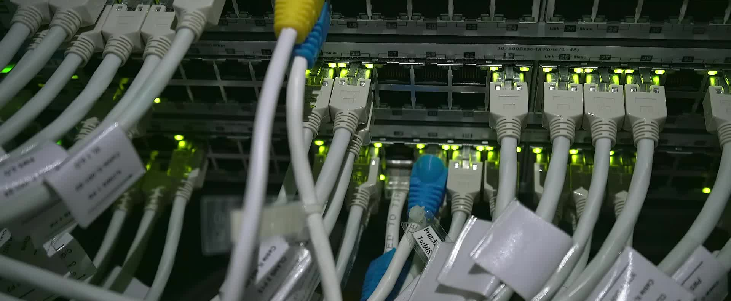
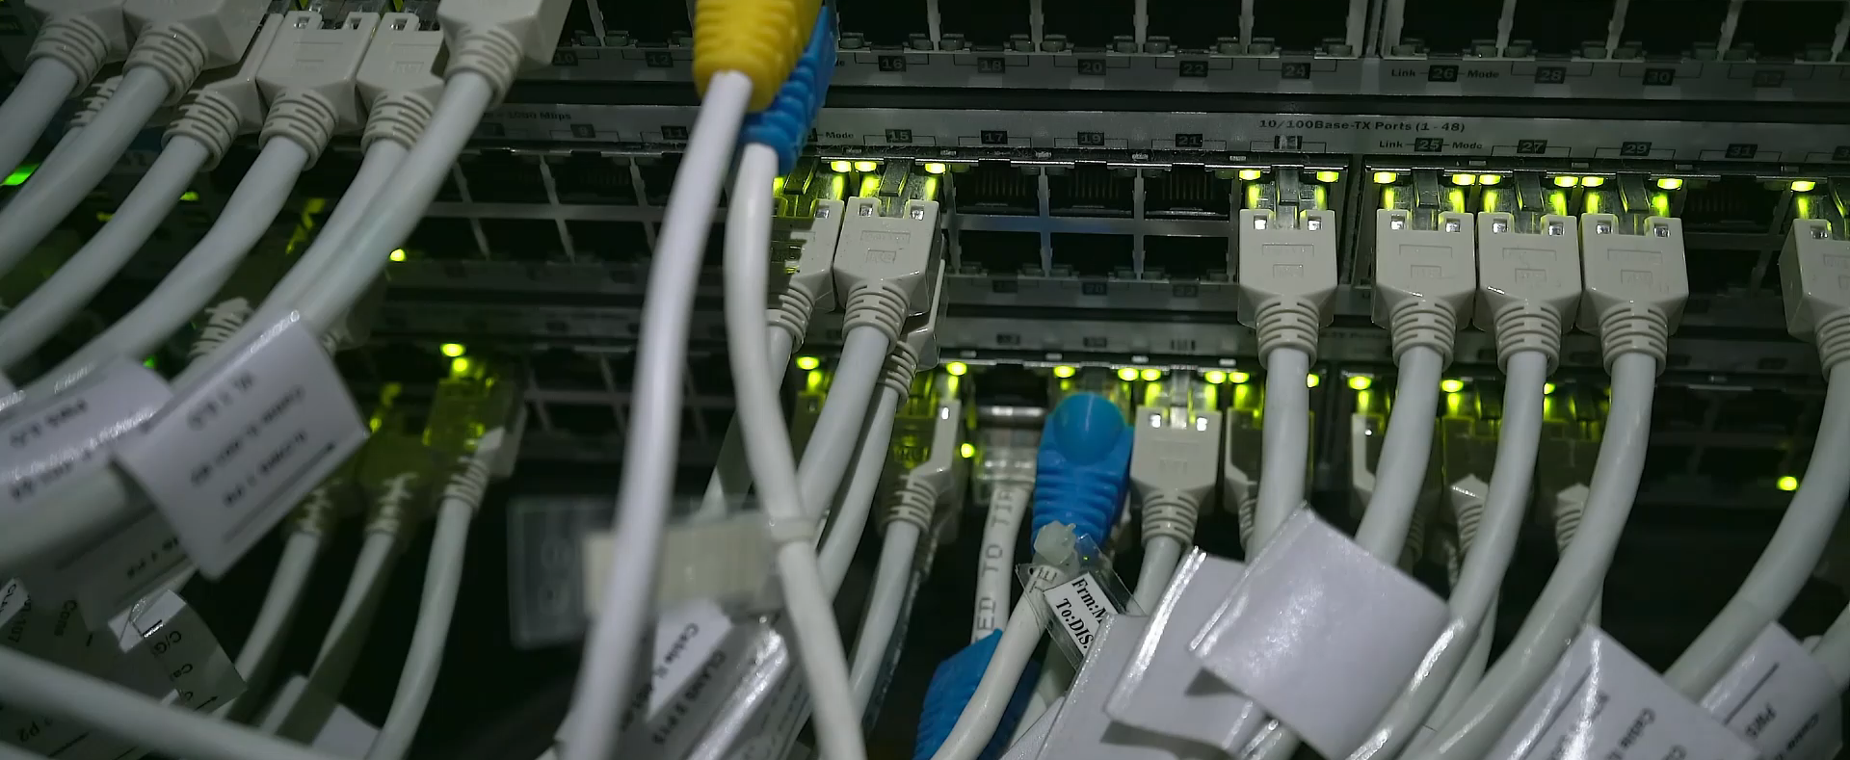
Network Layer
Internet Protocol

Slide 2
Network Layer
Source
  Creating a packet from the upper layer.
  The header contains source and destination IP addresses.
  Checking the routing table to find the routing info (eg. Outgoing interface, or machine address of the next hop)
  If the packet is larger than MTU (Maximum Transmission Unit ), fragment it.
Router
Routing the packet by consulting the routing table for each incoming packet and find the information that the packet must be sent to.
Destination
Address verification.
For fragmented frames, wait for all fragmentations then reassemble them before delivering the packet to the upper layer.

Slide 3
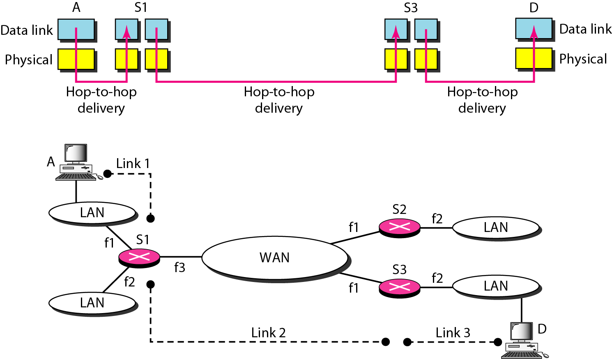
INTERNETWORKING
Internetworking, connecting networks together to make an internetwork or an internet.
Let us assume that host A needs to send a data packet to host D.
When data arrive at interface f1 of S1, how does S1 know that interface f3 is the outgoing interface?
There is no provision in the data link (or physical) layer to help S1 make the right decision.
Here Network layer comes into picture to solve this problem of delivery through several links.
Links between two hosts

Slide 4
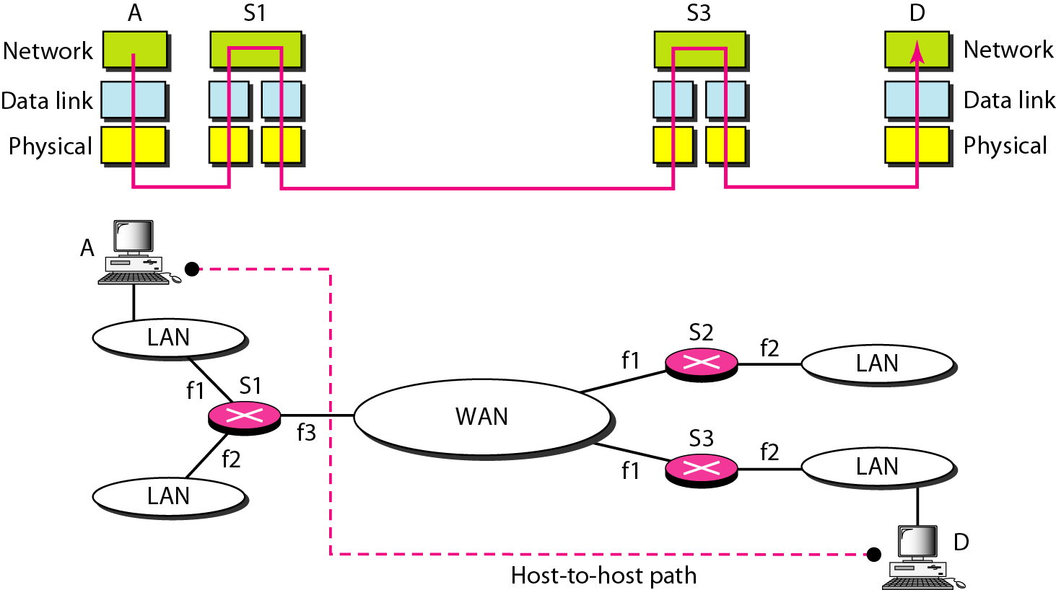
Network layer in an internetwork
To solve the problem of delivery through several links, the network layer was designed.
The network layer is responsible for host-to-host delivery and for routing the packets through the routers or switches.

Slide 5
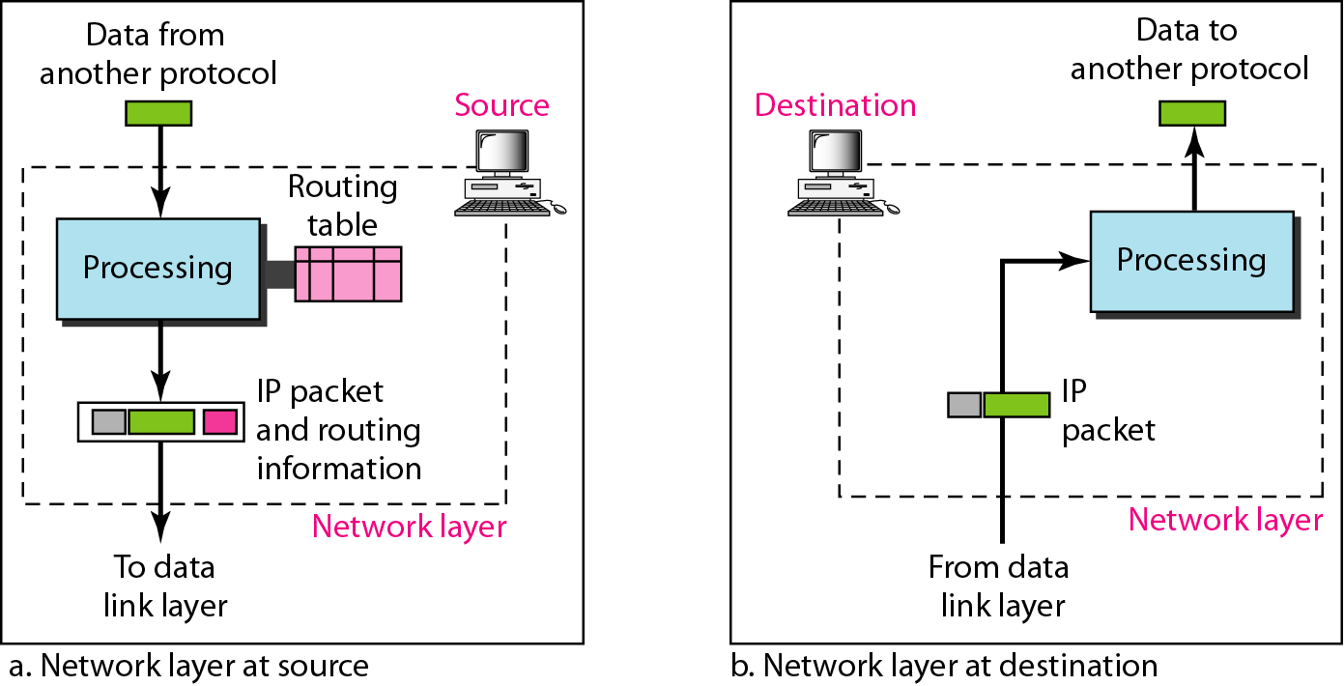
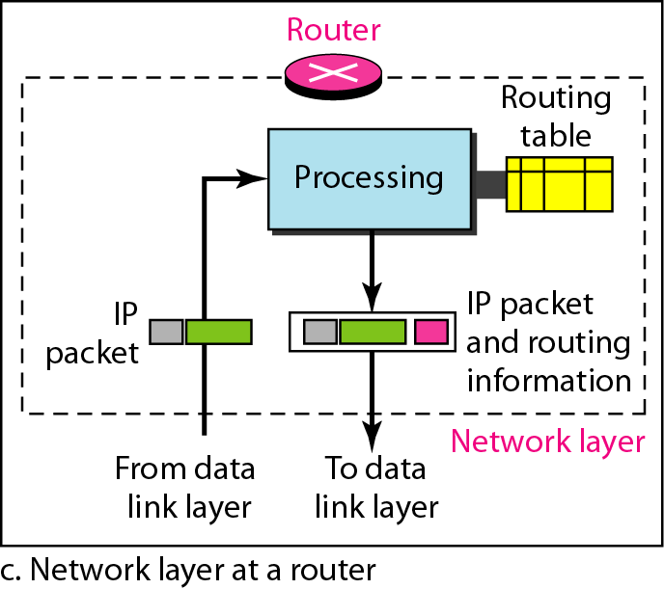
Network layer at the source, router, and destination

Slide 6
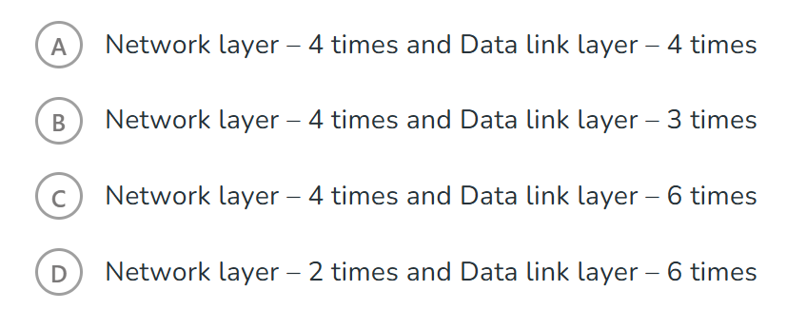
Quiz: Assume that source S and destination D are connected through two intermediate routers labeled R. Determine how many times each packet has to visit the network layer and the data link layer during a transmission from S to D.

Slide 7
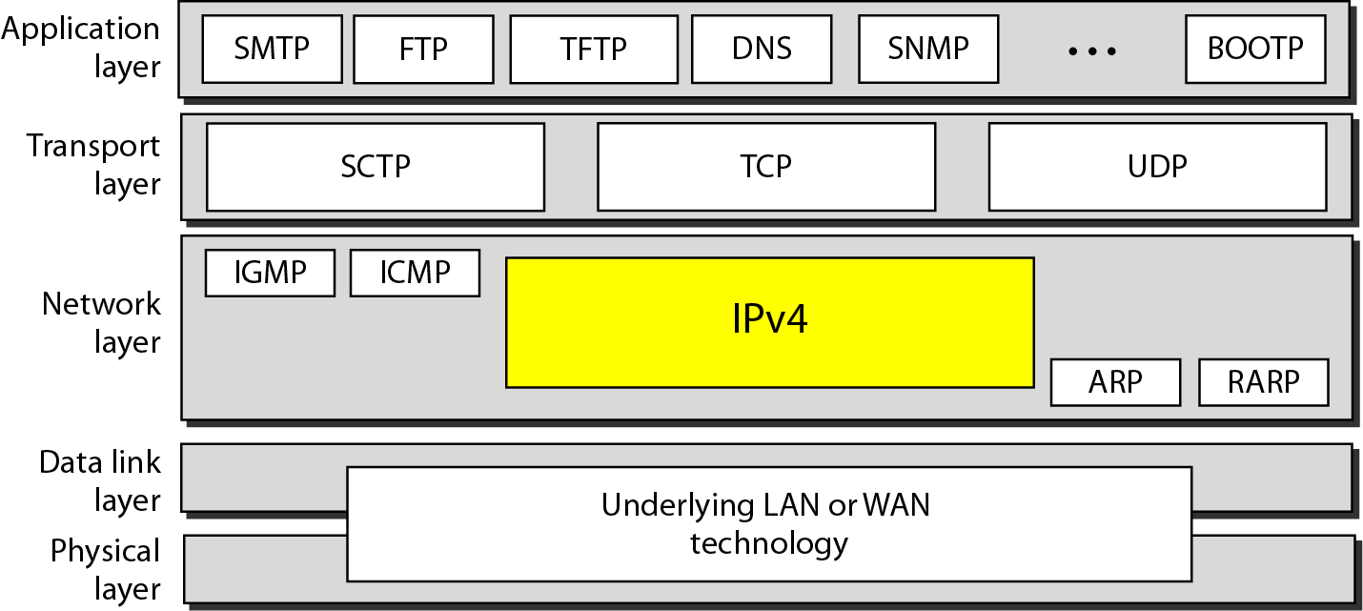
Internet Protocol version 4
The Internet Protocol version 4 (IPv4) is the delivery mechanism used by the TCP/IP protocols.
IPv4 is an unreliable and connectionless datagram protocol – a best effort delivery
Best effort means that IPv4 provides no error control (except for error detection on the header) or flow control
IPv4 does its best to get a transmission through to its destination, but with no guarantees
Position of IPv4 in TCP/IP protocol suite

Slide 8
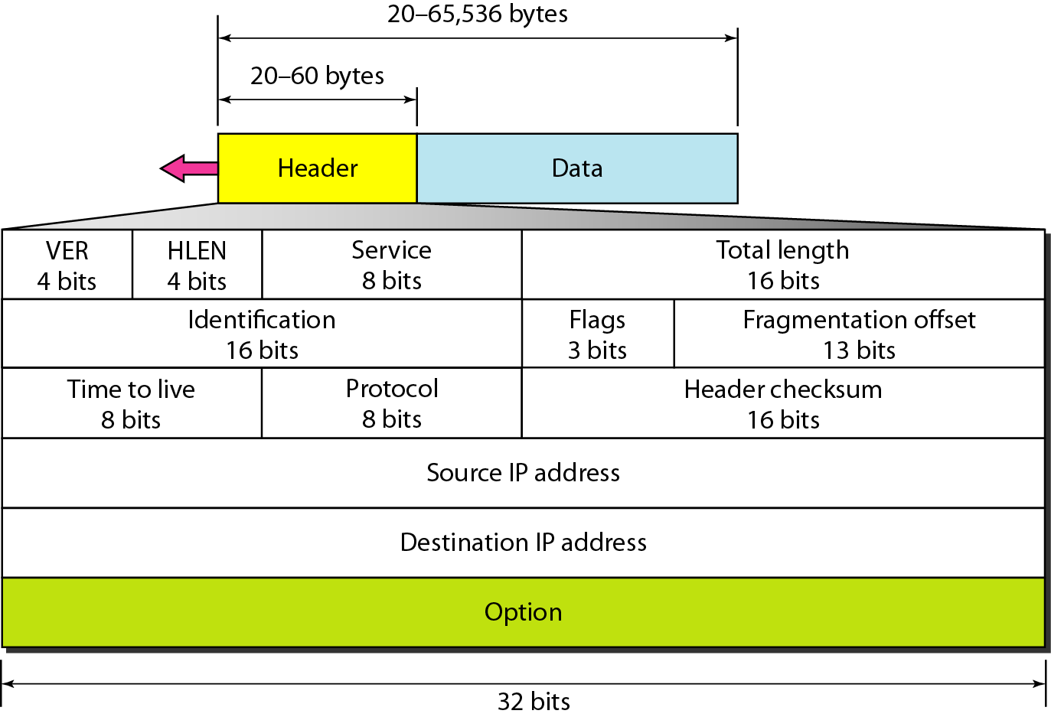
IPv4 Datagram Format
Version (VER): Version of the IP protocol.
Header length (HLEN): the total length of the datagram header in 4-byte words.
Services: service type or differentiated services
Total length: total length (header plus data) of the datagram in bytes.
  Total length of data = total length – header length
Time to live: it is used to control the maximum number hops visited by the datagram.
Protocol: defines the higher-level protocol that uses the services of the IPV4 layer.
Checksum: 1’s compliment checksum
Identification and Flags: used in fragmentation
Fragmentation offset: used in fragmentation

Slide 9
Question
An IPv4 packet has arrived with the first 8 bits as given below. The packet was discarded by receiver, why?
01000010

Slide 10
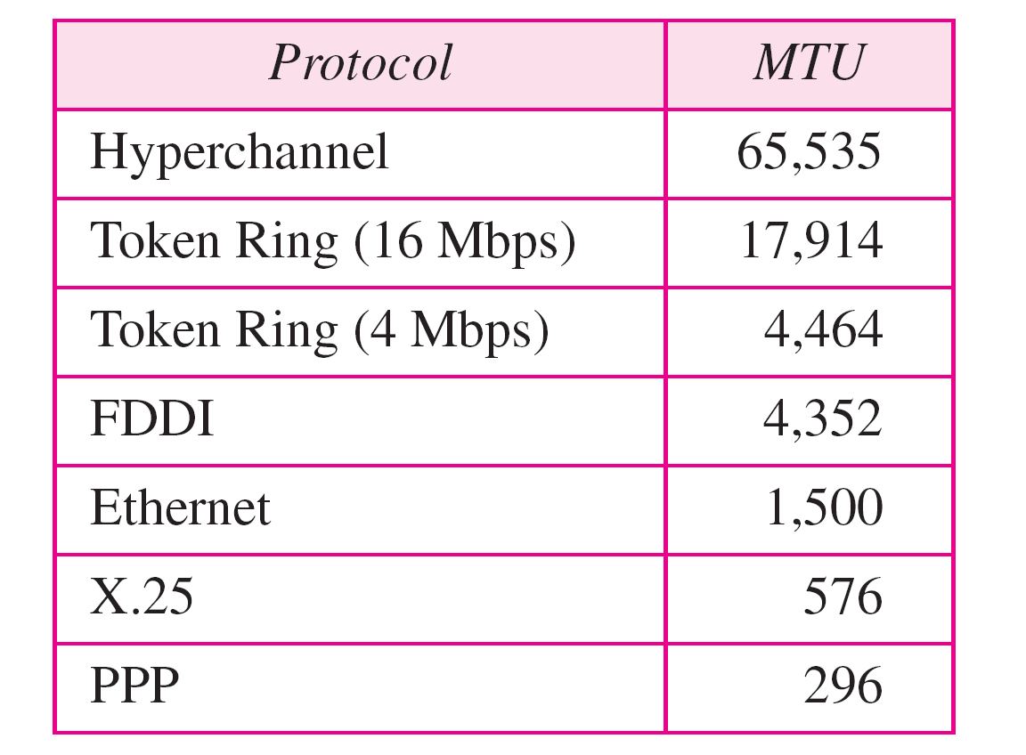
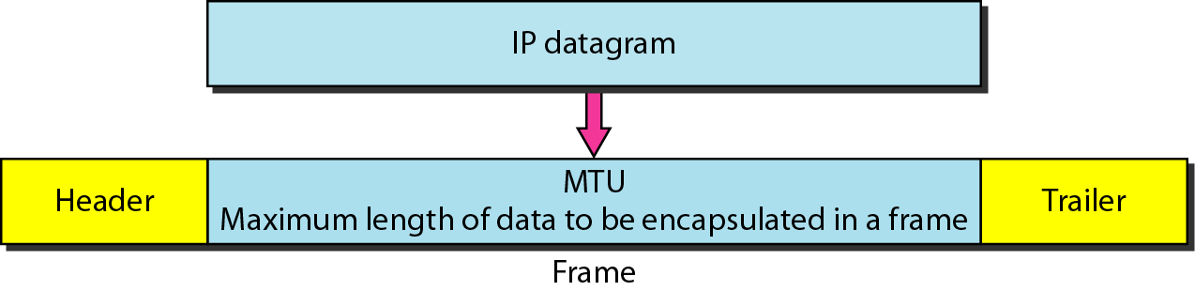
Fragmentation
Fragmentation occurs when an IP datagram traverses a network which has a maximum transmission unit (MTU) that is smaller than the size of the datagram.
MTU
  Each DL has its own frame format and limitation.
  One of such limitation is the maximum size of the frame, which is imposed by software, hardware, performance, and standards.
MTUs for some networks

Slide 11
Fields Related to Fragmentation
Identification: identifies a datagram originating from the source host. A combination of the identification and source address must uniquely define a datagram as it leaves the source node.
Fragmentation offset: is the offset of the data in the original datagram measured in units of 8 bytes.

Slide 12

Flags (3 bits) used in fragmentation
first bit: reserved (not used)
second bit: = 1 requires the packet not to be fragmented
drops the packet if it is > MTU
= 0 then datagram can be fragmented if necessary
third bit: =1 more fragmented packets later
=0 the last fragmented packet

Slide 13
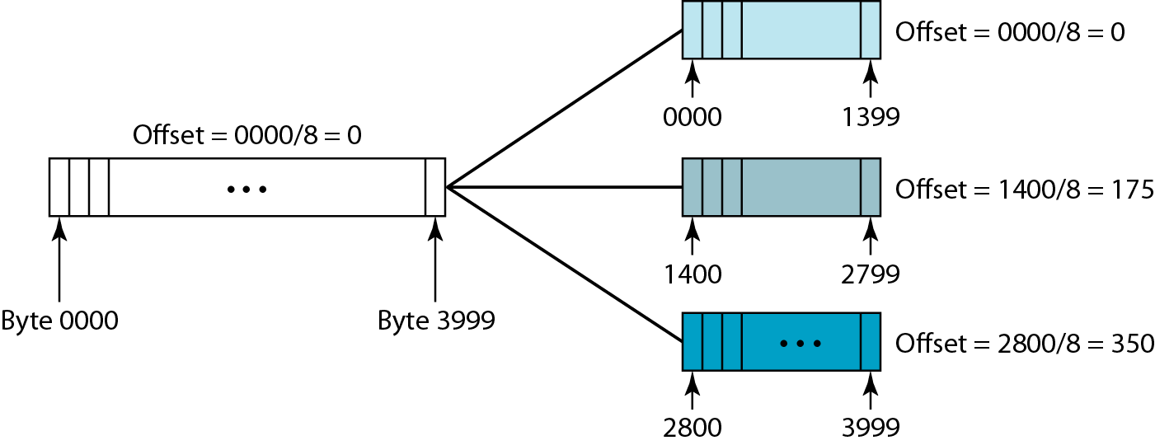
Fragmentation example
A datagram with a data size of 4000 bytes fragmented into three fragments.

Slide 14
Question
A packet has arrived in which the offset value is 100, the value of HLEN is 5, and the value of the tota1length field is 100. What are the numbers of the first byte and the last byte?

Slide 15
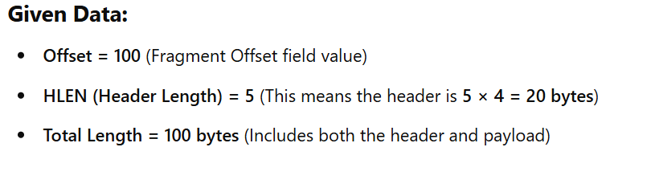
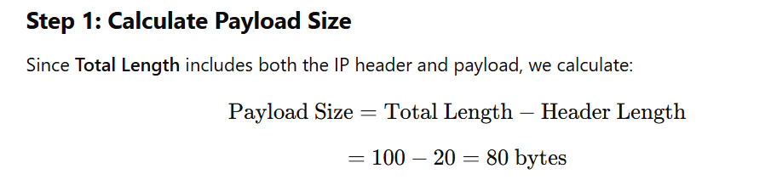
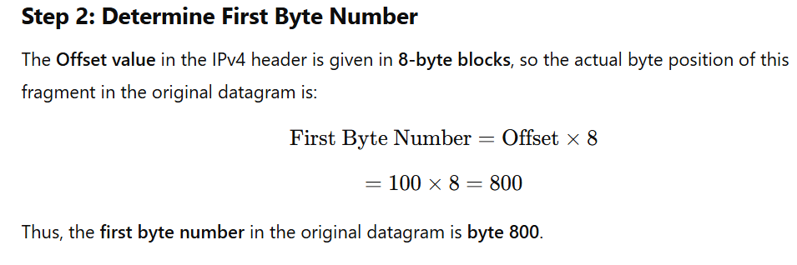
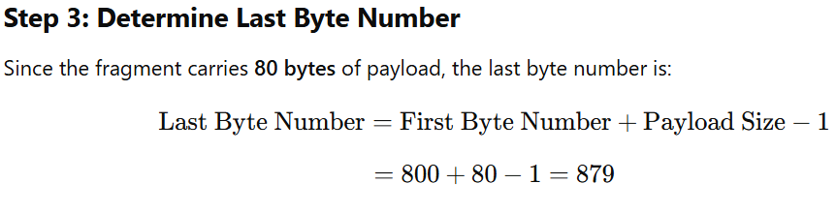
A packet has arrived in which the offset value is 100, the value of HLEN is 5, and the value of the tota1length field is 100. What are the numbers of the first byte and the last byte?

Slide 16
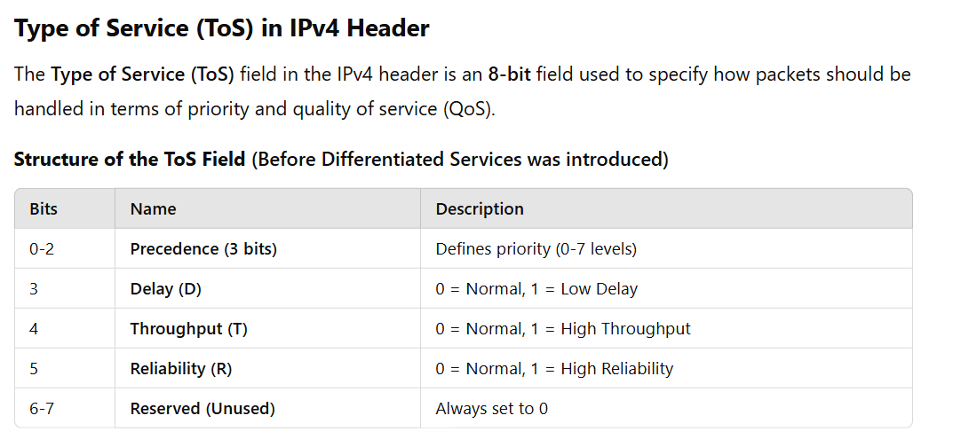
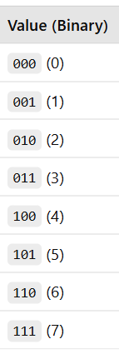
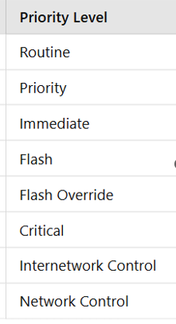

Slide 17
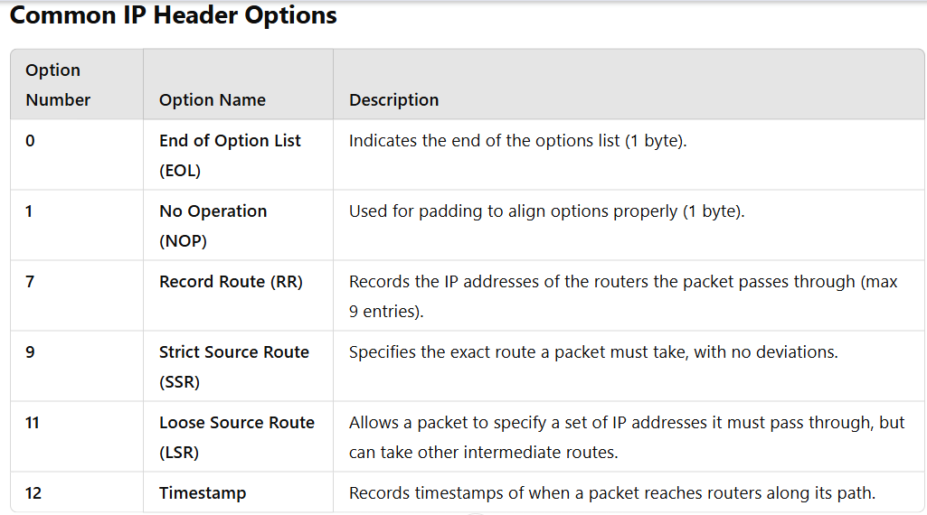
Options in IP Datagram Format (IPv4 Header)
The Options field in an IPv4 datagram is a variable-length field that allows for additional functionalities beyond the standard header. It is optional and is only included if the Internet Header Length (IHL) > 5 (i.e., when the header is longer than 20 bytes).

Slide 18
Question
​​Which of the following fields of an IP header is/are always modified by any router before it forwards the IP packet?
Source IP Address
Protocol
Time to Live (TTL)
Header Checksum
Answer:- C, D

Slide 19
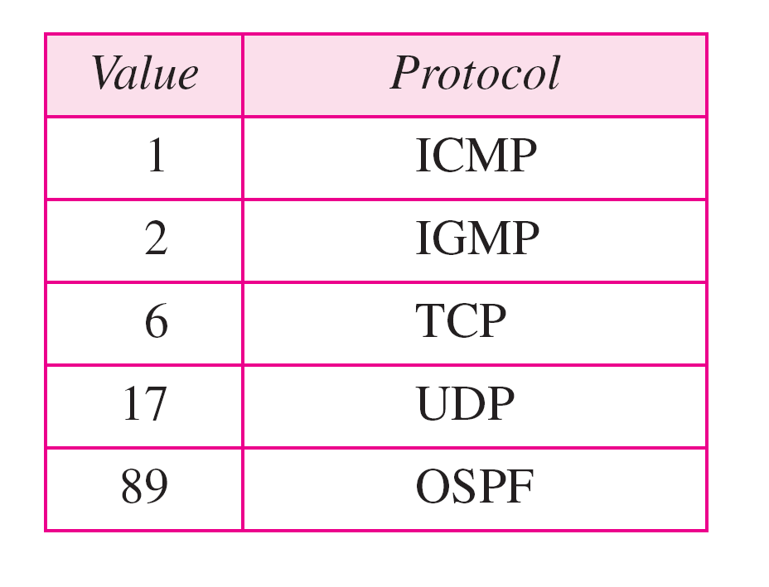
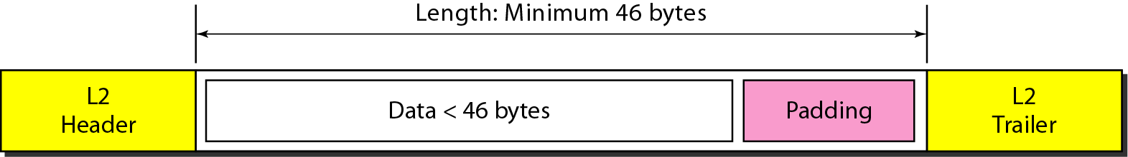
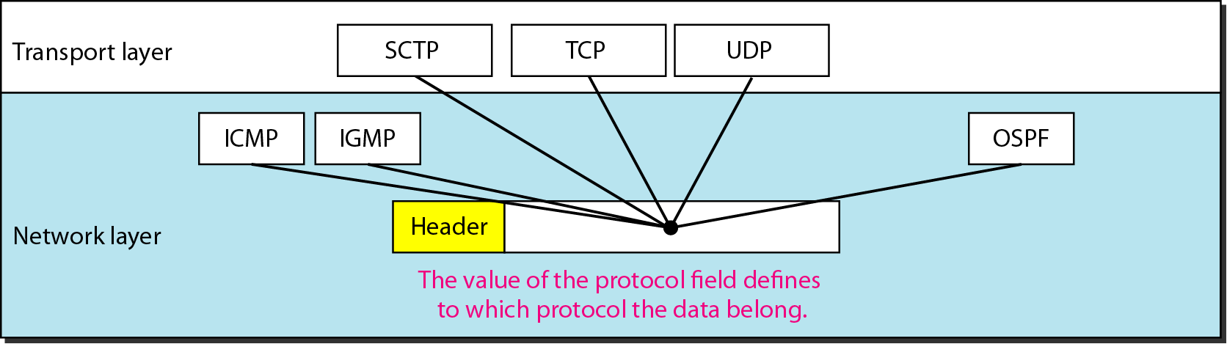
Encapsulation of a small datagram in an Ethernet frame
The total length field defines the total length of the datagram including the header.
One of the reason why “total length” field is required.
Protocol values
Protocol field and encapsulated data

