Slide 1

Network Layer: Address Mapping, Error Reporting, and Multicasting

Slide 2
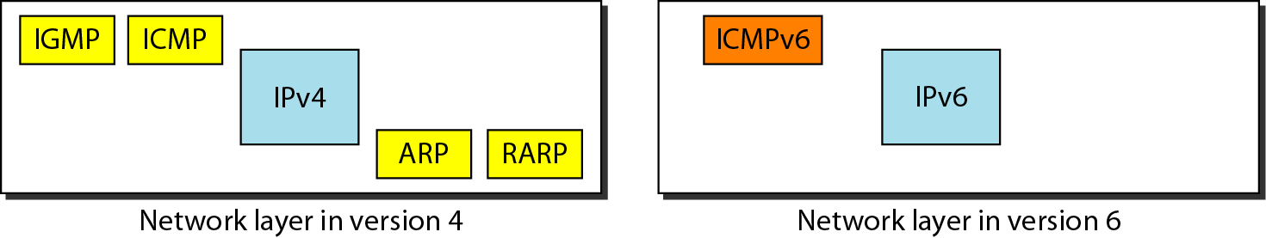
ADDRESS MAPPING
The delivery of a packet to a host or a router requires two levels of addressing: logical and physical.
Mapping of a logical address to its corresponding physical address and vice versa is needed
This can be done by using either static or dynamic mapping.

Slide 3
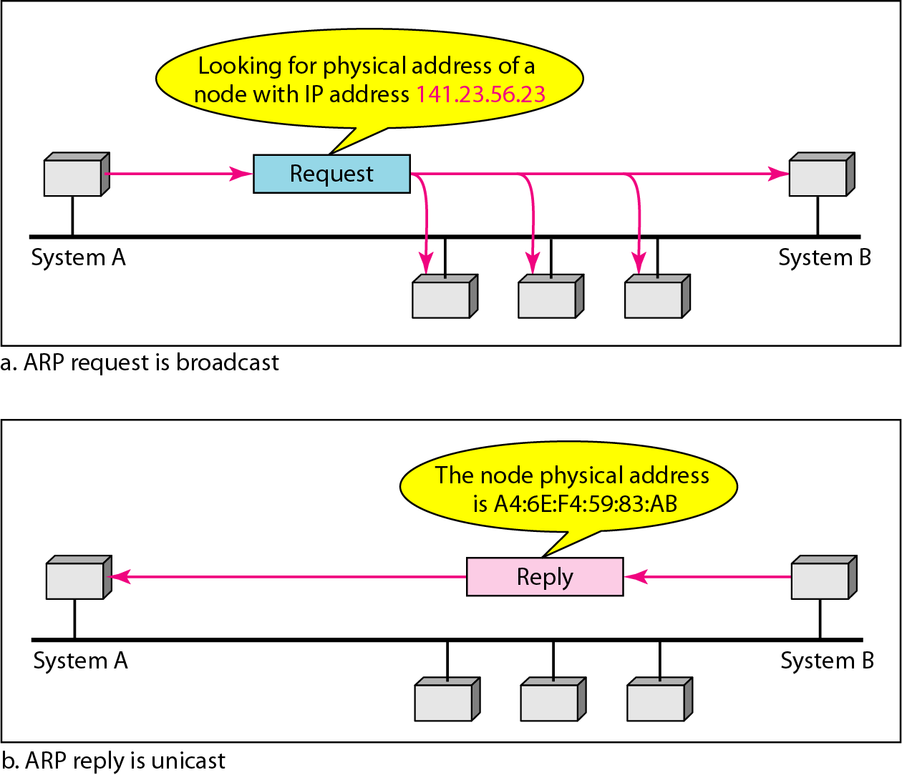
ARP (Address Resolution Protocol) operation
Mapping Logical to Physical Address: ARP
The host or the router sends an ARP query packet.
The packet includes the physical and IP addresses of the sender and the IP address of the receiver.
The query is broadcast over the network

Slide 4
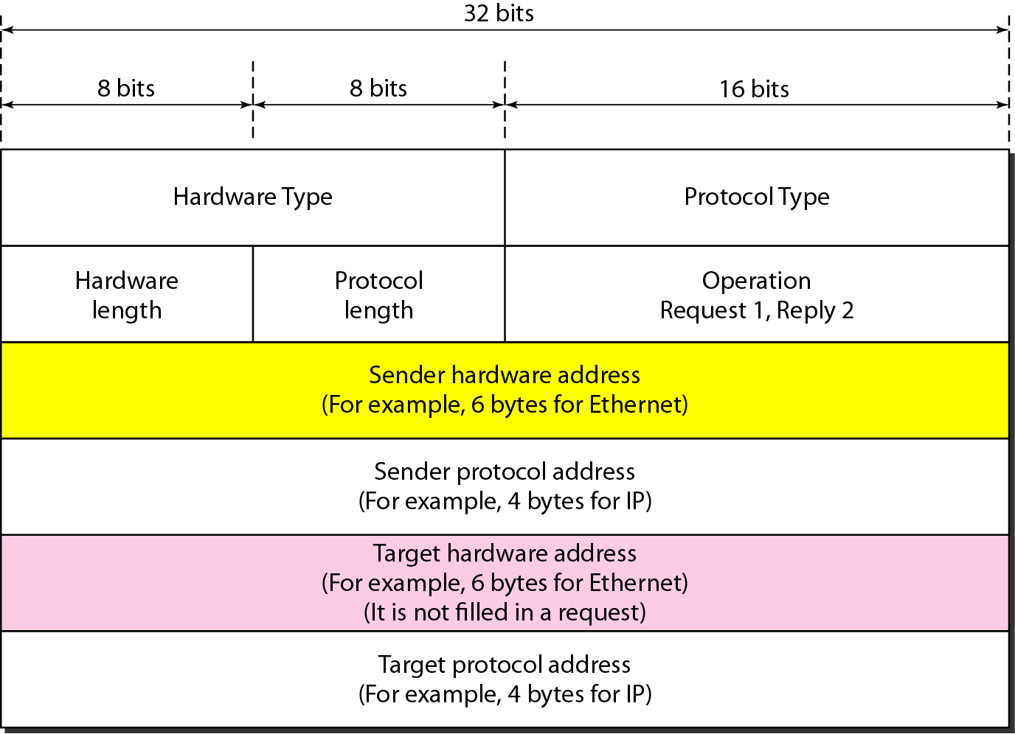
ARP packet
Hardware type- Each LAN has been assigned an integer based on its type (e.g. Ethernet =1).
Protocol type- The value of this field for the IPv4 protocol is 080016, ARP can be used with any higher-level protocol.
Hardware length- define the length of the physical address in bytes (e.g. Ethernet the value is 6).
Protocol length- Length of the logical address in bytes (e.g. for the IPv4 protocol the value is 4).
Operation.-Type of packet- ARP request (1) and ARP reply (2).

Slide 5
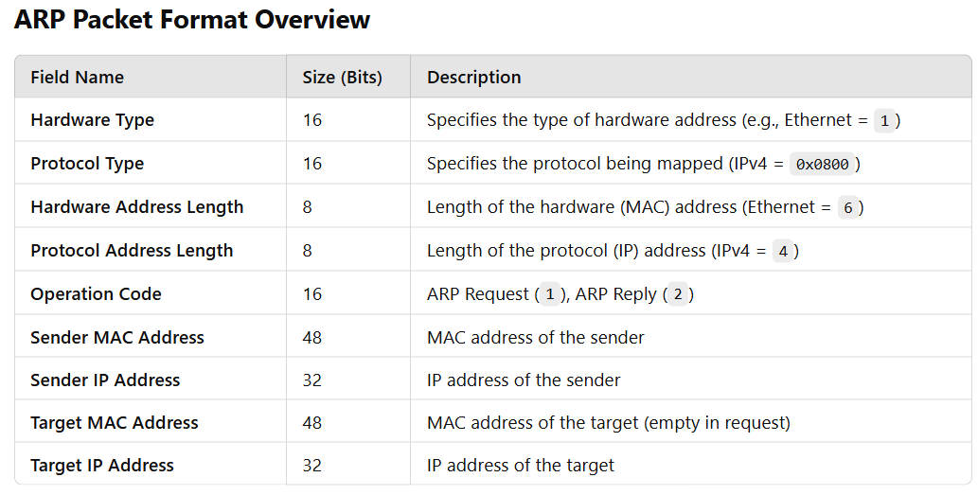

Slide 6
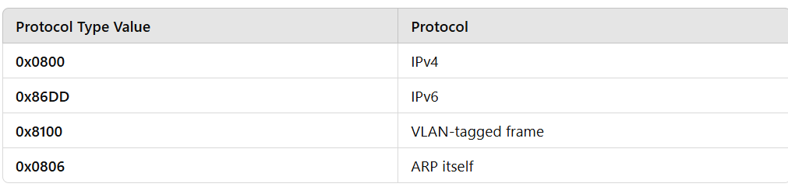
Protocol Type Values

Slide 7
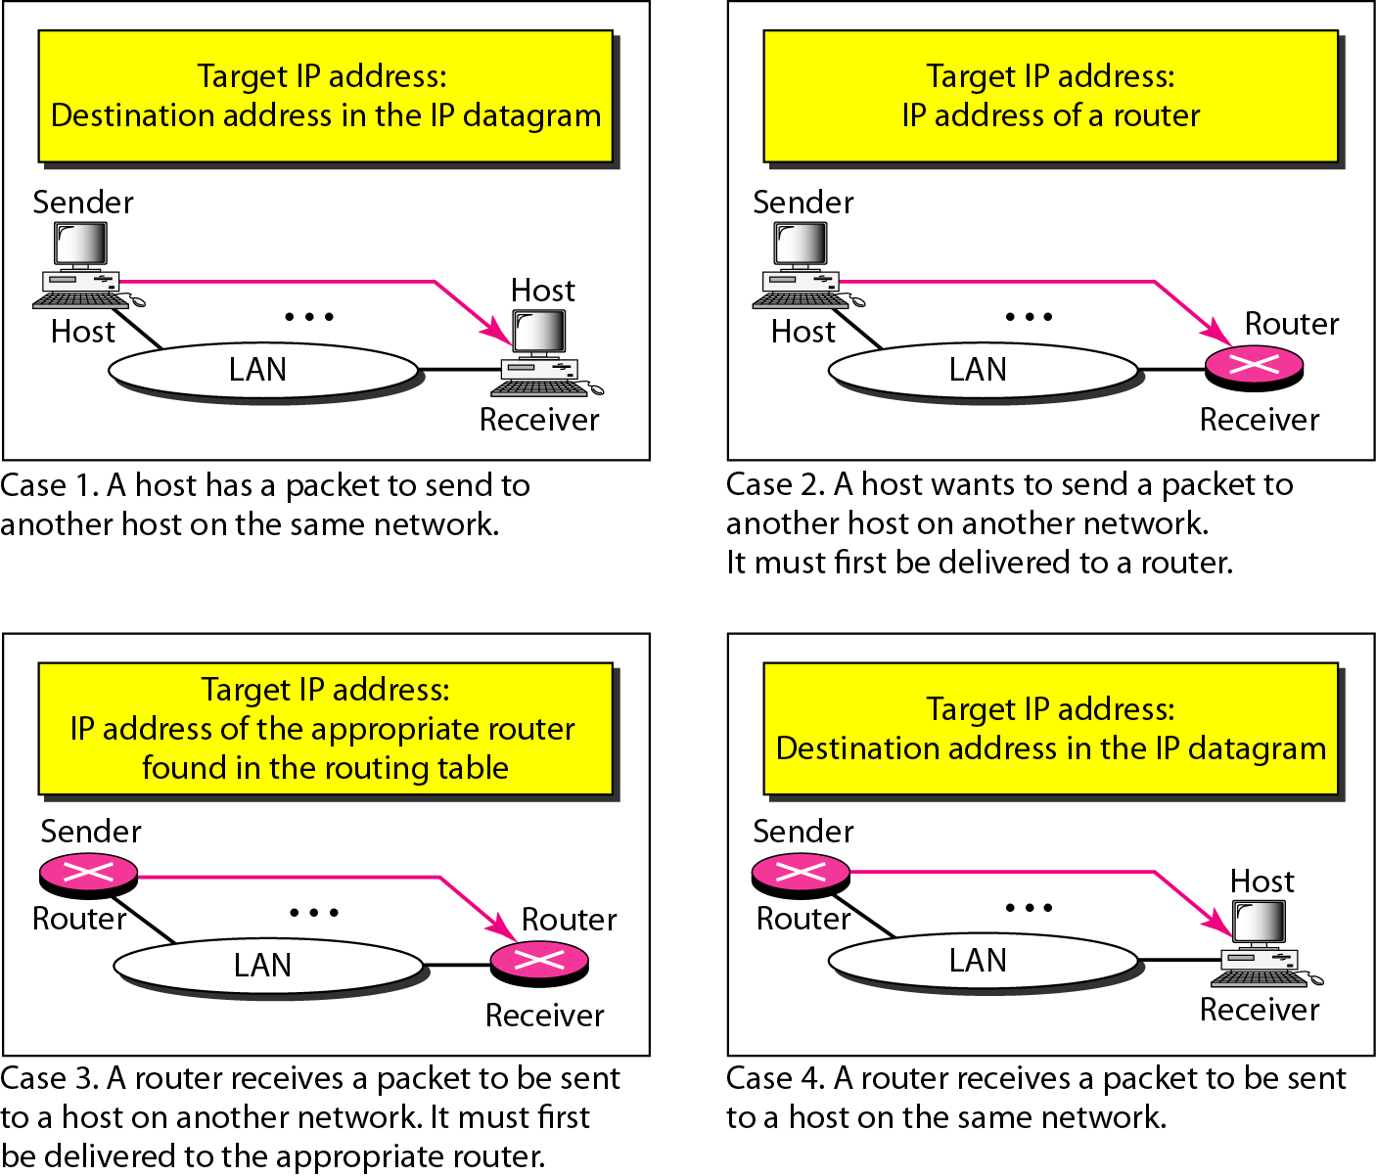
Four cases using ARP
An ARP request is broadcast.
ARP reply is unicast.

Slide 8
RARP
Mapping Physical to Logical Address
Reverse Address Resolution Protocol (RARP) finds the logical address for a machine that knows only its physical address.
To create an IP datagram, a host or a router needs to know its own IP address or addresses. The IP address of a machine is usually read from its configuration file stored on a disk file.
A RARP request is created and broadcast on the local network.
Two protocols, BOOTP and DHCP, are replacing RARP

Slide 9
BOOTP and DHCP
The Bootstrap Protocol (BOOTP) is a client/server protocol designed to provide physical address to logical address mapping. BOOTP is an application layer protocol and is not a dynamic configuration protocol.
The Dynamic Host Configuration Protocol (DHCP) has been devised to provide static and dynamic address allocation
DHCP has a second database with a pool of available IP addresses for Dynamic Address Allocation
DHCP server issues a lease for a specific time

Slide 10
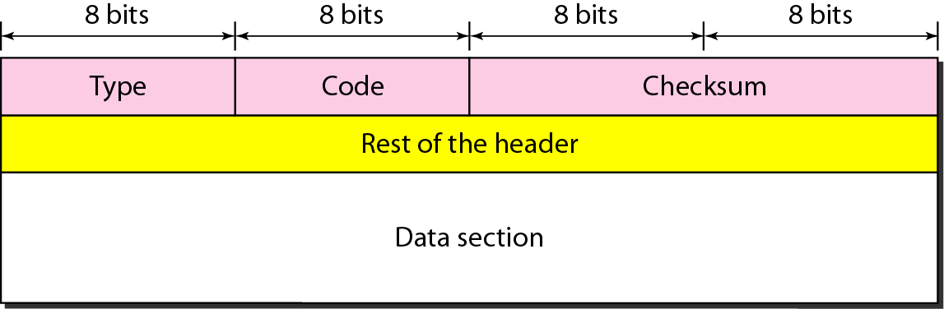
Internet Control Message Protocol
(ICMP)
The IP protocol is a best-effort delivery service that delivers a datagram from its original source to its final destination.
No error-reporting or error-correcting mechanism.
Lacks a mechanism for host and management queries.
The ICMP has been designed to compensate for the above two deficiencies. It is a companion to the IP protocol.
ICMP always reports error messages to the original source.
General format of ICMP messages

Slide 11
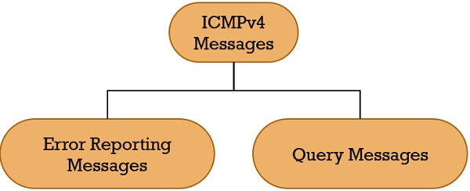
ICMP Messages
ICMP messages are divided into two broad categories:
Error-reporting messages
Query messages.
Error-reporting messages

Slide 12
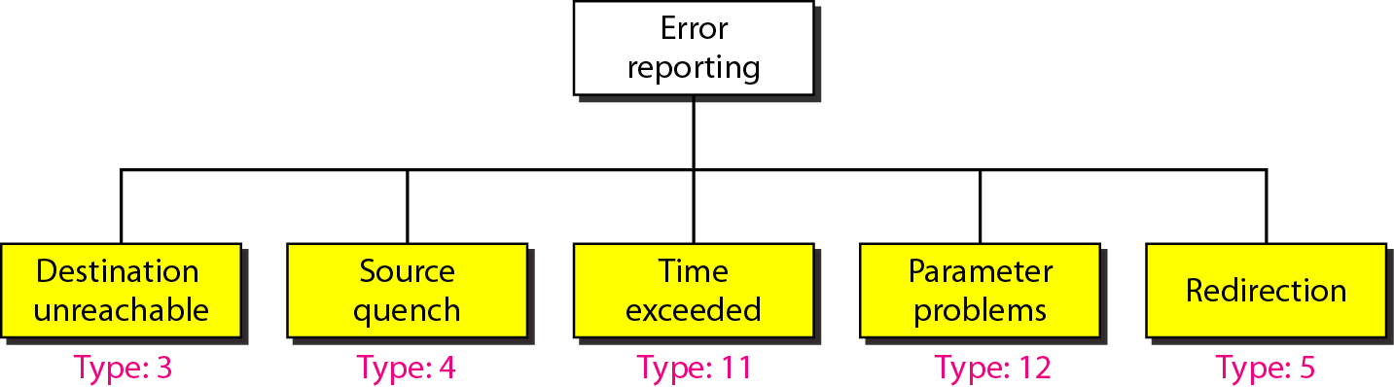
ICMP Error Messages
Type 3: When a router cannot route a datagram or a host cannot deliver a datagram
Type 4: When a router or host discards a datagram due to congestion.
Type 11: when not all fragments that make up a message arrive at the destination host within a certain time limit.
Type 12: If a router or the destination host discovers an ambiguous or missing value in any field of the datagram.
Type 5: Redirection- To update the routing table of the host, it sends a redirection message to the host.
Error-reporting messages
No ICMP error message will be generated for a datagram
multicast address.
special address such as 127.0.0.0 or 0.0.0.0.

Slide 13
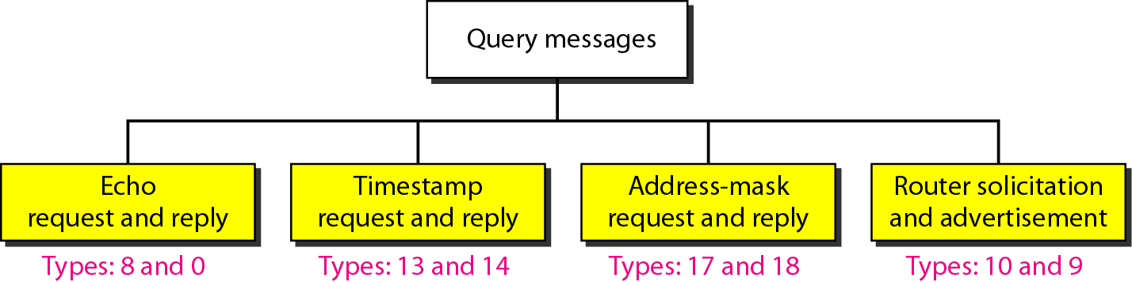
Query messages
Echo:-The combination of echo-request and echo-reply messages determines whether two systems (hosts or routers) can communicate with each other.
Timestamp:-To determine the round-trip time needed for an IP datagram to travel between them. It can also be used to synchronize the clocks in two machines.
Address Mask:-A host may know its IP address as 159.31.17.24, but it may not know that the corresponding mask is /24.
Router solicitation:- The router-solicitation and router-advertisement messages can help host in knowing if the routers are alive and functioning.

Slide 14
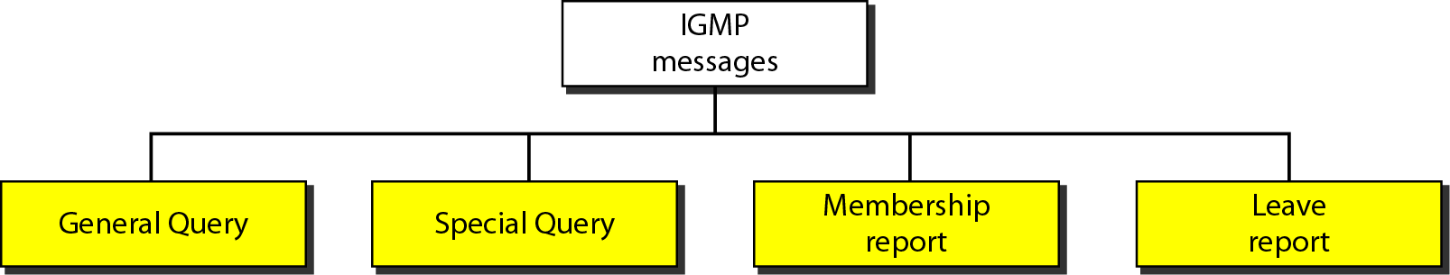
Internet Group Management Protocol (IGMP)
The IP protocol can be involved in two types of communication: unicasting and multicasting.
IGMP is one of the necessary, but not sufficient, protocols that is involved in multicasting.
IGMP is a companion to the IP protocol.
IGMP is a group management protocol. It helps a multicast router create and update a list of loyal members related to each router interface.
IGMP message types

Slide 15
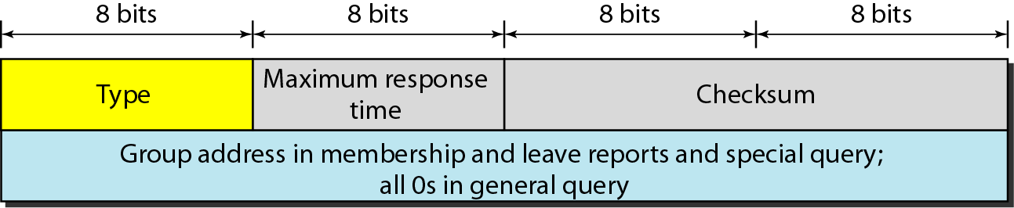
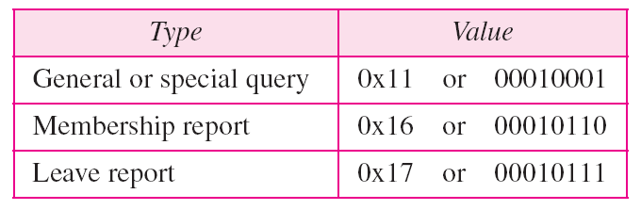
IGMP message format
IGMP type field

Slide 16
IGMP Membership Query: The Sent by routers to determine which multicast groups have members on a particular network segment. This query helps routers maintain accurate multicast group membership information.
IGMP Membership Report: Sent by hosts to indicate their interest in joining a multicast group. This report informs the router of the presence of a host that wants to receive multicast traffic.
IGMP Leave Group: Sent by hosts to indicate that they are leaving a multicast group. This message informs the router that the host no longer wants to receive traffic for that group.
IGMP V3 Membership Report (in IGMPv3): This allows hosts to specify the exact multicast group addresses they want to join or leave and can include source-specific multicast (SSM) information.
Applications:
Streaming – Multicast routing protocols are used for audio and video streaming over the network i.e., either one-to-many or many-to-many.
Gaming – Internet group management protocol is often used in simulation games which has multiple users over the network such as online games.
Web Conferencing tools – Video conferencing is a new method to meet people from your own convenience and IGMP connects to the users for conferencing and transfers the message/data packets efficiently.

Slide 17
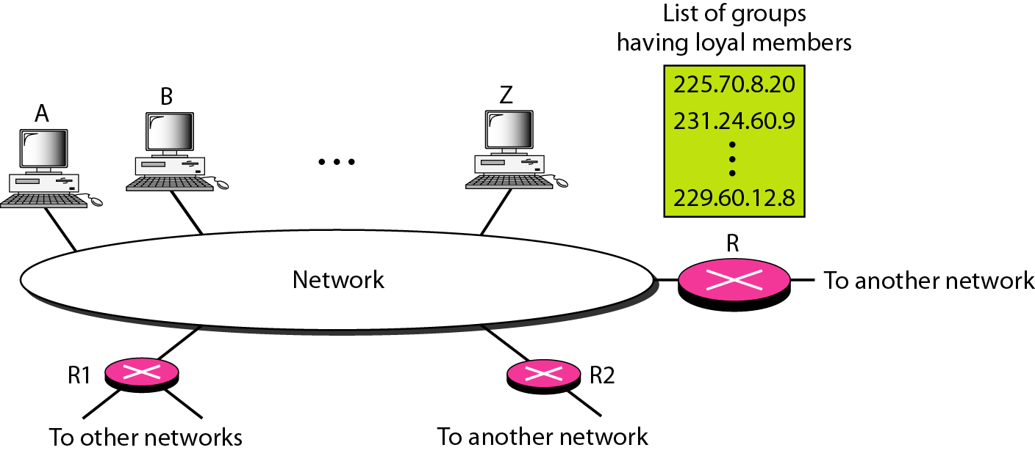
IGMP operation
In IGMP, a membership report is sent twice, one after the other.
The general query message does not define a particular group.

Slide 18
ICMPv6
Another protocol that has been modified in version 6 of the TCP/IP protocol suite is ICMP (ICMPv6).
This new version follows the same strategy and purposes of version 4.
Comparison of network layers in version 4 and version 6

Slide 19
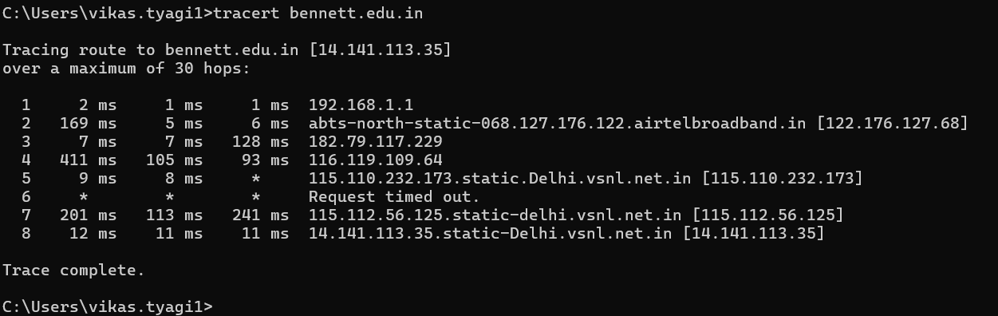
ICMP for debugging:
ping
traceroute or tracert
Debugging tools

Slide 20
Watch this video
https://www.youtube.com/watch?v=S5M4xKopg5A&ab_channel=Make8Real2017

Slide 21
Watch this video
https://www.youtube.com/watch?v=vJV-GBZ6PeM&ab_channel=PowerCertAnimatedVideos

