Slide 1
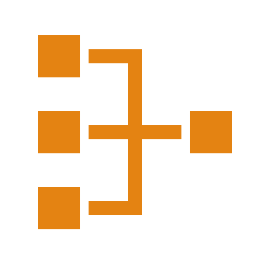
Network Layer: Routing- Distance Vector Routing

Slide 2

UNICAST ROUTING PROTOCOLS
A routing table can be either static or dynamic.
A static table is one with manual entries.
A dynamic table is one that is updated automatically when there is a change somewhere in the Internet.
A routing protocol is a combination of rules and procedures that lets routers in the Internet inform each other of changes.

Slide 3
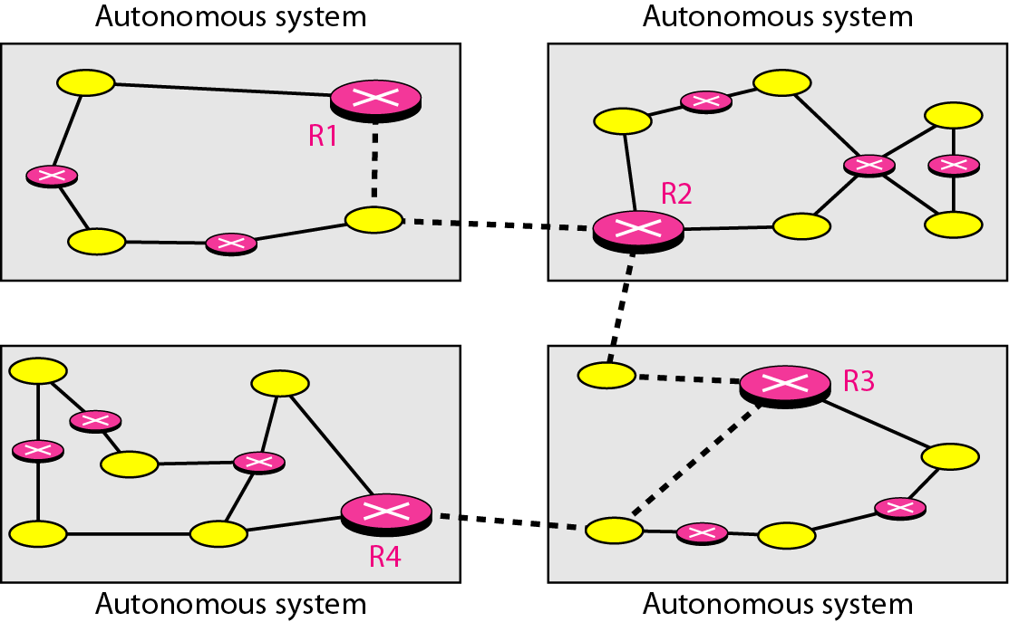
Autonomous systems
An autonomous system (AS) is a group of networks and routers under the authority of a single administration.

Slide 4
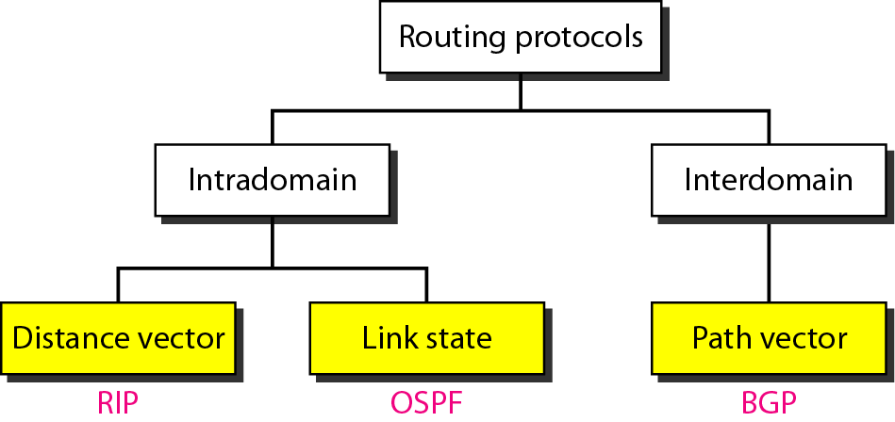
Popular routing protocols
Routing inside an autonomous system is referred to as intradomain routing.
Routing between autonomous systems is referred to as interdomain routing.
Routing Information Protocol (RIP) is an implementation of the distance vector protocol.
Open Shortest Path First (OSPF) is an implementation of the link state protocol.
Border Gateway Protocol (BGP) is an implementation of the path vector protocol.

Slide 5
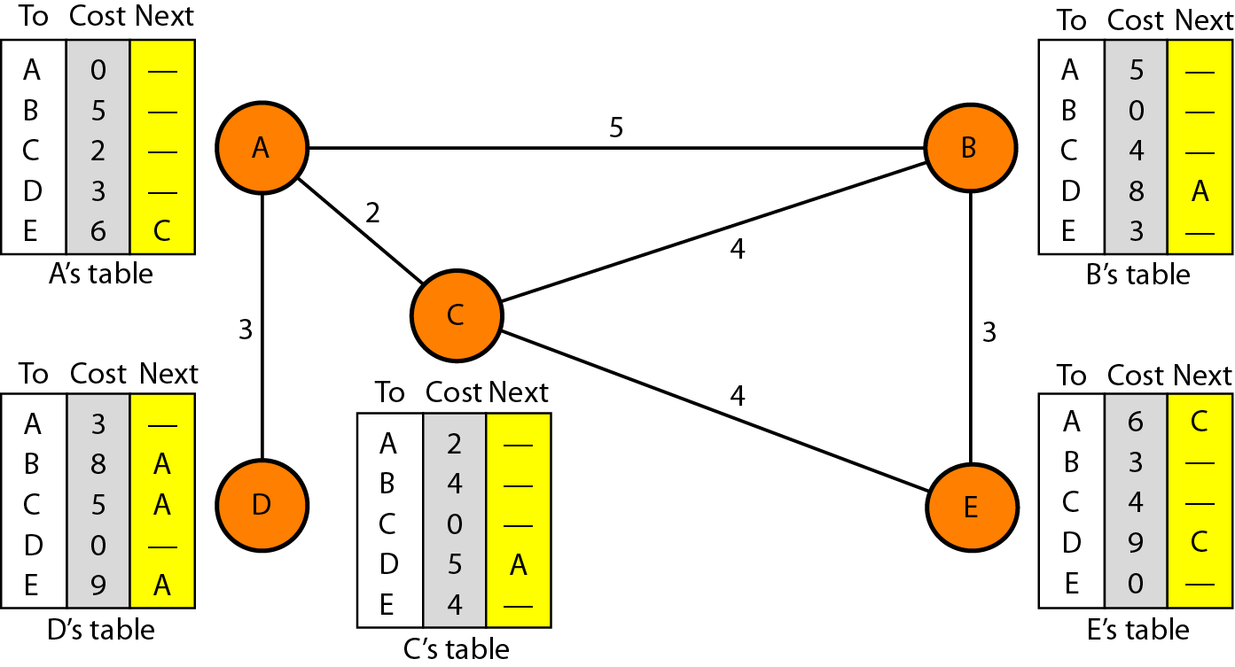
Distance vector routing
In distance vector routing, the least-cost route between any two nodes is the route with minimum distance.
In this protocol, each node maintains a vector (table) of minimum distances to every node.
Initialization
Sharing
Updating
Distance vector routing tables

Slide 6
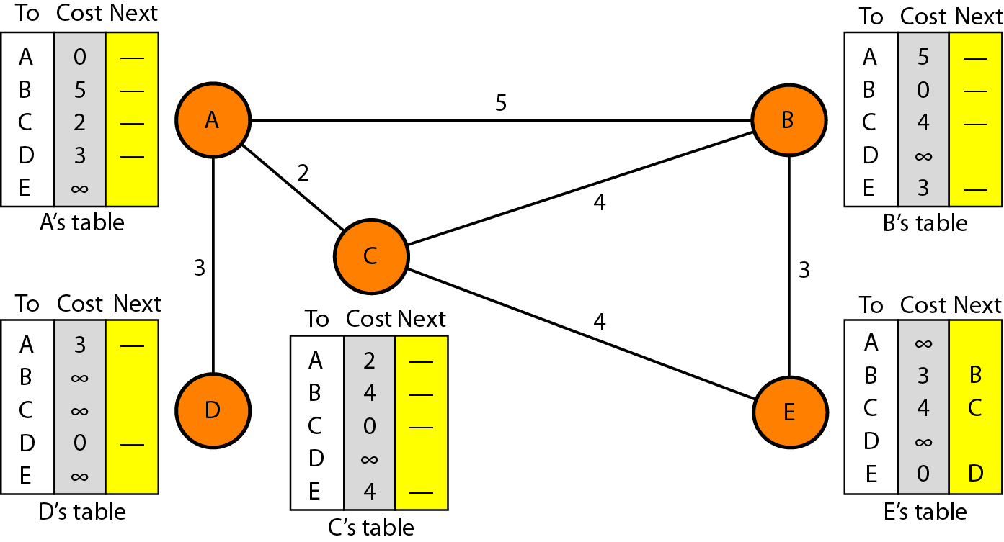
Initialization of tables in distance vector routing
It is assumed that each node can send a message to the immediate neighbors and find the distance between itself and these neighbors.
The distance for any entry that is not a neighbour is marked as infinite (unreachable).
Sharing- Each node shares its routing table with its immediate neighbors periodically and when there is a change.

Slide 7
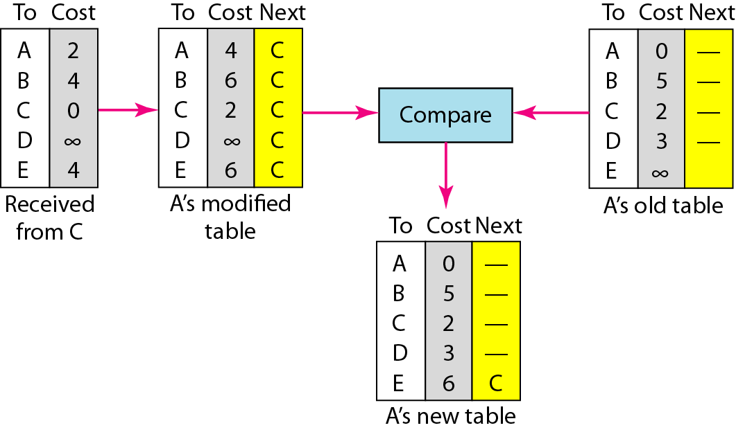
Updating in distance vector routing
When a node receives a two-column table from a neighbour, it needs to update its routing table.
Periodic Update- A node sends its routing table, normally every 30 s, in a periodic update.
Triggered Update- A node sends its two-column routing table to its neighbors anytime there is a change in its routing table.
The change can result from the following.
Two-Node Loop Instability
Three-Node Loop Instability

Slide 8
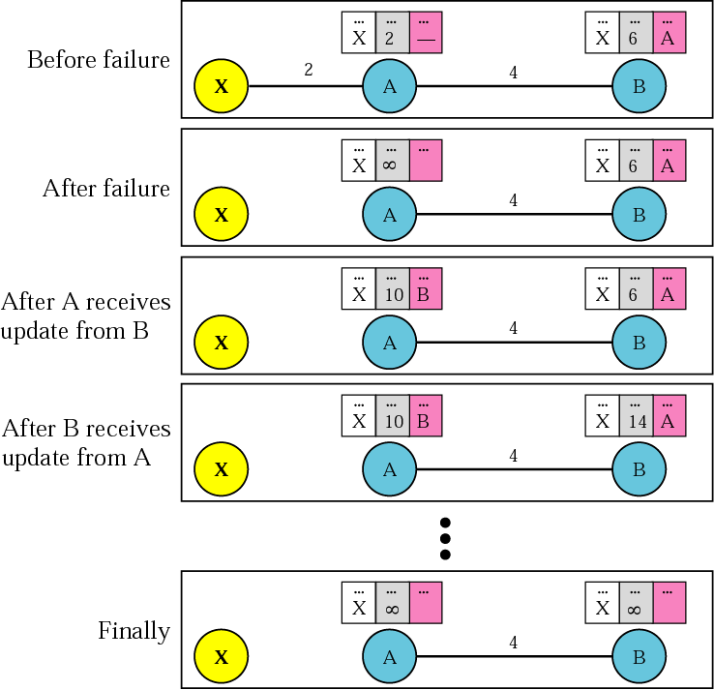
Two-node instability and Three-node instability
A problem with distance vector routing is instability, which means that a network using this protocol can become unstable.
Assume, suddenly, the link between A and X fails.
Two-Node Loop Instability

Slide 9
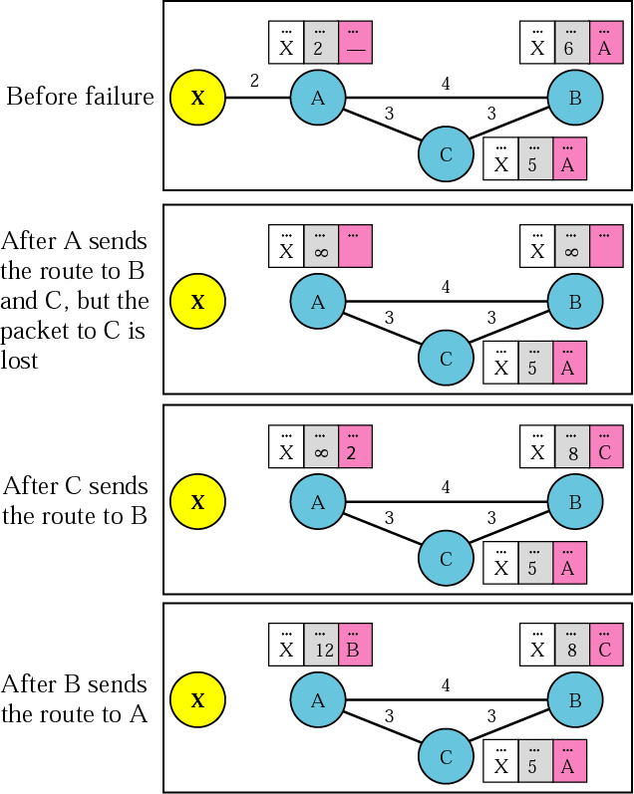
Two-node instability and Three-node instability
A problem with distance vector routing is instability, which means that a network using this protocol can become unstable.
Assume, suddenly, the link between A and X fails.
Three-Node Loop Instability

Slide 10
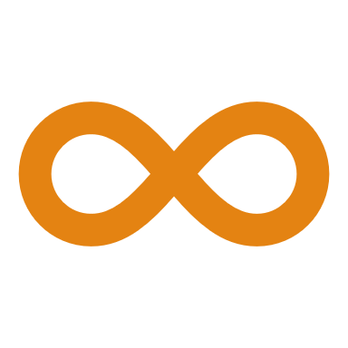
Proposed solutions for instability
A few solutions have been proposed for instability of this kind.
Defining Infinity- The first obvious solution is to redefine infinity to a smaller number, such as 100.
Split Horizon- In this strategy, instead of flooding the table through each interface, each node sends only part of its table through each interface.

Slide 11
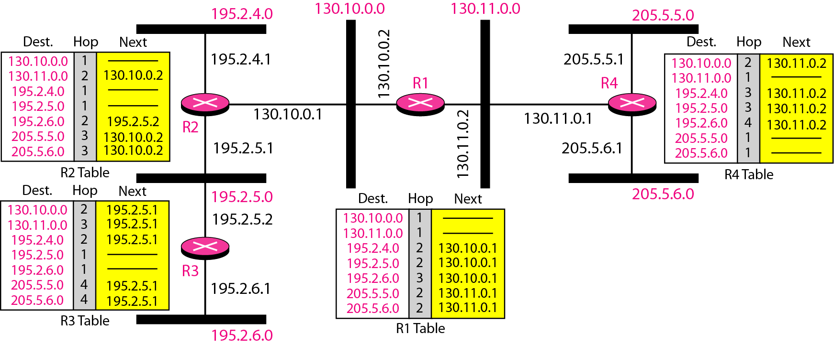
Routing Information Protocol (RIP)
RIP is an intradomain routing protocol used inside an autonomous system.
It is a very simple protocol based on distance vector routing.
RIP implements distance vector routing directly with some considerations.
Example of a domain using RIP:
an autonomous system with seven networks and four routers.

Slide 12

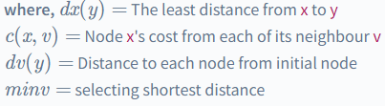
Bellman-Ford algorithm
Distance vector is the "Dynamic Routing" protocol.
The shortest path is determined using the distant vector protocol, also known as the Bellman-Ford algorithm.
The routing protocol is used to calculate the best route from source to destination based on the distance or hops as its primary metric to define an optimal path.

Slide 13
Distance Vector Routing
Advantage
Easy to implement for small networks.
Protocol faces a lower redundancy in the small network.
Disadvantages
Distance vector routing has a slow coverage problem because it takes longer to obtain accurate information for the routing table.
Traffic is generated as the network topology changes on a regular basis.
The distance vector routing problem is count-to-infinity.

Slide 14
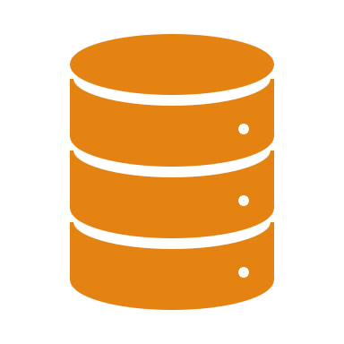
Question
How are tables updated in the distance vector routing algorithm?
Using flooding technique
By retrieving the information from all the nodes directly
By interchanging the information with neighbour nodes
By exchanging the information with a central device

