Slide 1

Network Layer: Routing Protocols

Slide 2
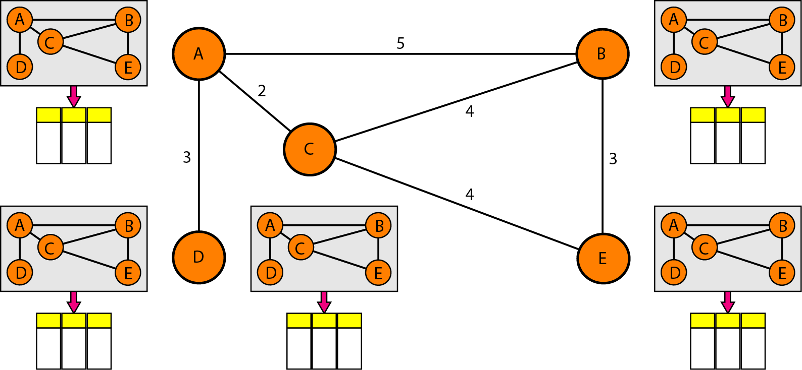
Link State Routing
In link state routing, each node in the domain has the entire topology of the domain
The list of nodes and links, how they are connected including the type, cost (metric), and condition of the links (up or down)
The node can use Dijkstra's algorithm to build a routing table.
A simple domain with five nodes. Each node uses the same topology to create a routing table,

Slide 3
Link State Routing
In link state routing, four sets of actions are required to ensure that each node has the routing table showing the least-cost node to every other node.
Creation of the states of the links by each node, called the link state packet (LSP).
Node identity, the list of links, a sequence number, and age.
2. Dissemination of LSPs to every other router, called flooding, in an efficient and reliable way.
3. Formation of a shortest path tree for each node.
4. Calculation of a routing table based on the shortest path tree.

Slide 4
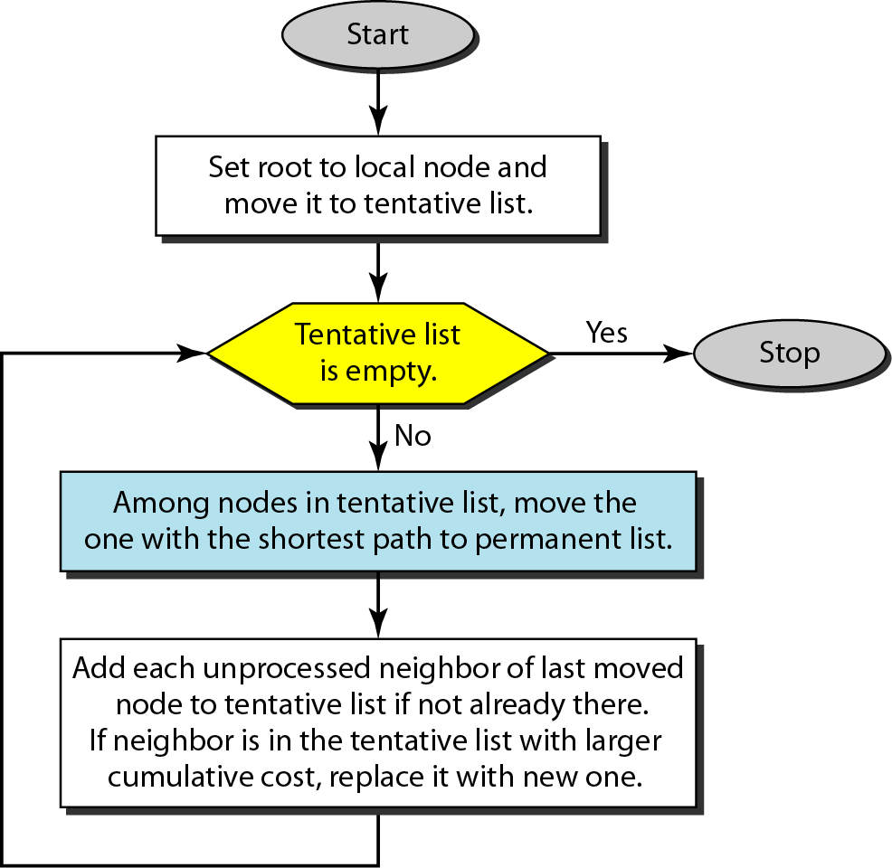
Dijkstra algorithm
The Dijkstra algorithm creates a shortest path tree from a graph.
The algorithm divides the nodes into two sets: tentative and permanent.
It finds the neighbours of a current node, makes them tentative, examines them, and if they pass the criteria, makes them permanent.

Slide 5
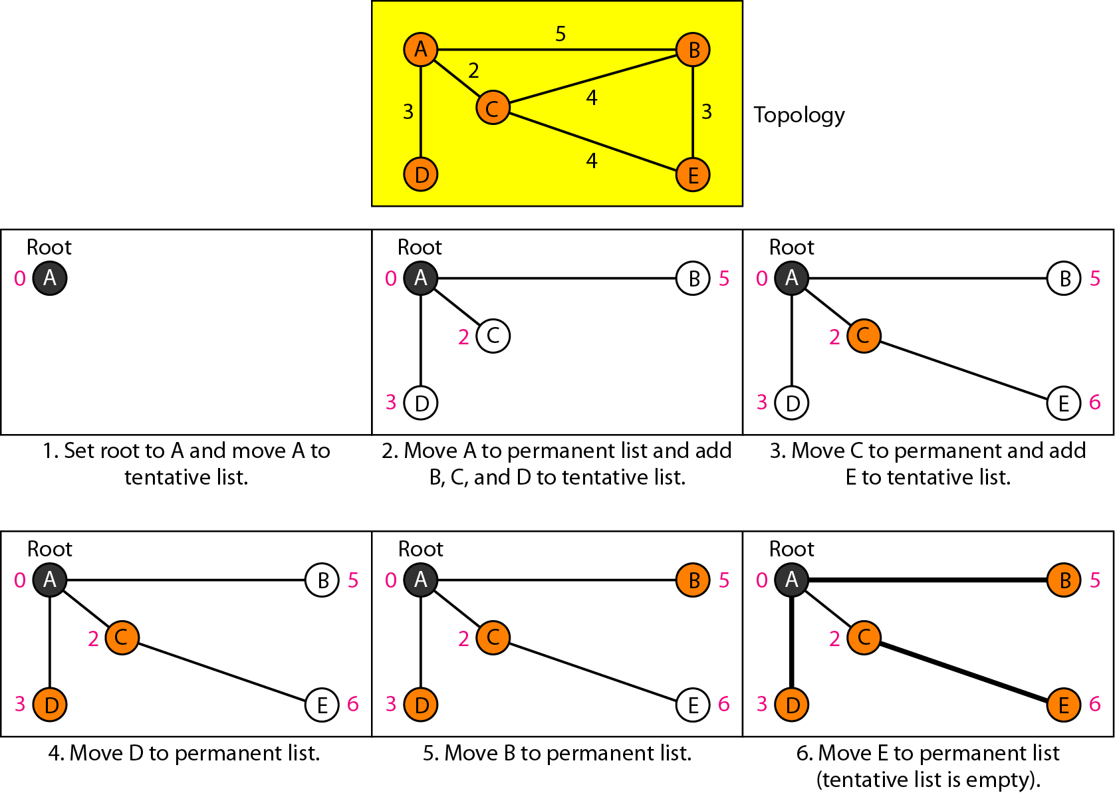
Formation of Shortest Path Tree: Dijkstra Algorithm
Routing table for node A
Permanent list: A(O), B(5), C(2), D(3), E(6)
Tentative list: empty

Slide 6
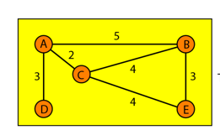
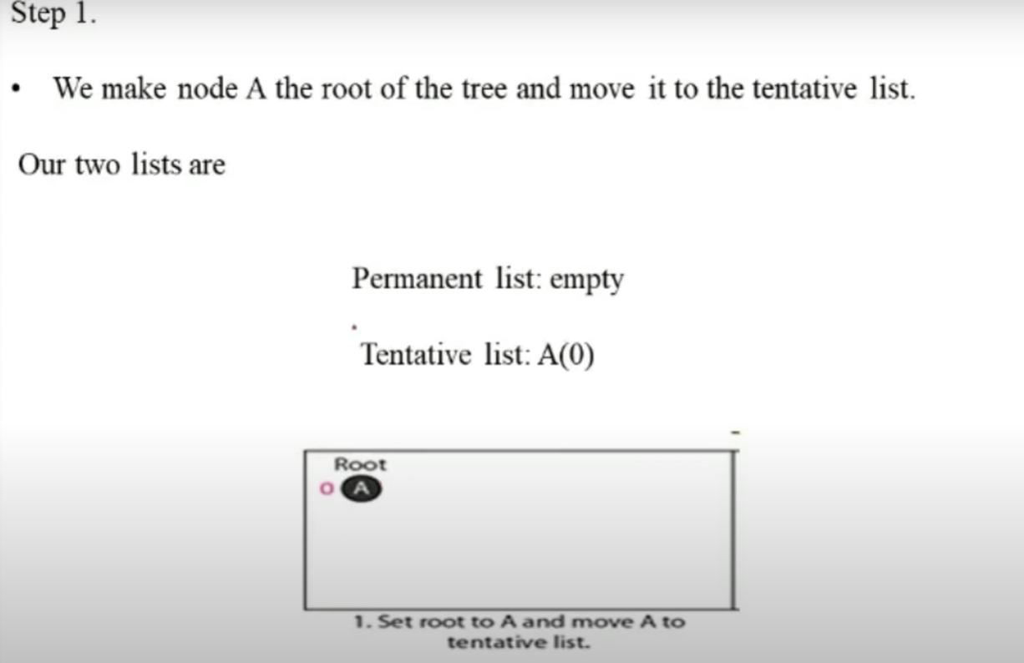
Formation of Shortest Path Tree: Dijkstra Algorithm

Slide 7
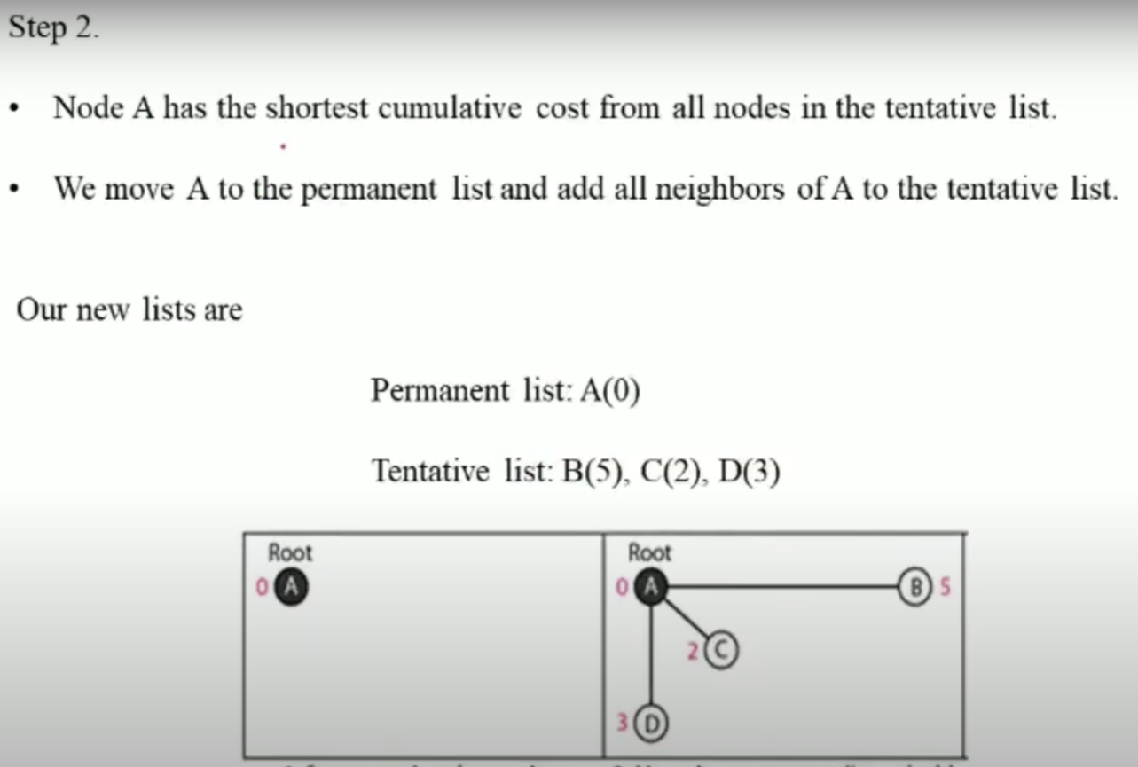
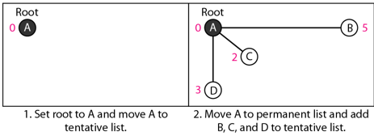
Formation of Shortest Path Tree: Dijkstra Algorithm

Slide 8
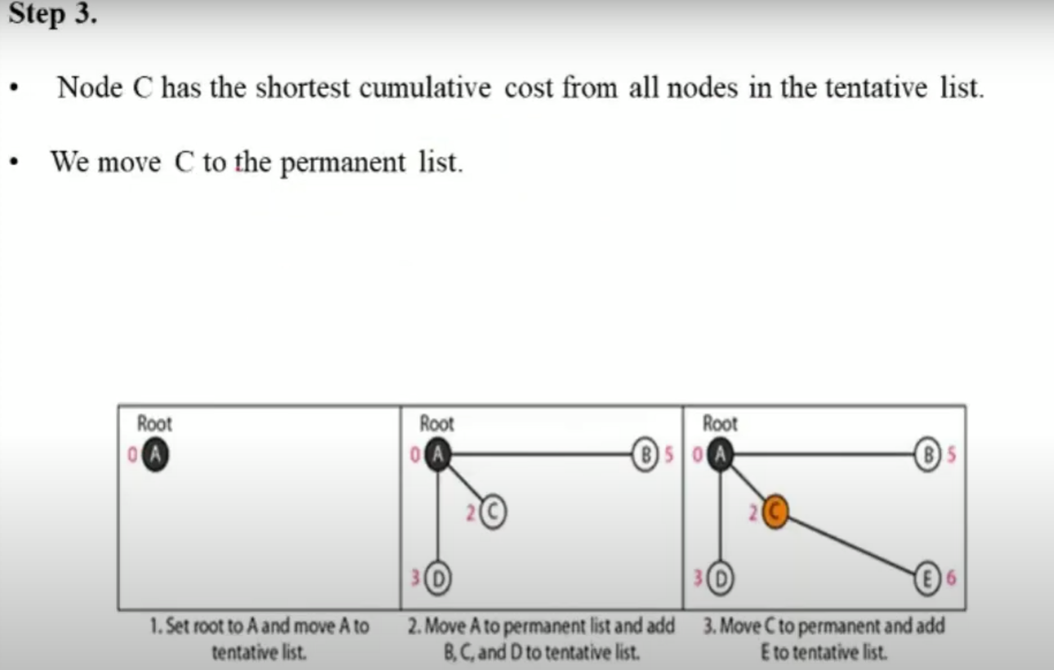
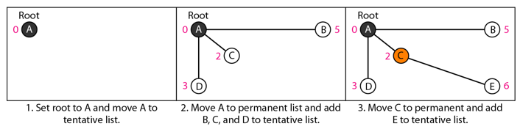
Formation of Shortest Path Tree: Dijkstra Algorithm

Slide 9
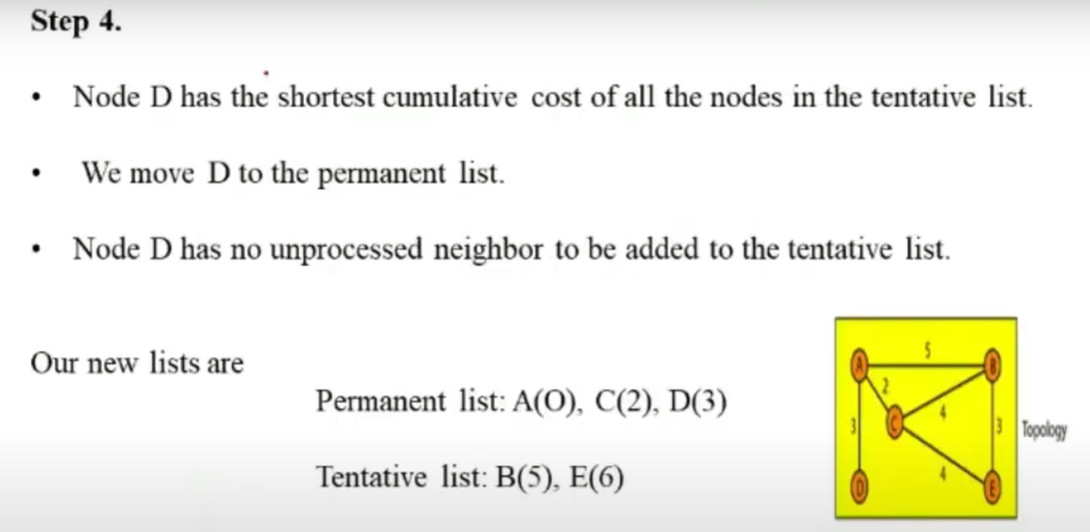
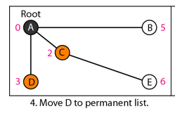
Formation of Shortest Path Tree: Dijkstra Algorithm

Slide 10
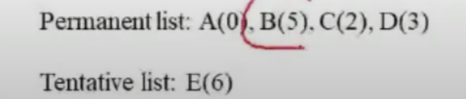
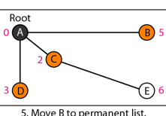
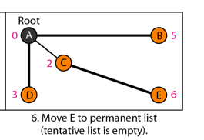
Formation of Shortest Path Tree: Dijkstra Algorithm
Step 6
Permanent list: A(O), B(5), C(2), D(3), E(6)
Tentative list: empty

Slide 11
Open Shortest Path First (OSPF)
The OSPF protocol is an intradomain routing protocol based on link state routing.
Its domain is also an autonomous system.

Slide 12
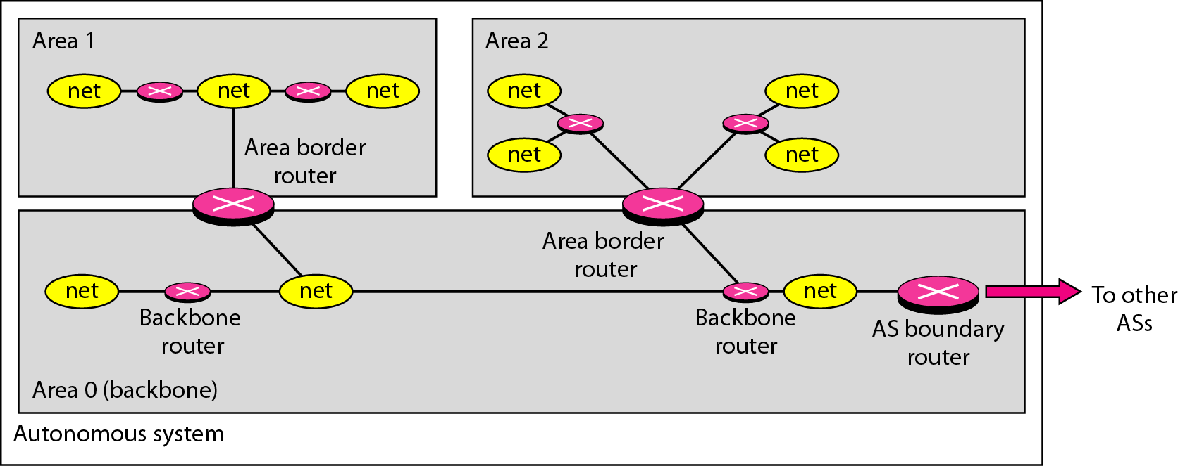
Areas in an autonomous system
Open Shortest Path First divides the autonomous system into areas which is the collection of hosts, routers and networks.
Router inside the area flood the routing information in the area.
Special routers summaries the information about the area and send it to other areas.
All area inside the AS should be connected to the Backbone or primary area.

Slide 13
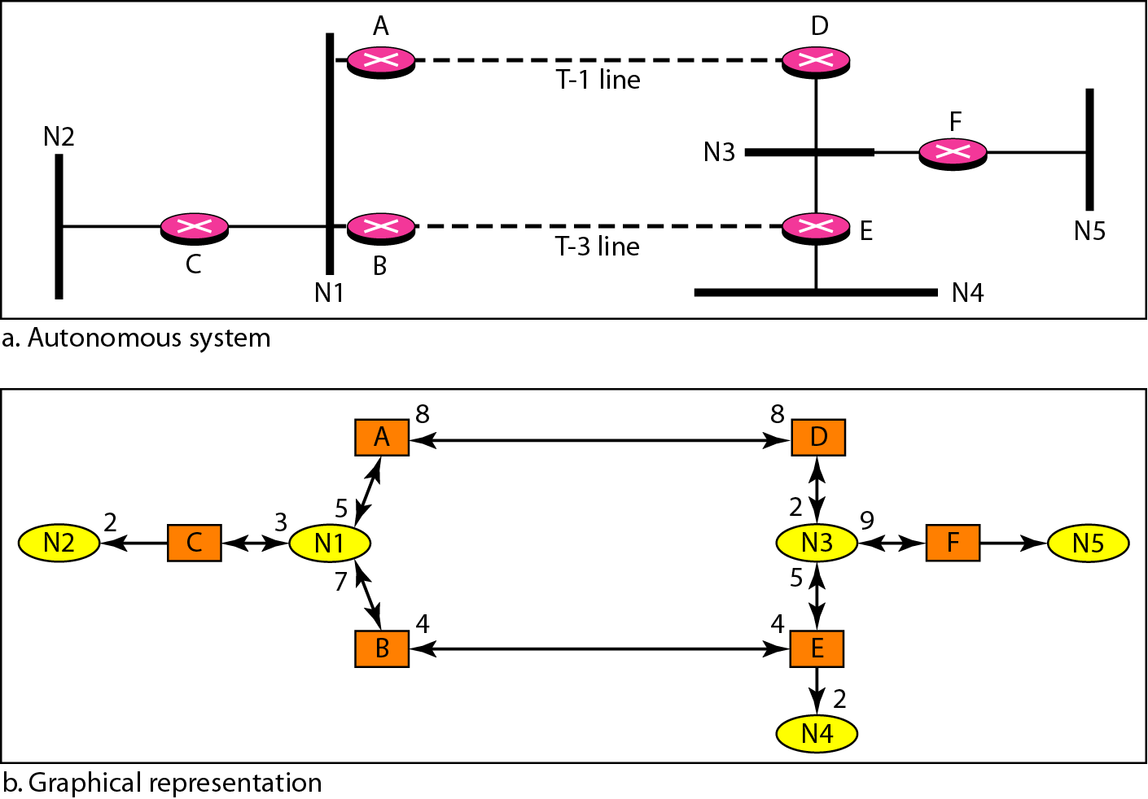
Example of an AS and its graphical representation in OSPF

Slide 14
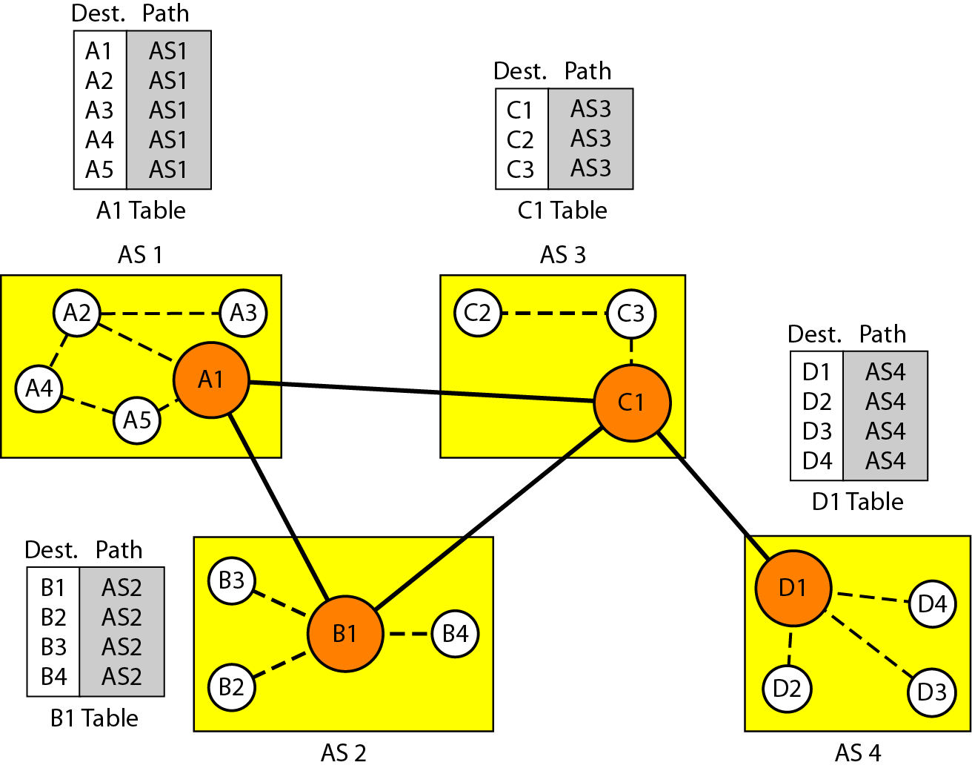
Path Vector Routing
Distance vector routing- Instability.
Link state routing- heavy traffic due to flooding.
In path vector routing, it is assumed that there is one node in each autonomous system that acts on behalf of the entire autonomous system.
Initialization
Sharing
Updating
Initial routing tables in PVR

Slide 15
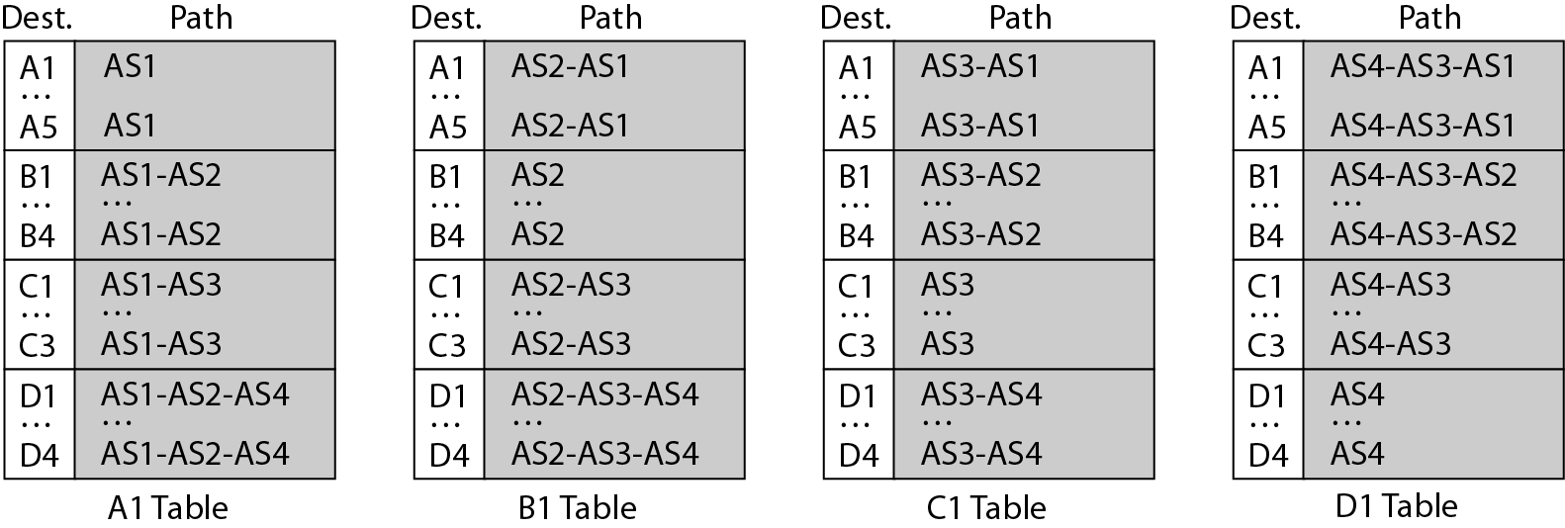
Path Vector Routing
Loop Prevention
Policy routing
Optimum path
Border Gateway Protocol (BGP) is an interdomain routing protocol which uses path vector routing.
Stabilized tables for three autonomous systems

Slide 16
Types of Autonomous Systems (AS)
There are three types of autonomous Systems
Stub AS- It has only one connection to other AS. Data traffic can not pass through a stub AS. It is either a source or sink.
Multihomed AS- It has more than one connection to another AS. It is also either a source or sink for data traffic
Transit AS- It is a multi-homed AS which allows transient traffic (e.g.- ISPs(Internet Backbone))
Path Attributes- used to get the path information stored in the routing table
Two types- Well known attributes (every BGP router must recognise) and optional attributes
BGP Sessions- External BGP session and Internal BGP session
BGP packets- Four types: open, update, keepalive, notification

Slide 17
Watch the videos
Routing-
https://youtu.be/gQtgtKtvRdo
BGP-
https://youtu.be/_Z29ZzKeZHc

