Slide 1
Network Layer: Multicast Routing

Slide 2
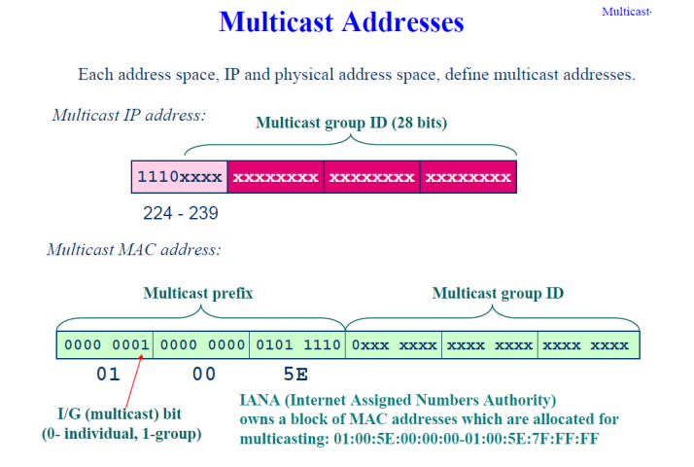

Slide 3
Question- Change the multicast IP address 238.212.24.9 to an Ethernet multicast physical address. Given, Ethernet multicast physical address range is
01 :00:5E:00:00:00 to 01:00:5E:7F:FF:FF.
Solution
Step1-
The rightmost 3 bytes in hexadecimal is D4:18:09.
Subtract 8 from the leftmost digit, resulting in 54:18:09
Step2- Add the result of part a to the Ethernet multicast starting address.

Slide 4
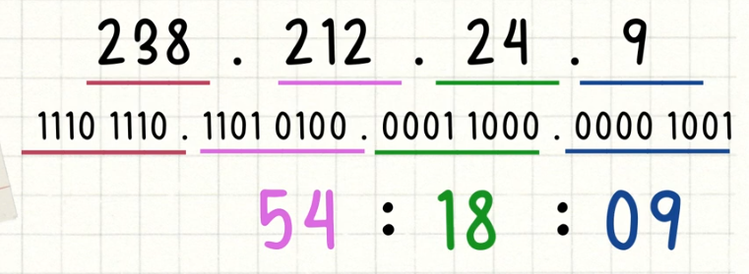
Question- Change the multicast IP address 238.212.24.9 to an Ethernet multicast physical address. Given, Ethernet multicast physical address range is
01 :00:5E:00:00:00 to 01:00:5E:7F:FF:FF.
Solution
Step1-
Convert 23 rightmost bits in hexadecimal
Step2- Add the result of part a to the Ethernet multicast starting address.

Slide 5
Question- Change the multicast IP address 232.43.14.7 to an Ethernet multicast physical address. Given, Ethernet multicast physical address range is
01 :00:5E:00:00:00 to 01:00:5E:7F:FF:FF.

Slide 6
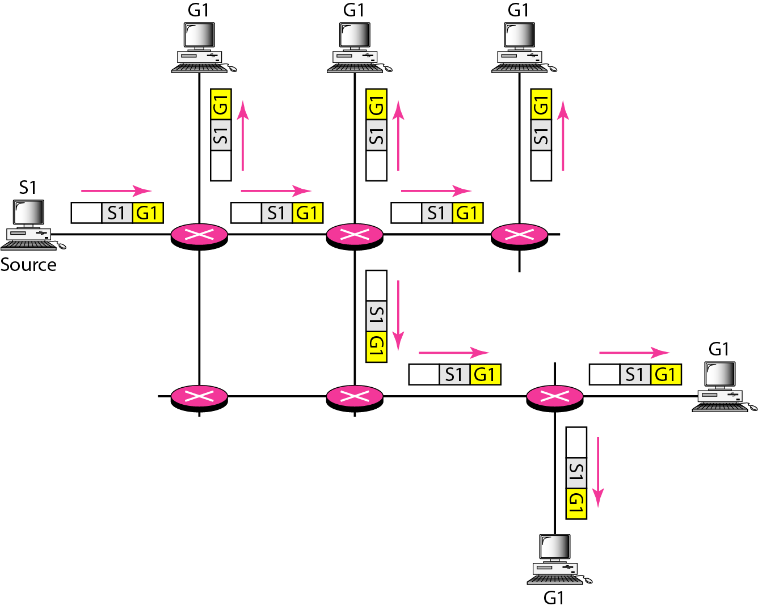
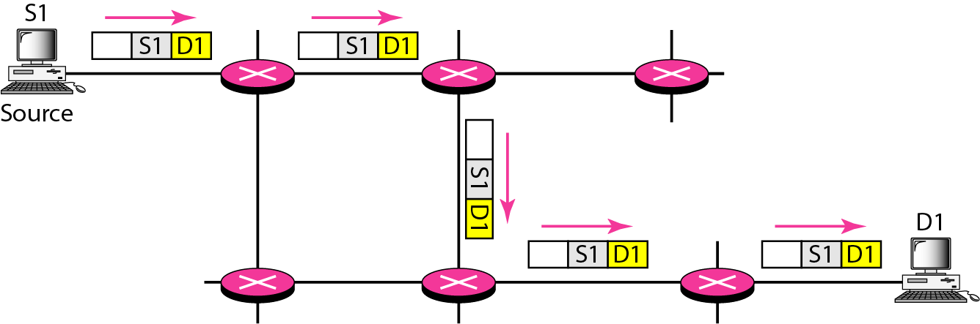
In unicasting, the router forwards the received packet through only one of its interfaces.
In multicast communication, there is one source and a group of destinations. In this case, the router may forward the received packet through several of its interfaces.
MULTICASTING Vs UNICASTING
Unicasting Multicasting

Slide 7
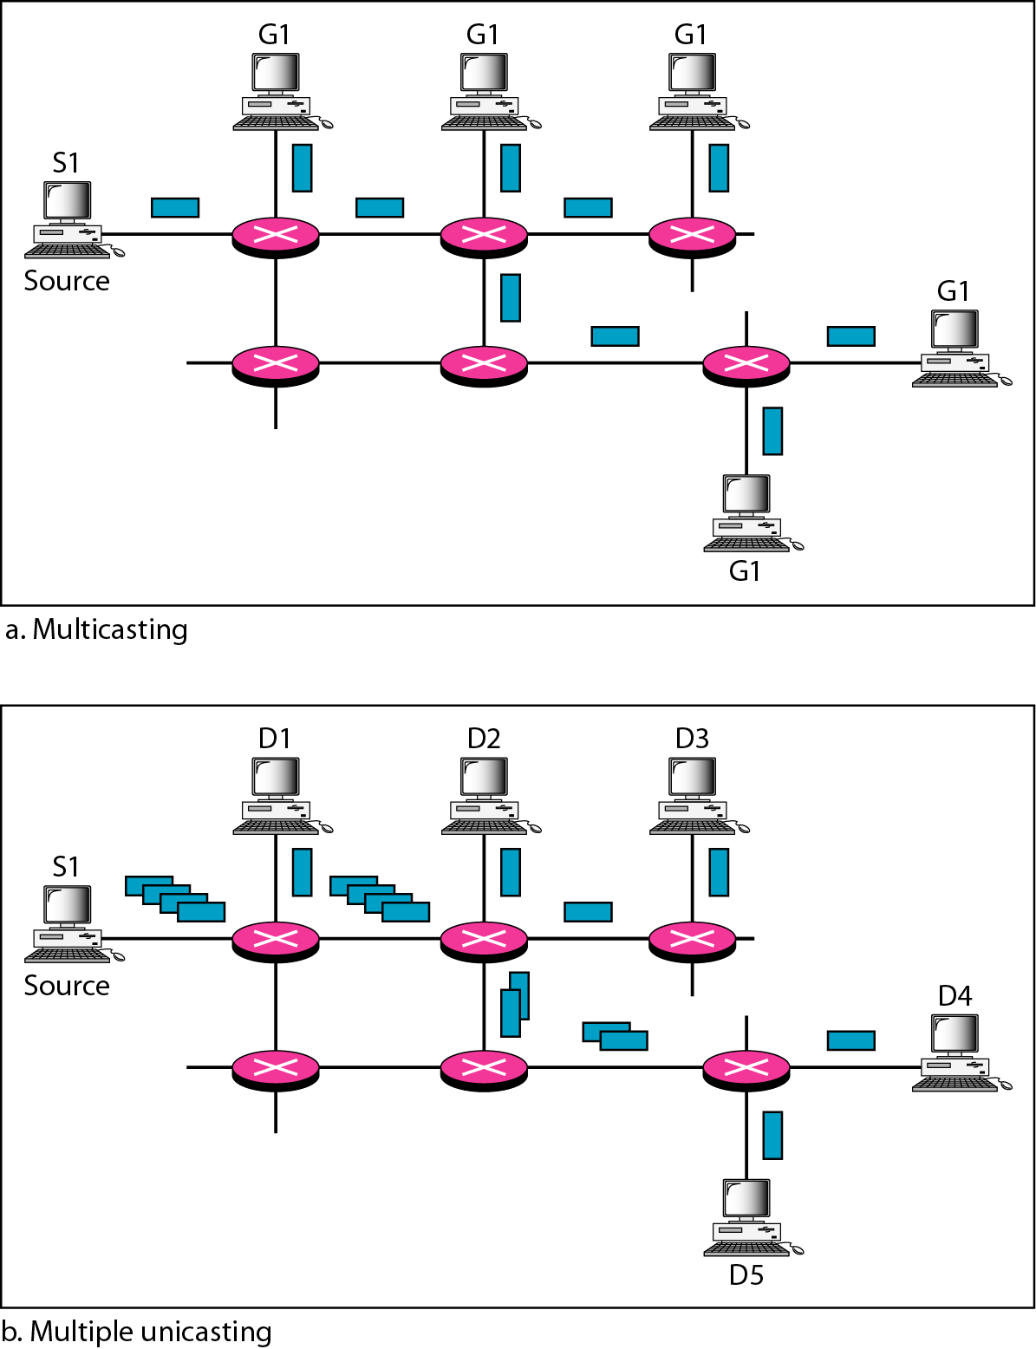
Multicasting versus multiple unicasting
Multicasting starts with one single packet from the source that is duplicated by the routers. The destination address in each packet is the same for all duplicates.
In multiple unicasting, several packets start from the source. If there are five destinations, e.g, the source sends five packets, each with a different unicast destination address.
Emulation of multicasting through multiple unicasting is not efficient and may create long delays, particularly with a large group

Slide 8
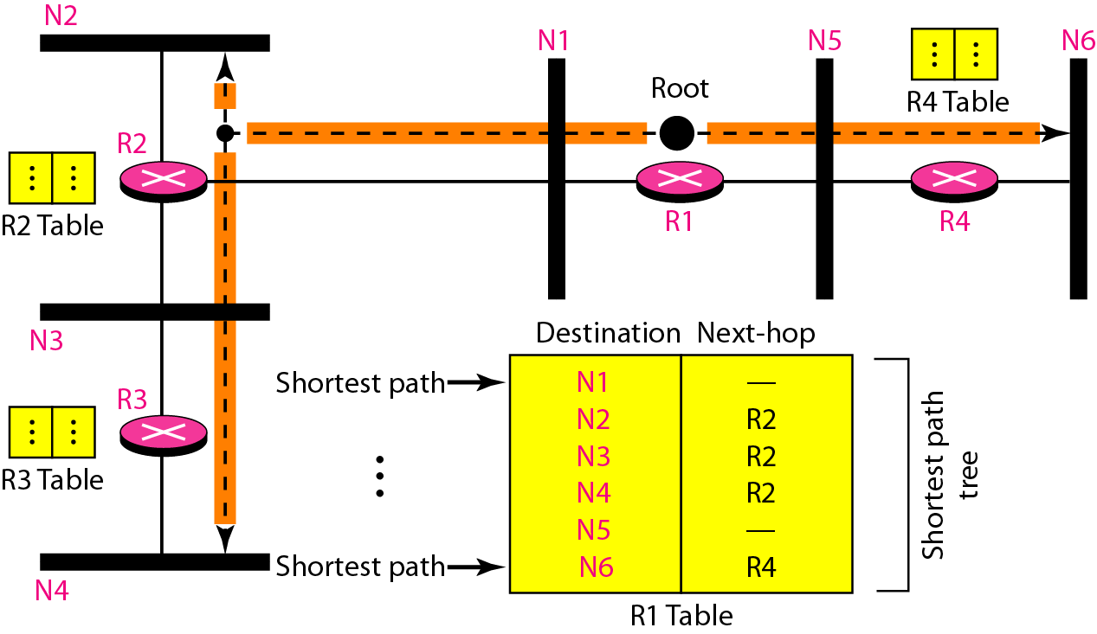
Shortest path tree in unicast routing
In multicast routing, each involved router needs to construct a shortest path tree for each group.

Slide 9
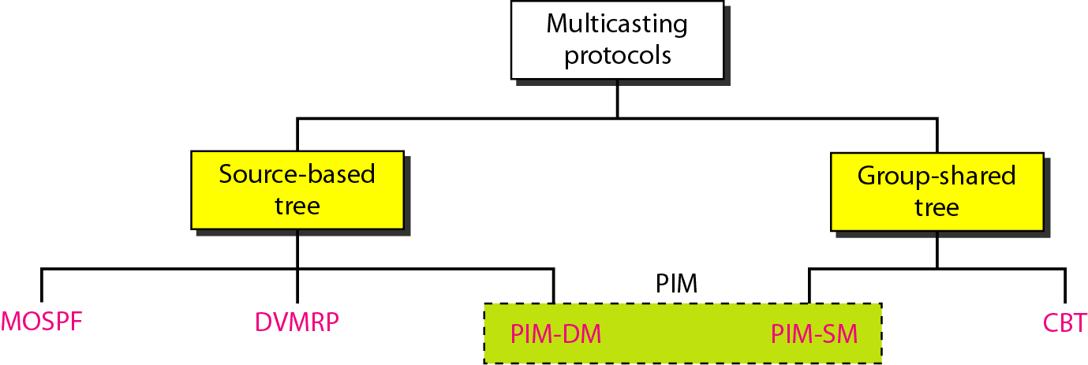
Multicast packet may have destinations in more than one network.
Forwarding of a single packet to members of a group requires a shortest path tree. (e.g. for n groups, n shortest path trees are required).
Two approaches have been used to solve the problem: source-based trees and group- shared trees.
Common multicast protocols
* PIM-Protocol Independent Multicast

Slide 10
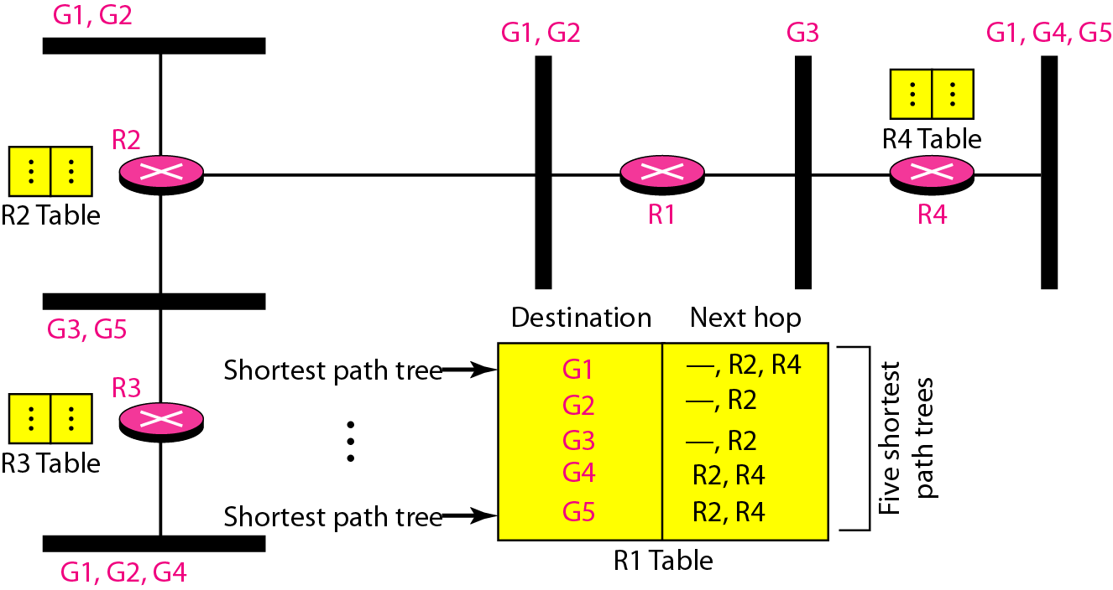
Source-based tree approach
In the source-based tree approach, each router needs to have one shortest path tree for each group.
The shortest path tree for a group defines the next hop for each network that has loyal member(s) for that group

Slide 11
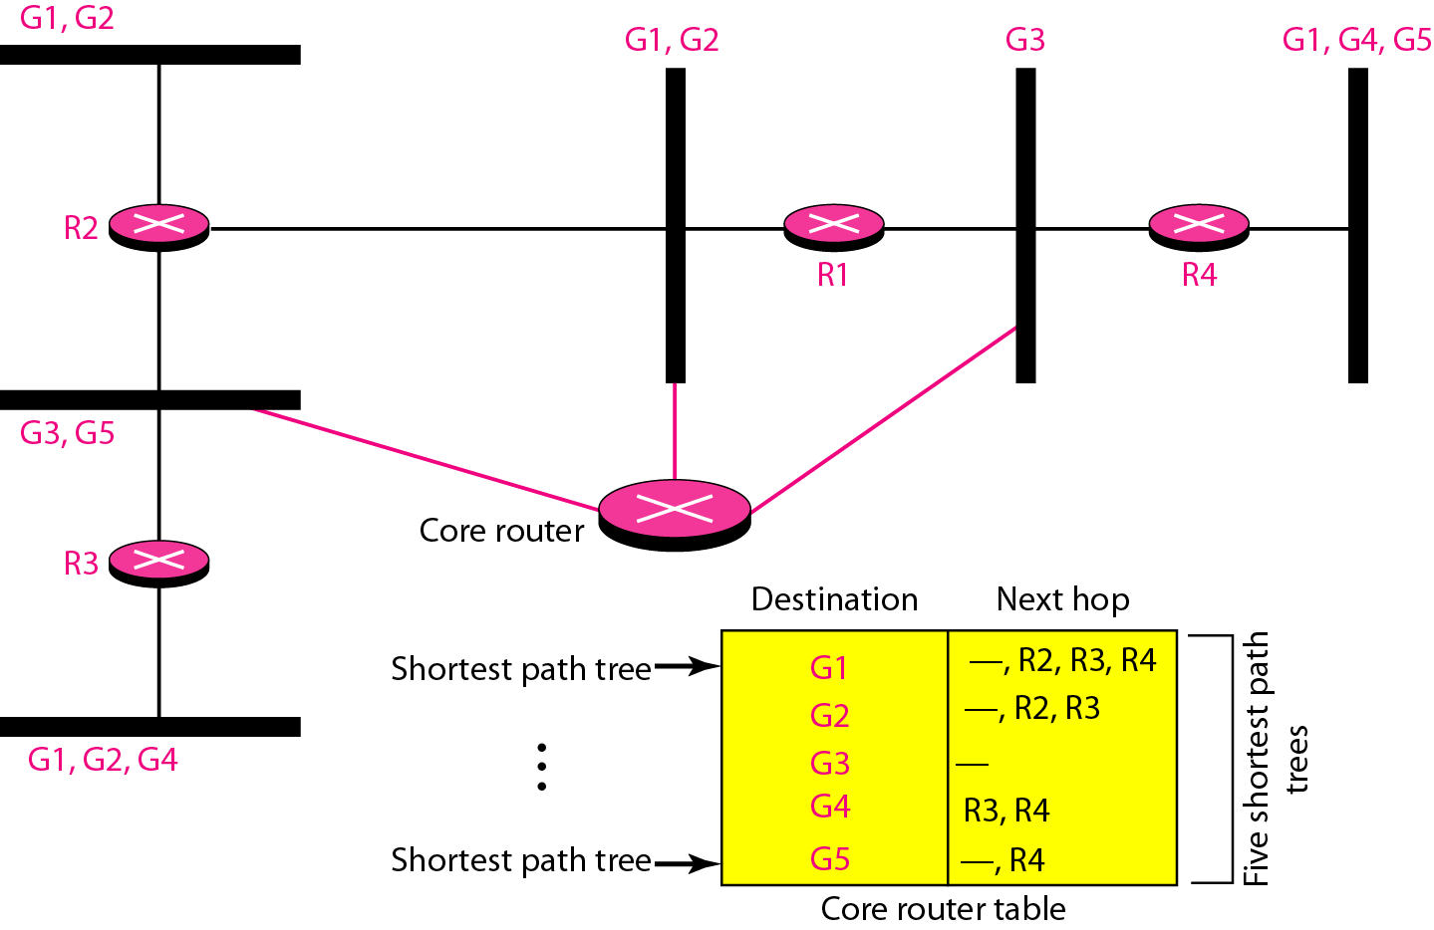
Group-shared tree approach
In this, instead of each router having m shortest path trees, only one designated router, called the center core, takes the responsibility of distributing multicast traffic.
The core has m shortest path trees in its routing table.

Slide 12
Multicast Open Shortest Path First (MOSPF) protocol –
Extension of the OSPF protocol and based on Multicast link state routing.
The Distance Vector Multicast Routing Protocol (DVMRP)
is an implementation of multicast distance vector routing and based on RIP.
Reverse Path Forwarding (RPF) is a modified flooding strategy.
It is used to prevent loops.
Only one copy is forwarded; the other copies are dropped.
RPF eliminates the loop in the flooding process.
Important Points

Slide 13
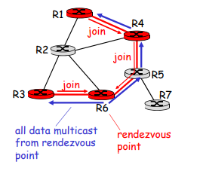
The Core-Based Tree (CBT) uses a core as the root of the tree. The autonomous system is divided into regions, and a core (center router or rendezvous router) is chosen for each region.
PIM-Protocol Independent Multicast
PIM-DM is used in a dense multicast environment, such as a LAN. It uses RPF, pruning and grafting strategies to handle multicasting.
PIM-SM is used in a sparse multicast environment such as a WAN. It is similar to CBT but uses a simpler procedure
PIM-SM

Slide 14
Pruning and Grafting
Pruning
The process starts when a router connected to a network finds that there is no interest in a multicast packet.
The router sends a prune message to the upstream router so that it can exclude the corresponding interface.
That is, the upstream router can stop sending multicast messages for this group through that interface.
Grafting
What if a leaf router (a router at the bottom of the tree) has sent a prune message but suddenly realizes, through IGMP, that one of its networks is again interested in receiving the multicast packet?
It can send a graft message.
The graft message forces the upstream router to resume sending the multicast messages.

Slide 15
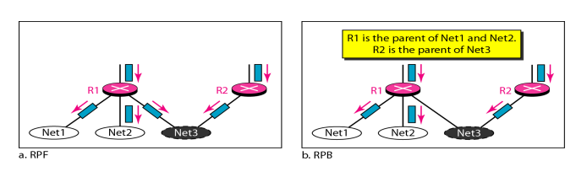
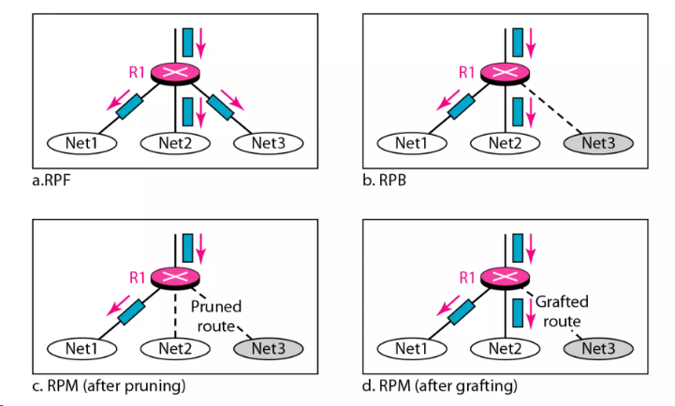
DVMRP: RPF, RPB and RPM
RPM- Reverse Path Multicasting
RPB- Reverse Path Broadcasting
RPF- Reverse Path Forwarding

Slide 16
Question
Pruning and grafting are strategies used in _______
RPF
RPB
RPM
None

Slide 17
https://www.youtube.com/watch?v=fRiOOWJDcK8&list=PLVND-cRwt9SNw9_EIK4GGDBAT0wtz0xSC]
Watch this video

