Slide 1
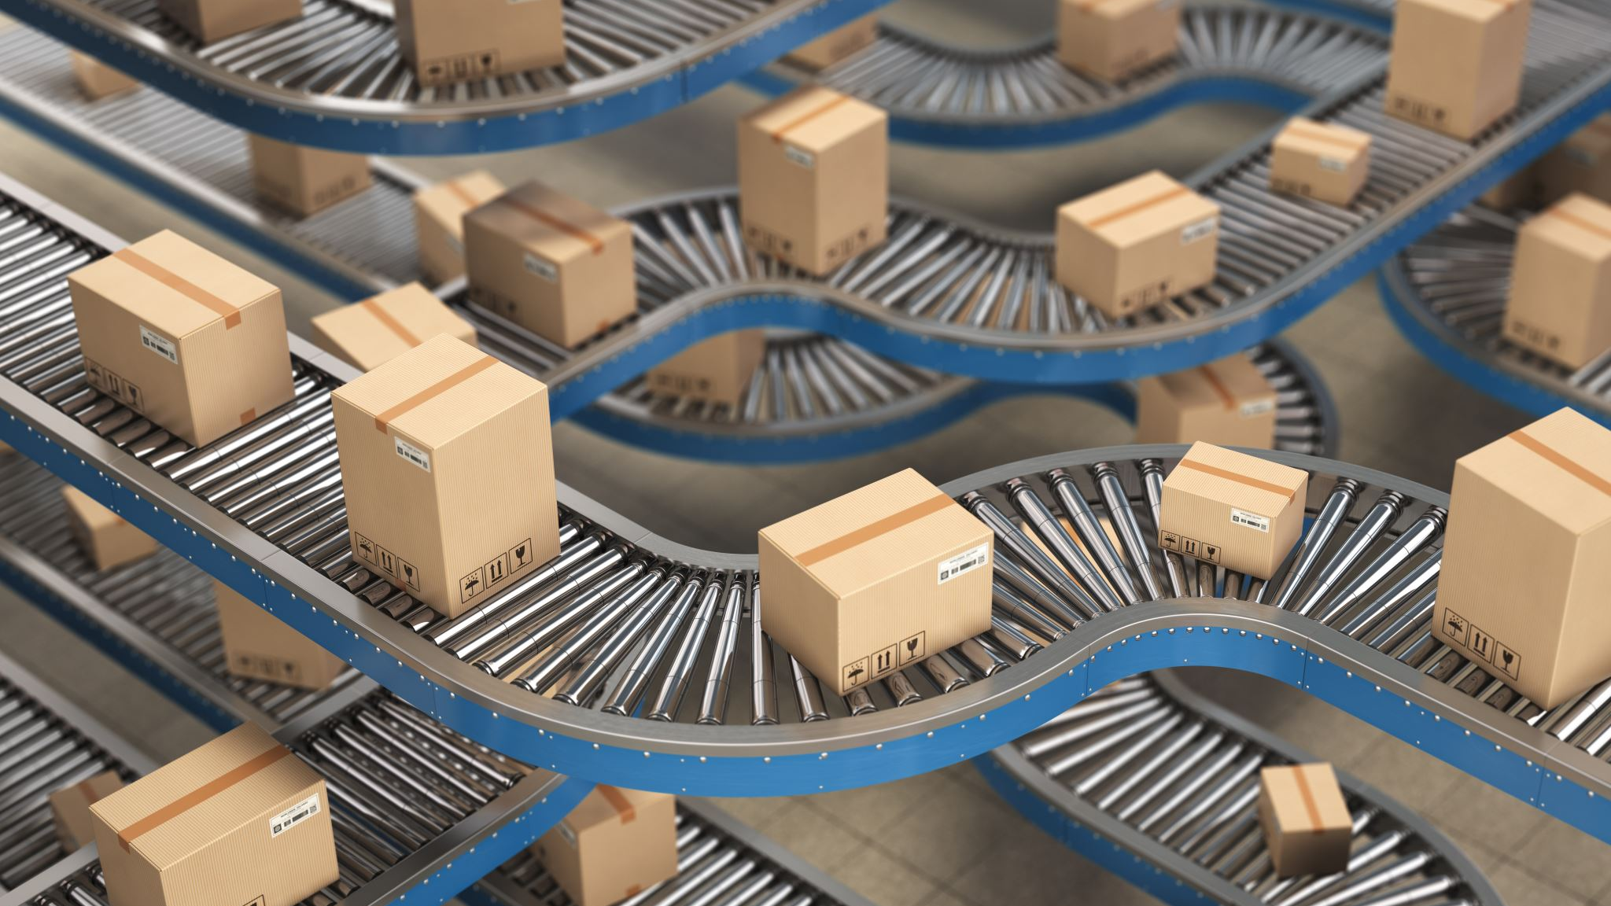
Transport Layer Process-to-Process Delivery

Slide 2
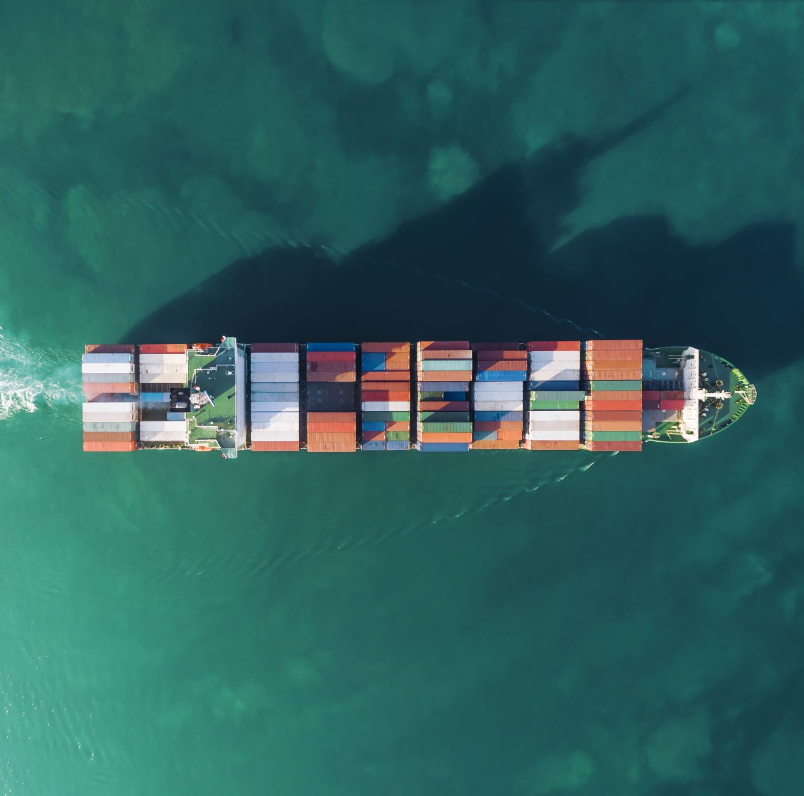
Transport Layer Tasks
The transport layer is responsible for process-to-process delivery—the delivery of a packet, part of a message, from one process to another.
Two processes communicate in a client/server relationship.
Connection Control
Segmentation and Reassembly
Flow Control
Error Control
Congestion Control

Slide 3
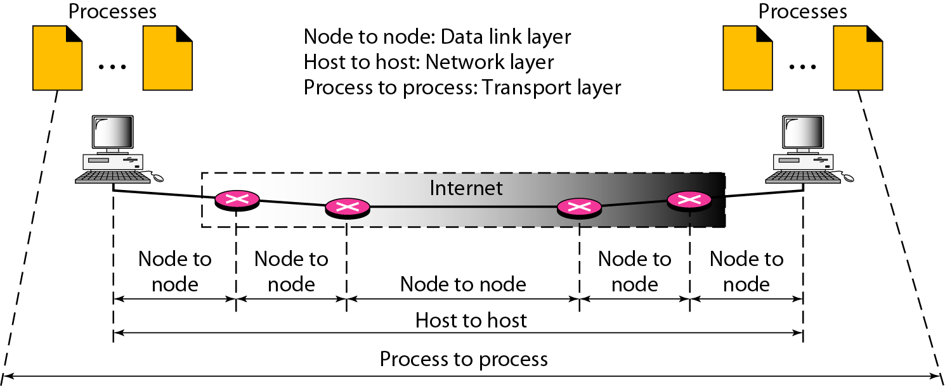
process-to-process delivery

Slide 4
Encapsulation in TCP/IP
HTTP Request
TCP Header contains source & destination port numbers
TCP header
HTTP Request
IP Header contains source and destination IP addresses; transport protocol type
IP header
TCP header
HTTP Request
Ethernet Header contains source & destination MAC addresses; network protocol type
Ethernet header
IP header
TCP header
HTTP Request
FCS

Slide 5
Connectionless & Connection-Oriented Services
A transport layer protocol can be either connectionless or connection-oriented.
Message is normally divided into transmittable segments.
Connection-Oriented
Creates a relationship between the segments using sequence numbers.
Three-phases:
Connection setup between two SAPs to initialize state information
SDU transfer
Connection release
e.g. TCP, SCTP, ATM
Connectionless
Each segment as an independent packet
Immediate SDU transfer
No connection setup
e.g. UDP, IP

Slide 6
Segmentation & Reassembly
A layer may impose a limit on the size of a data block that it can transfer
Thus a layer-n SDU may be too large to be handled as a single unit by layer-(n-1)
Sender side: SDU is segmented into multiple PDUs
Receiver side: SDU is reassembled from sequence of PDUs
(a)
Segmentation
n-SDU
n-PDU
n-PDU
n-PDU
(b)
Reassembly
n-SDU
n-PDU
n-PDU
n-PDU

Slide 7
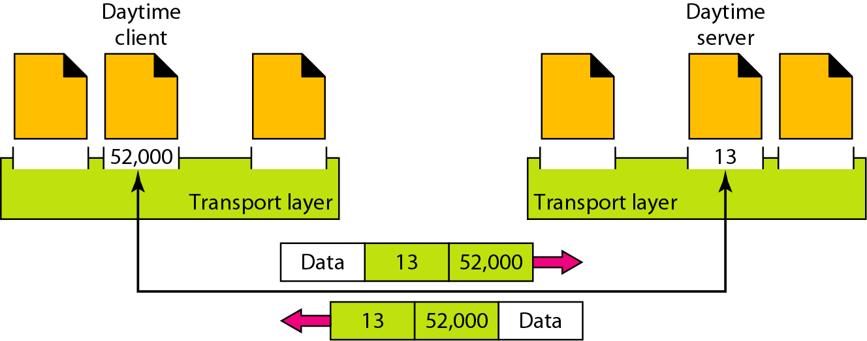
Port numbers
At the transport layer, transport layer address is needed which is called a port number, to choose among multiple processes running on the destination host.
The destination port number is needed for delivery; the source port number is needed for the reply.
In the Internet model, the port numbers are 16-bit integers between 0 and 65,535.
Every client process knows the well-known port number of the corresponding server process.
Daytime client process can use an temporary port number 52,000 to identify itself, the Daytime server process must use the well-known (permanent) port number 13.

Slide 8
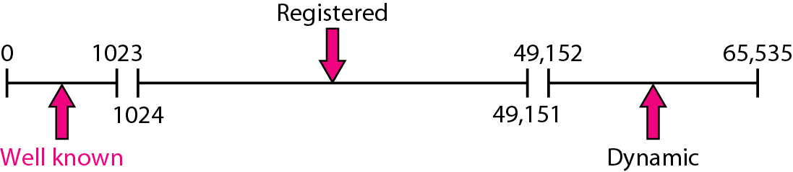
IANA Ranges for port numbers
The IANA (Internet Assigned Number Authority) three ranges of port numbers.: well known, registered, and dynamic (or private),
Well-known ports- The ports ranging from 0 to 1023 are assigned and controlled by IANA. Registered ports- The ports ranging from 1024 to 49,151 are not assigned or controlled by IANA. They can only be registered with IANA to prevent duplication.
Dynamic ports- The ports ranging from 49,152 to 65,535 are neither controlled nor registered. They can be used by any process and also called ephemeral ports.

Slide 9
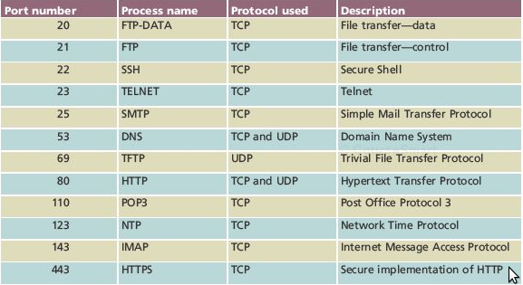

Slide 10
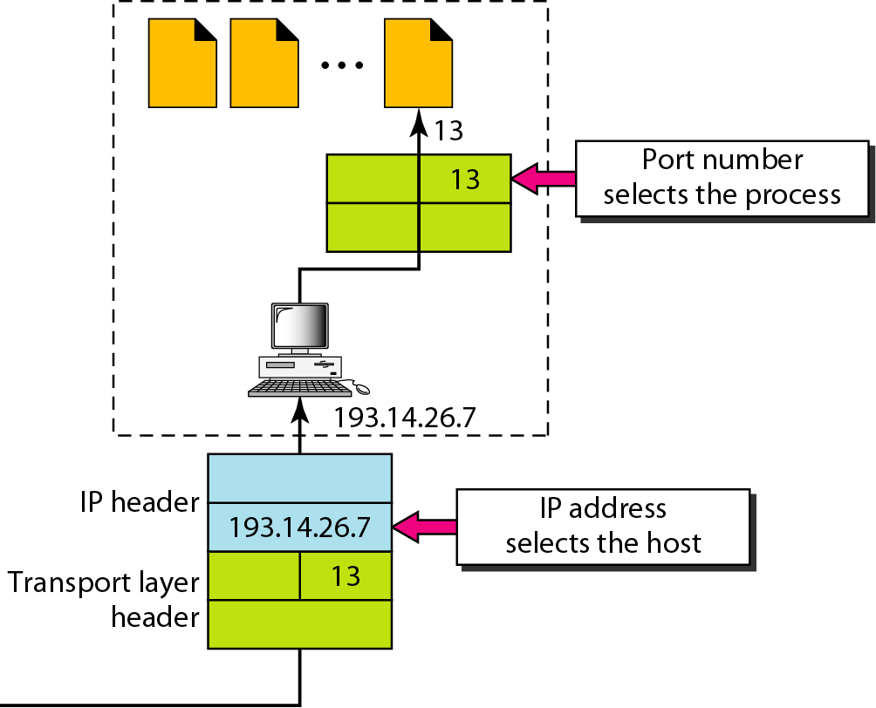

IP addresses versus port numbers
The IP addresses and port numbers play different roles in selecting the final destination of data.
The destination IP address defines the host among the different hosts in the world. After the host has been selected, the port number defines one of the processes on this particular host

Slide 11
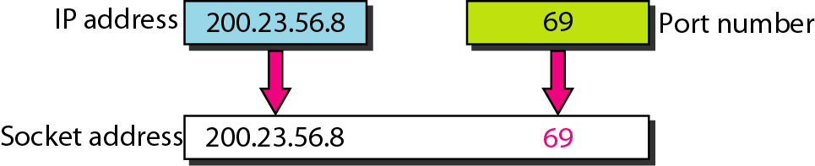
Socket address
Process-to-process delivery needs two identifiers.
The combination of an IP address and a port number is called a socket address.
The client socket address defines the client process uniquely just as the server socket address defines the server process uniquely.
A transport layer protocol needs a pair of socket addresses: the client socket address and the server socket address.

Slide 12
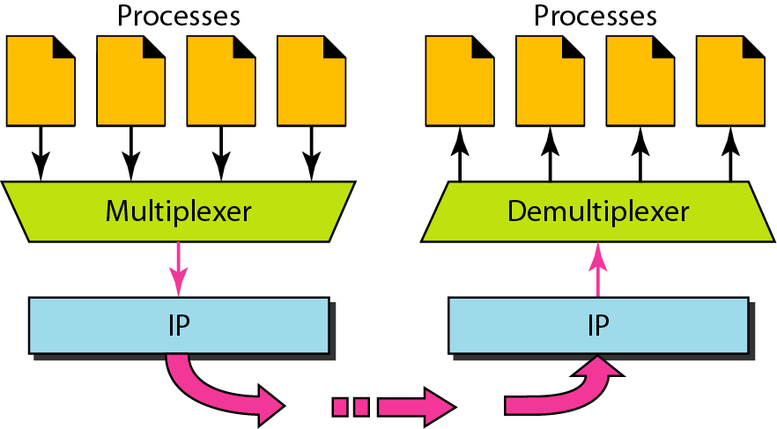
Multiplexing and demultiplexing
At the sender site, This is a many-to-one relationship and requires multiplexing
At the receiver site, the relationship is one-to-many and requires demultiplexing.
After error checking and dropping of the header, the transport layer delivers each message to the appropriate process based on the port number.

Slide 13
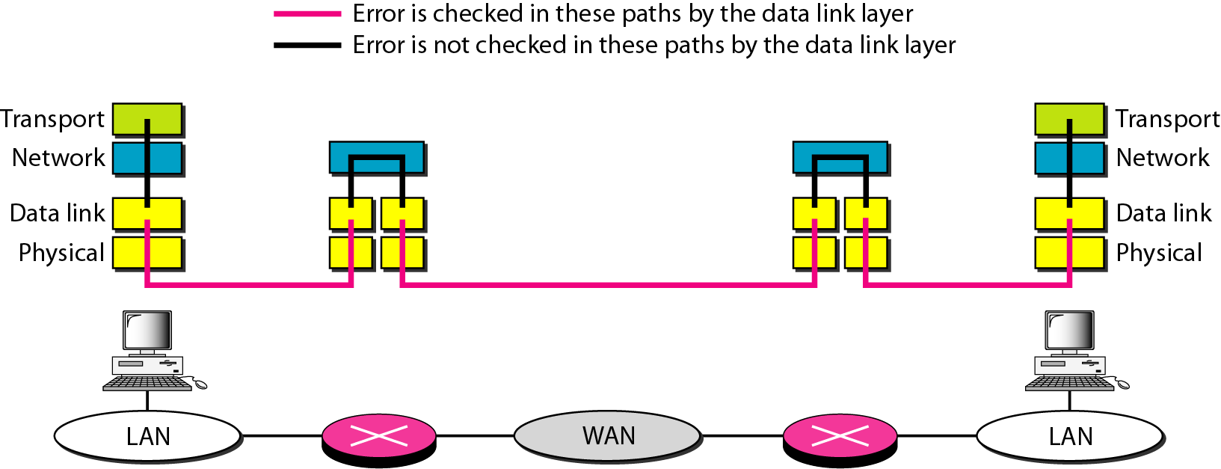
Error control and Flow Control
Reliability at the data link layer is between two nodes; we need reliability between two ends. Because the network layer in the Internet is unreliable (best-effort delivery).
It is needed to implement reliability at the transport layer.
Flow control is managed through windowing mechanism.

Slide 14
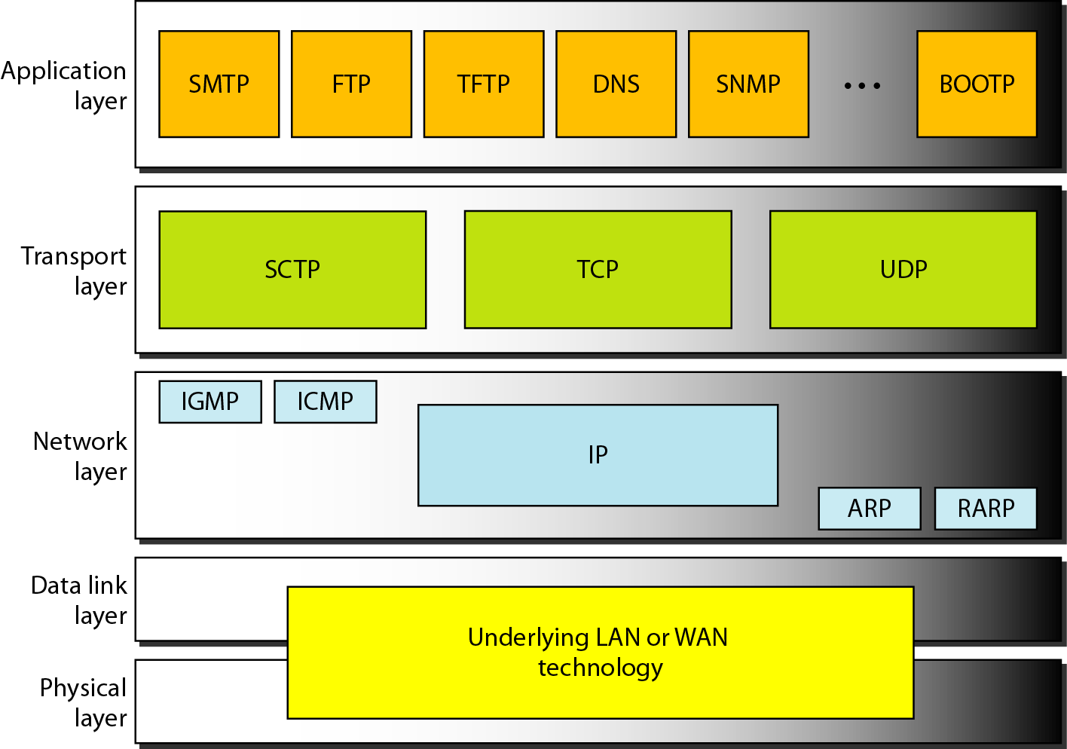
Position of UDP, TCP, and SCTP in TCP/IP suite
Connectionless Service
Packets are sent from one party to another with no need for connection establishment or connection release.
The packets are not numbered; they may be delayed or lost or may arrive out of sequence. There is no acknowledgment either.
Connection~Oriented Service
A connection is first established
Data are transferred
connection is released.

Slide 15

Question
User datagram protocol is called connectionless because _____________
All UDP packets are treated independently by transport layer
It sends data as a stream of related packets
It is received in the same order as sent order
It sends data very quickly

Slide 16
Watch this video
https://www.youtube.com/watch?v=uwoD5YsGACg

